Slide 1

Small Modular Reactors :
Scaling down to better scale-up?
NESS conference - 04.06.2024
Mathias Sabbe & Céline Parotte (Liège University)
HORIZON-EURATOM-2021-NRT-01
Notes:
Welcome to the short presentation of this paper co-written together with céline parotte from the Liège university

Slide 2
I. SMRs – At the forefront of the nuclear innovation race
“Innovation in nuclear technologies is a very dynamic space, particularly for nuclear power technologies such as Small Modular Reactors, or SMRs. Of course, as with every emerging technology, there are ups and downs, successes and failures, that is quite normal. But SMRs are a promising technology and there is a race underway. The race is among leading countries and companies to prove this technology and bring it to market.” (von der Leyen, 2024)
98 SMR projects at various stages of development in 2024 (NEA, 2024) ;
Most projects in the United States, Canada, and the United Kingdom ;
Spearheaded by Startups; Traditional nuclear actors; national laboratories and universities ;
Growing number of support policies (e.g., EU Industrial Alliance on SMRs, national measures, etc.)
Notes:
So as you may know, there is currently an innovation race surrounding SMRs. This is exemplified by this quote from EU commission president Ursula von der Leyen, in her address at the brussels nuclear energy Summit in March 2024 :

Slide 3
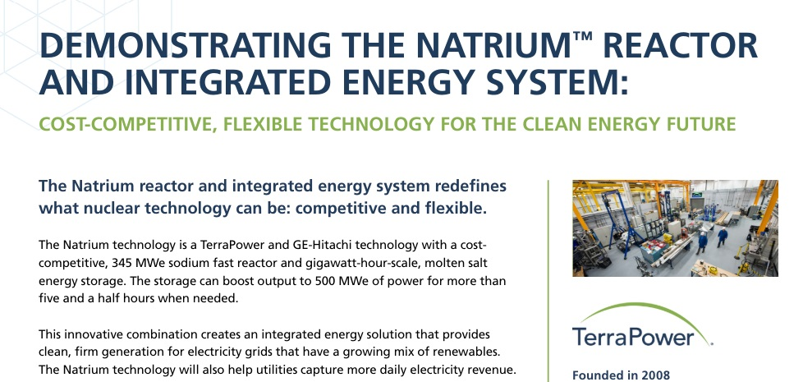
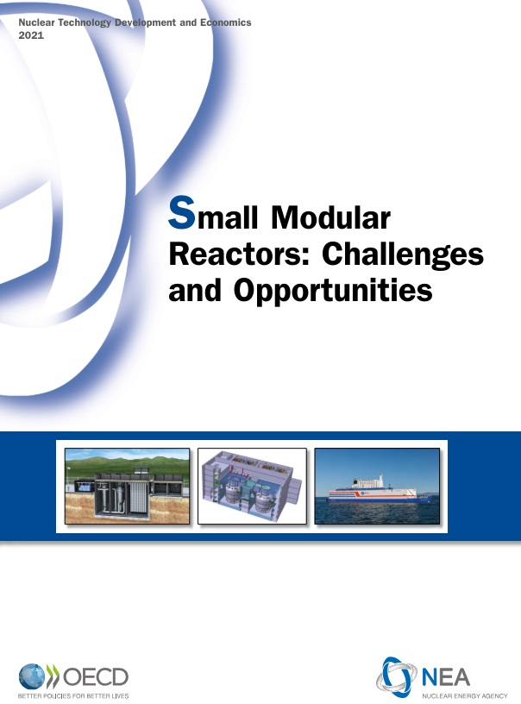
I. SMRs – At the forefront of the nuclear innovation race
https://www.terrapower.com/wp-content/uploads/2023/10/TP_2023_Natrium_Technology.pdf
SMRs are touted as cornerstone of future energy landscapes (e.g., Sovacool & Ramana, 2015);
Yet, there is scant evidence that the expectations associated with SMRs are actually shared among the scientists and engineers who actively develop SMR designs
https://www.oecd-nea.org/upload/docs/application/pdf/2021-03/7560_smr_report.pdf
Notes:
And there is a very big body of grey publications, public statements (promotional material, reports, press releases, etc.) witch promote SMRs as a cornerstone of future energy landscapes (e.g., Sovacool & Ramana, 2015)
Natrium, bill gates

Slide 4
II. Theoretical framework – the sociology of expecations
Expectations as “real-time representations of future technologies, situations and capabilities” (Borup et al., 2006, p. 286).
Expectations carry values, promises, and visions connected to the possible (dis)advantages which are assumed to derive from an innovation or a techno-scientific field
Expectations are performative as they can shape the collective practices and strategies in the development of a technology field
However, the literature usually focuses collective expectations “made available in public statements” (Van Lente, 2012, p. 775).
Tends to mask the diversity of expectations within communities of promise
Taking seriously the situatedness of expectations (Brown, 2003)
To what extend are the expectations upheld by the international SMR discursive community endorsed within the SMR innovation community?
Notes:
For instance all these declarations by International Nuclear agencies about SMRs, or all these startup claims about SMRs.
We can expect to highlight that by taking seriously the situatedness of expecations
➔

Slide 5
III. A two-step research process
A. Identifying SMR proponent’s expectation narratives
Grey literature review including 55 documents (white papers, commercial factsheets, analytical reports, and website content)
Published by developers and startups, international nuclear organizations, and initiatives promoting nuclear R&D
Thematic Analysis
B. Scientists’ and engineers’ expectations
25 semi structured interviews ESFR-SIMPLE project members (SFR SMR, 99 contributors, 17 partners, Euratom)
Variety of profiles : expertise, experience, WP contribution, organization
Thematic analysis

Slide 6
IV. Results
5 generic expectations narratives were identified in the international SMR discursive community’s public statements :
  The affordable energy expectation narrative (costs);
  The smart energy expectation narrative (flexibility) ;
  The green energy expectation narrative (environment) ;
  The safe energy expectation narrative (safety) ;
  The proliferation resistant expectation narrative (proliferation).
Each of these generic expectation narratives were confronted with the expectations of ESFR-SIMPLE scientists and engineers :
  On a superficial level: a general congruence between interviewees’ expectations and those of the international SMR discursive community (proliferation is the exception) ;
  On closer inspection: ESFR-SIMPLE interviewees tempered generic expectations by highlighting many caveats and limitations associated with smaller systems (e.g., on safety, flexibility, etc.) ;
  A general preference for larger, more efficient and optimized systems ;
  Variations in expectations depending on the proximity to core design, and level of experience.

Slide 7
IV. Results
SMRs as a necessary stepping stone towards a consolidation of the nuclear sector:
  Generate public interest with a new image (rebranding nuclear energy) ;
  Attract much needed human an financial resources for the nuclear sector ;
  Gradually rebuild the lost competences and industrial capabilities of the sector ;
  Gain back the competences needed to build larger systems
“So, modularity can help us to get back the competences. But once we have the competences, we can forget about small and forget about... Okay. Keep modular wherever we can, but once we have the competencies, we can build big and not small modular reactors” (L, Research Engineer, Reactor Physics).

Slide 8
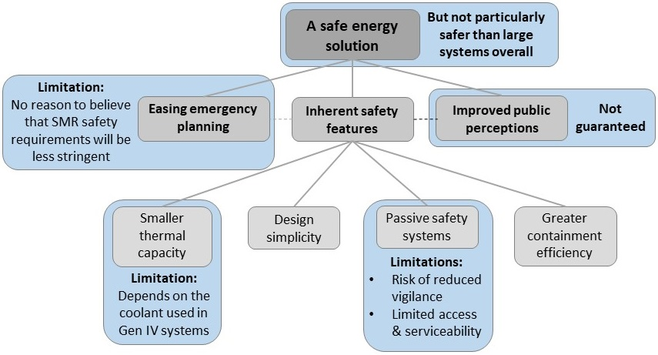
IV. Results

Slide 9
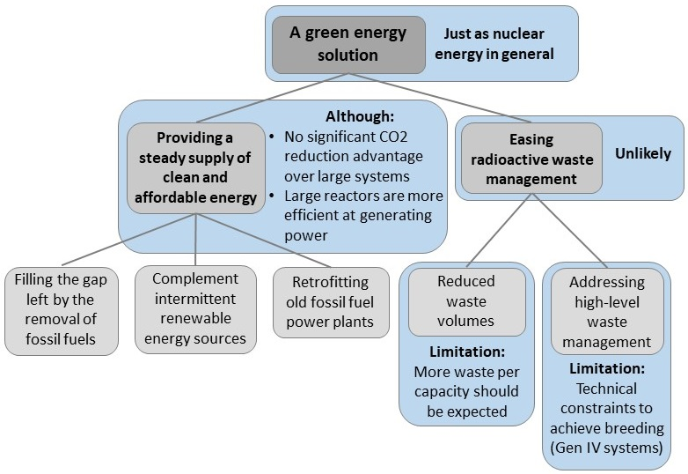
IV. Results

Slide 10
V. Preliminary conlusion and discussion
A. Aligning collective and situated expectations: towards strategic expectations ?
ESFR-Simple interviewees shared various expectations sometimes misaligned with the generic expectations expressed by international SMR proponents. We argue that misaligned expectations at the individual and collective level are reconciled through strategic expectations
Expectation layer | Sociotechnical expectations | Strategic expectations | Generic expectations
Description | Socio-technical assessments rooted in the theoretical knowledge, past research experiences, and practice of those engaged in research and development activities. Such sociotechnical expectations can temper or contradict generic expectations. | Uncertainties and potential conflicts between misaligned sociotechnical and generic expectations are reconciled in a new narrative that redirects expectations towards a higher desirable outcome that is shared by those who engage in research and development activities. | A set of shared expectations distilled in public statements emitted by a broad discursive community about a given innovation or a techno-scientific field. Generic expectations tend to have a performative ambition as aim to generate public interest and attract investments through inflated expectations
Example | Downsizing is beneficial for safety due to a reduced thermal capacity, but the resulting high neutron leakage generates a series of drawbacks that can hinder the seamless enactment of generic expectations. | Although less efficient and optimized, SMRs are a much-needed transitional solution in the replenishment of competences and industrial capabilities needed to build large nuclear reactors. | SMRs are a cheap, flexible, safe, and decarbonized solution for a sustainable and resilient future energy landscape.

Slide 11
V. Preliminary conlusion and discussion
B. Scaling up by scaling down: forms of nuclear solutionism
Solutionism as “the framing of problem diagnoses in response to readily available, often technological solutions” (Pfotenhauer, 2022, p. 15)
Scaling down to scale-up production of one size-fits-all systems:
  Solutionism expressed in the generic expectations emitted by international SMR proponents ;
  SMRs as a one size fits all solution to a very wide range of applications in a variety of grid configurations ;
  Problem framing focuses on the multiplicity of local energy needs and requirement in future energy systems.
Scaling down to scale-up production of large-scale systems
  Solutionism expressed by ESFR-Simple interviewees ;
  Although SMRs are less efficient and optimized than large reactors, SMRs are a transitional solution that should pave the way for scaling up the production of large reactors in the longer term ;
  Problem framing focuses on the loss of competences in the nuclear sector

Slide 12
Merci pour votre attention !
Any questions ?

Slide 13
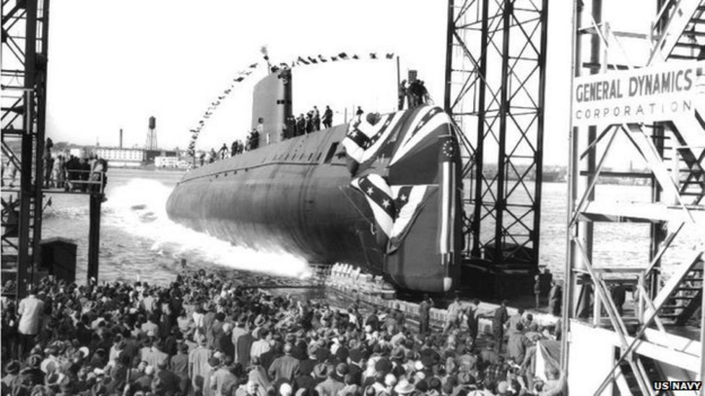
Notes:
Alors quand on voit tout ça on pourrait avoir tendance à croire que ces SMRs sont vraiment à la pointe de la technologie, et de l’innovation en quelque sorte. Mais en fait, les petits réacteurs sont une histoire assez ancienne. Les avancées technologiques dans le nucléaire militaire et civil sont intimement liées à ces petits réacteurs.
Ici à l’image, vous avez un sous-marin, L’USS Nautilus. Mis en opération en 1955, il contenait un REP de petite taille. Il existe encore et peut être visité
Dès les années 40 naissent les premiers programmes de développements de petits réacteurs pour la propulsion navale militaire aux Etats-Unis (sous l’impulsion de l’Amiral Rickover, le père de la marine nucléaire) :
De nb designs de petits réacteurs étaient apparus à l’époque : refroidis au sodium, refroidis au plomb, mais très vite le choix de design s’est fixé sur les réacteurs à eau pressurisée (plus stables, et moins prompts aux accidents dans un environnement marin)
Ces designs de réacteurs à eau pressurisée ont ensuite été utilisés / adaptés par westinghouse pour la production de nucléaire civil dans les années 50.

Slide 14
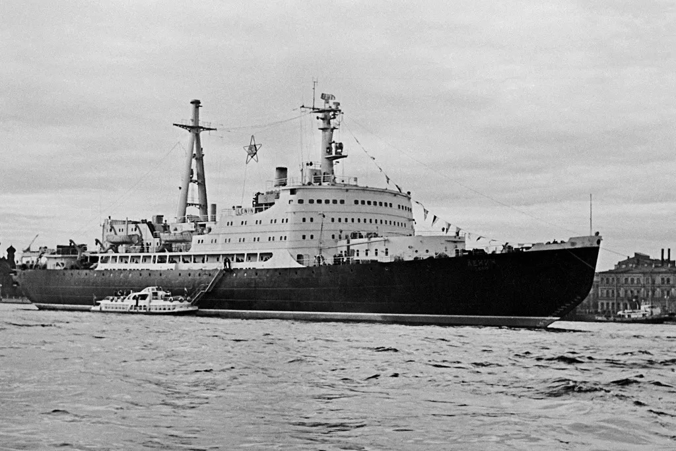
Notes:
Alors, sans rentrer dans le détail, l’URSS n’était bien sûr pas en reste : ici à l’image vous avez le Brise-glace Lénine lancé en 1957 qui est en fait le premier navire civil équipé d’une propulsion nucléaire. Il était équipé de trois petits réacteurs à eau pressurisée de conception soviétique. Il a été réparé dans les années 2000 : Navire musée
Comme les états unis, les soviétiques avaient aussi développé toute une série de navire militaires alimentés par des petits réacteurs (des sous-marins en particulier)
Alors bien sûr, ce ne sont pas encore des petits réacteurs modulaires, ce sont des petits réacteurs certes, mais du point de vue modularité les préoccupations n’étaient pas les mêmes à l’époque (donc pas de production en très grande série en usine, etc.). Mais ce que ça montre surtout, c’est que les capacités techniques, scientifiques, industrielles, etc. étaient déjà présentes à l’époque pour produire des réacteurs petits, en quantités non négligeables.
Alors si au fil du temps ils ont en grande partie disparu au profit des réacteurs de grande taille, on constate aujourd’hui un retour en force de ces petits réacteurs pour une utilisation civile.

