Slide 1


Non-destructive chemical analysis of artificially degraded
hafting adhesives with DHS-GC×GC-TOFMS
Organic and Biological Analytical Chemistry Group
Anika Lokker, Pierre-Hugues Stefanuto, Dries Cnuts, Veerle Rots*, Jean-François Focant*
*co-last
3rd AdvSepSci - June 12th 2025 - Gembloux

Slide 2
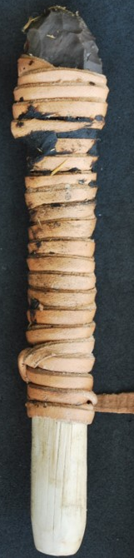
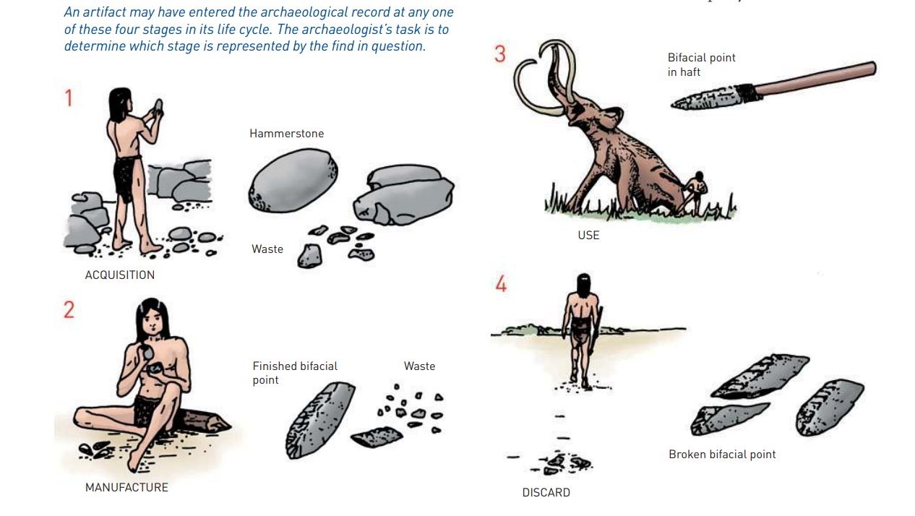
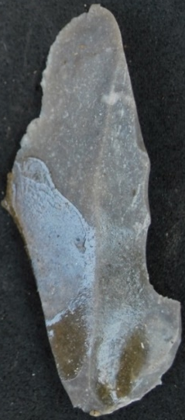
A brief history – what is hafting?
Transforming stone tools into powerful tools
Only stone pieces with traces adhesives found in archaeological record
Chemical analysis is important for understanding natural resources
Handles were made with pershibale organic materials
or
Adhesives were used as a protective wrapping
In archaeological debate hafting adhesive is an indication for cognitive development
Renfrew & Bahn 2016
Notes:
Hafting is a technique which has its roots in the prehistory and it was part of the tool making skill of Neanderthals and early modern humans. Hafting means the procedure of attaching a handle to a stone tool. This can be done with bindings, adhesives or a combination of both. Only these adhesives tend to preserve on the stone surface. The archaeological debate centres around the cognitive development involved into hafting, and which sort of tools were hafted.

Slide 3
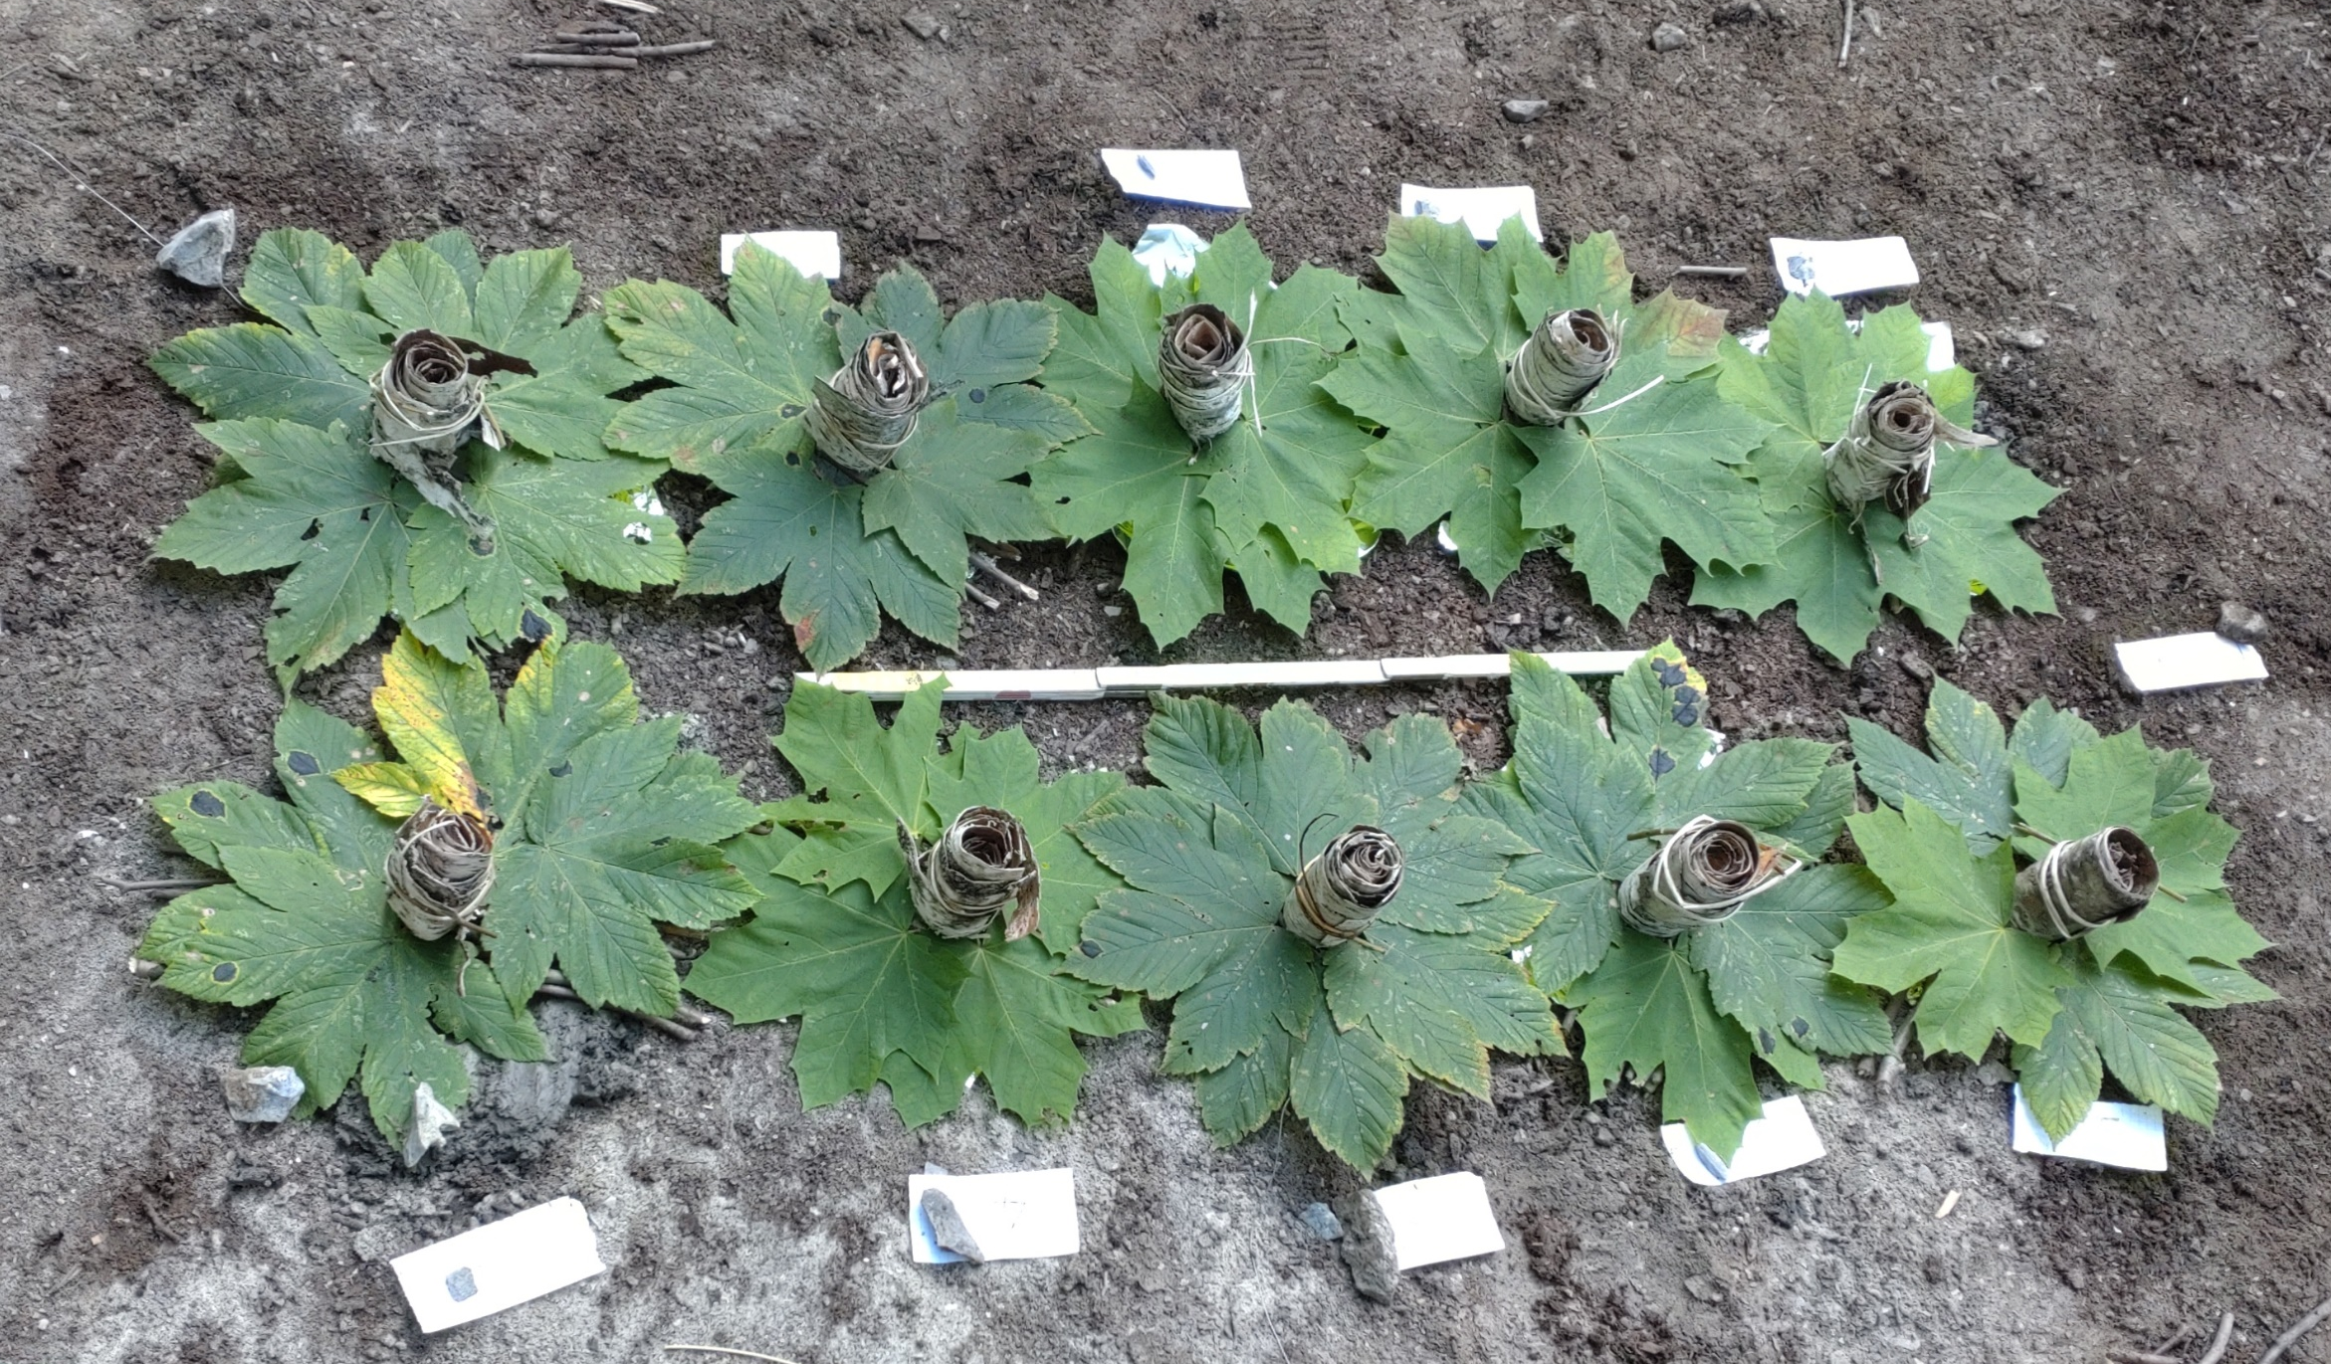
A brief history – adhesives
Man-made
Natural
VS.
(Birch) tar
Resin
Animal glue
Beeswax
Hide
Sinew
Bone
Notes:
Birch tar: pyrolysis of birch bark, different aceramic production methods.
Animal glue: slaughter waste, slow boiling transforms the collagen into a gluey substance
Resin: protective mechanisme of trees against bark damaging, mostly seen in coniferious trees
Beeswax: made by bees for inside the beehive, storage for honey -> used as a plasticizer with other adhesives such as resin

Slide 4
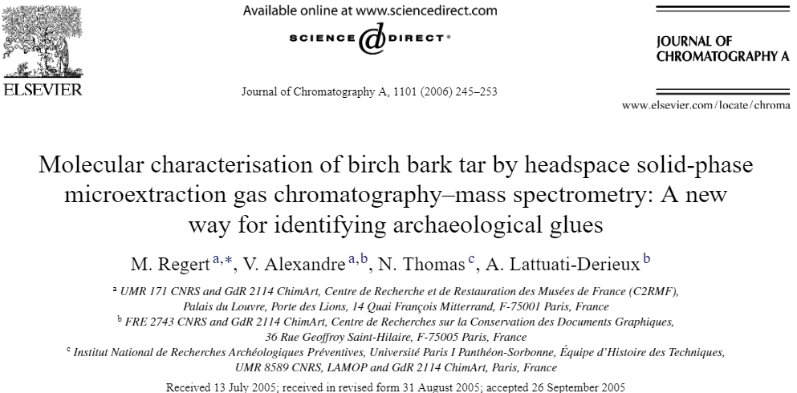
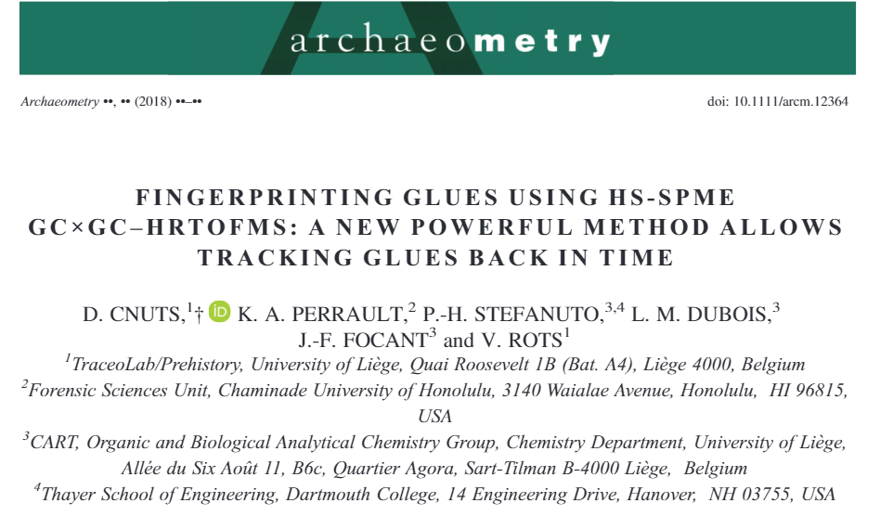
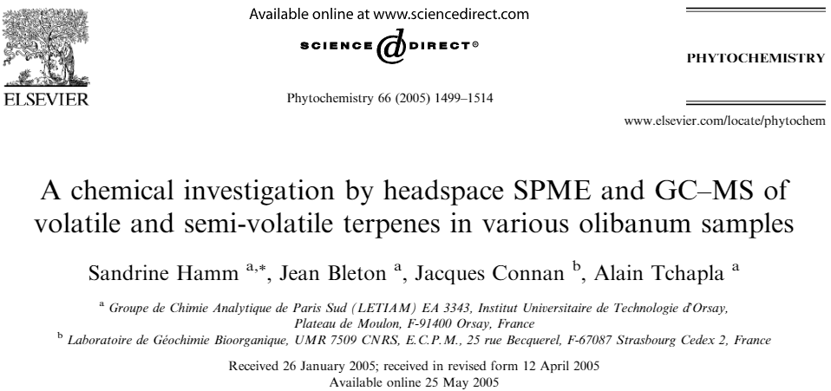
Chemical analysis of hafting adhesives
Microscopy
FTIR / Raman spectroscopy
SEM-EDX
GC-MS
Possible to use headspace techniques?
Informative & destructive
Notes:
Microscopy: first screening, what can colour tell?
FTIR&Raman: overal functional groups present, organic / inorganic
SEM-energy dispersive X-ray spectroscopy: elements of the residue organic / inorganic
GC-MS: destructive, able to investigate molecular composition, good samples might direct to type of adhesive
Need for a new method -> headspace analysis?
20 yrs ago first studies, afterwards is stayed quiet, untill recently when HS-SPME was couple to 2D GC-MS obtaining new results. While, HS-SPME is a great technique, it is a passive sampling and therefor not every analyte in the HS is sampled.

Slide 5
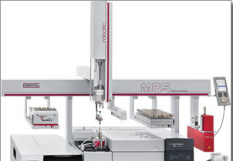
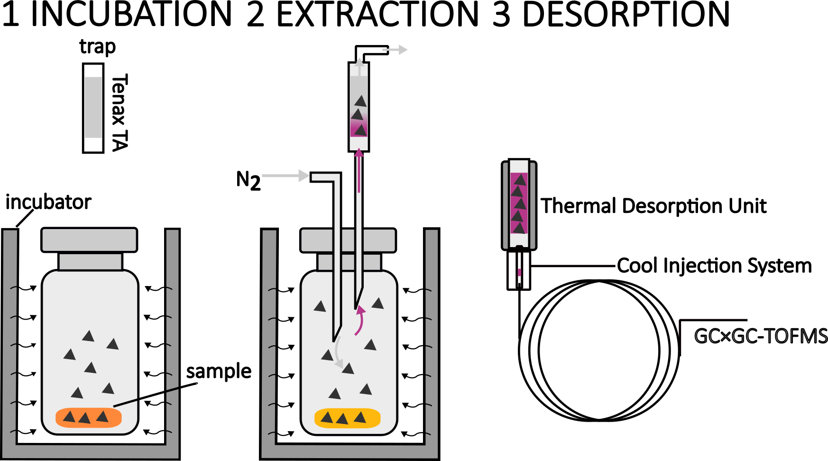
Non-destructive VOC sampling
Non-destructive
Low temperature to avoid heat damage
Exhaustive VOCs removal – sensitive
Fully automated
MultiPurposeSampler (MPS, Gerstel K.K)
MPS-DHS
Exhaustive VOCs removal – 1 time analysis
(Stone tool size restriction)
TDU: 40°C-280°C, 300°C/min
CIS: -20°C-250°C, 12°C/s
20 min, 50°C
20 min, 50°C
Notes:
In this research, we opt for a different sampling method: DHS, which is an active sampling method. Shortly, DHS consists of three steps, the first step is incubation to release the VOCs from the sample into the headspace. In the extraction step is the HS actively swept with a gas to remove the VOCs, the VOCs are retained on a trap. Afterwards, the trap is moved to the GC inlet and the VOCs are removed by thermal desportion, during the desportion the VOCs are retained on a CIS. For this sampling we chose an incubation and extraction temperature of 50ºC and these steps both took 20 min. The trap is a TD tube filled with tenax TA polymer.
Advantages: afterwards other analysis on the stone tool is possible.
not high heating to avoid heat damage for the stone tool and adhesives.

Slide 6
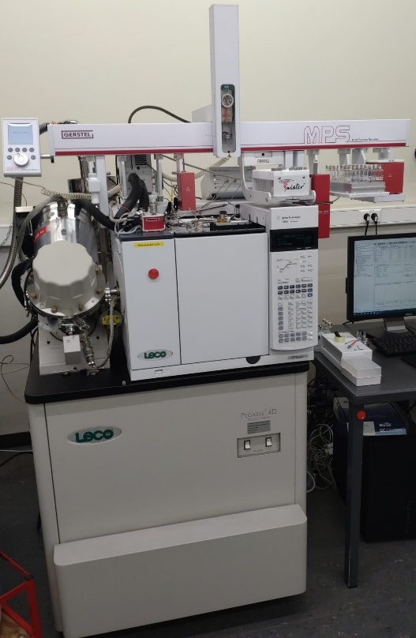
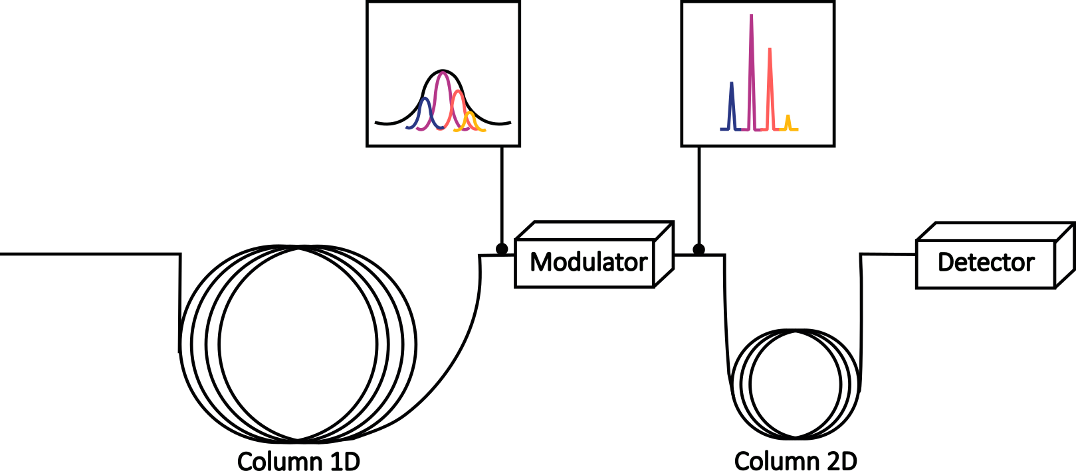
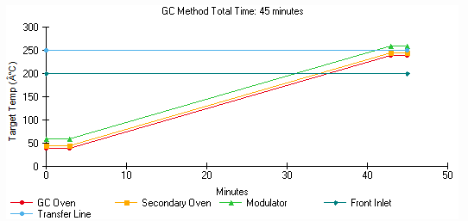
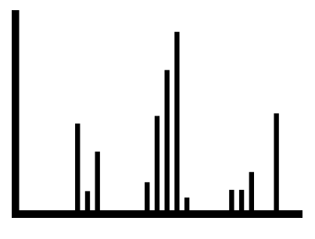
GC×GC-TOFMS instrumentation
1D: Rxi-624silMS (30 m x 0.25 mm i.d 1.4 μm df)
2D: Stabilwax (2 m x 0.25 mm i.d 0.5 μm df)
PEGASUS® GC-4D
GC×GC-TOFMS
LECO
Acquisition rate 200 Hz
Range: 35 – 550 amu
Notes:
In this research a pegasus 4D instrument is used with a cryo-modulator. The column set is a bit unusual with a semi-polar 624 silMS in the first and a polar stabilwax column in the 2D. The over program is a simple one with a total run time of 45 minutes. This column set and oven program is chosen to accomodate analysis of a large range of polarities, as present in prehistoric adhesives.
Advantages, not high heating to avoid heat damage for the stone tool and adhesives.

Slide 7
Data analysis
Untargeted approach
Peak table generation
Step 1: database collection
Step 2: case study
Classification
Multivariate
statistics
Notes:
We used an untargeted approach for the data analysis. Here, the whole peak table is used and the unknown samples are compared with known samples for identification. Shortly, the steps involved peak table generation, followed by a classification and the total area per class was calculated. The last step was statistics, multivariate analysis, based on the total area per class per sample. To compare the unknown sample with a database of adhesives. However, a database with VOCs profiles of adhesives does not exist so we had to make our own. This is the first step of the study, in the second part the theory is tested with a case study.

Slide 8
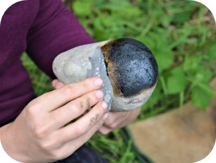
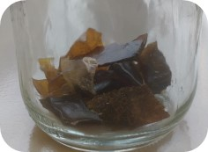
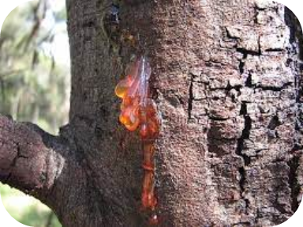
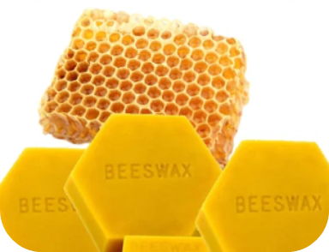
Database collection - Materials
4 production methods
4 species
(Birch)Tar
Animal glue
4 species
+
Resin:beeswax 70:30 (w/w)
1 sample
Resin
Beeswax
Total: 14 samples
Notes:
Different samples are taken from the four adhesive classes. The resin included one mix sample with beeswax. For the AG samples a little bit of water was added so that a gluey substance was formed and, on this substance, the DHS was performed. Each sample was analysed in triplicate.

Slide 9
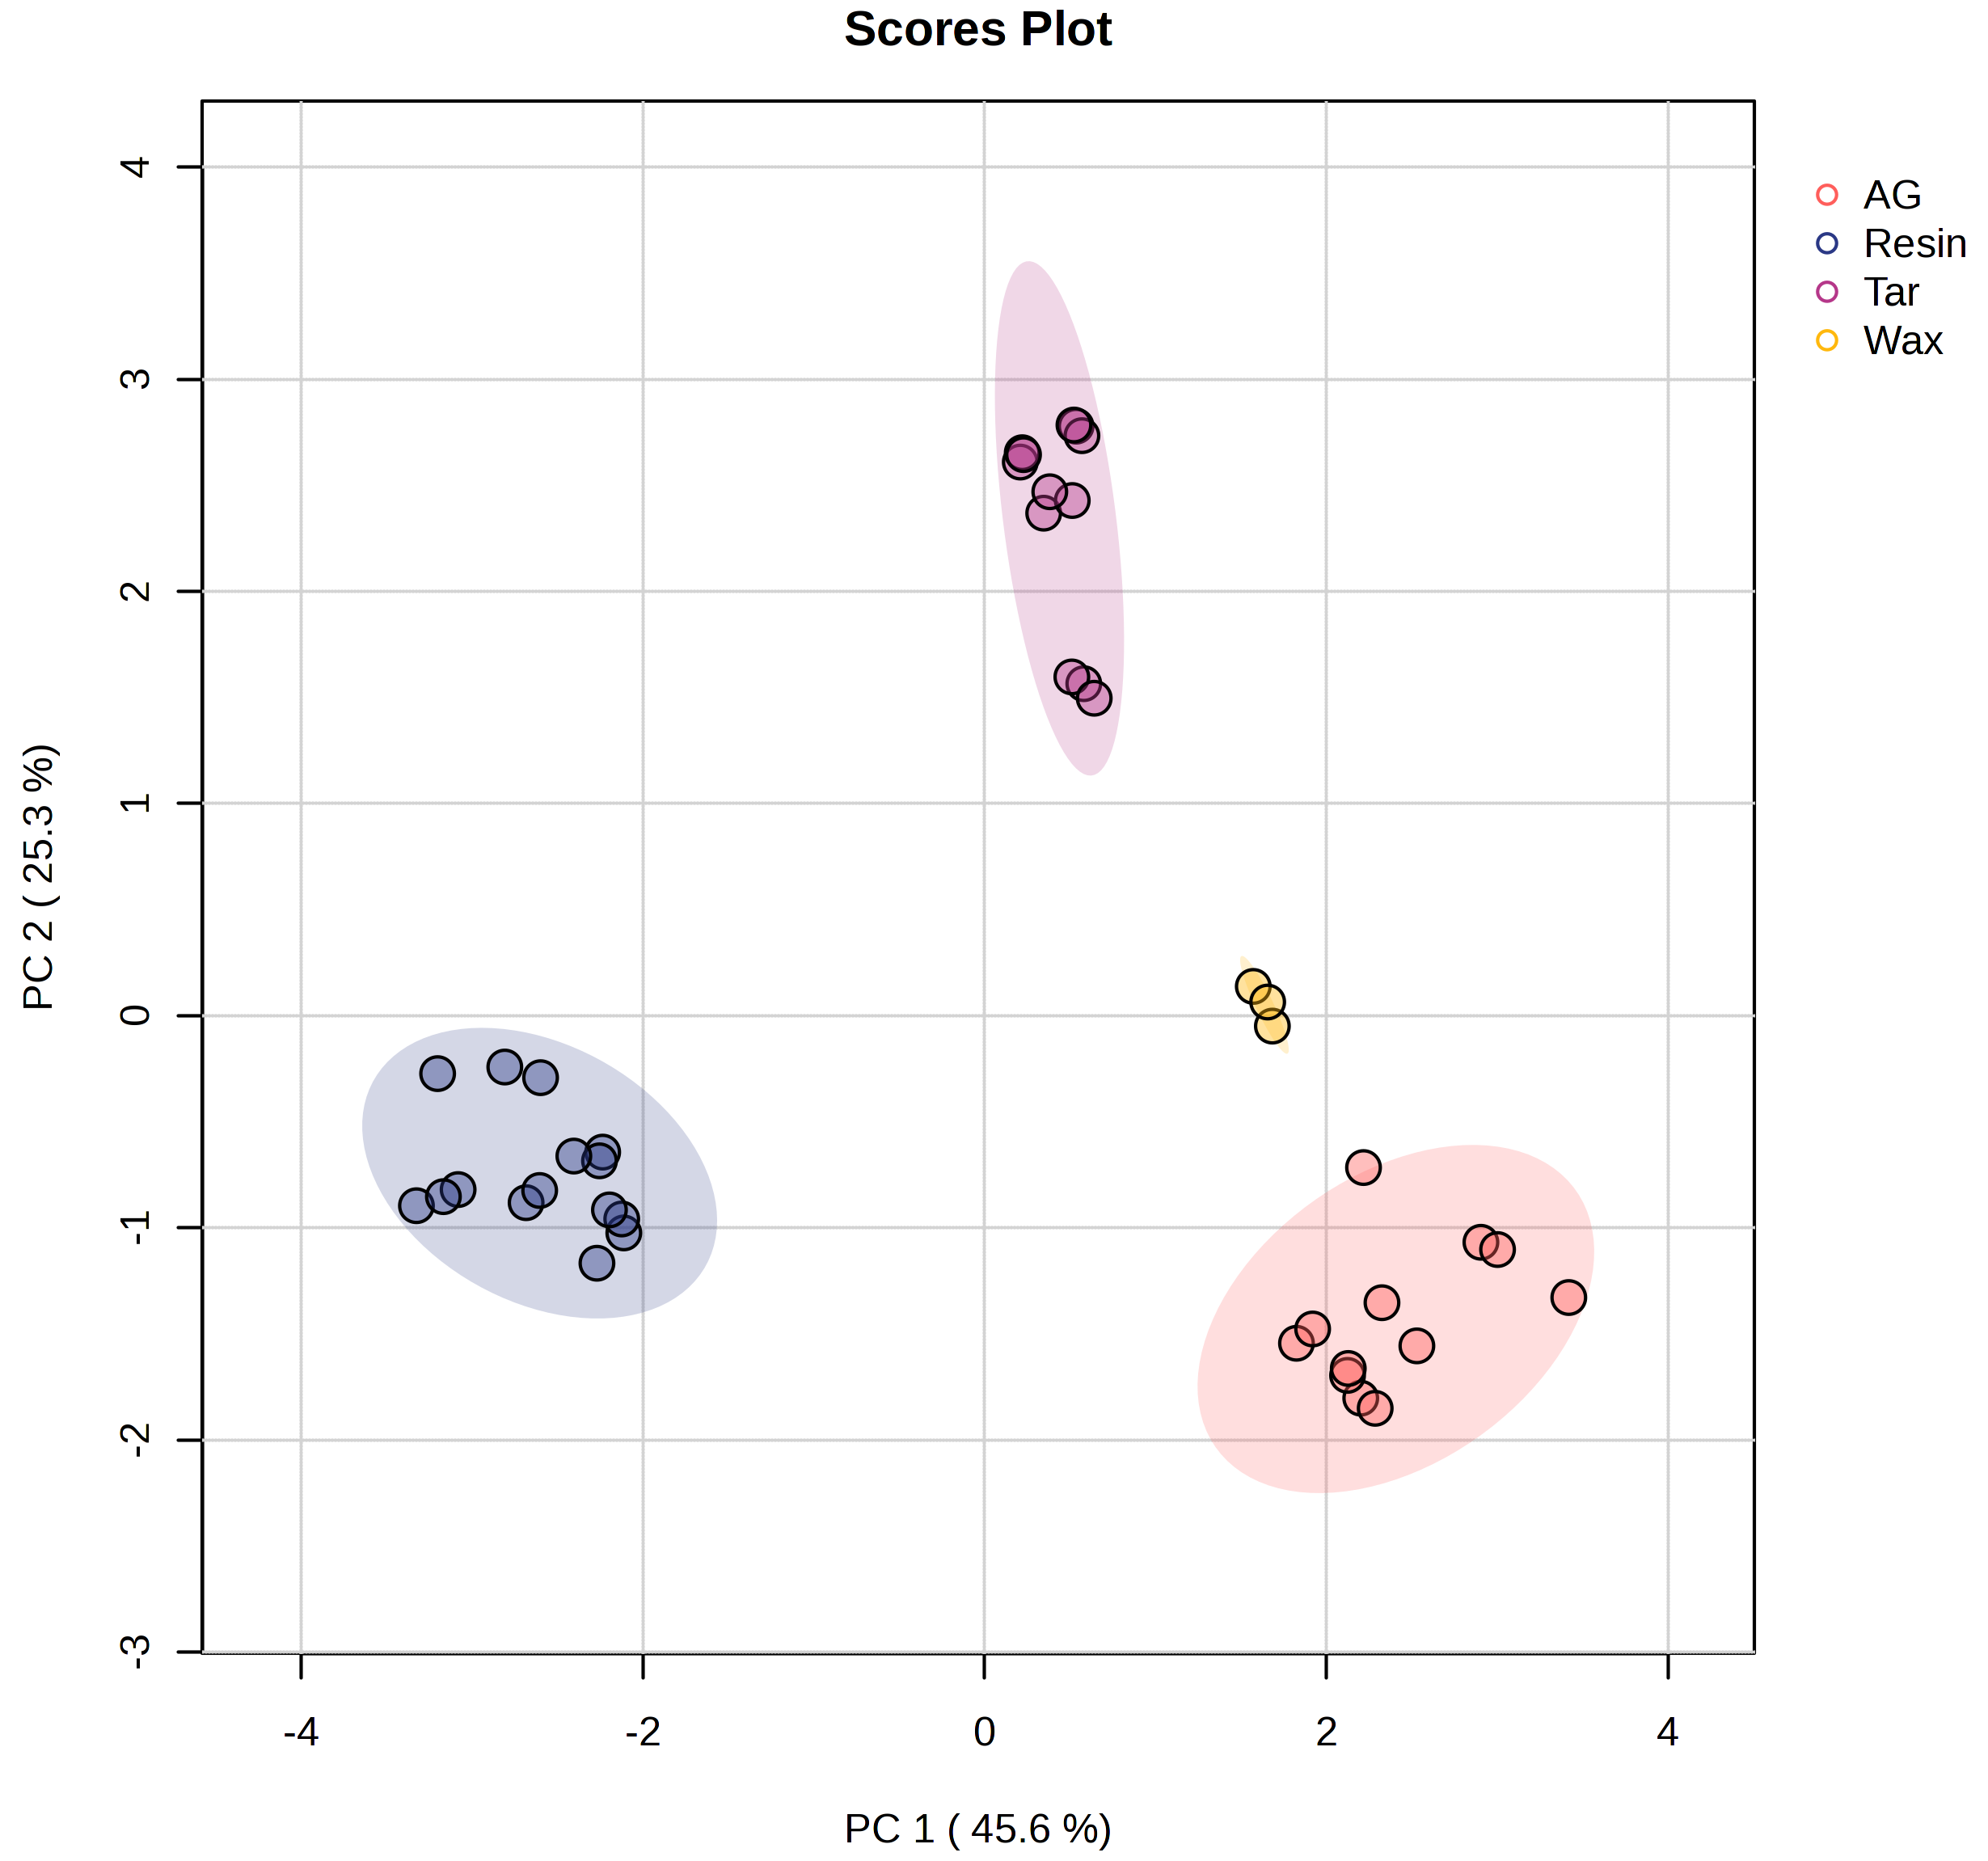
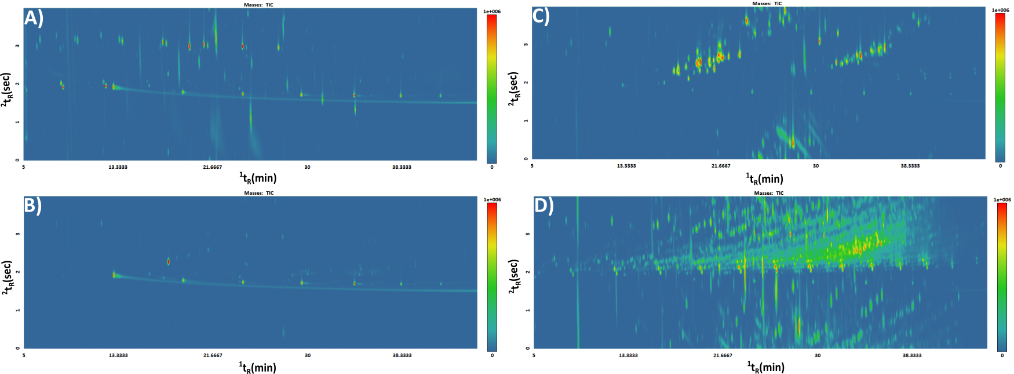
Database collection - Results
Notes:
A)AG, B) beeswax, C) resin, D) tar. The PCA explains 70% of the data in the first 2 components, the resins are fully apart as they contain a large number of terpenoids which are not present in the others. In the resin samples was one mixture with beeswax present, the resin VOCs were dominant and no difference in seen in the statistical analysis between this and the other resin samples.

Slide 10
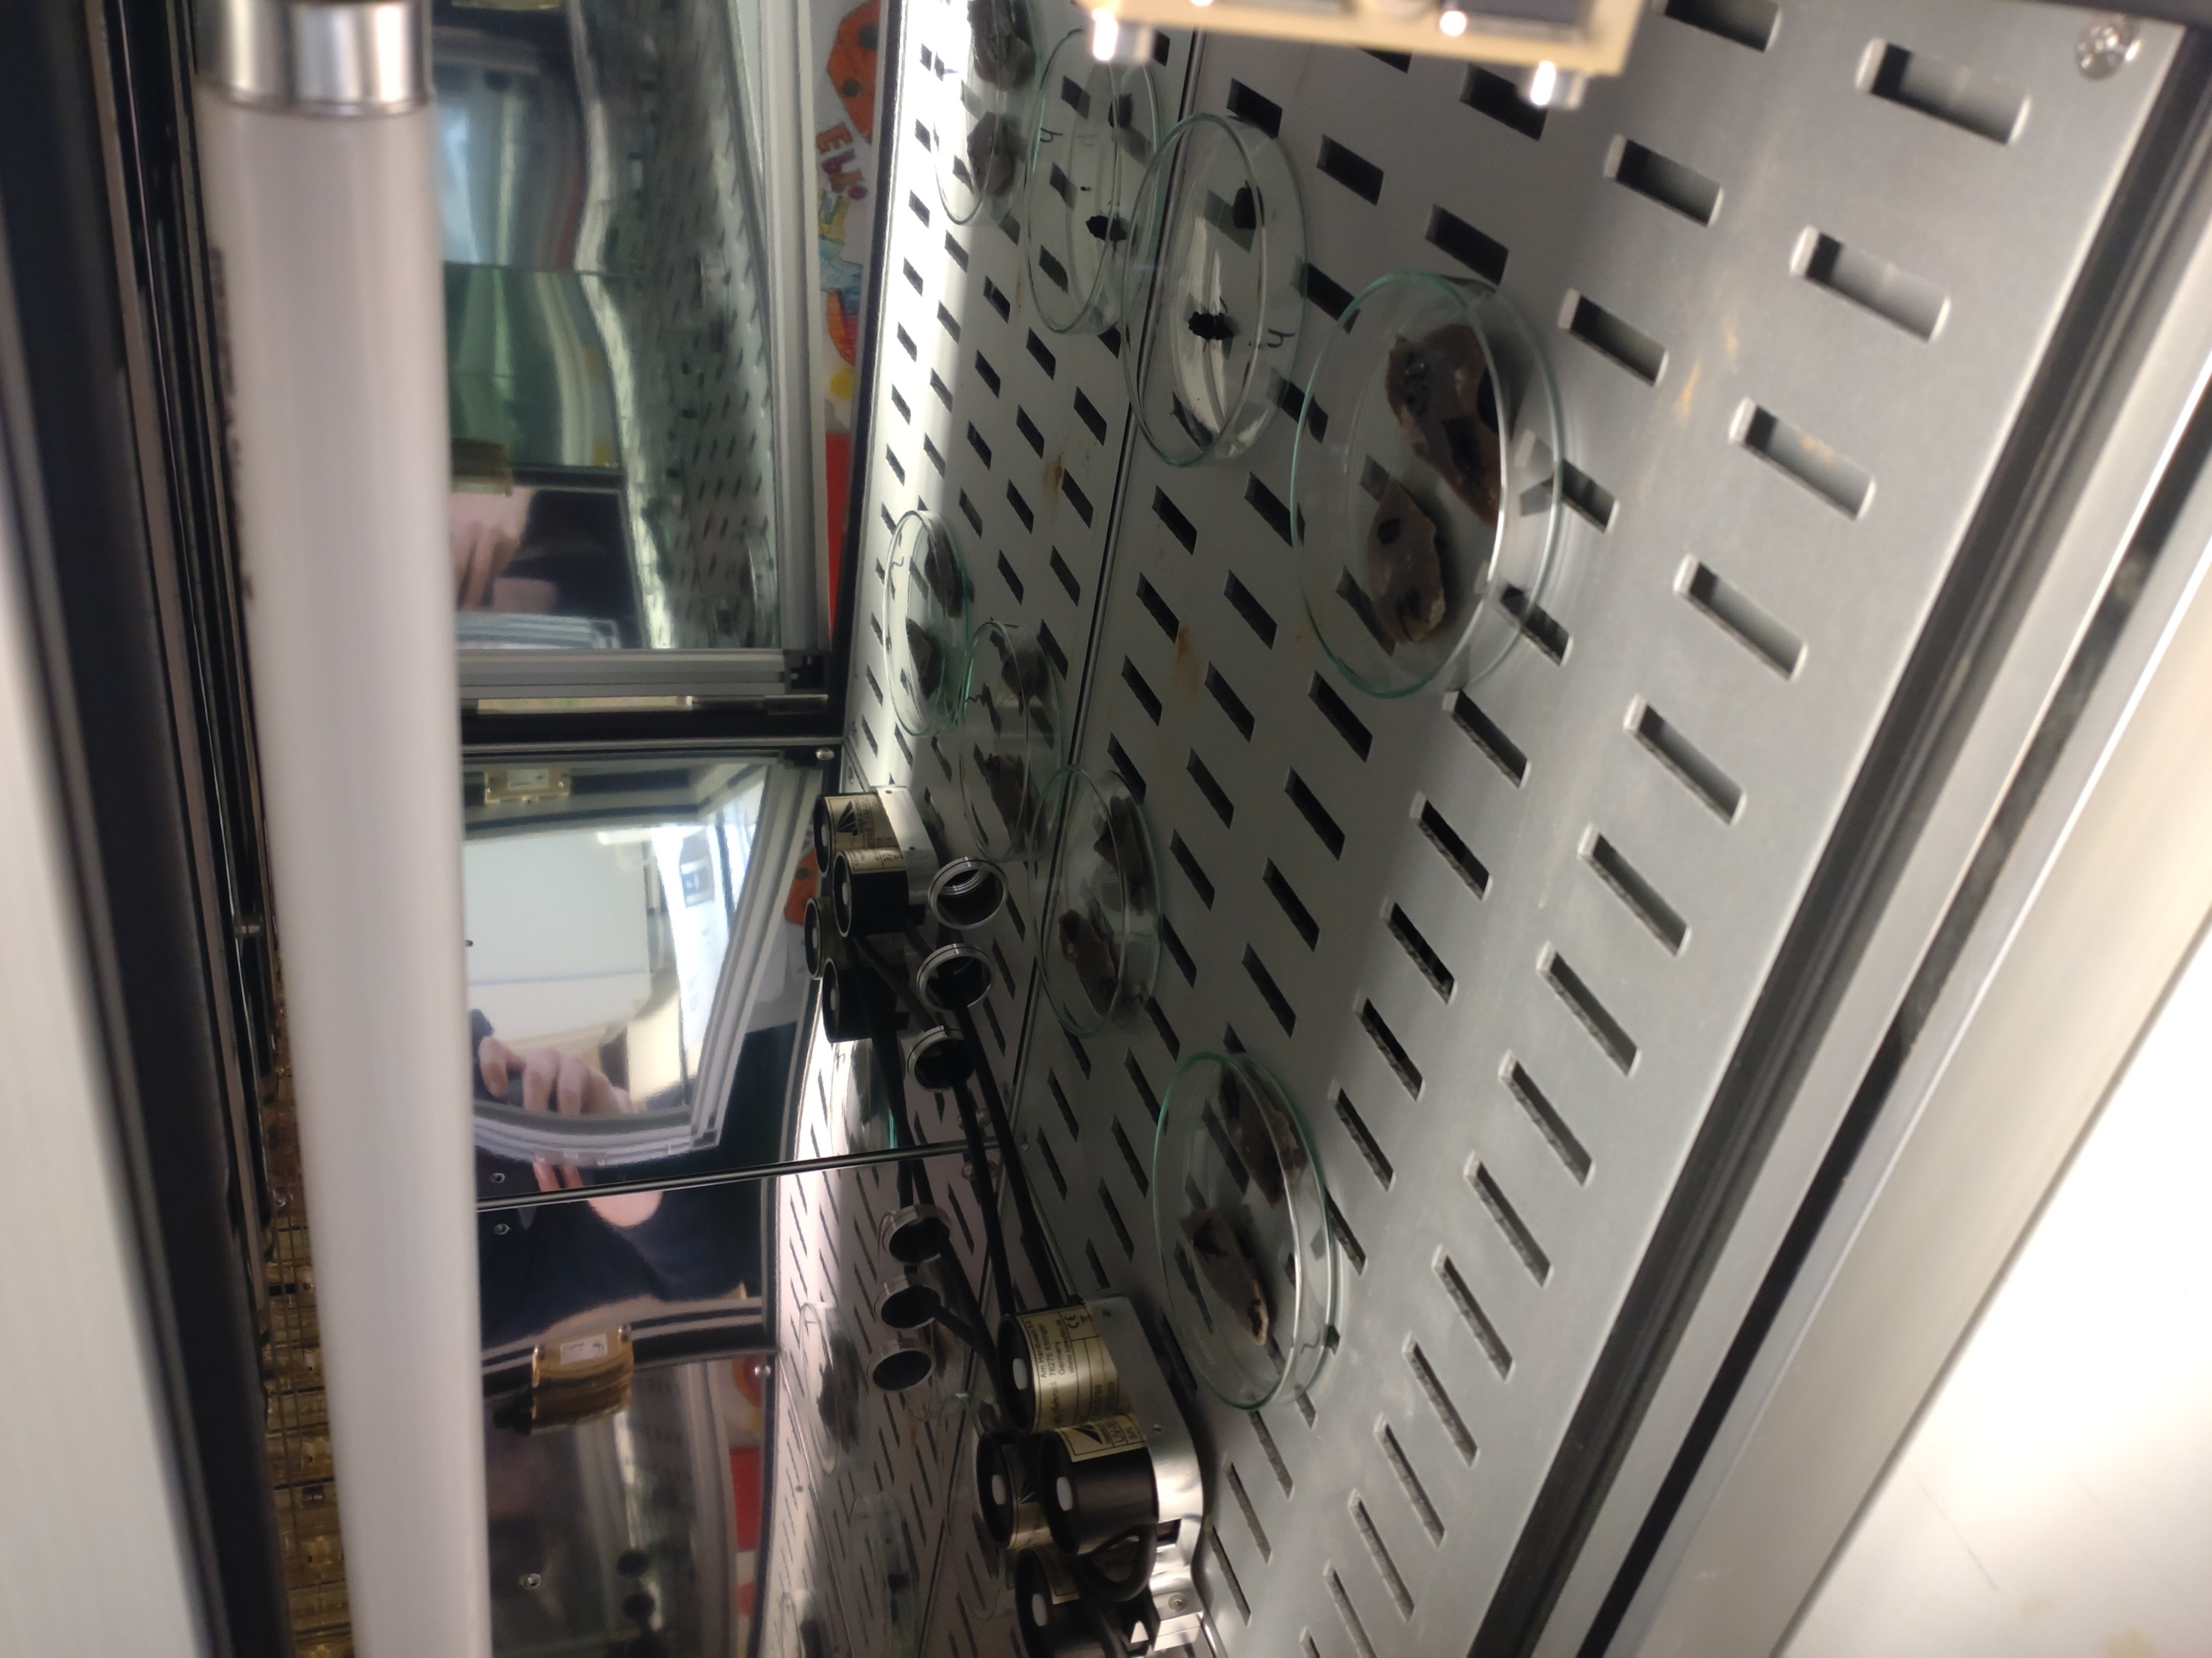
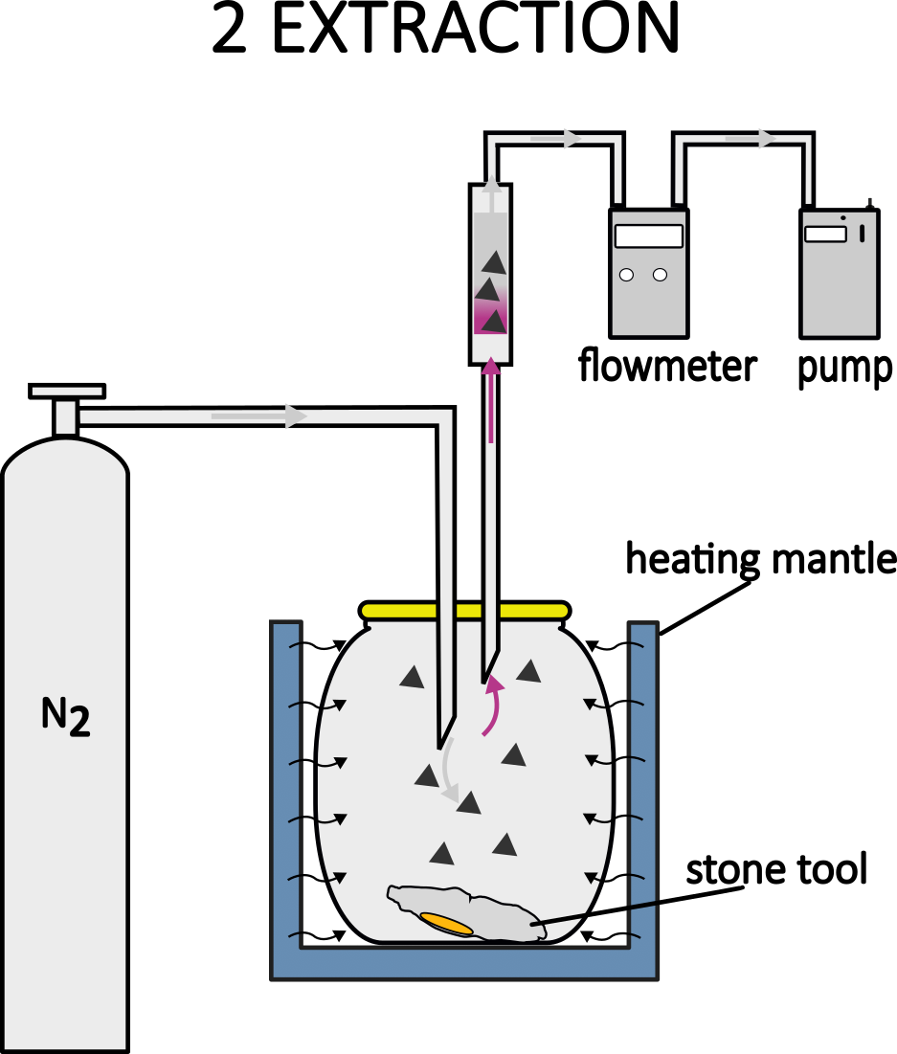

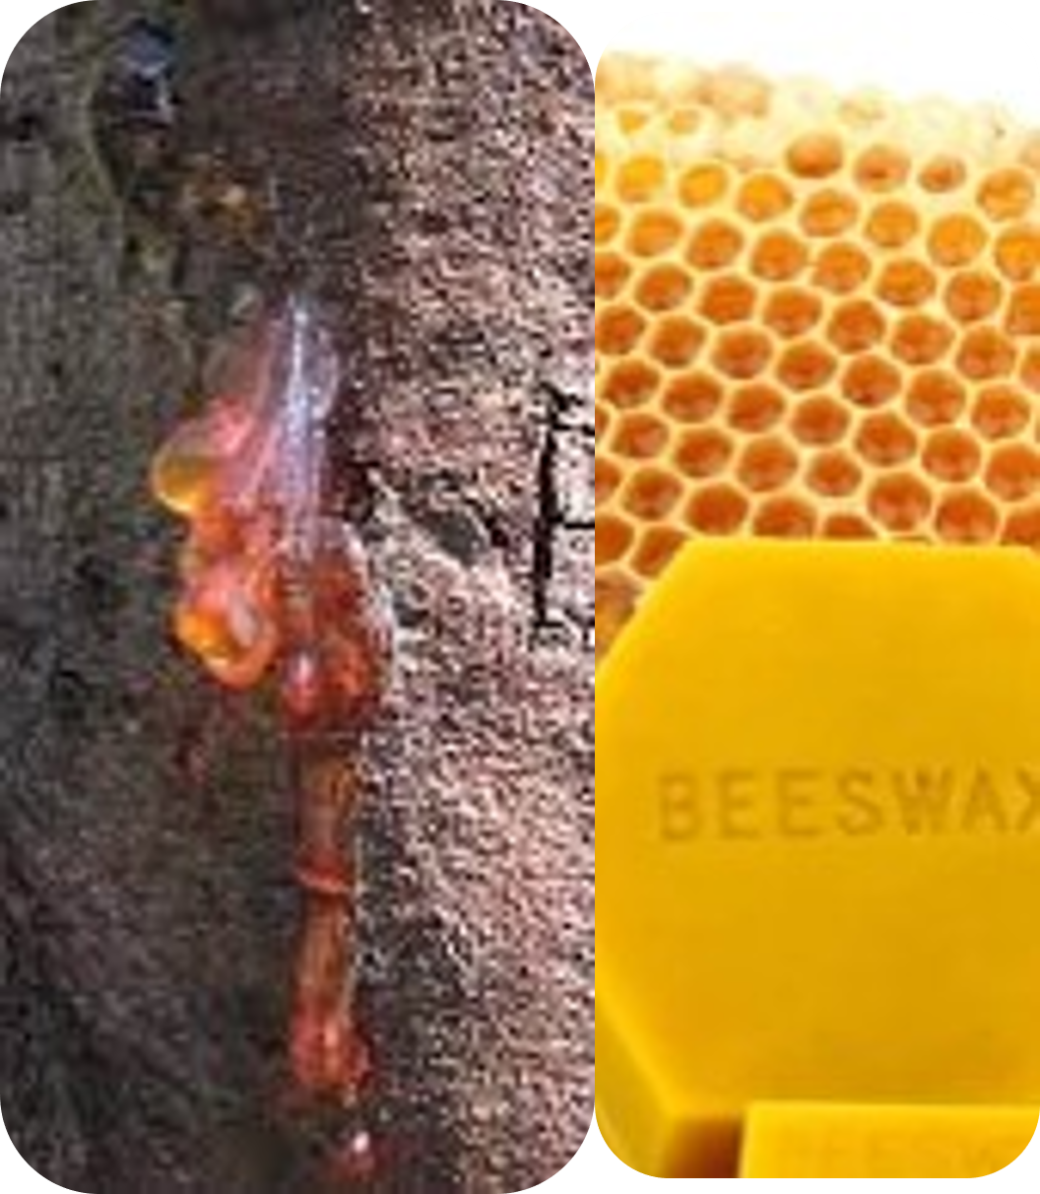
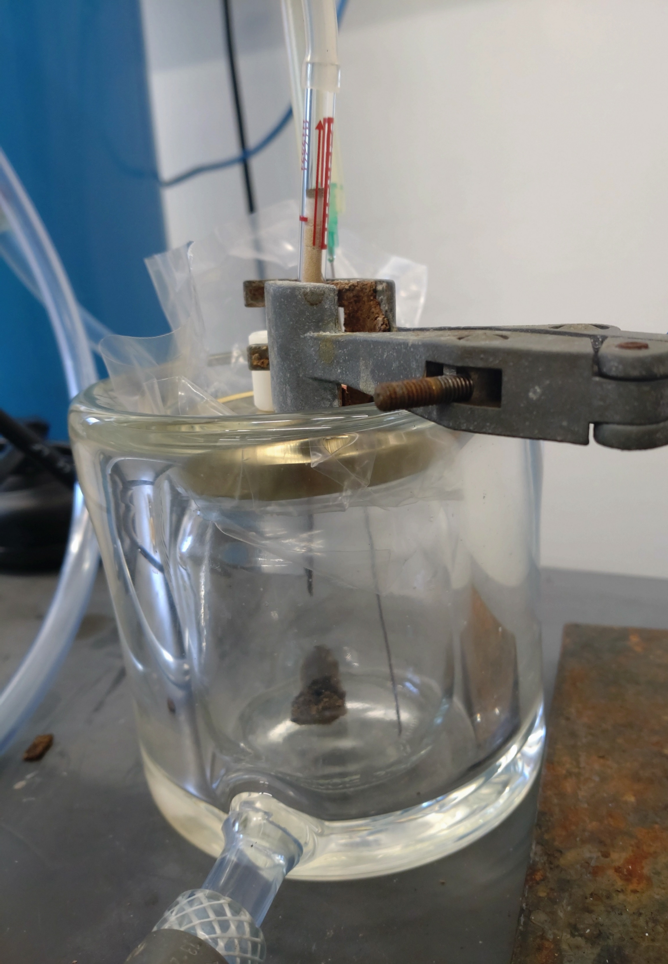
Case study – Materials & Methods
412 & 413
408 & 409
410 & 411
UVA & UVB¹
180 min, 50°C
1) Michel, M., Rots, V., 2022. Into the light: The effect of UV light on flint tool surfaces, residues and adhesives. Journal of Archaeological Science: Reports 43. https://doi.org/10.1016/j.jasrep.2022.103479
Notes:
Six different flint pieces with three different adhesives on top which had been degraded with UV light in another research were analysed. As mentioned before, we are restricted to 20 mL vials for the MPS DHS, for the case study we developed a manual DHS based on the parameters. The principle is the same, but with longer incubation and extraction times due to the larger vial and increased phase ratio. Moreover, the trap & needle temperature are less regulated.

Slide 11
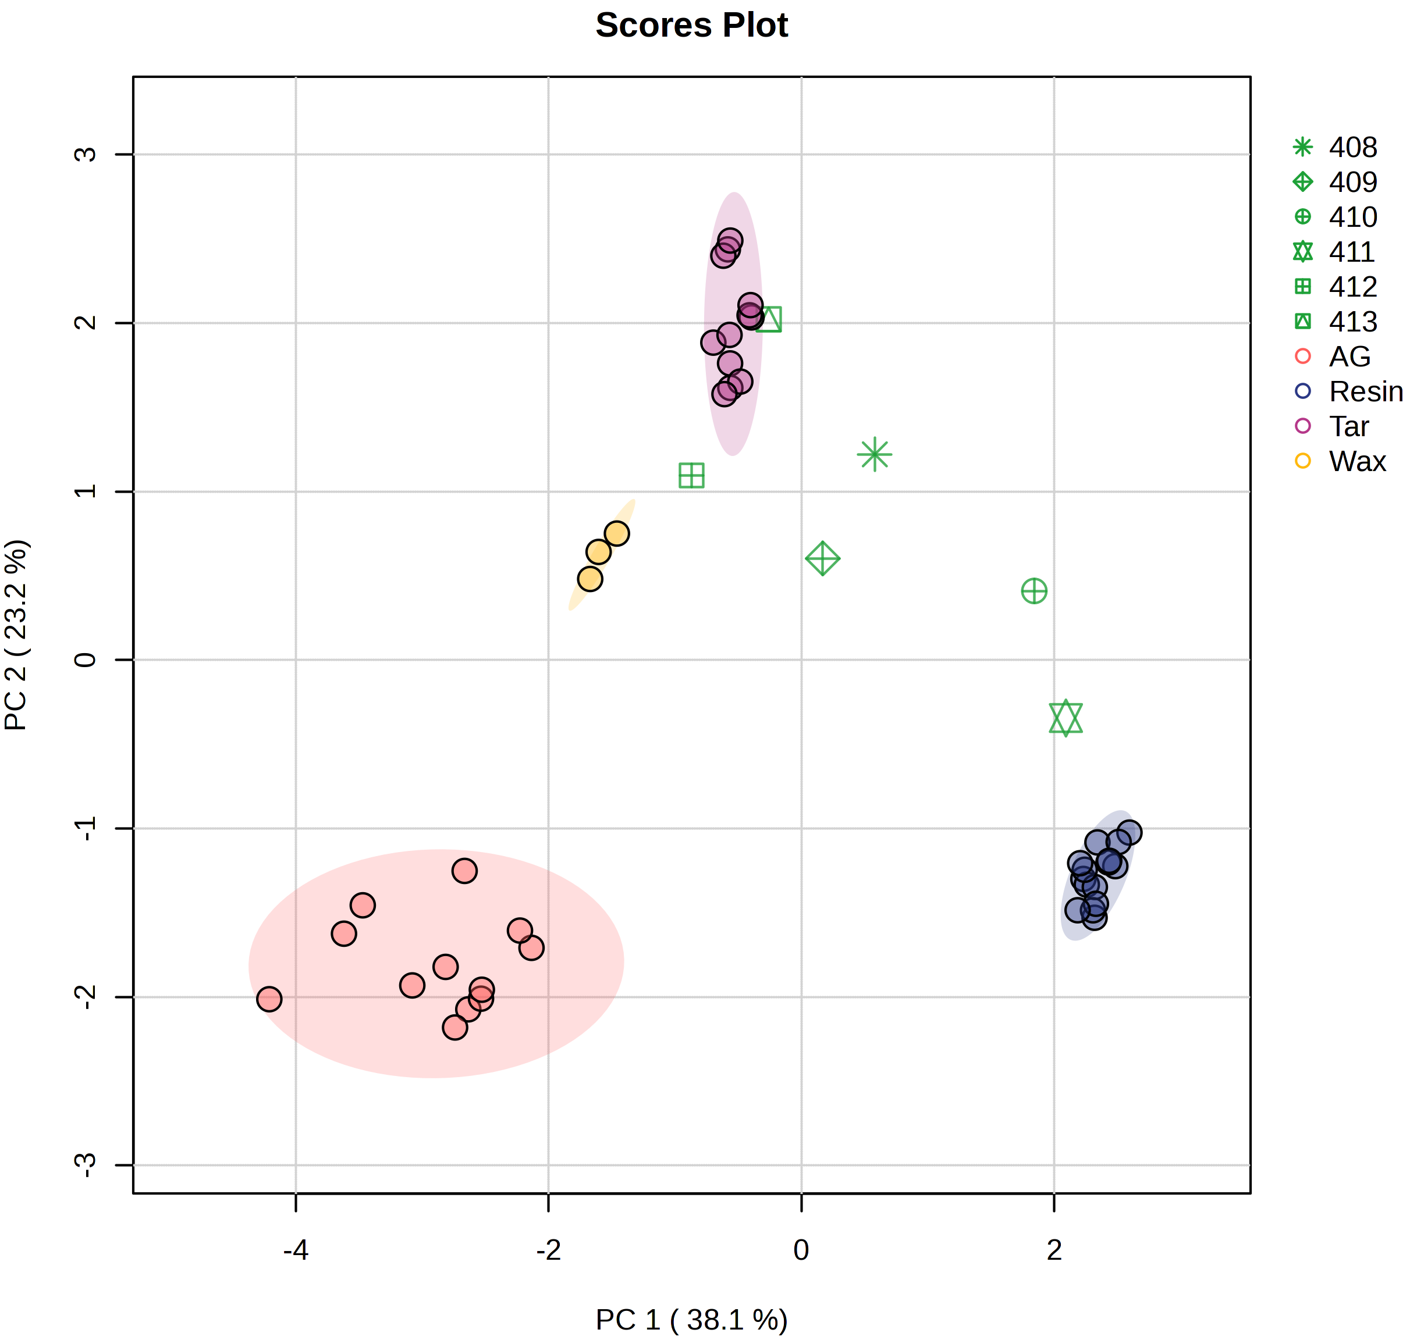
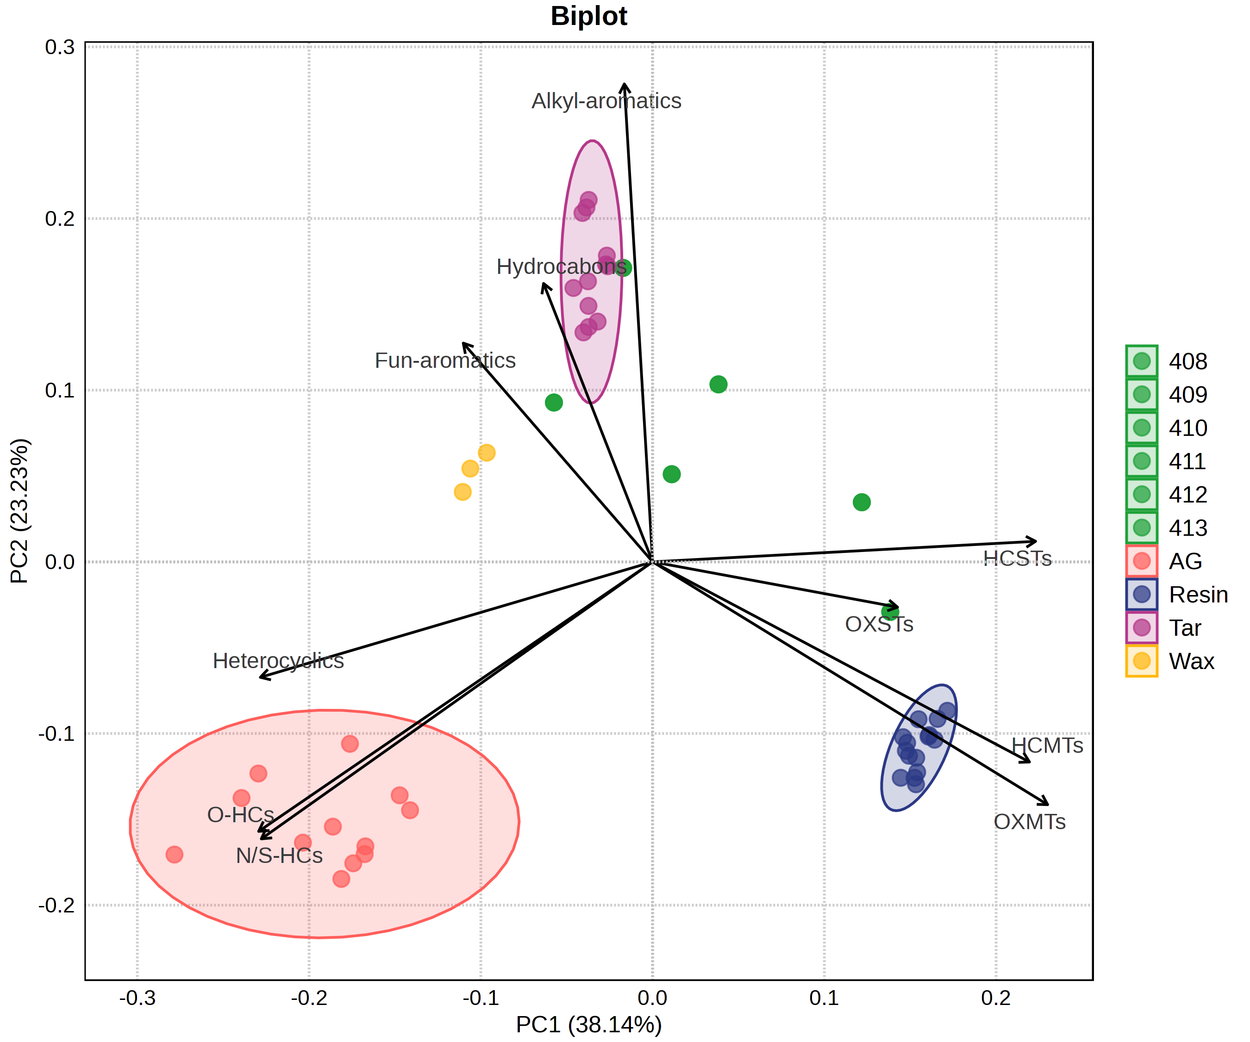
Case study - results
Notes:
The experimental samples are placed in the same space of the PCA as the database, this means that the different sampling did not affect the VOC profile. However, the UV-light degradation did. The tar samples were the least affected by the UV degradation and are placed close to the tar group in the PCA. The resin samples are the most affected, however in the biplot is seen that they still contain chemicals which are only present in resins, therefor it can be concluded that they are a highly degraded resin. The mixed with beeswax seems to preserve some of their original compounds, and are grouped closer to the resin group.

Slide 12
Conclusion
DHS-GC×GC-TOFMS
Good identification powers
Non-destructive
Sensitive
Automated

Slide 13
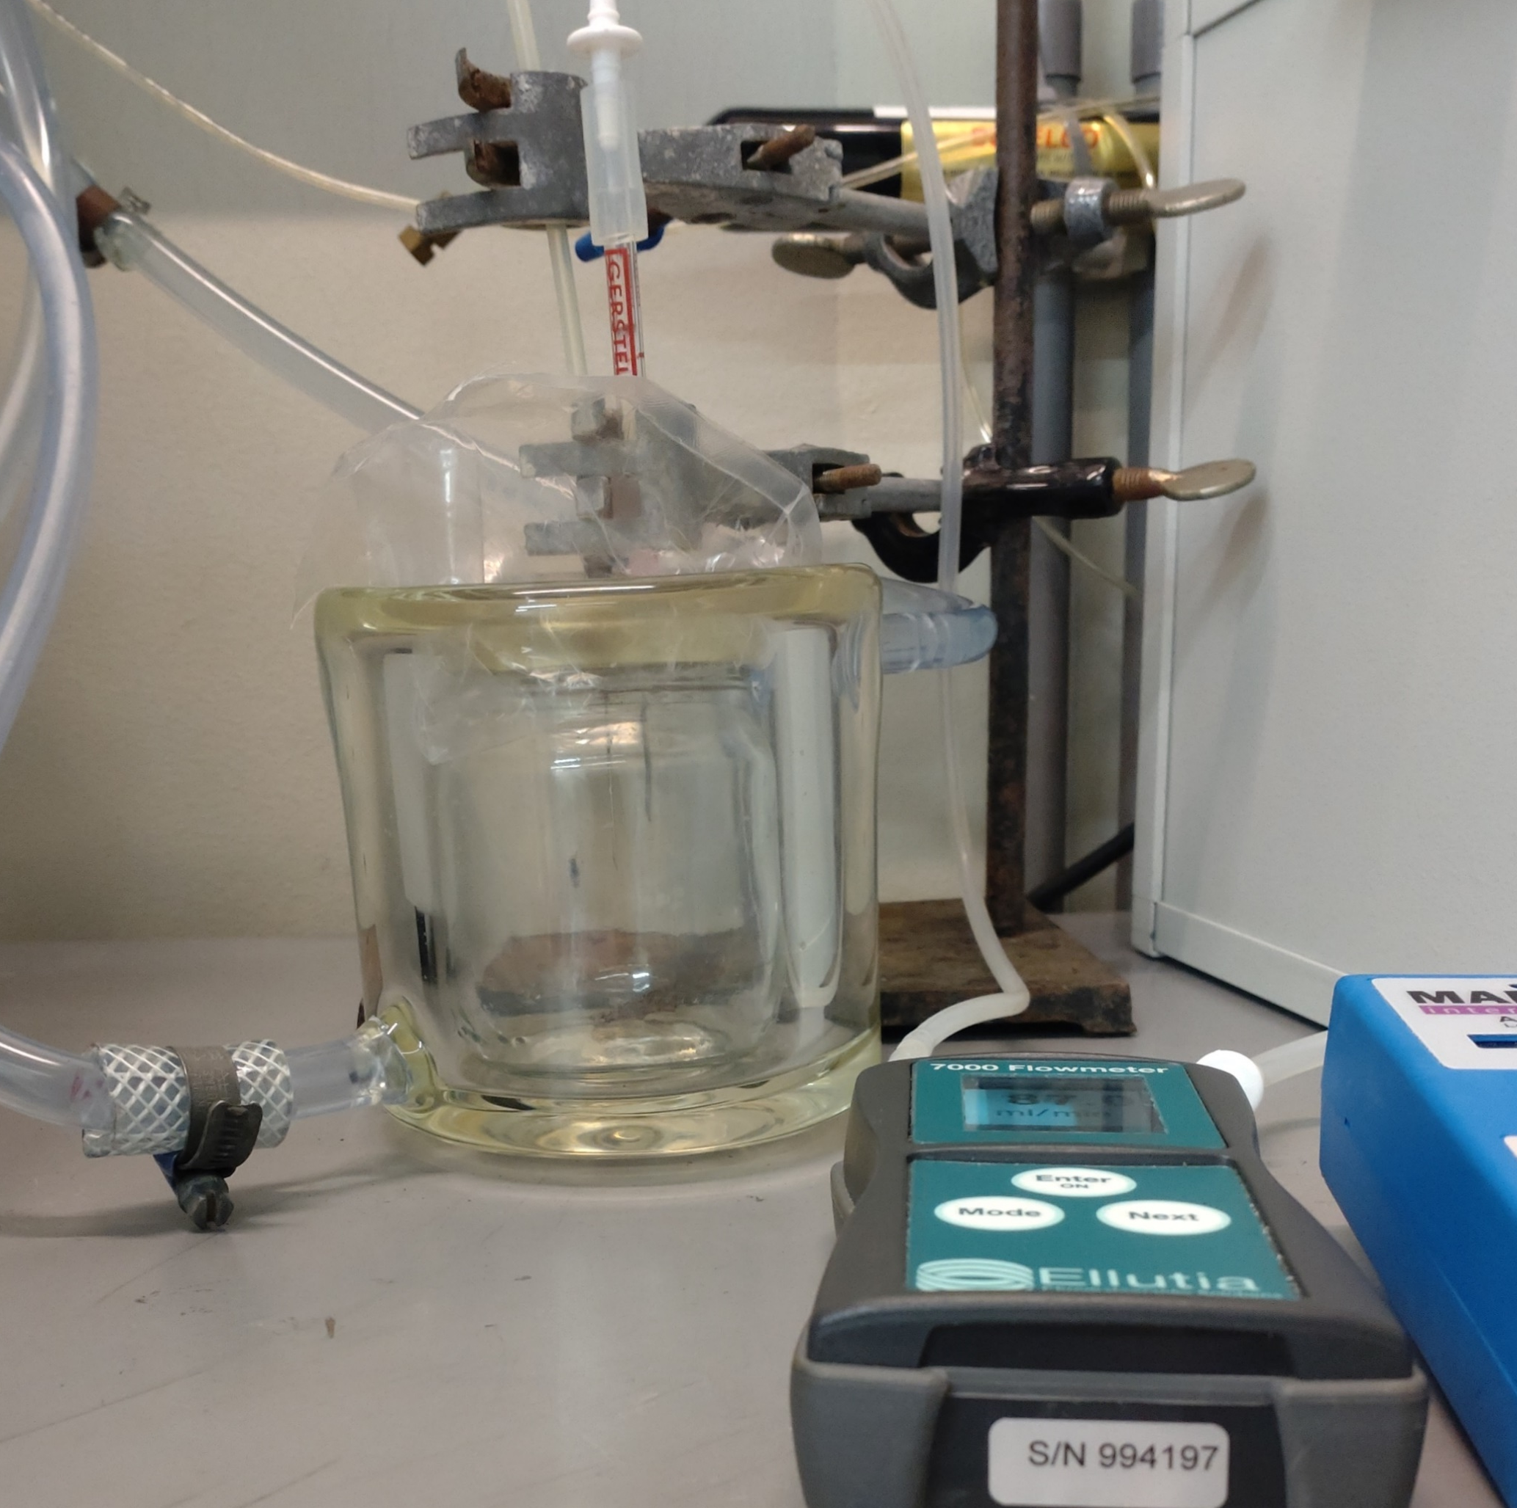
Perspectives
Real archaeological artefacts
Extent the database

Slide 14
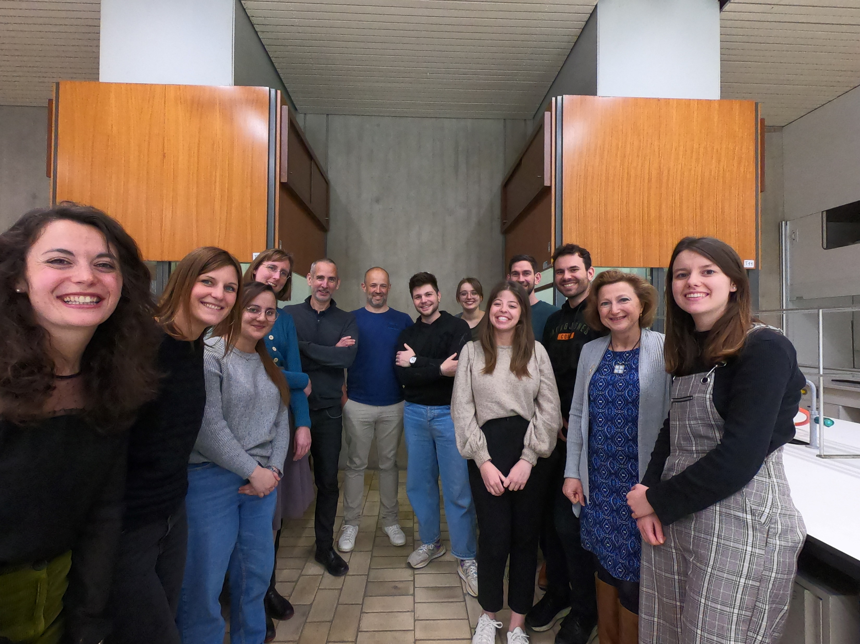
Thank you for your attention!
Prof. Jef Focant
Dr. PH Stefanuto
Thibaut Dejong
Thibault Massenet
Géraldine Dumont
Djulia Bensaada
Titziana Orlando
Anaïs Rodrigues
Siebe Lievens
Dr. Armélinda Agnello
Stéphanie Hendrick
Grégory Gridelet
Océane Tirsel
Organic and Biological Analytical Chemistry Group
Prof. Veerle Rots
Dr. Dries Cnuts
Ronè Oberholzer
Christian Lepers
This research was funded by the University of Liège though collaborative actions in the ARC-project GLUE (PI: V. Rots)

