Slide 1

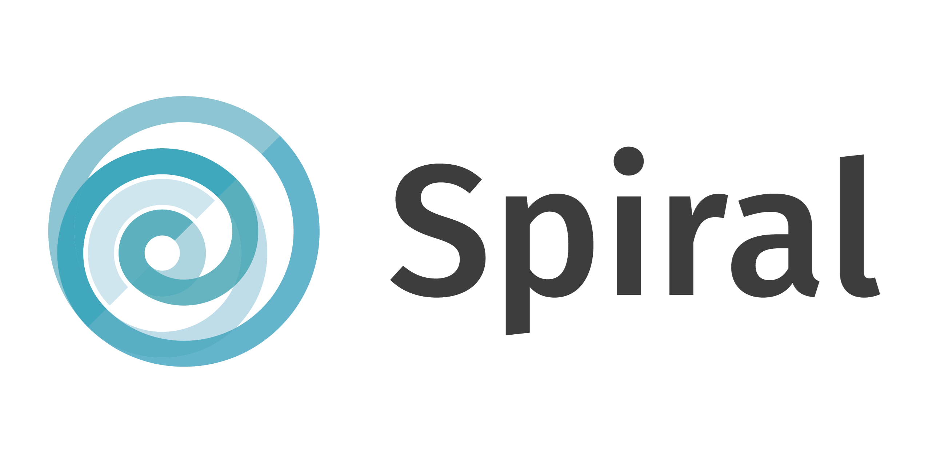
Small Modular Reactors :
Scaling down to better scale-up?
EASST-4s conference - 17.07.2024
Mathias Sabbe & Céline Parotte (Liège University)
HORIZON-EURATOM-2021-NRT-01
Notes:
Welcome to this presentation on Small Modular Reactors which is based on a paper written together with Céline Parotte from the Liège university

Slide 2
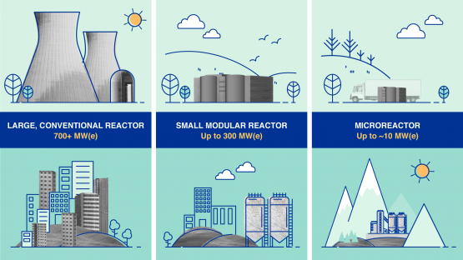
I. SMRs – At the forefront of the nuclear innovation race
https://www.iaea.org/newscenter/news/what-are-small-modular-reactors-smrs
Notes:
So without further a due, what are SMRs? So according to the International Atomic Energy Agency, SMRs are SMALL reactors in the sense that they come in a much smaller size compared to conventional nuclear reactors, but they are also SMALL in the sense that their power capacity is limited compared to larger systems (max 300 Mwe for SMRs vs. 1000 Mwe for typical nuclear reactors).
They are also MODULAR in the sense that their smaller sizes should allow for large scale production of standardized modules in factories. These modules would then be shipped for direct onsite installation, thus leading to reduced capital costs and construction times.

Slide 3
I. SMRs – At the forefront of the nuclear innovation race
“There is a race underway. The race is among leading countries and companies to prove this technology and bring it to market.” (von der Leyen, 2024)
98 SMR projects at various stages of development in 2024 (NEA, 2024) ;
Most projects in the United States, Canada, and the United Kingdom ;
Spearheaded by Startups; Traditional nuclear actors; national laboratories and universities
Notes:
So as you may know, there is currently an innovation race surrounding SMRs. This is exemplified by this quote from EU commission president Ursula von der Leyen, in her address at the Brussels nuclear energy Summit in March 2024 :
And indeed, according to the Nuclear Energy association, there are

Slide 4
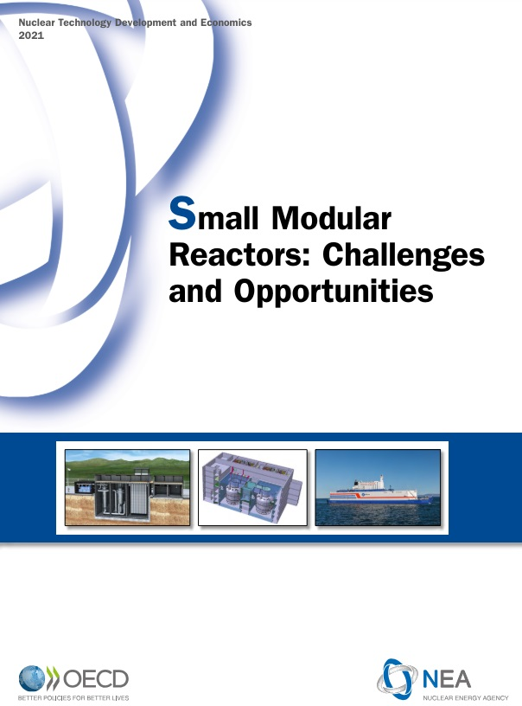
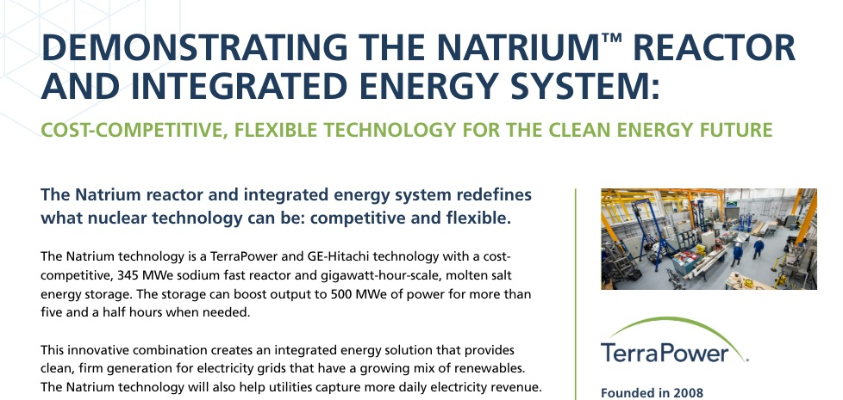
I. SMRs – At the forefront of the nuclear innovation race
SMRs touted as cornerstone of future energy landscapes (e.g., Sovacool & Ramana, 2015);
Yet, scant evidence that the expectations associated with SMRs are actually shared among the scientists and engineers who actively develop SMR designs.
Notes:
And there is a very wide body of publications (promotional material, reports, press releases, etc.), public statements witch promote SMRs as a cornerstone of future energy landscapes (e.g., Sovacool & Ramana, 2015)
But despite this growing body of grey literature,

Slide 5
II. Theoretical framework – the sociology of expecations
Expectations as “real-time representations of future technologies, situations and capabilities” (Borup et al., 2006, p. 286)
They carry values, promises, and visions connected to the possible (dis)advantages which are assumed to derive from an innovation or a techno-scientific field;
They are performative as they can shape the collective practices and strategies in the development of a technological field;
Notes:
This brings us to the theoretical framework of this paper. So, unsurprisingly we relied on the sociology of expecations. As you may know, expecations are ….

Slide 6
II. Theoretical framework – the sociology of expecations
However, the literature usually focuses collective expectations “made available in public statements” (Van Lente, 2012, p. 775).
This tends to mask the diversity of expectations within communities of promise;
The situatedness of expectations (Brown, 2003);
To what extend are the expectations upheld by the international SMR discursive community endorsed among SMR developers ?
Notes:
For instance all these declarations by International Nuclear agencies about SMRs, or all these startup claims about SMRs.

Slide 7

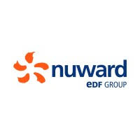




III. A two-step research process
A. Identifying SMR proponent’s expectation narratives
Grey literature review:
  55 documents;
  White papers, commercial factsheets, analytical reports, and website content
Published by developers and startups, international nuclear organizations, and initiatives promoting nuclear R&D;
Thematic analysis (MAXQDA software);
Generic expectations about SMRs.
Notes:
Generation IV International Forum

Slide 8
III. A two-step research process
B. Developers’ expectations
25 semi-structured interviews with ESFR-SIMPLE project members :
  Sodium-fast SMR (SFR);
  Euratom;
  17 partners;
  99 contributors;
Variety of profiles :
  Expertise : Reactor physics, Fluid dynamics, AI, etc.
  Experience : Phd students, research engineers, heads of research departments, etc.
  Organization : CEA, HZDR, LEMTA, STUBA, etc.
Thematic analysis (MAXQDA software);

Slide 9
IV. Results
5 generic expectations narratives were identified in the international SMR discursive community’s public statements :
  COSTS: The affordable energy expectation narrative;
  FLEXIBILITY: The smart energy expectation narrative;
  ENVIRONMENT: The green energy expectation narrative;
  SAFETY: The safe energy expectation narrative;
  PROLIFERATION: The proliferation resistant expectation narrative.
Each of these generic expectation narratives were confronted with the expectations of ESFR-SIMPLE developers
Notes:
These are articulated aroud the following topics

Slide 10
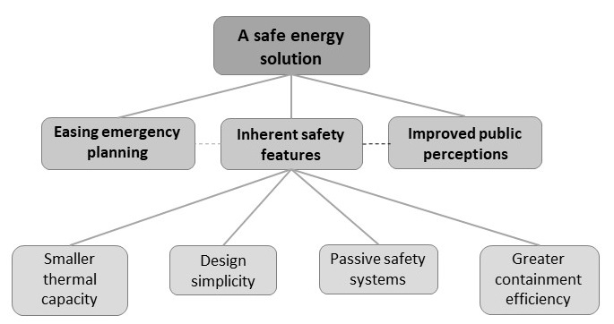
IV. Results (Safety)
Generic expectations : A safe nuclear energy solution narrative
Notes:
The generic expectations associated with safety are quite easy to grasp. The overaching expecation is that SMRs will provide a safer way to produce energy using nuclear power even more safely than larger reactors.
And this expecation is linked with the idea that SMRs will have inherent safety features due to …

Slide 11
IV. Results (Safety)
Interviewees’ expectations : a safer solution, but with a few serious caveats
At a first glance: interviewees’ safety expectations did broadly converge with generic safety expectations
On closer inspection: interviewees simultaneously expressed serious caveats regarding safety
To reach an equivalent power capacity to larger systems, nuclear accident probability would likely remain similar when using SMRs :
“When you reduce the power, you make it safer which means, in that language, that the probability of something terrible happening will be reduced by a factor of ten. […] In fact, you decrease the probability by a factor of ten for each small reactor but, at the same time, you have ten reactors. Yeah, so theoretically, the probability has not changed.” (L, Research Engineer, Reactor Physics);
Notes:
Now, when confronting these generic expecations with those of interviewees, what strikes first is that their safety expecations did broadly converge with generic safety expecations and the notion that SMRs will somehow be safer.
However, on closer inspection, the developpers also considerably tempered generic safety expecations
For instance, they noted that ….

Slide 12
IV. Results (Safety)
In order to keep costs acceptable, SMRs developers will likely not try to go beyond what is already expected in safety regulations :
“Honestly, I have a hard time convincing myself that we'll be able to scatter objects that are nuclear reactors all over a parking lot, on an industrial site, however secure it may be... [...] Because at a nuclear power plant, you've got fences, you've got a security force, you've got the national gendarmerie” (I, Head of engineering office, Reactor physics)
Depending on the technology used in the SMR, a smaller size does not necessarily improve safety :
“To say that smaller is safer may be too straightforward. Because smaller, for example, means higher heat losses. And if you are using, for example, a heavy metal [for cooling], then the probability of freezing will be higher for a small system. It's evident and this is a very dangerous accident for lead cooled fast reactor, for example” (M, Head of research group, Reactor physics).
Increased security risks due to the multiplication of nuclear infrastructures across territories :
“Honestly, I have a hard time convincing myself that we'll be able to scatter objects that are nuclear reactors all over a parking lot, on an industrial site, however secure it may be... [...] Because at a nuclear power plant, you've got fences, you've got a security force, you've got the national gendarmerie” (I, Head of engineering office, Reactor physics)

Slide 13
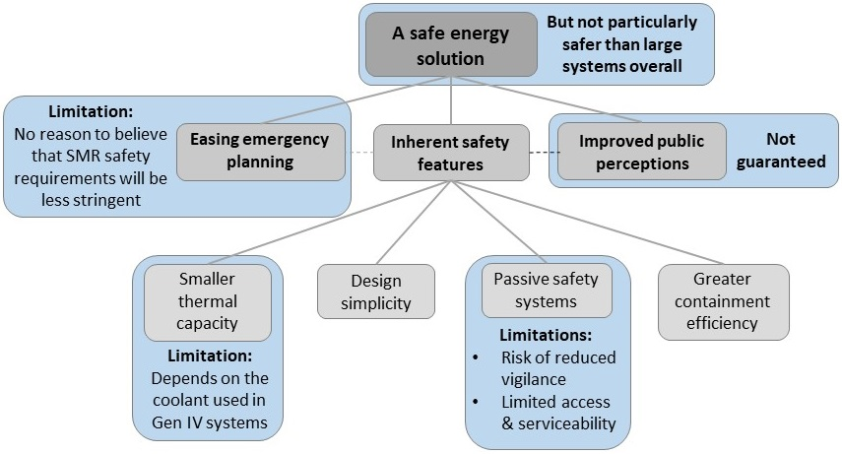
IV. Results (Safety)

Slide 14
IV. Results (General)
General results :
An apparent congruence between interviewees’ expectations and those of the international SMR discursive community;
Yet, developers tempered generic expectations by highlighting many caveats and limitations associated with smaller systems (e.g., on safety, flexibility, costs etc.) ;
A general preference for larger, more efficient and optimized systems ;

Slide 15
IV. Results (General)
Instead of a one size fits all solution, interviewees did generally depict SMRs as a necessary stepping stone towards a revitalization of the nuclear sector
Generate public interest with a new image (rebranding nuclear energy) ;
Attract much needed human an financial resources for the nuclear sector ;
Gradually rebuild the lost competences and industrial capabilities of the sector ;
Gain back the competences needed to build larger systems
“So, modularity can help us to get back the competencies. But once we have the competences, we can forget about small and forget about... Okay. Keep modular wherever we can, but once we have the competencies, we can build big and not small modular reactors” (L, Research Engineer, Reactor Physics).

Slide 16
V. Preliminary conclusion and discussion
Aligning collective and situated expectations: towards a strategic promise?
SMR developers did share many expectations which are not exactly aligned with generic expectations. Yet somehow, these mismatched expectations are realigned in developers’ discourses.
Misaligned expectations at the individual and collective level are reconciled by developers through the articulation of a strategic promise associated with SMRs;
Strategic promises as way of redirecting mismatched expectations towards a higher desirable outcome that is shared by all those who engage in R&D activities;
For example: SMRs hold the promise of a durable revitalization of the nuclear energy sector and the replenishment of competences needed to build large nuclear reactors.
Notes:
So, in guise of a short and quick conclusion I wanted to discuss the re-alignment of mismatched collective and situated expecations by SMR developpers.
As we discussed, SMR developers did share many expectations which did not exactly align with generic expectations. Yet somehow, these misaligned expectations are realigned in developers’ discourses because despite voicing many limitations (regarding costs, safety, flexibility and so on) they still broadly agreed with the generic expectations.
And so we argue that ….

Slide 17
Thank you for your attention !
Any questions ?

