Slide 1
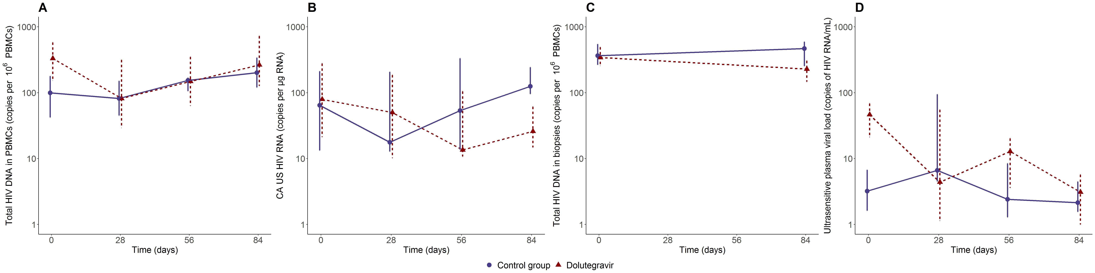
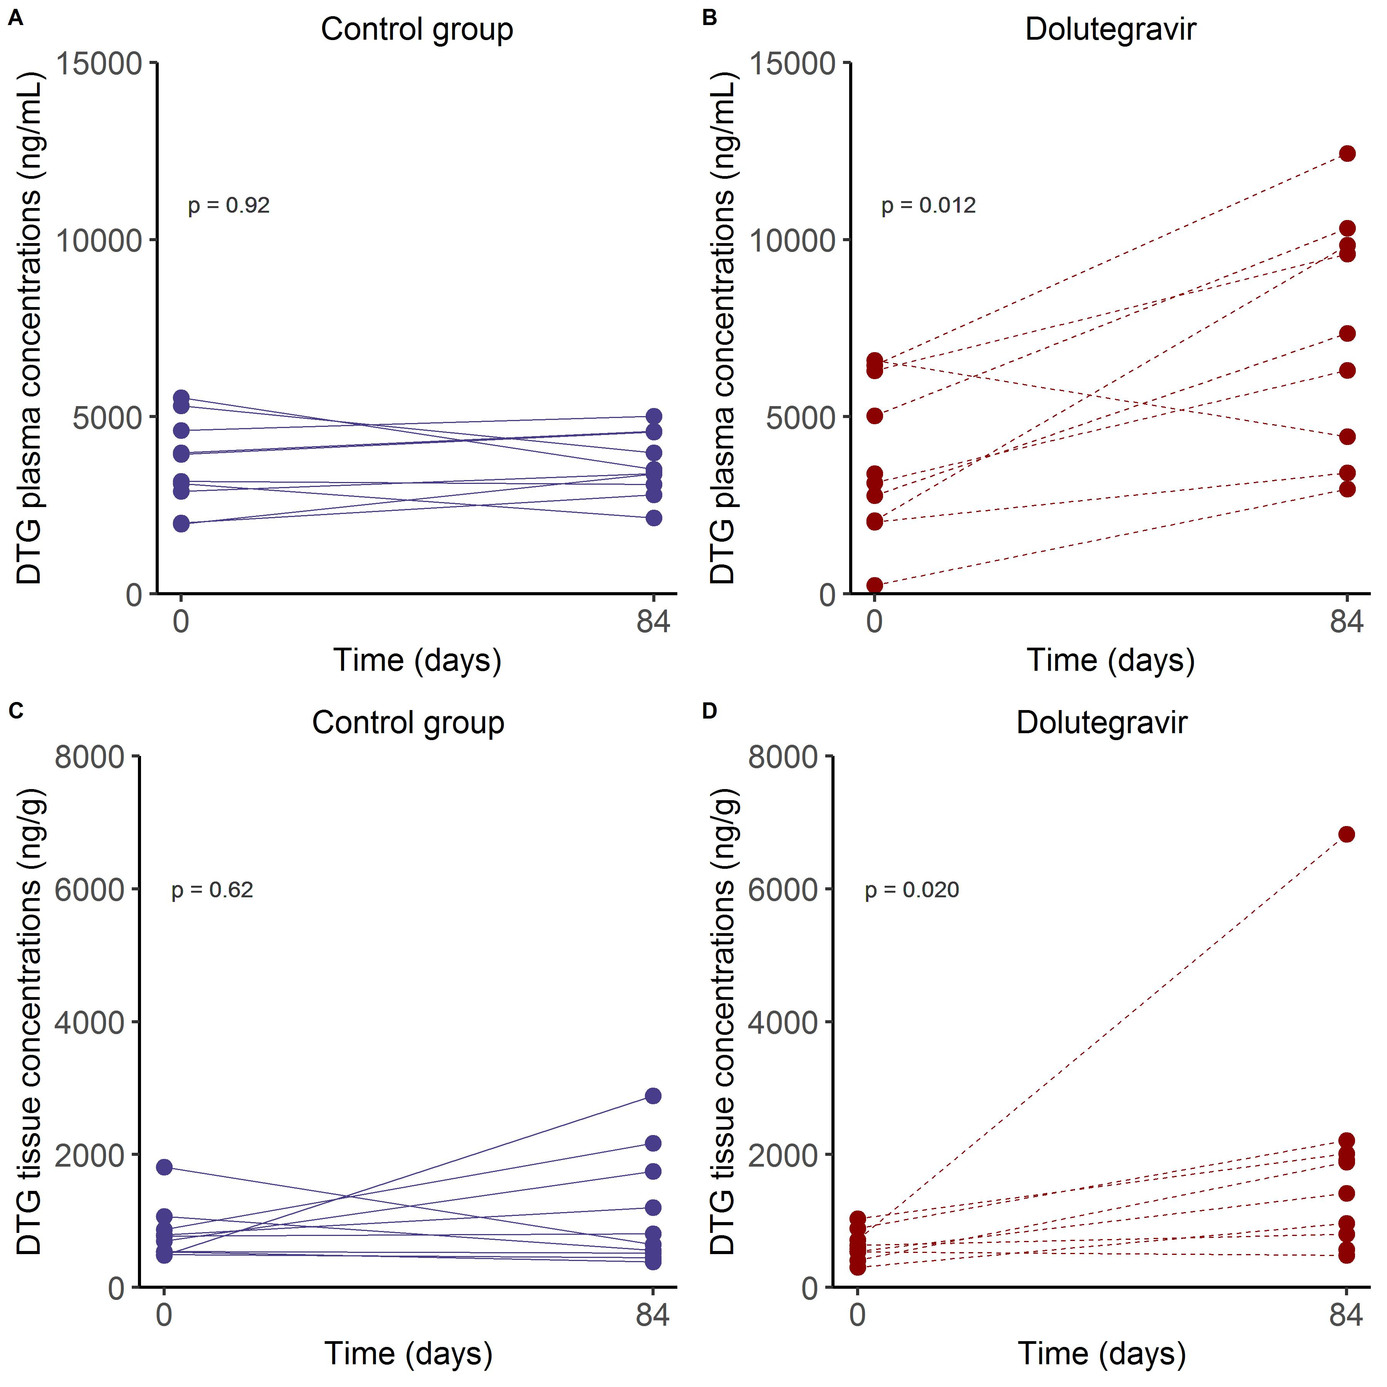
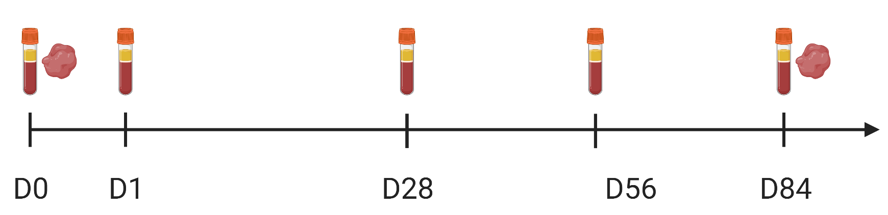
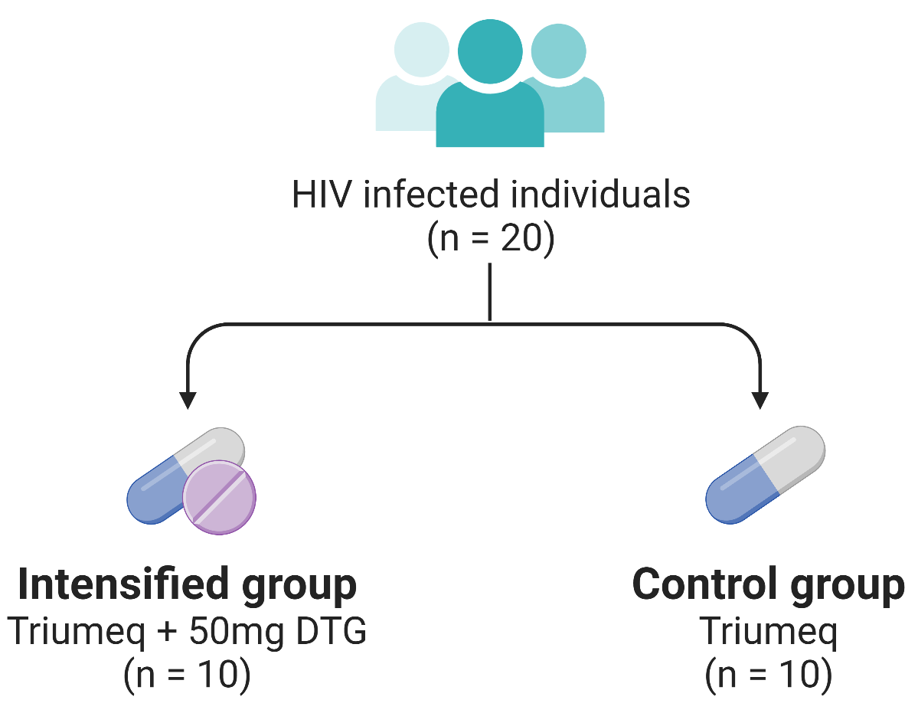

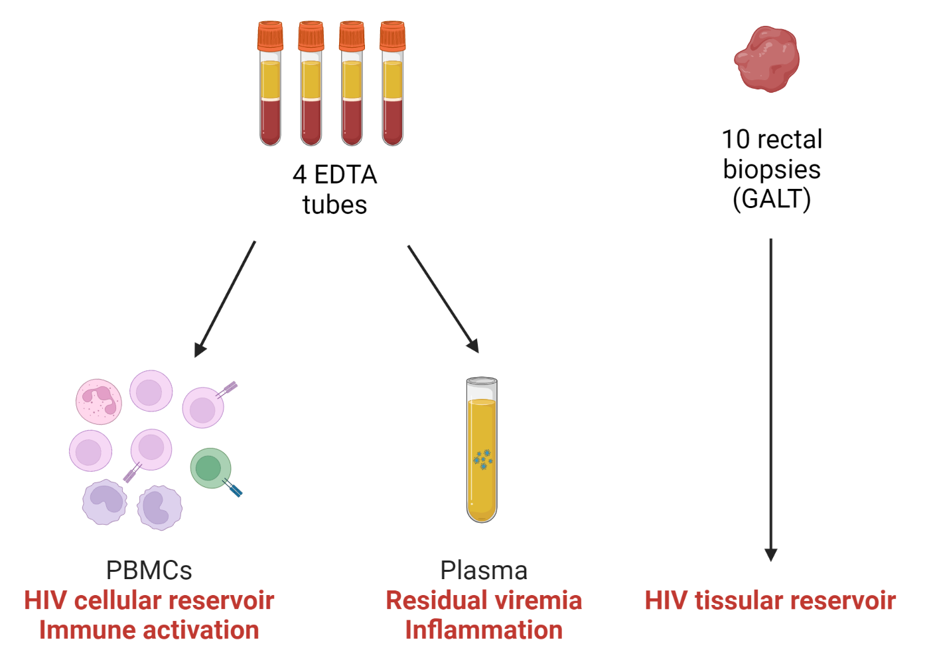
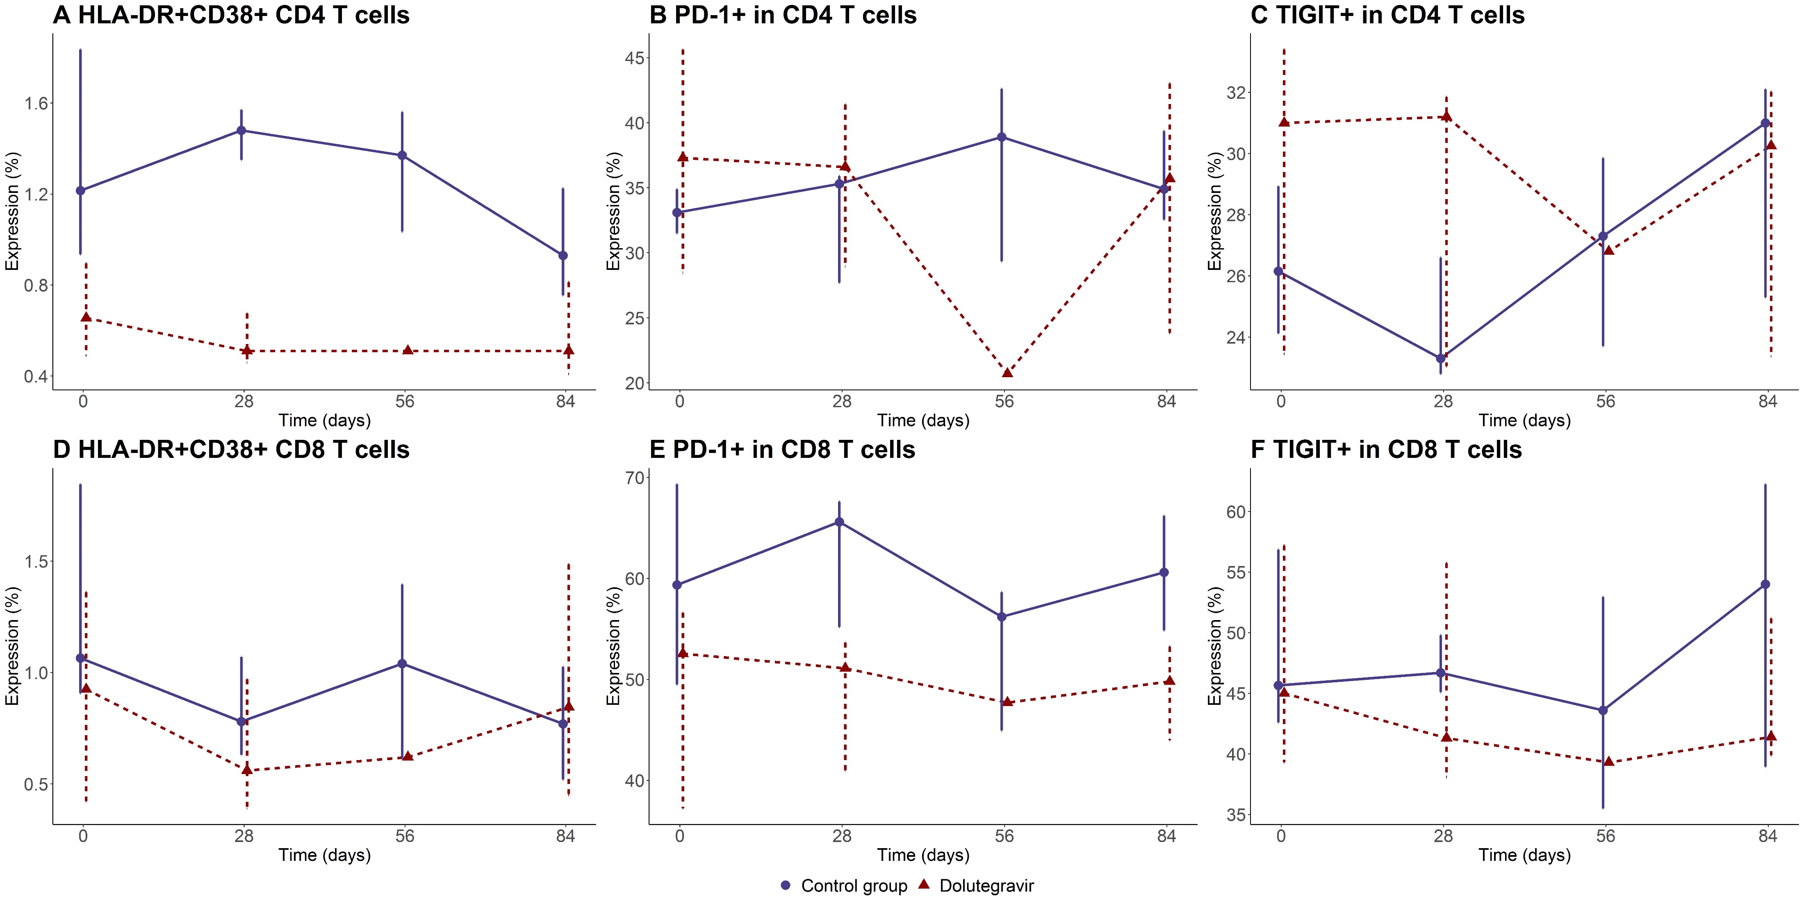
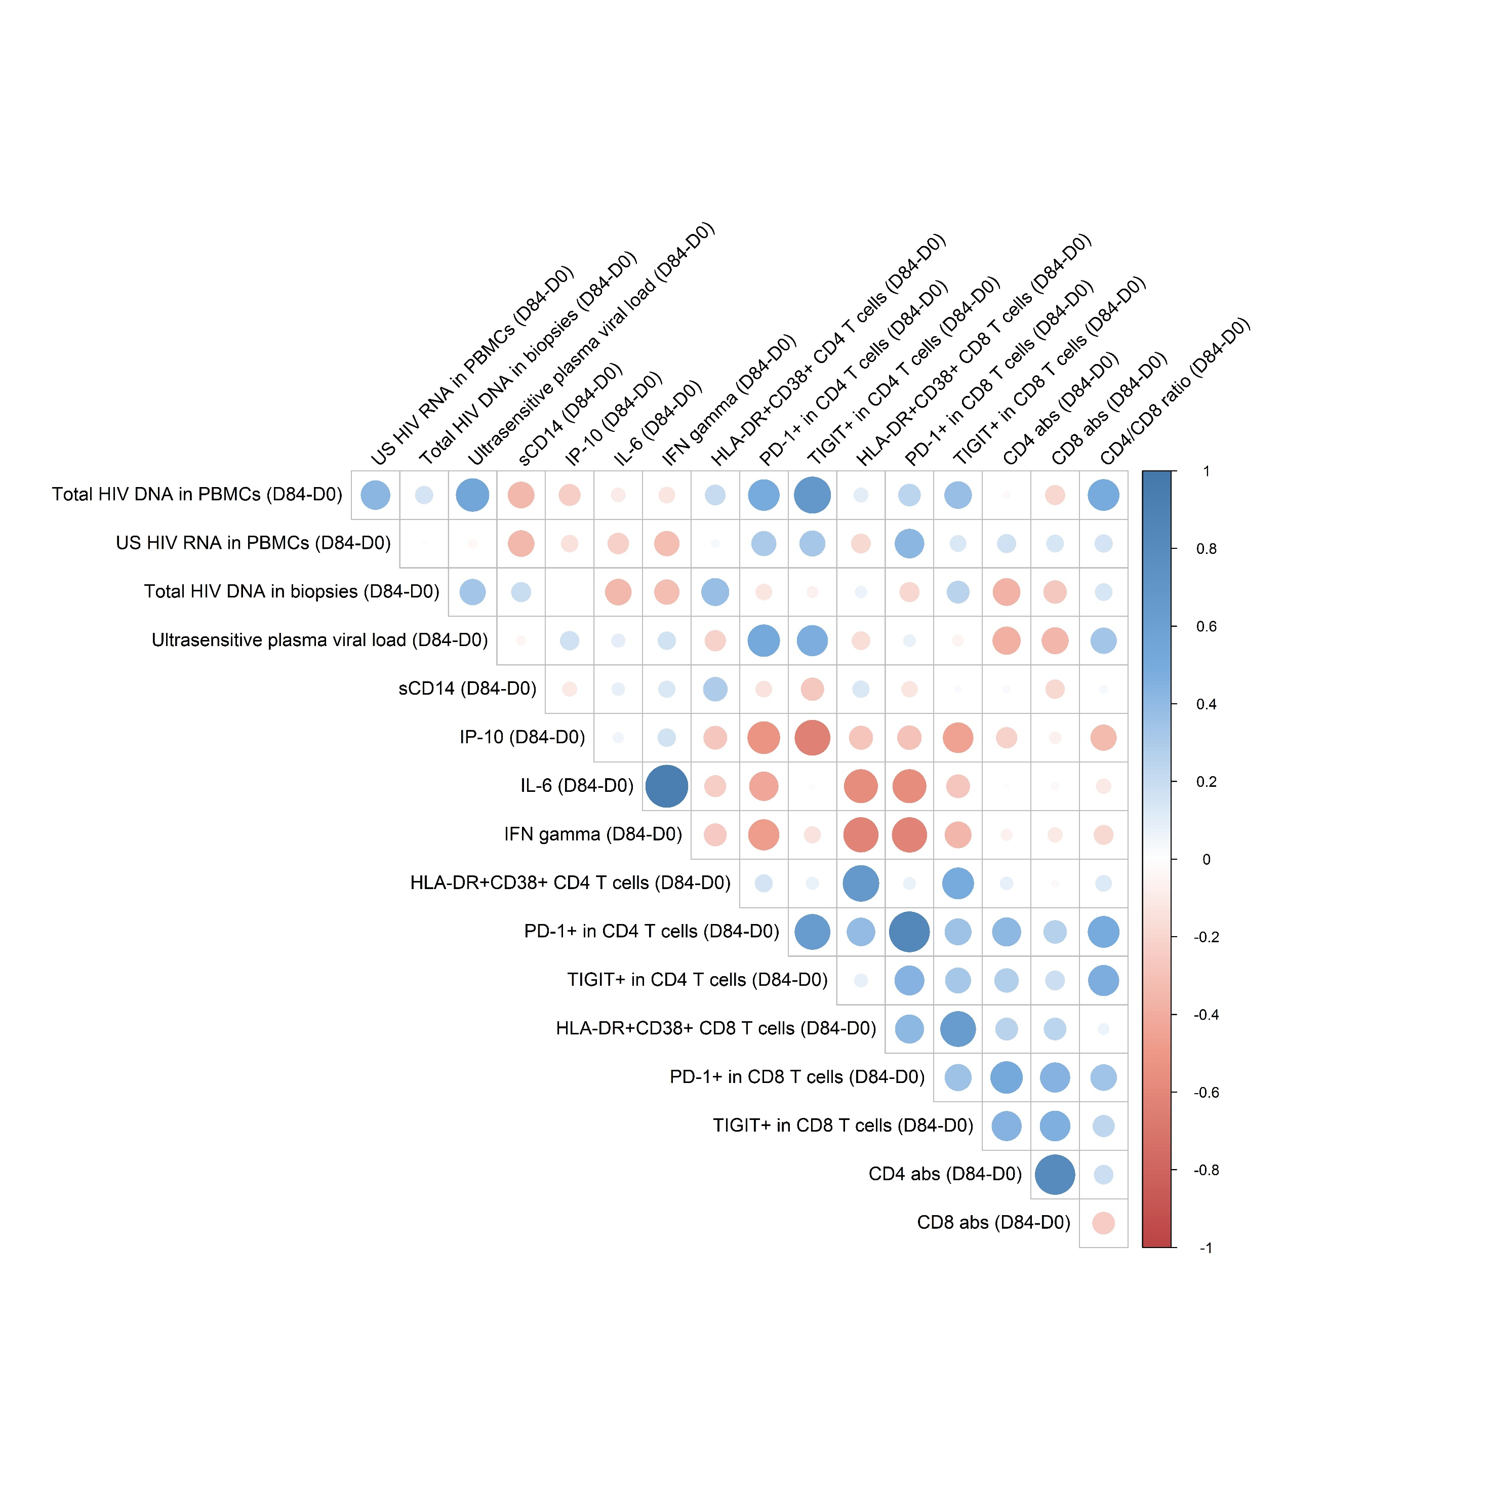
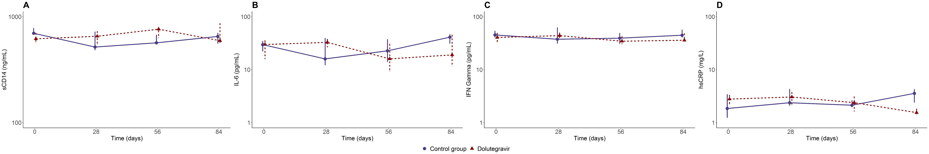





Title:
Doubling dolutegravir dosage reduces HIV persistence markers in ART-treated adults
00429
Céline Fombellida-Lopez¹ , Alexander O. Pasternak² , Aurelija Cicilionyté² , Nathalie Maes^{1,4} , Céline Vanwinge¹ , Sandra Ormenese¹ , Aurélie Ladang^{1,4} , Etienne Cavalier^{1,4} , Lee Winchester³ , Courtney V. Fletcher³ , Fabrice Susin⁴ ,
Dolores Vaira⁴ , Marie-Pierre Hayette^{1,4} , Catherine Reenaers^{1,4} , Michel Moutschen^{1,4} , Gilles Darcis^{1,4}
¹University of Liège, Liège, Belgium, ²University of Amsterdam, Amsterdam, Netherlands, ³University of Nebraska Medical Center, Omaha, Nebraska, US, ⁴University Hospital of Liège, Liège, Belgium
1. BACKGROUND
Whether ongoing viral replication occurs in people living with HIV (PLWH) despite antiretroviral therapy (ART) and leads to low-level residual viremia is still debated.
Here we report on a study, in which we intensified the ART regimen by doubling dolutegravir (DTG) dosage.
We investigated the impact of this strategy on HIV blood and tissue latent reservoirs, residual viremia, immune activation, and inflammation.
2. METHODS
Study design
Laboratory assays
Total HIV DNA
Cell-associated unspliced HIV RNA (US HIV RNA)
Intact Proviral DNA Assay by IPDA
Ultrasensitive plasma viral load by single-copy assay (SCA)
Immunophenotyping of activation/exhaustion markers (HLA-DR, CD38, PD-1, TIGIT) by flow cytometry
Inflammatory plasma biomarkers quantification
DTG concentration measurement in plasma and tissue
3a. RESULTS
No significant differences in total HIV DNA in PBMCs and in tissue between day 0 and day 84 in both groups.
Significant decrease in US HIV RNA in PBMCs (p=0.0156) and in ultrasensitive plasma viral load (p=0.016) between day 0 and day 84 in the intensified group.
No significant difference were observed between both groups in terms of immune activation and inflammation.
As expected, doubling DTG increased DTG plasma and tissue concentrations.
3b. RESULTS (figures)
Impact of treatment intensification on HIV latent reservoir and residual viremia
Impact of treatment intensification on DTG concentrations
Figure 1: Cell-associated virological markers during ART intensification.
Median (IQR) concentrations of total HIV DNA in PBMCs (A), cell-associated unspliced HIV RNA (B), total HIV DNA in rectal biopsies (C) and ultrasensitive plasma viral load (D).
Impact of treatment intensification on immune activation and inflammation
  Figure 4: Dolutegravir (DTG) concentrations in plasma and in tissue.
  Evolution of DTG plasma concentration in the control group (A), evolution of DTG plasma concentration in the intensified group (B), evolution of DTG tissue concentration in the control group (C), evolution of DTG tissue concentration in the intensified group (D).
Correlations between the evolution of
HIV persistence markers, immune activation/inflammation
  Figure 2: T-cell activation and exhaustion during ART intensification.
  Percentage of CD4+ T cells expressing HLA-DR and CD38 (A), PD-1 (B), TIGIT (C) measured by flow cytometry.
  Percentage of CD8+ T cells expressing HLA-DR and CD38 (D), PD-1 (E), TIGIT (F) measured by flow cytometry.
Figure 5: Spearman correlation between the evolution of HIV persistence markers, immune activation and inflammation during ART intensification.
Circle size reflects the magnitude of the correlation coefficient. Color represents the level of Sperman’s correlations (blue means positive correlation and red means negative correlation).
4. CONCLUSIONS
We observed a decrease in US HIV RNA and ultrasensitive plasma viral load following DTG intensification, suggesting ongoing viral replication in some participants.
However, it had no measurable impact on immune activation or inflammation.
If confirmed in larger clinical trials, these results could have an impact on the clinical management of PLWH.
  Figure 3: Biomarkers of inflammation during ART intensification.
  Median (IQR) concentrations of sCD14 (A), IL-6 (B), IFN-γ (C) and hsCRP (D).
  sCD14=soluble CD14, IL-6=interleukin-6, IFN-γ=interferon-gamma, hsCRP=high sensitivity C-reactive protein.
ADDITIONAL KEY INFORMATION
Author Contact Information: cfombellidalopez@uliege.be
We would like to acknowledge the study participants and funding resources that have made this work possible.

