Slide 1
Refractive index RI matching for PIV measurements of liquid-solid flow in a stirred tank bioreactor used for mesenchymal stem cell culture
Mohamad MADANI, Angélique DELAFOSSE, Dominique TOYE
m.madani@uliege.be
Product, Environment, and Processes (PEPs)
Department of Chemical Engineering
Université de Liège
http://chemeng.ulg.ac.be/

Slide 2
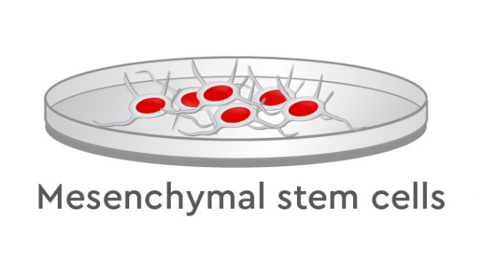
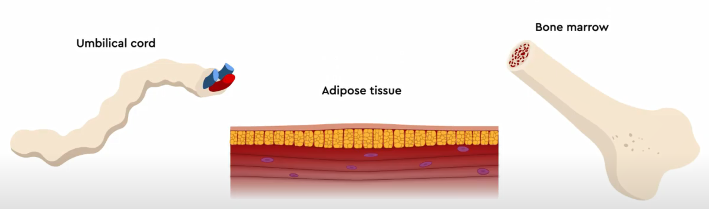
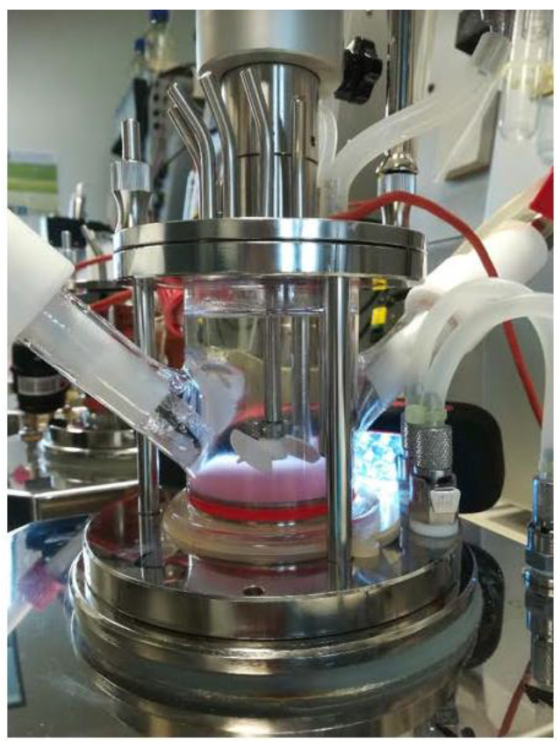
Overview
Overview
Problematic
Materials and Methods
Results
Prospects
Why?
Wide applications in medicine:
Gene therapy
Bone reconstruction
Repairing damaged tissues
Due to:
Differentiation & immunosuppressive properties
Insufficient quantities (<10⁶ cells per sample)
Study on the design and operation of stirred tank bioreactor
In vitro expansion
Desired:10⁷ to 10⁹ cells per injected dose
Notes:
Higher doses

Slide 3
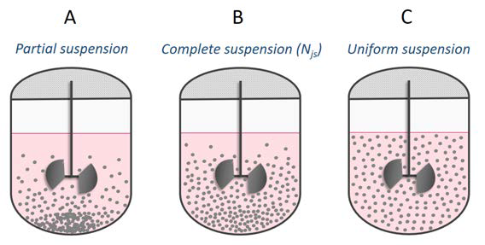
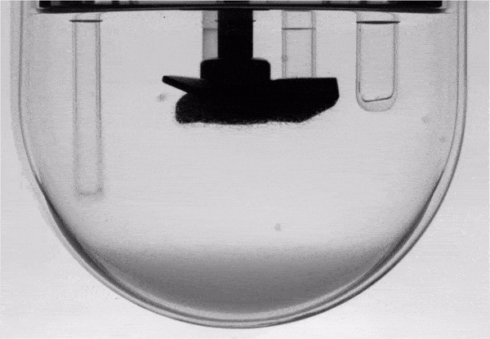
Principle
Overview
Problematic
Materials and Methods
Results
Prospects
Cells are anchorage dependent: adherence on particles to expand, e.g., commercial Cytodex-1
Suspending microcarriers to ensure nutrient transfer and mixing
Increase in agitation → more suspension → higher stresses and collisions → higher cells detachment and death
Unique system: ρ_{L}/ρ_{S} ≈1 and low viscosity
2-3 v% of microcarriers
Increasing rotation speed N
characterizing hydrodynamics: ➔ Relative velocities
➔ Turbulence
➔ Solids interactions
Notes:
Not so often studied in literature

Slide 4
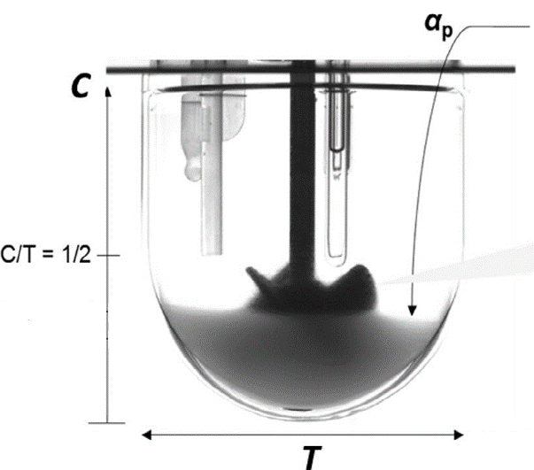
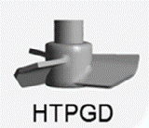
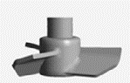

Reactor configuration
Overview
Problematic
Materials and Methods
Results
Prospects
Solids loading
V = 0.7 L
T = 0.12 m
H = 0.082 m
C/T = D/T = 0.5
HTPGD: axial 3-blade impeller – down pumping
T: tank diameter (m)
C: off-bottom impeller clearance (m)
D: impeller diameter
H: liquid height or depth (m)
HTPG impeller by: www.pierreguerin.com

Slide 5
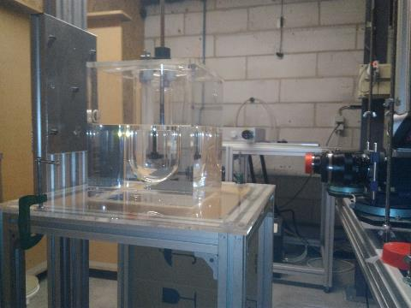
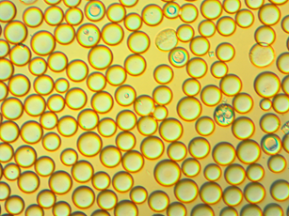

PIV – Particle Image Velocimetry
Overview
Problematic
Materials and Methods
Results
Prospects
Previous test
Laser
Pulse YAG 2x65mJ/532nm
CMOS camera
FlowSense EO 4M, 16-25 Hz
Cytodex-1 microcarrier in water
ρ_{S} = 1020 kg/m³
Aquarium filled with paraffine oil
Stirred tank
d_{P} = 170 µm
Notes:
Seems Translucent

Slide 6
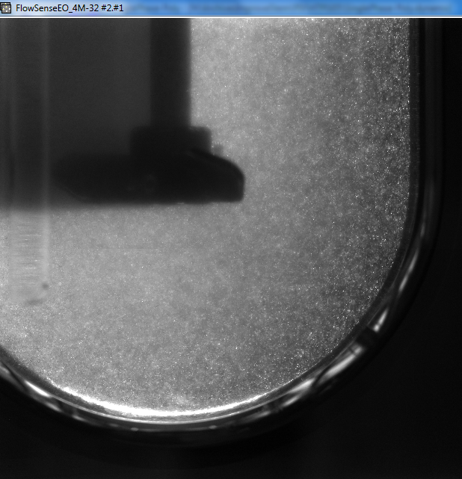

Problematic – PIV
Overview
Problematic
Materials and Methods
Results
Prospects
PIV raw image
Cytodex-1/water seeded with: Rhodamine (1-10 µm)
α_{s} = 0.5 %v only!
Blurry results, insufficient for retrieving data
α_{s} = 0.5 %v!
Issue:
poor optical characteristics for cytodex-1/water system
Light scattering!
Alternative solid/liquid model with good optical properties to evaluate velocities and fluctuations
Notes:
matched RI, density and viscosity

Slide 7

Matched RI for PIV
Overview
Problematic
Materials and Methods
Results
Prospects
Microparticles
+
Matched density system
RI matched
Chemical compatibility
Safety concerns
Water absorption of particles
Low viscosity ranges
Additional limitations:
CYTODEX-1/WATER
PMMA particles/AMMONIUM THIOCYANATE NH₄SCN
Theoretically
Reference: Borerro et al 2016
Notes:
Single particle properties Flow regime Estimated dissipated energy Stokes number

Slide 8
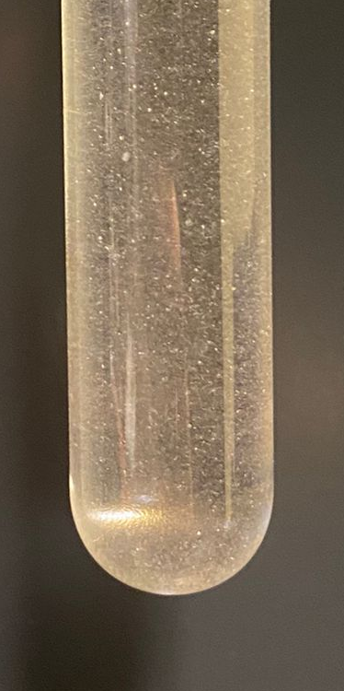
PMMA/NH₄SCN characterization
Overview
Problematic
Materials and Methods
Results
Prospects
NH₄SCN Solution of 55-61 wt%, T= 21-23°C
PMMA/NH₄SCN
Properties | PMMA/NH₄SCN | Cytodex-1/Water
ρ_{L}/ρ_{S} (-) | ≈0.96 | ≈0.97
μ_{L} mPa.s | ≈1.5-1.9 | ≈1
Particles size d_{S} μm | ≈168 | ≈170
Terminal velocity 10⁻⁴ m/s | ≈5-6 | ≈2.4
N_{js} ±3 rpm for α_{s} ≈ 2.5 %v | ≈108 | ≈77
same ranges of Reynolds number (Re = 5000-6000)
Stokes number is retained
Compatibility evaluation via Microscope
RI≈1.486-1.491

Slide 9
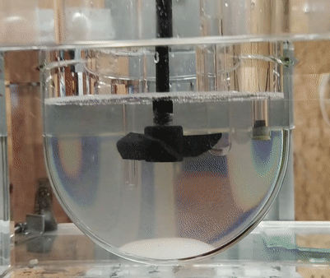
PIV – multiphase
Overview
Problematic
Materials and Methods
Results
Prospects
Evaluation of liquid phase
- Liquid phase:
61 wt% NH₄SCN - ρ_{L}= 1139 kg.m⁻³
seeded with Rhodamine coated PMMA (1-20 µm)
- Solid phase: PMMA microparticles
- Spatial resolution: ≈1.16 mm
- Frequency: 16 Hz
- Number of images: 1000
- Full Homogeneous suspension N=150 rpm
Experimental error: 3-8%

Slide 10
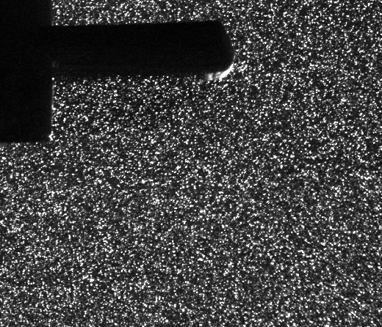
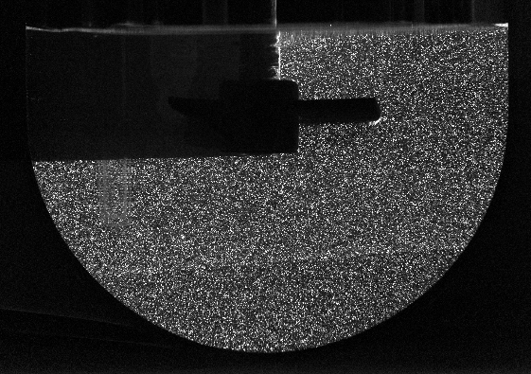
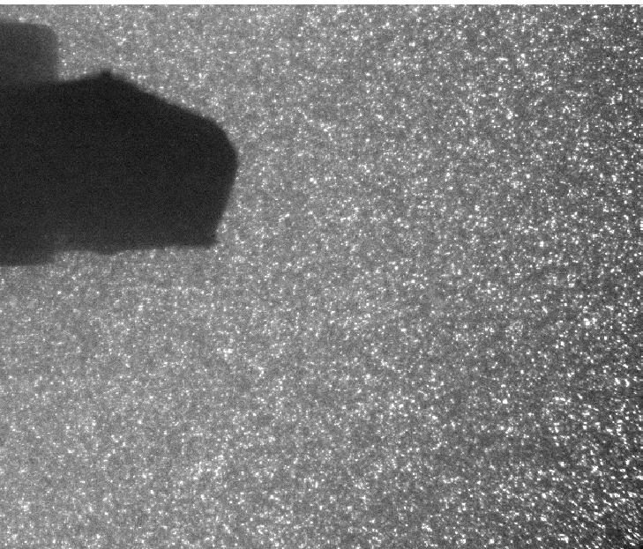
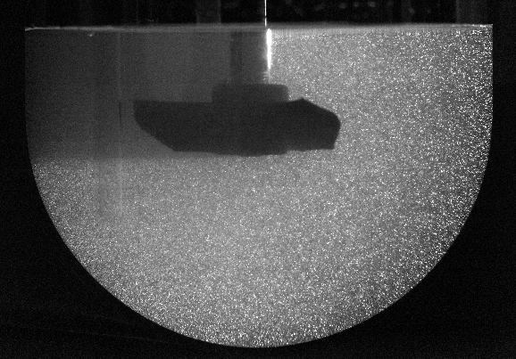
PIV – raw images
Overview
Problematic
Materials and Methods
Results
Prospects
α_{s}= 0 v % (blank)
α_{s}= 3 v %

Slide 11
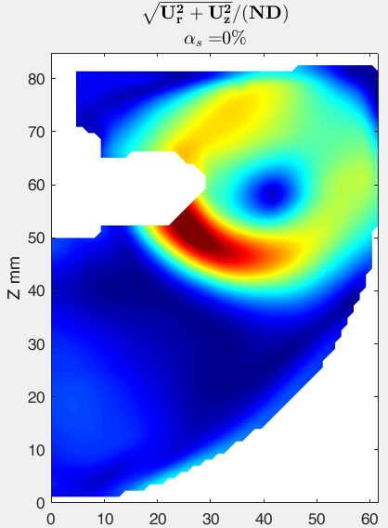
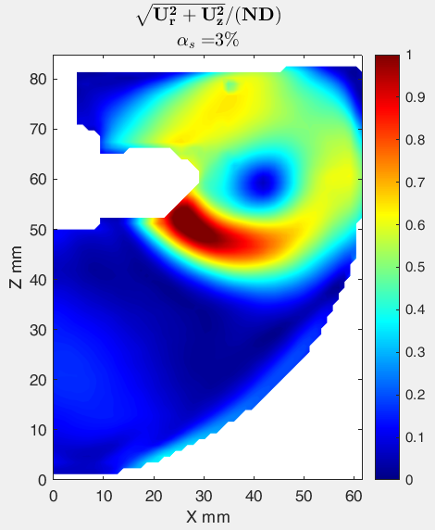
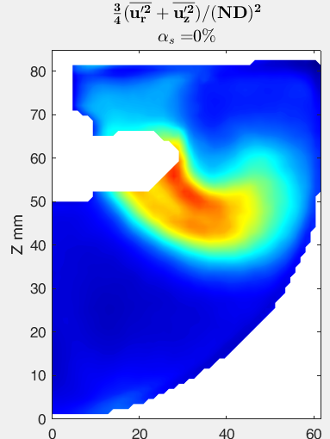
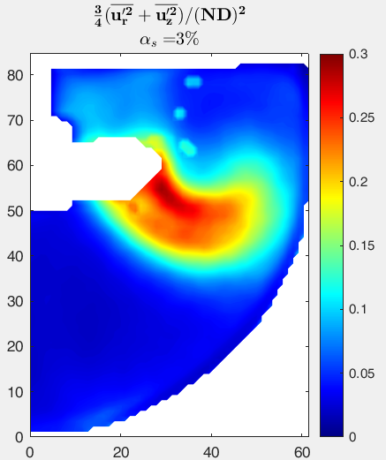
Contour plot
Overview
Problematic
Materials and Methods
Results
Prospects
Turbulent kinetic energy TKE
R mm
r/R =0.51
r/R =0.9
Mean flow magnitude
R mm

Slide 12
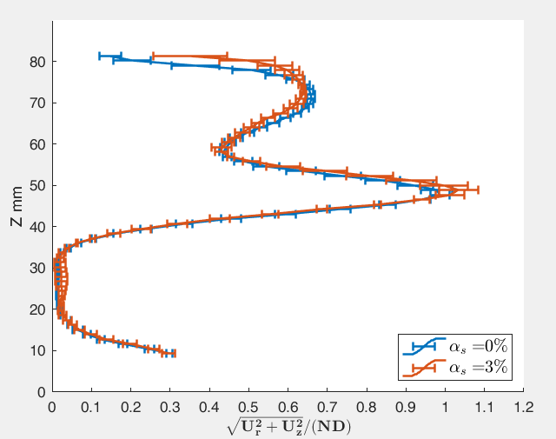
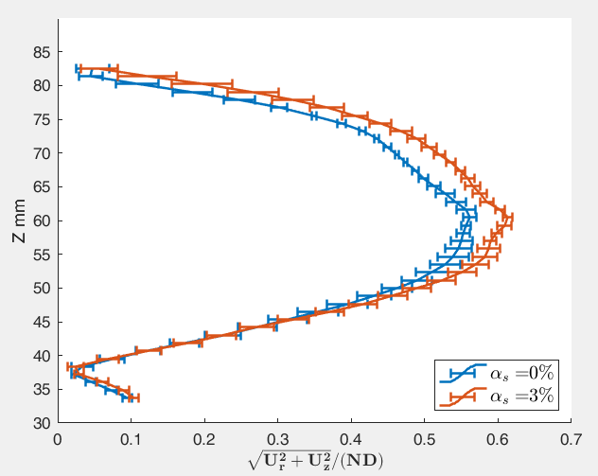
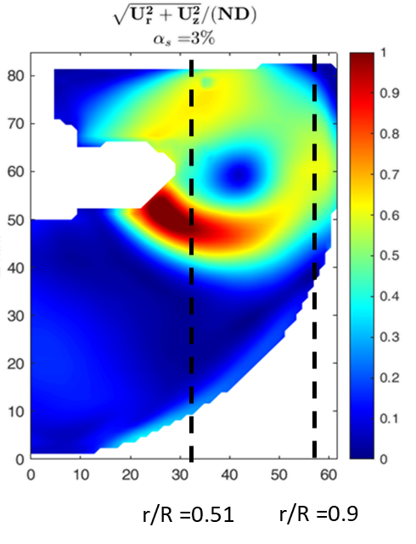
Profile plot
Overview
Problematic
Materials and Methods
Results
Prospects
Mean flow
In front of the blade
Far from the blade, near the wall
No significant impact
9% difference at the peak

Slide 13
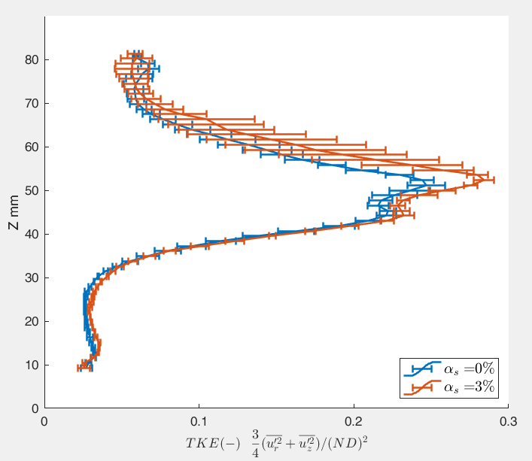
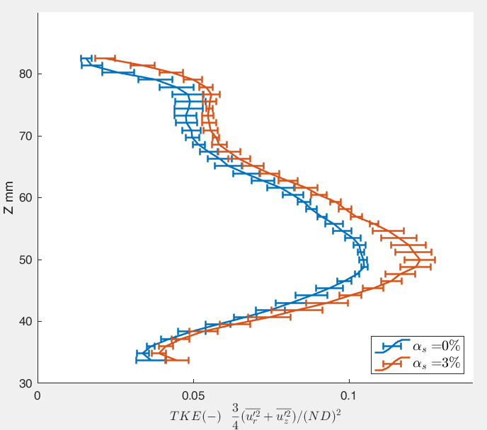
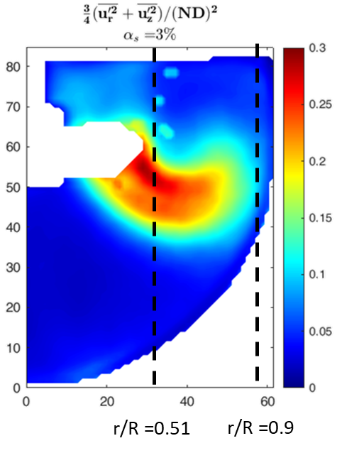
Profile plot
Overview
Problematic
Materials and Methods
Results
Prospects
Turbulent kinetic energy TKE
In front of the blade
Far from the blade, near the wall
20% difference at the peak
17.3% difference at the peak
Induce in turbulence

Slide 14
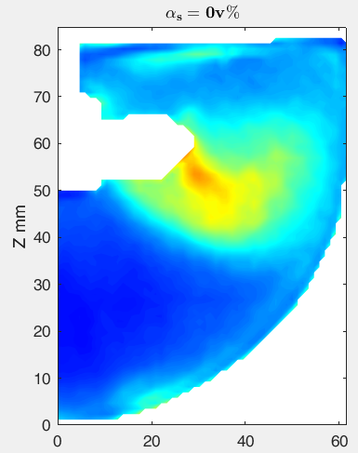
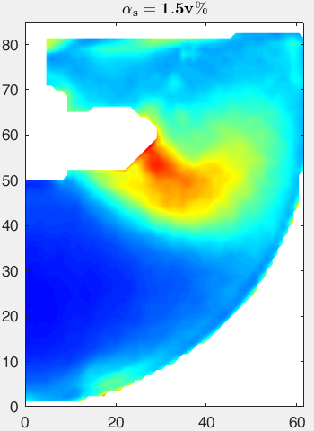
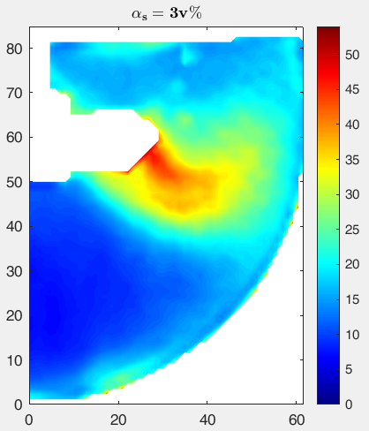
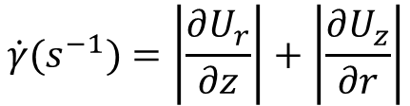
Average Absolute Shear rate
Overview
Problematic
Materials and Methods
Results
Prospects
$$\dot{γ}(s^{−1})=\left|\frac{∂U_{r}}{∂z}\right|+\left|\frac{∂U_{z}}{∂r}\right|$$
R mm

Slide 15
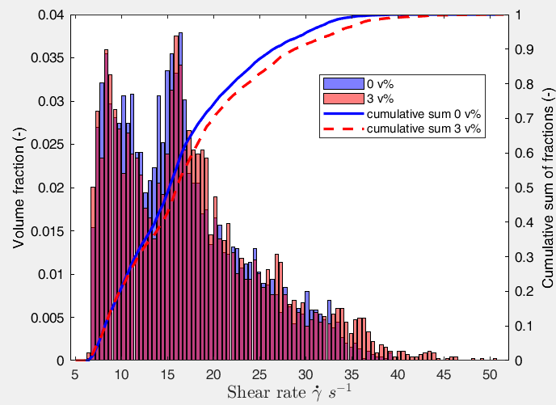
Average Absolute Shear rate
Overview
Problematic
Materials and Methods
Results
Prospects
Statistical distribution
In presence of solids:
Shift to higher shear rates
Higher fractions persist at high shear values
Notes:
To understand the effect more, different percentile plots are examined

Slide 16
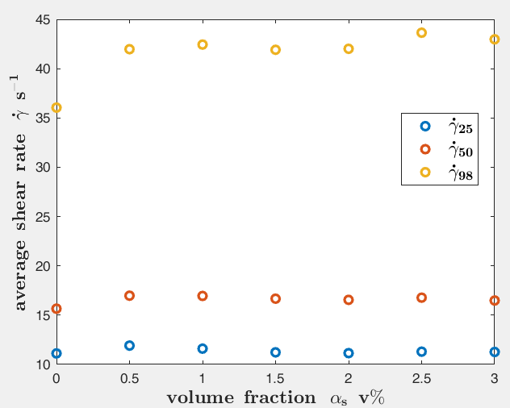
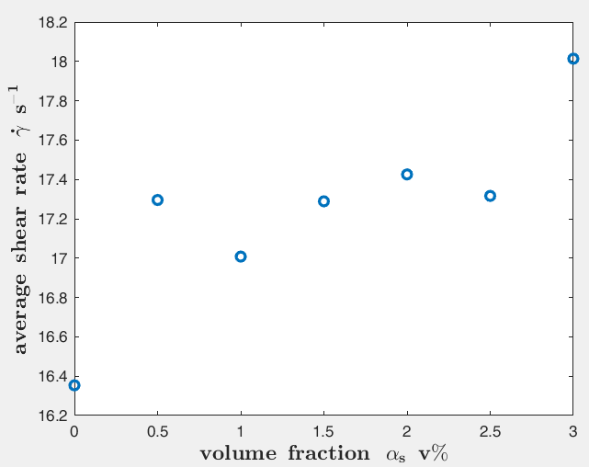
Average Absolute Shear rate
Overview
Problematic
Materials and Methods
Results
Prospects
Percentiles of average shear rate
Global average of shear rate in the domain
10% increase

Slide 17
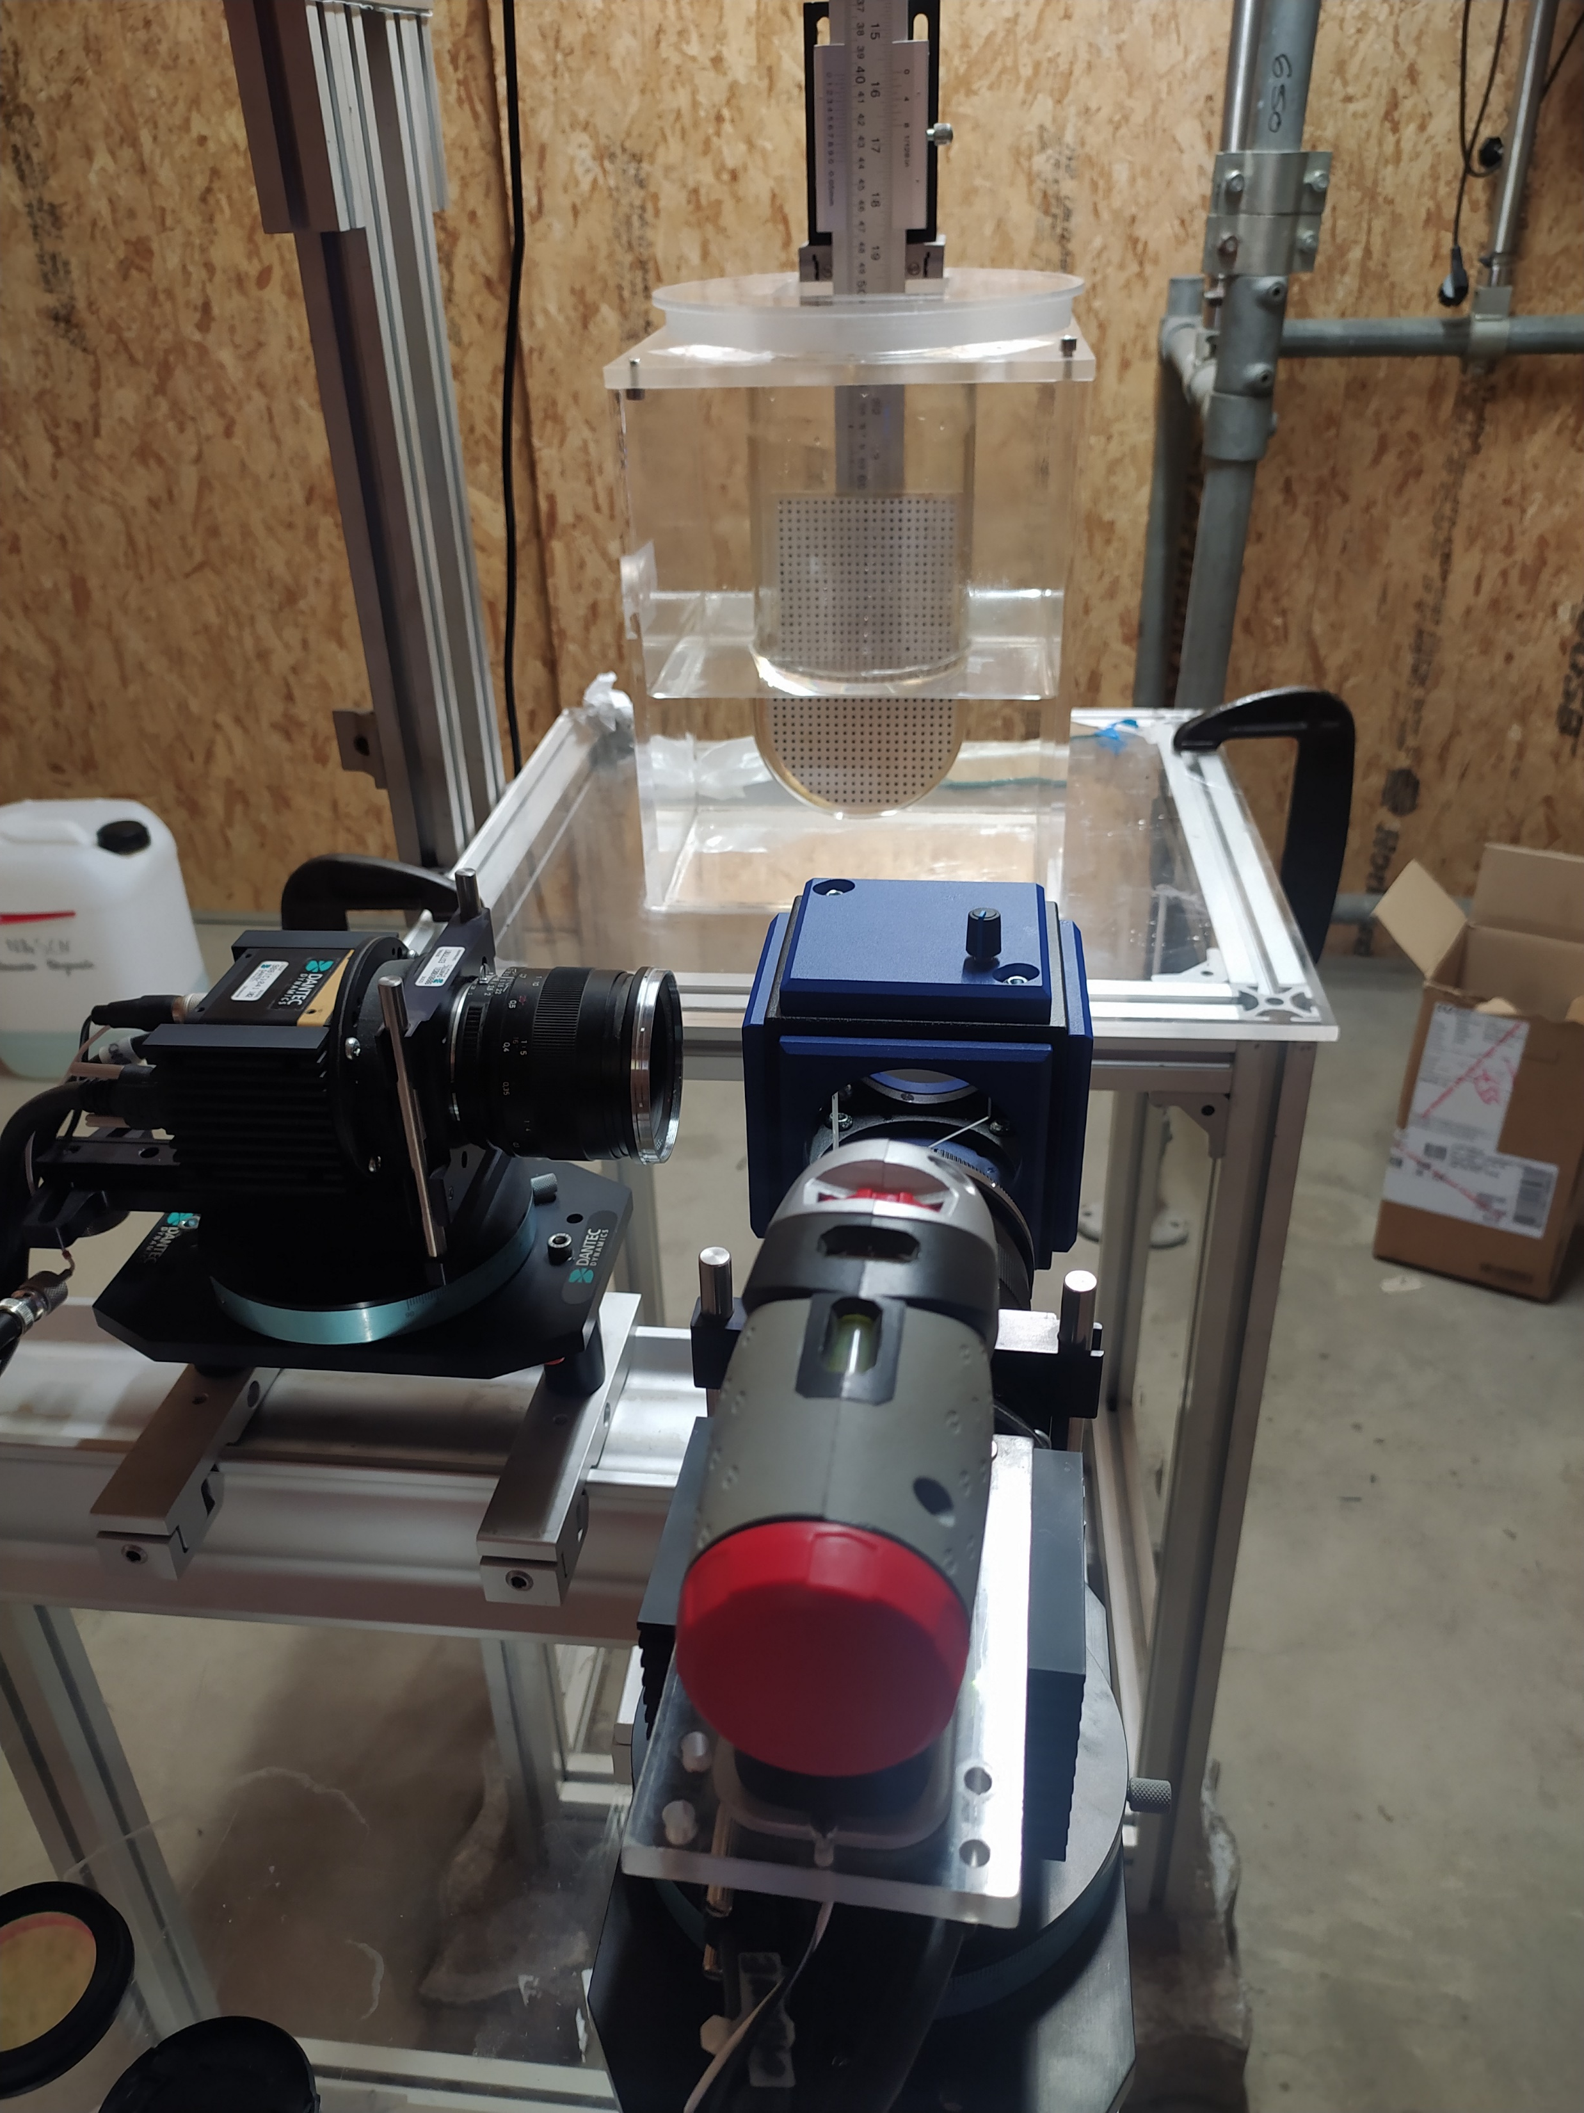
Conclusions
Overview
Problematic
Materials and Methods
Results
Prospects
A shift in liquid-solid system based on RI matching was necessary, while preserving initial system properties (cytodex/water) for a compatible analysis
PIV tests conducted for the new model on the liquid phase: alteration in turbulence
Useful data for CFD modeling
Next: PIV measurements on the solid phase → Relative velocities
Camera 2
Camera 1
Notes:
Focus more on PIV

Slide 18
Thanks for your attention!
The authors are grateful to the FNRS for their financial support.
m.madani@uliege.be

Slide 19
Turbulence Modulations
Parameter | description | Criteria
Particle diameter to integral length scale Gore and Crowe (1991) | dp/le | dp/le <0.1: Turbulence attenuation dp/le >0.1: Turbulence augmentation
particle stokes number - Elghobashi (1994) | St=τ_{p}/τ_{η} | St<1: particles follow fluid streamlines St>1: poor particle response to flow
Particle Reynolds number - Hetsroni (1989) | Rep =(uf – up)dp/ν | Rep <100: turbulence attenuation Rep >400: turbulence augmentation
Particle momentum number Tanaka and Eaton (2008) | Pa = StRe²(η/L)³ | 3x10³ ≤ Pa ≤ 10⁵: turbulence attenuation Pa<3x10³, Pa>10⁵: turbulence augmentation
dp/le = 0.023<0.1
Pa = 0.03< 3x10³
St = 0.078
Contradicting
In agreement

Slide 20
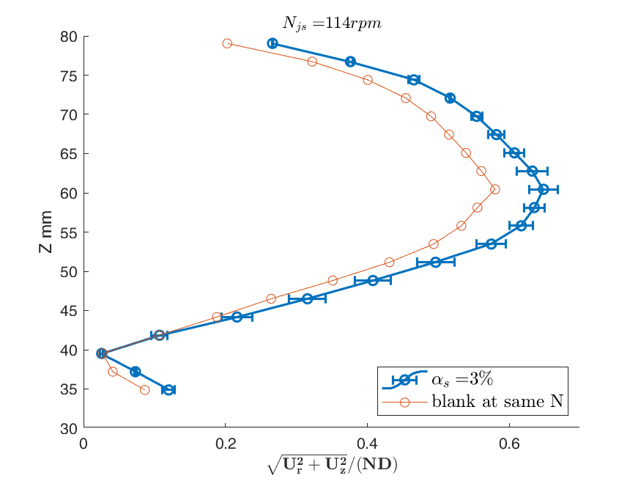
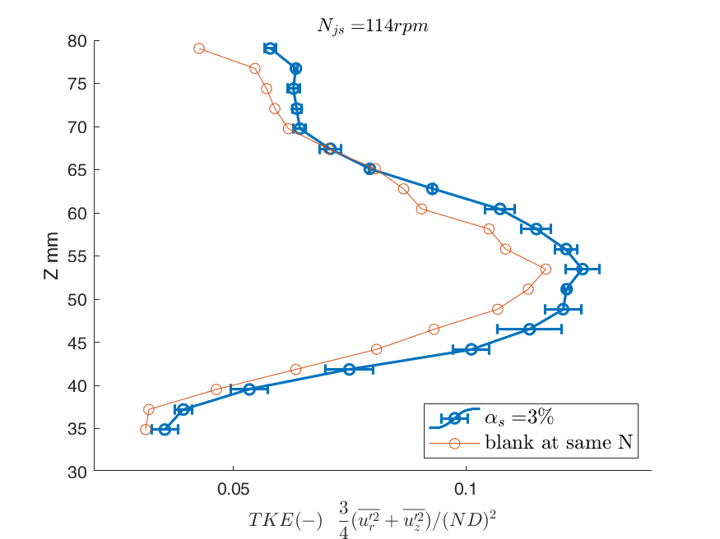
For α_{s}= 3 v % At N_{js} =114 rpm
Profile plot near the wall at r/R =0.9

Slide 21
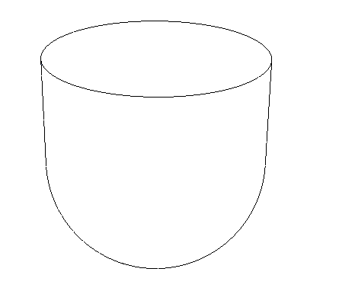
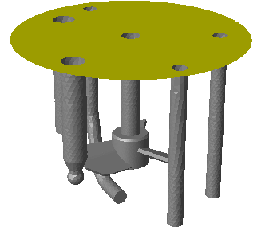
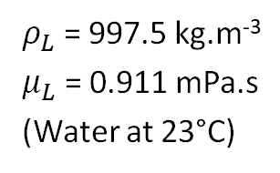
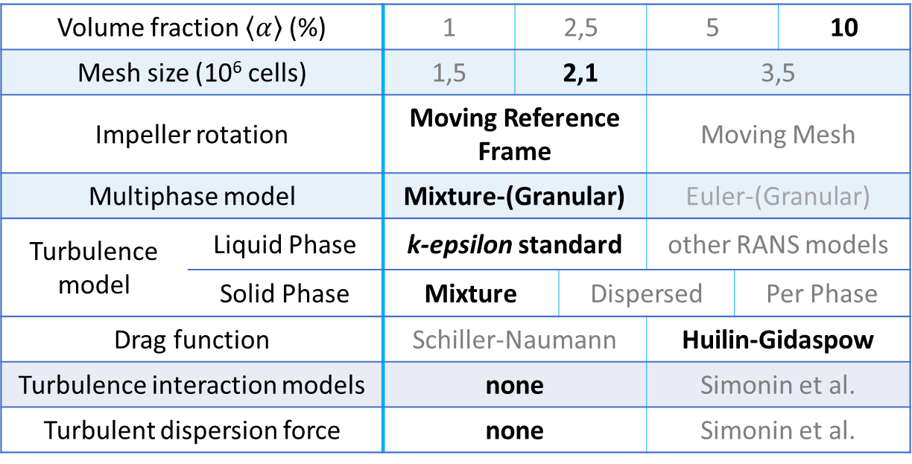
CFD Test – cytodex-1/water
CFD code: ANSYS Fluent R19.2
Volume fraction $\left\langle α\right\rangle$ (%) |  | 1 | 2,5 |  | 5 |  | 10
Mesh size (10⁶ cells) |  | 1,5 | 2,1 |  | 3,5
Impeller rotation |  | Moving Reference Frame |  |  | Moving Mesh
Multiphase model |  | Mixture-(Granular) |  |  | Euler-(Granular)
Turbulence model | Liquid Phase | k-epsilon standard |  |  | other RANS models
 | Solid Phase | Mixture |  | Dispersed |  | Per Phase
Drag function |  | Schiller-Naumann |  |  | Huilin-Gidaspow
Turbulence interaction models |  | none |  |  | Simonin et al.
Turbulent dispersion force |  | none |  |  | Simonin et al.
HTPG impeller
N = 50 - 200 rpm
V ≈ 1 L
Solid phase:
d_{P} = 170 µm
ρ_{S} = 1015 kg.m⁻³
a_{max}= 63 %
Liquid phase:
$ρ_{L}$ = 997.5 kg.m⁻³
$μ_{L}$ = 0.911 mPa.s
(Water at 23°C)

Slide 22
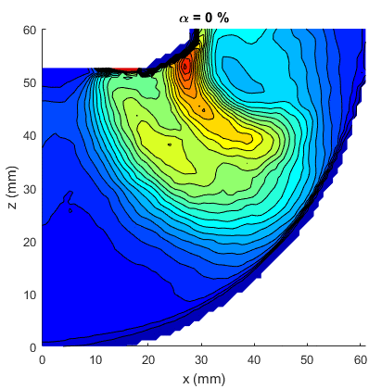
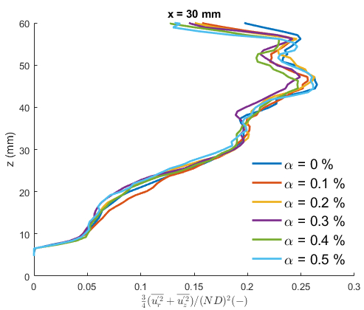
CFD Test
Liquid flow in presence of a solid phase (N = 200 rpm): TKE
Not fully evaluated
No clear influence of the solid phase on the liquid phase

