Slide 1
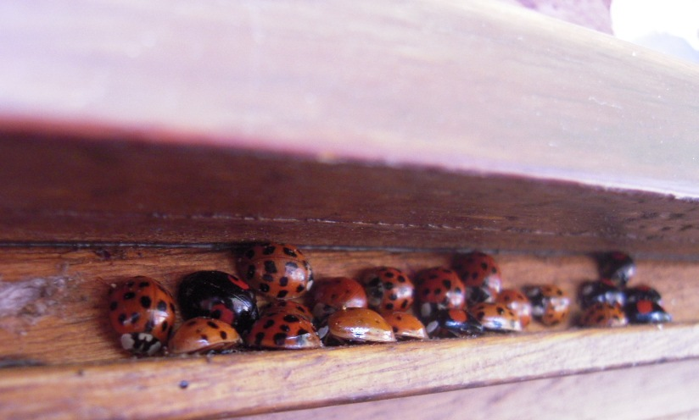



Chemical and physical factors involved in the aggregation behaviour of Harmonia axyridis Pallas
Department of Functional and Evolutionary Entomology
Durieux D., Fischer C., Deneubourg J.L., Brostaux Y., Lognay G. ,
Vandereycken A., Joie E., Haubruge E., Verheggen F. J.

Slide 2
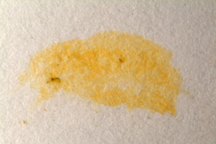
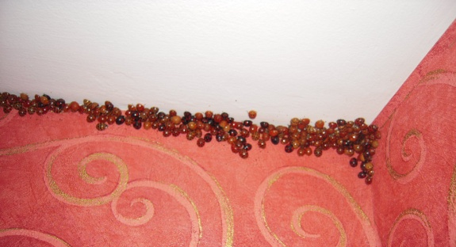
Context
ISCE, Durieux D. et al.
tainting walls and curtains
annoyance from their number
AGGREGATION
allergic reactions
rhinitis
asthma
urticaria
conjunctivitis
cough,…
Notes:
Ne pas oublier de dire que cette espèce est une espèce modèle d’espèce invasive

Slide 3
Context
ISCE, Durieux D. et al.
Migratory flight
Macrosite choice
Microsite choice
✓
?
Chemical factors
Physical factors

Slide 4
Chemical factors : Previous studies
ISCE, Durieux D. et al.
Volatile compounds
Pyrazines (al Abassi et al., 1998)
(-)- β-caryophyllene
the seven spotted ladybird, Coccinella septempuctata
Emission by H. axyridis in wintering conditions
(Brown et al., 2006)
Attractive and aggregative potential
(Verheggen et al., 2007)

Slide 5
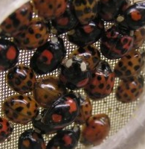
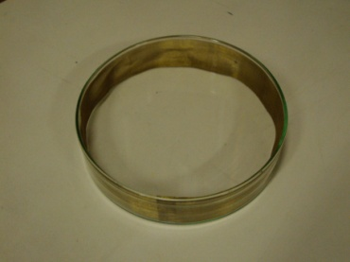

Chemical factors
ISCE, Durieux D. et al.
1
2
3
4
5
6
Multi-choice experiment
Implication of long chain hydrocarbons in the aggregation behavior of Harmonia axyridis (PALLAS) (Coleoptera: Coccinellidae) Durieux D., Fischer C., Deneubourg J.L., Lognay G., Vandereycken A., Joie E., Haubruge E. and Verheggen F.J. (under review)

Slide 6
Chemical factors
ISCE, Durieux D. et al.
After 8 hours:
1
2
3
4
5
6
Multi-choice experiment
Test χ² (chi-square of goodness-of-fit test) : P < 0,001
Implication of long chain hydrocarbons in the aggregation behavior of Harmonia axyridis (PALLAS) (Coleoptera: Coccinellidae) Durieux D., Fischer C., Deneubourg J.L., Lognay G., Vandereycken A., Joie E., Haubruge E. and Verheggen F.J. (under review)

Slide 7


Chemical factors
ISCE, Durieux D. et al.
1
2
3
hexane
4
5
6
Multi-choice experiment
Implication of long chain hydrocarbons in the aggregation behavior of Harmonia axyridis (PALLAS) (Coleoptera: Coccinellidae) Durieux D., Fischer C., Deneubourg J.L., Lognay G., Vandereycken A., Joie E., Haubruge E. and Verheggen F.J. (under review)

Slide 8
Chemical factors
ISCE, Durieux D. et al.
After 8 hours:
1
2
3
4
5
6
Multi-choice experiment
Test χ² (chi-square of goodness-of-fit test) : P < 0,001
The chemical blend ensures the cohesion of the aggregate
Implication of long chain hydrocarbons in the aggregation behavior of Harmonia axyridis (PALLAS) (Coleoptera: Coccinellidae) Durieux D., Fischer C., Deneubourg J.L., Lognay G., Vandereycken A., Joie E., Haubruge E. and Verheggen F.J. (under review)

Slide 9
Chemical factors
ISCE, Durieux D. et al.
Study of a potential trail
Y-olfactometer
Test χ² (chi-square of goodness-of-fit test) : P = 0.024 for females and P < 0.001 for males
Implication of long chain hydrocarbons in the aggregation behavior of Harmonia axyridis (PALLAS) (Coleoptera: Coccinellidae) Durieux D., Fischer C., Deneubourg J.L., Lognay G., Vandereycken A., Joie E., Haubruge E. and Verheggen F.J. (under review)

Slide 10
Chemical factors
ISCE, Durieux D. et al.
Hexane
Y-olfactometer
Test χ² (chi-square of goodness-of-fit test) : P = 0.001 for females and P = 0.002 for males
The chemical blend leads congeners towards the aggregate
Implication of long chain hydrocarbons in the aggregation behavior of Harmonia axyridis (PALLAS) (Coleoptera: Coccinellidae) Durieux D., Fischer C., Deneubourg J.L., Lognay G., Vandereycken A., Joie E., Haubruge E. and Verheggen F.J. (under review)

Slide 11
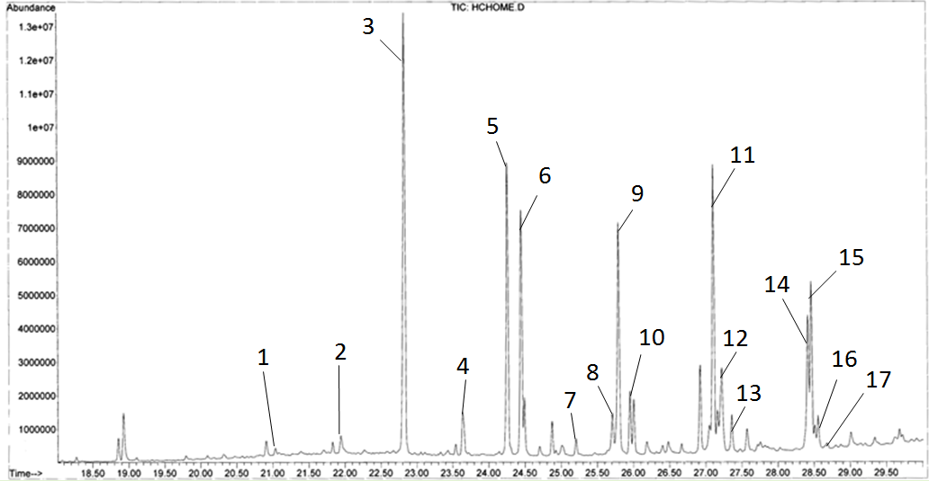
Chemical factors
ISCE, Durieux D. et al.
Identification of compounds by GC-MS analyses
Aggregation blend
Trail blend
Saturated hydrocarbons
Unsaturated hydrocarbons – one double bond
Unsaturated hydrocarbons – two double bonds
Identification of the compounds used by the multicolored Asian ladybeetle in its hivernation process. Durieux D., Fischer C., Lognay G., Vandereycken A., Joie E., Haubruge E. and Verheggen F.J. (in prep.)

Slide 12
Physical factors : previous studies
ISCE, Durieux D. et al.
Macrosite’s choice
Contrasting elements (Nalepa, 2005)
Whitish and light-colored objects (Obata, 1986)
Microsite’s choice
temperature
photoperiod
thigmotactism,…
presence of congeners
luminosity of shelters

Slide 13
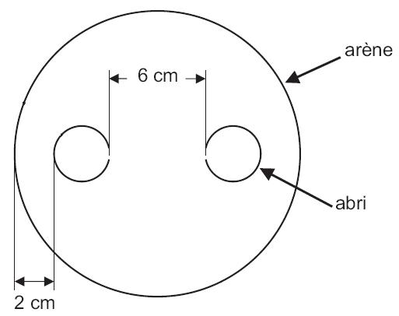
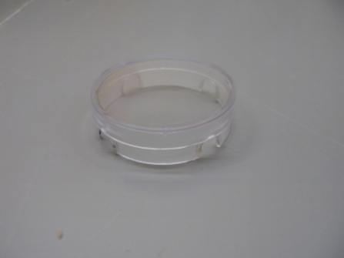
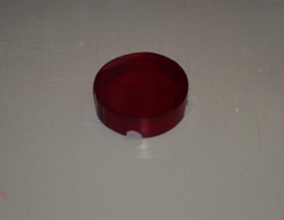
Physical factors
ISCE, Durieux D. et al.
arena
2 tested parameters:
- The luminosity of shelters
- The presence of congeners
1 ladybird
20 ladybirds
50 ladybirds
shelter
binary choice experiment
Aggregation behaviour of Harmonia axyridis adults in non-wintering conditions Durieux D., Deneubourg J.L., Brostaux Y., Vandereycken A., Joie E., Haubruge E. and Verheggen F.J. (in prep.)

Slide 14
Physical factors
ISCE, Durieux D. et al.
Impact of congeners
Generalized linear model comparing the observed distribution with a binomial one

Slide 15
Physical factors
ISCE, Durieux D. et al.
Impact of shelter’s luminosity
20 ladybirds tested
Binary logistic regression : luminosity : P < 0.001 ***
time : P < 0.001 ***

Slide 16
Conclusion
ISCE, Durieux D. et al.
Hydrocarbons are involved in the aggregation
To lead congeners towards aggregation sites
To ensure the cohesion of the aggregate
There are social interactions between ladybirds even in non-wintering conditions
Ladybirds prefer dark shelters

Slide 17
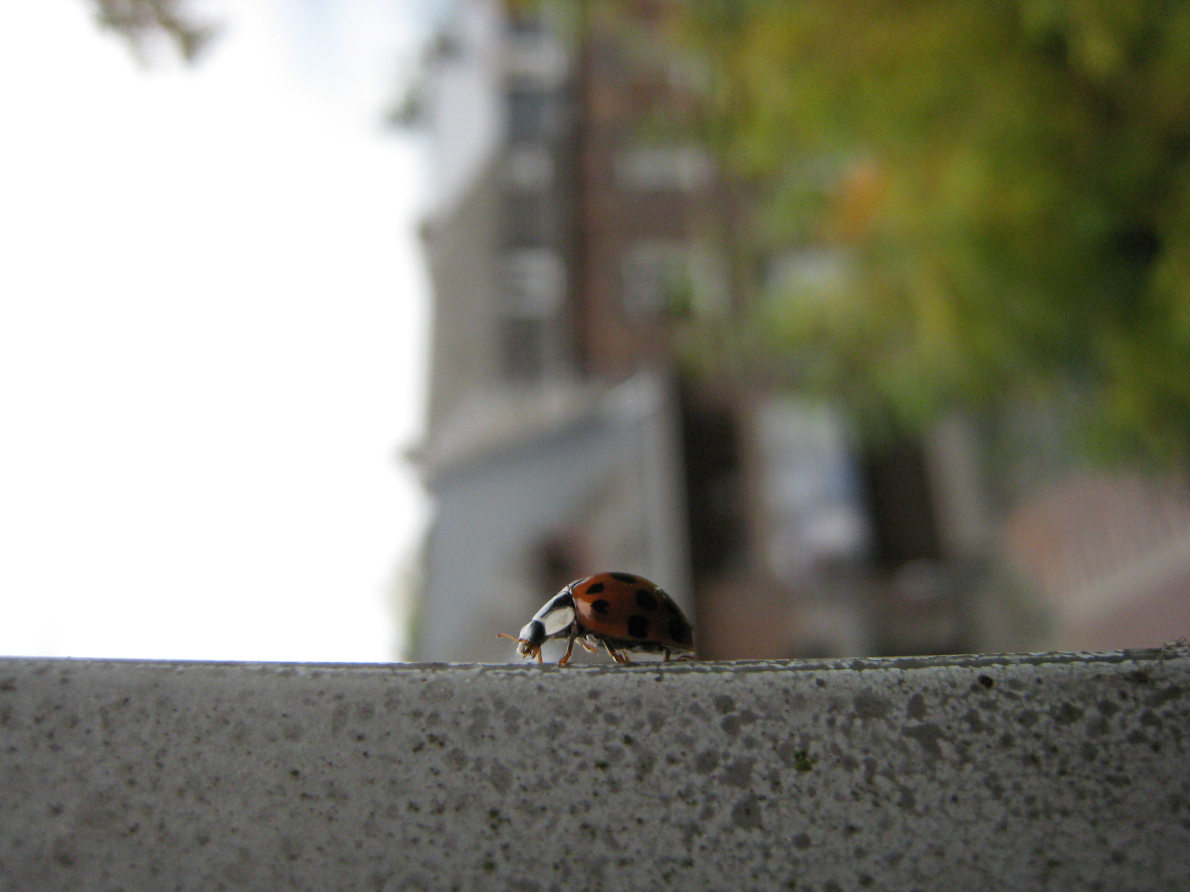
Thank you for your attention

Slide 18
Physical factors
Impact of shelter’s luminosity
Binary logistic regression : luminosity : P < 0.001 ***
time : P < 0.001 ***
luminosity * time : P < 0.001 ***

Slide 19
Physical factors
Impact of individuals’ density
Transparent shelters (TS)
Covered shelters (CS)

