Slide 1

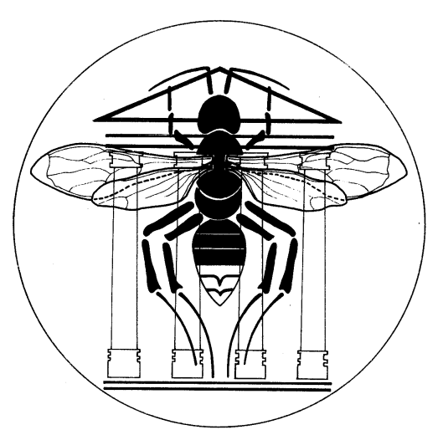

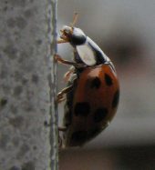
Implication of hydrocarbons in the aggregation behaviour of Harmonia axyridis (PALLAS)
(Coleoptera : Coccinellidae)
Delphine Durieux¹, Christophe Fischer², Georges Lognay², Jean-Louis Deneubourg³,
Axel Vandereycken¹, Emilie Joie¹, Eric Haubruge¹, and François J. Verheggen¹
1 Functional and Evolutionary Entomology – Gembloux Agro-Bio Tech - University of Liege – Passage des Déportés, 2 – 5030 Gembloux (Belgium)
2 Unit of Analysis Quality and Risk – Laboratory of Analytical Chemistry - Gembloux Agro-Bio Tech - University of Liege – Passage des Déportés, 2 – 5030 Gembloux (Belgium)
3 Unit of Social Ecology – Université libre de Bruxelles – Campus Plaine –CP 231 – 1050 Brussels (Belgium)
Introduction
The Multicoloured Asian ladybird beetle, Harmonia axyridis Pallas, has been introduced in Europe at the end of the nineties, in order to control aphid and coccid populations in a biological way. It was believed that it would not survive winter harshness of European climate but this exotic species found a solution by aggregating inside dwellings and buildings during those unfavourable conditions. Infestations of H. axyridis become more and more important, causing annoyance from their number but also allergic reactions (rhinitis, conjunctivitis, asthma,…). This overwintering behaviour is well documented concerning migratory flight and macrosite choice (i.e. the visual benchmark towards which ladybirds fly to aggregate). H. axyridis shows a hypsotactic behaviour (i.e. moving toward prominent objects on the horizon) and a clear preference for contrasting elements. But information about factors influencing the microsite selection is lacking, the microsite being the shelter wherein ladybirds take refuge to overwinter. In this work, we highlighted the existence of long chain hydrocarbons in aggregation sites and we observed the behavioural impact of these chemicals on the multicoloured Asian ladybeetle in multi-choice experiments conducted under laboratory conditions. Following our observations in infested houses, we have also tested the hypothesis that H. axyridis follows trails to join aggregates, using chemical trail in a Y-olfactometer.
Experimentations and results
Multi-choice experiment
Trail assays
10 ladybirds, coming from hivernation sites, were placed in an arena sidelong covered with a metal strip, partially coated with the aggregation blend. The arena was divided in seven areas: six identical portions, only the portion 1 containing the blend, and a circle one in the centre, defining a neutral area (Figure 1). The position of the ladybirds were registered after 24 hours. Two aggregation blends of different origin were tested: the first one was deposited by overwintering ladybirds themselves and the second was collected in infested houses and deposited by the experimenter.
The behaviour of H. axyridis towards any trail pheromone deposited by congeners was tested in a Y-olfactometer, by marking one of the two arms with the trail (Figure 3). Again, two blends were tested: the first one was deposited by two ladybirds in one arm of the olfactometer during 20 hours, the other one was deposited by the experimenter and was obtained by allowing 40 ladybirds walking in a glass petri dish during 24 hours.
Figure 1 : experimental set up used in the multi-choice experiment. The red curve represents the the deposited blend.
Figure 3 : olfactometric set up used in the trail assays
***
(a)
(b)
(a)
(b)
Figure 2 : Number of H. axyridis present in each area of the multi-choice set up 24 hours after the beginning of the test. Area 1 is the only one to contain the aggregation blend deposited by ladybirds themselves (a) or by the experimenter (b) (*** indicating statistical differences with P < 0.001)
Figure 4: Comparison of observed proportions of ladybirds, males and females, having chosen the marked arm (in dark grey) with theoretical proportions (in light grey) for experiments using trail deposited by ladybirds themselves (a) and by the experimenter (b) (* , ** and *** indicating statistical differences with P < 0.05, P < 0.01 and P < 0.001 respectively)
A greater proportion of H. axyridis is observed in the area containing the blend (area 1), compared to those present in control areas (areas 2 to 6). This was highlighted both for the blend deposited by the ladybirds and by the experimenter.
Both males and females H. axyridis preferentially chose the arm containing the trail, whether the blend was deposited by the ladybirds or by the experimenter.
Chemical analyses
3
The aggregation blends, coming from infested dwellings and the trail, obtained in laboratory from individuals collected in their hivernation site, were analyzed by GC-MS (gas chromatography – mass spectrometry).
5
6
9
11
The spectral analysis revealed that the aggregation blend is mainly made up of saturated (peaks 1, 2, 3, 4, 6, 7, 10, 13 and 17) and unsaturated (peaks 5, 8, 9, 11, 12, 14, 15 and 16) hydrocarbons (Figure 5).
It also appeared that the trail contains the same compounds, but the proportion between them differ from that observed for the aggregation blend.
10
14
15
1
2
4
8
12
16
17
7
13
Figure 5 : GC profile of an aggregation blend collected in infested dwelling
Discussion and conclusions
Our results highlight the use of hydrocarbons by the Multicoloured Asian ladybird beetles during their aggregation period. Two different blends were observed, one leading congeners towards the aggregate already formed and the other ensuring the cohesion of the group. These results support the potential use of these blends, in association of volatiles, in making of traps in order to control infestations of this species in dwellings.
Contact : Ir. Durieux Delphine entomologie.gembloux@ulg.ac.be
Durieux Delphine was financially supported by FRIA (Fonds pour la formation à la Recherche dans l’Industrie et l’Agriculture)

