Slide 1
Abnormalities of cyclicity during the post-partum in the cow.
Physiopathological aspects and treatments
Prof. Christian Hanzen
Prof. Zdzislaw Gajewski
Dr. Léonard Théron
Université de Liège
Faculté de Médecine Vétérinaire
Service de Thériogenologie des animaux de production
E-mail : Christian.hanzen@ulg.ac.be
Adres strony: http://www.therioruminant.ulg.ac.be/index.html
Publikacje : http://orbi.ulg.ac.be/

Slide 2
General view
To know
To understand
To treat

Slide 3
Definitions and basic knowledge

Slide 4
Different periods before and after calving

Slide 5
100 days to succeed the postpartum
Calving 2
Involution
Dry period
Anoestrus
End of pregnancy
Waiting
Repro
Pregn
Transition
- 60
- 20
0
+20
+30
+ 50
+ 80
Notes:
Normally, after calving and the end of previous pregnancy, we have normally 80 days to obtain a new pregnancy. In fact this period is a little bit longer.
After calving we have the waiting period. Normally, a cow should be inseminated after this period of 50 to 60 days. This period is followed by reproduction period or breeding period. If the cows is pregnant after one or two insemination, the lenght of this period should be of 1 to 30 days on average.
Waiting period includes involution period of the uterus. 30 days are normally necessary to obtain uterine horns with a diamter less than 5 cm.
After calving a cow needs to be cycled as soon as possible and at the latest 50 to 60 days post-partum.
During the same time, milk production increases drastically. Before calving it’s necessary to respect a dry period. This period of time is necessary to restore mammary gland tissue, to adjust by nutrition the body condition score or sometimes to vaccine the cow.
Finally, it’s also necessary to mention the transition period. The transition period is roughly defined as three weeks prior to calving until three weeks after calving. Major metabolic transitions occur in a cow’s body as she converts from a non-lactating to a lactating state and undergoes the stress of parturition. Cows often fail to adapt to these metabolic and management changes, resulting in 75% of dairy cow disease incidence during the first month after calving.
If we add 20 days before calving to 80 days after calving, we have in fact more or less 100 days to get a cow pregnant. That’ the challenge for each vet and …farmer.

Slide 6
Different post-partum anoestrus according to the lenght of WP

Slide 7
« Normal »
Abnormal
No heat detection by the farmer
Waiting period : 50 – 60 d ?
Detection
Detection
No or less
heat signs
Manifestation
Manifestation
Functionnal
Pyometra
Physiological
Functionnal
Pathological
Ovarian cyst
15 d : milking cow
30 d : suckling cow
No answer to GnRH
No regular follicular growth with ovulation and corpus luteum
No regular follicular growth with ovulation and corpus luteum after the end of WP
7
Notes:
The waiting period should normally be 50 to 60 days. This period should considered as normal. If prolonged, the situation can be considered as an abormal situation. During the waiting period two different anoestrus can be observed. The first is called physiological anoestrus. During this period of 15 daus in milking cows and 30 days in suckling cows, the hypophysis don’t answer to a stimulation by the GnRH. Later, we can observe in some cows a period of functionnal anoestrus. The period of time is caracterized by an absence of regular follicular growth, ovulation and development of an corpus luteum. IOf no oestrus is observed during the first 50 days postpartum, anoestrus become pathological. Three mains reasons can be involved. The fist and the main frequent is functionnal anoestrus. The situation observed before days 50 is prolonged. The second is an anoestrus due to a pyometra and the thirs is an anoestrus due to an ovarian cyst.
We need to mention two last kind of postpartum anoestrus. The first is due to an insufficient or absence of manifestaion of heat signs. The second is due to an absence of heat detection by the farmer.

Slide 8
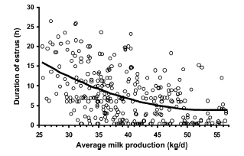
Manifestation of heat
Relation between milk production and oestrus
Lopez et al. Animal Reprod Sci. 2004, 81,209
Catabolism of steroids is proportional to the level of milk production
Wiltbank et al. Theriogenology 2006,65,17-29
Notes:
Absence or reduction of heat manifestation is a problem more frequently observed in high producing dairy cows (more than 8000 liters per lactation). So Lopez in 2004 has observed that estrus duration decrease when milk production increase. According to Wiltbank, such possibility is due to an increase of steroids catabolism in high producing dairy cows.

Slide 9
Different post-partum anoestrus according to the follicular growth dynamic
Peter et al. Theriogenology 2009,71,1333-1342
Peter et al. Theriogenology 2009, 71, 1343-1357
Notes:
Different post-partum anoestrus can be also distinguished according to the follicular growth dynamic

Slide 10
During a normal estrous cycle : 2 waves of follicular growth
mm
20
19
18
17
16
15
14
12
12
11
10
9
8
7
6
5
4
3
2
-3
-2
-1
0
1
2
3
4
5
6
7
8
9
10
11
12
13
14
15
16
17
18
19
20
21
0
Notes:
Cows as in many other mammals, follicular growth develops in the form of waves. During a 21-day cycle, there are usually two waves. The first wave emerge from the stock of primordial follicles at day 1 and the second at two 11. Such recruted, emerging follicles can be distinguished by ultrasonography.
During the 2.5 days of the emergence of a wave, the future dominant follicle is selected and continue to grow (6). The others non selected follicles undergoes atresia.
The diameter of the dominant follicles at this time is between 8 and 9 mm (7) that’to say 1 or 2mm higher than the other selected follicles. This moment is called follicular deviation.
The follicle continues to grow until they reach a diameter of 10mm (8).
The growth of the dominant follicle will continue until reaching a maximum diameter of 16 mm.
After and during more opr less 6 days, the dominant follicles goes through a static phase followed by atresia.
This atresia is followed by a new wave
In proestrus, the dominant follicle of the second wave continue his growth until ovulation.

Slide 11
Different stages of follicular development during a wave
mm
20
19
Potential ovulatory follicle
10 à 20 mm
18
17
16
15
14
12
12
11
Dominant follicle
8 à 10 mm
10
9
8
7
6
Emerging follicle
< 9 mm
5
4
3
2
-3
-2
-1
0
1
2
3
4
5
6
7
8
9
10
11
12
13
14
15
16
17
18
19
20
21
0
Notes:
So during a wave, it’s possible to distinguish different types of follicles.
Several merging follicles whose diamter is less than 8 to 9 mm
Usually one dominant follicles with a diameter between 8 to 10 mm
And finally a dominant preovulatory follicle with a diameter between 10 to 20 mm.

Slide 12
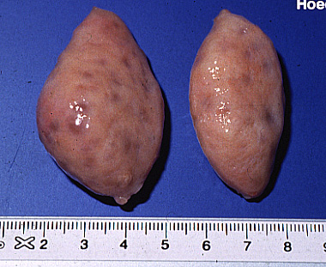
Anoestrus type I (« inactive ovaries »)
mm
Identification by echography of small follicles (< 9 mm)
without corpus luteum
20
19
18
17
No development of these follicles until
deviation or dominance stage
16
15
14
12
Etiology : severe undernutrition
and lack of LH stimulation for follicular growth
12
11
10
9
8
Norme : < 10 % of cows
7
6
5
4
3
2
Notes:
According to follicular and luteal ovarian activity four kinds of anoestrus can be distinguished during the postpartum period.
In anoestrus type I only receruited follicles with a diamter less than 8 mm can be observed by ultrasonography. At palpation such ovaries appears as smooth or granular.
These follicles do not develop and therefore can not reach the point of deviation.
Such situation results from a lack of luteinizing hormone (LH) needed for the final growth of the follicle
This lack is results from a severe undernutrition state.
This situation should occur in less than 10% of cows in a herd.

Slide 13
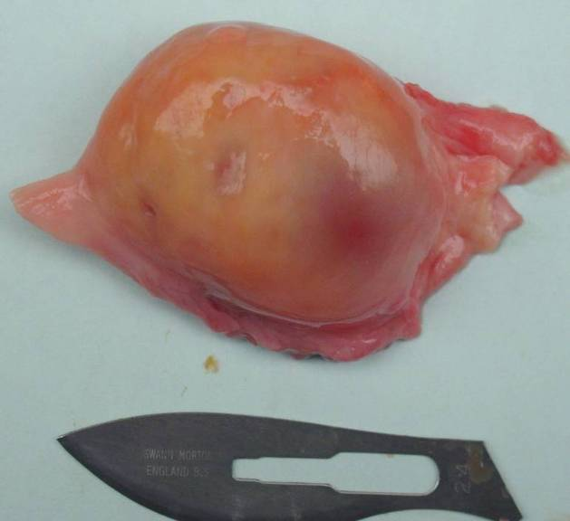
Anoestrus type II
Follicular growth continues until the deviation and dominance and atresia
Atresia is followed by a new wave of growth within 2 to 3 days
mm
20
19
18
17
16
15
14
12
12
11
10
9
8
7
6
5
4
3
2
Notes:
During anoestrus type II, there was a follicular growth that continues until that stage of the deviation and the emergence of a dominant follicle.
This growth is then followed by regression of the follicle.
2 to 3 days later a new wave of growth can appear.
Some times, nine waves can succeed before reaching ovulation
This lack of ovulation after follicular growth regularly is probably be due to an insufficient synthesis of estradiol by the follicle growth or a lack of his positive feedback on the release of luteinizing hormone.
At palpation, it’s quite possible to palpate a follicle without presence of cyst or corpus luteum.

Slide 14
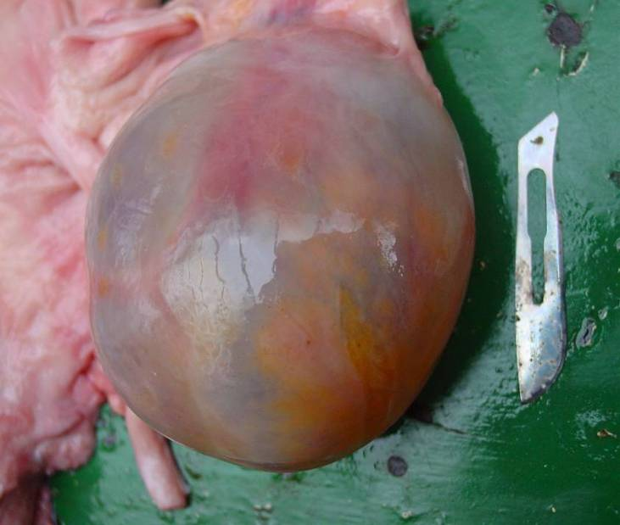
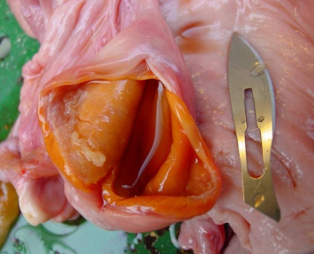
Anoestrus type III (« Cystic anoestrus»)
mm
KF
KF
20
19
18
17
16
KFL
15
14
12
12
11
A
10
9
8
7
6
B
5
4
3
2
Notes:
This type of anoestrus is characterized by the presence of a follicular cyst. This cyst can continue to growth or can evolve to a luteinized follicular cyst.
In presence of a cyst, follicular growth can be or not inhibited.

Slide 15
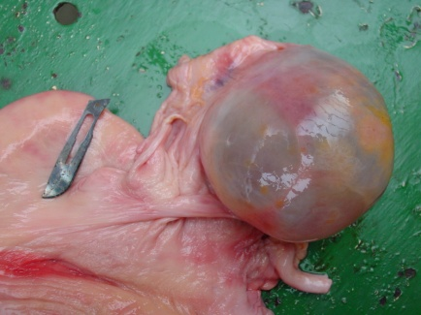

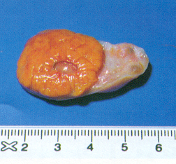
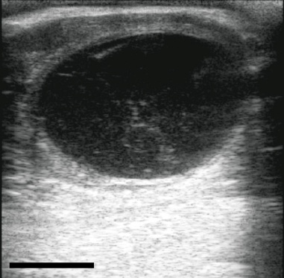
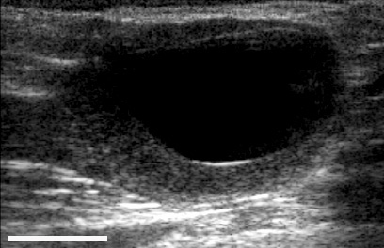
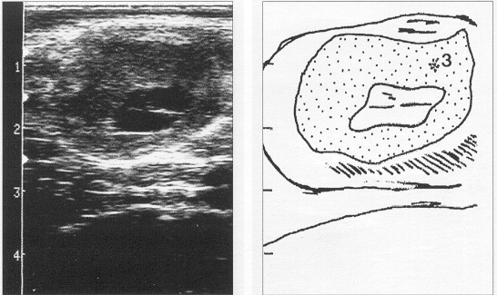
Differential diagnosis of ovarian cysts (US > manual palpation)
Follicular cyst
Luteinized foll cyst
CL with cavity
20 mm
20 mm
Notes:
At manual palpation or at ultrasonography examination follicular and luteinized ovarian cysts present different caracteristics. They must be distinguished from a cavitary corpus luteum who is a non pathological ovarian structure.
On transrectal palpation follicular cysts have a thin wall, feel fluctuant, and are likely to rupture during
manipulation. Luteal cysts on the other hand, have a thicker wall made up of luteal tissue, which makes them feel firmer.
The follicular cyst presents the same ultrasonographic characteristics as a follicle. Its diameter is > 25 mm and the thickness of the wall < 3 mm
Follicular cysts are anechogenic.
Some authors have proposed to base the differential diagnosis between a follicular and a luteal cyst on the thickness of the cyst wall, whereby the thickness of the wall of a follicular cyst is 3 mm, and the thickness of the wall of a luteal cyst is > 3 mm.
Differential diagnosis between a corpus luteum with a cavity and a luteal cyst can be based on the following
Criteria
- the lacuna of the corpus luteum usually has a diameter of less than 25 to 30 mm ;
- the thickness of the surrounding luteal tissue ranges from 5 to 10 mm;

Slide 16
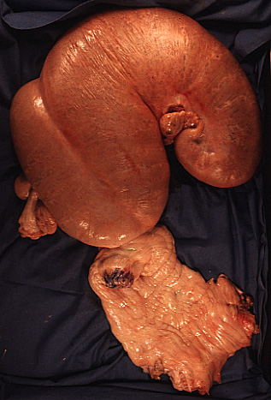
Anoestrus type IV
mm
20
19
18
17
16
15
14
Pyometra
12
PGF
12
11
10
9
8
7
6
5
4
3
2
Notes:
In the anoestrus in type IV, the dominant follicle continues to grow until ovulation.
This ovulation is followed by the development of a corpus luteum but corpus luteum does not regress and persist on the ovary.
This lack of reduction involves an alteration of the luteolytic process. It is possible that the synthesis of estradiol by the follicle growth was not sufficient for inducing the formation of oxytocin receptors in endometrium and thus prevent and the pulsatile release of PGF2a. It is also possible that the synthesis of PGF2a was not sufficient because of extensive endometrial lesions induced by a pyometra.
At palpation uterus is usually enlarged and the cervix is or not open. So pus can or not be seen by vaginoscopy.

Slide 17
In summary
Normal estrous cycle
A IV
KF
A I
A II
A III
Notes:
In summary,
Normally a follicular wave is followed by ovulation and development of a corpus luteum.
In anestrus type I, dominant follicle doesn’t appears.
In anestrus type II ovulation doesn’t appears.
In anoestrus type III, follicular growth continue and a cyst appears.
In anestrus type IV, corpus luteum persist.

Slide 18
Frequency of anoestrus

Slide 19
Prevalence of post-partum anoestrus in dairy cows (%)
19
Notes:
19
According to many studies, post-partum anestrus defined as an absence of regular follicular growth after day 50 to 60, appears at a frequency between 10 to 30 %.
It’s one of the most important factor responsible for an increase of calving interval.
NZ 2003 : Rhodes et al. J.Dairy Sci, 2003, 86, 1876-1894.
USA 2003 : Gumen et al. J.Dairy Sci, 2003, 86, 3184-3194
UK 1998 : Lamming et Darwash Anim Reprod Sci, 1998, 52, 175-190
B 2000 : Opsomer et al. Theriogenology 2000, 53, 841-857
USA Fl Moreira et al. J.Dairy Sci, 2001, 84,1646-1659.
USA K Cartmill et al. J.Dairy Sci 2001, 84, 1051-1059
USA MW Pursley et al. Improved fertility in non cycling lactating dairy cows treated with exogenous progesterone during Ovsynch. Midwestern branch ADSA: 2001, 63 (abs)
USA C Galvao et al. J.Anim.Sci., 2004, 82,3508-3517
USA W Lopez et al. J.Dairy Sci 2004, 87 (Suppl1, 64 (abs)
USA K El Zarkouny et al. J.Dairy Sci 2004,87 1024-1037
Mex 2004 Moreira et al. J.Dairy Sci 87 (Suppl1), 373 (abs)
Austr 2006 Segwagwe et al. JS Afr.Vet Assoc. 2006,77,1,33-39
Autr 1989 Jubb et al. Austr Vet J, 1989,66,334-336

Slide 20
Frequency of ovarian cysts
Fourichon et al., 2000 : meta-analyse (20.000 cows in 196 dairy herds) : 12 % (3 à 29 %)
Lubbers 1998 (Hollande) : 12.626 lactations during ten years in 39 herds : 7,2 % (1,9 to 11,3 % according to herds)
Erb et Martin, 1980 and Kinsel et Etherington, 1998 (Canada) 24.356 lactations : 9,3 %
If > 10 % : herd problem
Notes:
Considering studies with huge numbers of cows, the frequency of cysts is between 7 and 12 %. Also, we can consider that at the herd level, the threshold value can be 10 %.

Slide 21
Etiopathogeny of anoestrus

Slide 22
Negative energy balance
ENVAlfort
Effect on anoestrus type 1, 2, and 3
Effect through an inhibition of synthesis and/or release LH
22
Notes:
Negative energy balance is the most important risk factor responsible of postpartm anestrus type I, II or III.
His effect if mediated through an inhibition of synthesis and/or a release of LH.
Most cows go through some period of negative energy balance during early lactation when feed consumption does not meet demands of milk production.
The blue line showned on this graphy represent the increase demand in energy after calving. The green line represents evolution of milk production. If milk production is higher than the ingestion capacity of the cow,
Negative energy balance appears during one or two weeks. Sometimes this period is prolonged.

Slide 23
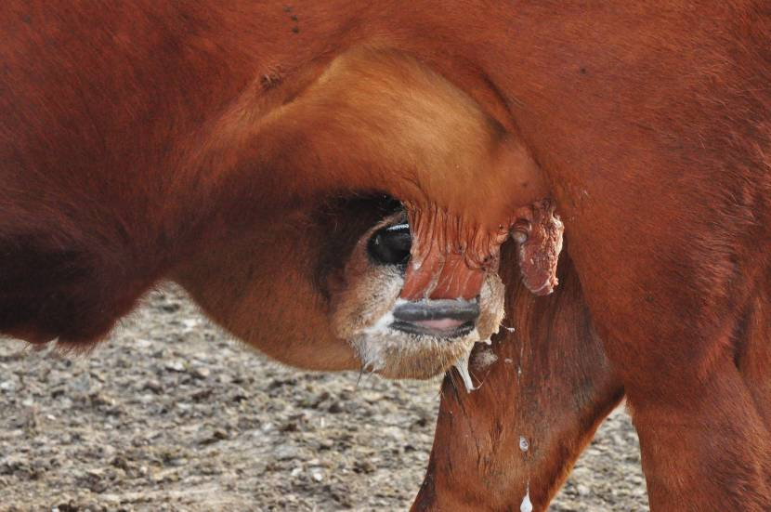
Suckling
Effect on anoestrus type 1, 2, and 3
Effect through an inhibition of synthesis and/or release LH
23
Notes:
Suckling can induce anoestrus type 1, 2, and 3 depending on nutrition.
Suckling exerts an effect through an inhibition of synthesis and/or release LH

Slide 24
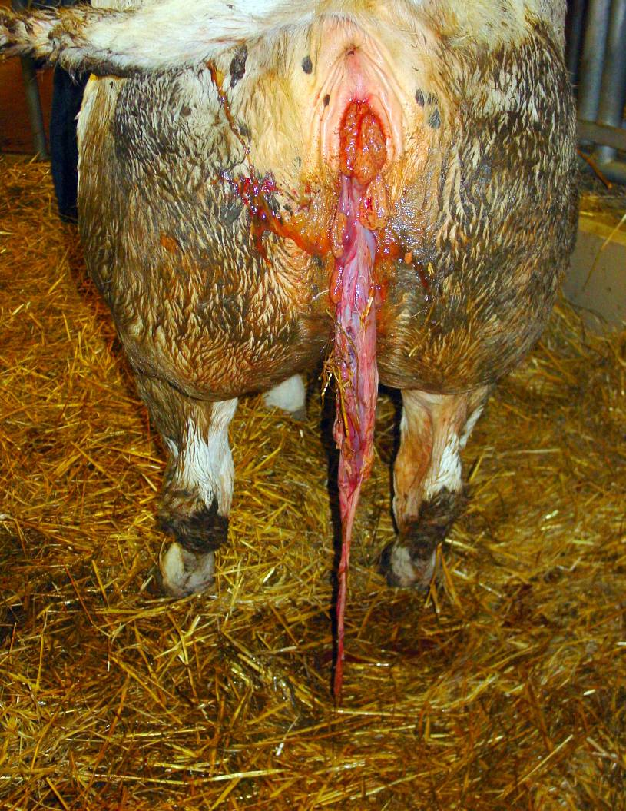
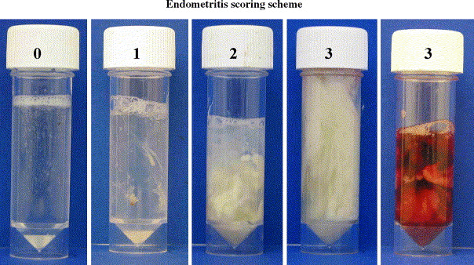
Postpartum pathologies placental retention, acute metritis, clinical endometritis
Effect on anoestrus type 4 (pyometra)
Effect through an inhibition of synthesis of PGF
24
Notes:
Placental retention and uterine infections are predisposing factors of pyometra.
Acute metritis can modify synthesis and/or liberation of LH.

Slide 25
Risk factors of ovarian cysts
Environment
Hypothalamo-
Hypophysis complex
Animal
Number of lactation
Level of milk production
Post-partum stage
Post-partum pathologies
Genetic
Season
Stress
Follicular wall
Cortisol
Negative energy balance
Nutrition
LH Inhibition
Hypoinsulinemia
Hypoglycemia
Decrease of leptine
Decrease of IGF1
Increase of NEFA
and cetones bodies
Decrease of LH/FSH
Decrease of GnRH
Notes:
Pathogeny of ovarian cyst is rather very complex. Four groups of factors can be distinguished.
Hypothalamo-hypophysis complex function can be affected by modification of ovarian steroids feedback.
Alterations of follicular wall can result in an absence of ovulation.
Concerning animal factors, frequency of cyst increase with niulmber of lactations, level of milk production, stage os post-partum, frequency of post-partum pathologies. Moreover some family of cows present more often cysts.
But the most important determining factor if an extended period of negative energy balance. Such status induced hyoinsulinemia and so increase of non esterified fatty acids and cetone bodies.
Hypoglycemia is also observed during a negative energy balance. Such hypoglycemia incresase hypoinsulinemia.
Decrease of leptine induces a decrease of GnRH.
Finally, decrease of IGF1 induced a direct decrease of LH and FSH
Environment that’s say season, stress or nutrition can also be a risk factor of ovarian cyst.

Slide 26
Therapeutic strategy
Alternatives
Zootechnical control : weaning and control of nutrition
Hormonal control : PGF, GnRH, hCG, ecG, progestagens

Slide 27
Hormonal treatment of post-partum anoestrus

Slide 28
First recommandation
Make a good differential diagnosis of the different post-partum anoestrus with anamnese, manual palpation, echography, BCS and vaginoscopy
Second recommandation
Avoid to treat with hormones any anoestrus (except pyometra) during the first 50 to 60 days post-partum.
Third recommandation
Detect and treat as soon as possible uterine infections (including pyometra).
Fourth recommandation
Avoid to treat with hormones, cows with a BCS lower than 2.5

Slide 29
Anoestrus type I (« inactive ovaries »)
pathological functionnal anoestrus grade 1
No hormonal treatment :
increase the BCS
Anoestrus type II : follicular growth but no ovulation
(pathological fiunctionnal anoestrus grade 2
Progestagens
with GnRH, eCG
Anoestrus type III (« Cystic anoestrus»)
PGF, GnRH, hCG, Progestagens
Anoestrus type IV : (pyometra)
PGF
Detection anoestrus (cycled animal )
PGF (different protocols
Any use of oestradiol is forbidden in Europe
GnRH alone has no effect to treat anoestrus type 1 and II

Slide 30
Basic principles
10
GnRH
2
1
9
8
4
5
eCG
6
GnRH
7
Removal PRID/CIDR/implant
3
PGF2a
Notes:
Obtaining an ovulation (1) presupposes optimal growth of follicular wave (2). The terminal growth can be achieved if we induce a decrease of progesterone (3) by the removal of a progestogen or by the injection of PGF2a to induce luteolysis of the corpus luteum eventually present. The decrease of P4 is essential for optimal release of FSH (4) for follicular growth and LH (5) for ovulation. In anostrus animals, FSH effect can be reenforced by the injection of eCG (6). Similarly injection of GnRH (7) can reenforce LH release. The emergence at the optimum time (ie within which the oocyte can assure the best chance of being fertilized) of this wave of follicular atresia involves atresia (8) of the FD of the previous wave of follicular growth (9), if present at time of treatment. The atresia may be obtained indirectly by GnRH (10), the injection may induce ovulation or luteinization of FD and in a second time.

Slide 31
Hormonal treatment of anoestrus type II

Slide 32
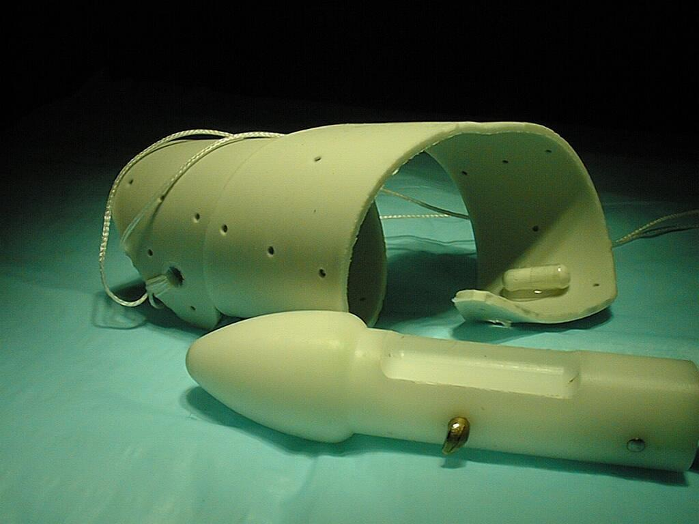
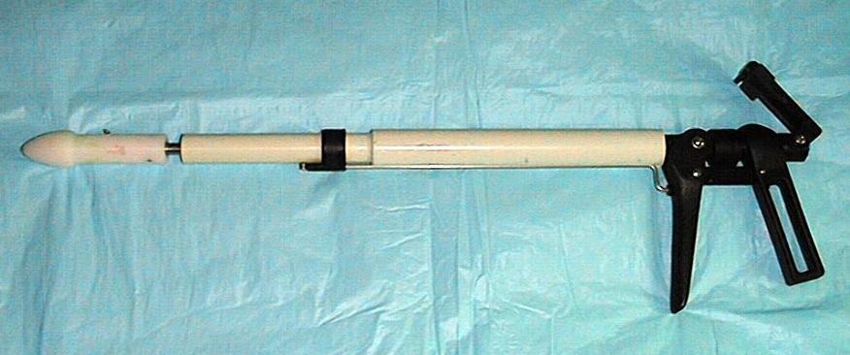
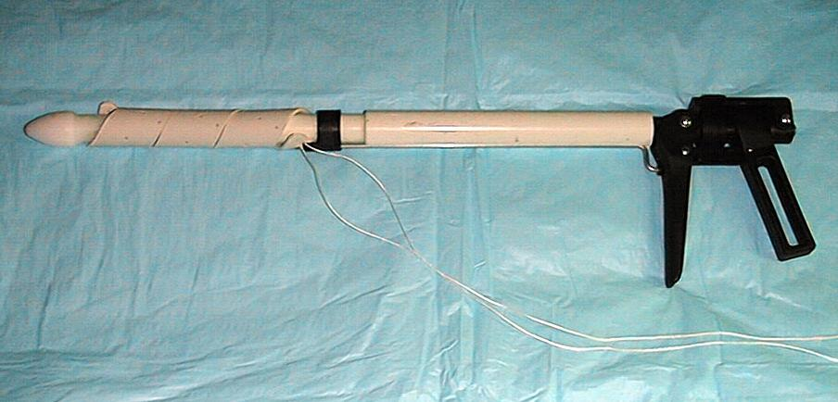
How to treat with progestagens
PRID CEVA (progesterone relasing intravaginal device : progesterone 1,5 g) :
X

Slide 33
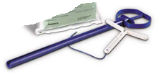
How to treat with progestagens
Easi-breed CIDR Pfizer (Controlled internal drug releasing device : progesterone 1,38 g)

Slide 34
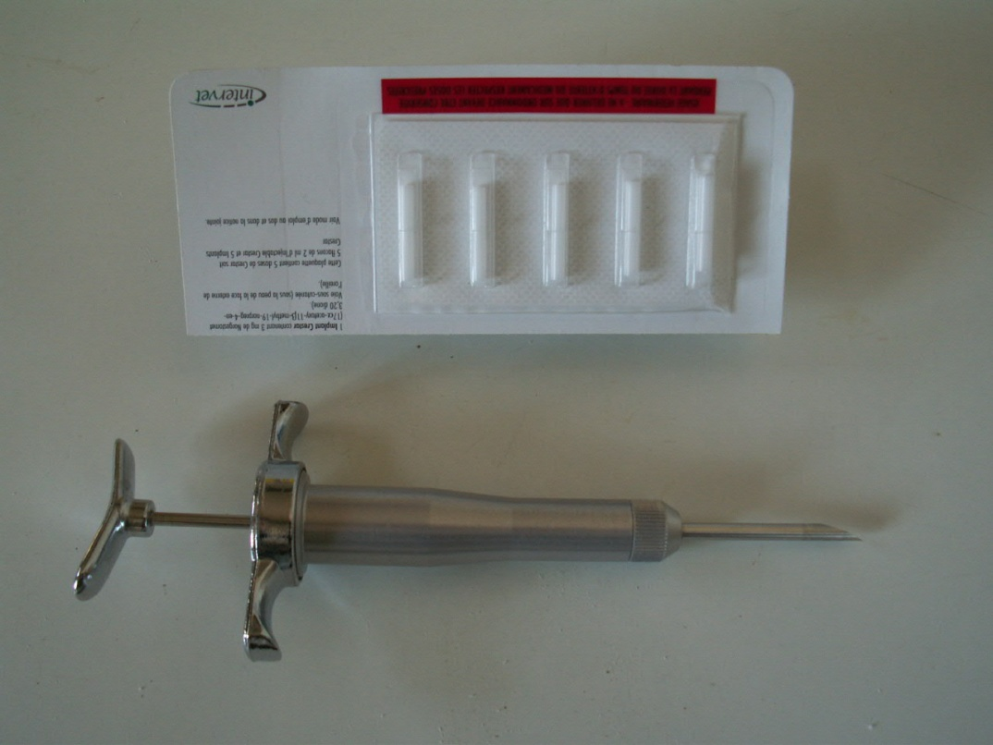
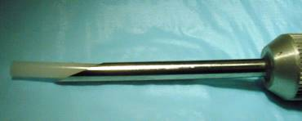
How to treat with progestagens
Crestar (norgestomet 3 mg) : Intervet

Slide 35
Protocols with progestagens
Heifers and cows suspected to be cycled
GnRH
PGF2a
Timed artif insemin
Progestagen (Progesterone/norgestomet) (7 à 9 d)
24
48
56
72
96
GnRH
eCG 500 UI
AI on observed estrus
Heifers and cows non cycled

Slide 36
Hormonal treatment of anoestrus type III (cysts)

Slide 37
Treatment of follicular cyst
hCG or GnRH
7 à 14 j
PGF2a
2 à 5 j
GnRH
Oestrus

Slide 38
Treatment of follicular luteinized cyst
PGF2a
2 à 5 j
GnRH
Oestrus

Slide 39
Alternative : progestagen-GnRH-PGF
Bartolome et al. Theriogenology, 2005,63,1643-1658.
PRID/CIDR (7 j)
Oestrus
TAI 16 h
GnRH
PGF2a d7
GnRH d9

Slide 40
Treatment of cysts with Ovsynch protocol
AI
16 – 24 h
0
7
9
GnRH
PGF2a
GnRH

Slide 41
Comparison of hormal treatments of cysts
(Hanzen et al. Ann.Med.Vet. 2008)
Traitement | N | PR (%)
PRID (12d) + OB | 63 | 14 to 28
GnRH (J0)-PGF(J14) | 62 | 8 to 16
GnRH-PGF (J0)-PGF(J14) | 65 | 22 to 36
OVSYNCH | 791 | 17
GnRH(J0)-Ovsynch(J8) | 89 | 30

Slide 42
Hormonal treatment of anoestrus type IV (pyometra)
PGF is the best choice one or two times 7 to 10 days apart
Intrauterine treatment during the induced estrus
Don’t use progestagens

Slide 43
Hormonal treatment of detection anoestrus
(Cycled cows)

Slide 44
Some preliminary recommandations
PGF2a induce a luteolysis only if a corpus luteum (> 2cm) is present
  No effect during metoestrus, prooestrus or oestrus
  Be sure that cow is not pregnant
  Earlier PGF2a is injected during dioestrus, smaller is interval between injection and beginning of estrus
Two approachs
  Individual for induction
  Group for synchronization

Slide 45
Why PGF2a is not always active ?
Storage conditions
Environment : T° ?
Exactitude of diagnosis
Palpation : 75%
US/P4 : 90 %
Injection : IM
PGF2a : 100 %
Oestrus 65 %
45

Slide 46
Comparison between dinolytic and cloprostenol
Stevenson JS, Phatak AP. Theriogenology, 2010, 73, 1127-1138
(Experiment 1 : 1077 cows and experiment 2 : 396 cows)
 | Cloprostenol | Dinoprost
Experiment 1 : % of luteolysis | 86,6 | 91,3
Experiment 1 : % of pregnancy | 36.7 | 37.8
Experiment 2 : % of luteolysis | 69.1 | 78.5
Experiment 2 : % of pregnancy | 31.3 | 32.8
46

Slide 47
Different protocols
Presynch
PGF2a
GnRH
PGF2a
Select synch
PGF2a
GnRH
PGF2a
GnRH
Ovsynch
GnRH
PGF2a
GnRH
Cosynch
0
12
14
12 - 14
0
1
2
3
4
5
6
7
8
9
10
GnRH
PGF2a
ECP
Heatsynch

Slide 48
Protocols of insemination
Protocol Ovsynch : TAI (Timed Artificial insemination)
  16 to 18 or 16 to 20 h after GnRH injection
TAI (single or twice)
After PGF
Heifer
24
48
60
65
72
80
96
PGF2a
Cow
24
48
60
72
75
84
96
On heat detected

Slide 49
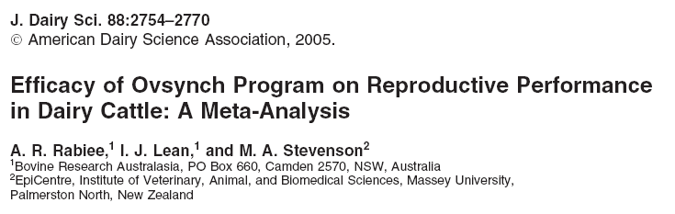
Conclusions with a metaanalysis (71 studies published in 53 papers)
1. Conception and pregnancy rates obtained with the prostaglandin, Select Synch, and modified Ovsynch (including presynch and CoSynch) programs were comparable with the Ovsynch program.
2. Ovsynch program could benefit dairy operations without detection of estrus if CR and PR would be increased.
3 The costs of labor and hormone administration should be considered when selecting this form of reproductive technology for routine use.

Slide 50
General conclusions
Post-partum anoestrus remains one of the most important factor responsible of an increase of days open.
Manual palpation and ultrasonography are the best methods to make a differential diagnosis of post-partum anoestrus
Such methods joined to BCS evaluation should be used between 20 to 50 days and after 50 to 70 days if the cow has not been seen in heat
Hormonal methods remains costly and offer less results than good reproduction and zootechnical management

