Slide 1
Epigenetic Regulation of angiogenesis
Molecular and Cellular Epigenetics
Béatrice Sulka, T.V. Shiva Shankar and Luc Willems

Slide 2
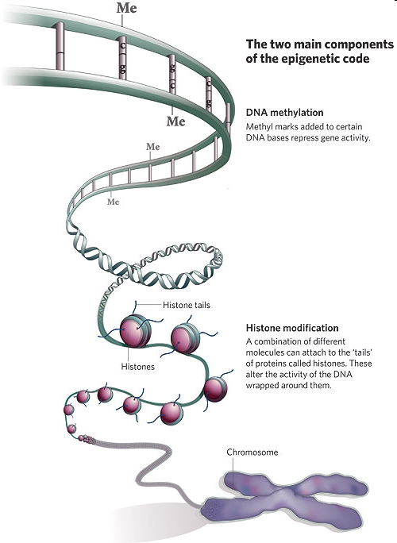
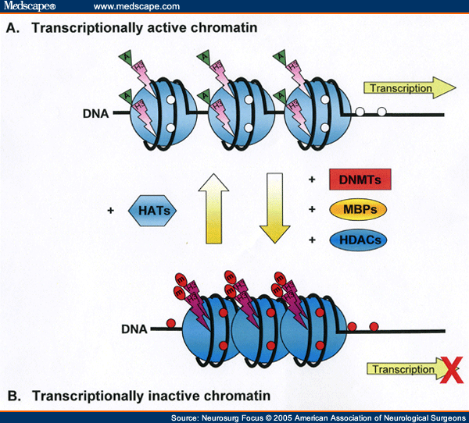
Epigenetic modifications

Slide 3

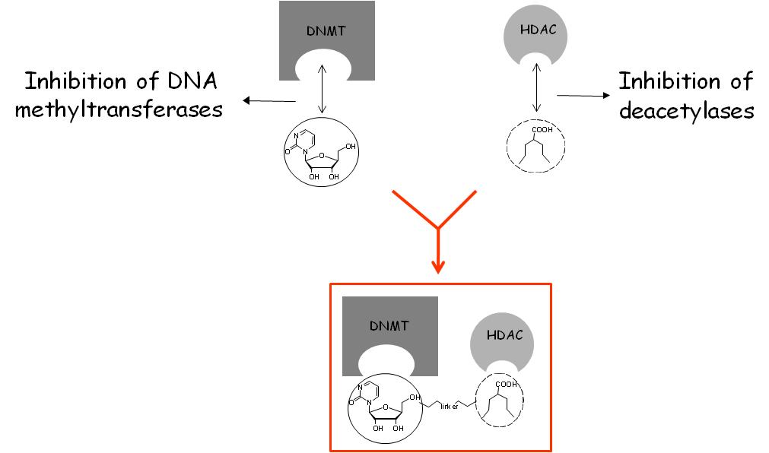
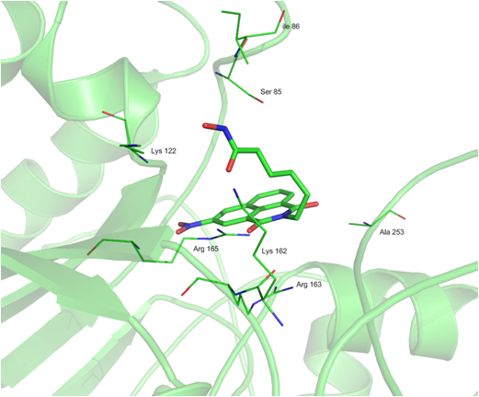
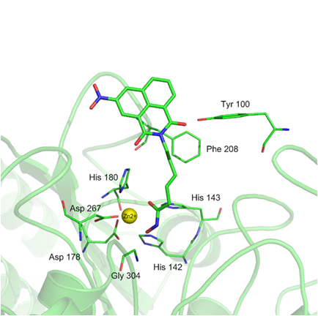
Epigenetic Modulators
TELEVIE: WOUTERS (FUNDP), LAMBERT (UCL), Van LINT and FUKS (ULB), WILLEMS and DELVENNE (ULG), SCULIER (BORDET)

Slide 4
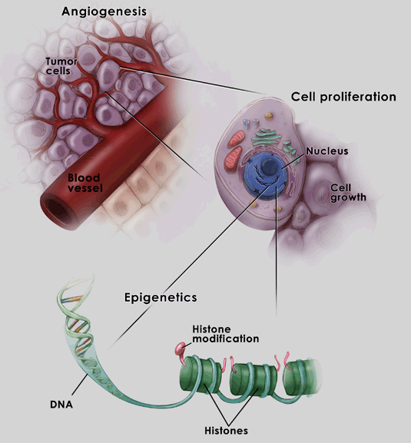
Compounds used to modulate epigenetics and angiogenesis
Twin drug:
  EPI
References compounds/molecules:
  VEGF
  Cisplatin
  HDAC inhibitors:
    Valproic acid (VPA)
    Suberoylanilide hydroxamic acid (SAHA)
  DNMT inhibitors:
    5-Azacytidine (5-azaC)
    5-Aza-2’-deoxycytidine (DAC)

Slide 5
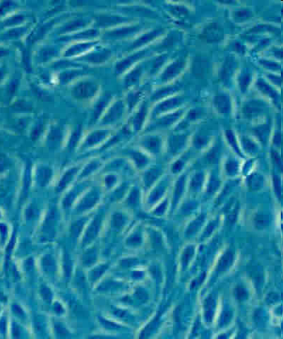
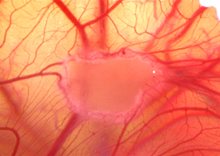
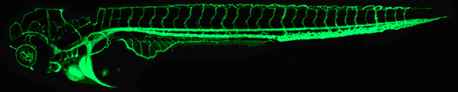
Relevant models of angiogenesis
Human Umbilical Vein
Endothelial Cells (HUVEC)
Aortic
ring assay
Chick chorioallantoic membrane (CAM) assay
Zebrafish (Danio rerio)

Slide 6
Experimental strategy
Western-blot
and IF
Global histone acetylation
Microarray and IPA software
DNA methylation (Illumina Infinium BeadChip Methylation27 v1 Assay)
Metabolic MTS assay
Transcriptional expression analysis (Illumina HumanHT-12 v3 Expression BeadChip)
PE Annexin V - 7AAD labelling
Apoptosis
Angiogenesis assays
Cell migration and tubulogenesis in Huvec
Quantification of anti-angiogenic effect of ES8 in relevant models of angiogenesis
Cell viability/Cytotoxicity

Slide 7
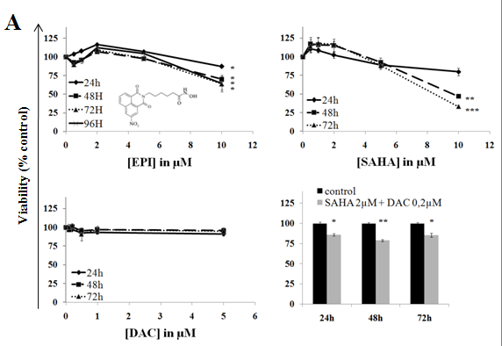
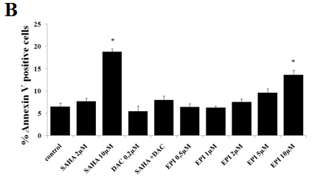
Effects of EPI and control compounds on the viability and Apoptosis of HUVEC cells

Slide 8
Experimental strategy
Western-blot
and IF
Global histone acetylation
Microarray and IPA software
DNA methylation (Illumina Infinium BeadChip Methylation27 v1 Assay)
Metabolic MTS assay
Transcriptional expression analysis (Illumina HumanHT-12 v3 Expression BeadChip)
PE Annexin V - 7AAD labelling
Apoptosis
Angiogenesis assays
cell migration and tubulogenesis in huvec
quantification of anti-angiogenic effect of epi in relevant models of angiogenesis
Cell viability/Cytotoxicity

Slide 9
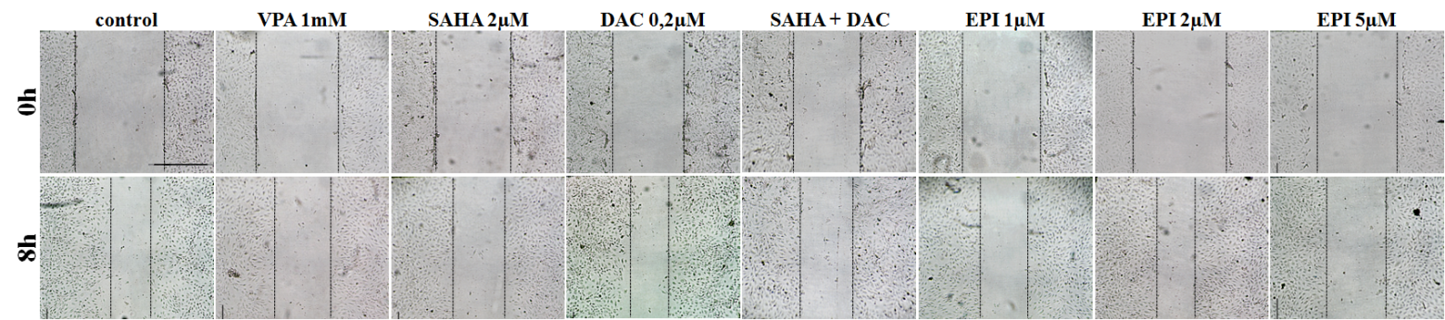
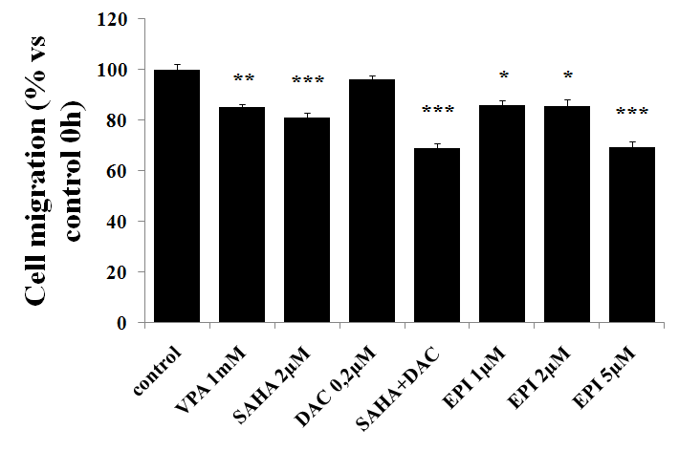
Anti-angiogenic effect of EPI in Huvec
1) Scratch wound assay
A
B

Slide 10
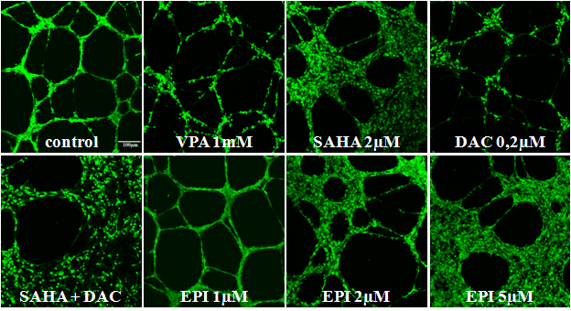
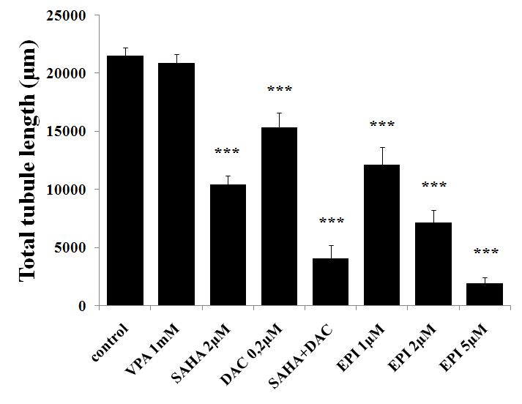
Anti-angiogenic effect of EPI in Huvec
2) Tubulogenesis
A
B

Slide 11
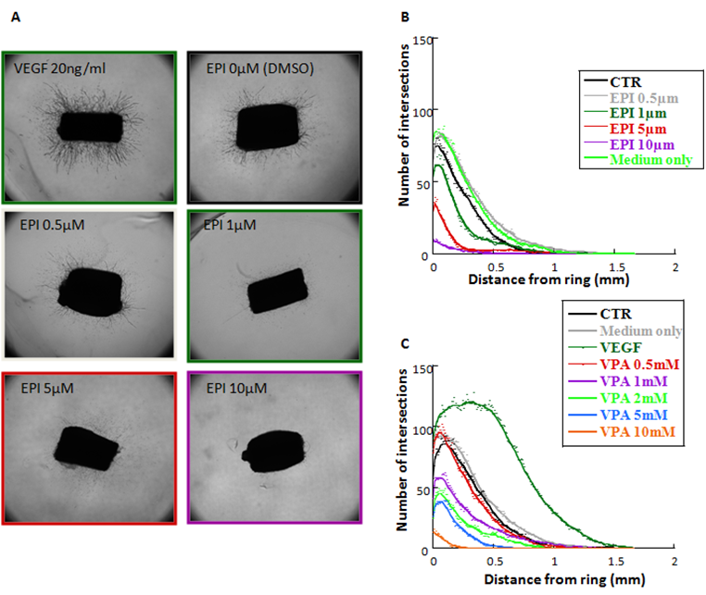
Anti-angiogenic effect of EPI and control compounds in the aortic rings
A
B

Slide 12
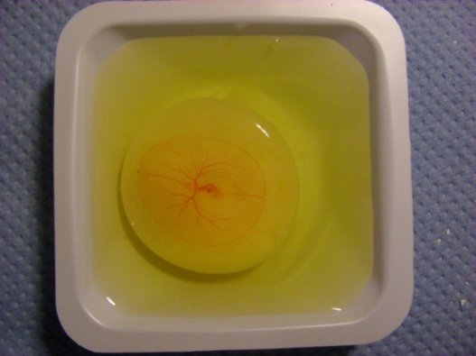
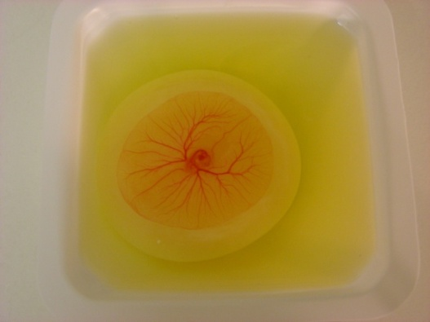
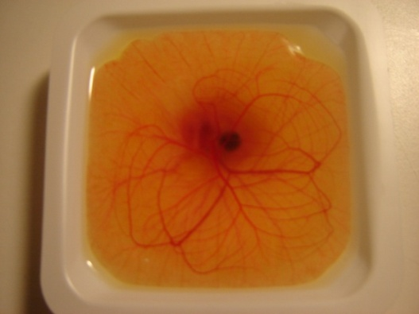
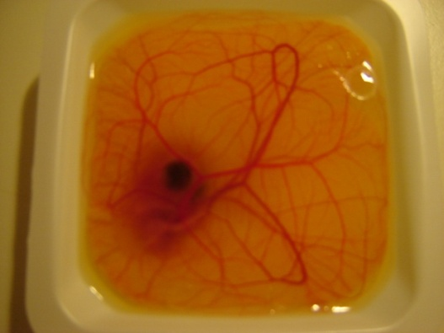
Chicken chorioallantoic membrane
ex ovo model
Photos and labeling of the CAM
Opening the shell
CAM’s development
Treatment of the CAM
Day 3,5
Day 4
Day 8
Day 11
Development of the CAMs ex ovo on plastic weight boats covered with square Petri dishes and placed into the incubator at 38°C and 80% of humidity.
➔Preservation of the CAM’s integrity
➔Statistically more reliable data

Slide 13
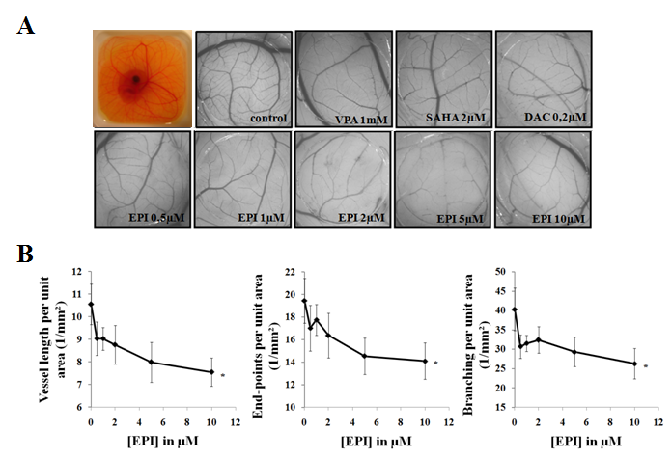
Quantification of anti angiogenesis in Chicken chorioallantoic membrane assay

Slide 14
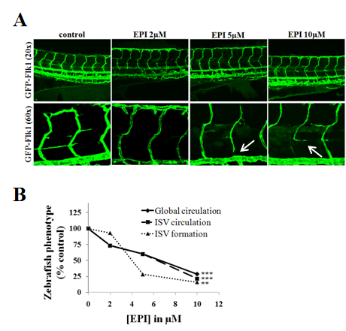
EPI interferes with the establishment of ISV vessels and blood circulation in
Zebrafish embryos

Slide 15
Experimental strategy
Western-blot
and IF
Global histone acetylation
Microarray and IPA software
DNA methylation (Illumina Infinium BeadChip Methylation27 v1 Assay)
Metabolic MTS assay
Transcriptional expression analysis (Illumina HumanHT-12 v3 Expression BeadChip)
PE Annexin V - 7AAD labelling
Apoptosis
Angiogenesis assays
Cell migration and tubulogenesis in huvec
Quantification of anti-angiogenic effect of epi in relevant models of angiogenesis
Cell viability/Cytotoxicity

Slide 16
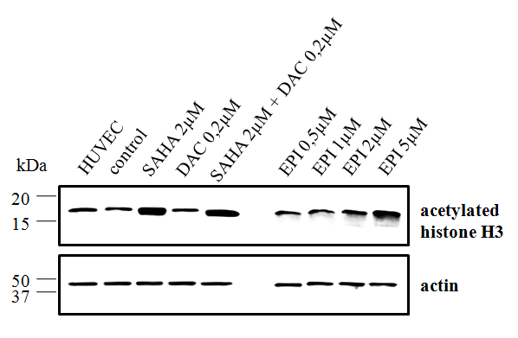
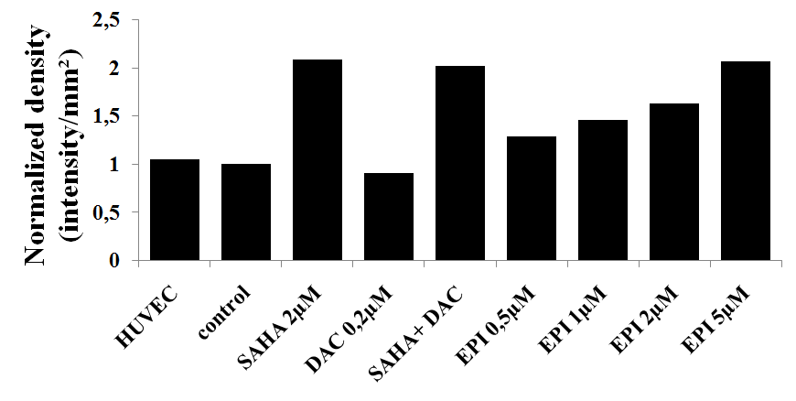
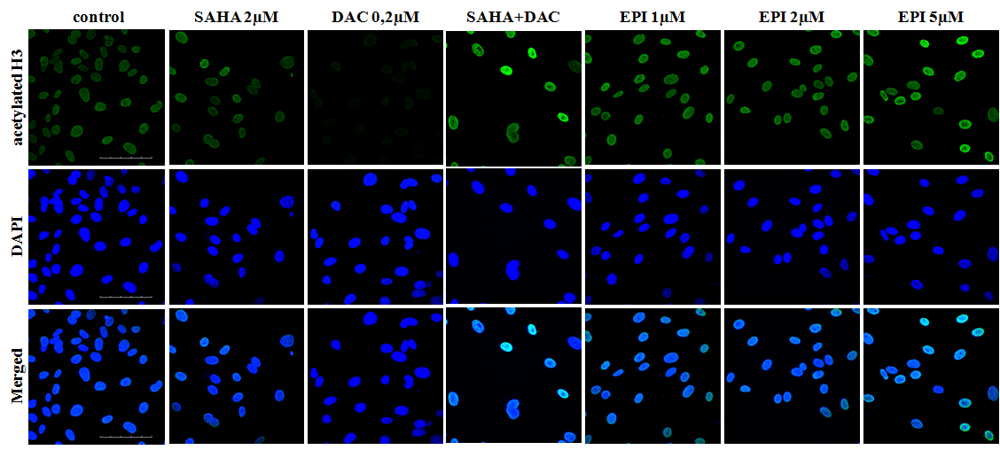
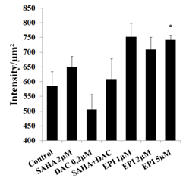
Global histone acetylation in Huvec
A
B
C
D
E

Slide 17
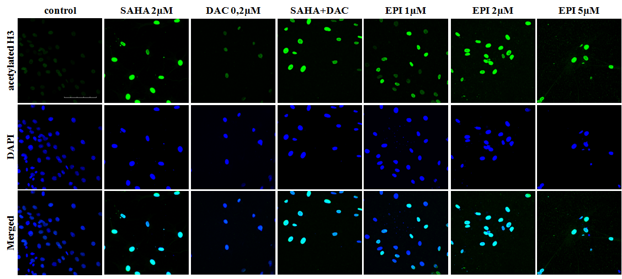
Global histone acetylation in Aortic rings

Slide 18
Experimental strategy
Western-blot
and IF
Global histone acetylation
Microarray and IPA
DNA methylation (Illumina Infinium BeadChip Methylation27 v1 Assay)
Metabolic MTS assay
Cell viability/cytotoxicity
Transcriptional expression analysis (Illumina HumanHT-12 v3 Expression BeadChip)
PE Annexin V - 7AAD labeling and flow cytometry
Apoptosis
Angiogenesis assays
Cell migration and tubulogenesis in Huvec
Quantification of anti-angiogenic effect of ES8 in relevant models of angiogenesis

Slide 19
Epigenetic regulation at molecular level
Post treatment Huvec cell lysate
Gene Expression analysis
(HumanHT-12 v3 Expression BeadChip)
DNA methylation pattern
Analysis (Illumina Infinium
27 v1 BeadChip)
Validation of microarray results and
Ingenuity Pathway Analysis

Slide 20
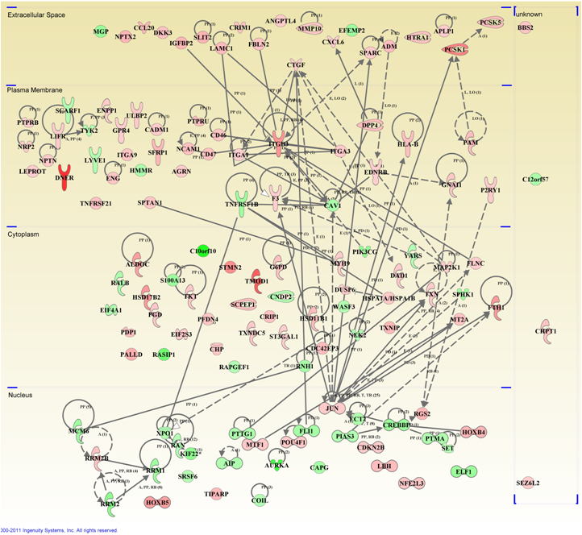
Spatial localization and interaction of EPI unique
angiogenic genes using the Ingenuity Pathway Analysis

Slide 21
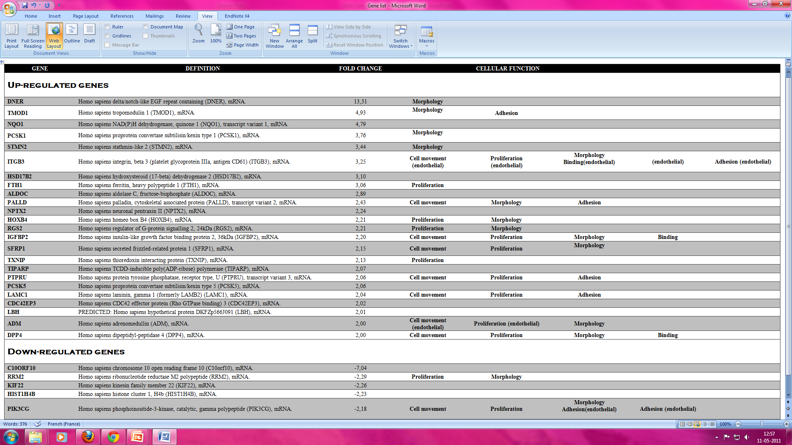
List of differentially expressed (2-fold) top genes after EPI (5µM) treatment of HUVEC cells

Slide 22
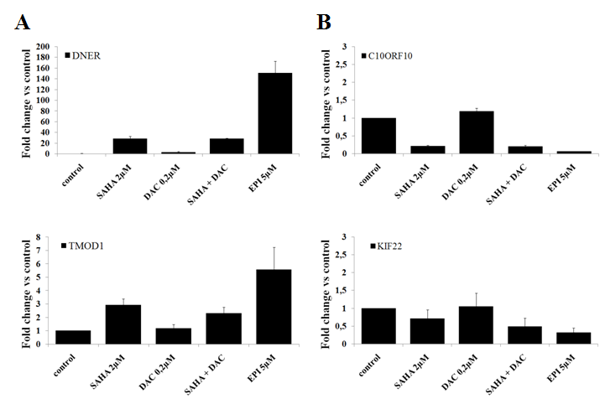
Effect of EPI on selected genes associated
with angiogenesis
Upregulated
Downregulated

Slide 23
Conclusions
EPI is anti-angiogenic without being cytotoxic or apoptotic in vitro but also in relevant in vivo models of angiogenesis
EPI induces Hyperacetylation of histone H3 in both HUVEC and aortic rings
Parallel microarray analyses underscored a list of genes exclusively affected by the EPI (5µM) but not by other HDAC or DNMT inhibitors in the context of angiogenesis
Epigenetic regulation of genes

Slide 24


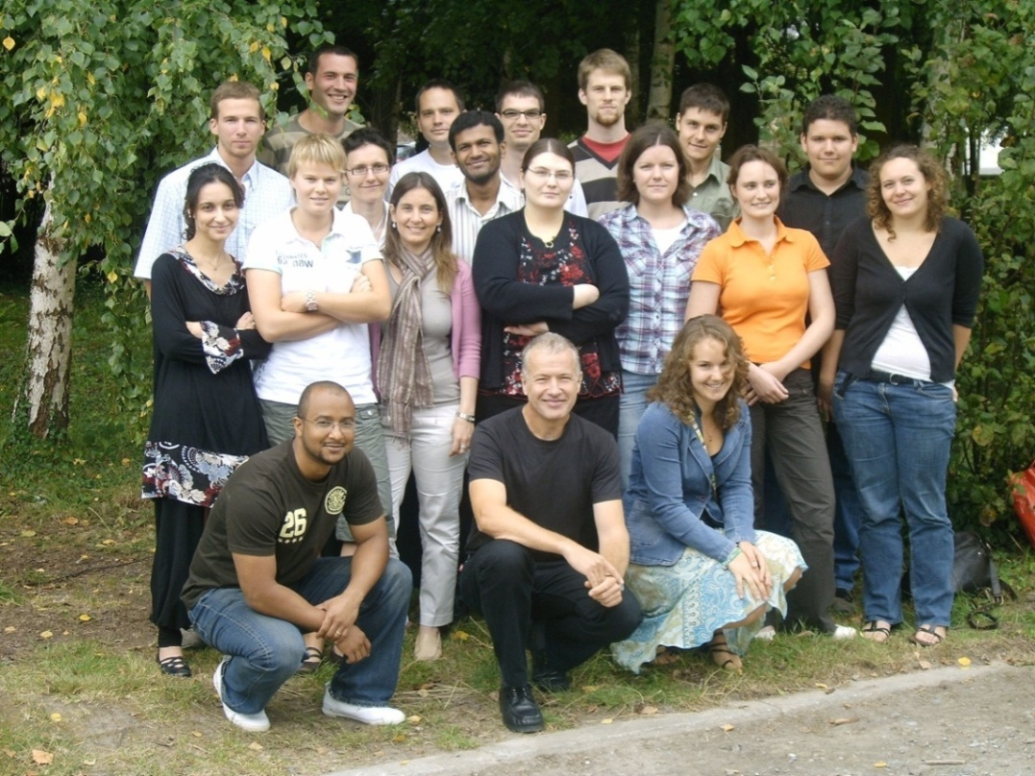








Mathieu Boxus
Jean-philippe Cosse
Fanny Boulanger
Chrisostome Costa
Alix de Brogniez
Arnaud Florins
Roland Hubaux
Sabrina Rodriguez
T.V. Shiva Shankar
Béatrice Sulka
Jean-Rocq Jacques
Fabian Vandermeers
Nicolas Gillet
Sathyanarayana Reddy
Maria Teresa Alcaraz
Luc Willems
ARC
Collaboration with C. Maillard/S. Blacher/A. Noël, H.Pendeville and P. Hubert/P. Delvenne

