Slide 1

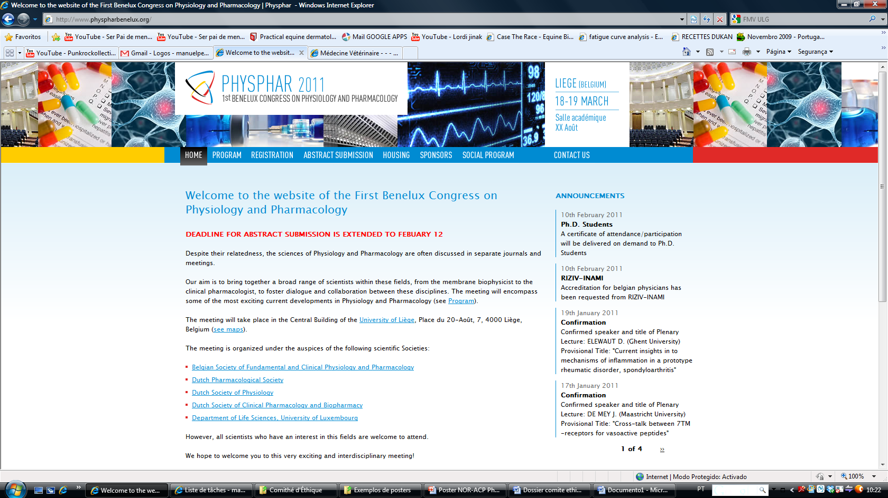

REVERSAL OF ACEPROMAZINE-INDUCED HEMODYNAMIC ALTERATIONS BY NOREPINEPHRINE IN STANDING HORSES
Pequito M.¹, Amory H.², Péters F.², de Moffarts B.², Busoni V.², Serteyn D.², Sandersen C.²
1 Faculty of Veterinary Medicine, Lusófona University, Portugal; 2 Faculty of Veterinary Medicine, Liege University, Belgium
INTRODUCTION
Acepromazine (ACP) is a phenothiazine commonly used to sedate horses. Additionally, ACP exerts strong anti-inflammatory effects, which might have a therapeutic potential in horses suffering from systemic inflammatory response syndrome (SIRS). However, the ACP-induced vasodilation precludes its use in horses with SIRS-related cardiovascular compromise.
The objective of this study was to test if the hemodynamic effects of the administration of 0,1 mg/kg of ACP could be counteracted by an intravenous infusion of norepinephrine (NOR) at 1μg/kg/min in healthy horses.
MATERIAL AND METHODS
In 5 healthy adult horses, a 15 minutes NOR IV infusion was administered 45 minutes after an injection of 0,1 mg/kg of ACP IV. The systolic arterial blood pressure (SAP) was non-invasively measured by Doppler sphingometry at the tail. Hemodynamics of the median artery of the left forelimb were studied using Doppler ultrasonography, through calculation of the vessel’s surface (SURF), diameter (DIAM), circumference (CIRC), and peak systolic velocity (PSV), end diastolic velocity (EDV), mean velocity (MV), volumetric flow (VF) and resistivity index (RI) of the flow. Both SAP and Doppler parameters were determined at regular intervals during the entire study. Results were analyzed using a mixed procedure in the SAS® system, considering the different horses and the repetition of the measures. Standard deviation is taken into consideration in results figures. A p-value inferior to 0.05 was considered statistically significant.
RESULTS
ACP induced a hypotension and a vasodilatation, that were evidenced by a significant rise of the SURF, DIAM, CIRC, PSV, EDV, MV and VF and reduction of the SAP and RI. During NOR infusion, all these ACP-induced hemodynamic changes were reversed.
NOR IV infusion
NOR IV infusion
*
º
*
º
*
º
º
*
º
*
º
*
*
*
*
*
*
*
*
*
*
*
º
*
º
º
º
º
*
*
º
º
º
º
*
º
º
º
º
Figure 1 Mean (±SD) of the variation percentage of the systolic arterial pressure (SAP) before, during and after norepinephrine infusion (NOR). * significantly different from T0.
º significantly different from T45.
Figure 2 Mean (±SD) of the variation percentage of the diameter (DIAM), circumference (CIRC) and surface (SURF) of the median artery before, during and after norepinephrine infusion (NOR). * significantly different from T0. º significantly different from T45.
NOR IV infusion
NOR IV infusion
*
*
*
*
*
*
*
*
*
º
º
º
º
º
º
º
*
*
*
*
*
º
º
º
º
*
*
*
Figure 3 Mean (±SD) of the variation percentage of the peak systolic velocity (PSV) and the end diastolic velocity (EDV) of the median artery before, during and after norepinephrine infusion (NOR). * different from T0. º significantly different from T45.
Figure 4 Mean (±SD) of the variation percentage of the resistivity index (RI), volumetric flow (VF) and mean velocity (MV) of the median artery before, during and after norepinephrine infusion (NOR). * significantly different from T0. º significantly different from T45.
DISCUSSION
The NOR effect of reverting the hemodynamic variations induced by ACP is likely to be the consequence of the vasoconstriction induced by its α-adrenergic activity (1). Furthermore, as ACP has α−blocking proprieties (1) and no direct effect on β2-adrenergic receptors, this confirms that, for the reversal of this vasodilation, NOR is acting principally as α-adrenergic agonist, with little or no β2-effects, in these animals. The short half-life of NOR is confirmed by the quick ending of NOR’s effects after the end of the infusion.
CONCLUSIONS
These findings suggest that a continuous NOR IV infusion at 1mg/kg/min is able to revert ACP-induced hypotension and vasodilation in healthy adult horses.
REFERENCES
1 - Adams HR. Adrenergic agonists and antagonists. In: Riviere JE, Papich MG, eds. Veterinary Pharmacology and Therapeutics. 9th ed. Iowa: 2009: Willey-Blackwell, 125-156.

