Slide 1



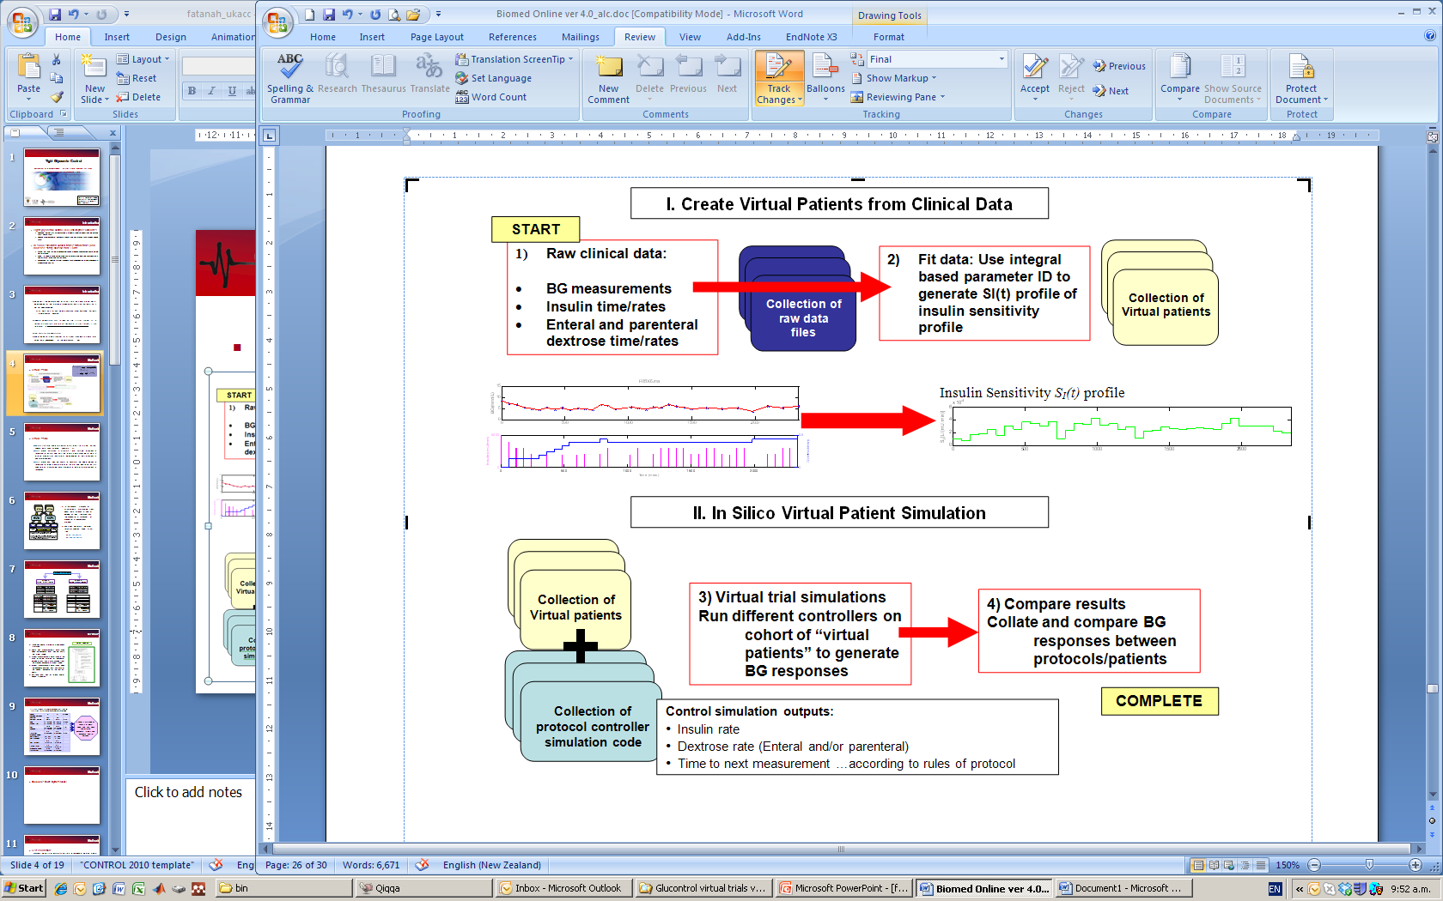
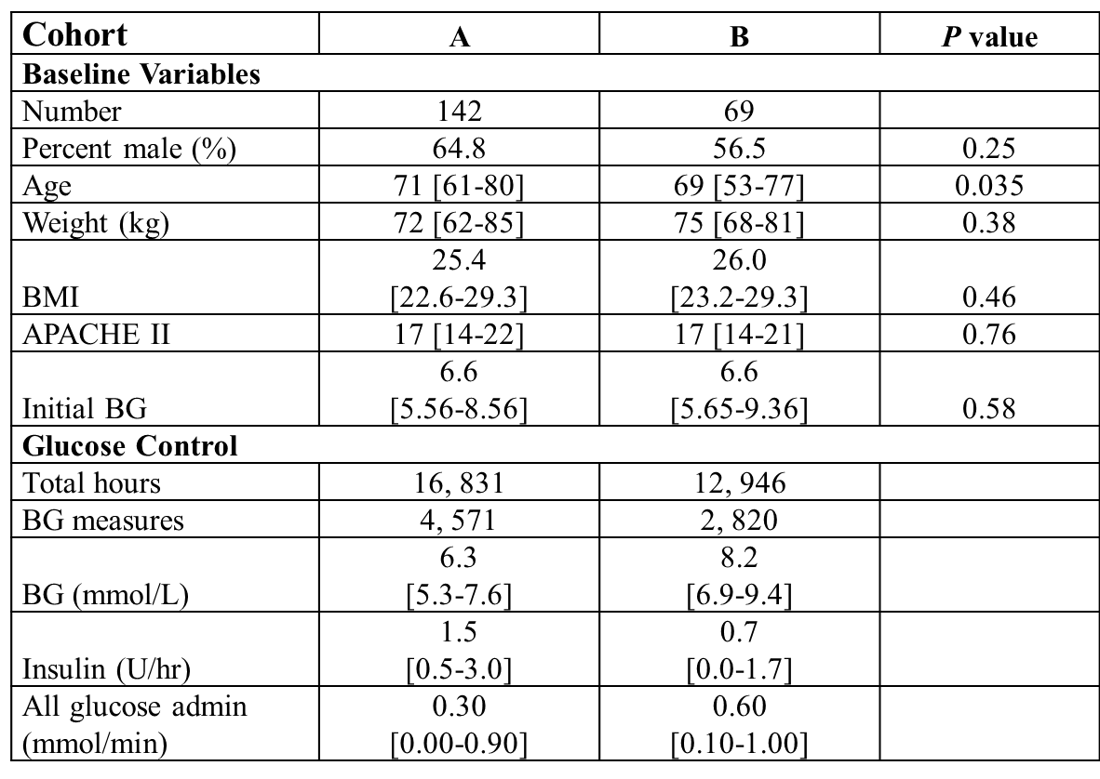
Validation of a Virtual Patient and Virtual Trials Method for Accurate Prediction of TGC Protocol Performance
F Suhaimi^{1,5}, A.J. LeCompte¹, S Penning⁴, C.G. Pretty¹, J.C. Preiser⁴, T Desaive⁴, G.M.Shaw^{2,3} and J.G.Chase¹
Centre for Bioengineering, Department of Mechanical Engineering, University of Canterbury
Department of Intensive Care Medicine, Christchurch Hospital, New Zealand
3. Christchurch School of Medicine and Health Sciences, University of Otago, New Zealand
4. Dept of Intensive Care, Centre Hospitalier Universitaire de Liege (CHU), Liege, Belgium
5. Advanced Medical and Dental Institute, Universiti Sains Malaysia, Penang, Malaysia
INTRODUCTION
OVERVIEW: Tight glucose control (TGC) reduced intensive care unit (ICU) patient mortality up to 45% using a target of 6.1 mmol/L. TGC also reduce organ failure rate, severity and cost.
“Virtual trials” are performed using a clinically validated model of the glucose-insulin system. Insulin sensitivity, S_{I}, is used as the critical marker of a patient’s metabolic state and is assumed independent of the model inputs.
Virtual trials can be used to simulate a TGC protocol using a S_{I} profile identified from clinical data and different insulin and nutrition inputs. Virtual patient trials have been used in design of TGC protocols . The clinical results of SPRINT showed very close agreement to expected results from simulation.
The performance of virtual trials on separate cohorts, independent of the ICU used to generate the virtual patients, has not yet been performed.
GOALS: This study provides a source of independent, matched patient data for two groups treated with different TGC protocols. Patients in the Glucontrol study were randomised into two, matched cohorts with different glycemic protocols and targets. Only data from one Glucontrol centre (University Hospital of Liege, Belgium) was used.
Virtual trial simulations are used to assess model errors and validate the overall virtual trials approach.
VIRTUAL TRIALS METHOD
  Glucose-Insulin System Model
SELF & CROSS VALIDATION
CLINICAL DATA
211 patients were treated using the Glucontrol protocol at CHU de Liege, Belgium, between March 2004 and April 2005.
Patients were randomly divided into two groups:
  Group A – Glucontrol A protocol.
  Group B – Glucontrol B protocol.
  SELF VALIDATION:
  Assess the ability of in-silico virtual trials to reproduce the clinical data.
  Differences of simulation results to clinical results are due to model errors and/or lack of perfect compliance.
  CROSS VALIDATION:
  Test the assumption that the SI profiles accurately capture patient dynamics, independent of the insulin and nutrition inputs used to create them.
  The patients in simulation will receive very different amounts of insulin compared to what was given clinically.
  Both cohorts are matched clinically, differences can be ascribed to the independence assumption behind this virtual trials method.
RESULTS & DISCUSSION
Clear separation in clinical BG results between Glucontrol A and Glucontrol B indicates difference in protocol behaviour.
Self-validation and cross-validation results closely match clinical results for both Groups A and B.
Cross validation result lies between the clinical data and self validation result indicating it is within the model and/or compliance error compared to the clinical data.
Overall, simulation results reproduce clinical results using any collection of matched virtual patients.
Wider error below 8 mmol/L is due to the fact that the Glucontrol B protocol requires zero exogenous insulin below its target.
Gap between the self validation and clinical data indicates the possibility of compliance error whereas the difference between self validation may be model error, but may also suggest that lower intensity Group B protocol may not have been followed as strictly.
CDFs of Blood Glucose levels for clinical Glucontrol data
and virtual trials on a (whole cohort basis)
CDFs of Blood Glucose levels for clinical Glucontrol data
and virtual trials on a (per-patient basis)
CONCLUSIONS
Self Validation indicates a clinically insignificant error in these virtual patient methods due to model and/or clinical compliance.
Cross Validation clearly shows the virtual patients enabled by the identified patient-specific SI(t) profiles are independent of the clinical inputs used to generate these profiles.
These outcomes validate the ability of the virtual patients and in silico virtual trial methods presented to accurately simulate, in advance, the clinical results of an independent TGC protocol, directly enabling rapid design and optimisation of safe and effective TGC protocols with high confidence of clinical success.
REFERENCES
[1] G. Van den Berghe, et al., "Intensive insulin therapy in the critically ill patients," N Engl J Med, vol. 345, pp. 1359-1367, Nov 8 2001.
[2] J. G. Chase, et al., "Model-based insulin and nutrition administration for tight glycaemic control in critical care," Curr Drug Deliv, vol. 4, pp. 283-96, Oct 2007.

