Slide 1





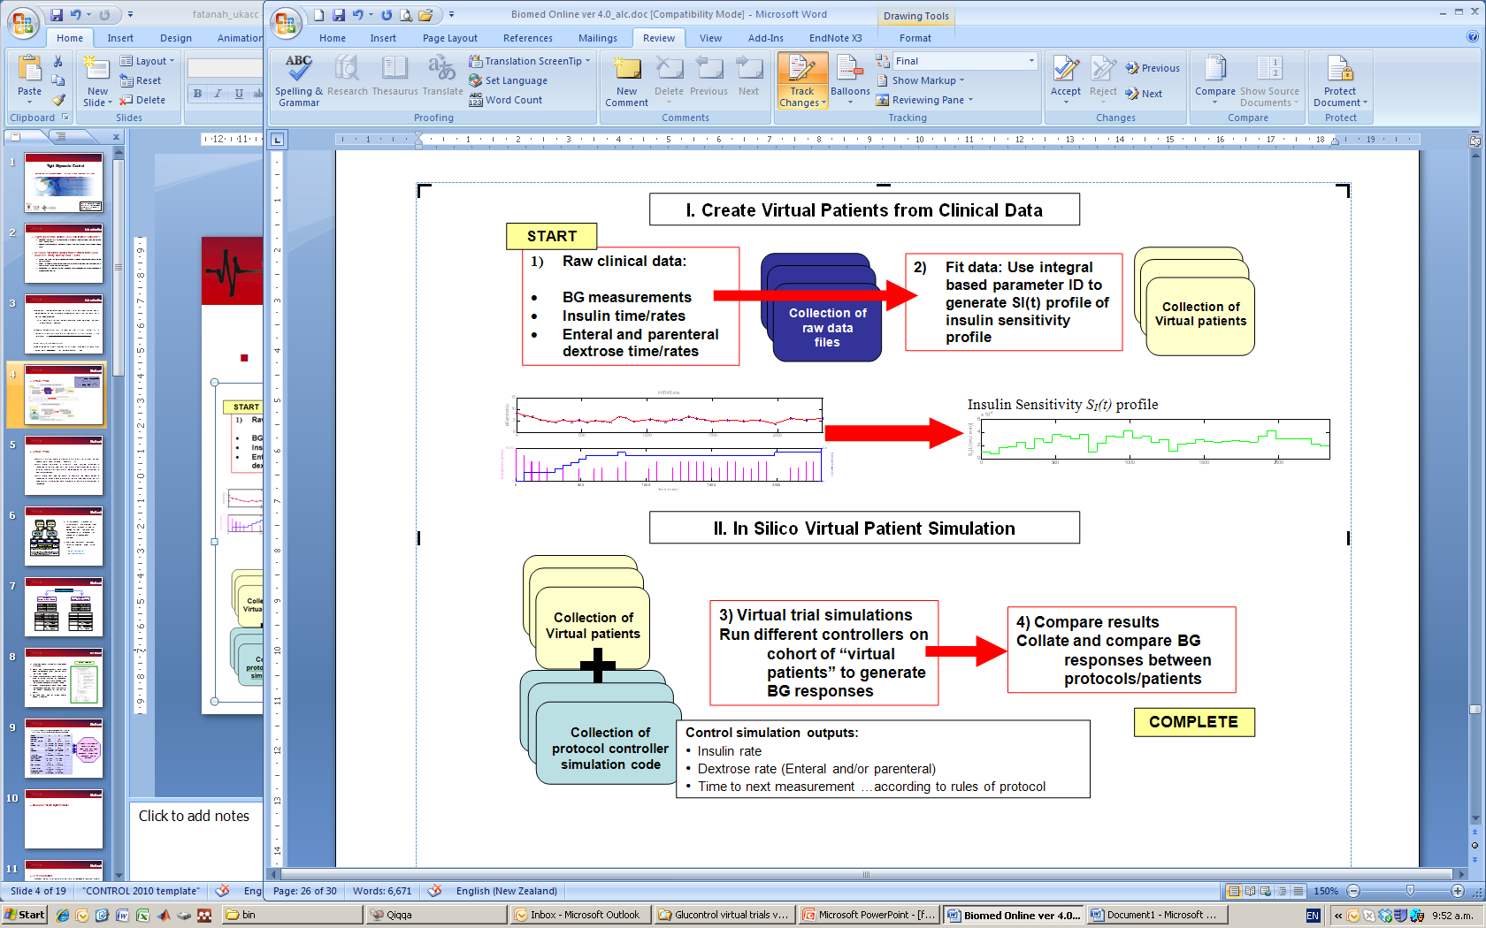
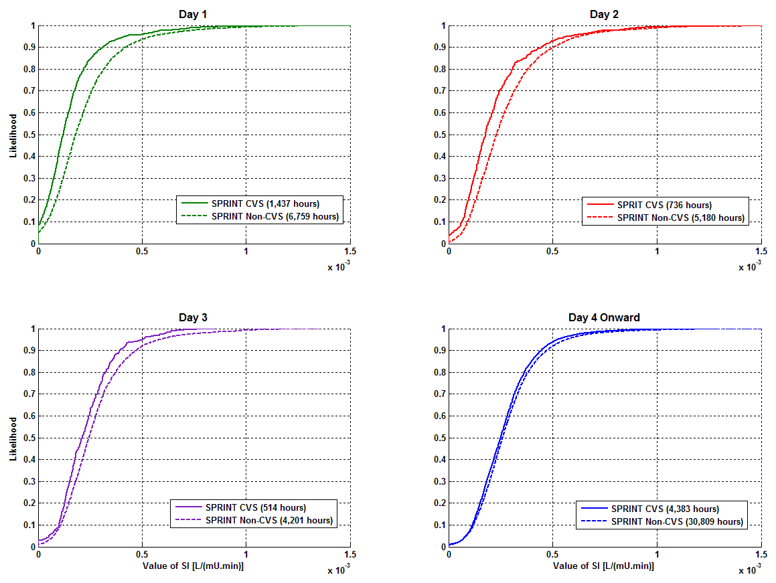
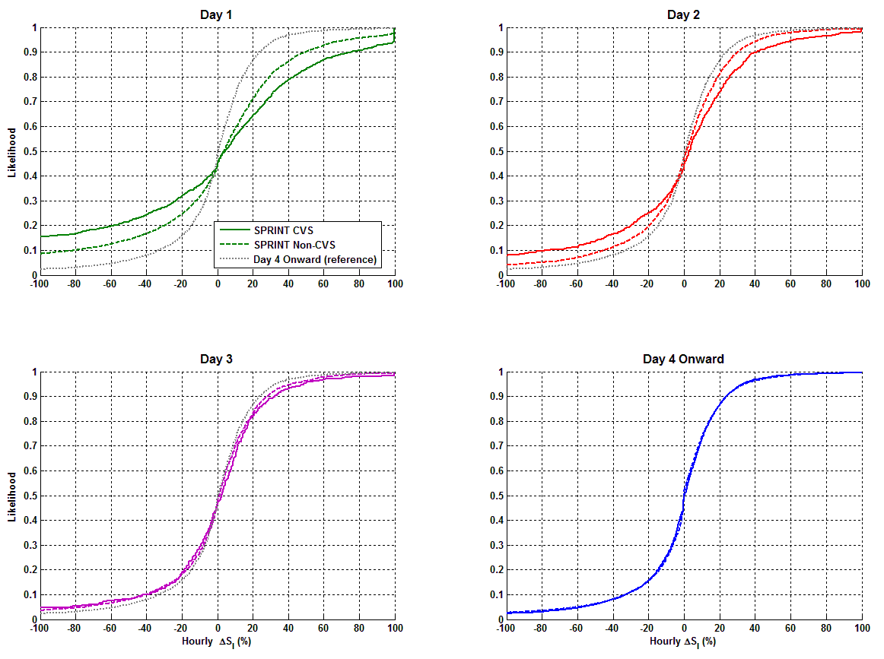
Enhanced insulin sensitivity variability in the first 3 days of ICU stay: Implications for TGC
J.G.Chase¹ , A.J. LeCompte¹, S Penning², K.T. Moorhead², P. Massion³, J.C. Preiser⁴, C.G. Pretty¹, G.M.Shaw⁵ and T Desaive²
Centre for Bioengineering, Department of Mechanical Engineering, University of Canterbury
2. Cardiovascular Research Centre, University of Liege, Liege, Belgium
3. Dept of Intensive Care, Centre Hospitalier Universitaire de Liege (CHU), Liege, Belgium
4. Dept of Intensive Care, Erasmes Hospital, ULB, Brussels, Belgium
5. Department of Intensive Care, Christchurch Hospital, Christchurch, New Zealand
INTRODUCTION
OVERVIEW: Tight glucose control (TGC) reduced intensive care unit (ICU) patient mortality up to 45% using a target of 6.1 mmol/L. TGC also reduces organ failure rate and severity, as well as cost [1,2]. Thus, effective tight glycemic control (TGC) can improve outcomes, which has been particularly noted in cardiovascular surgery. However, achieving these outcomes has proven difficult.
Variability in insulin sensitivity/resistance resulting from the level and evolution of stress response, particularly early in a patient’s stay, can lead to hyperglycemia and glycemic variability, both of which are associated with increased risk of mortality. This study quantifies the daily evolution of the variability of insulin sensitivity for cardiovascular surgical and all other ICU patients.
Variability, hour to hour, is important to understanding the glycemic variability that results, whether explicit TGC protocols are used, or not. The greater the variability, the greater the risk for excessive hyper or hypo glycemia, for a given insulin intervention. Hence, hour to hour level and variability in insulin sensitivity will, for a given TGC protocol, determine the outcome glycemia and glycemic variability.
GOALS: This study uses a clinically validated model to assess insulin sensitivity and its variability every hour. The goal is to assess how a patient or cohorts metabolic status changes each day of stay, as well as to assess how variability changes each day of stay.
MODELING METHOD
CLINICAL DATA
DATA: Are taken from the SPRINT [3] TGC cohort totalling 393 patients and ~40,000 patient hours of data
CVS and Non-CVS patient data including combined full SPRINT data for comparison. Starred (*) values have significant difference (p < 0.05) between CVS and Non-CVS. APACHE = Acute Physiology And Chronic Health Evaluation; BG = Blood Glucose (level); IQR = Inter-Quartile Range; LoS = Length of Stay; SD = Standard Deviation (lognormal)
  Glucose-Insulin System Model
RESULTS
Insulin Sensitivity Level
Insulin sensitivity increases for both cohorts each day of stay
SI is lower for CVS Surgery than Non-CVS for each day
Median values converge to within 3% by Day 4 Onwards
Overall
The overall SPRINT Cohort results are the average of the specific cohort CDFS shown. Thus, the results hold for the entire cohort as a whole.
Glycemic control was equivalent for both cohorts
Greater SI variability, for a given insulin dose yields greater outcome glycemic variability, reducing quality of control and (potentially) outcomes.
Insulin Sensitivity Variability (%)
SI Variability is greatest on Day 1 and declines over Days 2 and 3
Variability is greater for the CVS group but declines faster
CVS and Non-CVS are similar (p > 0.10) on Day 3 and Days 4 Onward (see table for all values)
 | Day 1 | Day 2 | Day 3 | Day 4 On
CVS vs Non-CVS | < 0.0001 | < 0.0001 | 0.13 | 0.29
CVS vs Day 4 On | < 0.0001 | < 0.0001 | < 0.0001 | 0.35
Non-CVS vs Day 4 On | < 0.0001 | < 0.0001 | < 0.0001 | 0.78
CONCLUSIONS
All ICU patients exhibit greater insulin sensitivity variability over Days 1-3, and cardiovascular surgery patients are more variable than others.
Clinically, the results imply that TGC patients, especially cardiovascular surgery patients, will require greater measurement frequency, reduced reliance on insulin, and more explicit specification of carbohydrate nutrition in Days 1-3 to safely minimise glycemic variability and maximise control for best outcome.
These results should be tested prospectively
REFERENCES
[1] G. Van den Berghe, et al., "Intensive insulin therapy in the critically ill patients," N Engl J Med, vol. 345, pp. 1359-1367, 2001.
[2] J. G. Chase, et al., “Organ Failure and Tight Glycemic Control in the SPRINT Study,” Critical Care, Vol 14:R154, 2010.
[3] J. G. Chase et al., “Implementation and Evaluation of the SPRINT Protocol for Tight Glycaemic Control in Critically Ill Patients: A Clinical Practice Change,” Critical Care, BMC (open access), Vol 12(2):R49, 2008.

