Slide 1
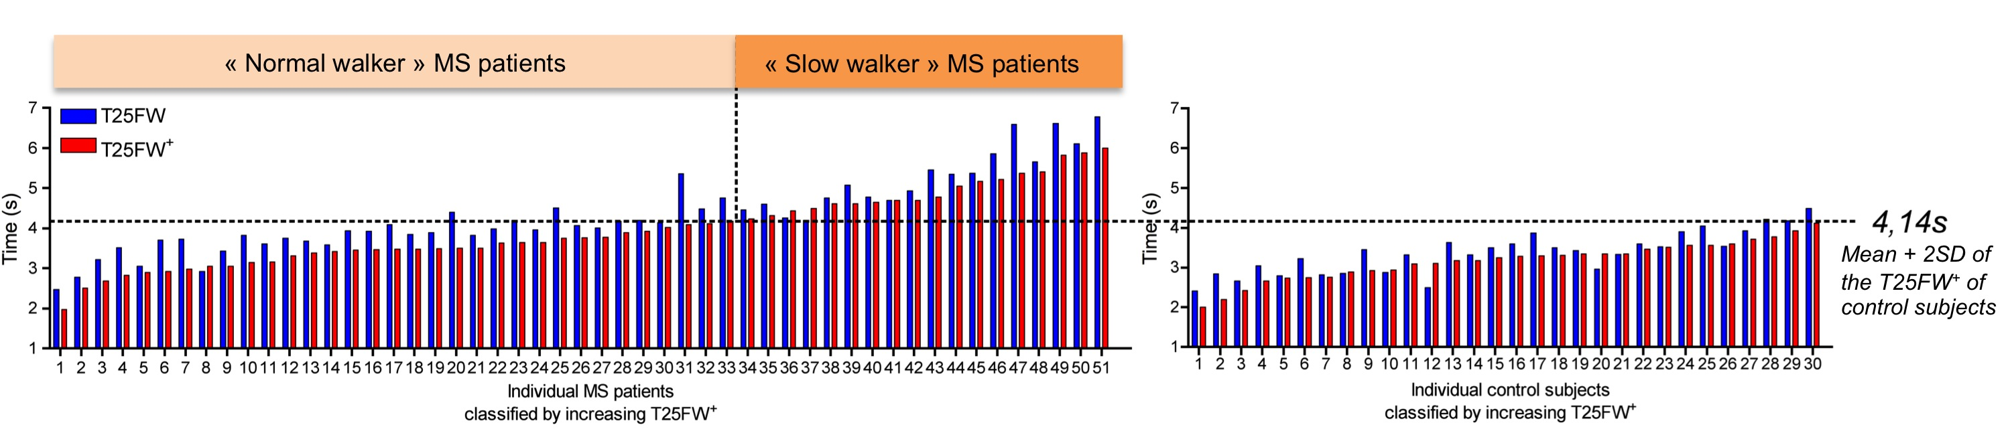
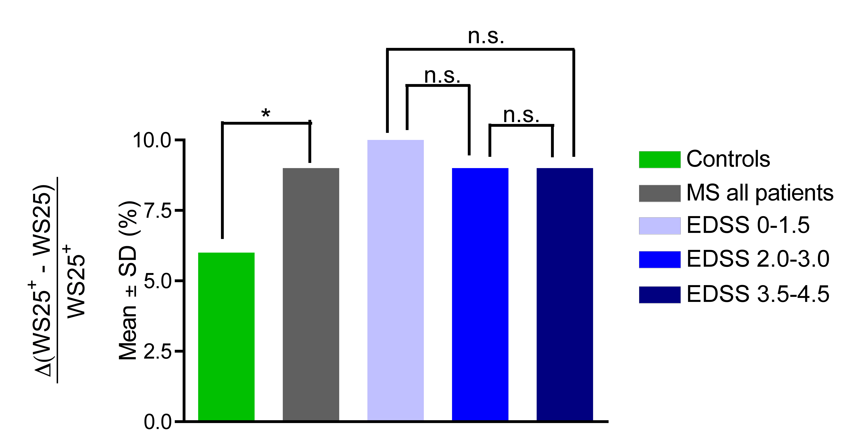
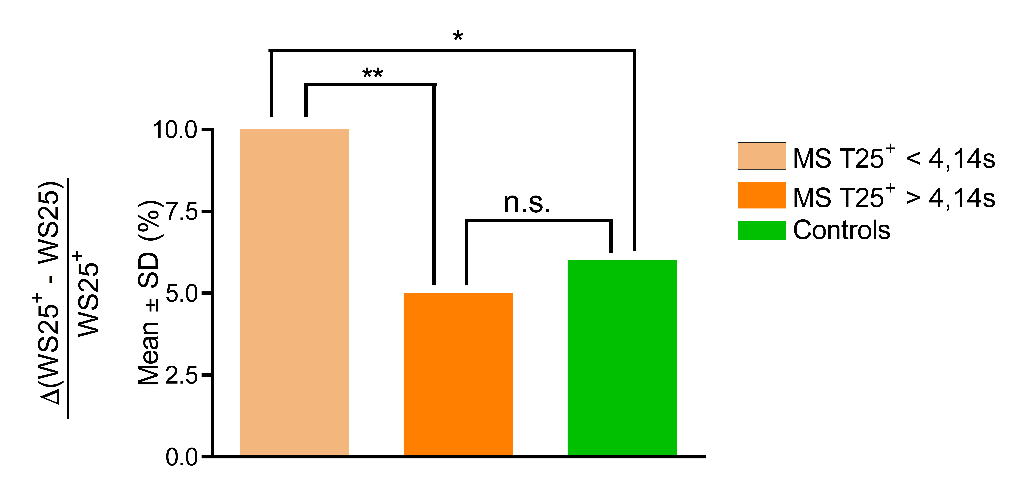
P654
26th Congress of the European Committee for Treatment and Research in Multiple Sclerosis (ECTRIMS), Gothenburg, Sweden, 13 – 16 October 2010
Real maximum walking speed on short distance
assessed by a corrected version of the Timed 25 Foot Walk Test (T25FW)
R. Phan Ba^{1, 2}, P. Calay^{1, 2}, P. Grodent^{1, 3}, G. Delrue^{1,2}, G. Moonen², G. Nagels⁴, S. Belachew^{1, 2}
1: MYelin Disorders REseArch teaM (MYDREAM), C.H.U. de Liege (Liege, BE); 2: Dept. of Neurology, C.H.U. de Liege (Liege, BE); 3: Dept. of Physical Medicine and Rehabilitation, C.H.U. de Liege (Liege, BE); 4: National Center For Multiple Sclerosis (Melsbroek, BE)
Table 1: Characteristics of patients and control subjects
Fig. 1
 | MS patients | Healthy Controls
Number of patients/controls | 51 | 30
Gender (% female) | 63 | 71
Age (mean ± SD, range) | 37,2 ± 10,4, 15-64 | 29,7 ± 10,1, 18-60
EDSS (median, range) | 2.5, 0-4.5
MS subtype (CIS/RR/progressive) | 5/42/4
Disease duration (year, median, range) | 5, 1-35
MWD in metres (median, range) | 1000, 300-1700
Patients with limited ambulation¹: Number (%) | 13 (25.4)
1. Limited ambulation was defined as the inability to walk more than 4000 m; 2. MWD: Maximum Walking Distance.
Background:
Analysis of ambulation is a crucial component of the functional status and reflects disability progression in multiple sclerosis (MS) patients. The Timed 25 Foot Walk Test (T25FW) is the more widely used test in clinical trials to measure the potential impact of therapies on ambulation performances^{1, 2} and was considered to represent the maximum walking speed (WS) patients can reach³. However, we have previously shown that the T25FW test is not an accurate measure of the maximum WS, since we demonstrated that the mean WS was paradoxically higher when measured over a longer distance of 100 meters compared to that of the classical short distance of 25 foot⁴. We also showed that as much as 30% of the MS population though considered fully ambulatory according to the EDSS rules could display early locomotor impairment with significant maximum walking distance restrictions. The failure of the T25FW to represent the maximum WS might be explained by several potential limitations⁵, including patients’ ability to accelerate and the time and distance it takes to reach their maximum pace, which are influenced by multiple factors, such as the motivation, the tester’s training and perhaps early MS-related motor and cognitive disability.
Fig. 2
Objective: To develop a new version of the T25FW removing this fluctuant phase of initial acceleration that makes it a poor indicator of the accurate maximum WS on a short distance.
Methods:
In 51 ambulatory MS patients (EDSS ≤ 4.5 and maximum walking distance ≥ 300 m without aid or rest) and 30 healthy control volunteers (Table 1), we measured the T25FW, as previously described^{1, 2} and the so-called corrected T25FW (T25FW⁺) where the subjects performed the T25FW following the standard guidelines except that they were asked to take a run-up of 3 meters behind the starting line allowing them to possibly reach their maximum WS at the time they crossed the line and triggered the stopwatch. Statistical analysis (student t-tests, pearson r correlation coefficient) were then performed using GraphPad Prism, version 4.0b for Macintosh, GraphPad Software, San Diego California USA (www.graphpad.com).
Fig. 3
Results:
In both healthy control volunteers and MS patients, the two tests displayed a good correlation (r=0,8554 and 0,9480, both p<0,0001, respectively).
Nearly all MS patients (96%, i.e. 49/51) and most of healthy control volunteers (83%, i.e. 25 /30) performed consistently faster on the T25FW⁺ than on T25FW with varying levels of differences between the two tests (Fig. 1).
In healthy control volunteers, the mean WS of the T25FW (WS25) and that of the T25FW⁺ (WS25⁺) were 2,31 ± 0,37 m/s and 2,46 ± 0,43 m/s (mean ± SD, p<0,005), respectively (Fig. 2). In MS patients, WS25 and the WS25⁺ were 1,84 ± 0,39 m/s and 2,05 ± 0,49 m/s (mean ± SD, p<0,0001), respectively (Fig. 2). The mean WS25⁺ was actually higher than the mean WS25 in different subsets of the MS population at distinct levels of disability measured by the EDSS status (0 to 1.5, n=15, 2.0 to 3.0, n=18, and 3.5 to 4.5, n=18) (Fig. 3). Using a threshold value of 4,14s (corresponding to the mean T25FW⁺ + 2SD in healthy control volunteers, Fig. 1), we also stratified MS patients according to the maximum WS on T25FW⁺ and identified “normal walker” (with a T25FW⁺ < 4,14s or WS25⁺>1.84 m/s, n=33) and “slow walker” (with T25FW⁺ ≥ 4,14s or WS25⁺≤1.84 m/s n=18) subjects. The mean WS25⁺ was also significantly higher than the mean WS25 both in normal and slow walker MS patients (Fig. 3).
We calculated the mean relative difference between WS25⁺ and WS25 (calculated for individual subjects as the difference between WS25⁺ and WS25, divided by WS25⁺, Δ(WS25⁺-WS25)/WS25⁺). The mean relative difference between WS25⁺ and WS25 was significantly higher in MS patients compared to controls (p<0,05, Fig. 4). No significant difference was found in the mean relative difference between WS25⁺ and WS25 for MS patients at different levels of disability assessed by the EDSS (Fig. 4). The mean relative difference between WS25⁺ and WS25 was significantly higher in “normal walker” MS patients compared with that of “slow walker MS patients (p<0,001) and healthy control volunteers (p<0,05) (Fig. 5). No significant difference was found between “slow walker” MS patients and healthy control volunteers (Fig. 5).
Conclusion and discussion:
The time to reach the maximum WS has a significant impact in the results of the T25FW, since a run-up of 3 meters can lead to significantly higher mean WS measured on the same 25 foot distance, both in healthy control volunteers and in all subsets of MS patients.
Removing part if not all of this accelerating phase to reach the maximum pace using a 3 meters run-up before the T25FW induced a more important difference between the two tests in the MS population, regardless of the EDSS status. This might be related to an early mild cognitive disability, impairing the reaction time to a simple command^{6, 7}, or to other yet elusive EDSS-independent MS-related factors.
The observation that the difference between the two tests was more pronounced in “normal walker” MS subjects, with no apparent ambulatory deficit may reflect that “slow walker” (WS25⁺≤1.84 m/s) MS patients may necessitate a shorter distance of accelerating phase to reach their maximum pace which is lower. “Slow walker” MS patients may afford thereby to perform a longer proportion of the classical T25FW at their maximum WS.
Further evaluations including this corrected version of the T25FW (T25FW⁺) allowing a more accurate assessment of the real maximum WS should be compared to WS measurements performed using longer distance tests such as the Timed 100 Metre Walk Test (T100MW). This may lead to the development of a deceleration index (WS100/WS25⁺) that may be a reliable outcome measure of ambulation fatigability, which is present at very early stages of disease progression. The improvement of ambulation outcome measures will help us to disentangle the early effects of disease-modifying or symptomatic treatments and rehabilitation programmes on ambulation speed and limitation that is a major component of patients’ disability.
Fig. 4
Fig. 5
References:
Cutter GR, Baier ML, Rudick RA et al. Development of a multiple sclerosis functional composite as a clinical trial outcome measure. Brain. 1999;122 ( Pt 5):871-882
Fischer JS, Rudick RA, Cutter GR, Reingold SC. The Multiple Sclerosis Functional Composite Measure (MSFC): an integrated approach to MS clinical outcome assessment. National MS Society Clinical Outcomes Assessment Task Force. Mult Scler. 1999;5:244-250
Goodman AD, Brown TR, Krupp LB et al. Sustained-release oral fampridine in multiple sclerosis: a randomised, double-blind, controlled trial. Lancet. 2009;373:732-738
Phan-Ba R PA, Calay P, Grodent P, Douchamps F, Hyde R, Hotermans C, Delvaux V, Hansen I, Moonen G, Belachew S. Ambulation performances of MS patients on short and long distance: the timed 25-foot walk test does not tell the tale. Submitted, 2010.
Nieuwenhuis MM, Van Tongeren H, Sorensen PS, Ravnborg M. The six spot step test: a new measurement for walking ability in multiple sclerosis. Mult Scler. 2006;12:495-500
Schulz D, Kopp B, Kunkel A, Faiss JH. Cognition in the early stage of multiple sclerosis. J Neurol. 2006;253:1002-1010
Potagas C, Giogkaraki E, Koutsis G et al. Cognitive impairment in different MS subtypes and clinically isolated syndromes. J Neurol Sci. 2008;267:100-106
The authors have nothing to disclose.

