Slide 1

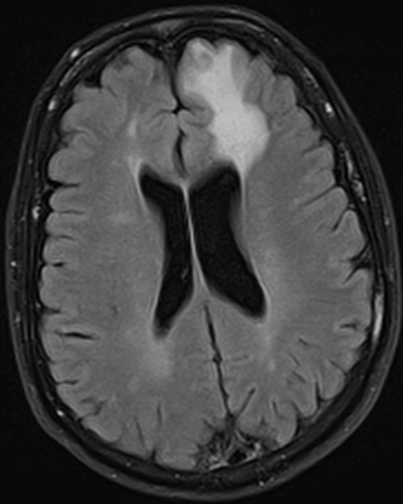
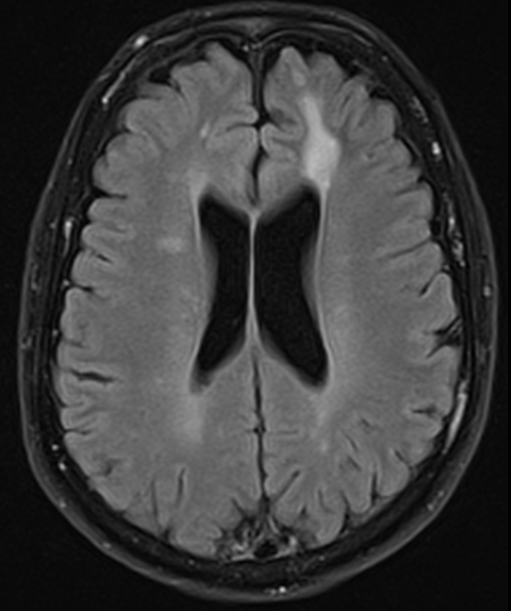
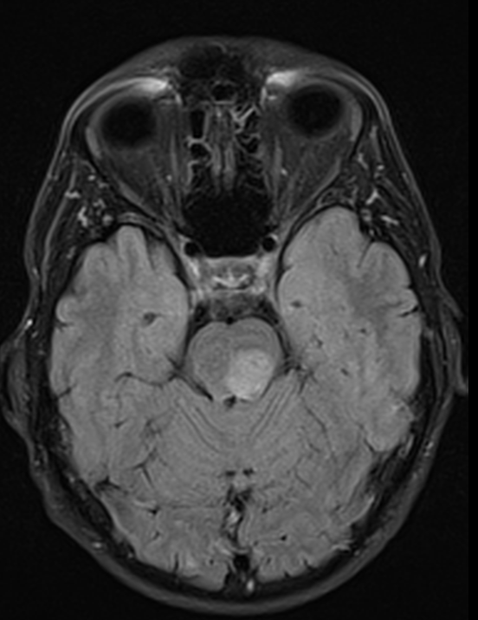
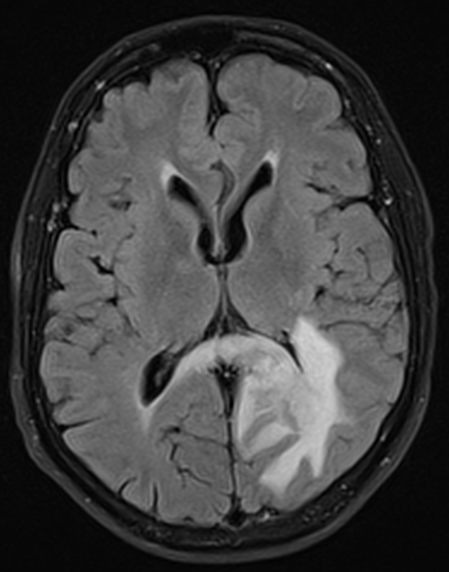
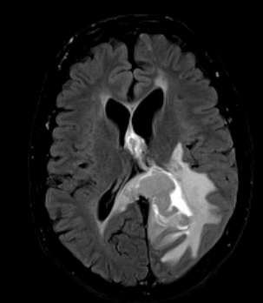
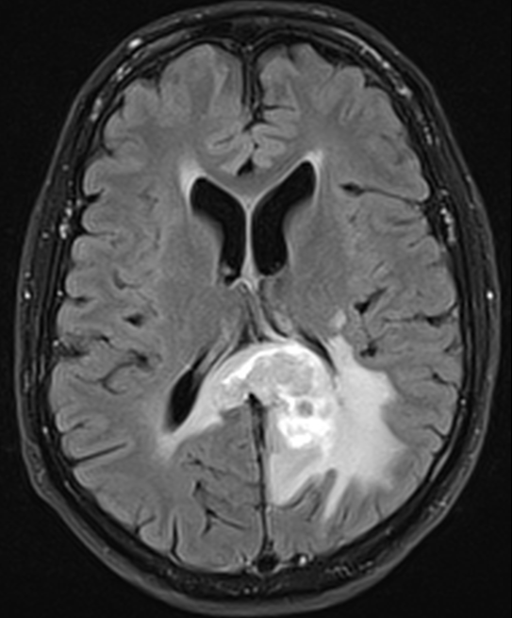
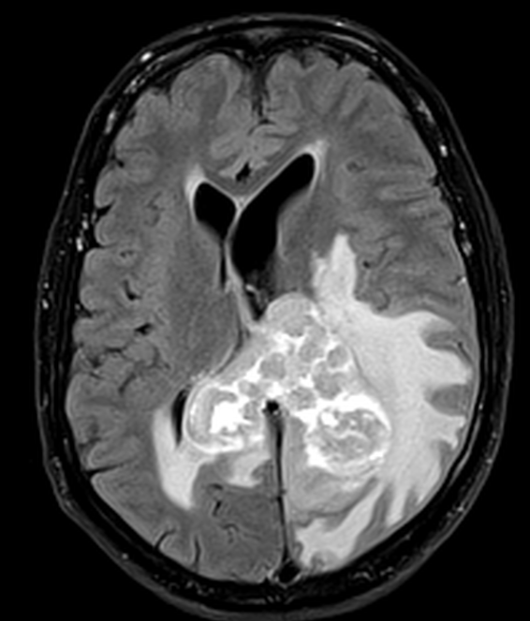
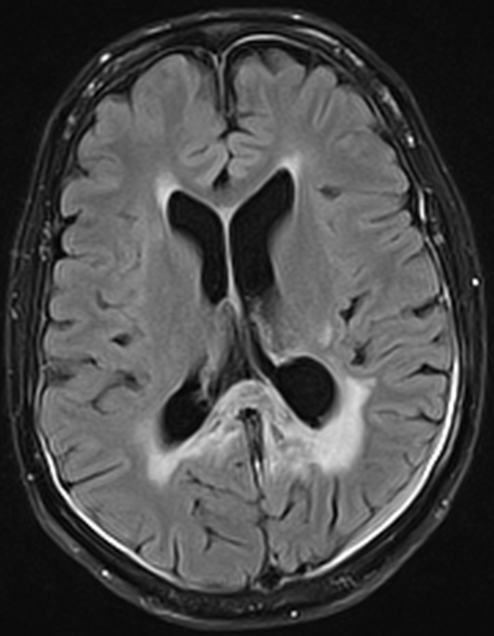
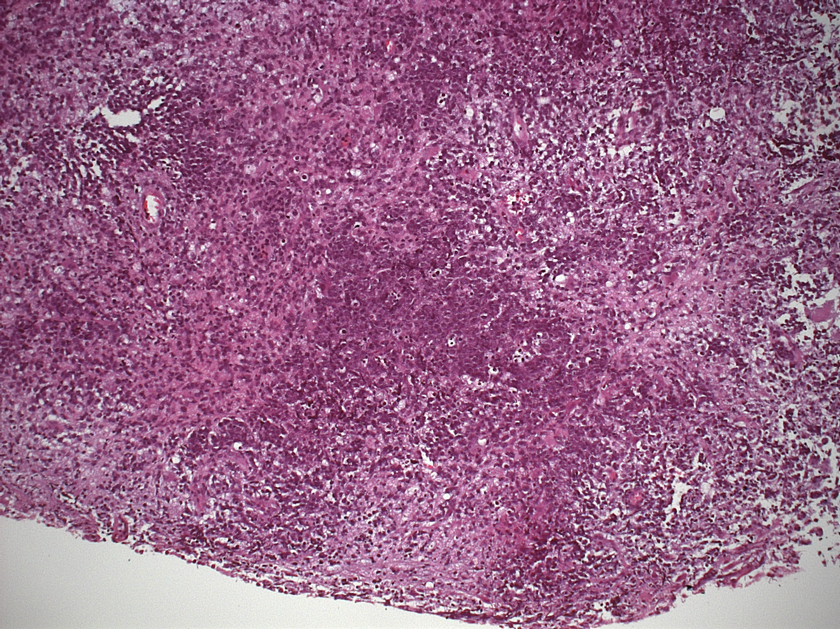
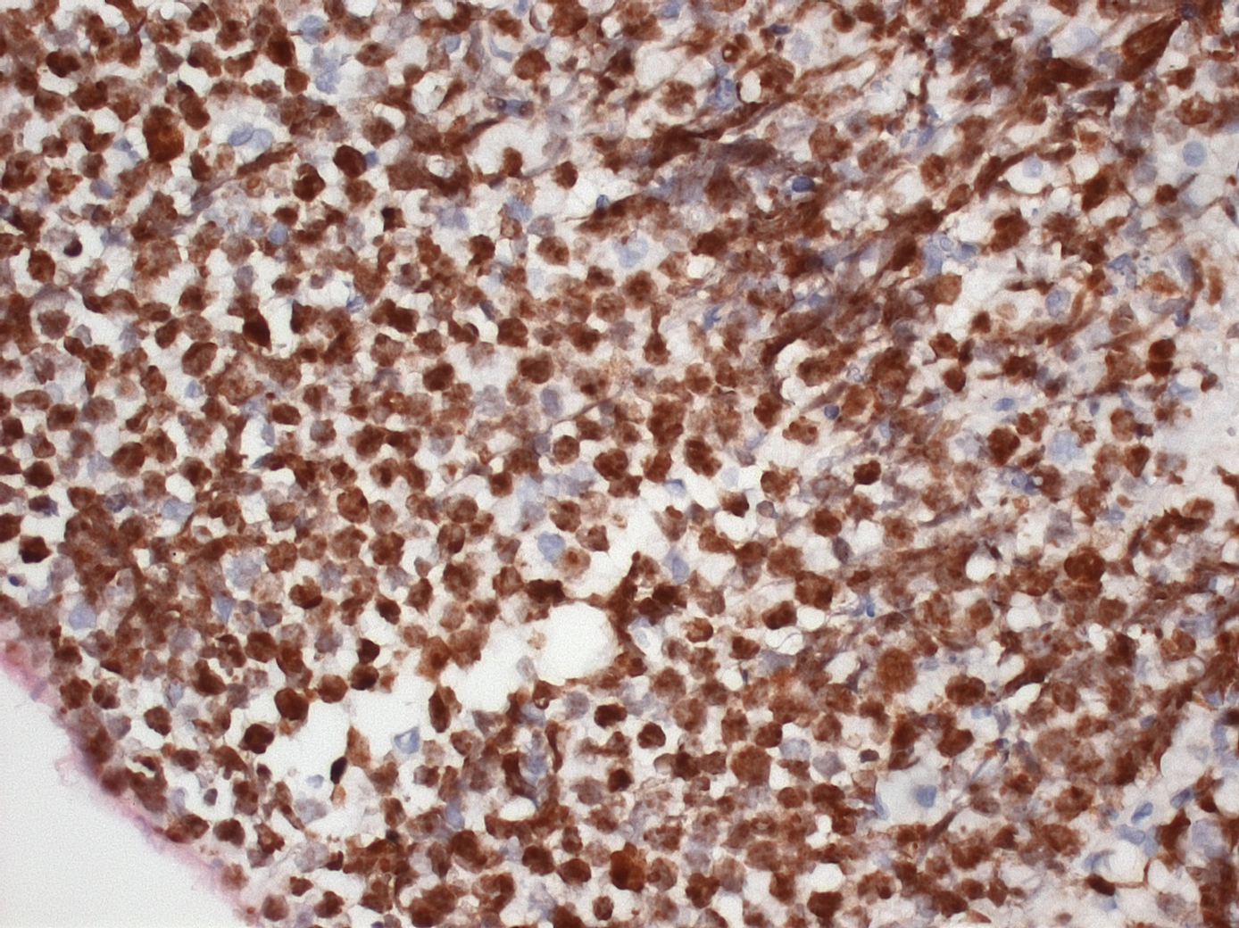
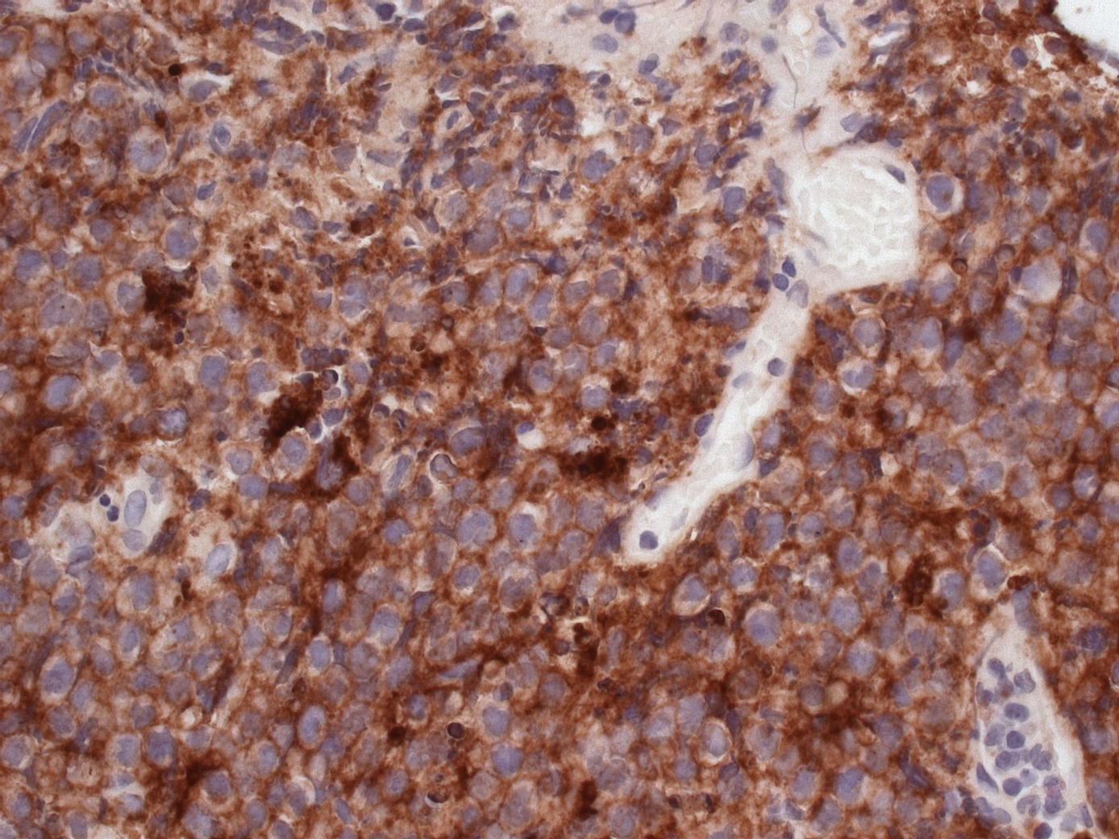
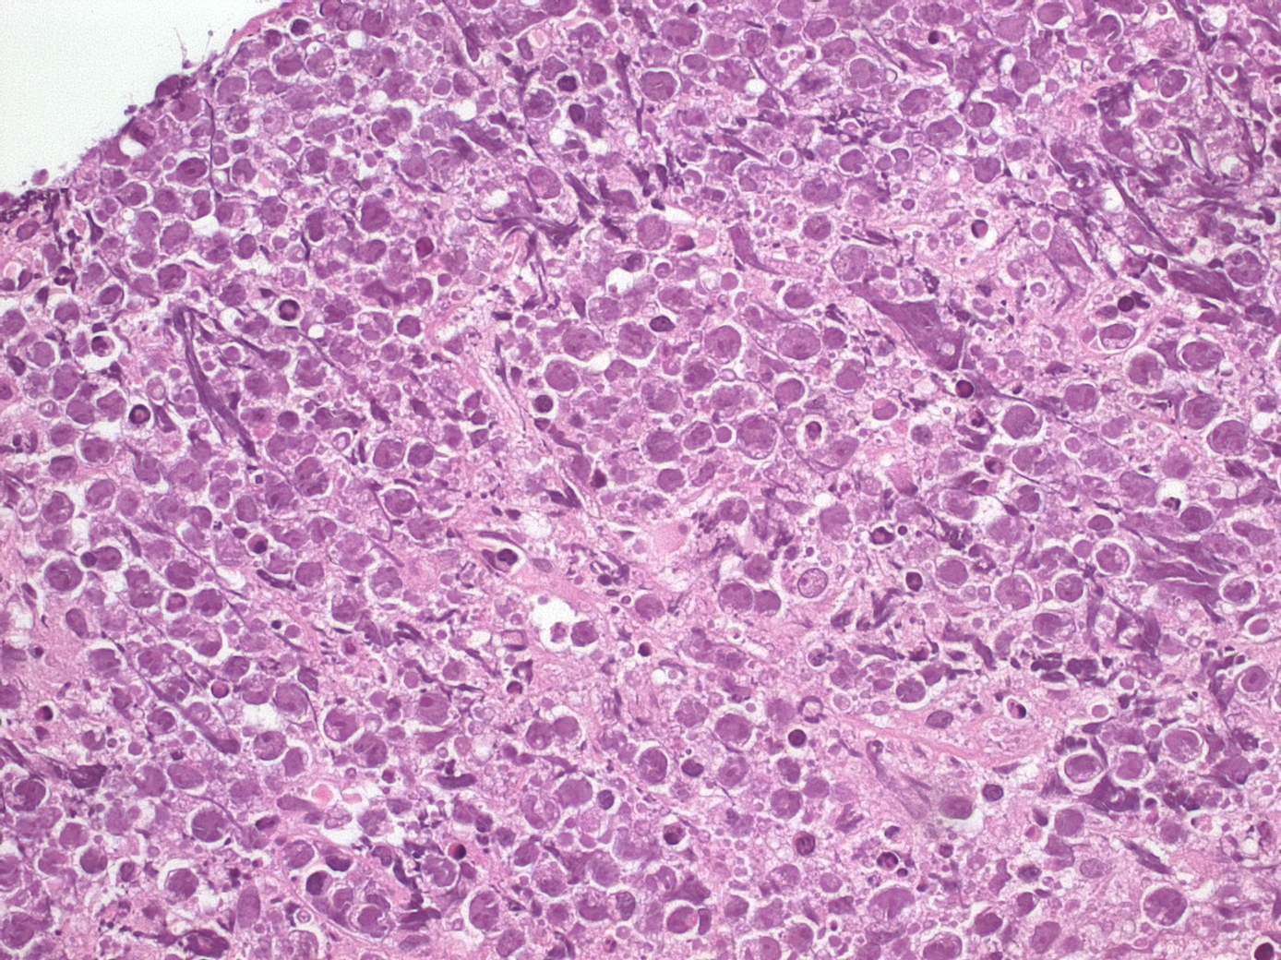
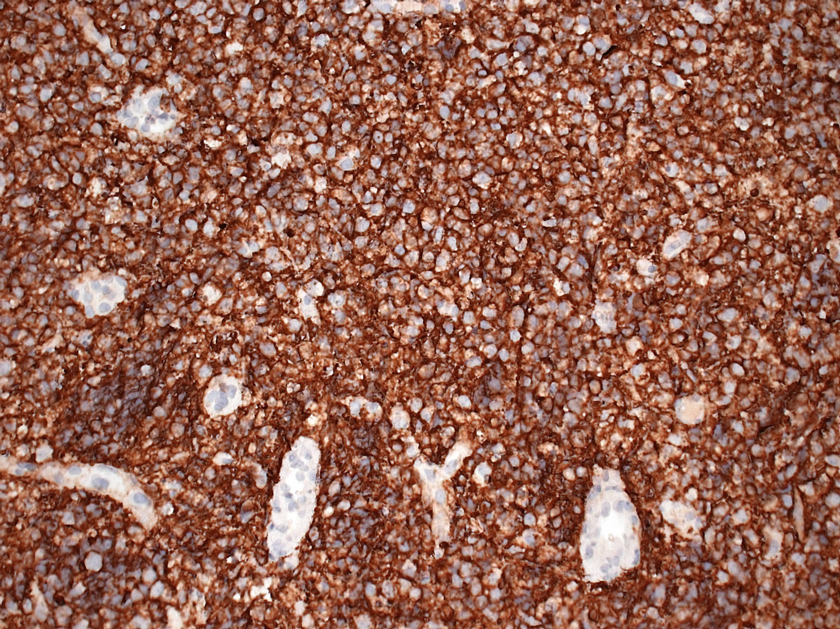
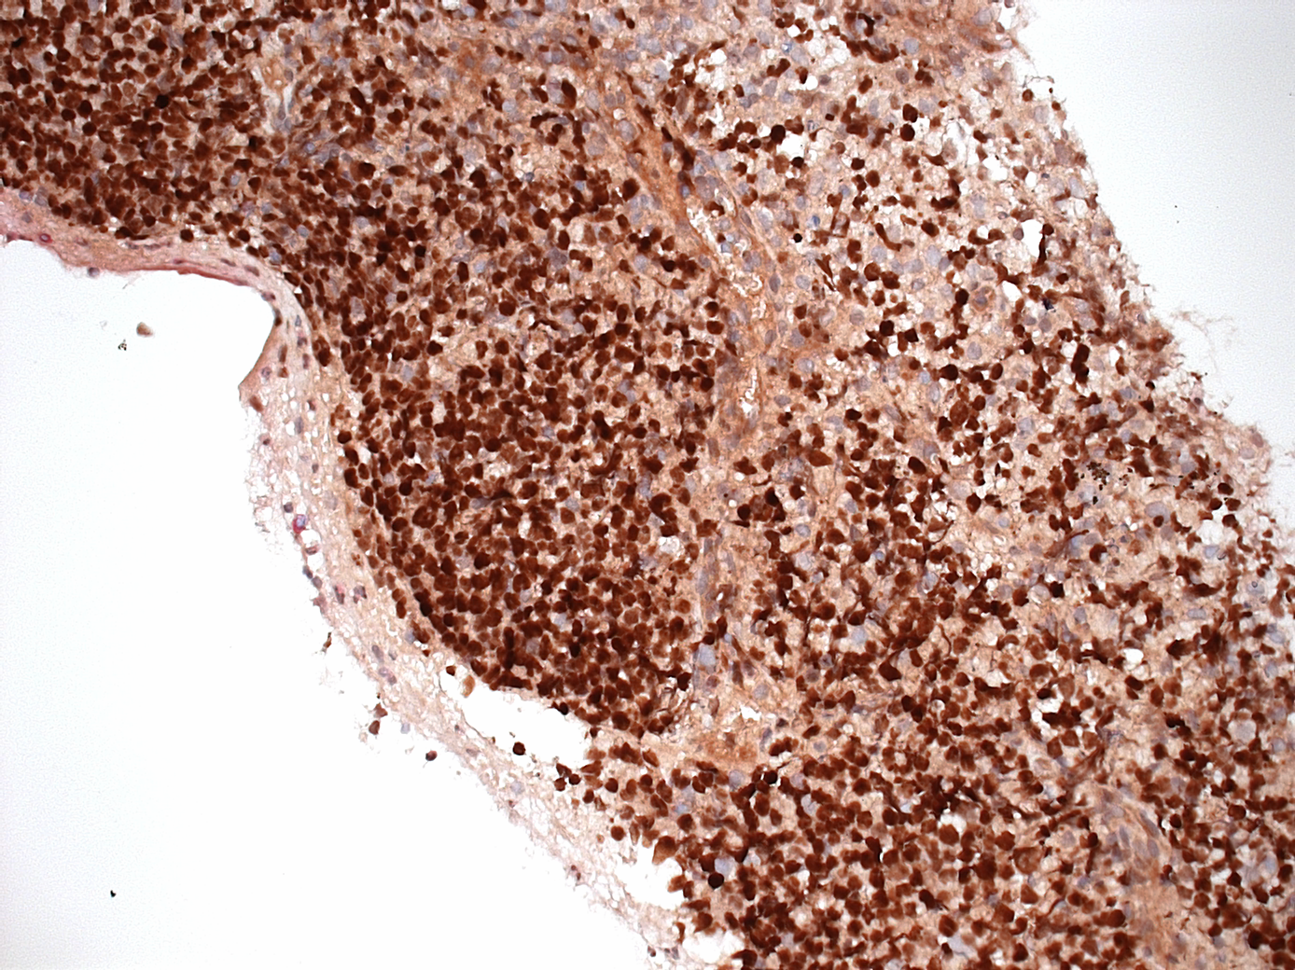
P598
26th Congress of the European Committee for Treatment and Research in Multiple Sclerosis (ECTRIMS)
Gothenburg, Sweden
13 – 16 October 2010
Primary high-grade B-cell central nervous system lymphoma in a patient
with tumefactive multiple sclerosis treated with Natalizumab.
R. Phan-Ba^{1,2}, B. Bisig³, G. Moonen², S. Belachew^{1,2}, M. Deprez³, L. de Leval⁴
1: MYelin Disorders REseArch teaM (MYDREAM) (Liege, BE); 2: C.H.U. of Liege, Department of Neurology (Liege, BE); 3: C.H.U. of Liege, Department of Pathology (Liege, BE); 4: Centre Hospitalier Universitaire Vaudois (Lausanne, CH), Institute of Pathology
Description :
A 40-year-old patient with a 20 year history of “tumefactive” multiple sclerosis (MS) (Figure 1, 2007 and 2008) fulfilling the current diagnostic criteria, who had never benefited of any type of disease modifying therapy was admitted with complaints of blurred vision, headaches and attention disorders. The neurological examination disclosed a mild bilateral loss of vision and pyramidal tract involvement signs, but was otherwise normal. The EDSS was rated at 1.5. The first brain MRI scan (december 2009) displayed a nodular enhancing lesion in the brain stem and a left splenial enhancing lesion with vasogenic oedema and mass effect. A five days intravenous course of corticosteroids was administered. The control MRI scan realised 1 month later (january 2010) showed that the brainstem lesion had disappeared, while the splenial lesion had enlarged. The neurological status had also worsened with serious memory end executive deficits, and a Kurtzke mental functional system score reaching a level of 3. A new intravenous corticosteroids course and a first 300mg natalizumab intravenous therapy were attempted. The 1 month control brain MRI scan (february 2010) displayed marked reduction of the splenial lesion (see septum pellucidum infiltrate regression, arrows), and a second infusion natalizumab was dosed. Due to massive expansion of the splenial lesion on the next brain MRI scan one month after the second dose of natalizumab (march 2010), a stereotactic biopsy was performed. Pathology (Figure 2) revealed a high-grade lymphomatous infiltrate composed of diffuse sheets of medium to large-sized blastic cells, that by immunohistochemistry were CD20+ BCL6+ CD10+ BCL2- IgM+ kappa+, with a proliferation fraction over 95%. Tumour cells were EBV- by in situ hybridization (ISH), and there was no evidence for c-MYC or BCL6 gene rearrangements by fluorescence ISH. Systemic staging was negative. A four course of chemotherapy (two courses of COPADEM-DepoCyte and two courses of R-CYM) was administered, and follow-up MRIs (june) demonstrated a drastic reduction of the lesion’s size (june 2010). The patient is about to start autologous bone marrow transplantation.
2010
2007 2008 December 2009 January February March June


1
HE 100X
Ki67
CD 10
Discussion and conclusion:
Primary CNS lymphoma (PCNSL) is a rare high-grade non-Hodgkin’s lymphoma. In immunocompetent patients, they are almost exclusively of B-cell type with an incidence of 0,3/100 000 between 35 and 44 years of age*. Mortality is high, and recurrence is common despite aggressive chemoradiotherapy. Despite several reports in the literature, no clear association has been drawn between classical forms of relapsing and primary progressive MS and PCNSL to date. However PCNSL can be associated with preceding demyelinating pseudotumoral/tumefactive lesions, as briefly described in several case reports (Alarcia et al., 2000; Alderson et al., 1996; Heckmann et al., 2000; Ng et al., 2007). The ‘sentinel’ demyelinating lesions recede spontaneously or with corticosteroid, and are followed by the diagnosis of PCNSL typically within 6–12 months (Alderson et al., 1996, Ng et al., 2007). It has been postulated that the resolution of the sentinel lesion may represent a host immune response to the lymphoma (Alderson et al., 1996) that could actually be modified by natalizumab. The present case is the second well-documented report of a PCNSL arising in a MS patient treated with natalizumab. Strikingly, even though unusual for a PCNSL, the pathological characteristics of our patient’s lymphoma were very similar to the previous description, with a blastoid morphology and a germinal center-like immunophenotype bringing up the diagnosis of B-cell lymphoma with features intermediate between diffuse large B-cell lymphoma and Burkitt lymphoma. Although the temporal relationship between the events may preclude the causal role of natalizumab in this lymphoma, questions are raised concerning its potential impact on the pathological characteristics of the lesion. This case report also emphasizes the importance to consider PCNSL in patients presenting with space-occupying lesions even with previously confirmed pseudotumoral/tumefactive demyelination.
HE 400X
CD 20
2
BCL 6
References:
Alarcia R, Ara JR, Marta E, Barrena MR, Giménez-Más JA, Capablo JL, Serrano M : Demyelinating pseudotumoral lesion prior to a primary cerebral lymphoma. Rev Neurol, 2000, 31: 955–958.
Alderson L, Fetell MR, Sisti M, Hochberg F, Cohen M, Louis DN : Sentinel lesions of primary CNS lymphoma, J Neurol Neurosurg Psychiatry, 1996, 60: 102–105.
Heckmann JG, Druschky A, Kern PM, Romstöck J, Huk W, Neundörfer B : « Ghost and mimicry-tumour » Primary central nervous system lymphoma. Nervenarzt, 2000, 71: 305–310
Ng S, Butzkueven H, Kalnins R, Rowe C: Prolonged interval between sentinel pseudotumoral demyelination and development of primary CNS lymphoma. J Clin Neurosci, 2007, 14:1126-1129.
Schweikert A, Kremer M, Ringel F, Liebig T, Duyster J, Stüve O, Hemmer B, Berthele A: Primary central nervous system lymphoma in a patient treated with natalizumab. Ann Neurol, 2009, 66:403-406.
*CBTRUS Statistical report (February 2010) : Primary Brain and Central Nervous System Tumors diagnosed in the United States in 2004-2006, http://www.cbtrus.org/2010-NPCR-SEER/CBTRUS-WEBREPORT-Final-3-2-10.pdf.
The authors have nothing to disclose.

