Slide 1
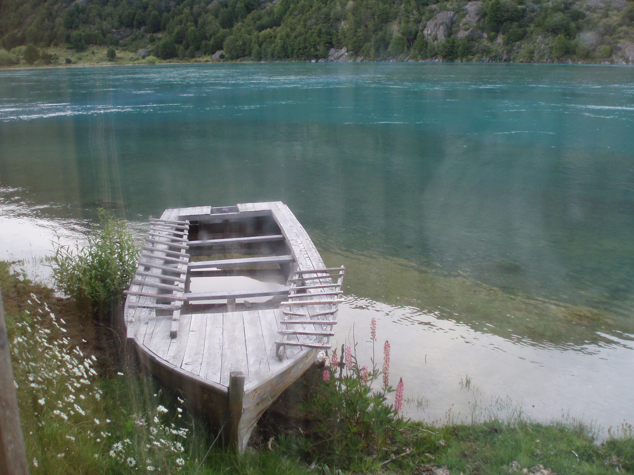




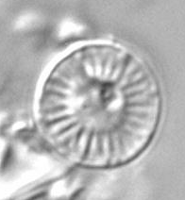
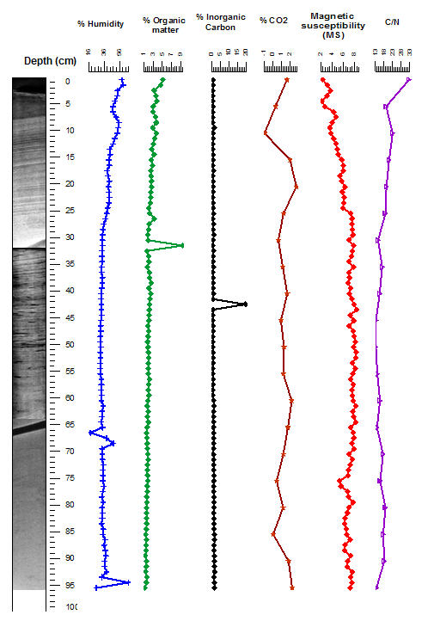
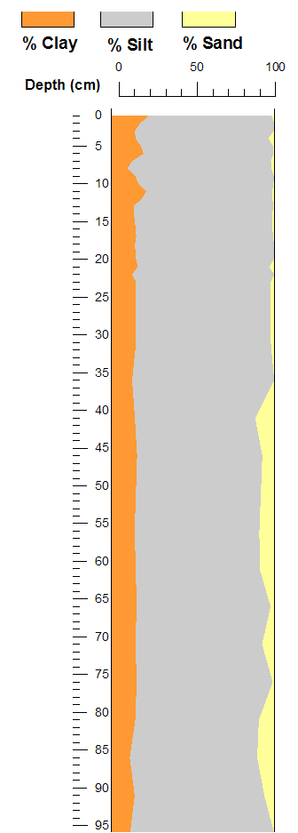
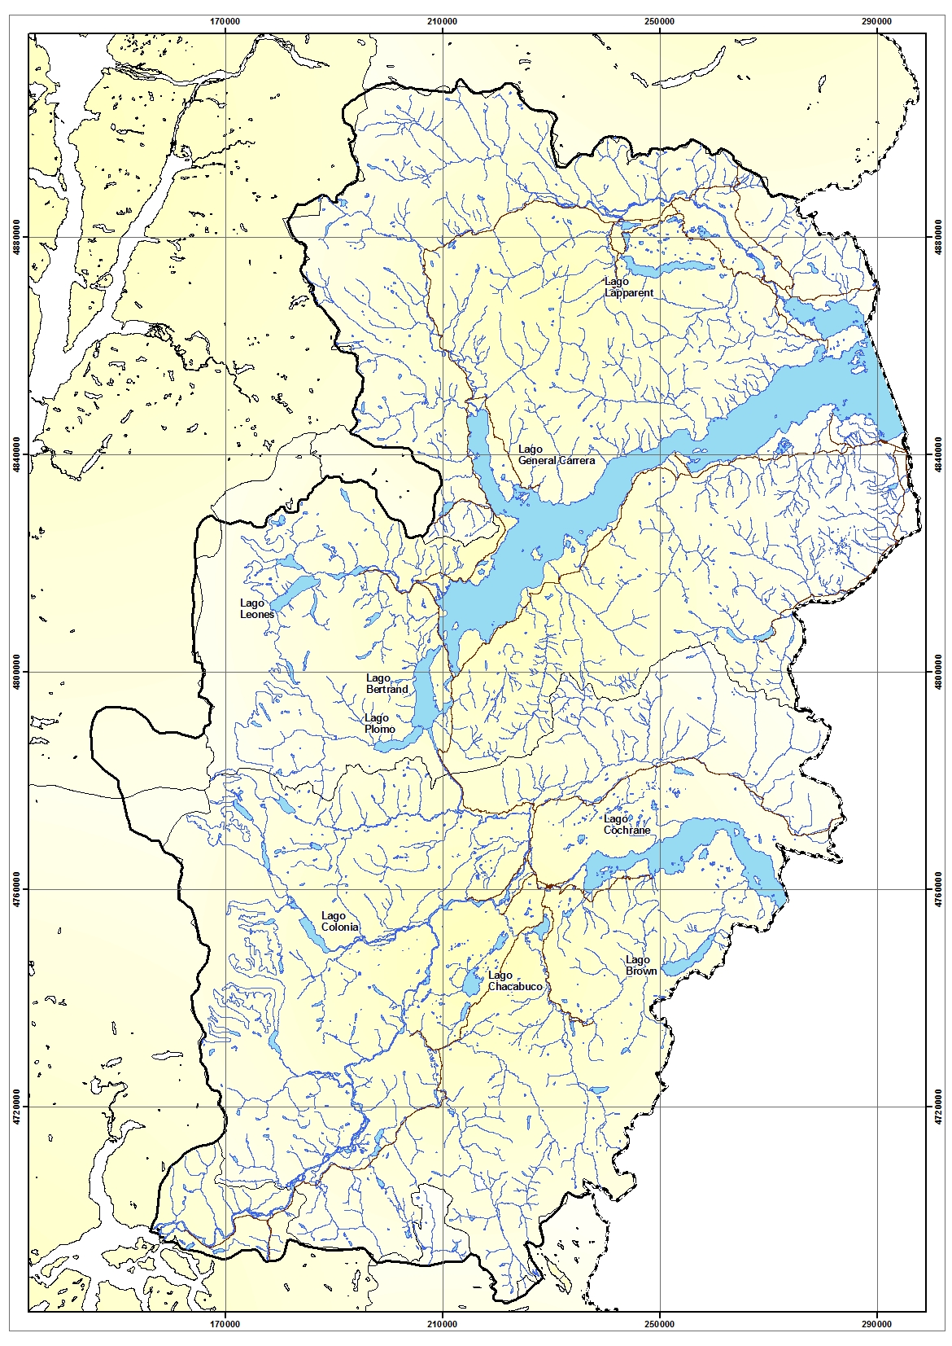
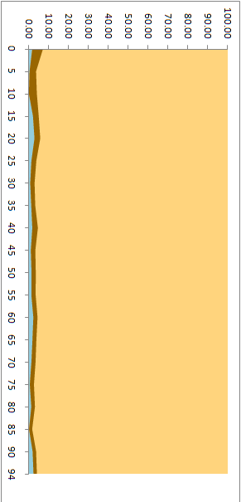
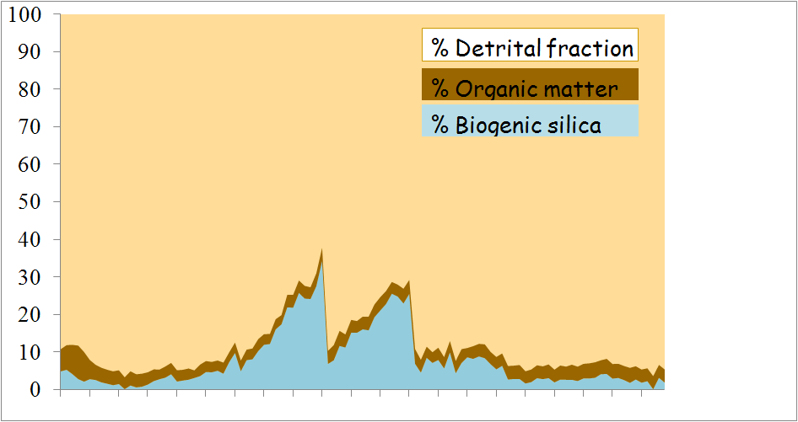
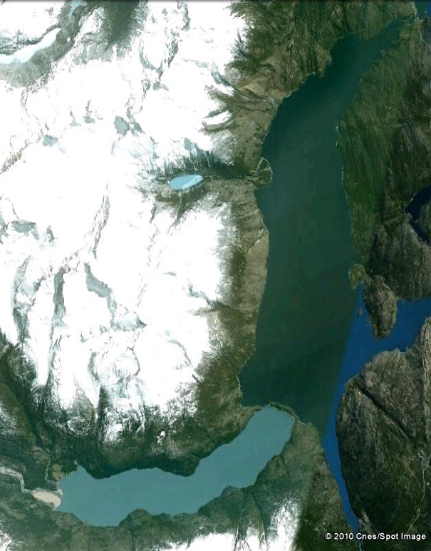
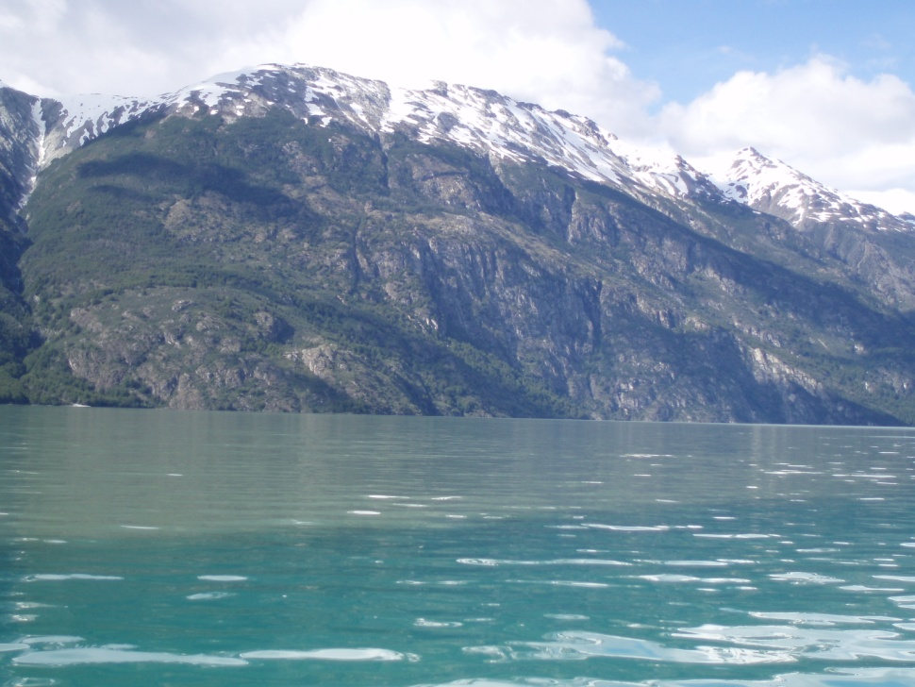
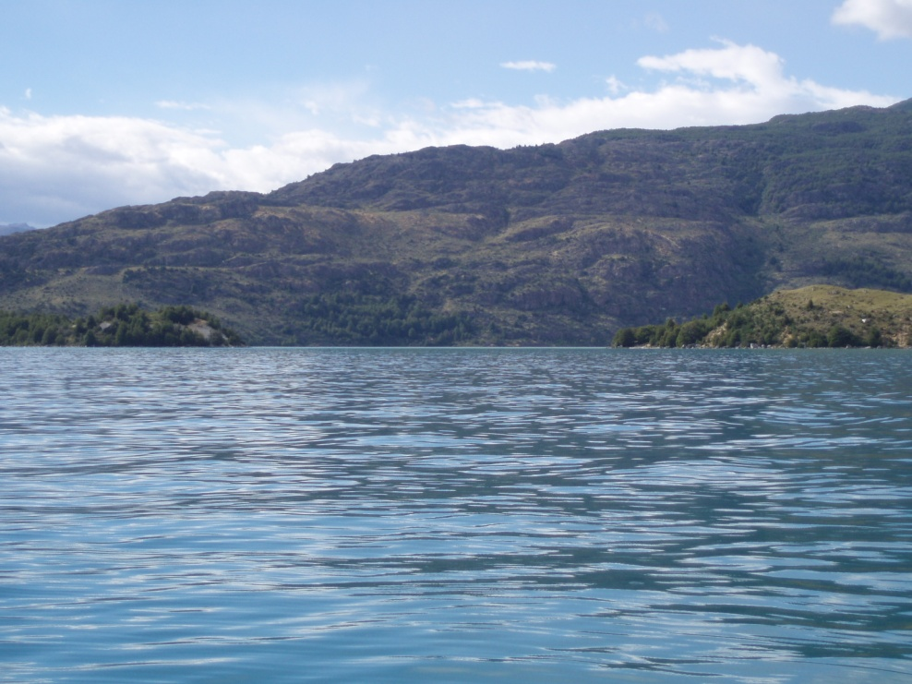
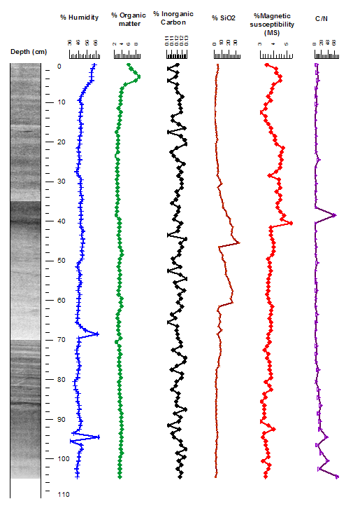
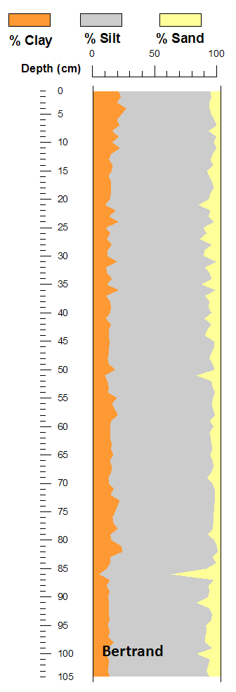
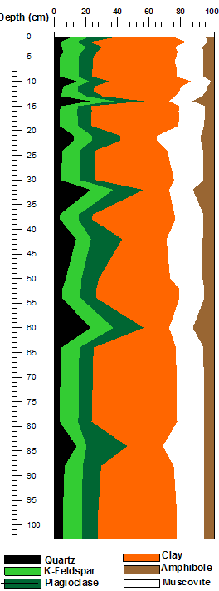
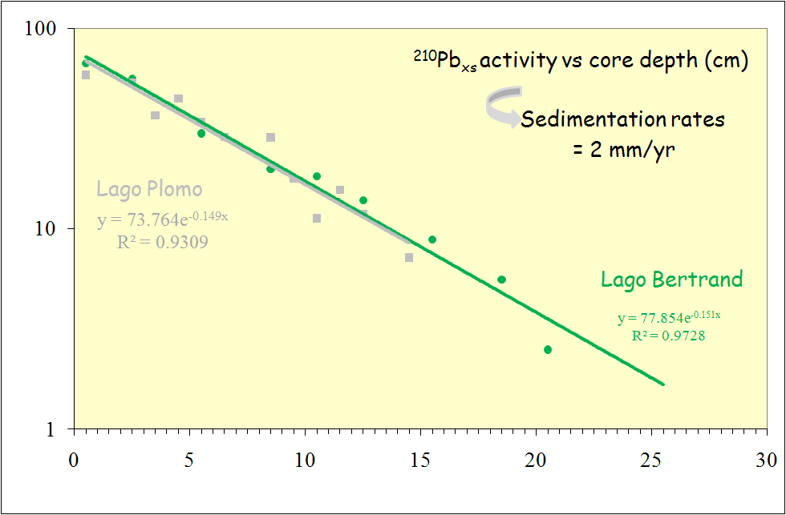
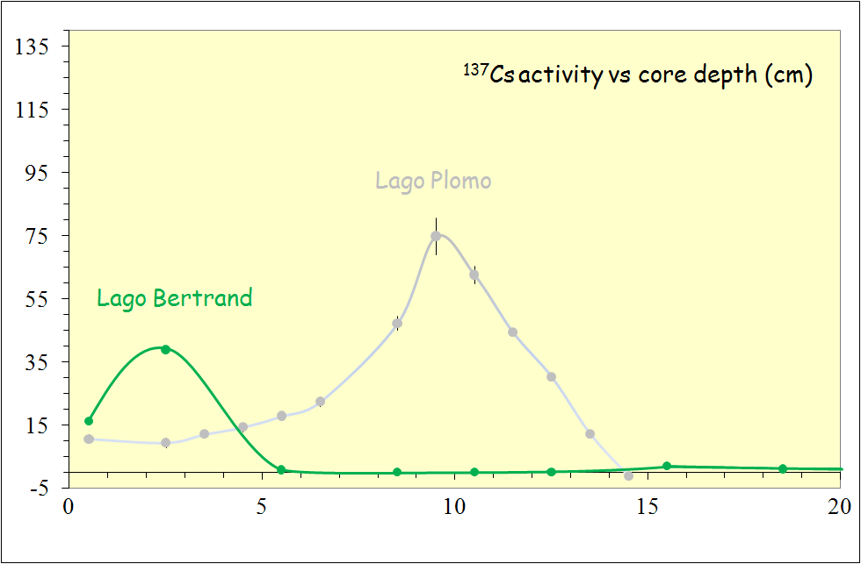
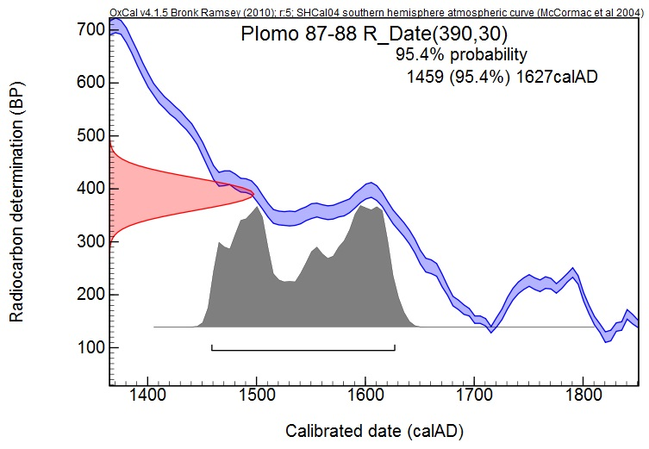
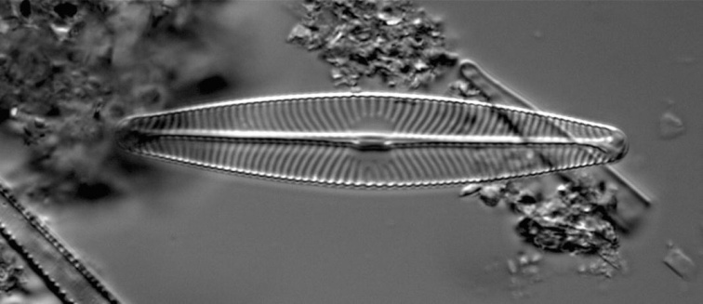
A 500-yr record of Northern Patagonian environmental changes: Lago Plomo and Lago Bertrand
N. Fagel^{1,2}, J. Brix¹, M. El Ouahabi¹, G. Lepoint^{2,} S. Schmidt³, A. Araneda^{4,5} and R. Urrutia^{4,5}
AGEs - Clays, Sedimentary environments and Geochemistry, Department of Geology, University of Liege, Belgium; (2) Marine Research Centre (Mare), Laboratory of Oceanology, ULg, Belgium (3) EPOC, Département de Géologie et Océanographie, Bordeaux, France; (4) Aquatic Systems Research Unit, EULA – University of Concepcion, Chile; (5) Patagonian Ecosystems Research Center (CIEP), Coyhaique, Chile – nathalie.fagel@ulg.ac.be
Aim = to estimate the natural climate variability over the Last centuries in Northern Chilean Patagonia
RESULTS
Lago Plomo
Climate signal?
The varve thickness change over time. Such change may record variations in glacial regime of the adjacant glacial, related to the Northern Patagonian ice field.
Lake Plomo sediments are made by light brown silts with 20% of clay and 5-10% of sand in the lower section.
Radiographies demonstrate that the sediment is finely laminated, rich in organic macro-remains. The C/N ratio is stable, the average value of 15 supports the important terrestrial supply to the lake. The organic content of the sediment, calculated from 550°C loss of ignition, represent a few percents. The biogenic silica content of the sediment, estimated by atomic absorption after NaOH leaching, is very low (<5%). Microscopic slides reveal the sparse occurrence of small 6 to 10 μm diatoms.
Location
We study the sedimentary record of 2 lakes from Chilean Patagonia (46.5°S 72.5°W).
The lake Bertrand is adjacent to the pro-glacial lake, Lake Plomo. The connection between both lakes is limited by a morainic barrier.
0-1 cm: diatom 6 μm
N
32-64 cm
Plomo
Bertrand
Bertrand
Grey level
NNE
Backside
= Plomo
SSW
In Plomo the sedimentary record is dominated by detrital components. The detrital supply does not change over time, neither in composition (mineralogy, C/N) or in size.
Plomo
Moraine
Bulk mineralogy
Lago Bertrand
Bertrand
Material
The coring sites were selected after a bathymetric survey using an echo-sounder. Short cores were retrieved in 2009 using a gravity corer. we conduct a multiproxy study combining sedimentology and geochemistry.
0-1 cm diatom 56 μm
Climate signal? Like in Plomo the detrital supply does not change over time, neither in composition (mineralogy, C/N) or in size.
However the sedimentary record contains a variable contribution of a biogenic component. The biogenic silica profile evidences two peaks (Si bio ~30%) above a 5% background level. They record a two-step increase in the productivity of the lake between ~1700 and 1850 AD.
1850AD
X-ray radiographies from lake Plomo evidences fine ~1 mm laminations over the whole core. In the upper 20 cm ²¹⁰Pb and ¹³⁷Cs data support a constant accumulation range of 2 mm/yr, confirming the seasonal record of the lacustrine record (varves). Radiocarbon ages suggest that the sedimentation does not change significantly for the lower part of the record. A radiocarbon date measured on a macroremain gives a calibrated ages ranging from 1459 to 1627AD at 87-88 cm.
1700AD
Does it correspond to a Little Ice Age-equivalent climate event in North Patagonian Andes?
The sediment is made by homogeneous silts with some clays (< 20%) and 5 to 10% of sand. The low C/N ratio (10) supports an important aquatic productivity. Diatoms are abundant and larger in size (50-100 μm) than in Plomo.
1500AD
For lake Bertrand the sediment is not finely laminated. ²¹⁰Pb data support an average sedimentation rate of 2 mm/yr in the upper 25 cm. However the ¹³⁷Cs peak may suggest a lower sedimentation rate in the upper 5 cm. Radiocarbon dates are in progress.
Conclusion
Our preliminary results evidence the potential of such lacustrine records to reconstruct the Last Millennium climate changes in North Patagonia.
0-1cm: diatom 56 μm
ACKNOWLEDGEMENT - This research is funded by Chilean Fondecyt project number 1070508 and Belgian projects (FNRS proposal 1360 2007-2010, ULg CFRA 1060 2009-2010).

