Slide 1

The French system of control of the sensitive items’ trade: From Security to Competitive Security
Conference « The political responsibility of industrial actors in trade: the blurring of differences between sensitive and classical items’ trade »
Chaudfontaine, 13-15 October 2010
Sylvain Paile
European Studies Unit
spaile@ulg.ac.be

Slide 2
Structure of the presentation:
-The French industrial capacity: risks and opportunities
-The emergence of a « dual-use » culture: legislation and authorities
-Controlled movements
-Controlled items and technologies
-Licenses
-Interaction between authorities and industries
-Jurisdiction and sanctions
-Reflections about potential improvements of the system

Slide 3
The French industrial capacity: risks and opportunities
-Participation to all international export control fora (and technical groups): Zangger, Australia, NSG, CWC, MTCR, Wassenaar… And EU (first implementation in 1994)
-Internally: since 1939 for weapons, 1944 for dual-use
-« Specialist » of risky businesses:
-4th world exporter of weapon and related-equipments (1st-2nd per capita)
-2nd in EU
-8 billion € in 2009 (2008: all exports = 406,1 b€)
A commitment and a culture of export control

Slide 4
Heavy weight actors:
-Thalès (defence, aeronautics, security): 50 countries, 60,000 employees, 12,7b€ (2008)
-Safran (aeronautics & space propulsions systems, defence and security): 50 countries, 55,000 employees, 10,5b€ (2009)
-Areva (nuclear fuel cycle, energy): worldwide 1st, 48,000 employees, 8,5b€ (2009, 60% outside FR)
Industrial flagships of France (also consortia). However, it must not be forgotten the share of the small and medium-size companies: often 1 main product, may not be aware of the risks and export control.
French « spécialités »:
-Almost all categories of items: 1,2,3,5,6,7,9 (satellites and engines)…And 0.
-Estimate of dual-use exports in 2009: 20b€
-2005-3000 licences/year (increasing)
-Very few global licences, no data on transit, little weight of brokering and catch-all
-Breakdown: 55%Wass., 17%NSG, 3%MTCR, 23%Australia, 1%Iran, l-t 1%catch-all

Slide 5
The emergence of a « dual-use » culture: legislation and authorities
-The legislative (regulatory) « package »: 2001 « round » = dual-use and weapons, 2010 « round » = dual-use only
-2010, new structure of the DU export control:
-SETICE/DGDDI (customs’ Ministry) to SBDU/DGCIS (industry’s Ministry): succession + staff… Young but experienced!
-CIBDU (new): inter-ministries procedures = opinions, FA « head »
-Technical ministries: Defence, FA, Environment, Treasure (embargoes)
-SETICE: IIC + DVC + 1236/2005 + military (deposit of demands)
-CPN (Nuclear Policy), etc.
Progressively: an emancipated « dual-use » culture + slide toward « competitiveness »

Slide 6
Controlled movements:
-Definitions of Art.2 428/2009: no real French (not even for customs) specialty
-FR has a merged approach: no distinct regulation for export, brokering, transit (except for weapons)
-Catch-all apply to all movements: importance of CIBDU for comprehensive controls
-No regulatory distinction for intangible transfers: 1 comprehensive rule (+principle of authorisation instead of ban). In the future, perhaps a particular approach (taking care of the difficulties for effective controls) but at the moment, precaution prevails (SBDU)

Slide 7
Controlled goods:
-Complete alignment on annexes of 428/2009
-Exception: cryptology items (cat.5 part2): licences given by ANSSI (not SBDU) + licence required for intra-community transfers (further than Art.22§9)
-Powder explosives: SBDU if civilian, SETICE if military
-Intangible goods (technologies): regulation to come?
-Torture items (1236/2005): SETICE for deposit of licence files
-More items controlled: « tear gas and anti-insurrection agents » and « helicopters and their pieces » (through an advice to exporters) = licences « 02 ». SBDU receipts applications (technical ministries). May be linked to « torture » concerns.

Slide 8
Licences:
-Individual and GCEA (on behalf of European authorities): nothing specific
-Global: little use in FR (see ICP)
-General: industrial items, chemical products, graphite, some GMO biological products (not the same countries of destination, FR territorial specificity) + licences 02 (“avis” instead of “arrêtés”)
-FR involved in the discussions for a General CEA in the European corpus: 6 directions are proposed (safe countries, low-value of an export, fixing/replacing, shows, calculus, telecommunication, chemical materials). This would also include brokering and transit.

Slide 9
Interaction between authorities and industry:
-Global « information » mission of the SBDU: enhancing interaction (notably / classification of items & tech.), communication (intangible transfers, forthcoming website incl. Descriptions of procedures and forms to become familiar with)
-The forms (CERFA): fully aligned on Annex III.
Not yet finalised for « 02 ».
General licences: 5 conditions that the exporter undertakes to respect
Other (trade-related) documents needed (trade register proofs)
End-User Certificate: a CERFA + commercial documents
IIC & DVC: a CERFA
-Customs procedures (separate): possible indirect links with authorisation… more difficulties for industries?

Slide 10
Interaction between authorities and industry:
-ICPs: -Evolution from 2001 to 2010: from « tend to the responsibility » to « shall undertake »
-Mean to « assure a first control of the respect of the principles driving the export of dual-use items and technologies »
-ICP must be finalised and presented before application for authorisation (kind of registration?)
-Responsibility for effectiveness of the ICP is the responsibility of the SBDU
-5 criteria listed in the legislation
-Timelines and delays: -nothing in the legislation
-9 months silence procedure (denial)
-In practice: average between 24h and 2 months
-Lack of predictability for the industries(?)

Slide 11
Jurisdiction and sanctions:
-Control of trans-boundary movements = customs (investigation, characterization, sanctions)
-Weapons (and material) and DU civil & mili.: police, gendarmerie and customs means
-Exporting, brokering or transiting without licence = custom offence: 3y imprisonment, seizure of the item, transport means, collateral objects, fine (1-2 times the value of the fraud)
-If criminal (trafficking): 10-30 months imprisonment, fine (150-450,000€). Criminal offence to be found in the chapter « fundamental interest of the Nation » in the Code Pénal.
-At the time being, communication with other MS remains informal: intelligence and diplomacy

Slide 12
Sources for improvements:
-Timelines (main concern for industries):
-Now: GCEA is quickest, global and general may take time (possible inter-ministries), rarely more than 2 months
-Industries want predictability and to include timelines in the legislation
-Objective (SBDU): 1 month (but issues linked to registration)
-Information mission of SBDU: prospects for an advisory section (classification)?
-Proposition from (major) industries: application to them of a registration instead of a list-based controls. Objective: smoother trade, notably between companies of the same group + technological cooperation.
Somehow similar to ICPs required for global licences
Already an « Accredited Economic Operator » status in custom procedures…

Slide 13
Sources for improvements - the growth of the SBDU:
-SBDU is improving information and interaction with industry (also public, students)
-It is finalising its transition process (from 4 to 18 agents)
-Looks forward to interacting more with other MS’ authorities
-Pushing for ICPs’ implementation
-Aims at reducing delays
-Achieving the dematerialisation of procedures (authorisation and custom in parallel)
-The 2010 package implemented and structured inter-ministries procedures
A young but experienced structure, relying on a culture of the export control (more and more focused on DU), but the transition from « security first » to « security = competitiveness » needs time and discussions.

Slide 14
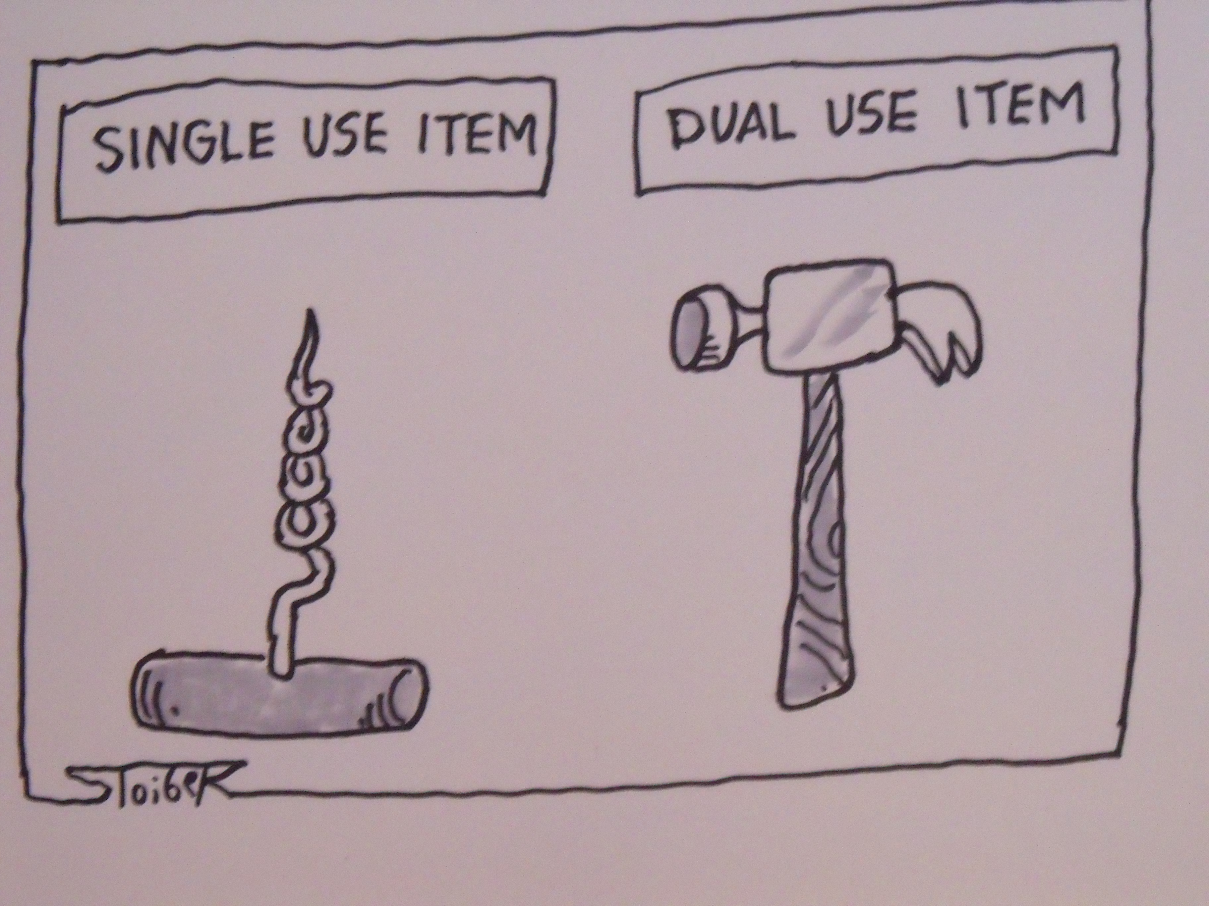
Thank you for your attention! Questions?

