Slide 1
Eurocodes applied to fire scenarios From a fire scenario to dimensioning jm.franssen@ulg.ac.be

Slide 2
What are the Eurocodes?
A series of textbooks
containing recommendations
for calculating
the stability
of building structures

Slide 3
Redaction started in 1975, the Eurocodes were written on a voluntary base (by professional associations) with the support of the C.E.C., then a mandate was given to CEN in 1989.
Eurocodes (circa 1990)
prENV
ENV (circa 1995) + National Application Documents
prEN
EN (circa 2000-2005) +National Annexes

Slide 4
On a voluntary base
Because of a contract
Because of a law
On a voluntary base
Because of a contract
Because of a law
Requirements
Utilisation of the Eurocodes
Fire resistance = ….

Slide 5
Because of a law
Which law?
Basis norms
Annex 2 (low rise buildings)
Annex 3 (middle rise buildings)
Annex 4 (high rise buildings)
Annex 6 (industrial buildings)
Regional decrees
Etc
Requirements

Slide 6
On a voluntary base
Because of a contract
Because of a law
On a voluntary base
Because of a contract
Because of a law
Requirements
Utilisation of the Eurocodes
Fire resistance = ….

Slide 7
Which law ?
Because of a law
Article 2 of Annex 1 of Basis Norms.
Utilisation of the Eurocodes

Slide 8
The fire resistance of a building element can be demonstrated,
either by a fire test (used to be NBN 713-020, now EN’s)
or by a calculation method approved by the Ministry of Interior.
As of today (October 2010), there is no approved method.
The following situation might be adopted:
Approved method = Eurocodes
For tabulated data, calculation can be made by the person responsible of the stability under room temperature.
For simple calculation models: either the designer is approved, or the calculation is checked by an approved organisation.
For general calculation models (F.E.) or utilisation of any natural fire curve: Derogation Commission.

Slide 9
Which law ?
Because of a law
Article 3.1 of Annex 6 of Basis Norms.
Utilisation of the Eurocodes

Slide 10
Eurocode number | Ambient canditions | Fire conditions
Basis of design | EN 1990 | -
Actions | EN 1991-1-1 | EN 1991-1-2
Concrete structures | EN 1992-1-1 | EN 1992-1-2
Steel structures | EN 1993-1-1 | EN 1993-1-2
Composite steel-concrete structures | EN 1994-1-1 | EN 1994-1-2
Timber structures | EN 1995-1-1 | EN 1995-1-2
Masonry structures | EN 1996-1-1 | EN 1996-1-2
Geotechnical design | EN 1997 | -
Earthquake resistance | EN 1998 | -
Aluminium alloy structures | EN 1999-1-1 | EN 1999-1-2

Slide 11
From fire scenario to dimensioning: general layout
Mechanical loads
in the fire situation
Fire Scenario
M, N, V
T = f(x,y,z,t)
Thermal calculation
Design method
R = x minutes
Mechanical calculation

Slide 12
Eurocode number | Ambient canditions | Fire conditions
Basis of design | EN 1990 | -
Actions | EN 1991-1-1 | EN 1991-1-2
Concrete structures | EN 1992-1-1 | EN 1992-1-2
Steel structures | EN 1993-1-1 | EN 1993-1-2
Composite steel-concrete structures | EN 1994-1-1 | EN 1994-1-2
Timber structures | EN 1995-1-1 | EN 1995-1-2
Masonry structures | EN 1996-1-1 | EN 1996-1-2
Geotechnical design | EN 1997 | -
Earthquake resistance | EN 1998 | -
Aluminium alloy structures | EN 1999-1-1 | EN 1999-1-2

Slide 13
From fire scenario to dimensioning: general layout
Mechanical loads
Fire Scenario
M, N, V
T = f(x,y,z,t)
Design method
R = x minutes

Slide 14
From fire scenario to dimensioning
Method 1: Tabulated data
P_{d,fi} ⁼ G_{k} ⁺ 0.5 q_{k,1}
ISO fire
Load ratio m_{fi} = p_{d,fi} / p_{d}
T = f(x,y,z,t)
Tabulated data
Element by element
R = x minutes

Slide 15
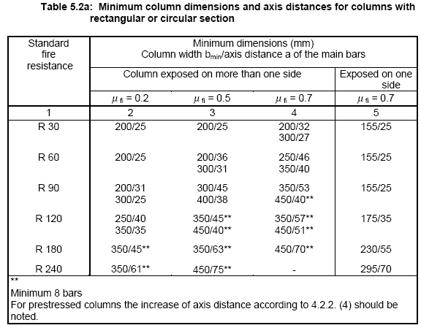

Slide 16

From fire scenario to dimensioning
Method 2: Simple calculation model
P_{d,fi} ⁼ G_{k} ⁺ 0.5 q_{k,1}
ISO fire
M, N ,V at t = 0
T = f(t)
Simple calculation model
Element by element
R = x minutes

Slide 17
From fire scenario to dimensioning
Method 3: Advanced calculation model
P_{d,fi} ⁼ G_{k} ⁺ 0.5 q_{k,1}
Any fire
M, N ,V at t = 0
T = f(x,y,t)
Advanced calculation model
For the whole structure
R = x minutes

Slide 18
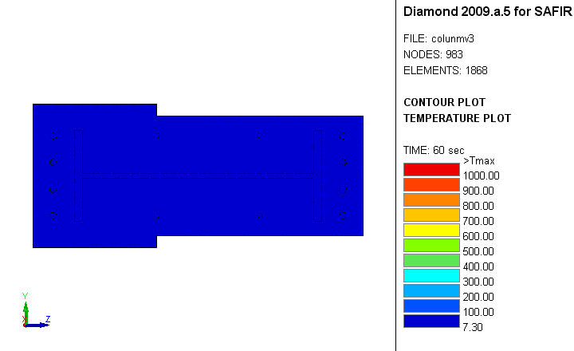

Slide 19
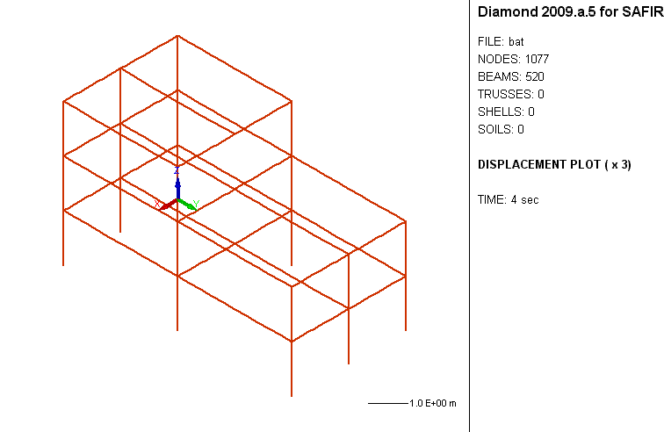

Slide 20
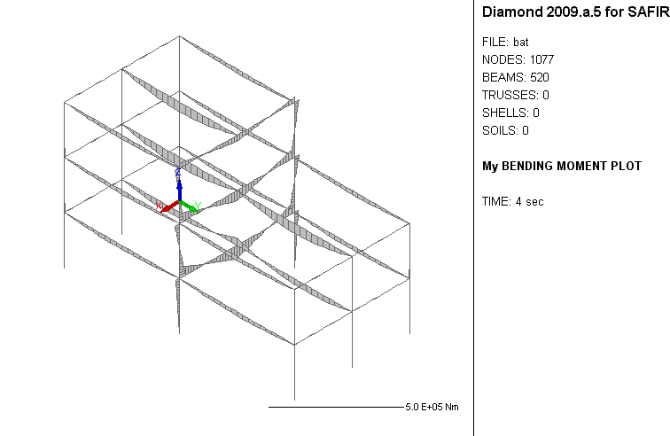

Slide 21

Thank you

