Slide 1


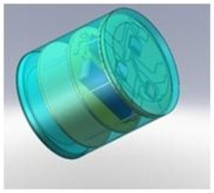
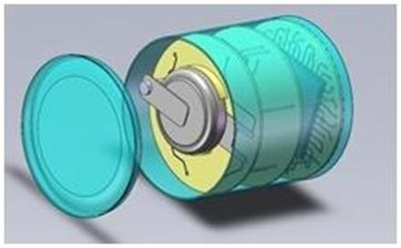


Micro-multi-sensor platform for industrial processes monitoring
Michel Saint-Mard, Managing director, TAIPRO Engineering SA, Angleur, Belgium
Dr. Serguei Stoukatch*, Senior Scientist, Microsys Laboratory
Bruno Heusdens*, Project Engineer, Microsys Laboratory
Prof. Jacques Destiné*, Professor at Electronics, Microsystems, Measurements, and Instrumentation Department,
*University of Liege, Liege, Belgium
Introduction
Because of a recent progress in microelectronics towards functionality, miniaturization and cost reduction, many industrial processes can be monitored in an accurate and cost effective way. Up to now there is no a standard or a common platform to design and to manufacture the monitoring systems for industrial processes. In response to that, Taipro Engineering with the support of the Microsys lab (University Liege) are designing a micro-multi-sensor-platform. The platform is a development tool for rapid integration of different existing sensors in one miniaturized (<1cm3) autonomous device. The system is capable to acquire, to process, and to transmit the data’s to the standard receiver.
The micro-multi-sensor platform for smart systems design
Energy harvesting
Photovoltaic
Thermal
Vibration
RF
Hybrid
Power Management
System Power
Wireless interface
Figure 1: Conceptual model of autonomous smart microsystem designed using TAIPRO and Microsys lab micro-multi-sensor-platform.
Energy Storage
Compact long life battery
Microcontroller
Environment
Information
Sensors
Temperature
Pressure
Vibration
Commercial
receiver
The micro-multi-sensor platform is a development tool for:
rapid integration of different (in terms of functionality) existing, off-the-shelf sensors and components in one miniaturized (<1cm3) autonomous device. The sensors and components can be processed by different technology and can have different package format, including non-packaged sensors in a form of a bare die.
Objectives
We are designing the fully functional prototype of the miniaturized (<1cm³) autonomous device for the industrial process monitoring. The device comprises:
a temperature (-10…150°C) sensor
pressure (1…10 bar) sensor
vibration sensors(0…100 kHz, up to 5g acceleration)
a logic element to control the sensors
data’s processing unit and a local memory
a wireless transmitter to send the information to the receiver
a power block to provide the autonomy for the miniaturized device.
Figure 2: The smart system 3-D view
The receiver is a standard PC that processes and stores the acquired information. The life cycle of the monitoring system is designed equal to life cycle of the equipment. The smart system meets standard industrial operational conditions specification.
Conclusion
The micro-multi-sensor platform developed by TAIPRO with the support of the Microsys is unique open construction tool box to design a smart microsystem for broad variety industrial process monitoring. Use the micro-multi-sensor platform helps your company to concentrate on your core business competence and results in lower cost of ownership and shorter time to market smart microsystems.
Microsys supported by: Le Fonds Européen de Développement Régional et la Région wallonne investissent dans votre avenir
Copyright : M. Saint-Mard.

