Slide 1


Analysis of simple connections in steel structures subjected to natural fire
Academic year 2009-2010

Slide 2
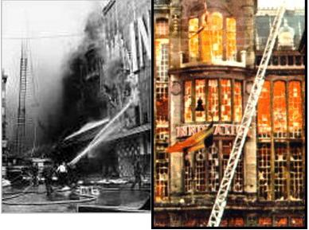
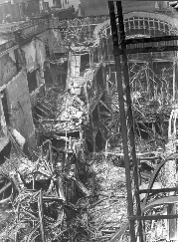
1. Introduction
Fire in a building cause deaths and destruction of goods (Department Store « Innovation », 1967).
Division of buildings in compartments
Three types of criteria should be fulfilled : insulation, integrity and resistance.

Slide 3
1. Introduction
90’s : fire research focused on the single elements.
Then, global behaviour of steel structures without focusing on the behaviour of connections because :
a) Exposure of joints to fire is lower than for beams and columns.
b) More material is concentrated in the joint zone
Conclusion : A same level of fire protection for joints and structural elements was considered as sufficient

Slide 4
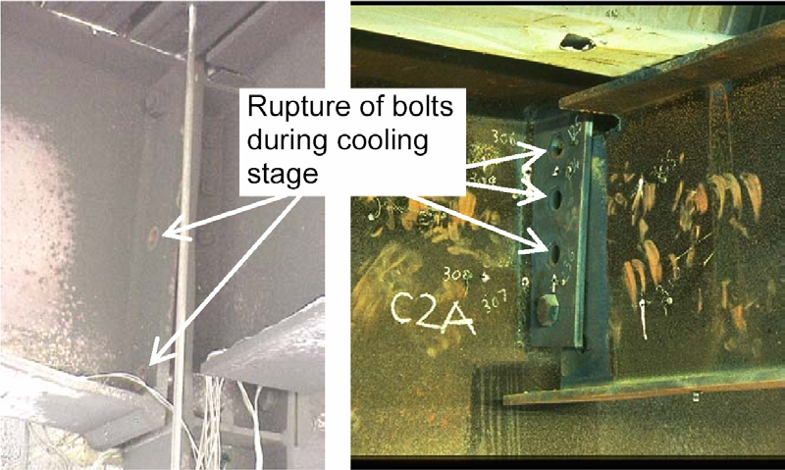
1. Introduction
Cooling phase : key issue for the fire resistance of steel structures (WTC, Cardington, Coimbra tests,…)

Slide 5
1. Introduction
Origins of failures in connections during cooling
Development of tensile forces due to axial restraints and plastic deformations
Limited ductility of bolts and welds components when joint resistance is not sufficient
Bolts and welds strengths under fire decreases faster than the carbon steel strength

Slide 6
1. Introduction
Previous work on steel connections (Heating)
Behaviour of bolts and welds at elevated temperatures (Riaux, Kirby, Latham)
Behaviour of bolted joints (Wainman, Universities of Manchester and Sheffield)
Investigations about the influence of connections behaviour on the performance of beams under fire (University of Manchester)

Slide 7
1. Introduction
Previous work on steel connections (natural fire)
7th Cardington test
Investigations on rigid and semi-rigid connections under natural fire (University of Coimbra)
The objective of the present work is to focus on the behaviour of simple steel connections (and of connected beams) under natural fire.

Slide 8
Overview of the thesis
Introduction
Distribution of temperature in joints
Prediction of internal forces in steel joints under natural fire
Experimental tests and models for the behaviour of connection components under heating/cooling
Experimental tests and numerical investigations for the mechanical behaviour of steel connections under natural fire
General conclusions and perspectives

Slide 9
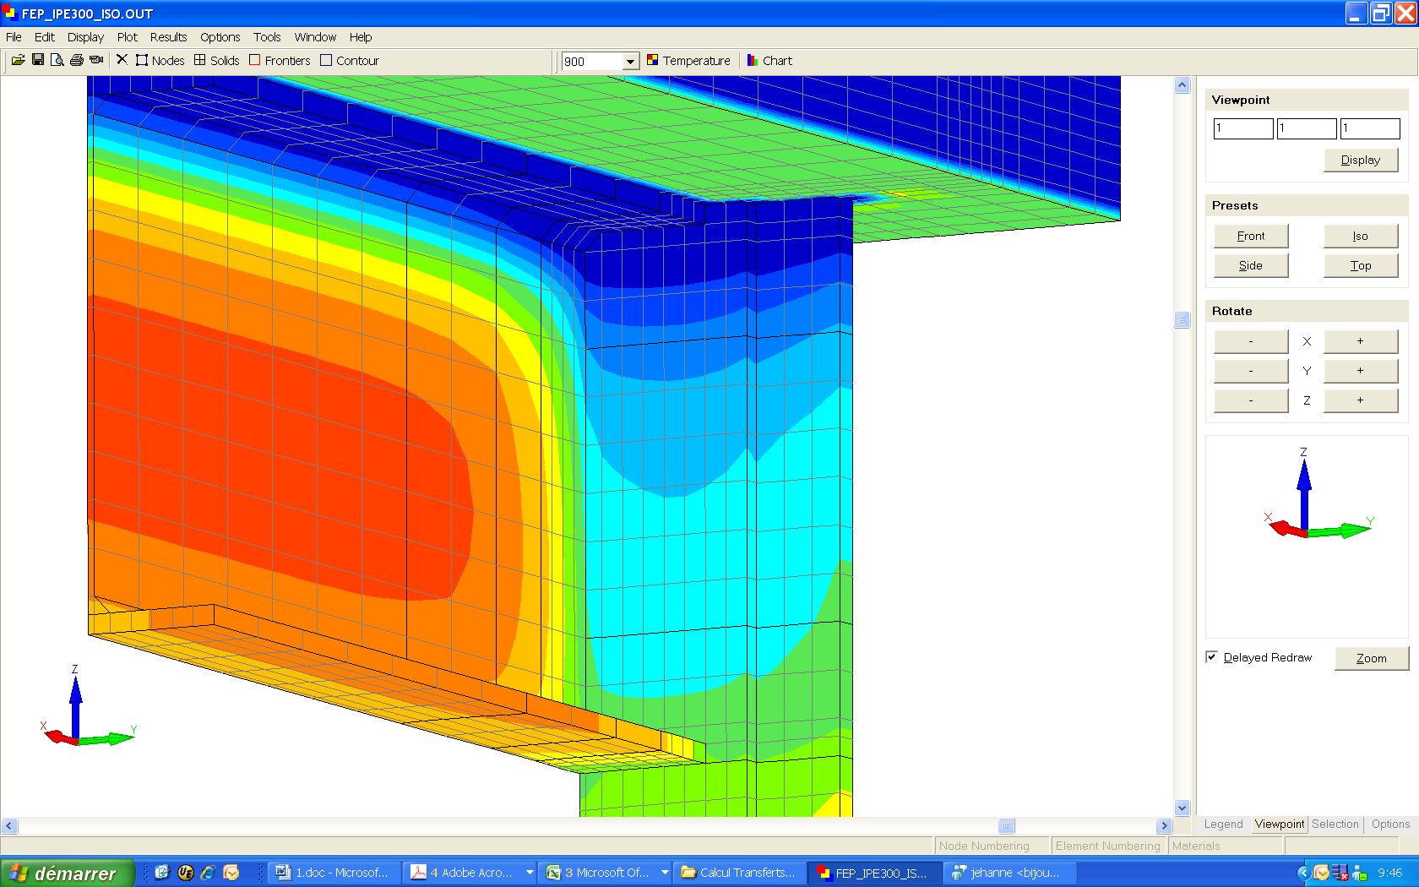
Part 2
Temperature in joints of a steel structure during a natural fire
Academic year 2009-2010

Slide 10
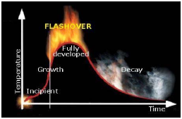
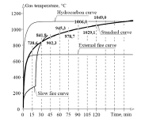
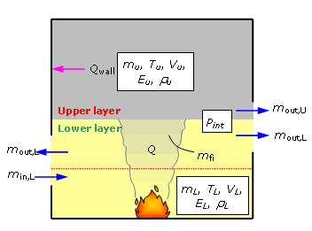
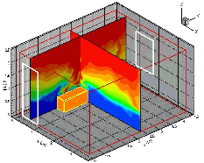
2. Distribution of temperature
Time-temperature curve divided in four stages
Analytical models, Zone models and Field models to predict the distribution of temperature of the compartment

Slide 11
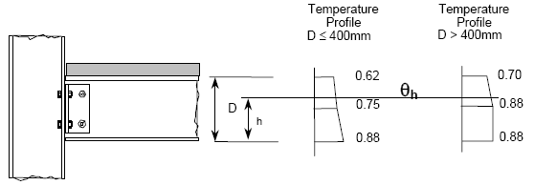
2. Distribution of temperature
Prediction of temperature : steel members and joints
Lumped Capacitance Method for steel members (EN 1993-1-2 and EN 1994-1-2) + joints (Annex D of EN 1993-1-2)
Temperature profile of joints covered by a concrete slab (EN 1993-1-2)

Slide 12
2. Distribution of temperature
Assumptions of the Lumped Capacitance Method
Uniform temperature in the zone considered
Heat exchanges between the steel section and the concrete slab are not taken into account (adiabatic)
Zone considered for joints not defined accurately

Slide 13
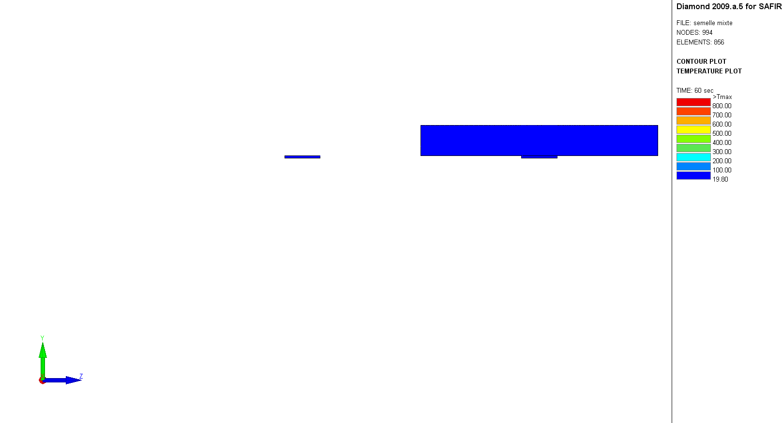
2. Distribution of temperature
Flange heated on 3 sides (ISO)
Flange heated on 3 sides + slab
Evolution of Temperature

Slide 14
2. Distribution of temperature
Flange heated on 3 sides (ISO)
Flange heated on 3 sides + slab
Evolution of Temperature

Slide 15
2. Distribution of temperature
Assumptions of the temperature profile for joints
Adapted to ISO curve
Ratios independent of time
Geometry of the joint not considered in detail

Slide 16
2. Distribution of temperature
What we want ?
Predict temperature at flanges levels accounting for the presence of the concrete slab
Profile of interpolation for temperature between flanges
How ?
Adaptations to existing methods or new methods
Validations against numerical simulations under heating and cooling phases

Slide 17
2. Distribution of temperature
FE Model : SAFIR 2D and 3D
IPE 180 to IPE 550 sections
ISO and parametric fires
Case n° | Beam | Column | Plate
1 | IPE 300 | HEA 300 | 200*380*10
2 | IPE 550 | HEM 300 | 410*625*25

Slide 18
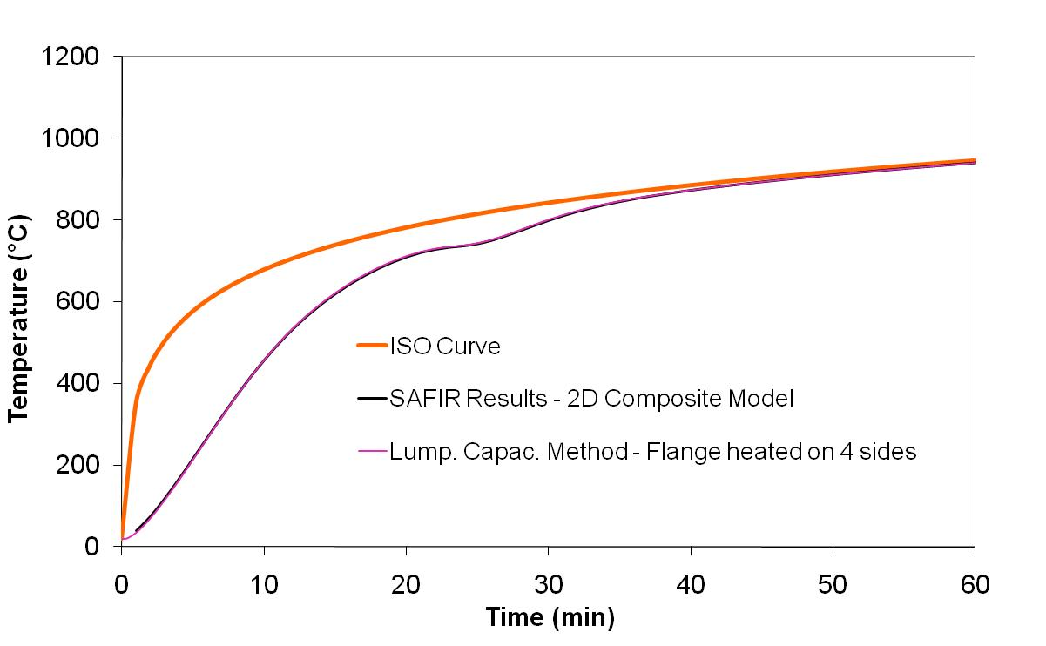
2. Distribution of temperature
2.1 Level of the bottom flange – 2D Beam section
Lumped capacitance Method : (A_{m}/V) of the flange
OK
Point of reference

Slide 19
2. Distribution of temperature
2.2 Level of the bottom flange – 3D Joint zone
Lumped Capacitance Method : (A_{m}/V)_{joint} = (A_{m}/V)_{beam}/2
IPE 300 configuration
OK
Point of reference

Slide 20
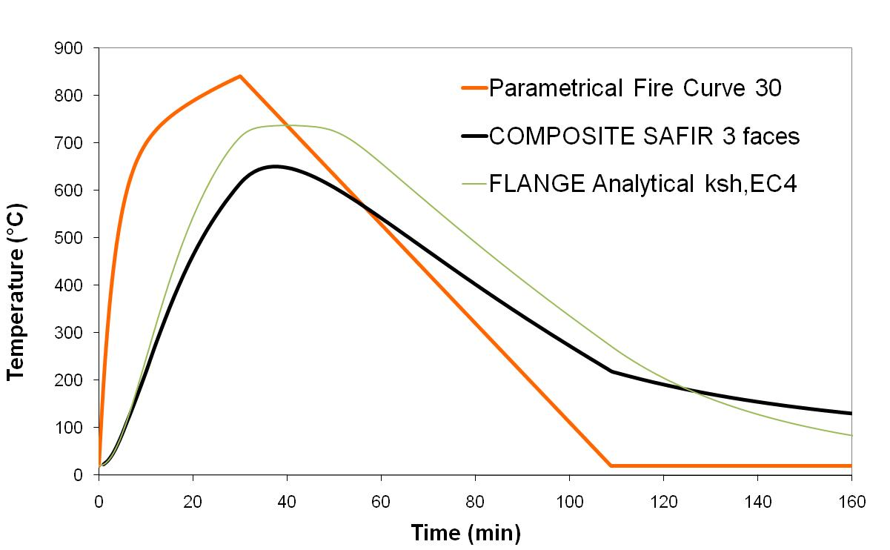
2. Distribution of temperature
2.3 Level of the top flange – 2D Beam section
Lumped Capacitance Method : (A_{m}/V) of the flange (3 sides heated)
Not OK
IPE 300 beam
Point of reference

Slide 21
2. Distribution of temperature
2.3 Level of the top flange – 2D Beam section
Composite Section Method

Slide 22
2. Distribution of temperature
2.3 Level of the top flange – 2D Beam section
Composite Section Method
OK for heating phase
Heating
Heating + Cooling

Slide 23
2. Distribution of temperature
2.3 Level of the top flange – 2D Beam section
Heat Exchange Method
Lumped Capacitance
Method
T₁, T₂ : Temperatures of the top and bottom flanges
x : Length of heat transfer (chosen equal to the root fillet)

Slide 24
2. Distribution of temperature
2.3 Level of the top flange – 2D Beam section
Heat Exchange Method
OK
Graph n°1 : IPE 300 beam – Γ = 1 – t_{heating} = 30 min
Graph n°2 : IPE 550 beam – Γ = 1 – t_{heating} = 30 min
Graph n°3 : IPE 550 beam – Γ = 1 – t_{heating} = 60 min

Slide 25
2. Distribution of temperature
2.4 Level of the top flange – 3D Joint zone
Lumped Capacitance Method : (A_{m}/V)_{joint} = (A_{m}/V)_{beam}/2
Not OK (idem 2D beam)
Composite Section Method
OK for heating phase (idem 2D beam)

Slide 26
2. Distribution of temperature
2.4 Level of the top flange – 3D Joint zone
Heat Exchange Method
Lumped Capacitance
Method
T₁, T₂ : Temperatures of the top and bottom flanges

Slide 27
2. Distribution of temperature
2.4 Level of the top flange – 3D Joint zone
Heat Exchange Method
OK
Graph n°1 : Heating
Graph n°2 : Heating + Cooling
Beam section : IPE 300
Beam section : IPE 300

Slide 28
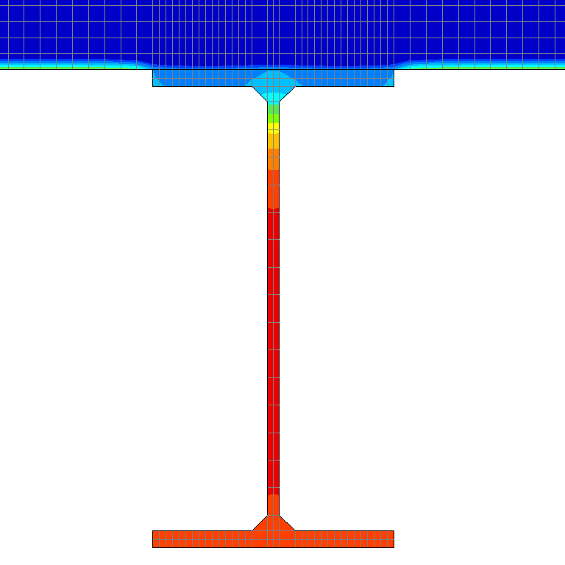
2. Distribution of temperature
Interpolation between levels of top and bottom flanges
A. Beam – IPE 300
Temperature profile suggested (beam + joint)
B. Joint – IPE 300
Graph n°1 : ISO (Heating)
Graph n°2 : Param (Cooling)
Reference Lines
2-D
3-D

Slide 29

2. Distribution of temperature
Summary
Level of the bottom flange (2D and 3D)
Lumped Capacitance Method
OK
Level of the top flange (2D and 3D)
Lumped Capacitance Method
Composite Section Method
Heat Exchange Method
Not OK
OK for heating phase
OK
Limited field of application

Slide 30
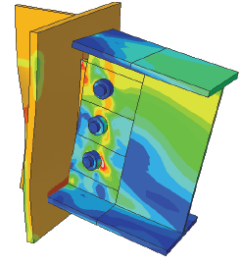
Part 3
Internal forces in an axially and rotationally restrained beams subjected to natural fire
V
M
N
Academic year 2009-2010

Slide 31
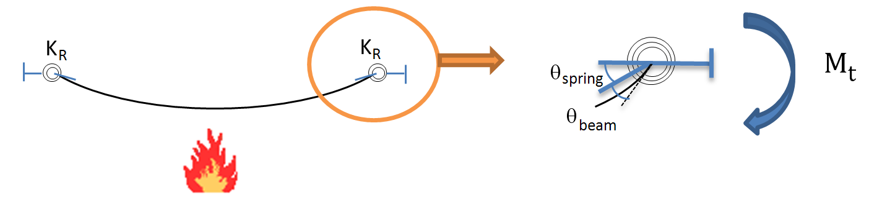
3. Prediction of internal forces
A
In real cases : superposition of axial forces and bending moments due to non-uniform elevation of temperature.

Slide 32
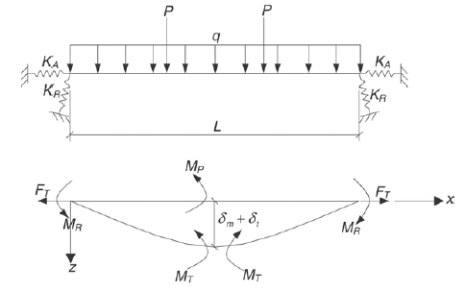
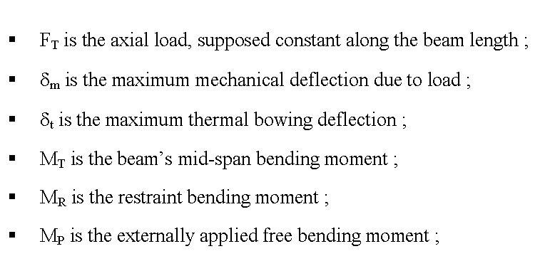
3. Prediction of internal forces
Vertical deflections induce beam shortening or axial forces
The combination of axial forces and vertical deflections influences the distribution of bending moments
Equilibrium must be stated in the deformed configuration
Yin (2005)

Slide 33
3. Prediction of internal forces
All terms are function of the mid-span deflection δ_{m,max}
Deflection profile :
Pinned :
Rigid :
Semi-rigid :
Axial force :
where :

Slide 34
3. Prediction of internal forces
All terms are function of the mid-span deflection δ_{m,max}
Mid-span bending moment :
Support bending moment :
Inelastic interaction :

Slide 35
3. Prediction of internal forces
All terms are function of the mid-span deflection δ_{m,max}
Adaptations for non-uniform profiles of temperature :
Pinned :
Rigid :
Semi-rigid :
where :

Slide 36
3. Prediction of internal forces
Modification n°1 :
Consideration of the elliptic branch for evaluation of F_{T}
F
F_{pl}
F_{propor}
ΔL_{m,propor}
ΔL_{m,pl}
ΔL_{m}
(f_{p ,} f_{y ,} E)
(F_{propor ,} F_{pl ,} K’_{A})

Slide 37
3. Prediction of internal forces
Modification n°2 :
Consideration of the elliptic branch for evaluation of M_{T} and M_{R} based on the development of a method to predict the (M,χ) diagram of a beam section under axial force and a non-uniform distribution of temperature.

Slide 38
3. Prediction of internal forces
Modification n°2 :
Comparison with FE model (SAFIR) with fibre elements

Slide 39
3. Prediction of internal forces
Modification n°3 :
Expression of the thermally-induced bending moment M_{t}
Equation of compatibility :
+ Limitation of the bending moment to M_{pl,beam} and M_{pl,joint}

Slide 40
3. Prediction of internal forces
Modification n°4 :
Extensional stiffness of the beam (2nd order effects)
F_{T,1} = 1
δ
F_{T,1} = 1
L
Pinned connections
Rigid connections

Slide 41
3. Prediction of internal forces
Modification n°5 :
Coefficient of interpolation between deflection profiles with pinned and rigid connections evaluated by stating the equilibrium between the bending moments at the beam extremity and the joint.
L = 5m
IPE 300 beam
w = 10 kN/m
K_{R} = 10.000 kN.m/rad
Equilibrium

Slide 42
3. Prediction of internal forces
Validation of a model built in SAFIR by simulating tests performed at the University of Manchester (Liu, 1999)
« Rugby goal post » sub-structure
Flush End-plate
2 tests on simply-supported beams
3 tests on sub-structures with web-cleats connections
10 tests on sub-structures with flush end-plate connections
Web Cleats

Slide 43
3. Prediction of internal forces
Validation of the model built in SAFIR by simulating tests performed at the University of Manchester (Liu, 1999)
Mechanical Analysis : Simply-supported beams
T_{critical} if T is uniform

Slide 44
3. Prediction of internal forces
Validation of the model built in SAFIR by simulating tests performed at the University of Manchester (Liu, 1999)
Mechanical Analysis : Sub-structures with flush end-plate connections
Axial restraints
Identical horizontal displacement
Symmetry conditions
Rotational restraints
Identical rotation

Slide 45
3. Prediction of internal forces
Validation of the model built in SAFIR by simulating tests performed at the University of Manchester (Liu, 1999)
Mechanical Analysis : Sub-structures with flush end-plate connections
K_{A} = 8 kN/mm
Mid-span deflections :
Axial Force :
Hogging Bending Moment :

Slide 46
3. Prediction of internal forces
Validation of the Modified Method under heating
1. Simply-supported beam - Non-uniform distribution of T°
Deflections
Axial Force
Bending Moments

Slide 47
3. Prediction of internal forces
Validation of the Modified Method under heating
2. Bilinear rotational restraints - Non-uniform distribution of T°
Bending Moments
Deflections
Axial Force
Mid-span
Support

Slide 48
3. Prediction of internal forces
Analysis of the influence of the proposed modifications
Modifications n°1 & 2 : Elliptic branch of the stress-strain diagram of carbon steel for (F, ΔL_{m}) and (M, χ_{m}) diagrams
6 meter-long IPE 300 beam (S275)
Distribution of T° : Ratios 0.8 – 1 – 1.2
K_{R} = 3000 kN.m/rad (elastic)
w = 0.5 – K = 3%
Degree of accuracy enhanced
Better convergence at the transition « bending - catenary »

Slide 49
3. Prediction of internal forces
Analysis of the influence of the proposed modifications
Modification n°3 : Expression of the thermally-induced bending moment M_{t}
Aimed at extending the field of application of the Modified Method !

Slide 50
3. Prediction of internal forces
Analysis of the influence of the proposed modifications
Modification n°4 : Extensional stiffness K_{A} of the beam accounting for 2nd order effects
Results obtained from the Modified Method before and after Modification n°4 are superposed
Deformability of the beam << Deformability of the spring
The extensional stiffness K_{A} of the beam is modified for large deflections where F_{T} = F_{T,pl}

Slide 51
3. Prediction of internal forces
Analysis of the influence of the proposed modifications
Modification n°5 : Coefficient of interpolation c_{f} used for deflection profile of the beam
6 meter-long IPE 300 beam (S275)
Distribution of T° : Ratios 0.8 – 1 – 1.2
K_{R} = 3000 kN.m/rad (elastic)
w = 0.5 – K = 3%
No influence on deflections and axial forces
Prediction of bending moments significantly improved (low T°)

Slide 52
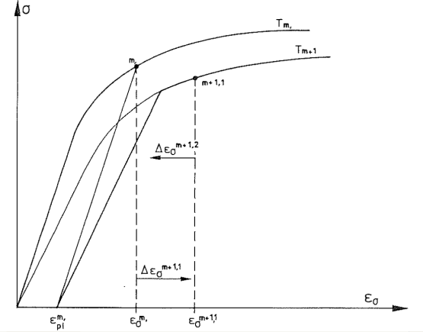
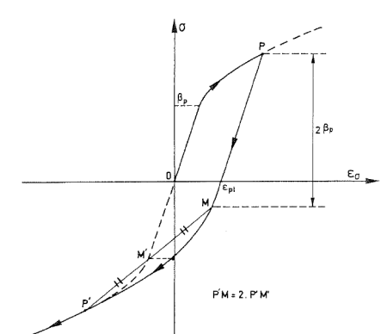
3. Prediction of internal forces
Extension to the cooling phase (Li, 2006)
Based on the 2 principles proposed for material law of carbon steel when cooling (Franssen, 1990)
Validated only for the prediction of deflections and axial forces
Plastic strains constant during the variation of T°
Length of the elastic branch constant when unloading

Slide 53
3. Prediction of internal forces
Adaptation of the Modified Method to the cooling phase
The resolution of the General Equation is made at the end of the heating phase (reference point)
The (F_{T}, ΔL_{m}) and (M, χ_{m}) diagrams are adapted for the cooling phase
The General Equation is solved at any instant of the cooling phase
Mid-span Bending Moment

Slide 54
3. Prediction of internal forces
Adaptation of the General Method to the cooling phase
1. Simply-supported beam - Non-uniform distribution of T°
6 meter-long IPE 300 beam (S275)
T_{ref} : 600°C – 650°C – 700°C
w = 0.3 – K = 3%
Deflections
Axial Force
Mid-span Bending Moment

Slide 55
3. Prediction of internal forces
Adaptation of the General Method to the cooling phase
2. Bilinear rotational restraints - Uniform distribution of T°
Mid-span
6 meter-long IPE 300 beam (S275)
T_{ref} : 700°C – 700°C – 700°C
w = 0.5 – K = 10%
Deflections
Axial Force
Bending Moments
Support

Slide 56
3. Prediction of internal forces
Summary (1st)
Simplified method developed by Yin and Li has been modified in order to improve the prediction of bending moments in restrained beams (heating + cooling)
It has also been possible to limit the bending moment at the beam extremities in order to account for joint resistance
A numerical model built in SAFIR software has been used as reference for the validation of these modifications
For each modification, the enhancement of accuracy and the extension of the field of application have been underlined

Slide 57
3. Prediction of internal forces
Summary (2nd)
Good predictions of internal forces and deflections
Field of application remains limited to bilinear and constant rotational restraints in spite of several modifications making the algorithm more complex
Including the real behaviour of connections in this Method seems difficult (contact between beam and column flanges, M-N interaction) and the use of simple FE models is recommended for the analysis of the behaviour of simple steel connections

Slide 58
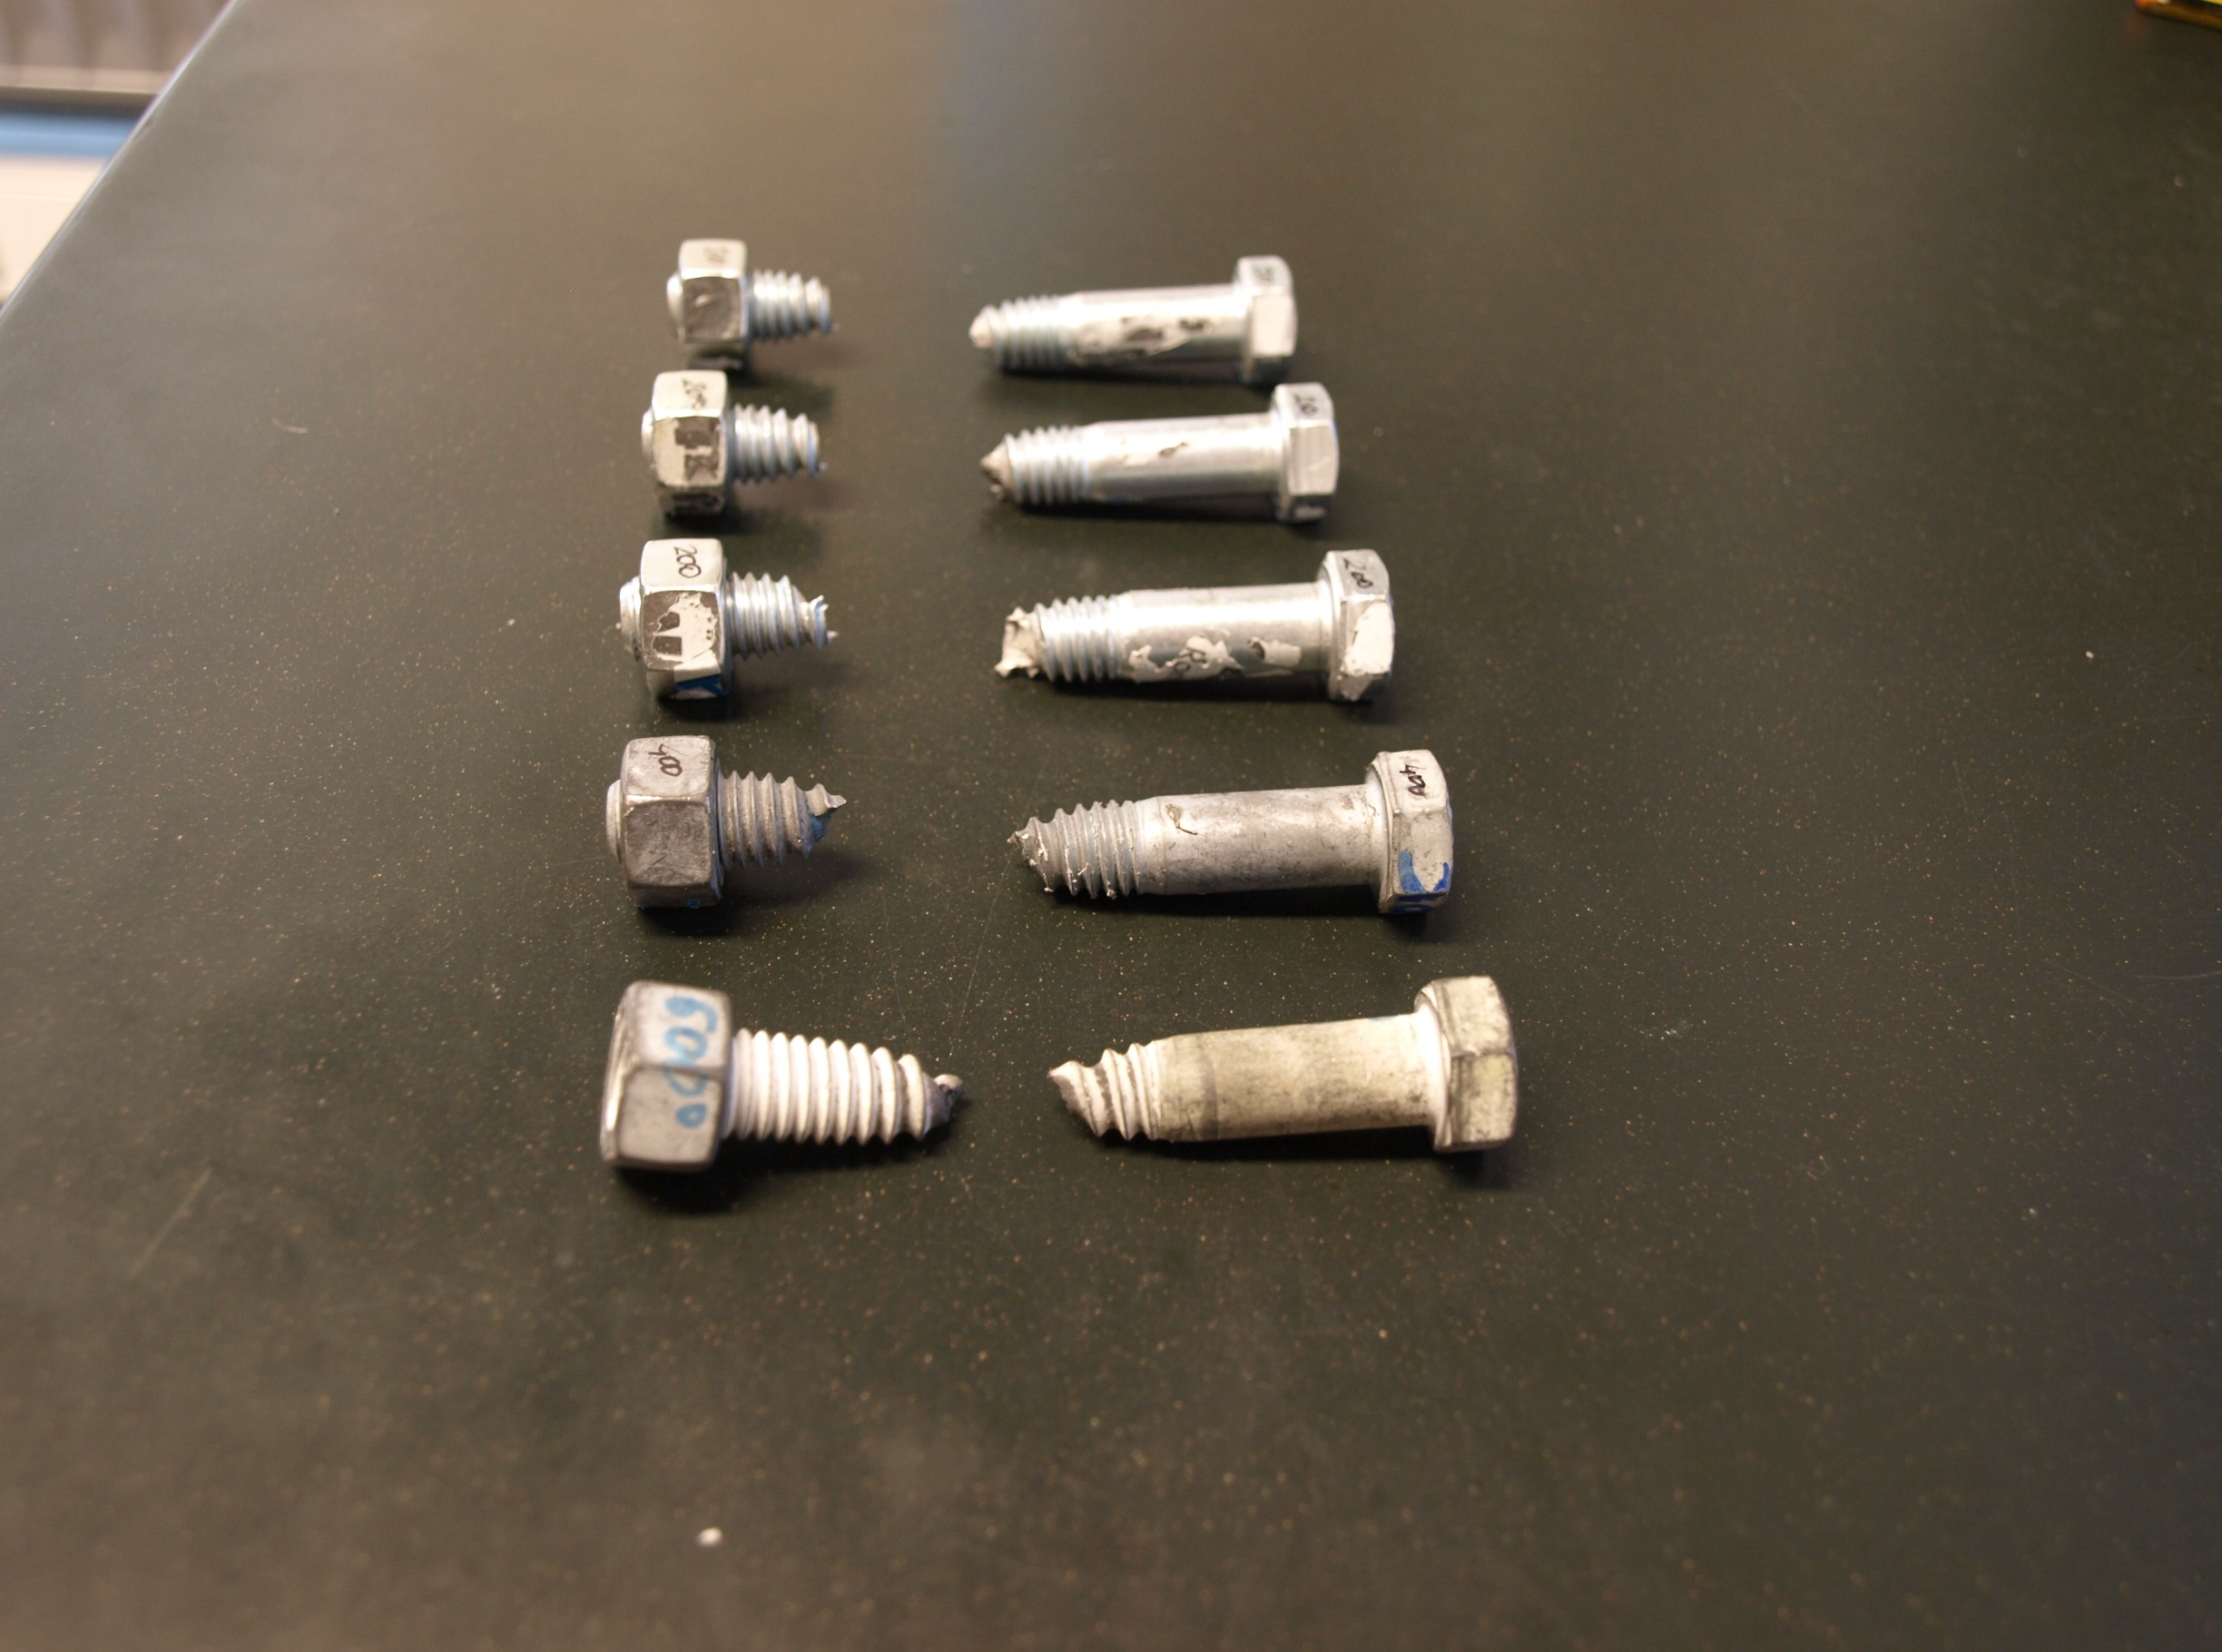
Part 4
Experimental tests and models for bolts and welds under heating and subsequent cooling
Academic year 2009-2010

Slide 59
4. Tests and models for bolts/welds
Review of previous work on bolts and welds
Riaux (1980) : Tensile and shear tests on Grade 8.8 bolts after heating
Kirby (1995) : Tensile and shear tests on Grade 8.8 bolts after heating EN 1993-1-2
Gonzalez (2008) : Tensile tests on Grade 10.9 bolts during heating and after cooling (residual)
Latham (1993) : Tests on fillet and butt welds after heating EN 1993-1-2

Slide 60
4. Tests and models for bolts/welds
Objective
Bolts
Heating phase : OK
Residual : Few data
Cooling phase : No data
Strength Reduction Factor
Welds
Heating phase : OK
Residual : No data
Cooling phase : No data
Temperature

Slide 61
4. Tests and models for bolts/welds
Test methodology
Room temperature tests
Steady-state tests at elevated temperatures (a)
Steady-state tests performed at various T_{f} after temperature has reached T_{u} (b)

Slide 62
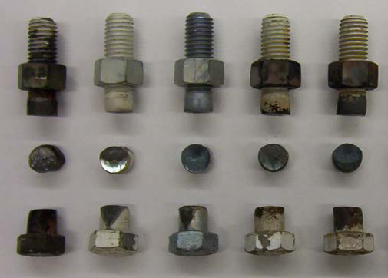
4. Tests and models for bolts/welds
Schedule of tests performed on Grade 8.8 bolts
Tensile tests
Shear tests
Heating |  | Cooling
T_{u} = T_{f} [°C] | n. tests | T_{u} [°C] | T_{f} [°C] | n. tests
20 | 2 | 400 | 200 | 2
200 | 1 |  | 100 | 1
400 | 1 |  | 20 | 1
600 | 1 | 600 | 400 | 1
800 | 1 |  | 300 | 1
 |  |  | 200 | 2
 |  |  | 100 | 1
 |  |  | 20 | 1
 |  | 800 | 600 | 1
 |  |  | 400 | 1
 |  |  | 300 | 1
 |  |  | 200 | 2
 |  |  | 100 | 1
 |  |  | 20 | 1
 |  | 900 | 20 | 1
Heating |  | Cooling
T_{u} = T_{f} [°C] | n. tests | T_{u} [°C] | T_{f} [°C] | n. tests
20 | 2 | 600 | 400 | 1
200 | 1 |  | 300 | 1
400 | 1 |  | 200 | 2
600 | 1 |  | 100 | 1
800 | 1 |  | 20 | 1
 |  | 800 | 600 | 1
 |  |  | 400 | 1
 |  |  | 300 | 1
 |  |  | 200 | 2
 |  |  | 100 | 1
 |  |  | 20 | 1
 |  | 900 | 20 | 1

Slide 63
4. Tests and models for bolts/welds
Schedule of tests performed on welds
Heating |  | Cooling
T_{u} = T_{f} [°C] | n. tests | T_{u} [°C] | T_{f} [°C] | n. tests
20 | 1 | 400 | 200 | 1
200 | 1 |  | 100 | 1
400 | 1 |  | 20 | 1
600 | 1 | 600 | 400 | -
800 | 1 |  | 200 | -
 |  |  | 20 | 1
 |  | 800 | 600 | 1
 |  |  | 400 | 1
 |  |  | 200 | 1
 |  |  | 20 | 1
 |  | 900 | 400 | 1
 |  |  | 200 | 1
 |  |  | 20 | 1

Slide 64
4. Tests and models for bolts/welds
Experimental values of reduction factor for bolt strength k_{b}
Tensile tests
Shear tests
Heating Tests
Heating Tests
T_{f} (°C)
T_{f} (°C)

Slide 65
4. Tests and models for bolts/welds
Model for bolt strength f_{ub} during cooling
EN 1993-1-2
T_{f} : Failure temperature
T_{u} : Upper temperature (at the end of heating phase)

Slide 66
4. Tests and models for bolts/welds
Force-displacement model for bolts in tension
F
F_{ub,θ}
F_{pb,θ}
F_{tb,θ}
S_{b,θ}
d
d_{tb,θ}
d_{pb,θ}
d_{yb,θ}
d_{ub,θ}

Slide 67
4. Tests and models for bolts/welds
Force-displacement model for bolts in tension
Heating (T_{u} = T_{f})
Large displacements

Slide 68
4. Tests and models for bolts/welds
Force-displacement model for bolts in tension
Residual (T_{f} = 20°C)
Cooling (T_{f} = 400°C)
Significant loss of strength
Large displacements

Slide 69
4. Tests and models for bolts/welds
Force-displacement model for bolts in shear
R
R_{ub,θ}
R_{b,θ}
S_{st,θ}
S_{b,θ}
d
d_{b,θ}
d_{ub,θ}
d_{fb,θ}

Slide 70
4. Tests and models for bolts/welds
Force-displacement model for bolts in shear
Cooling (T_{f} = 20°C)
Cooling (T_{f} = 200°C)
Significant loss of strength

Slide 71
4. Tests and models for bolts/welds
Experimental values of reduction factor for weld strength k_{w}
No Cooling
Heating + Cooling

Slide 72
4. Tests and models for bolts/welds
Analytical values of reduction factor for weld strength k_{w}
EN 1993-1-2
T_{f} : Failure temperature
T_{u} : Upper temperature (at the end of heating phase)

Slide 73
4. Tests and models for bolts/welds
Summary
The influence of heating-cooling cycles on bolts and welds strength is significant (k_{nr,b,min} = 0.6 ; k_{nr,w,min} = 0.8)
Ductility of bolts is increased when submitted to a heating-cooling cycle where T_{u} (at the end of the heating phase) exceeds 500°C.
Material laws, including a descending branch, have been proposed for bolts in tension and bolts in shear. They can be applied to component-based models aimed at predicting the behaviour of steel connections under natural fire.

Slide 74
Part 5
Global behaviour of simple connections under natural fire
Pinned
Academic year 2009-2010

Slide 75
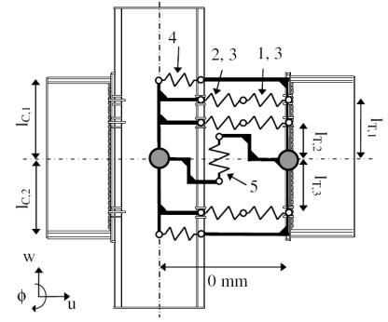
5. Tests and models of connections
State-of-the-art
Models for semi-rigid joints : curve fit models, mechanical models, FE models and macro-elements
Curve-fit models
Mechanical models
Solid models
Macro-elements
Ang (1984)
Cerfontaine (2004)
Block (2006)

Slide 76
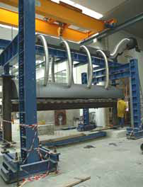
5. Tests and models of connections
State-of-the-art : Simple connections under fire conditions
Isothermal tests on isolated connections performed at the University of Sheffield (Yu, 2009) + mechanical models
One of the natural fire tests performed at University of Coimbra (Santiago, 2008)
Type of connection (FP, WC and HP)
Temperature (20°C – 450°C – 550°C – 650°C)
Angle of the loading (35° – 55°)
Number, diameter and grade of bolts

Slide 77
5. Tests and models of connections
Description of the tests performed recently by Efectis
Test n°1 (Metz)
Heated gradually until failure
Flush end-plate connections
5.5 meter-long IPE 300 beam
Thermally-protected HEA 220 column
K = 1%
L.R. = 0.3 (theoretically)
Test stopped at T_{furnace} = 840°C (T_{bottom flange} = 800°C)
Beam deflection > 220 mm
No failure of bolts
10mm-thick plate
IPE 300 beam

Slide 78
5. Tests and models of connections
Description of the tests performed recently by Efectis
Test n°2 (Metz)
Heated gradually until 700°C before natural cooling
Flush end-plate connections
5.5 meter-long IPE 300 beam
Thermally-protected HEA 220 column
K = 1%
L.R. = 0.3 (theoretically)
Beam deflection = 58 mm (constant during cooling)
No failure of bolts
10mm-thick plate
IPE 300 beam

Slide 79
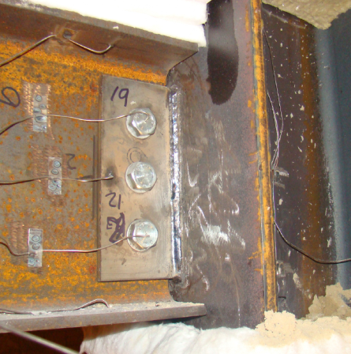
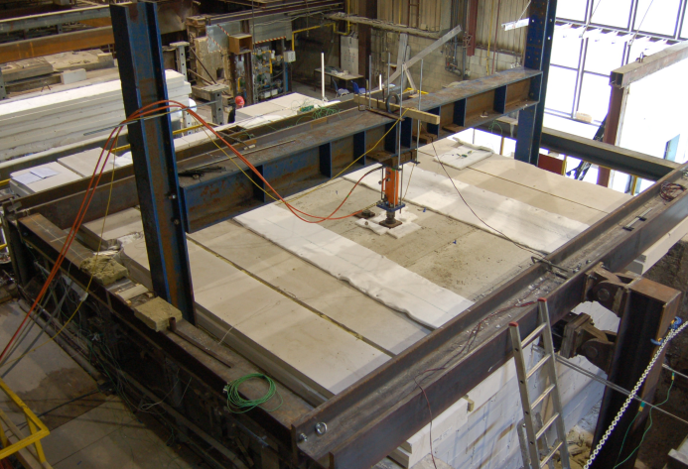
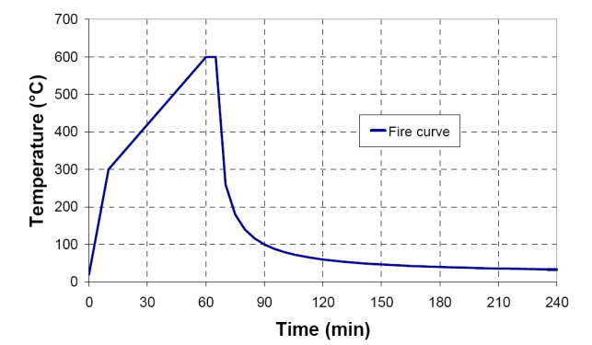
5. Tests and models of connections
Description of the tests performed recently by Efectis
Test n°3 (Delft)
Heated gradually until d = 200 mm before natural cooling
Fin plate connections
4.4 meter-long IPE 300 beam
Thermally-protected HEB 300 column
K = 6.6%
L.R. = 0.3 (f_{y} = 345 MPa)
Temperature reached 650°C in the beam and 600°C near the joint
Failure of bolts after 127 minutes

Slide 80
5. Tests and models of connections
Description of the tests performed recently by Efectis
Test n°4 (Delft)
Heated gradually until d = 200 mm before natural cooling
Web cleats connections
4.4 meter-long IPE 300 beam
Thermally-protected HEB 300 column
K = 6.6%
L.R. = 0.3 (f_{y} = 345 MPa)
Temperature reached 670°C in the beam and 600°C near the joint
No failure of bolts

Slide 81
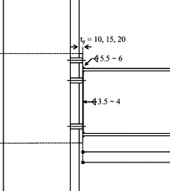
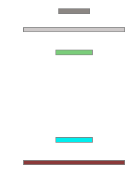
5. Tests and models of connections
Numerical model for connections : Bilinear Fibres Model
The action of joints is represented by beam elements including one fibre per bolt or compressive row
Cross-section of the beam element

Slide 82
5. Tests and models of connections
Numerical model for connections : Bilinear Fibres Model
Fin plate
Web cleats
Header Plate
Flush end-plate

Slide 83
5. Tests and models of connections
Numerical model for connections : Bilinear Fibres Model
BILIN
Translated BILIN_COMP
BILIN_COMP
BILIN_TENS
BILIN_BOLTS
BILIN_ASYM
Symmetric to BILIN_COMP !

Slide 84
5. Tests and models of connections
Numerical model for connections : Bilinear Fibres Model
Failure criteria
1. Classes of ductility
Resistance
Plastic resistance of weakest ductile component
Ultimate resistance of weakest ductile component
Class C
Class A
Resistance of weakest brittle component
Class B
Temperature

Slide 85
5. Tests and models of connections
Numerical model for connections : Bilinear Fibres Model
Failure criteria
2. Criteria
Resistance
Criterion n°1 : One fibre representing the action of a class C bolt row is yielded
or
Criterion n°2 : All the fibres representing the action of bolt rows are yielded and at least one bolt row is class B
Class C
Class A
Class B
Temperature
Plastic resistance of weakest ductile component
Ultimate resistance of weakest ductile component
Resistance of weakest brittle component

Slide 86
5. Tests and models of connections
Numerical model for connections : Bilinear Fibres Model
Test n°1 (Metz)
Restraining system modelled by one element (elastic spring)
f_{y} = 355 MPa.
f_{ub} : 956 Mpa (tests at room T°)
- Experimentally, failure after 70 min (T_{furnace} = 797°C)
- Good correlation

Slide 87
5. Tests and models of connections
Numerical model for connections : Bilinear Fibres Model
Test n°2 (Metz)
No failure

Slide 88
5. Tests and models of connections
Numerical model for connections : Bilinear Fibres Model
Test n°3 (Delft) : Fin plate connections
Criterion n°2 reached after 119 min. – Experimentally : failure after 127 min.

Slide 89
5. Tests and models of connections
Numerical model for connections : Bilinear Fibres Model
Test n°4 (Delft) : Web cleats connections
The weakest components are ductile – No failure

Slide 90
5. Tests and models of connections
Numerical model for connections : Bilinear Fibres Model
Parametric Analyses
Parameters investigated :
Type of connection : Fin plate, Web cleats, Header plate
Load ratio : 0.3, 0.5 and 0.7
Duration of the fire : Short (ISO) or Long (60 min)
Beam span : 6 m (IPE 300) or 12 m (IPE 550)

Slide 91
5. Tests and models of connections
Numerical model for connections : Bilinear Fibres Model
Parametric Analyses : Fin plate connections
Bilinear Fibres Model
Abaqus Model
FEM model - Source : Corus Ltd

Slide 92
5. Tests and models of connections
Numerical model for connections : Bilinear Fibres Model
Parametric Analyses : Web cleats connections
Bilinear Fibres Model
ANSYS Model
FEM model - Source : CTICM
d >> L/20

Slide 93
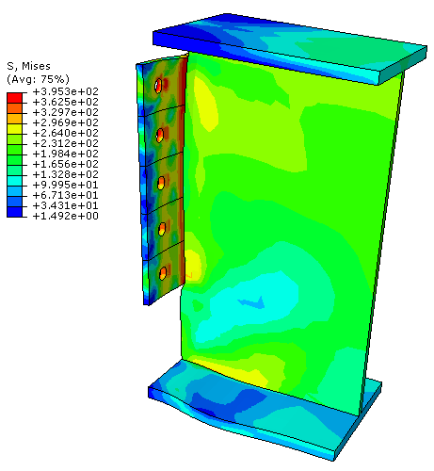
5. Tests and models of connections
Numerical model for connections : Bilinear Fibres Model
Parametric Analyses : Header plate connections
Bilinear Fibres Model
Abaqus Model
FEM model - Source : Corus Ltd

Slide 94
5. Tests and models of connections
Parametric Analyses : Conclusions
Influence of ductility classes (design + T_{max}) : ratio « resistance of bolts in shear/resistance of beam web in bearing » higher for web cleats than fin plates.
Bolts situated close to the top flange increase the fire resistance but this effect is counter-balanced by failures during cooling phase
Cases with large deflections (d > L/20) at the end of the heating phase should be rejected

Slide 95
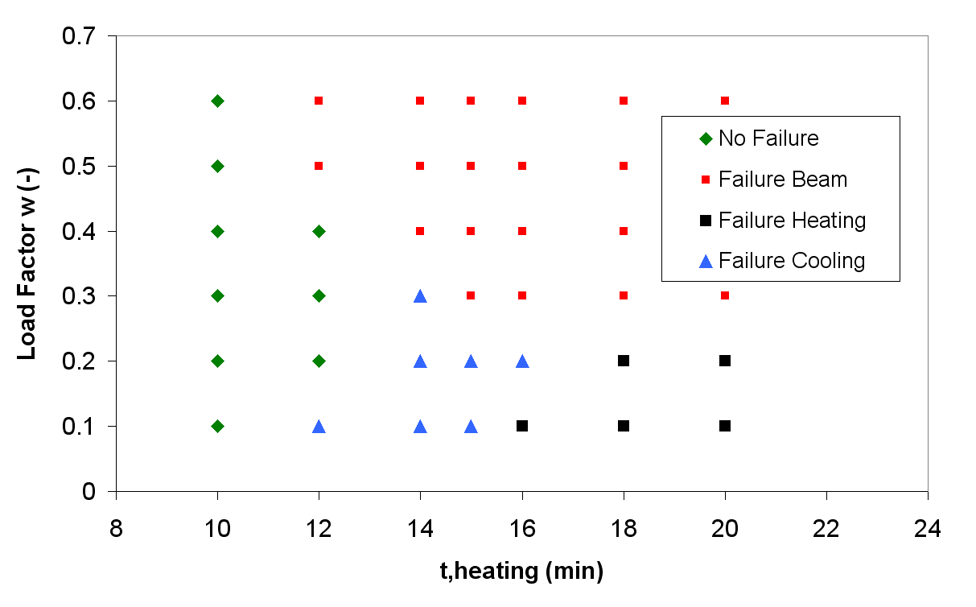
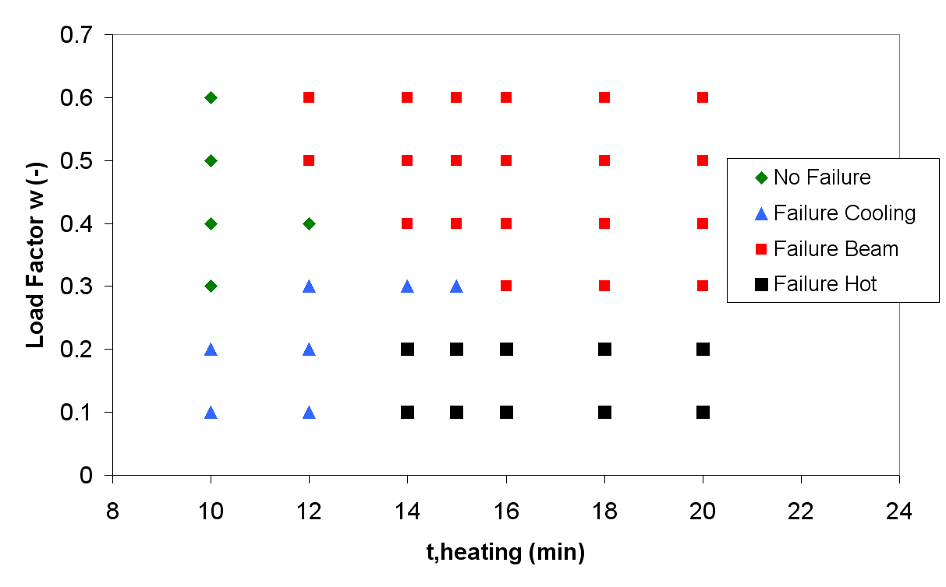
5. Tests and models of connections
Numerical model for connections : Bilinear Fibres Model
Additional cases : Fin plate connections
K = 5%
K = 12%

Slide 96
5. Tests and models of connections
Proposed design procedure for simple connections
1. Heating phase
Evolution of temperature profiles (cfr. part 2)
Multiplication of w by 1.1 (restraints)
Evaluation of the time of fire resistance t₁ (following EN)
Evaluation of κ_{cooling}
Verification that κ_{cooling}*t₁ > t_{heating}

Slide 97
5. Tests and models of connections
Proposed design procedure for simple connections
2. Cooling phase
Recommendation n°2 :
Recommendation n°1 :
T_{bottom flange} < T_{lim} at the end of heating phase
or w > w_{lim}
or The resistance of the brittle components is higher than the ultimate resistance of the weakest ductile component
(accounting for k_{nr}) multiplied by 1.2 → NO CLASS B
The resistance of the brittle components is higher than the plastic resistance of the weakest ductile component (accounting for k_{nr}) multiplied by 1.2 → NO CLASS C
Fin plate : w_{lim} = 0.35
Web cleats : w_{lim} = 0.25
Header plate : w_{lim} = 0.45

Slide 98
5. Tests and models of connections
Proposed design procedure for simple connections
3. Summary
CLASS B during cooling :
CLASS A during cooling :
CLASS C during cooling :
Inacceptable
w
Acceptable
Inacceptable Heating
Inacceptable Heating
w_{lim}
Inacceptable Cooling
Acceptable
t(T_{lim})
t_{heating}

Slide 99
5. Tests and models of connections
Proposed design procedure for simple connections
Fin-plate connections
K = 3%
K = 10%

Slide 100
5. Tests and models of connections
Numerical model for connections : Nonlinear Fibres Model
General Material Law
On the contrary of Bilinear F.M., the Nonlinear F.M. allows an automatic detection of connection failures !

Slide 101
5. Tests and models of connections
Experimental tests performed at Sheffield (2009)

Slide 102
5. Tests and models of connections
Numerical simulation of tests realised at Sheffield (2009)
Force-displacement diagrams of bolt rows
Heating Phase
Cooling Phase

Slide 103
5. Tests and models of connections
Numerical simulation of tests realised at Sheffield (2009)
Force-rotation diagrams : Tests n°1 to 4 (α = 55°)

Slide 104
5. Tests and models of connections
Numerical simulation of tests realised at Sheffield (2009)
Force-rotation diagrams : Tests n°5 to 8 (α = 35°)

Slide 105
5. Tests and models of connections
Numerical simulation of tests realised at Delft (Test n°3)

Slide 106
5. Tests and models of connections
Case Study
Joint represented by Nonlinear Fibres Model

Slide 107
5. Tests and models of connections
Summary
Component-based models and material laws defined for the modelling of simple connections under natural fire
Bilinear Fibres Models and Nonlinear Fibres Models validated against experimental tests and other numerical simulations (solid models). Differences by the degree of difficulty, the field of application and the ability to predict connection failures
Predominent influence of ductility on the occurrence of connection failures → design procedure proposed.

Slide 108
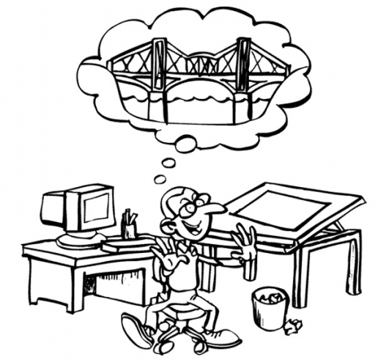


Part 6
General conclusions
Academic year 2009-2010

Slide 109
6. General Conclusions
Detailed list of personal contributions (1/3)
Proposal of new simple methods for the prediction of temperature in 2D-beam sections and 3D-joint zones covered by a concrete slab and calibration on numerical results
Validation against experimental tests performed at the University of Manchester of a model built in SAFIR for the prediction of internal forces in axially- and rotationally-restrained beams under fire conditions
Adaptations to the simplified method developed by Yin and Li for predicting bending moments profiles in axially- and rotationally-restrained beams during heating and cooling phases of a fire and extension to joints with a bilinear moment-rotation diagram
Treatment of results of tests performed on bolts and welds under fire.

Slide 110
6. General Conclusions
Detailed list of personal contributions (2/3)
Development of analytical models for bolts (tension or shear) and welds during the heating and cooling phases of a fire
Definition of two models and material laws for modelling the action of simple steel connections under natural fire conditions
Definition of failure criteria for connections modelled by Bilinear Fibres Models and validations against experimental tests and numerical results obtained with more complex models
Realisation of parametric analyses using the Bilinear Fibres Models for fin plate, double web cleats and header plate connections and definition of design procedures to avoid connection failures

Slide 111
6. General Conclusions
Detailed list of personal contributions (3/3)
Development of Nonlinear Fibres Models for fin plate connections and validation against experimental results of isothermal tests performed on isolated joints (Sheffield) and a fire test performed on a sub-structure (Delft)
Application of the Nonlinear Fibres Models to a large-scale steel structure with fin plate connections

Slide 112
6. General conclusions
General Conclusions (1/2)
By use of quite simple methods that does not require FE models, possibility to predict distribution of temperature in beams and joints covered by a concrete slab
The use of simplified methods for predicting internal forces in joints under natural fire is limited to cases where the behaviour of joints is bilinear and constant
The influence of heating-cooling cycles on the resistance and the ductility of bolts and welds should be considered (k_{nr,b,min} = 0.6 ; k_{nr,w,min} = 0.8) → force-displacement models for bolts

Slide 113
6. General conclusions
General Conclusions (2/2)
The action of simple connections in steel structures under natural fire may be represented by fibre models, able to predict failures
The ductility of connections has a major influence on the occurrence of connection failures → classes of ductility

Slide 114
6. General Conclusions
Perspectives
Validation of the Heat Exchange Method against experimental results (beam-slab contact) + protected members
Analysis of the reversibility of deformations in carbon steel elements subjected to a heating-cooling cycle
Integration of group effects and instability phenomena into numerical models for connections
Definition of an adimensional fibre element for representing the action of joints following the Component Method
Extension of this work to composite joints (tests available, models adapted). Attention should be paid to the concept of collaborating width)

Slide 115
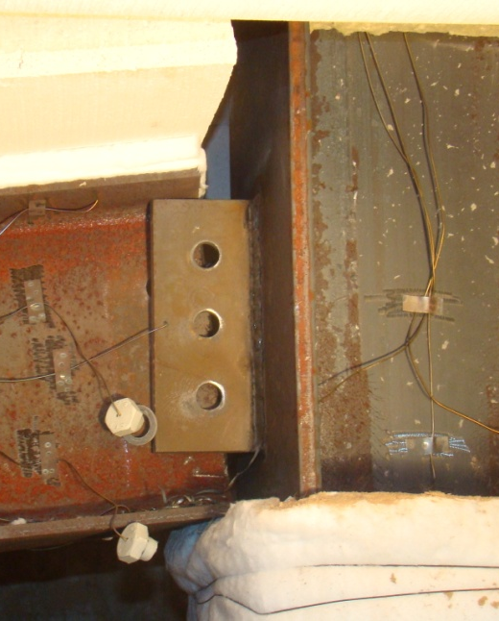
Thank you for your attention !

