Slide 1
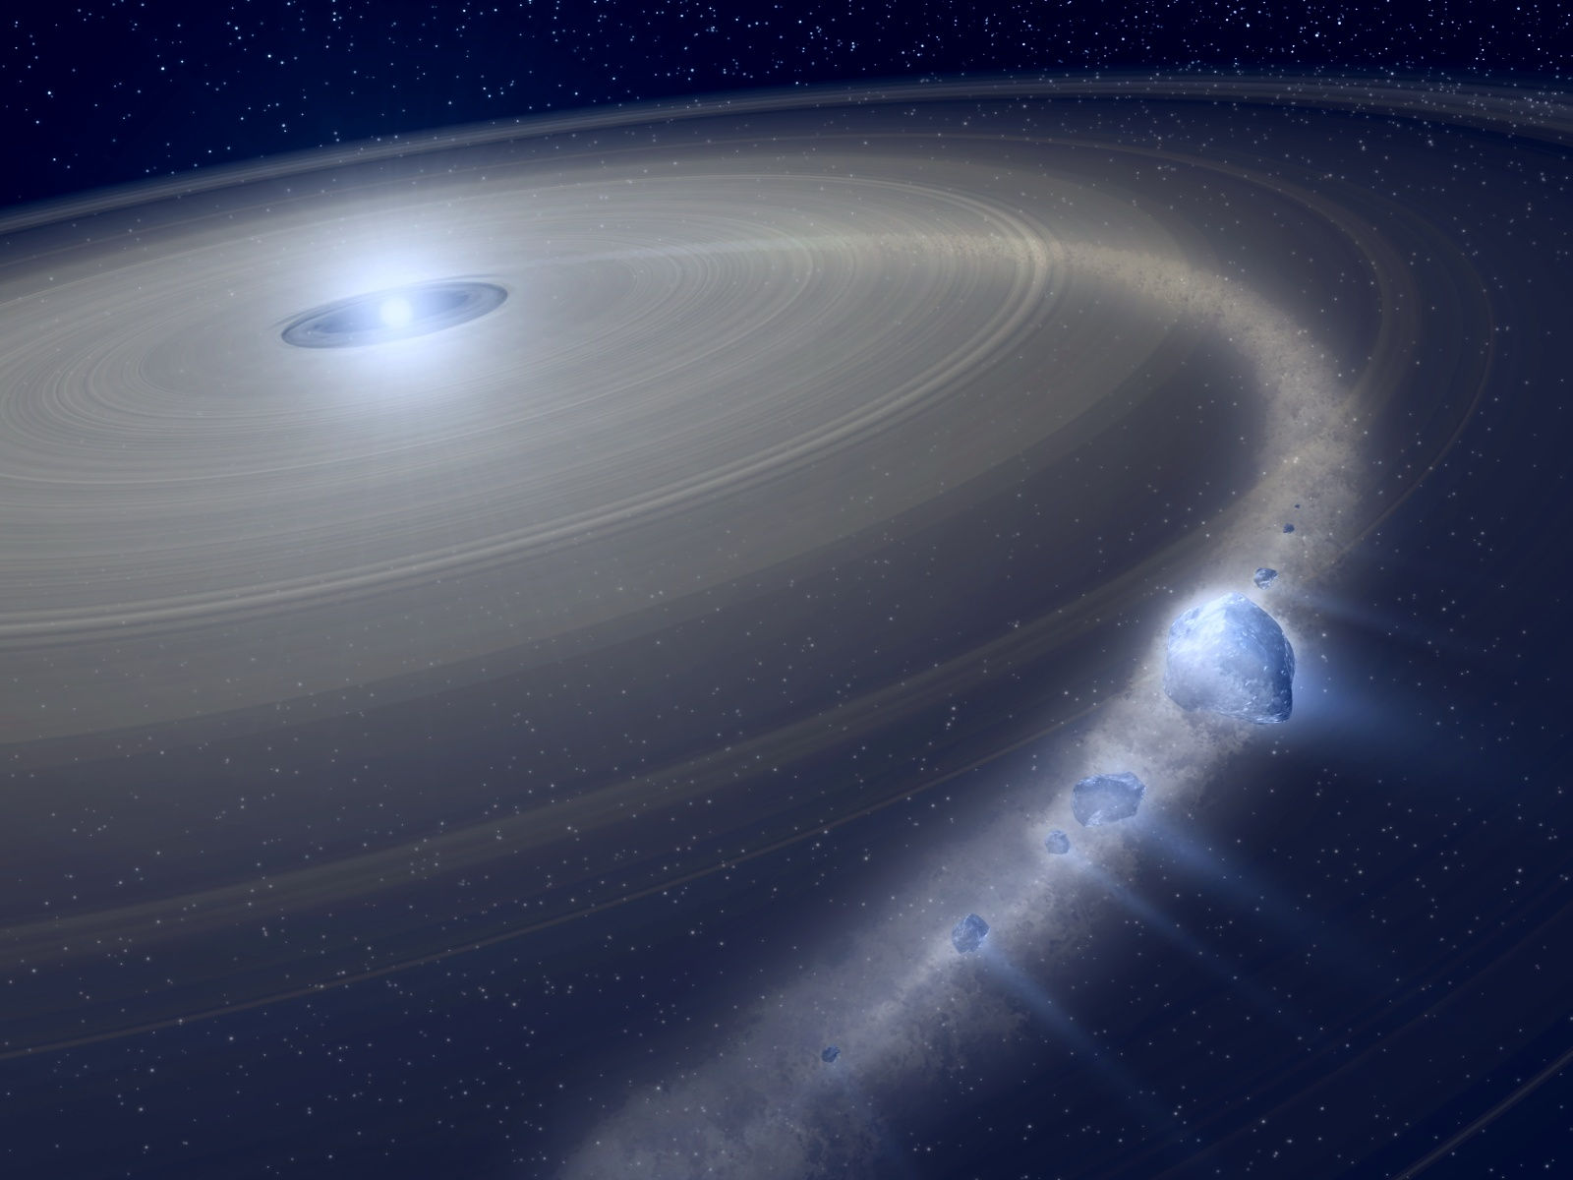
Hot dust in the inner parts of circumstellar debris discs
The contribution of stellar interferometry
*
Olivier Absil
FNRS Postdoctoral Fellow
ULg – Institut d’Astrophysique et de Géophysique
BPS meeting
Hasselt – 01/04/2009

Slide 2
Quiz
When was discovered the first extrasolar planetary system?
2000
1995
1992
1984

Slide 3
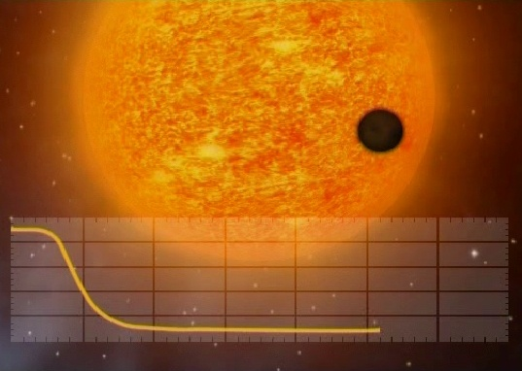
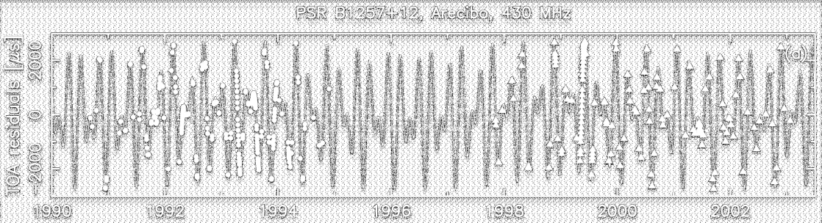
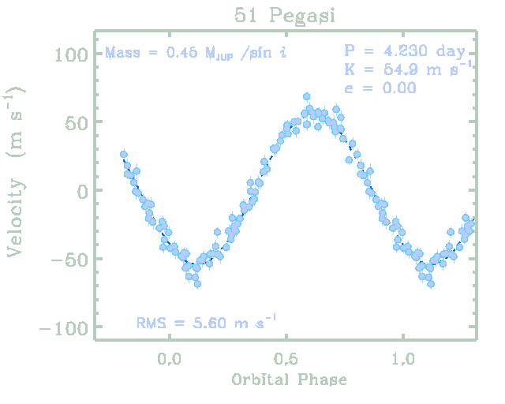
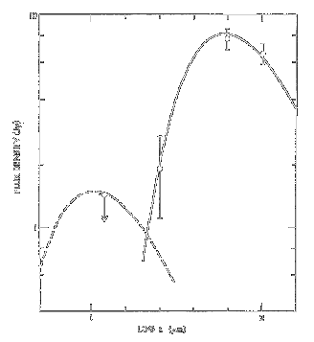
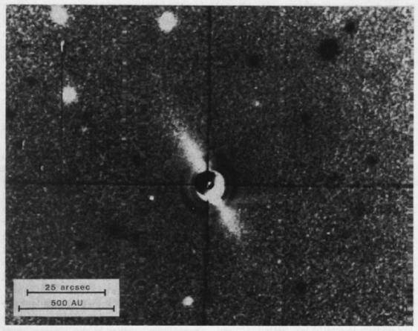
And the winner is...
2000: first exoplanet transit detected
1992: three planets around a pulsar
1995: first hot Jupiter by radial velocity
1984: first debris discs detected
Notes:
Debris discs: maybe the most akin to our Solar System!

Slide 4
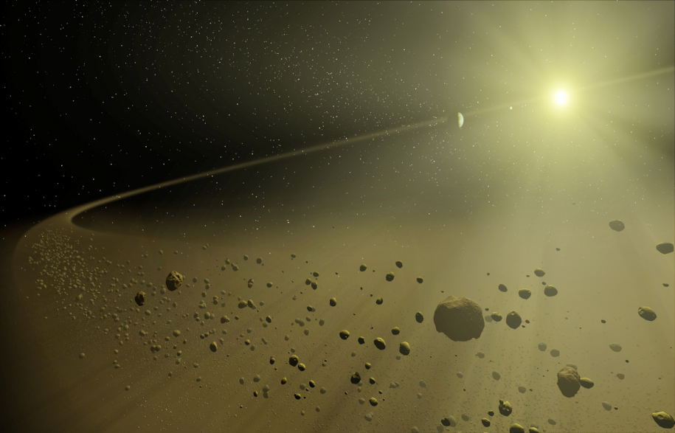
¿ Debris discs ?
2nd generation dust grains (≠ primordial)
Dust lifetime << star age
Produced by “planetesimals”
Asteroid collisions / Comet outgassing

Slide 5
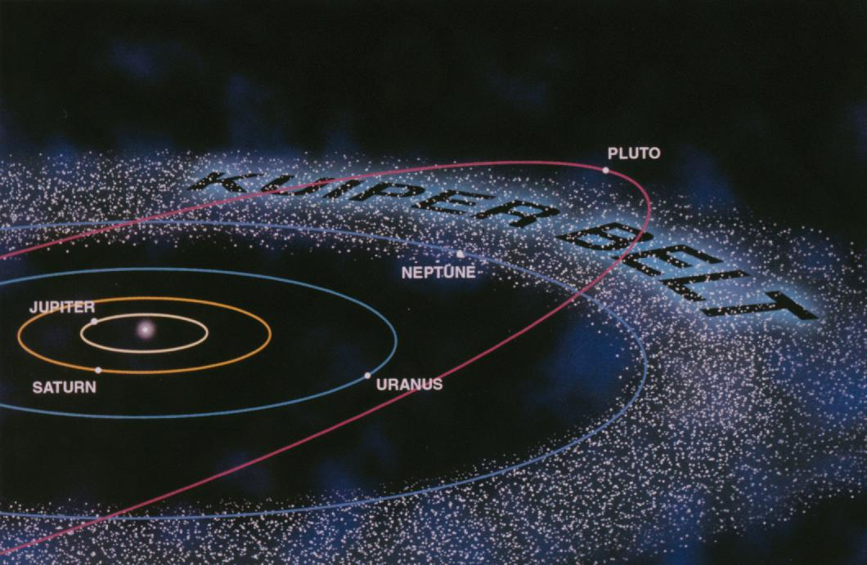
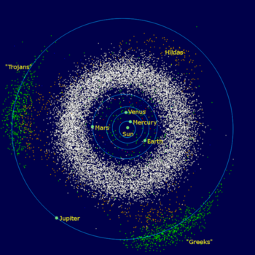
We all live in ... a debris disc!
Solar system dust
Kuiper belt → cold dust
Zodiacal disc (asteroid belt) → warm dust

Slide 6
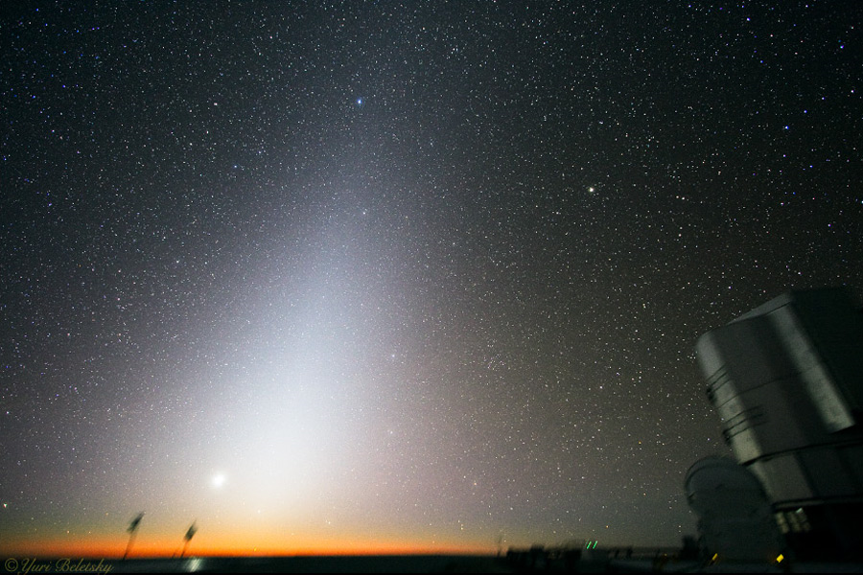
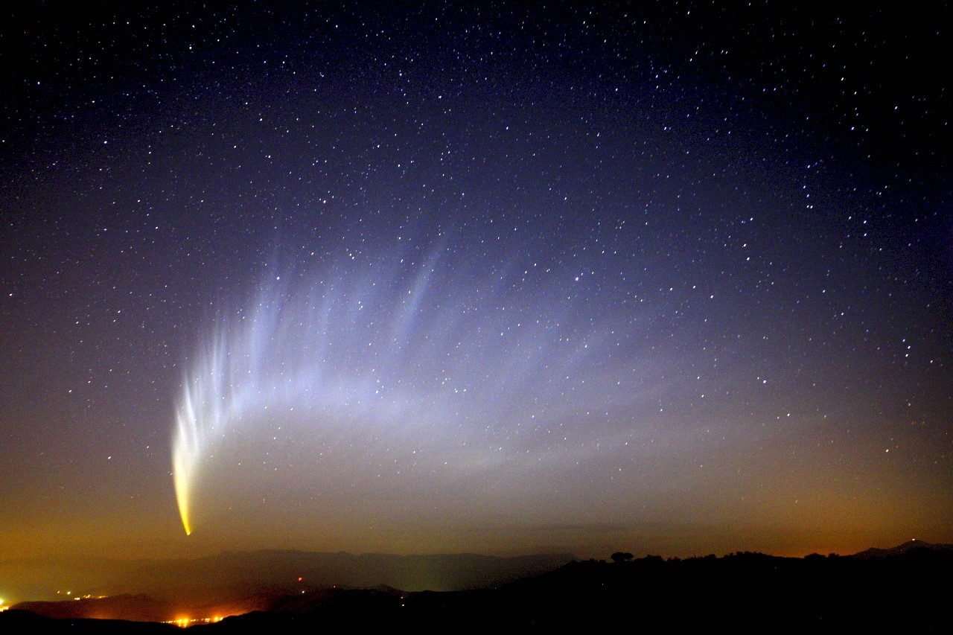
The zodiacal disc seen from Earth
Dust production (comet)
The zodiacal disc

Slide 7
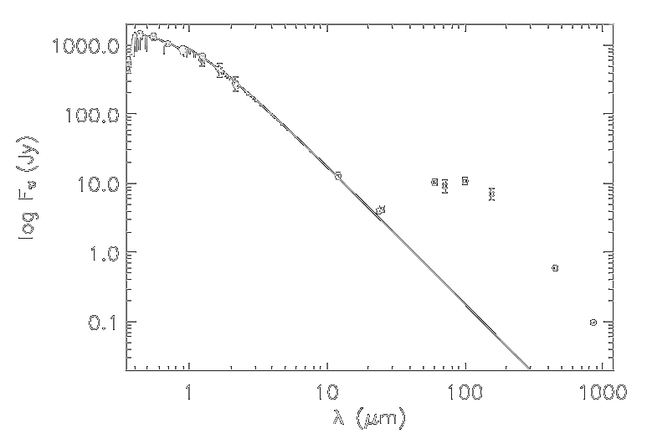
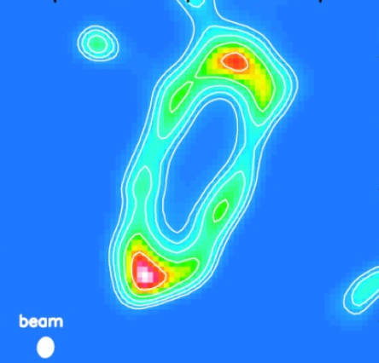
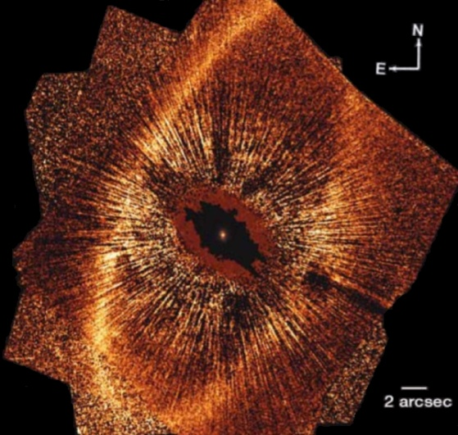
Debris discs: current view
Extrasolar debris discs
Detection: far-infared photometry + images
Cold and distant (~100 AU)
Massive (few 100s × Kuiper belt)
Evidences for inner holes
High frequency
30% of A-type stars
15% of solar-type stars
Stapelfeldt et al. 2004
T ≈ 75 K
Marsh et al. 2005 (350 µm)
Kalas et al. 2005 (0.8 µm)
150 AU
150 AU
(150 AU ≈ 20’’ at 7.7 pc)

Slide 8
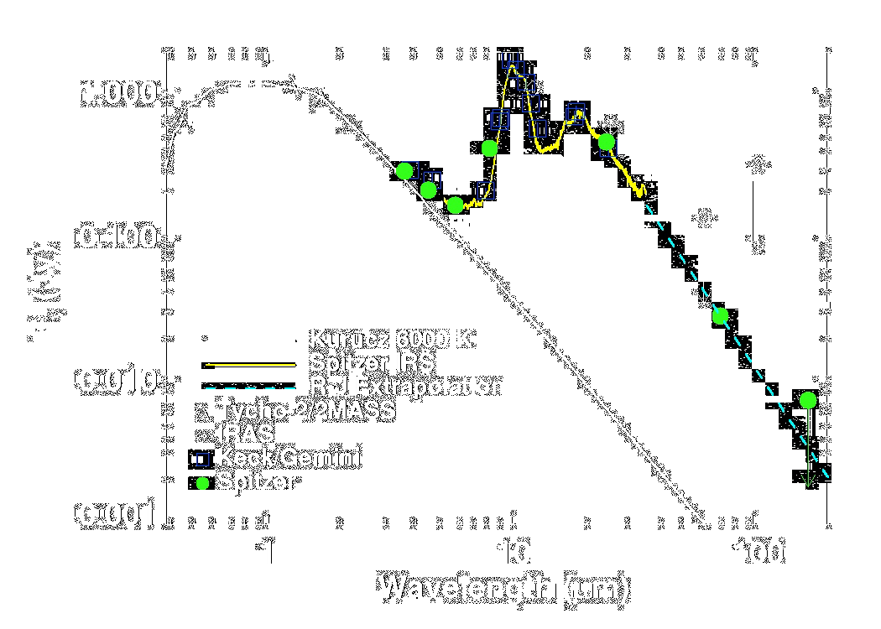
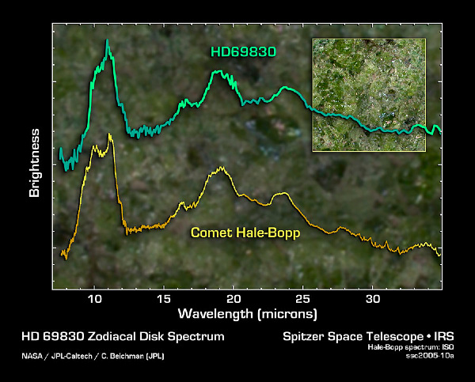
What about warm dust?
Very few « exozodiacal » discs identified
Dust not precisely located (SED modelling)
Global architecture of planetary systems?
Environment of terrestrial planets?
Possible threat for Earth-like planet imaging
Beichman et al. 2005
Weinberger et al. 2009

Slide 9

quest for warm dust
Direct imaging

Slide 10
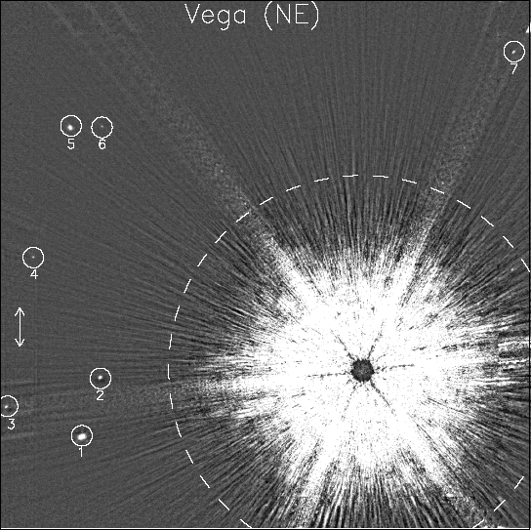
The challenges of direct imaging
High contrast (≥ 1:100)
Small angular separation
Inner disc: a few 10 mas
Requires IR interferometry
?
?
15’’
40 K
1500K → 300K
Macintosh et al. 2003 (Keck AO)
Vega’s SED

Slide 11
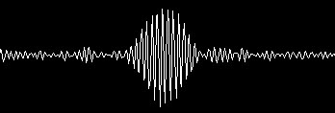
Stellar interferometry
calibration
Model: stellar disk
1 baseline = information on source morphology at 1 given spatial frequency (b/λ)
Notes:
Light path equalization to produce interference fringe (coherence length only a few wavelengths)
Van Cittert – Zernike theorem: each baseline gives ONE information on the morphology of the source
More precisely, the fringe contrast is equal to the Fourier transform of the source at spatial frequency b/lambda
Band-pass filter instead of low-pass filter
Warning: calibration needed to measure the response of the instrument (like the point spread function of a telescope)

Slide 12


Debris discs by interferometry
Disc larger than angular resolution (λ/b) → incoherent flux
Induces a loss visibility at all baselines
Best detected at short baselines (~10-30m)
Fully resolved at ~200m
Flux ratio
Requires very good accuracy (~1%)
Fully resolved at ~10m

Slide 13
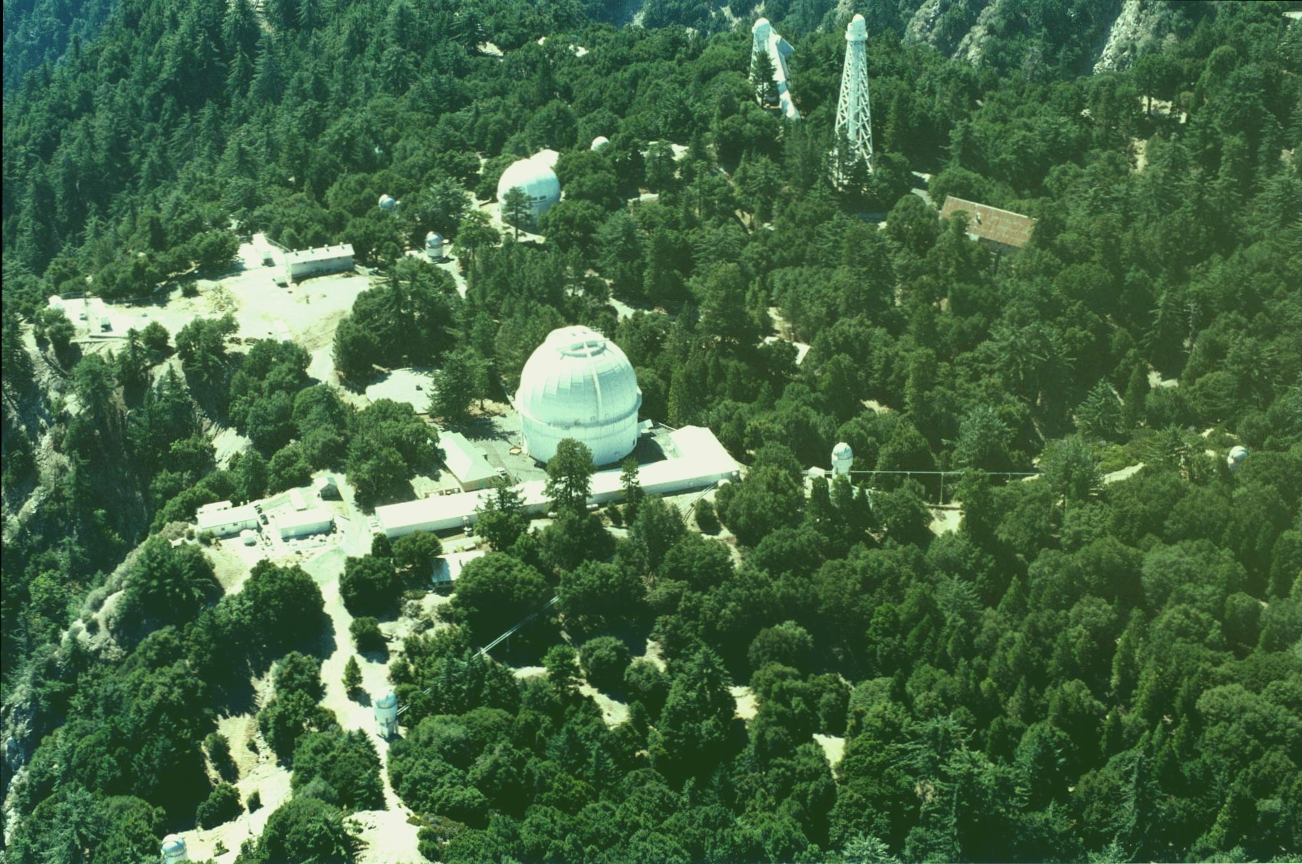
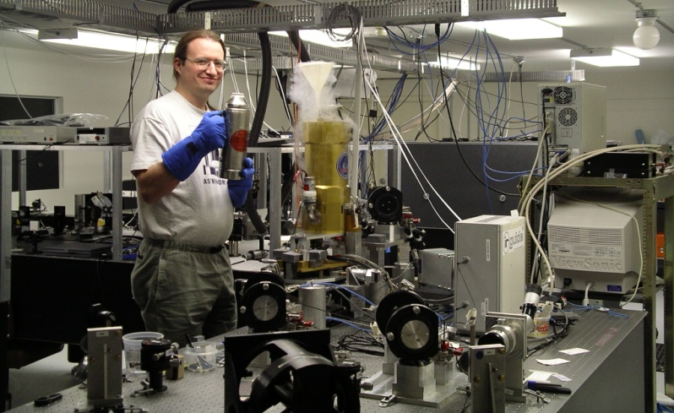
CHARA – FLUOR
Centre for High Angular Resolution Astronomy
Fibre Linked Unit for Optical Recombination
K band (2.2µm)
FoV: 1 arcsec
34m
330m
1m collectors
Notes:
One of the world’s most advanced interferometer
FLUOR: fibres → perfect coherence of the beams, intensity monitored, field-of-view
Very stable transfer function → most precise interferometric instrument currently available! (stellar diameter measurements at a few 0.1%)
Thanks to CHARA/FLUOR, we are now in a position to investigate inner debris disks!

Slide 14

Vega: fitting photosphere model

Slide 15

Vega: fitting photosphere + disc
Absil et al. 2006
3σ

Slide 16
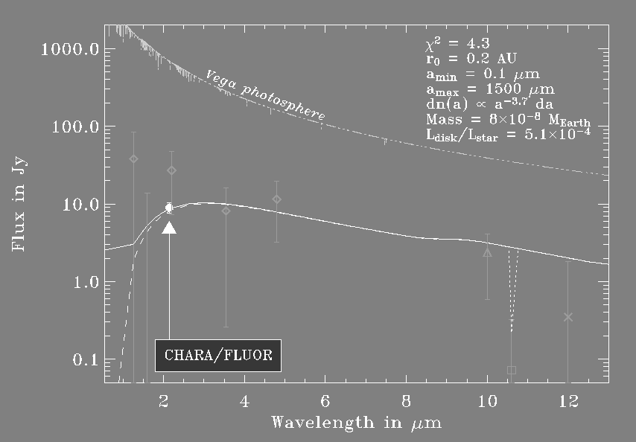
Reproducing the global SED
Radiative transfer modelling of the inner debris disc
Imply small carbon grains at 0.1-0.5 AU, close to sublimation (1500 K)
Absil et al. 2006
Notes:
Plot of stellar photospheric flux and of the constraints on the disk flux
Most constraining is our point, other = archival photometric measurements
Fitted a circumstellar disk model to these data, using various compositions and size distribution for the grains with model from JC Augereau (1999)
Gives the following information on the nature of the dust:
(…)
Objective:
Show that our measurement is compatible with photometry and N-band constraint from nulling interferometry
Derive some properties of the dust disk
Fitting procedure:
Using various compositions and size distribution for the grains with model from JC Augereau (1999)
Adjusting minimum grain size and inner radius of the dust disk to the observed SED
Size smaller than domestic dust
Physical explanation: large K-band flux while moderate N-band flux → small, hot and not silicate!

Slide 17
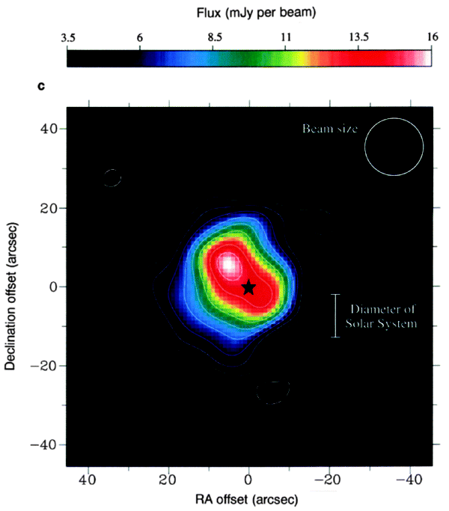
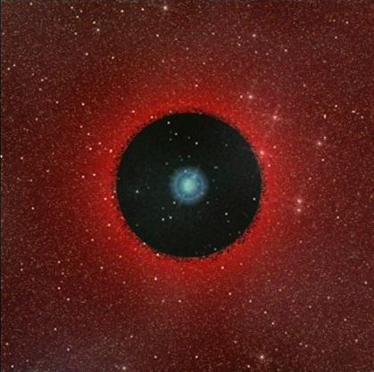
Our new view of Vega
Holland et al. 1998
Debris disc
8 × 10⁻⁸ M⊕
5 × 10⁻⁴ L
200 AU
0.3 AU
3 × 10⁻³ M⊕
3 × 10⁻⁵ L
Where does all this dust come from?
Small → very short lifetime (radiation pressure)
Need high replenishment rate
More than 1000 × our zodiacal cloud!

Slide 18
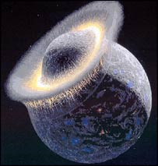
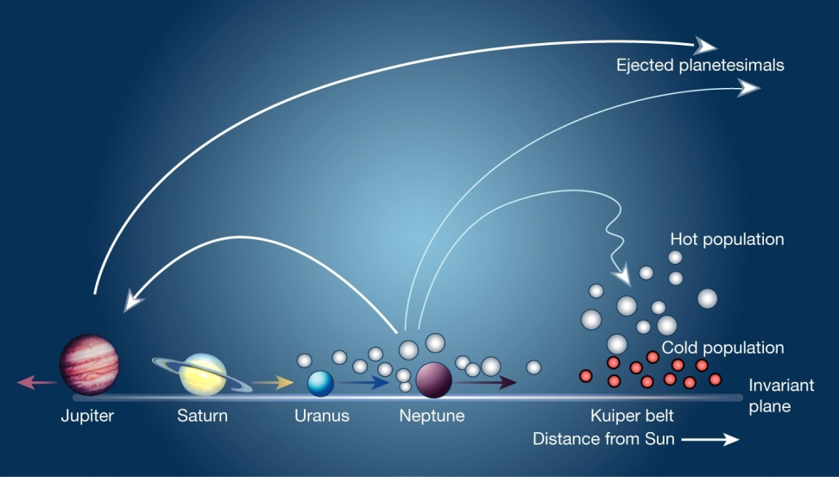
Possible scenarios?
Steady state asteroid belt
Exceeds maximum luminosity at 350 Myr (Wyatt 2007)
Need transient event
Isolated event?
Large collision (e.g. Earth-Moon)
Break-up of a super-comet
Dynamical perturbations?
Falling Evaporating Bodies
Asteroid belt disturbed by MMR with massive planet
Late Heavy Bombardment
Global rearrangement

Slide 19
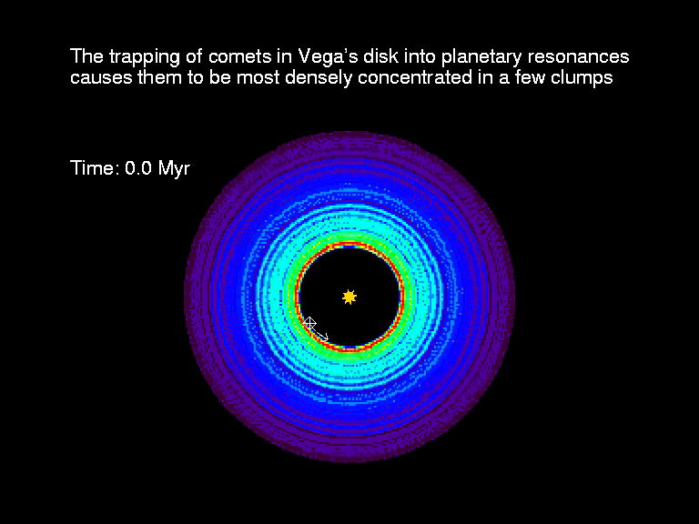
Late Heavy Bombardment
Can also explain structure of Vega’s outer disc
Outward migration of a Saturn-type planet
Holland et al. 1998
Wyatt et al. 2003

Slide 20
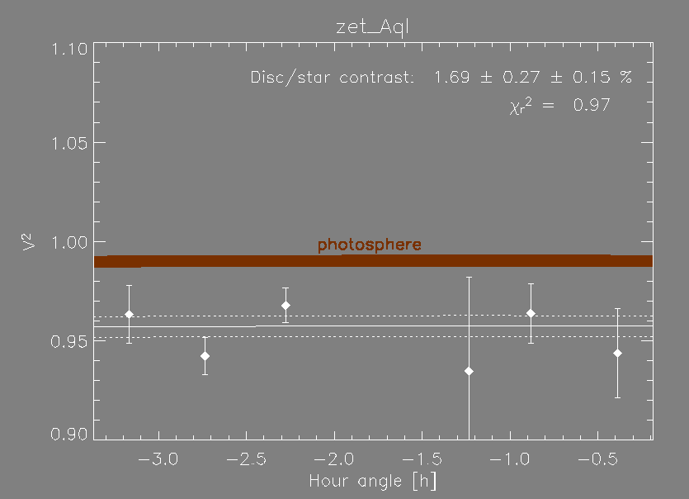
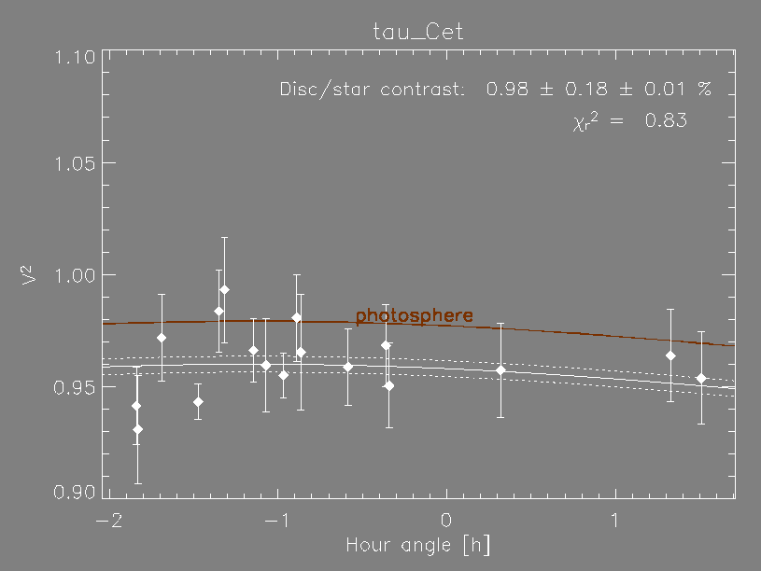
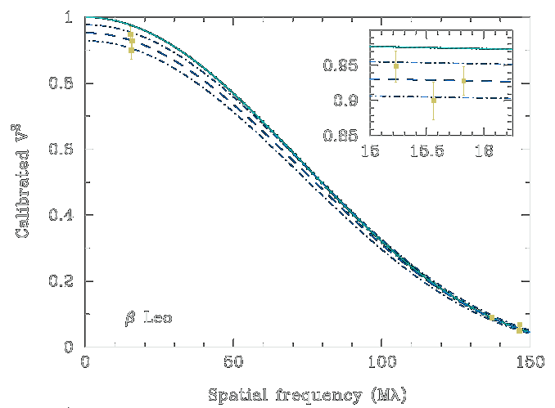
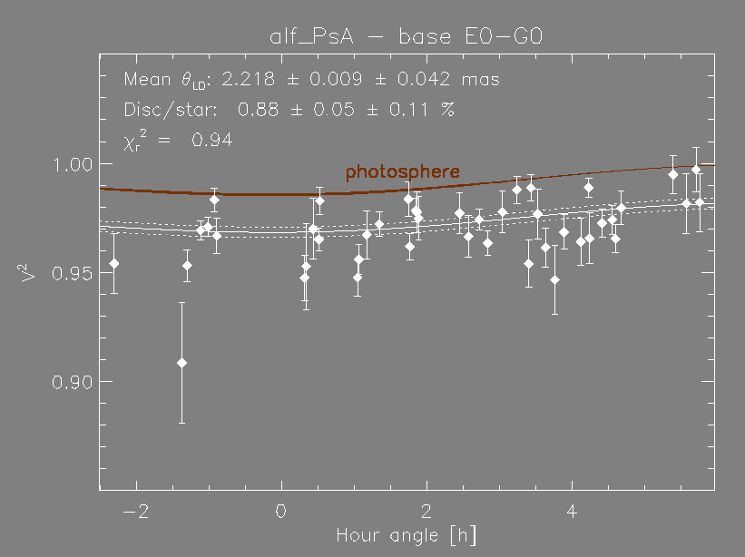
Exozodiacal discs galore!
ζ Aql – A0V
τ Cet – K2V
Absil et al. 2008
Di Folco et al. 2007
β Leo – A2V
Fomalhaut – A4V
Akeson et al. 2009
Absil et al., submitted

Slide 21
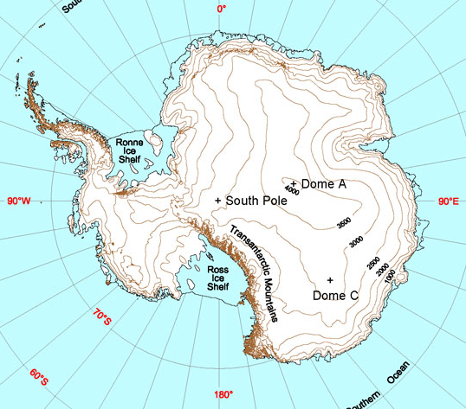
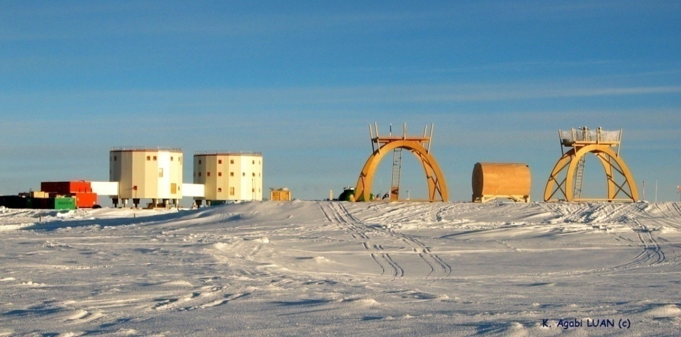
Future: nulling ... in Antarctica
b
2λ/D
Constructive
0
π
λ/b
Destructive
Key parameter = atmosphere stability

Slide 22
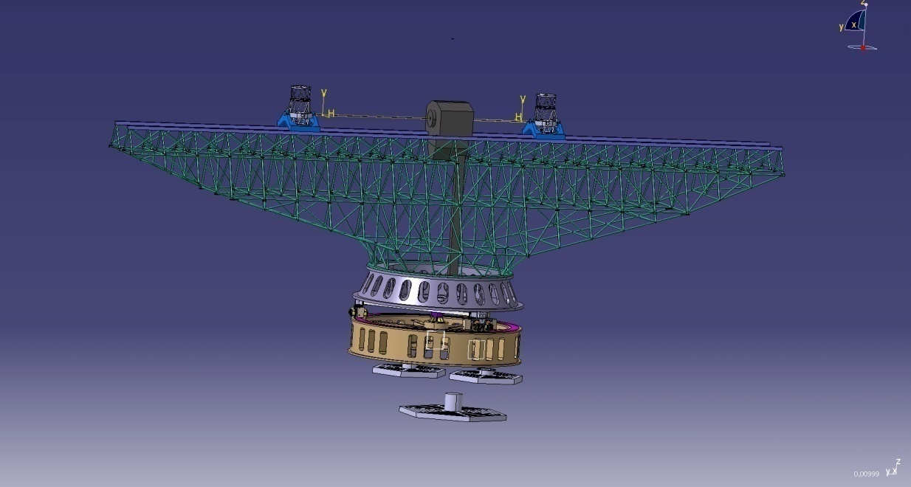
The ALADDIN project
Expected sensitivity: 10x to 100x better
Based on realistic end-to-end modelling (Absil et al. 2007)
© AMOS 2008

