Slide 1
STEEL HOLLOW COLUMNS FILLED WITH SELF-COMPACTING CONCRETE UNDER FIRE CONDITIONS
Jean Claude Dotreppe, Thi Binh Chu, Jean Marc Franssen
University of Liège, Belgium

Slide 2
INTRODUCTION
Concrete filled steel hollow section (CFSHS) columns can carry important loads and therefore are used extensively in the construction of high-rise buildings.
Steel hollow sections are filled usually with ordinary concrete, but filling problems may arise with small cross sections and dense reinforcement or hollow sections (tubes) surrounding another profile (tube or H section) when the distance between the two profiles is small.
For such a configuration, self-compacting concrete can be recommended.
Ten columns filled with self-compacting concrete embedding another steel profile have been tested in the Fire Engineering Laboratory of the University of Liege – Belgium.

Slide 3
In order to simulate these tests, advanced calculations have been performed using the non linear finite element software SAFIR developed at the University of Liege for the simulation of thermal and structural behavior under ordinary and fire conditions.
The aim of these simulations was to analyse the behaviour of these columns and to see whether some calibrations had to be introduced in SAFIR.
This numerical experimentation aimed also at indicating whether the properties of SCC at high temperatures could be considered to be the same as those of ordinary concrete.
Another purpose of this study was to give practical tools to consulting engineers in order to perform a quick and safe design of this type of profile under fire conditions.

Slide 4
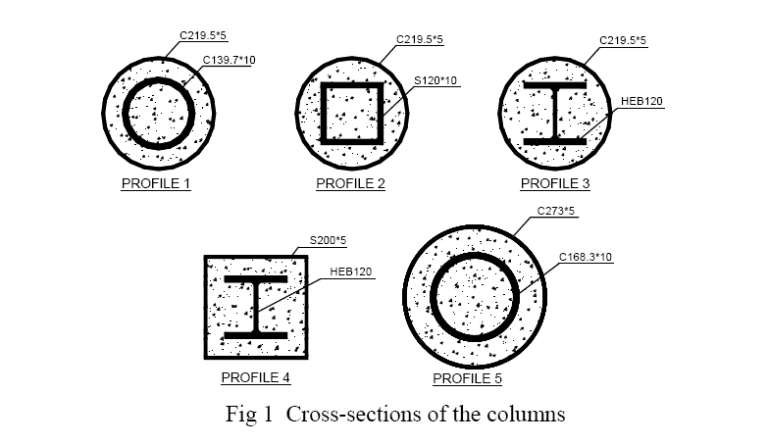
EXPERIMENTAL PROGRAM
SPECIMEN PREPARATION
10 specimens have been tested
All columns are simply supported with the length 3310 mm. There are five different cross sections named profile 1 to profile 5 (Fig.1), each profile being tested twice.
The details of each column are listed in Table 1 presented in the paper, but not reproduced here.

Slide 5
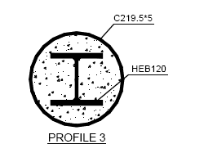

The cross-section of columns 3A and 3B are identical but column 3A has been tested with the eccentric compressive load creating buckling around the major axis, while column 3B has been tested with buckling around the minor axis.
In this case, the fire resistance will be much lower. Therefore, column 3B was protected by intumescent paint.
The same is valid for the couple 4A – 4B.

Slide 6
TESTING DEVICE
The fire tests have been performed in the Fire Testing Laboratory of the University of Liege-Belgium. The tests have been carried out in accordance with EN 1365-4.
The vertical furnace is 3250 mm wide and 3250 mm high. At the origin the furnace was built to test only vertical separating elements. Therefore a new part was built and attached to the old part.
All burners are inside the old part of the furnace chamber.
Therefore thermal gradients are expected between the new part and the old part of the furnace, which will be confirmed by experimental results.

Slide 7
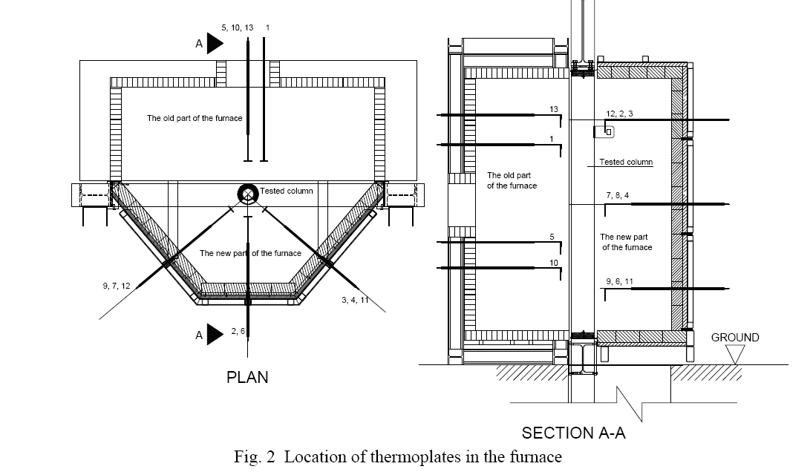

Slide 8
EXPERIMENTAL RESULTS AND BEHAVIOR OF THE COLUMNS
In all tests the columns were hinged at both ends.
The transversal displacement at mid-height of the columns was registered using a wire going outside of the furnace. The error due to the thermal elongation of the wire has been estimated.
In some tests the deflection during loading was evaluated by another procedure. Two strain gauges were attached for measuring the strains at two points situated opposite on the external tube at middle height of the column. It was thus possible to measure the deformation of the column in the loading stage (at room temperature).

Slide 9
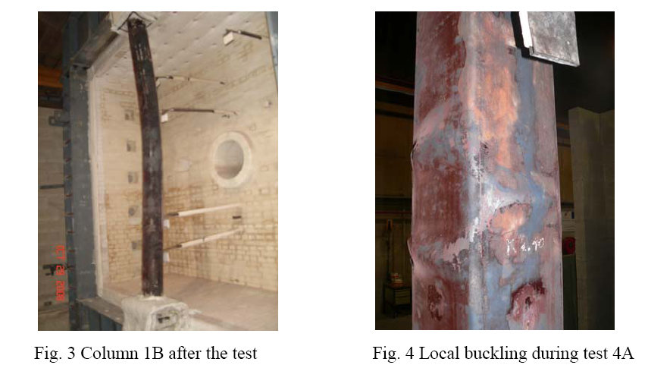
All columns failed by overall buckling although small marks of local buckling of the steel tube have been observed on some columns.

Slide 10
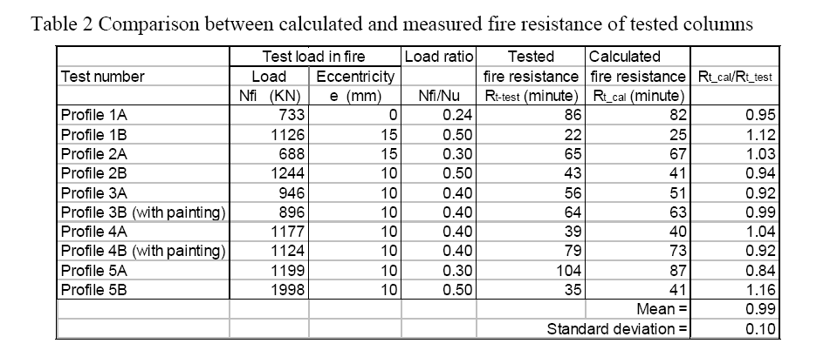

Slide 11
SIMULATIONS AND EVALUATION
All tested columns have been simulated using SAFIR computer code, a non linear finite element software developed at the University of Liege for the simulation of thermal and structural behaviour under ordinary and fire conditions.
The analysis of a structure exposed to fire consists of two steps :
« thermal analysis »
« structural analysis », i.e. the mechanical response of the structure due to the thermal effects, the load remaining constant during the fire.

Slide 12
THERMAL ANALYSIS
The thermal interaction (gap) between external steel section and concrete core is taken into account by means of a fictitious thermal resistance assumed constant along the steel-concrete interface and independent of the temperature.
This thermal resistance (R) has been obtained by numerical experimentation, comparing a large number of experimental results with the simulations made by SAFIR.
The value adopted is 0.013 m² K/W.

Slide 13
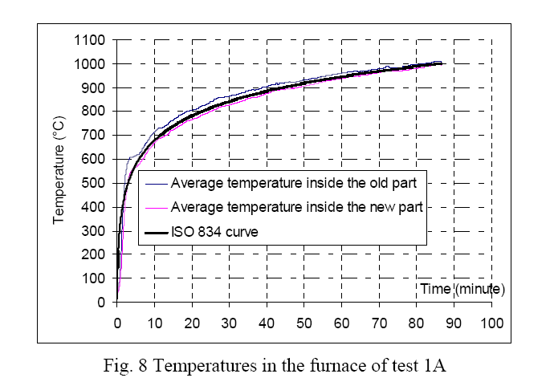
As previously mentioned, thermal gradients are expected between the old part of the furnace with burners and the new part without burners.
The differences are less important than expected (about 30°C to 50°C) but they have been introduced in the simulations

Slide 14
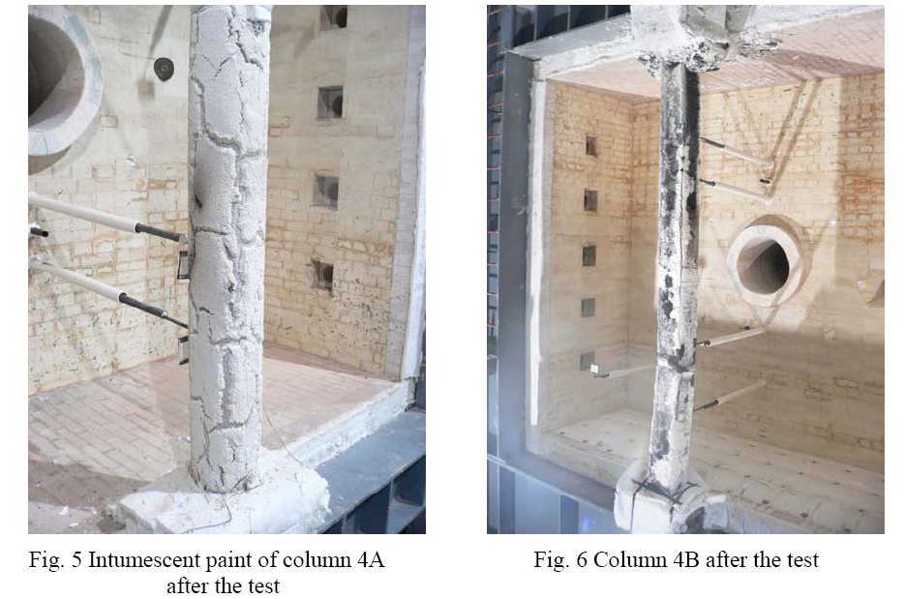
Two columns 3B and 4B are fire protected by intumescent paint that starts swelling at relatively low temperatures (about 200°C to 300°C).
According to the observations made during the test, there were many cracks in the painted layer and they were progressing with temperature (Fig. 5).

Slide 15
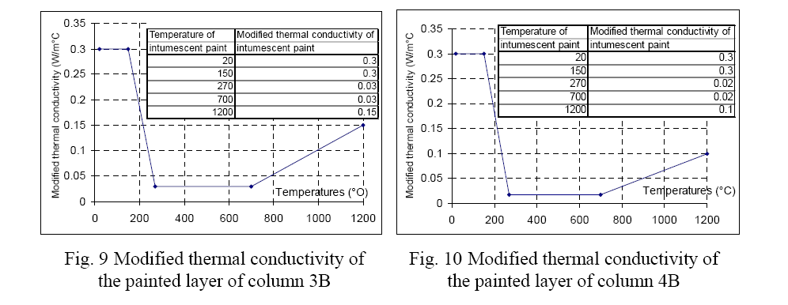
It is of course impossible to measure the change of thickness of the layer of intumescent paint during fire.
Therefore, in simulations, it is assumed that the thickness remains unchanged with temperature (fixed at 1 mm in calculations), while the characteristic value of the thermal conductivity varies with temperature.
The modified thermal conductivity of the painted layer was adjusted to get a good agreement between measured and simulated temperatures in the profiles.

Slide 16
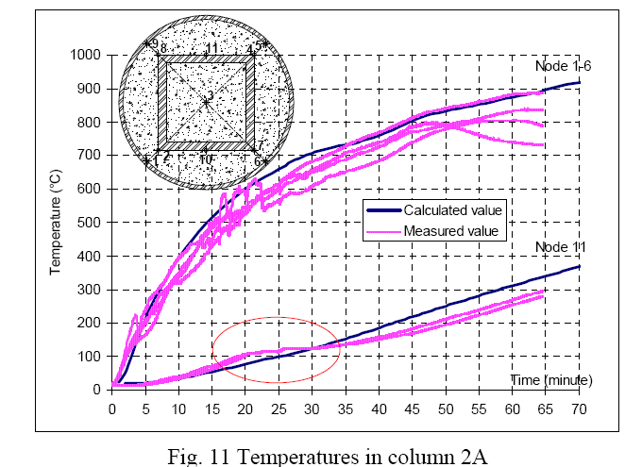
Calculated temperatures on the external hollow section are in good agreement with the measured temperatures ;
There are systematic differences between calculated and measured temperatures at the internal profile. These differences can be explained by the migration of vapour in concrete (not taken into account in the model)

Slide 17
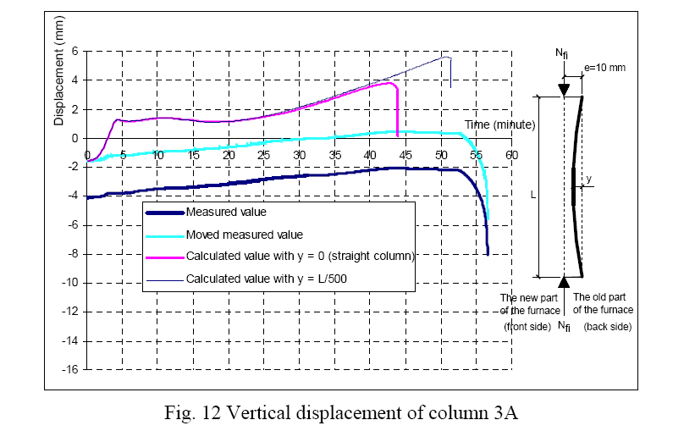
STRUCTURAL ANALYSIS

Slide 18
At the beginning of the fire test, there is a difference between the measured and the calculated displacements. This has been explained by the particularity of the testing device. To easily compare vertical displacements, a translation of the measured value has been made.
The calculated elongation of the columns is higher than the measured value in the first 5 minutes of testing. This can be explained by differences between calculated and measured temperatures at the very beginning of the test.
After this early stage, the calculated variation of vertical displacements agrees well with the measured values.

Slide 19
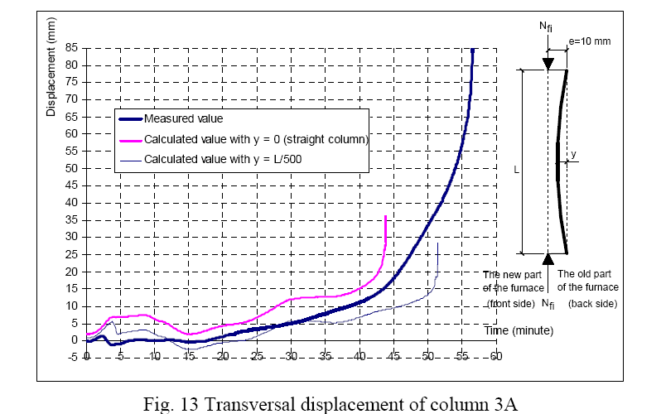

Slide 20
The transversal displacements are predicted rather well except at the beginning and near failure.
The discrepancies at the beginning are due to various parameters
the value of the initial deformation
the direction of this deformation (same or opposite with respect to the initial eccentricity)
the thermal gradient in the furnace
the differences between the real temperature field and the one chosen in the model
The tested columns behaved in a relatively ductile manner. But in simulations, the columns failed in a less ductile manner : the transversal displacements change steeply from small to large values. This ductile behaviour could be due to the confinement of the concrete core due to the internal steel tube (not taken into account in the model).

Slide 21
CONCLUSIONS
A series of fire tests on steel hollow section columns filled with self-compacting concrete embedding another steel profile has been reported. The following main observations have been made during the tests :
All columns failed by overall buckling;
Small marks of local buckling of the external steel tube have been observed on some columns;
The tested columns behaved in a relatively ductile manner;
The fire resistance is highly dependent on the load ratio.

Slide 22
Numerical simulations using SAFIR computer code have been performed.
The calculated temperatures are in agreement with reality provided a thermal resistance between the steel tube and the concrete core is introduced;
For profiles covered with intumescent paint, a modified thermal conductivity based on a constant thickness of 1 mm has been proposed;
There is a very good agreement between the tested and calculated values of the fire resistance duration;
The axial and lateral displacements of the columns are predicted rather well except at the beginning and near failure;
The ductile behavior near failure could be due to the confinement effect of the internal steel tube not taken into account in the simulations;
The properties of SCC at elevated temperatures appear to be very similar to those of normal vibrated concrete.

Slide 23



This research study has been performed at :
University of Liège, Belgium
Department of Architecture, Geology, Environment and Construction (ArGEnCo)
Division of Structural Engineering (SE)
The authors gratefully acknowledge the financial support of Belgian FNRS –
National Funds for Scientific Research

