Slide 1


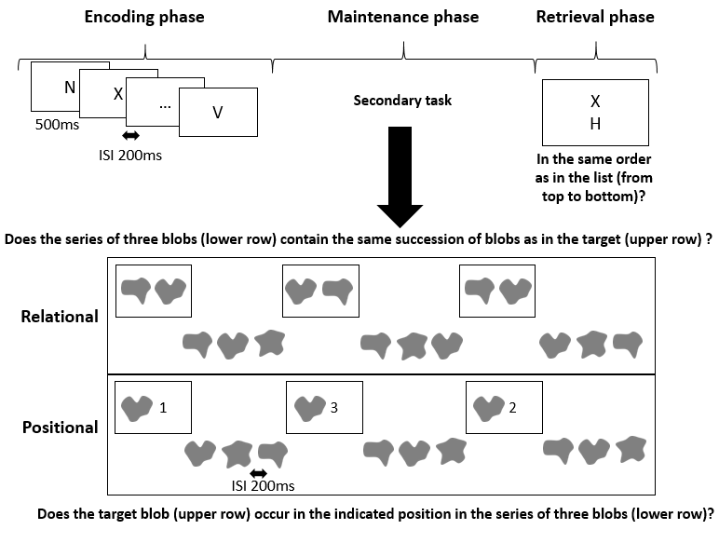
The nature of serial order codes in verbal working memory
R. REMOUCHAMPS ª, S. MAJERUS ª
ª University of Liège, Belgium
Introduction
Results
The nature of codes used for representing serial order in verbal working memory (WM) is a critical yet unresolved question
Positional models propose that serial order is encoded through position-item bindings (e.g., Burgess & Hitch, 1999, Oberauer et al., 2012).
Chaining models propose that serial order is represented by a chaining mechanism (i.e., relational codes) where each item predicts the next (Ebbinghaus, 1964).
Both codes may operate independently or jointly, or only one type of the codes may be involved.
We tested these predictions by selectively manipulating positional and relational interference during encoding of serial order information in WM, by examining the impact on the distance effect, a marker of serial order processing in WM.
Proportion correct
N=50
Condition*Distance
BF01: 19.378
Best model | condition + distance + (1+condition*distance|ID) | BF10 = 1784944
Hypotheses
Note. Bayes factor results from a model comparison against a null model..
Standard distance effect
= higher accuracy and faster RTs for large distances due to more distinctive positional separation of items to-be-compared
→ Positional interference: attenuates the effect → Relational interference: amplifies the effect
Reverse distance effect
= higher accuracy and faster RTs for shorter distances due to shorter item chains to examine
→ Relational interference: attenuates the effect
→ Positional interference: amplifies the effect
RT
N=50
Condition*Distance
BF01: 480.427
Methods
Serial order probe recognition task
Best model | condition + distance + (1+condition + distance|ID) | BF10 = 6499.17
Note. Note. Bayes factor results from a model comparison against a null model. RT data was clean using MAD (Median absolute deviation) (Leyse et al., 2013).
Discussion
No interaction effects were observed for either accuracy or RTS, indicating that neither interference condition modified the distance effect. However, overall accuracy showed a standard distance effect, consistent with positional accounts, whereas RTs showed a non-monotonic pattern partly consistent with both accounts.
References
Burgess, N., & Hitch, G. J. (1999). Memory for serial order: A network model of the phonological loop and its timing. Psychological review, 106(3), 551.
Oberauer, K., Lewandowsky, S., Farrell, S., Jarrold, C., & Greaves, M. (2012). Modeling working memory: An interference model of complex span. Psychonomic bulletin & review, 19(5), 779-819.
Ebbinghaus, H. E. Memory: A contribution to experimental psychology. New York: Dover, 1964. (Originally published,1885.)
Leys, C., Ley, C., Klein, O., Bernard, P., & Licata, L. (2013). Detecting outliers: Do not use standard deviation around the mean, use absolute deviation around the median. Journal of experimental social psychology, 49(4), 764-766.

