Slide 1


Modal response of a tapered lightning tower subjected to vortex-induced vibrations
Juliette Zeoli¹, Tom Bertrand¹, Edouard Verstraelen², Vincent Denoël¹
¹ Structural & Stochastic Dynamics research group, department of Architecture, Geology, Environment and Constructions, University of Liège, Belgium
² Wind Tunnel Lab (WTL), department of Aerospace and Mechanics, University of Liège, Belgium
In-Vento 2026 – 14th Italian conference on wind engineering – 16th of September 2026

Slide 2
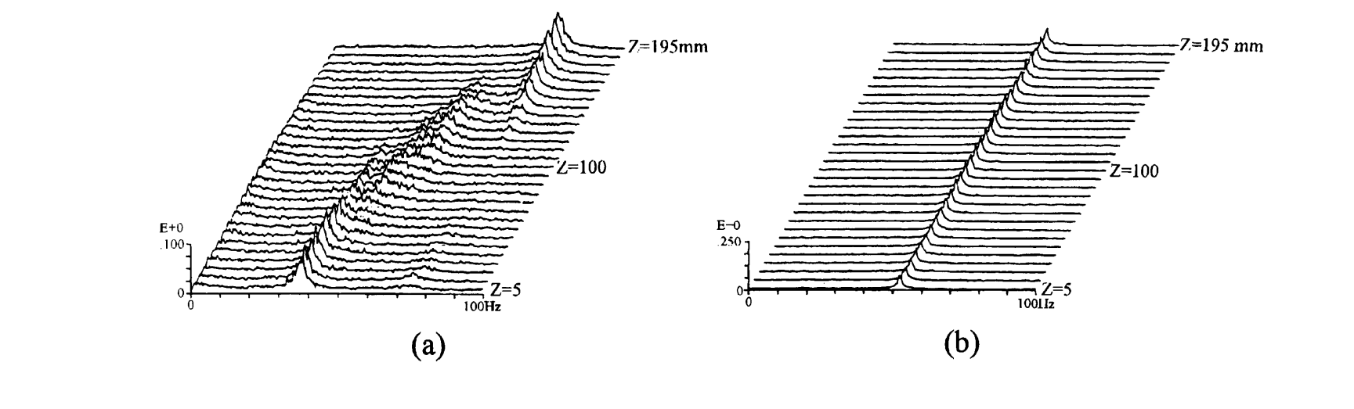
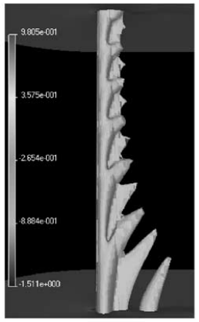
State of the art
Tapering induces shedding cells
Higher Re → more cells
Interaction with structural motion : larger lock-in range and coexistence of shedding modes
Studies at low Re (20 – 200)
Power spectra of the flow along the span for a constant-diameter cylinder
Constant height (4d-6d)
Constant shedding frequency
Power spectra of the flow along the span for a tapered cylinder
From Hsiao, Fei-Bin, and Chih-Huang Chiang. "Experimental study of cellular shedding vortices behind a tapered circular cylinder."
Instantaneous flow field
From Valles, B., H. I. Andersson, and C. B. Jenssen. "Oblique vortex shedding behind tapered cylinders."
Gaster, 1969: Vortex shedding from slender cones at low Reynolds numbers
Piccirillo and Von Atta, 1993: An experimental study of vortex shedding behind linearly tapered cylinders at low Reynolds number
Hsiao et al., 1998: Experimental study of cellular shedding vortices behind a tapered circular cylinder
Vallès et al., 2002: Oblique vortex shedding behind tapered cylinders
Visscher, J., B. Pettersen, and H. I. Andersson, 2011: Experimental study on the wake behind tapered circular cylinders

Slide 3
Challenge
4 cm
Rod
4 m
15 cm
Fatigue failure on the rod
VIV issues on lightning towers
Mast
22 m
55 cm

Slide 4
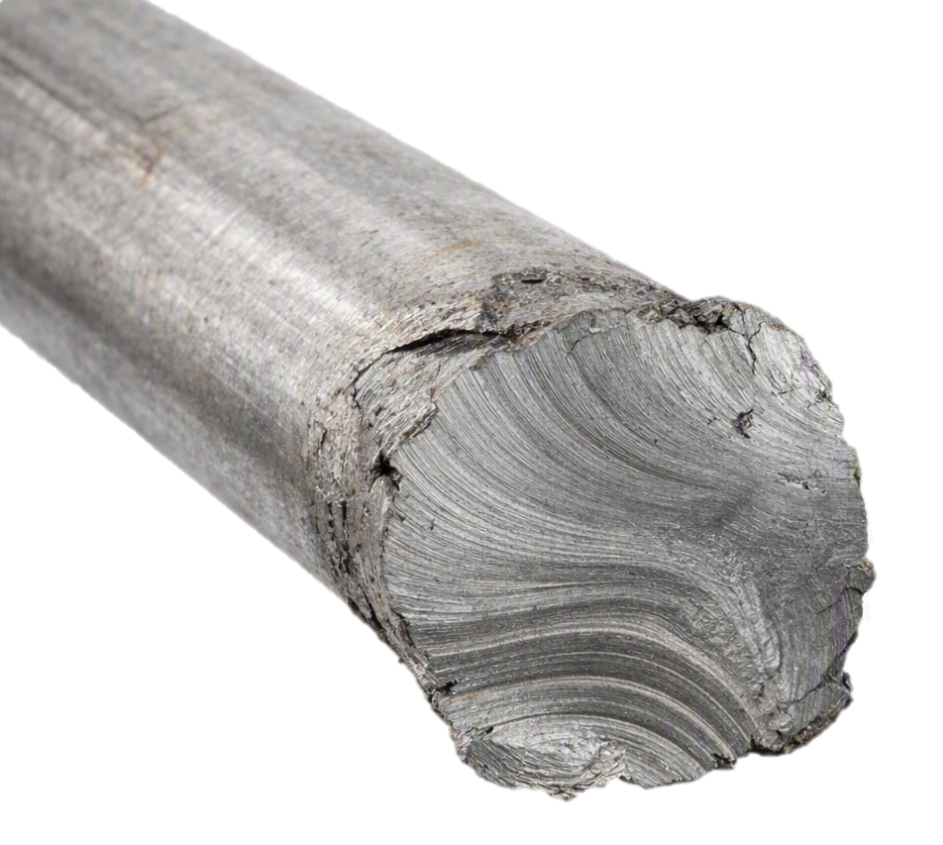
Challenge
4 cm
Rod
4 m
15 cm
Fatigue failure on the rod
VIV issues on lightning towers
Whip effect on the rod
  Eurocode computations
  Wind tunnel tests
Fatigue failure
Mast
22 m
55 cm

Slide 5


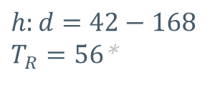
Models
Cylinder
$$h:d=42$$
Tapered Cylinder
$$h:d=42−168$$
$T_{R}=56$*
2.4 cm
0.5 cm
100 cm
84 cm
2.4 cm
2.02 cm
$${\text{∗ }T}_{R}=\frac{h}{d_{bottom}−d_{top}}$$

Slide 6
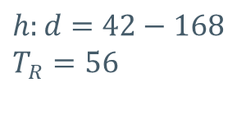
Models
Cylinder
$$h:d=42$$
Tapered Cylinder
$$h:d=42−168$$
$$T_{R}=56$$
2.4 cm
0.5 cm
100 cm
84 cm
2.4 cm
2.02 cm

Slide 7
Models
Cylinder
$$h:d=42$$
Tapered Cylinder
$$h:d=42−168$$
$$T_{R}=56$$
2.4 cm
0.5 cm
PLA
(3d printed)
100 cm
PVC
84 cm
2.4 cm
2.02 cm

Slide 8
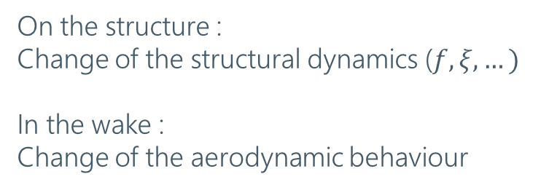
Sensors
On the structure :
Change of the structural dynamics ($f, ξ, …)$
In the wake :
Change of the aerodynamic behaviour
Pitot tube
Wind profile
Force sensor
ATI Gamma Multi-Axis force sensor
I_{v} ~0.3%
Re [1300-30,000]

Slide 9


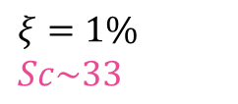
Measurements
Ping test
$$ξ=1\%$$
$$Sc\sim 33$$
$$σ_{y}/d$$
Low VIV expected
$$Sc$$
Speed range [1 ; 20] m/s
  ↗Ramp up
  ↙Ramp down
30’’ steady-state + 45’’ measurement

Slide 10


Base shear
$$u=15 m/s$$
1.00
0.75
0.50
0.25
0.00
-0.25
-0.50
-0.75
-1.00
$$u=15 m/s$$
6.0
4.0
2.0
0.0
-2.0
-4.0
-6.0
Cross-flow force [N]
Cross-flow force [N]
1.0 1.5 2.0 2.5 3.0 3.5 4.0 4.5 5.0
1.0 1.5 2.0 2.5 3.0 3.5 4.0 4.5 5.0
10⁰
10⁻²
10⁻⁴
10⁻⁶
10⁻⁸
Time [s]
10⁰
10⁻²
10⁻⁴
10⁻⁶
10⁻⁸
Time [s]
Amplitude [N²/Hz]
Amplitude [N²/Hz]
0 50 100 150 200 250 300 350 400
0 50 100 150 200 250 300 350 400
Frequency [Hz]
Frequency [Hz]

Slide 11
Base shear
$$u=15 m/s$$
1.00
0.75
0.50
0.25
0.00
-0.25
-0.50
-0.75
-1.00
$$u=15 m/s$$
6.0
4.0
2.0
0.0
-2.0
-4.0
-6.0
Cross-flow force [N]
Cross-flow force [N]
1.0 1.5 2.0 2.5 3.0 3.5 4.0 4.5 5.0
1.0 1.5 2.0 2.5 3.0 3.5 4.0 4.5 5.0
10⁰
10⁻²
10⁻⁴
10⁻⁶
10⁻⁸
Time [s]
10⁰
10⁻²
10⁻⁴
10⁻⁶
10⁻⁸
Time [s]
Amplitude [N²/Hz]
Amplitude [N²/Hz]
0 50 100 150 200 250 300 350 400
0 50 100 150 200 250 300 350 400
Frequency [Hz]
Frequency [Hz]

Slide 12
Base shear
$$u=15 m/s$$
1.00
0.75
0.50
0.25
0.00
-0.25
-0.50
-0.75
-1.00
$$u=15 m/s$$
6.0
4.0
2.0
0.0
-2.0
-4.0
-6.0
Cross-flow force [N]
Cross-flow force [N]
1.0 1.5 2.0 2.5 3.0 3.5 4.0 4.5 5.0
1.0 1.5 2.0 2.5 3.0 3.5 4.0 4.5 5.0
10⁰
10⁻²
10⁻⁴
10⁻⁶
10⁻⁸
Time [s]
10⁰
10⁻²
10⁻⁴
10⁻⁶
10⁻⁸
Time [s]
Amplitude [N²/Hz]
Amplitude [N²/Hz]
0 50 100 150 200 250 300 350 400
0 50 100 150 200 250 300 350 400
Frequency [Hz]
Frequency [Hz]

Slide 13
Spectrogram of the base shear
20.0
17.5
15.0
12.5
10.0
7.5
5.0
2.5
0
Flow Speed [m/s]
log base shear [N²/Hz]
-30
0 100 200 300 400
Frequency [Hz]

Slide 14

Spectrogram of the base shear
20.0
17.5
15.0
12.5
10.0
7.5
5.0
2.5
$$u=10 m/s$$
10⁻²
10⁻³
10⁻⁴
10⁻⁶
10⁻⁷
10⁻⁸
Amplitude [N²/Hz]
Flow Speed [m/s]
0 100 200 300 400
Frequency [Hz]
0 100 200 300 400
Frequency [Hz]

Slide 15
Natural frequencies
20.0
17.5
15.0
12.5
10.0
7.5
5.0
2.5
$$u=10 m/s$$
10⁻²
10⁻³
10⁻⁴
10⁻⁶
10⁻⁷
10⁻⁸
Mode 1
Mode 2
Mode 3
Mode 4
Mode 5
Amplitude [N²/Hz]
Flow Speed [m/s]
0 100 200 300 400
Frequency [Hz]
0 100 200 300 400
Frequency [Hz]

Slide 16
Strouhal Law
20.0
17.5
15.0
12.5
10.0
7.5
5.0
2.5
$$u=10 m/s$$
10⁻²
10⁻³
10⁻⁴
10⁻⁶
10⁻⁷
10⁻⁸
Amplitude [N²/Hz]
f_{shedding}
Flow Speed [m/s]
0 100 200 300 400
Frequency [Hz]
0 100 200 300 400
Frequency [Hz]

Slide 17
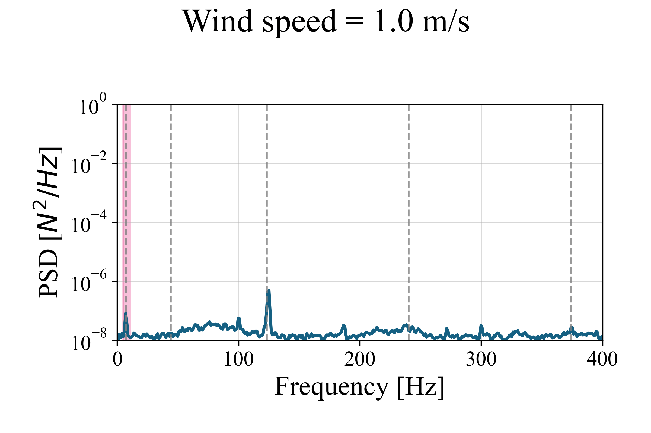
Strouhal Law
20.0
17.5
15.0
12.5
10.0
7.5
5.0
2.5
10⁰
10⁻²
10⁻⁴
10⁻⁶
10⁻⁸
f_{shedding}
Flow Speed [m/s]
Amplitude [N²/Hz]
0 100 200 300 400
Frequency [Hz]
0 100 200 300 400
Frequency [Hz]

Slide 18
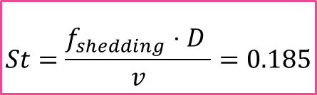
Strouhal Law
20.0
17.5
15.0
12.5
10.0
7.5
5.0
2.5
$$St=\frac{f_{shedding}⋅D }{v}=0.185$$
f_{shedding}
Flow Speed [m/s]
0 100 200 300 400
Frequency [Hz]

Slide 19
Strouhal Law
20.0
17.5
15.0
12.5
10.0
7.5
5.0
2.5
$$u=10 m/s$$
10⁻²
10⁻³
10⁻⁴
10⁻⁶
10⁻⁷
10⁻⁸
3f_{shedding}
Amplitude [N²/Hz]
Flow Speed [m/s]
f_{shedding}/3
0 100 200 300 400
Frequency [Hz]
0 100 200 300 400
Frequency [Hz]

Slide 20
Filtering of the PSDs + standard deviation
0.2
0.1
0.0
20.0
17.5
15.0
12.5
10.0
7.5
5.0
2.5
7.0 Hz
0.4
0.2
0.0
Mode 1
44.0 Hz
4.0
2.0
0.0
Mode 2
120.5 Hz
Mode 3
Flow Speed [m/s]
Amplitude of the cross-flow force at the base [N]
0.10
0.05
0.00
240.0 Hz
0.06
0.00
Mode 4
374.0 Hz
0 100 200 300 400
Mode 5
Frequency [Hz]
0 5 10 15 20
Flow Speed [m/s]

Slide 21
VIV-triggered zones
0.2
0.1
0.0
20.0
17.5
15.0
12.5
10.0
7.5
5.0
2.5
7.0 Hz
0.4
0.2
0.0
Mode 1
44.0 Hz
4.0
2.0
0.0
Mode 2
120.5 Hz
Mode 3
Flow Speed [m/s]
Amplitude of the cross-flow force at the base [N]
0.10
0.05
0.00
240.0 Hz
0.06
0.00
Mode 4
374.0 Hz
0 100 200 300 400
Mode 5
Frequency [Hz]
0 5 10 15 20
Flow Speed [N]

Slide 22
VIV-triggered zones
0.2
0.1
0.0
20.0
17.5
15.0
12.5
10.0
7.5
5.0
2.5
7.0 Hz
0.4
0.2
0.0
Mode 1
44.0 Hz
4.0
2.0
0.0
Mode 2
120.5 Hz
Mode 3
Flow Speed [m/s]
Amplitude of the cross-flow force at the base [N]
0.10
0.05
0.00
240.0 Hz
0.06
0.00
Mode 4
374.0 Hz
0 100 200 300 400
Mode 5
Frequency [Hz]
0 5 10 15 20
Flow Speed [m/s]

Slide 23
VIV-triggered zones
0.2
0.1
0.0
20.0
17.5
15.0
12.5
10.0
7.5
5.0
2.5
7.0 Hz
0.4
0.2
0.0
Mode 1
44.0 Hz
4.0
2.0
0.0
Mode 2
120.5 Hz
Mode 3
Flow Speed [m/s]
Amplitude of the cross-flow force at the base [N]
0.10
0.05
0.00
240.0 Hz
0.06
0.00
Mode 4
374.0 Hz
0 100 200 300 400
Mode 5
Frequency [Hz]
0 5 10 15 20
Flow Speed [m/s]

Slide 24
VIV-triggered zones
0.2
0.1
0.0
20.0
17.5
15.0
12.5
10.0
7.5
5.0
2.5
7.0 Hz
0.4
0.2
0.0
Mode 1
44.0 Hz
4.0
2.0
0.0
Mode 2
120.5 Hz
Mode 3
Flow Speed [m/s]
Amplitude of the cross-flow force at the base [N]
0.10
0.05
0.00
240.0 Hz
0.06
0.00
Mode 4
374.0 Hz
0 100 200 300 400
Mode 5
Frequency [Hz]
0 5 10 15 20
Flow Speed [m/s]

Slide 25
Inertial regime
0.2
0.1
0.0
20.0
17.5
15.0
12.5
10.0
7.5
5.0
2.5
7.0 Hz
0.4
0.2
0.0
Mode 1
44.0 Hz
4.0
2.0
0.0
Mode 2
120.5 Hz
Mode 3
Flow Speed [m/s]
Amplitude of the cross-flow force at the base [N]
0.10
0.05
0.00
240.0 Hz
0.06
0.00
Mode 4
374.0 Hz
0 100 200 300 400
Mode 5
Frequency [Hz]
0 5 10 15 20
Flow Speed [m/s]

Slide 26
Comparison of the models
20.0
17.5
15.0
12.5
10.0
7.5
5.0
2.5
20.0
17.5
15.0
12.5
10.0
7.5
5.0
2.5
Flow Speed [m/s]
Flow Speed [m/s]
0 100 200 300 400
0 100 200 300 400
Frequency [Hz]
Frequency [Hz]

Slide 27
Comparison of the models
20.0
17.5
15.0
12.5
10.0
7.5
5.0
2.5
20.0
17.5
15.0
12.5
10.0
7.5
5.0
2.5
Flow Speed [m/s]
Flow Speed [m/s]
0 100 200 300 400
0 100 200 300 400
Frequency [Hz]
Frequency [Hz]

Slide 28
Natural frequencies
20.0
17.5
15.0
12.5
10.0
7.5
5.0
2.5
Mode 1
Mode 2
Mode 3
Mode 4
Mode 5
Mode 6
Flow Speed [m/s]
0 100 200 300 400
Frequency [Hz]

Slide 29
Shedding areas
20.0
17.5
15.0
12.5
10.0
7.5
5.0
2.5
Flow Speed [m/s]
0 100 200 300 400
Frequency [Hz]

Slide 30
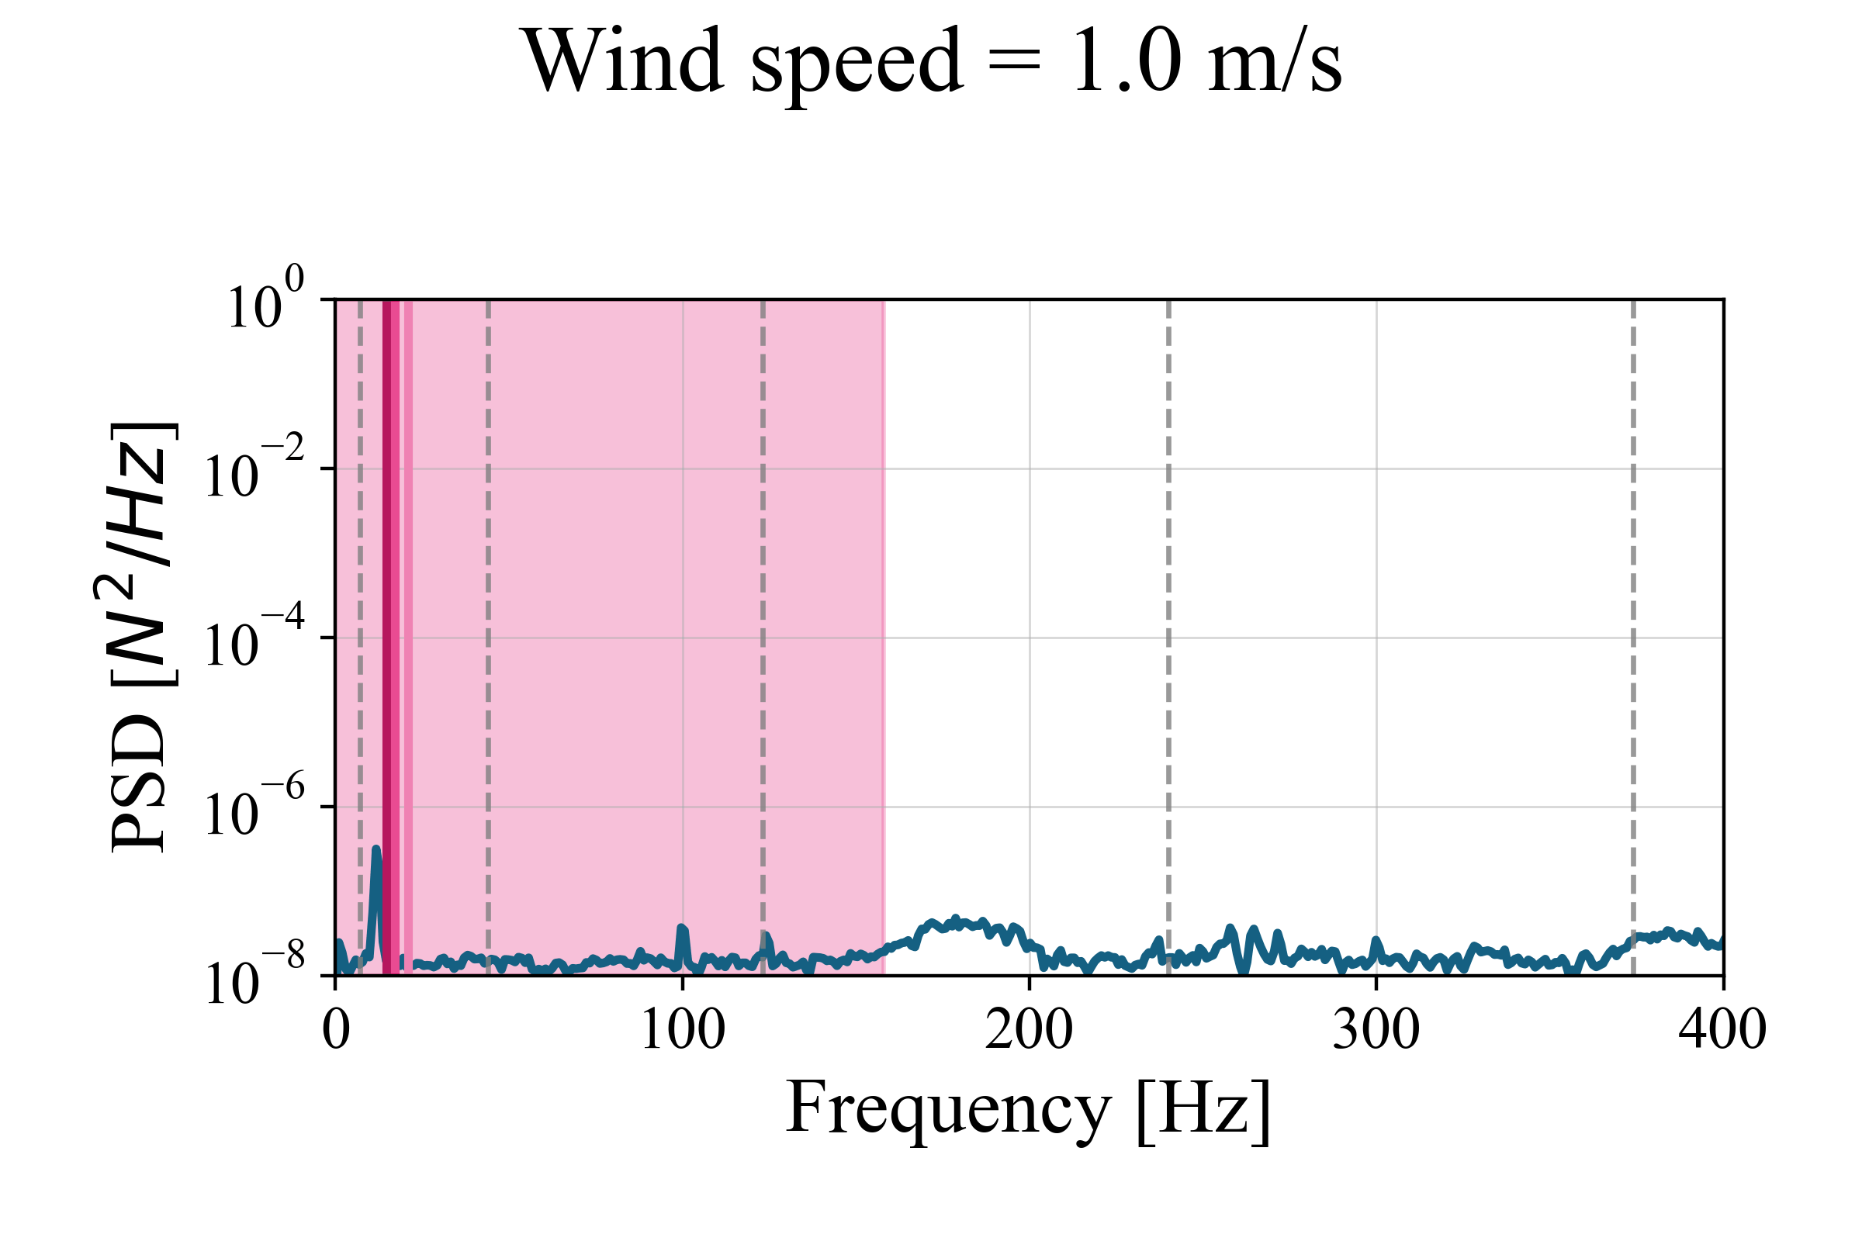
Shedding areas
20.0
17.5
15.0
12.5
10.0
7.5
5.0
2.5
10⁰
10⁻²
10⁻⁴
10⁻⁶
10⁻⁸
Flow Speed [m/s]
Amplitude [N²/Hz]
0 100 200 300 400
Frequency [Hz]
0 100 200 300 400
Frequency [Hz]

Slide 31
Filtering of the PSDs + standard deviation
0.02
0.01
0.00
20.0
17.5
15.0
12.5
10.0
7.5
5.0
2.5
11.9 Hz
0.04
0.02
0.00
Mode 1
39.9 Hz
0.05
0.00
Mode 2
91.0 Hz
Flow Speed [m/s]
Amplitude of the cross-flow force at the base [N]
0.2
0.1
0.0
Mode 3
169.0 Hz
1.0
0.5
0.0
Mode 4
268.7 Hz
0 100 200 300 400
Mode 5
Frequency [Hz]
0 5 10 15 20
Flow Speed [m/s]

Slide 32
Shedding cells
0.02
0.01
0.00
20.0
17.5
15.0
12.5
10.0
7.5
5.0
2.5
11.9 Hz
0.04
0.02
0.00
Mode 1
39.9 Hz
0.05
0.00
Mode 2
91.0 Hz
Flow Speed [m/s]
Amplitude of the cross-flow force at the base [N]
0.2
0.1
0.0
Mode 3
169.0 Hz
1.0
0.5
0.0
Mode 4
268.7 Hz
0 100 200 300 400
Mode 5
Frequency [Hz]
0 5 10 15 20
Flow Speed [m/s]

Slide 33

Shedding cells identification with diameter
0.02
0.01
0.00
11.9 Hz
0.04
0.02
0.00
Mode 1
39.9 Hz
0.05
0.00
Mode 2
91.0 Hz
$$St=0.185$$
Amplitude of the cross-flow force at the base [N]
0.2
0.1
0.0
Mode 3
169.0 Hz
1.0
0.5
0.0
Mode 4
268.7 Hz
Mode 5
0 5 10 15 20
Flow Speed [m/s]

Slide 34


Shedding cells identification with diameter
0.02
0.01
0.00
11.9 Hz
0.04
0.02
0.00
Mode 1
39.9 Hz
0.05
0.00
Mode 2
91.0 Hz
$$St=0.185$$
$$5.4d_{shed}$$
Amplitude of the cross-flow force at the base [N]
Mode 3
$$∈[4d −6d]$$
0.2
0.1
0.0
169.0 Hz
1.0
0.5
0.0
Mode 4
268.7 Hz
Mode 5
0 5 10 15 20
Flow Speed [m/s]

Slide 35
Conclusion
0.02
0.01
0.00
11.9 Hz
0.04
0.02
0.00
Mode 1
39.9 Hz
0.05
0.00
Mode 2
91.0 Hz
$$St=0.185$$
Power spectra of the flow along the span for a constant-diameter cylinder
$$5.4d_{shed}$$
Amplitude of the cross-flow force at the base [N]
Mode 3
$$∈[4d −6d]$$
0.2
0.1
0.0
169.0 Hz
1.0
0.5
0.0
Mode 4
268.7 Hz
Power spectra of the flow along the span for a tapered cylinder
From Hsiao, Fei-Bin, and Chih-Huang Chiang. "Experimental study of cellular shedding vortices behind a tapered circular cylinder."
Mode 5
0 5 10 15 20
Flow Speed [m/s]

Slide 36
References
Brusco, S., A. Bagnara, S. Cammelli, and G. Piccardo (Oct. 2023). Experimental investigations on the vortex shedding from a highly tapered circular cylinder in smooth flow. Journal of Fluids and Structures 122, 103983.
Gaster, M. (Sept. 18, 1969). Vortex shedding from slender cones at low Reynolds numbers. Journal of Fluid Mechanics 38, 565–576.
Piccirillo, P. S. and C. W. Van Atta (Jan. 1993). An experimental study of vortex shedding behind linearly tapered cylinders at low Reynolds number. Journal of Fluid Mechanics 246, 163–195.
Visscher, J., B. Pettersen, and H. I. Andersson (Nov. 2011). Experimental study on the wake behind tapered circular cylinders. Journal of Fluids and Structures 27, 1228–1237.

