Slide 1


Revisiting Energy Balance Non-Closure through
Multivariate Atmospheric Regime Analysis
AGROFLUX
ICOS Science Conference 2026
Arquin Neo – Longdoz Bernard – Heinesch Bernard

Slide 2
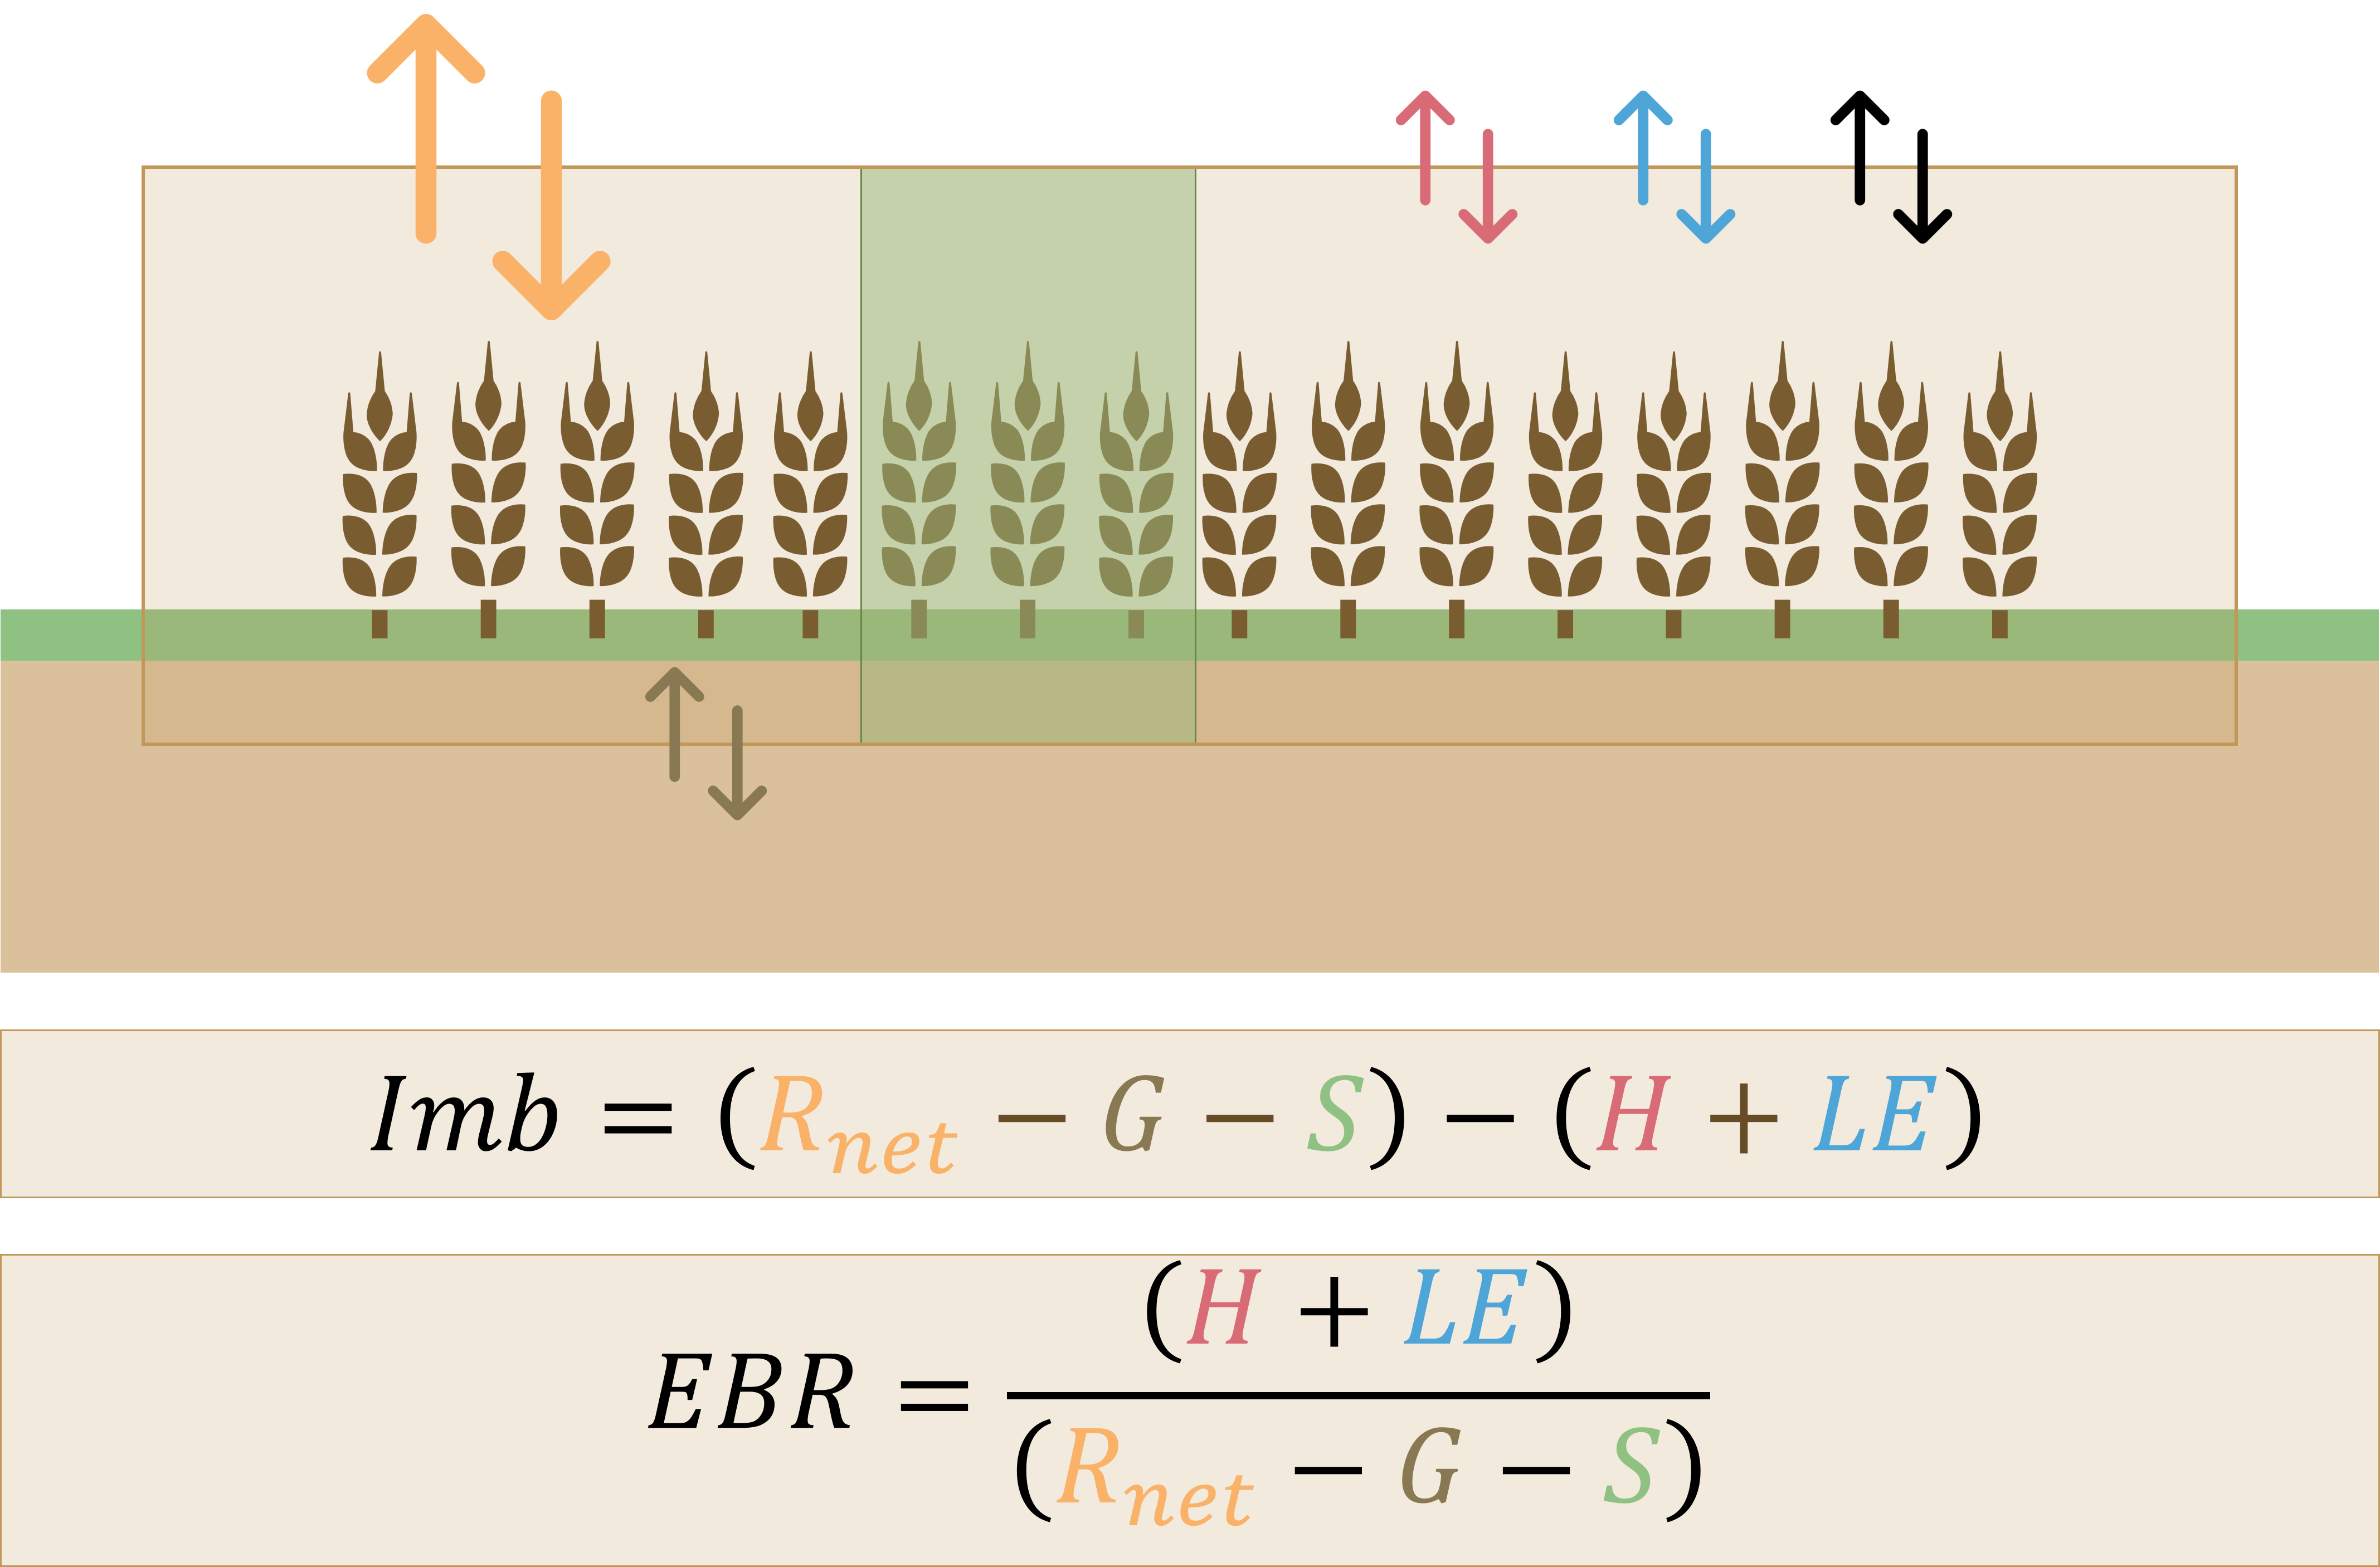
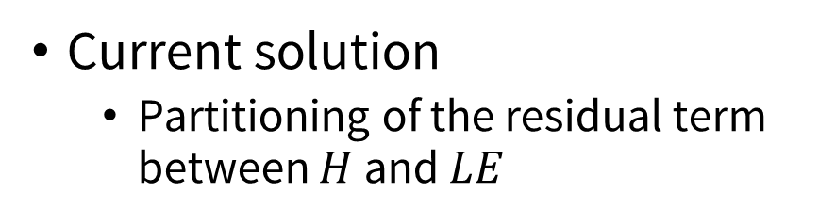

Energy balance closure
Surface energy imbalance
  Eddy covariance underestimates turbulent energy fluxes
  Need to add a residual term $Imb$
Widespread problem
  Known for 30 years
  Still relevant topic
  (AGU Chapman 2025)
Current solution
  Partitioning of the residual term between $H$ and $LE$

Slide 3
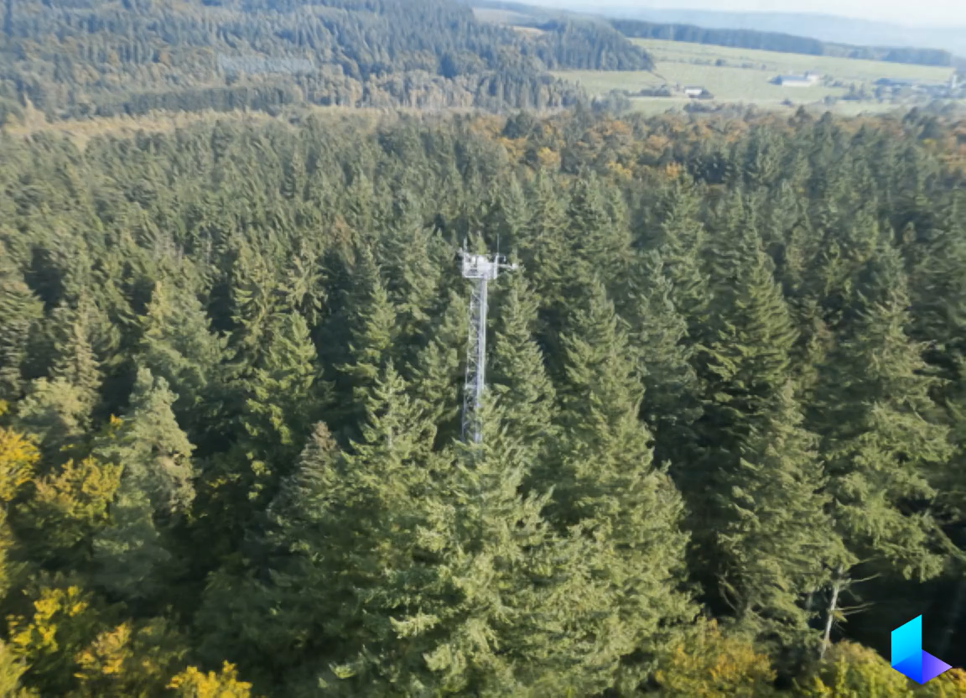
ICOS BE-Vie
Vielsalm, Belgium
30-years time series
(PI-processed)
Mature mixed forest
ICOS since 2018

Slide 4
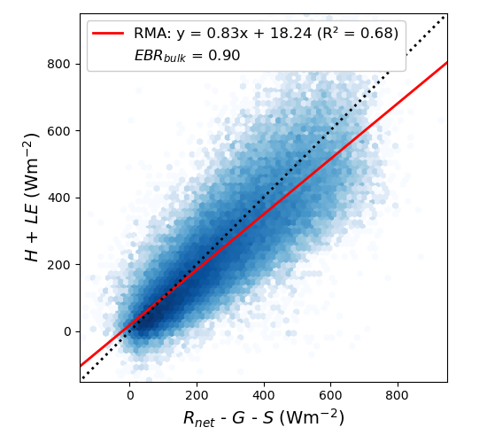
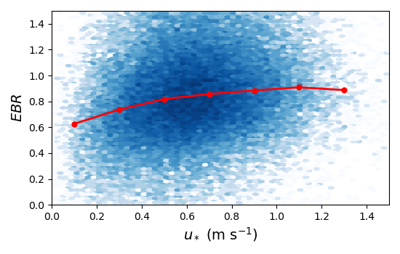
ICOS BE-Vie
Expected for mixed forests
  Nicolini et al. 2026

Slide 5
Objectives
Objectives
Investigate whether recurrent atmospheric regimes emerging from EC and meteorological observations are associated with systematic differences in energy balance closure
Offer guidance for measurement campaigns and LES for local project
Hypotheses
H1. Recurrent atmospheric regimes can be identified from meteorological and EC observations
H2. Atmospheric regimes exhibit distinct closure behaviors
H3. Closure differences among regimes reflect processes contributing to non-closure

Slide 6
Workflow
Multivariate approach
  Atmospheric state is characterized as a whole
Temporal coherence
  Observations are analyzed in terms of coherent episodes than span several half-hours
Data driven
  EBC is evaluated a posteriori
PCA
Temporal
Segmentation
Clustering
Physical Interpretation
EC / Meteo daytime Dataset
Reduced Space
Coherent Episodes
Atmospheric Regimes
Energy Balance Closure

Slide 7
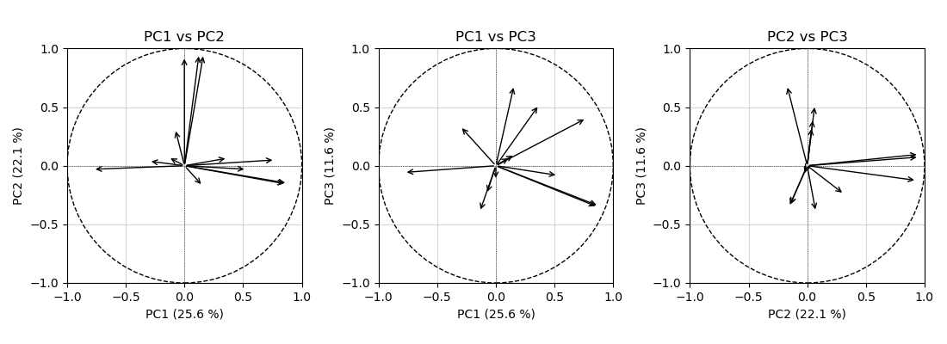


Principal Component Analysis
Reducing the data's size to a few synthetic axes
  Each axis maximizes the variance explained by a combination of variables
PC1 : thermal and radiative state
PC2 : mechanical turbulence intensity
PC3 : storage and energy fluxes dynamics
$$WS$$
$$u_{∗}$$
$$σ_{w}$$
$$S$$
$$S$$
$$σ_{T}$$
$$R_{net}$$
$$σ_{T}$$
$$ξ$$
$$SWC$$
$$R_{net}$$
$$σ_{T}$$
$$R_{net}$$
$$σ_{w}$$
$$SWC$$
$$σ_{w}$$
$$SWC$$
$$WD$$
$$u_{∗}$$
$$RH$$
$$u_{∗}$$
$$RH$$
$$G$$
$$T_{air}$$
$$RH$$
$$ξ$$
$$WS$$
$$G$$
$$G$$
$$S$$
$$T_{surf}$$
$$T_{air}$$
$$T_{surf}$$
$$ξ$$
$$WS$$
$$WD$$
$$T_{surf}$$
$$T_{air}$$
$$WD$$

Slide 8
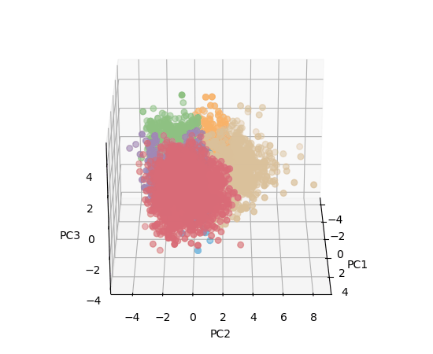
Principal Component Analysis
The position of every half-hour is known in the PCA space
  Colors represent the regime into which the atmospheric conditions fall
  (clustering explained after)
Day
Time

Slide 9
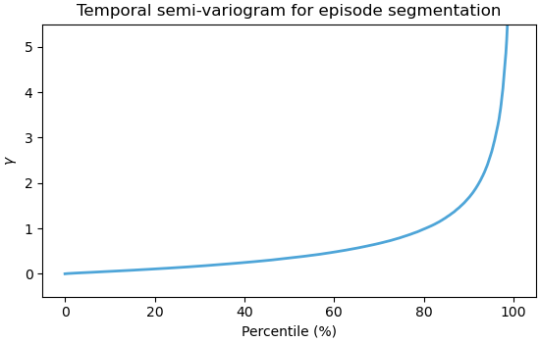
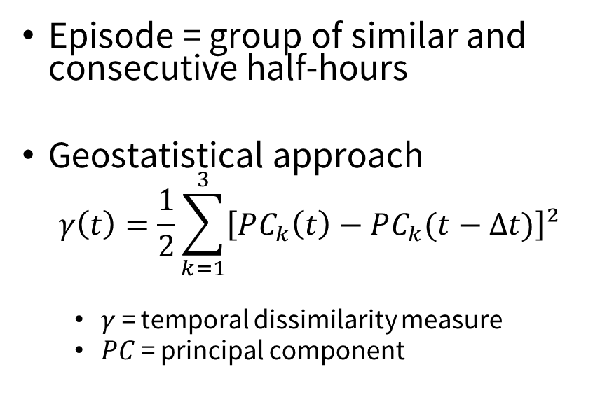
Temporal Segmentation
Episode = group of similar and consecutive half-hours
Geostatistical approach
$$γ\left(t\right)=\frac{1}{2}\sum_{k=1}^{3}{\left[PC_{k}\left(t\right)−PC_{k}(t−Δt)\right]²}$$
  $γ$ = temporal dissimilarity measure
  $PC$ = principal component
Day
Time

Slide 10
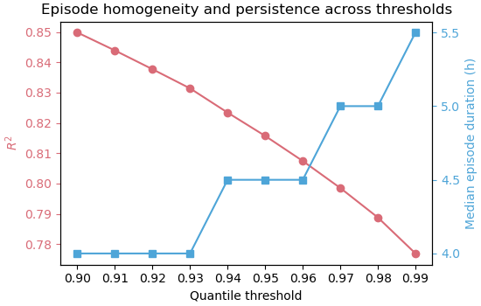
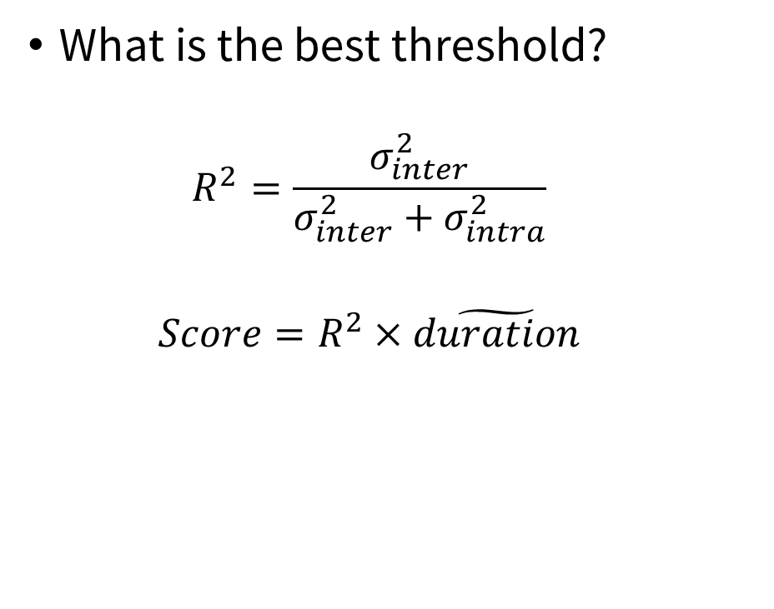
Temporal Segmentation
What is the best threshold?
$$R^{2}=\frac{σ_{inter}^{2}}{σ_{inter}^{2}+σ_{intra}^{2}}$$
$$Score=R^{2}×\tilde{duration}$$

Slide 11
Temporal Segmentation
What is the best threshold?
$$R^{2}=\frac{σ_{inter}^{2}}{σ_{inter}^{2}+σ_{intra}^{2}}$$
$$Score=R^{2}×\tilde{duration}$$

Slide 12
Temporal Segmentation
What is the best threshold?
$$R^{2}=\frac{σ_{inter}^{2}}{σ_{inter}^{2}+σ_{intra}^{2}}$$
$$Score=R^{2}×\tilde{duration}$$

Slide 13
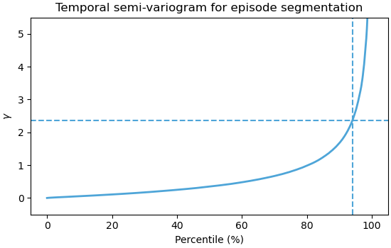
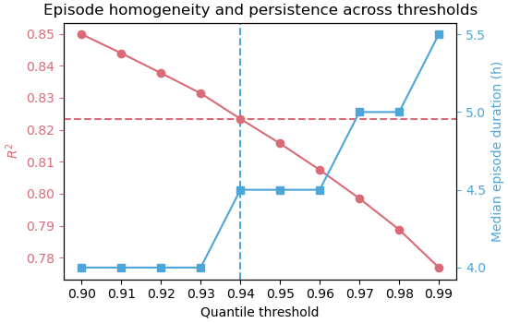
Temporal Segmentation

Slide 14
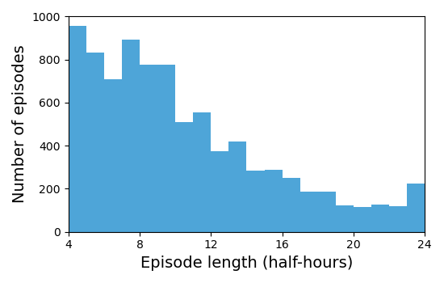
Temporal Segmentation
8707 episodes made of 86.929 half-hours

Slide 15
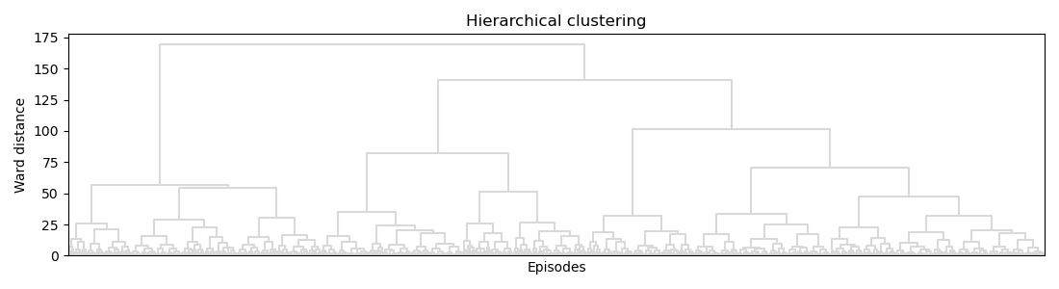
Clustering
Regime = group of episodes with similar atmospheric conditions
Dendrogram and Ward distance

Slide 16
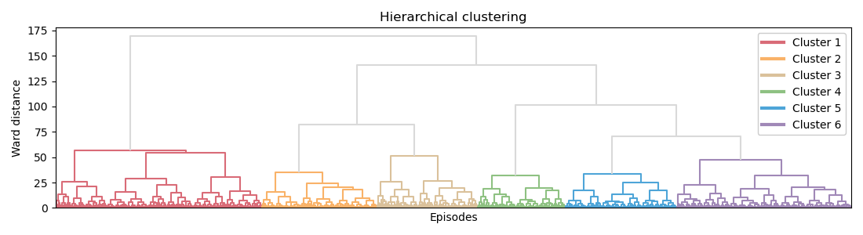
Clustering
Regime = group of episodes with similar atmospheric conditions
Dendrogram and Ward distance

Slide 17
Physical Interpretation
1
Hot unstable regime
PC1 ++ PC2 –
Cold humid neutral regime
PC1 -- PC2 +
2
3
PC1 - PC2 +++
Windy neutral regime
Cold humid unstable regime
PC1 --- PC2 -- PC3 +
4
5
Hot quasi-neutral regime
PC1 + PC2 + PC3 -
Humid unstable regime
PC1 - PC2 -
6
PC1 : thermal and radiative state
PC2 : mechanical turbulence intensity
PC3 : storage and energy fluxes dynamics

Slide 18
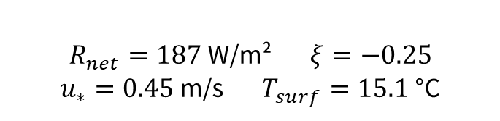
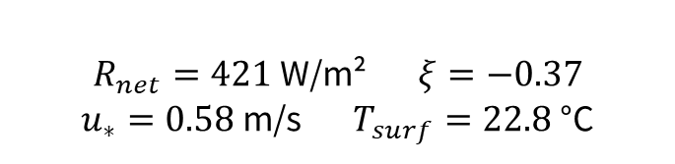
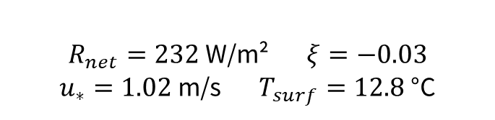
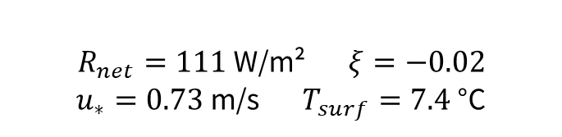
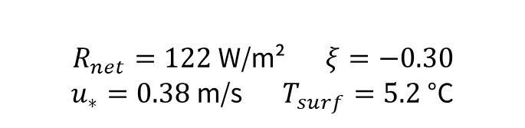
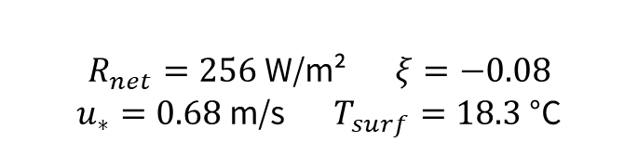
Physical Interpretation
1
Hot unstable regime
$R_{net}=421$ W/m² $ξ=−0.37$
$u_{∗}=0.58$ m/s $T_{surf}=22.8$ °C
Cold humid neutral regime
$R_{net}=111$ W/m² $ξ=−0.02$
$u_{∗}=0.73$ m/s $T_{surf}=7.4$ °C
2
3
$R_{net}=232$ W/m² $ξ=−0.03$
$u_{∗}=1.02$ m/s $T_{surf}=12.8$ °C
Windy neutral regime
Cold humid unstable regime
$R_{net}=122$ W/m² $ξ=−0.30$
$u_{∗}=0.38$ m/s $T_{surf}=5.2$ °C
4
5
Hot quasi-neutral regime
$R_{net}=256$ W/m² $ξ=−0.08$
$u_{∗}=0.68$ m/s $T_{surf}=18.3$ °C
Humid unstable regime
$R_{net}=187$ W/m² $ξ=−0.25$
$u_{∗}=0.45$ m/s $T_{surf}=15.1$ °C
6

Slide 19
Physical Interpretation
1
Hot unstable regime
Very high net radiation
Low mechanical turbulence
Cold humid neutral regime
High mechanical turbulence
Very low net radiation
2
3
Very high mechanical turbulence
Moderate net radiation
Windy neutral regime
Cold humid unstable regime
Very low net radiation
Very low mechanical turbulence
4
5
Hot quasi-neutral regime
Moderate net radiation
High mechanical turbulence
Humid unstable regime
Moderate net radiation
Low mechanical turbulence
6

Slide 20
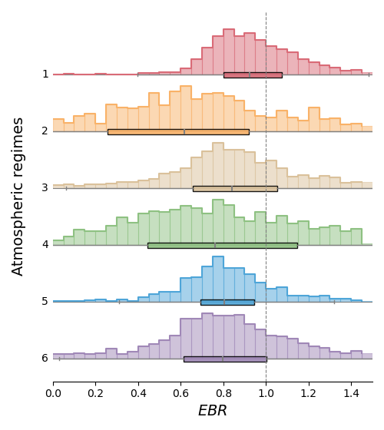
Energy Balance Closure
1
Hot unstable regime
Cold humid neutral regime
2
3
Windy neutral regime
Cold humid unstable regime
4
5
Hot quasi-neutral regime
Humid unstable regime
6

Slide 21
Take-Home Message
Objectives
A generic methodology was successfully developed and can be applied across the ICOS network to better understand the EBC problem
Hypotheses
H1. → The multivariate approach makes it possible to identify different atmospheric regimes from half-hourly EC and meteorological data
H2. → Distinct closure behaviors emerge across regimes, but some remain difficult to interpret
H3. → The regimes showing the best closure were not those expected, pointing to more complex drivers of non-closure

Slide 22
Thank you for listening!
Any question?

