Slide 1
Revisiting the Serious Game Classification and Definition
Alice Thise
Alice.Thise@uliege.be
DIVA, Art Archaeology Heritage Research Unit, Faculty of Architecture, University of Liège, Belgium
Research thesis: The Impact of Serious Game on Communication and Knowledge of Inaccessible Architectural Heritage
ECGBL 2026
30 September – 02 October | Darmstadt, Germany

Slide 2
What is a game or a play
  In English
  Game : The artefact (the object with which one plays, its materials and its rules)
  Play : The activity (the players’ actions with and in the game, their attitudes, etc.)
  In French
  Game / Play : Jeu
  Most of the early researchers who studied games were French-speaking (e.g. Brougère, 2012; Caillois, 1958; Henriot, 1989/2023) and have therefore mostly defined the object and the activity without distinguishing them.
  Structuralist approach
  Definition of Play/Game by several criterias:
  Free activity
  Separate
  Unproductive
  Uses defined rules
  A fictional aspect (or non-literality)
  Uncertainty
Phenomenological approach
Definition of Play is subjective and not absolute or universal while the game (object) remains a game (determined by its creators)
(Brougère, 2012; Caillois, 1958; Huizinga, 1938/1951)
(Brougère, 2012; Henriot, 1989/2023)
VS
  This approach contradicts the opposition between play and work as the basis of the traditional idea of play.
  Play can be serious, thought as such, and have serious consequences (e.g. gambling or a match played by a professional athlete)
(Brougère, 2012; Caillois, 1958; Henriot, 1989/2023; Huizinga, 1938/1951)
Notes:
Moray, 2022.

Slide 3
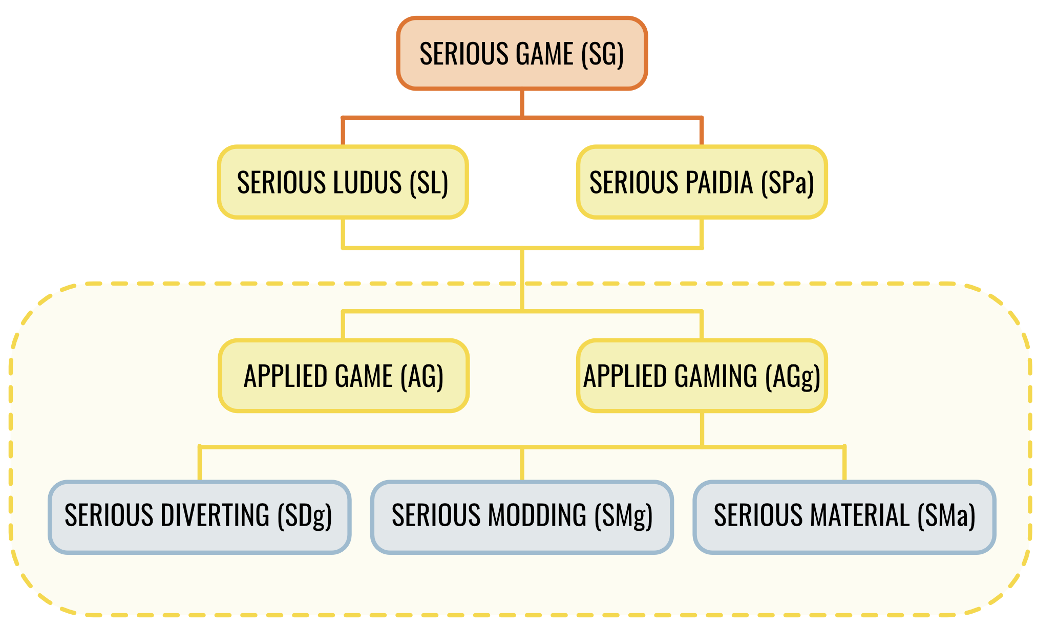
What is a Serious Game
  No fixed definition regarding the medium : Strictly digital VS No restrictions
  First assumption : a Serious Game is not a game anymore
  Serious purpose VS criteria of the structuralist approach => The playful part disappears
  Second assumption : a Serious Game is just a game
  Its only utility remains entertainment => there are ‘playful games’ and ‘serious games’ => The term Serious Game is not the most appropriate
  Gameplay/P/S
(de Grandmont, 1997; Lavigne, 2016)
(Brougère, 2012)
  G/Purpose/S
  Broadcasting a message
  Providing training
  Promoting the exchange of data
  Gamifying a task
  G/P/Sector
  Market (the domain for which the game is used)
  Public (the type of players the game is aimed at)
GAMEPLAY : Representation and adaptation of the Serious Game’s classification of Alvarez, Djaouti and Rampnoux (2012)
Notes:
Moray, 2022.

Slide 4
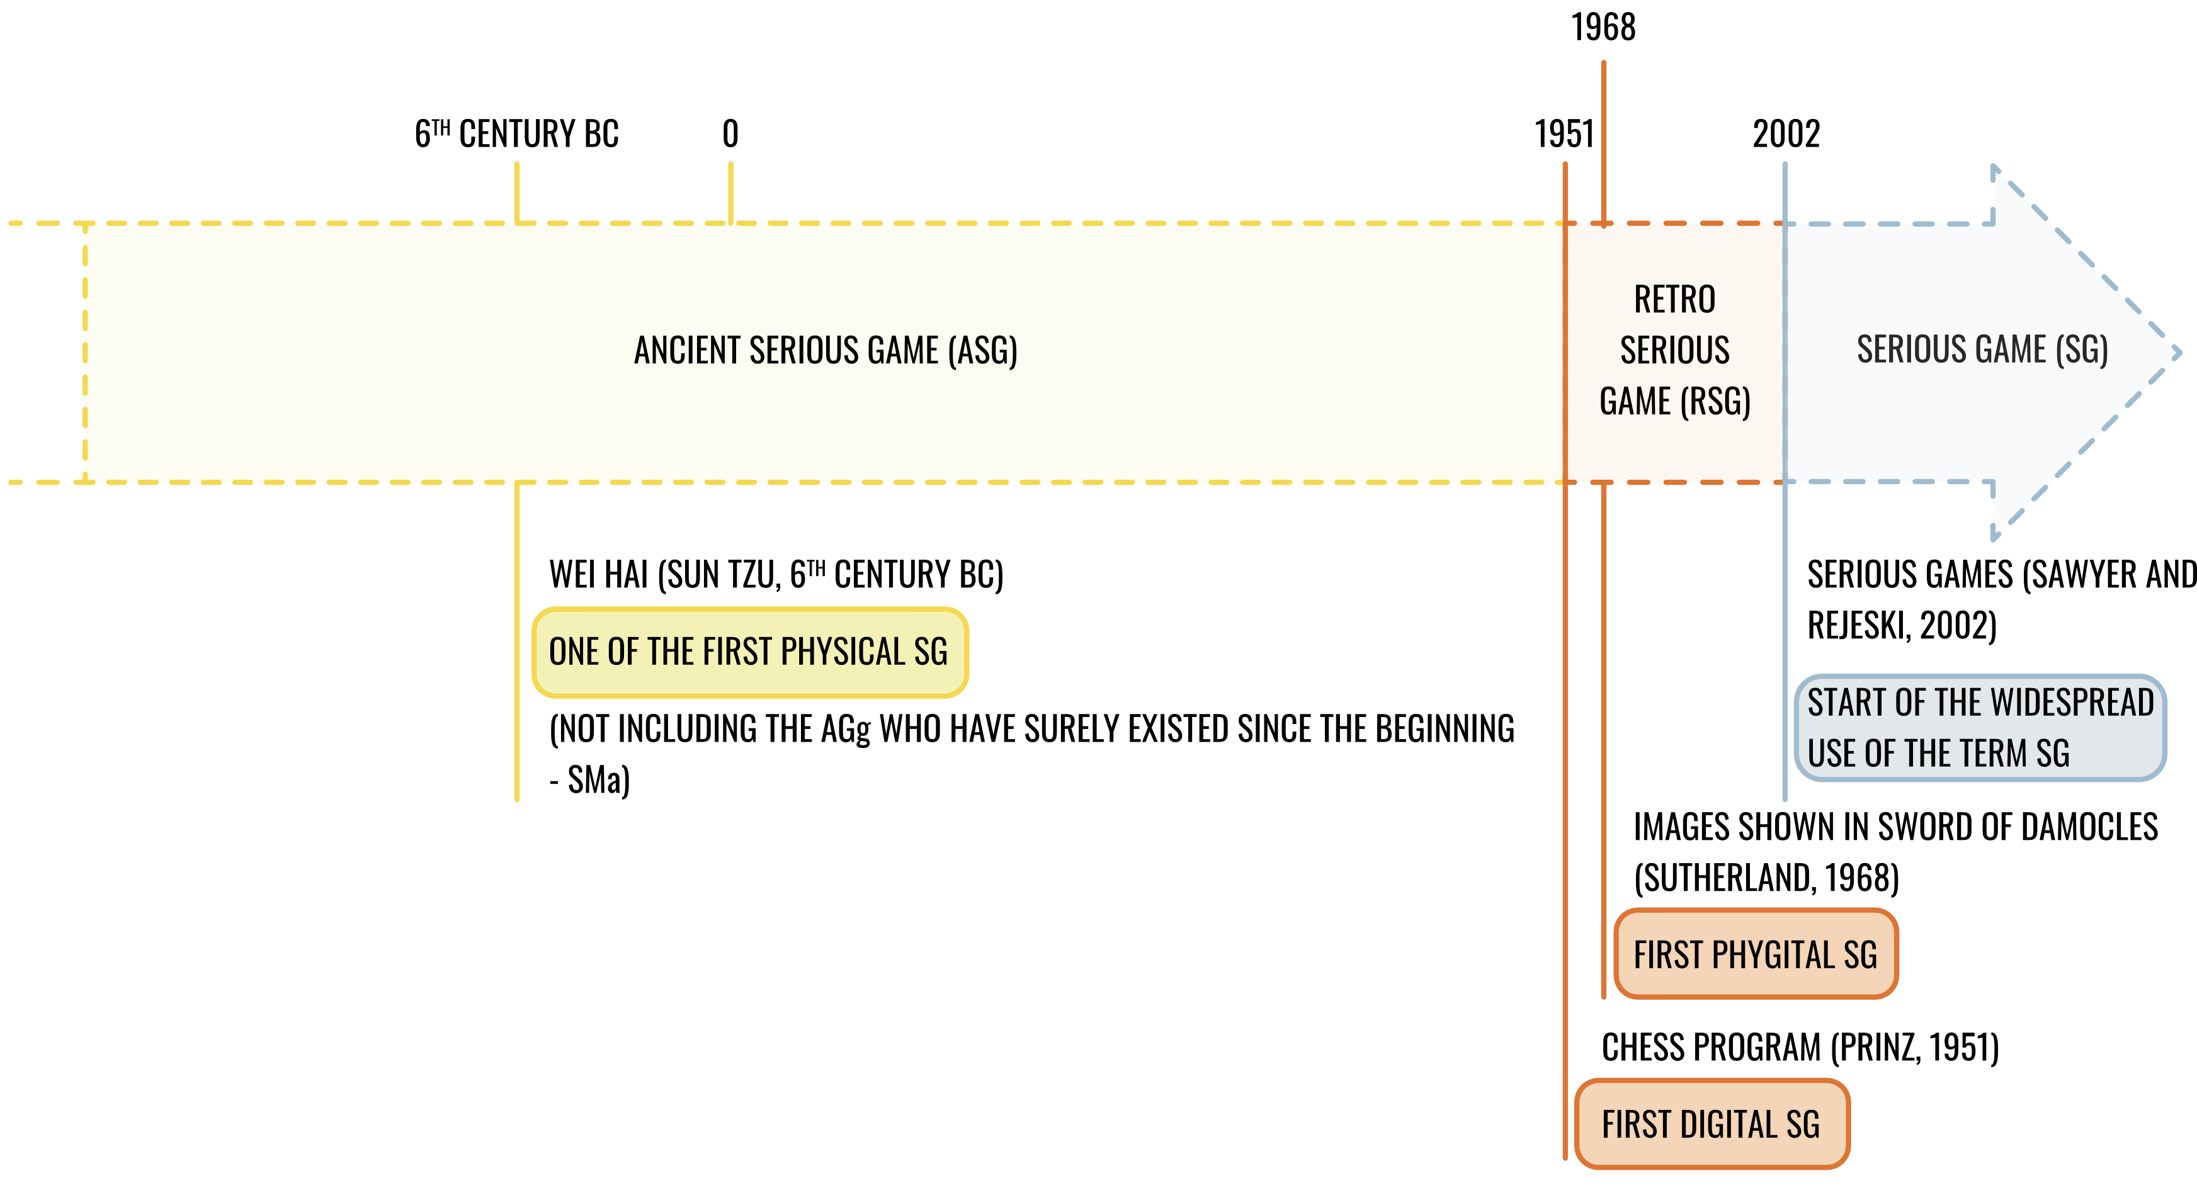
Evolution of Serious Game
Representation of the two original SG’s periods of Alvarez, Djaouti and Rampnoux (2012) and the one that we add
+ important dates in their history
(Abes et al,, 2025; Alvarez, Djaouti and Rampnoux, 2012; Michael and Chen, 2006; Sawyer and Rejeski, 2002)
Notes:
Moray, 2022.

Slide 5
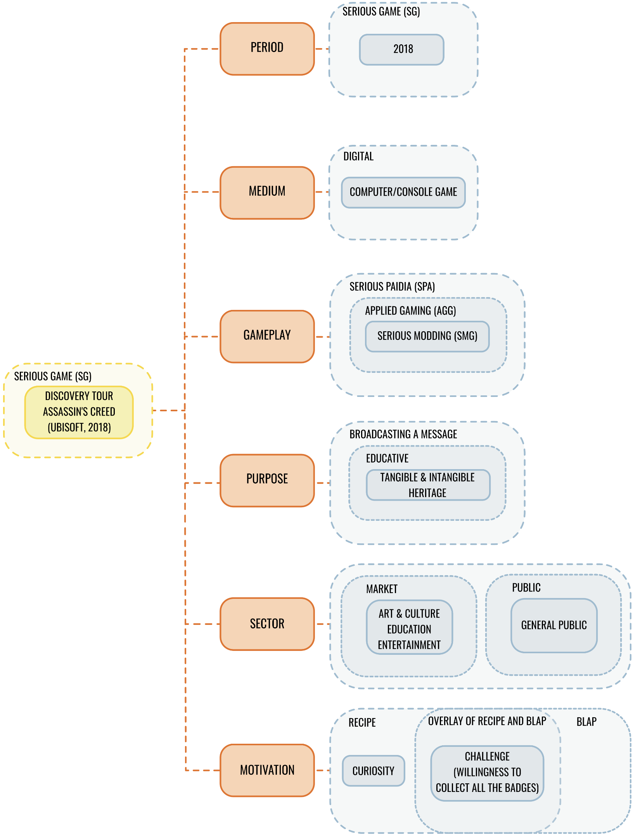
Effectiveness of Serious Game and Conclusion
  Effectiveness - Motivation:
  Macro-involvement
  Achievement
  Social
  Immersion
  Micro-involvement
  BLAP (or behavioural ludification)
  Short-term extrinsic motivation
  Use of positive and negative rewards
(Calleja, 2011; Yee, 2006)
(Bonenfant, 2023; Bonenfant and Philippette, 2018; Calleja, 2011; Csikszentmihalyi, 1990; Malone, 1981; Morris et al., 2013; Nicholson, 2015)
  Make someone do
  RECIPE (or humanistic ludification)
  Long-term intrinsic motivation
  Link between the game and the player’s life
  Make someone be
  Conclusion:
  Definition of play = Subjective
  Original model needed to be modified to not only consider the game, but also the player’s subjectivity, in line with our game/play definition
  Still many factors influencing the SG’s effectiveness that need to be analysed
Representation and modification of the G/P/S model and application on the Discovery Tour
Notes:
Moray, 2022.

