Slide 1
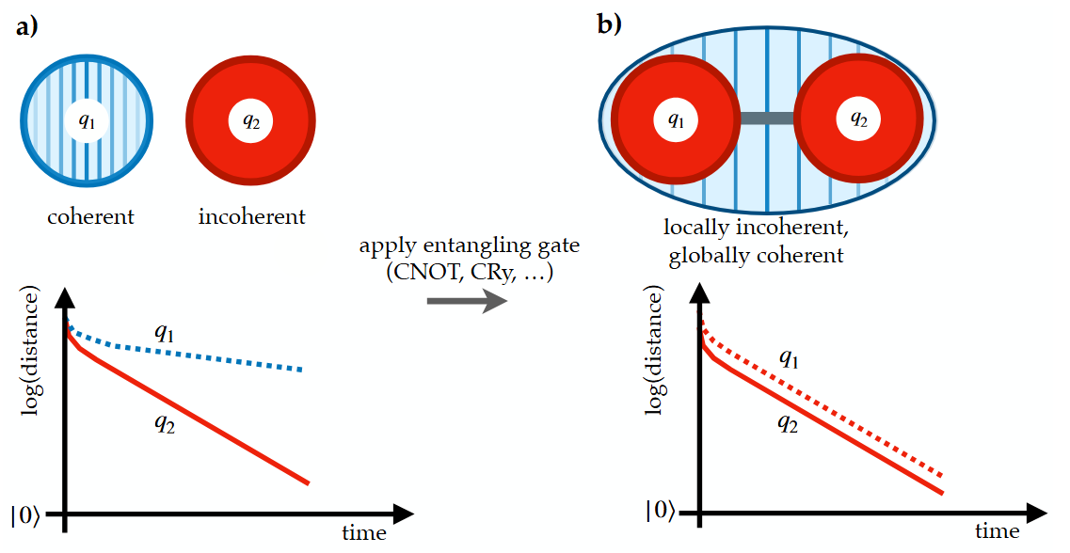




Accelerating qubit reset through the Mpemba effect
DQUT - Palma
Théo Lejeune
30 September 2026

Slide 2
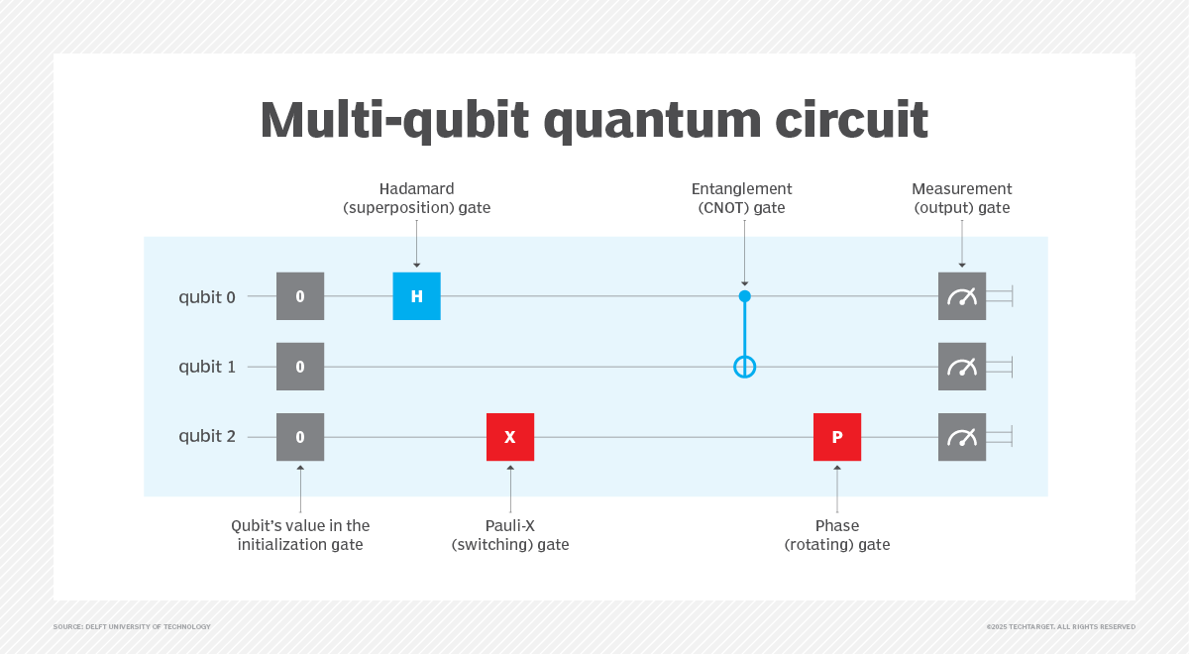
When to reset qubits ?
Before the algorithm
DELFT UNIVERSITY OF TECHNOLOGY
At every shot of the algorithm (~10³)

Slide 3
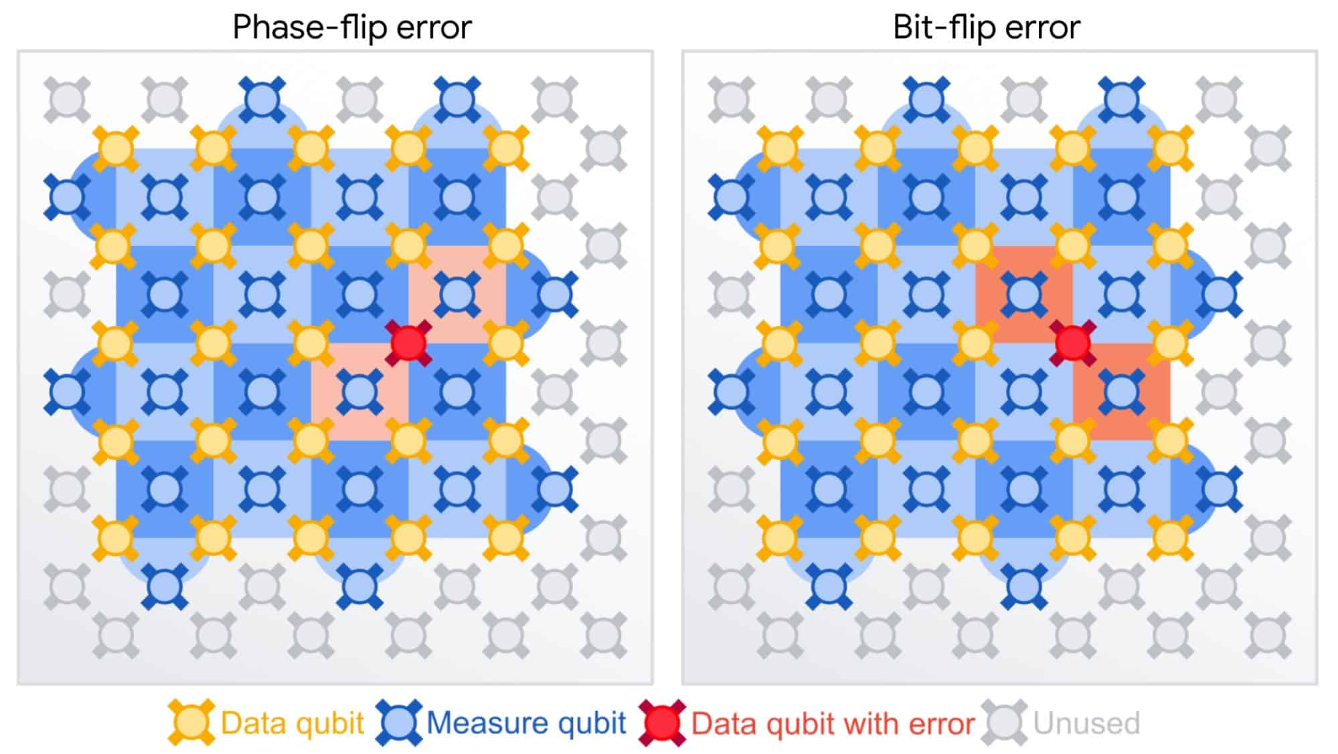
When to reset qubits ?
Before the algorithm
During the algorithm
https://yuchenssr.github.io/qce.html
DELFT UNIVERSITY OF TECHNOLOGY
Quantum Error Correction
Thousands of times per shot
At every shot of the algorithm (~10³)
HUGE Bottleneck

Slide 4
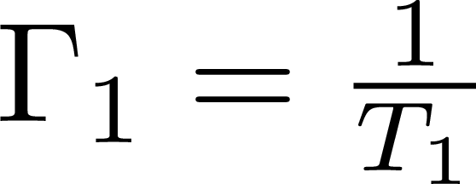
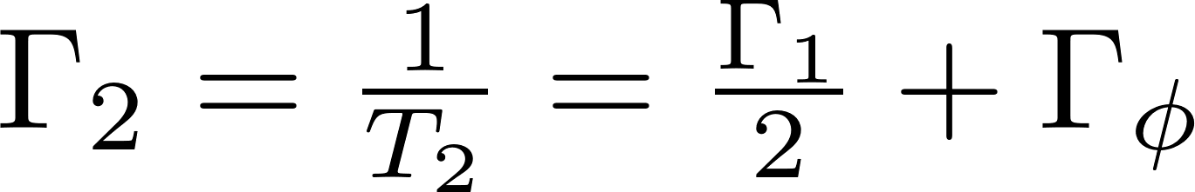
T1 and T2
Characteristic decay rate of the populations
Characteristic decay rate of the coherences

Slide 5
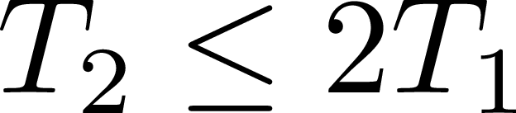
T1 and T2
Characteristic decay rate of the populations
Characteristic decay rate of the coherences

Slide 6
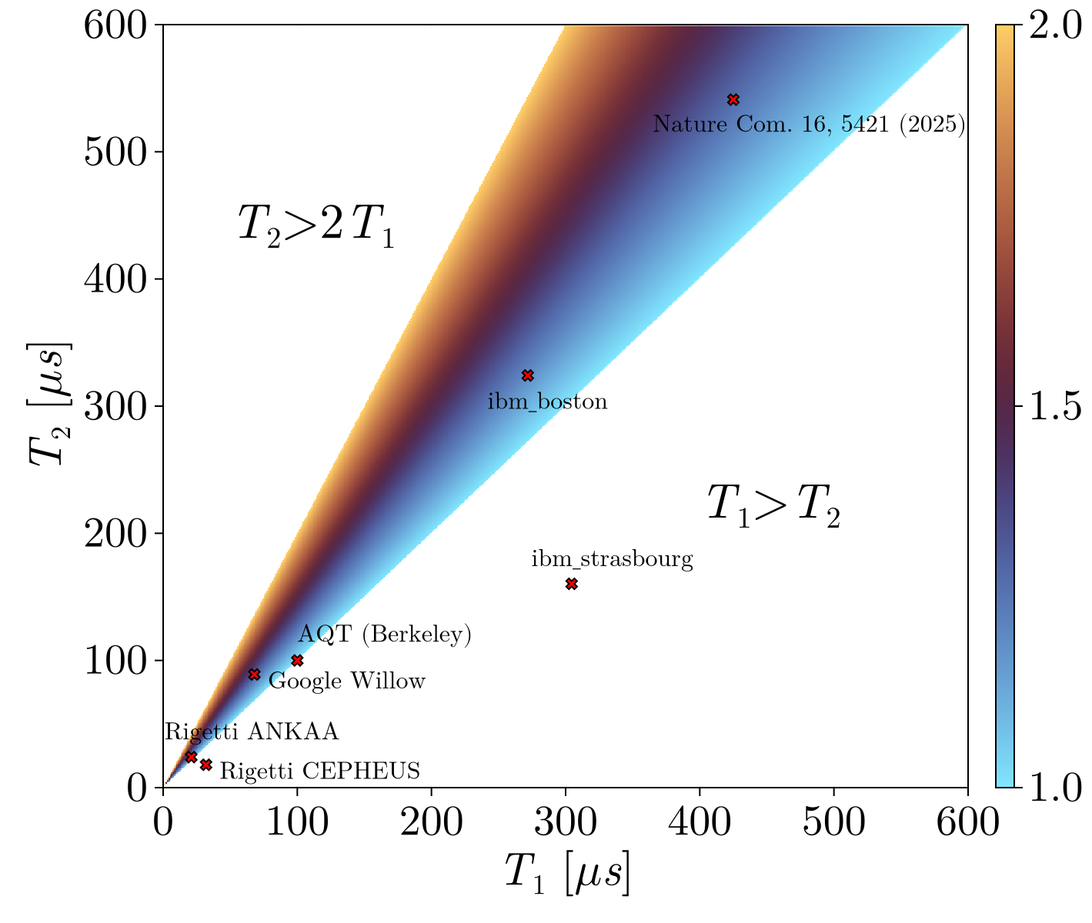
T1 and T2

Slide 7
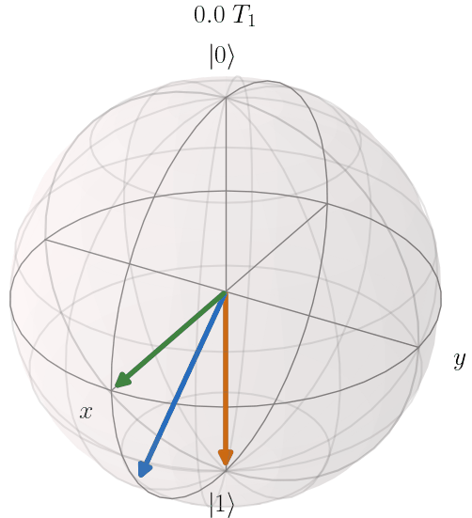
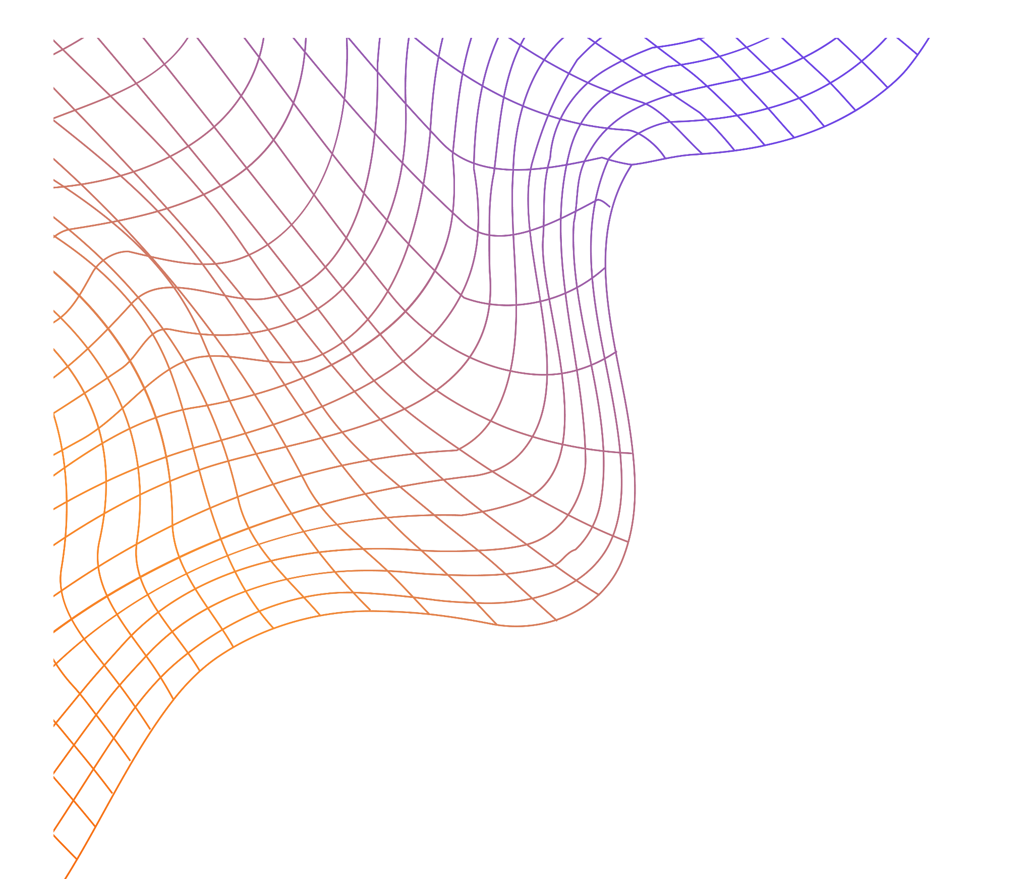
Qubit Resetting
Passive
Wait for a multiple of T₁
Slow but easy
Residual coherences affect next operations

Slide 8
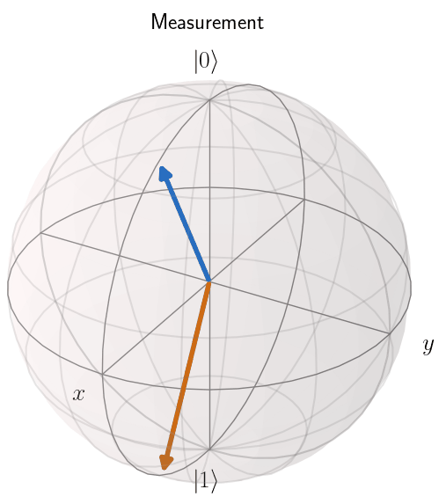
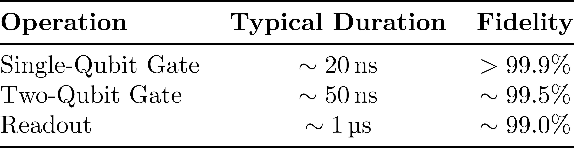
Qubit Resetting
Active
Measurement + conditional NOT gate
Fast but imprecise
Quantum Computing: Not Even Close, The Technology Letter, O. Ezratty (2025)

Slide 9
Qubit Resetting
Passive
Active
Wait for a multiple of T₁
Measurement + conditional NOT gate
Slow but easy
Fast but imprecise
Residual coherences affect next operations
Our goal: Improve passive reset when T₂ > T₁

Slide 10
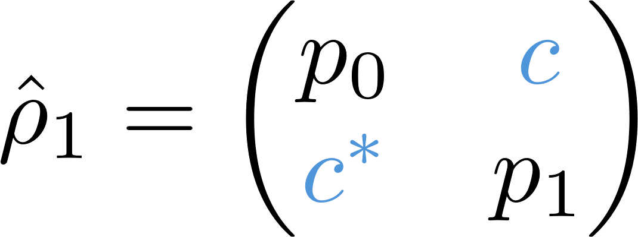
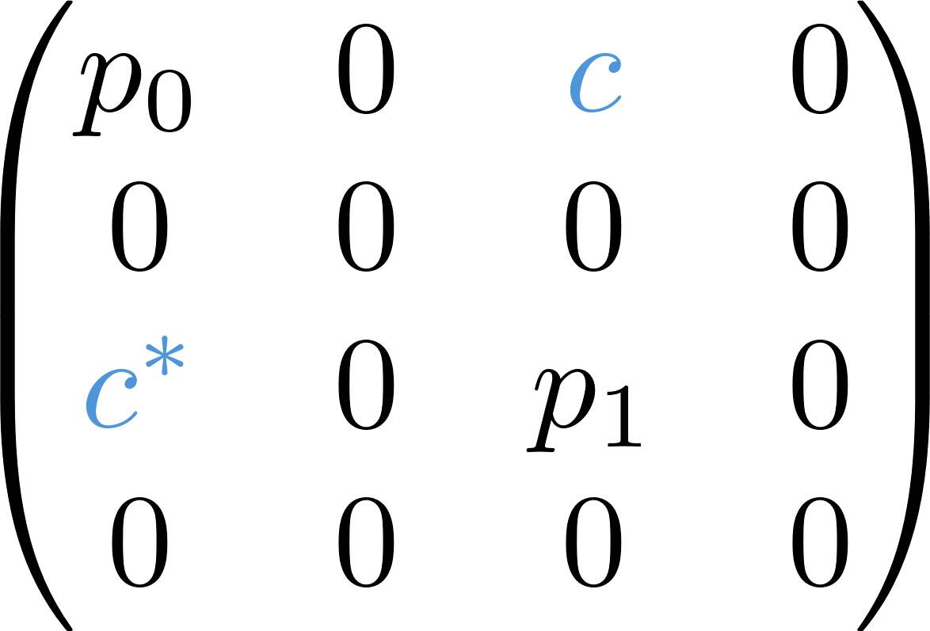
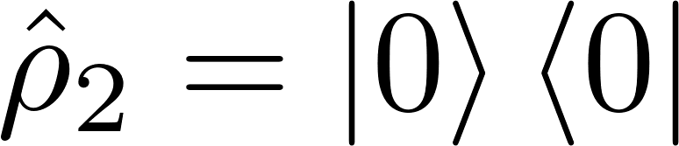
Speedup process
Idea: apply a two-qubit gate to transform local coherences into global ones

Slide 11
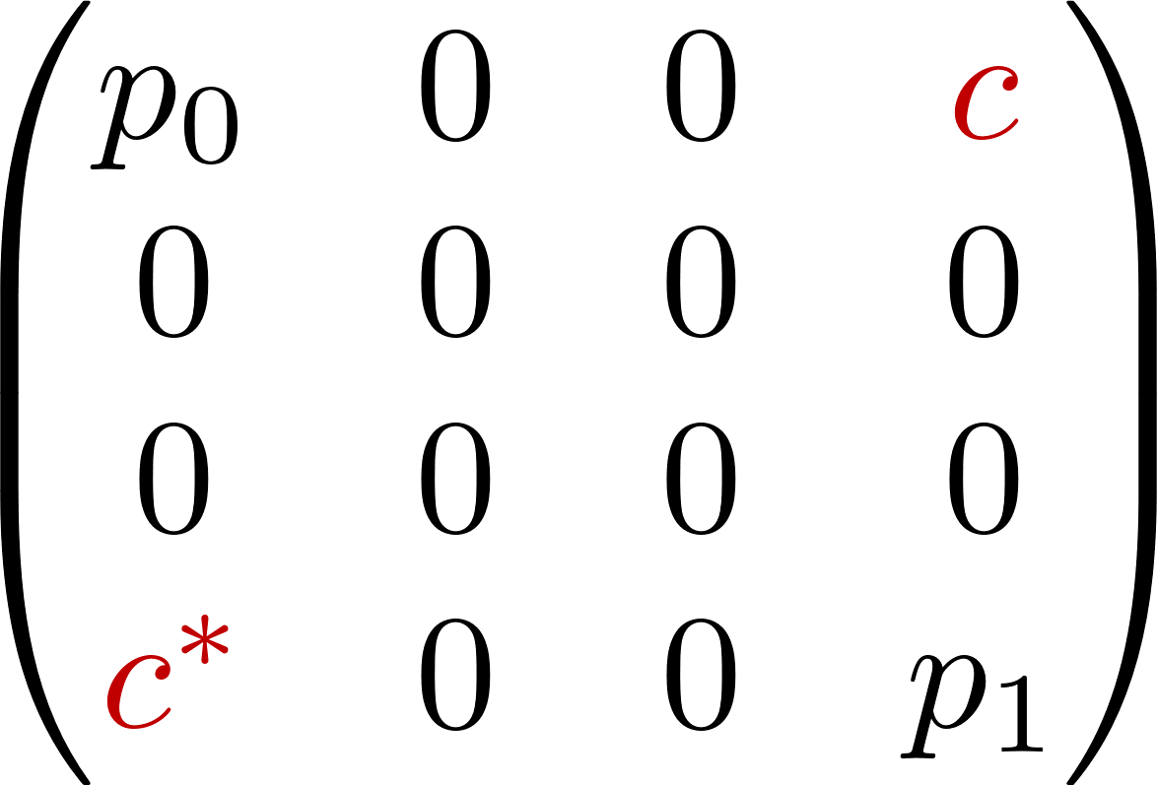
Speedup process
Idea: apply a two-qubit gate to transform local coherences into global ones
Two-qubit
Gate

Slide 12
Why does it work ?
Liouvillian Spectral Theory:

Slide 13
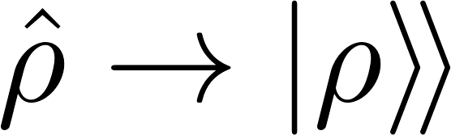
Why does it work ?
Liouvillian Spectral Theory:
Matrix to vector

Slide 14
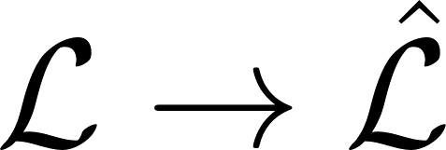
Why does it work ?
Liouvillian Spectral Theory:
Matrix to vector
Superoperator to operator

Slide 15
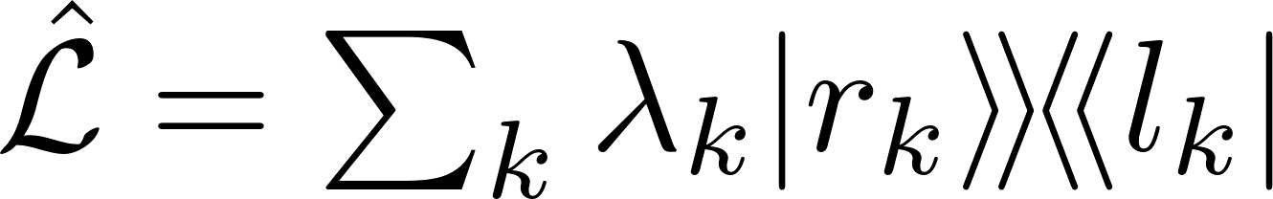
Why does it work ?
Liouvillian Spectral Theory:
Matrix to vector
Superoperator to operator
Spectrum

Slide 16
Why does it work ?
Liouvillian Spectral Theory:
Matrix to vector
Superoperator to operator
Spectrum
Sort

Slide 17
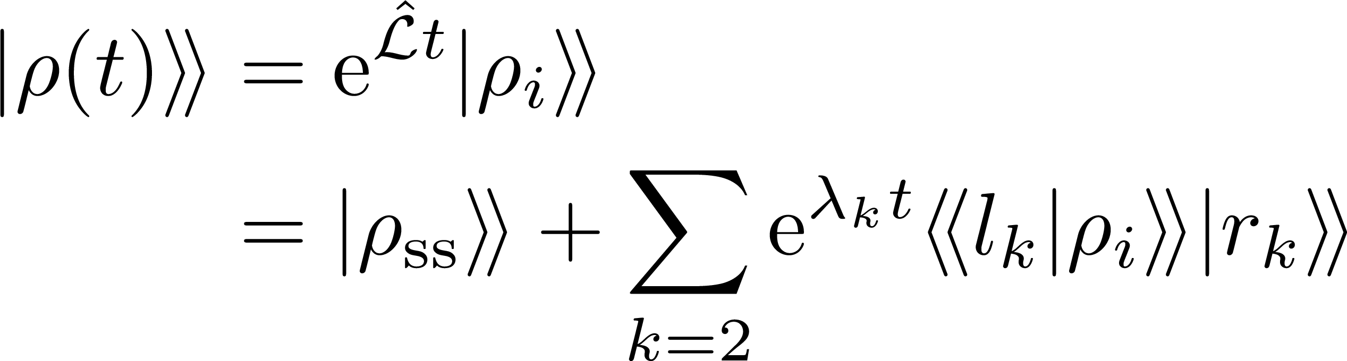
Why does it work ?
Liouvillian Spectral Theory:
Matrix to vector
Arbitrary state evolution:
Superoperator to operator
Spectrum
Sort

Slide 18
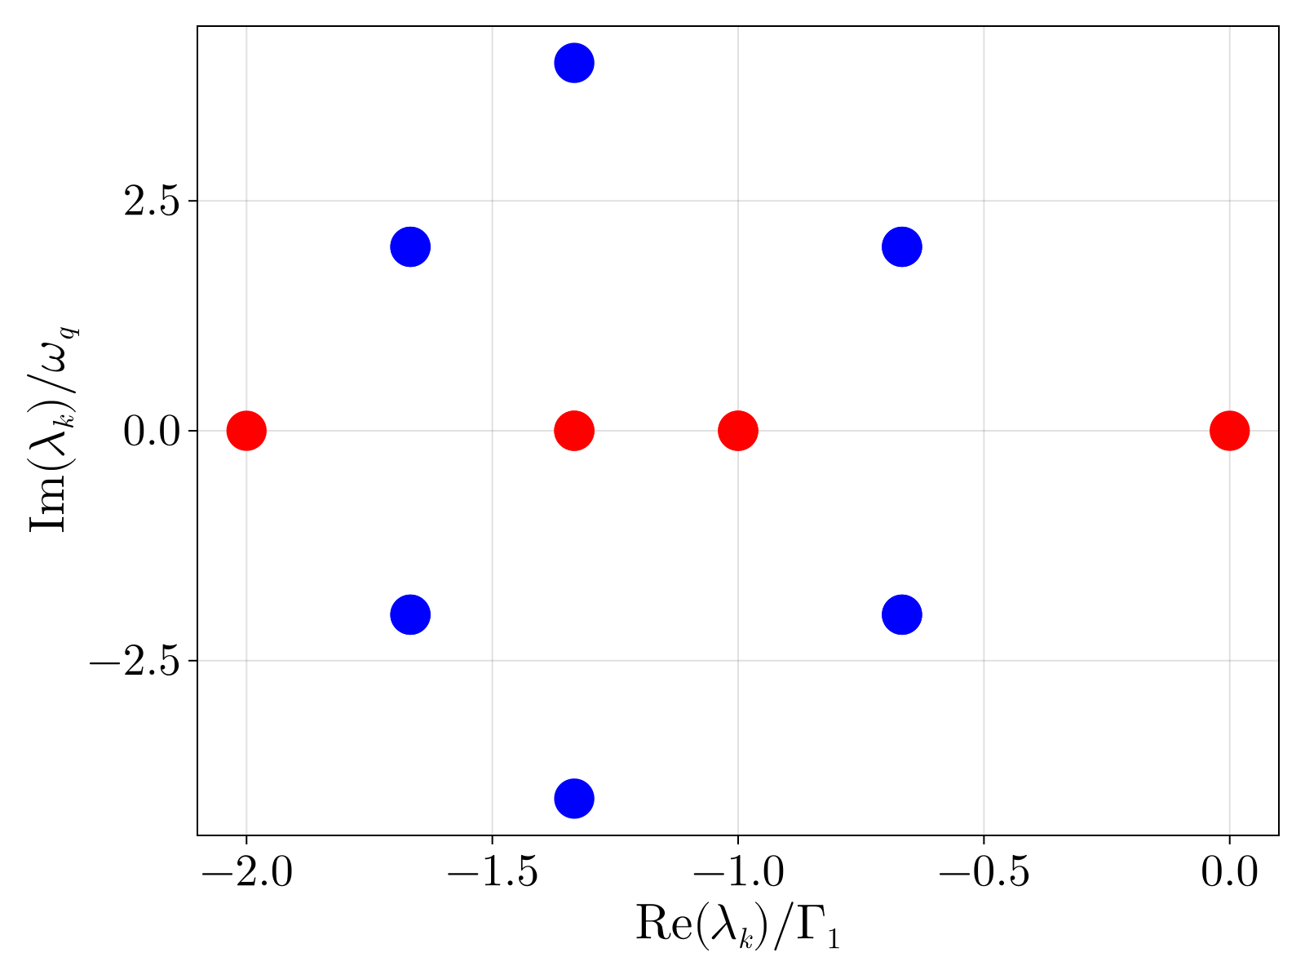
Why does it work ?
Liouvillian Spectral Theory:
Arbitrary state evolution:

Slide 19
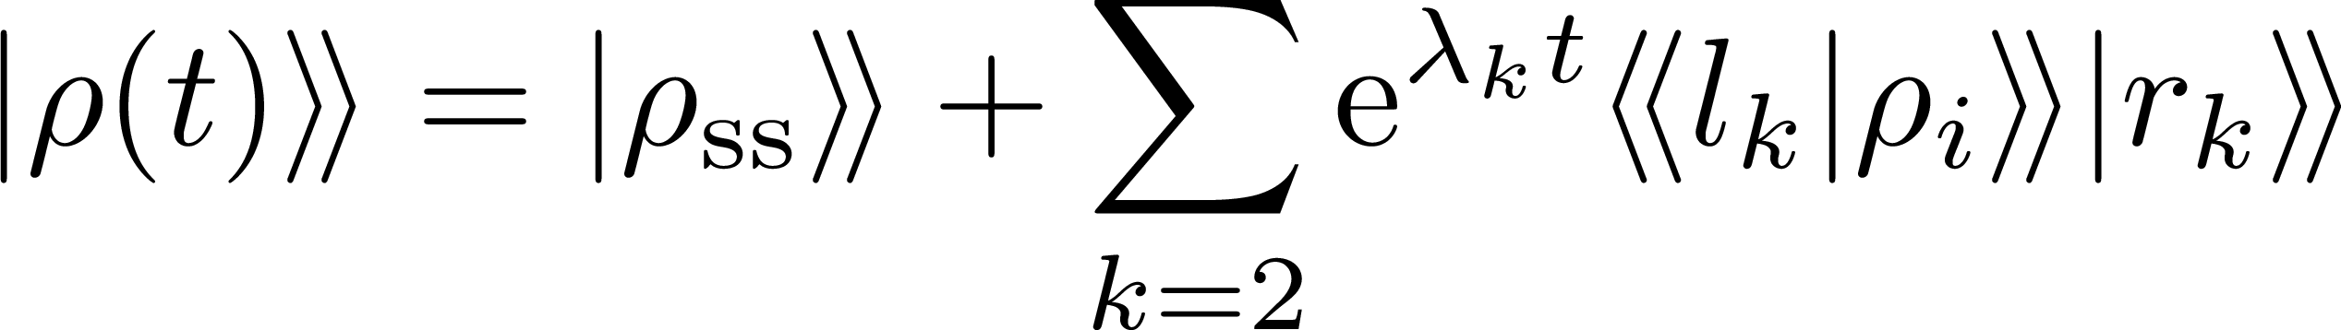
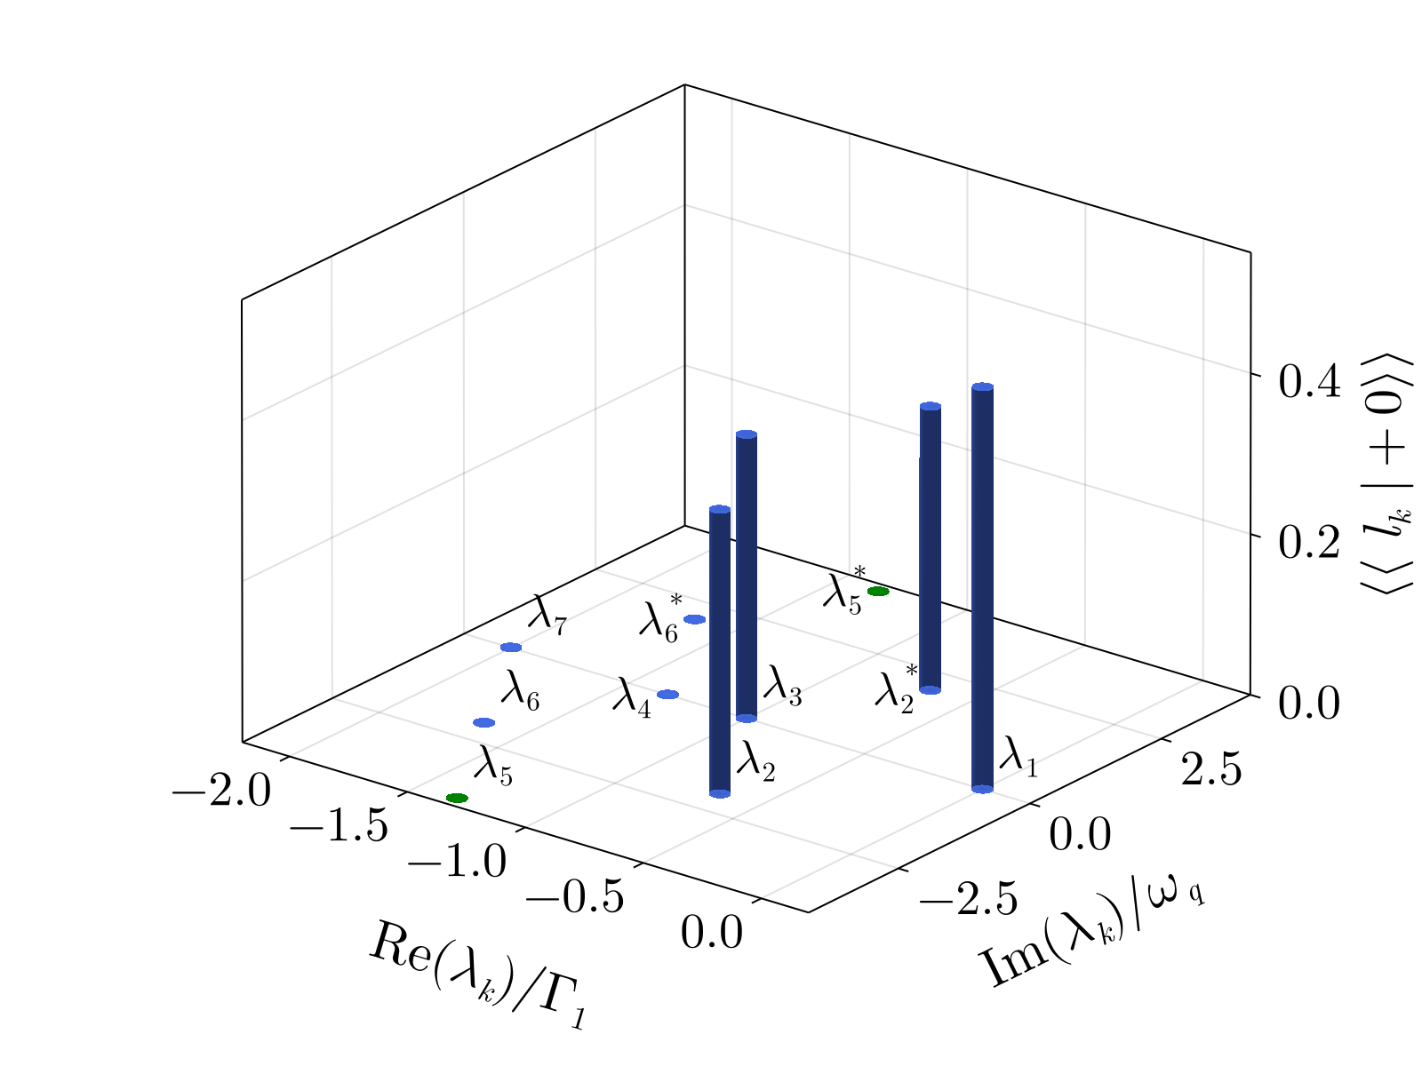
Why does it work ?
Gate suppresses the overlap with the slowest decaying mode of the Liouvillian

Slide 20
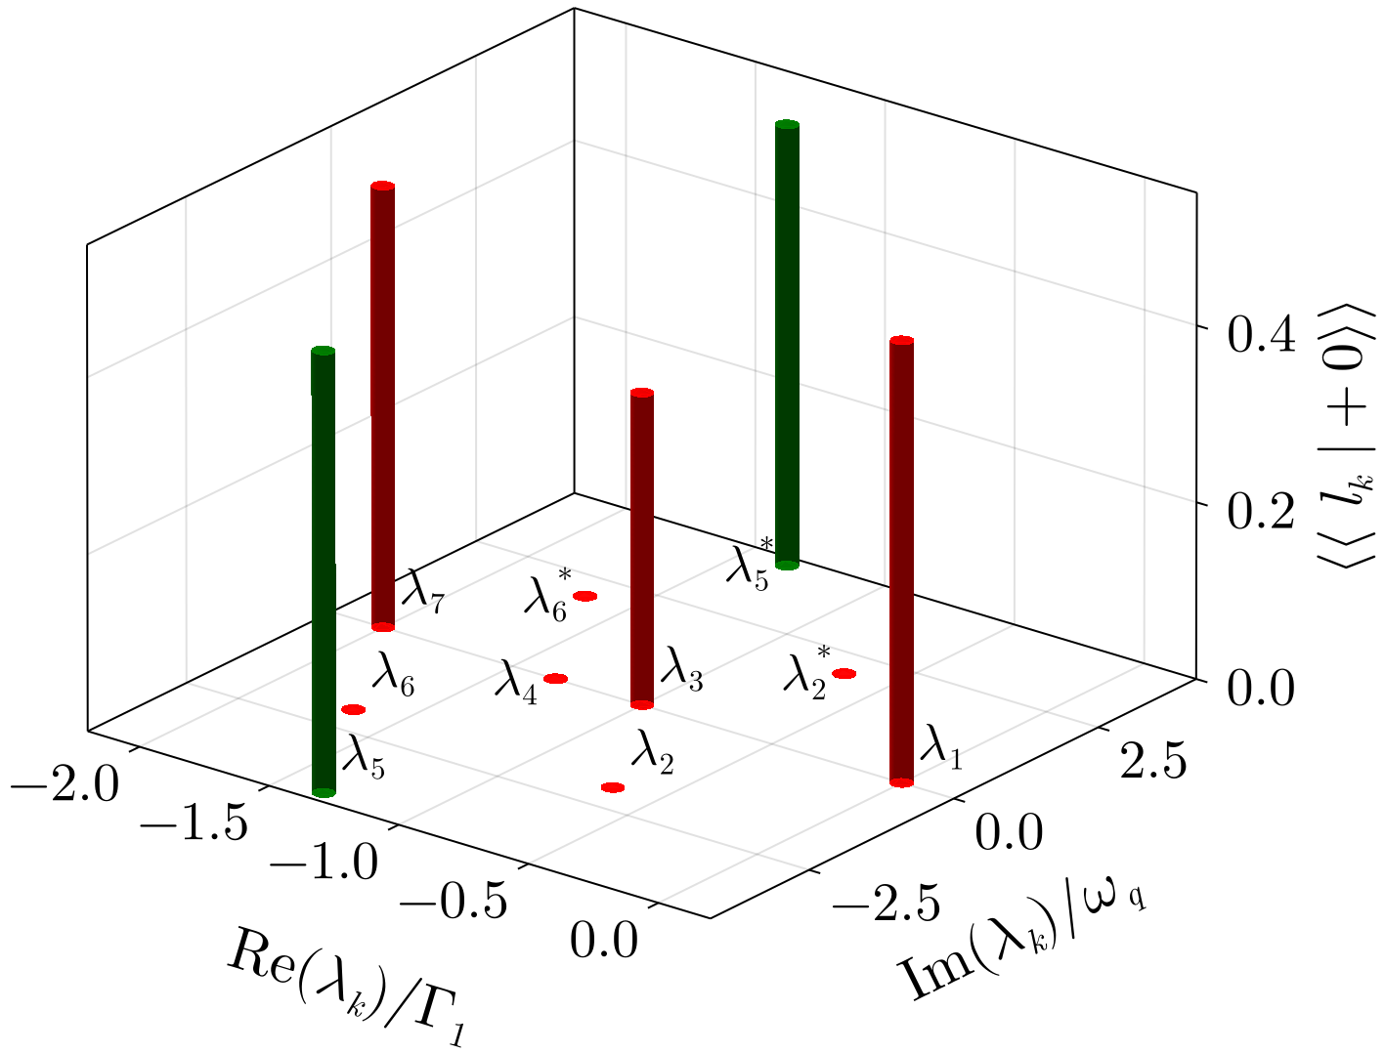
Why does it work ?
Gate suppresses the overlap with the slowest decaying mode of the Liouvillian
Two-qubit
Gate

Slide 21
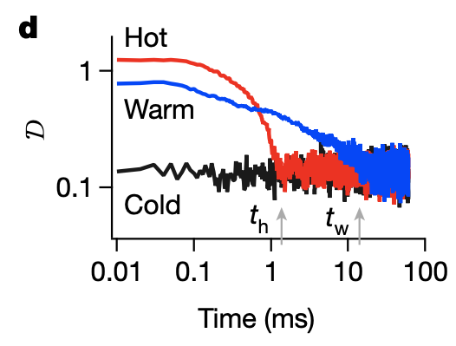
Mpemba Effect
Hot systems can cool faster than warm ones
Can happen if the hot state has a lower overlap with the slowest decaying mode of the Liouvillian
Exponentially faster cooling in a colloidal system, A. Kumar and J. Bechhoefer, Nature 584.7819 (2020)

Slide 22


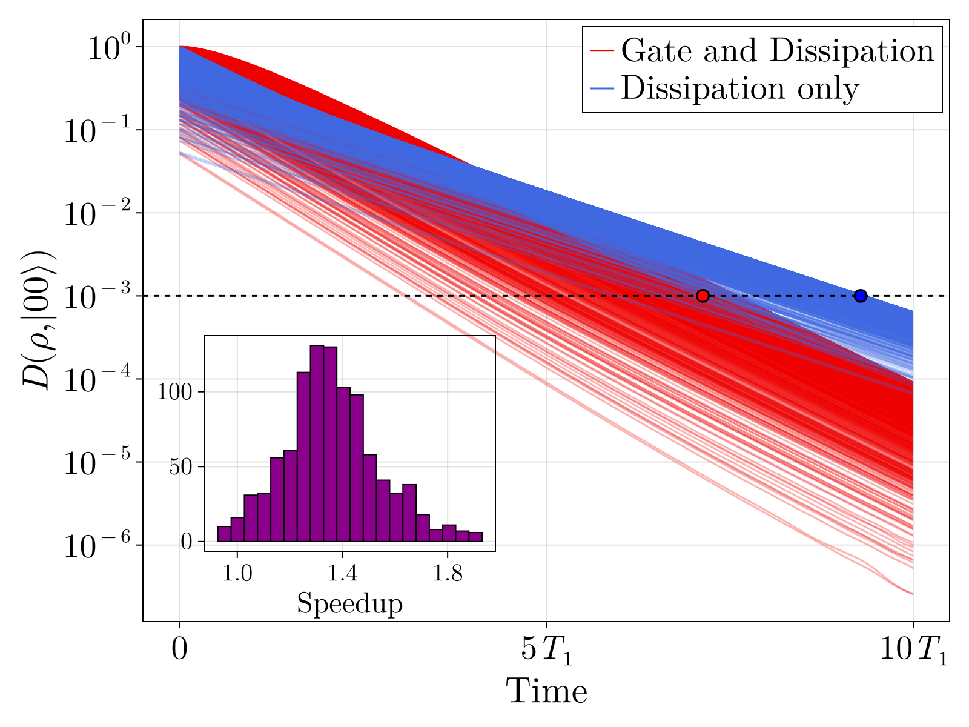
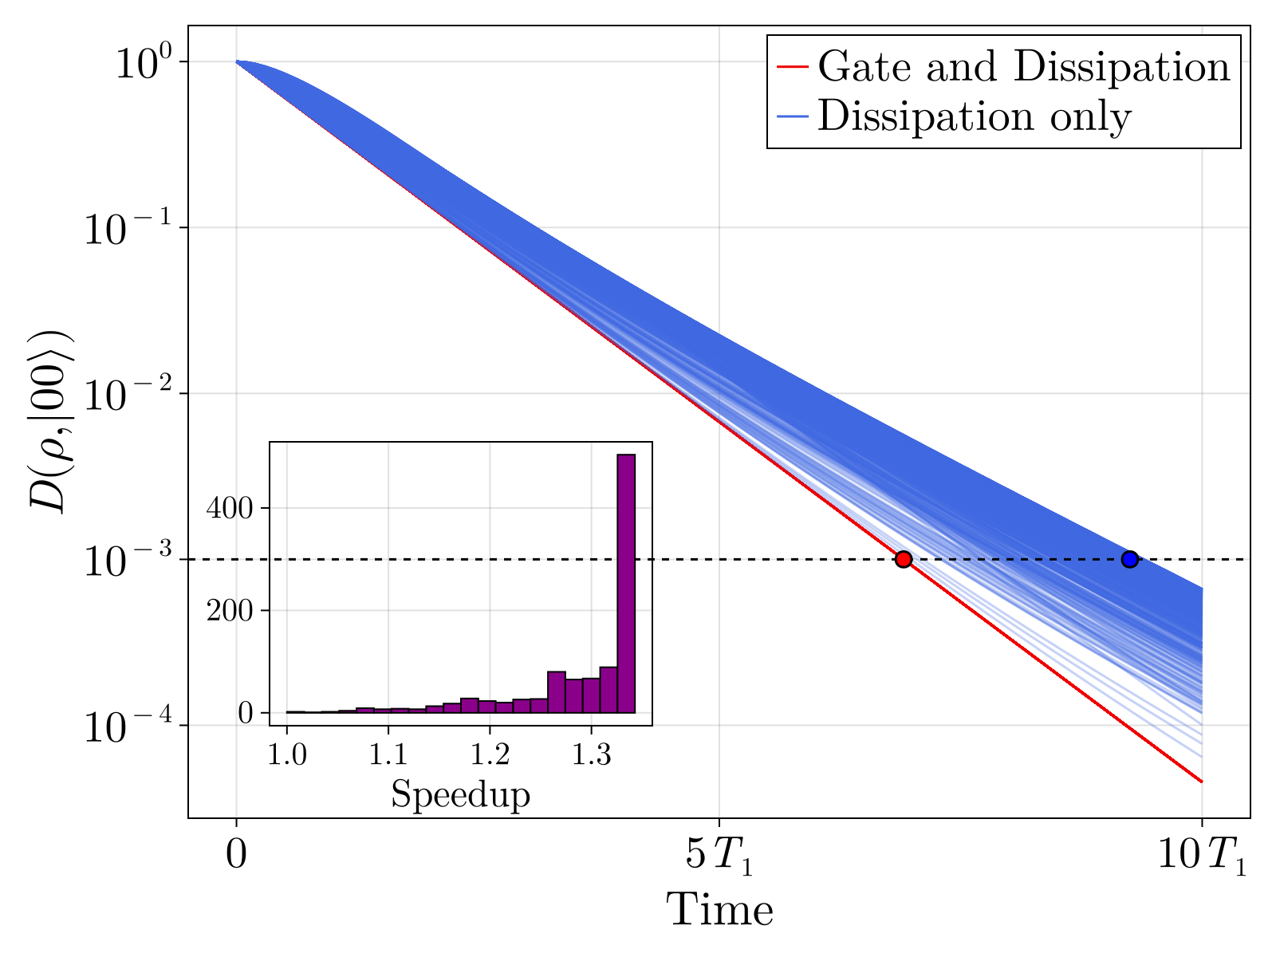
Results
Exponential speedup of the two-qubit state relaxation:
Trace distance to the ground state
Ancilla in
Ancilla in

Slide 23
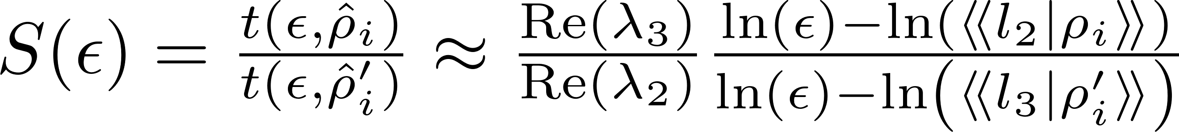
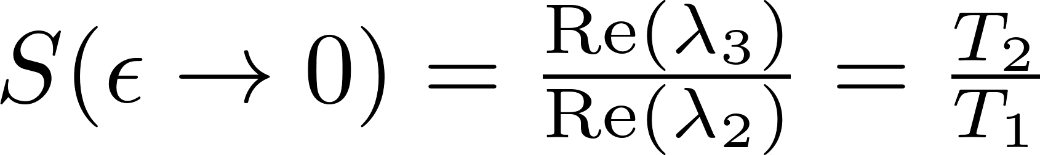
Results
Exponential speedup of the two-qubit state relaxation:
Ancilla in
Theoretical speedup

Slide 24
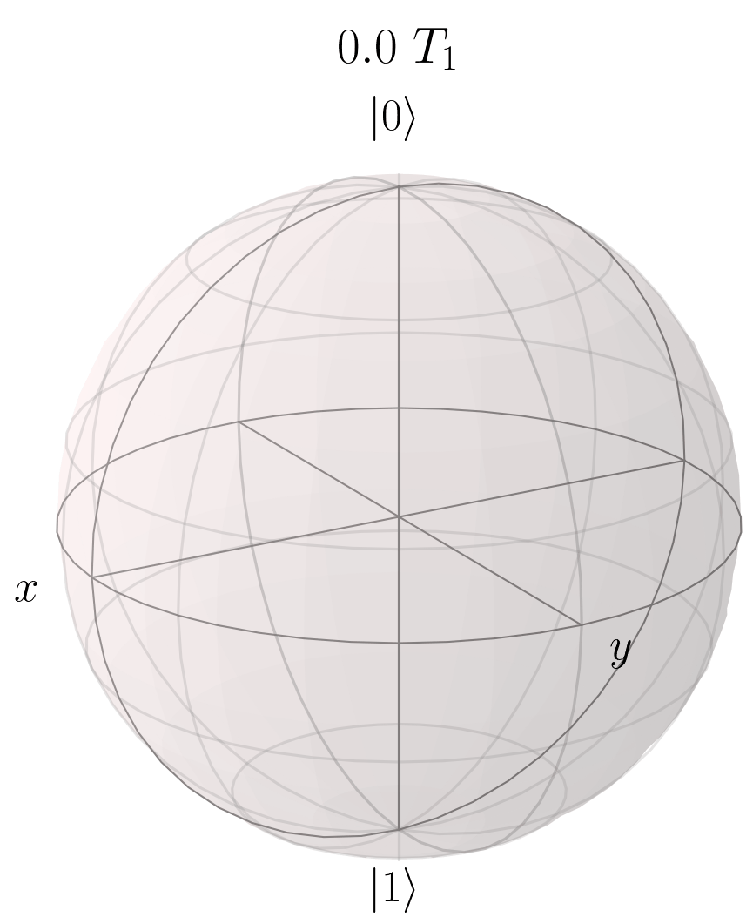
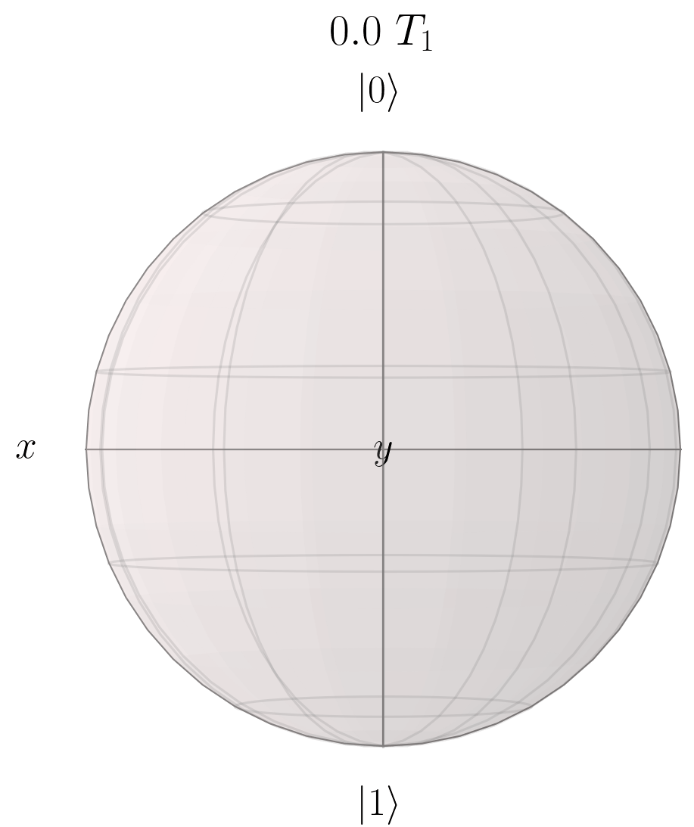
Results
Single-qubit trajectories

Slide 25
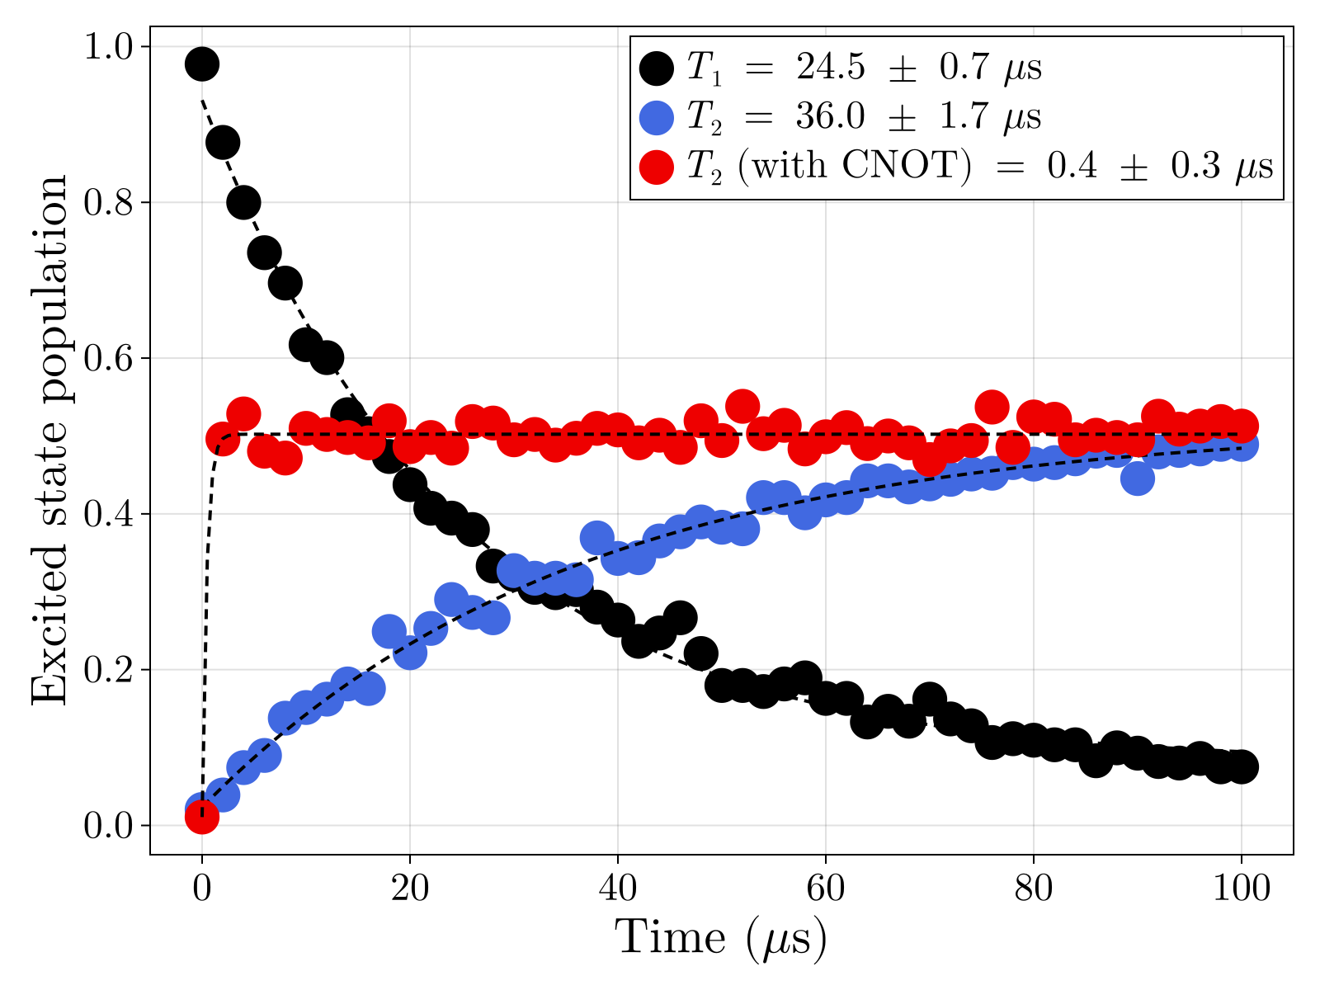
Experimental implementation
Performed on Garnet superconducting processor

Slide 26
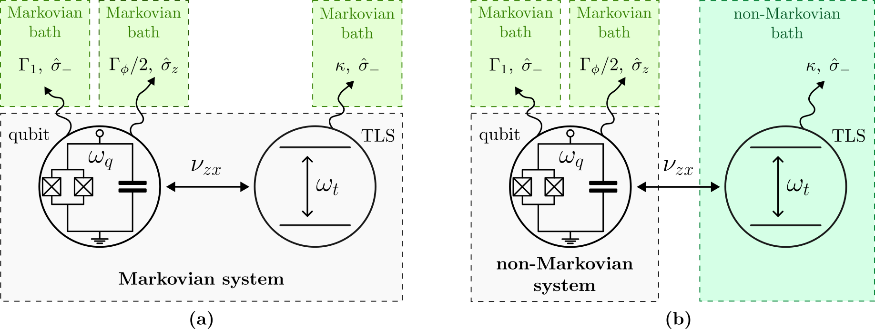
Non-Markovian Case
SC qubits are coupled to a bath of TLSs
Good effective model: One strongly coupled TLS to model real hardware noise
Agarwal et al 2024 Quantum Sci. Technol. 9 035017

Slide 27
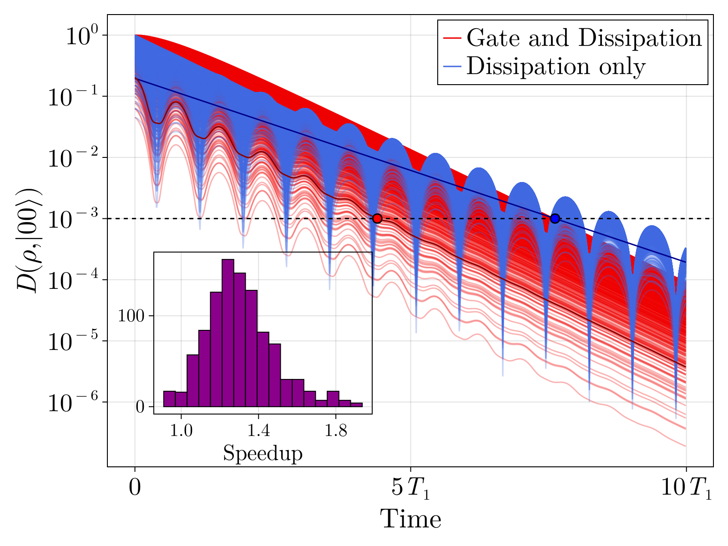
Non-Markovian Case
Trace distance to the ground state

Slide 28
Conclusion
When T₂ > T₁ , we can accelerate qubit reset by entangling it with an incoherent ancilla, obtaining a speedup S = T₂/ T₁
This simple protocol is robust under non-Markovian dissipation, imperfect ancilla states, finite temperature and imperfect gate application

Slide 29

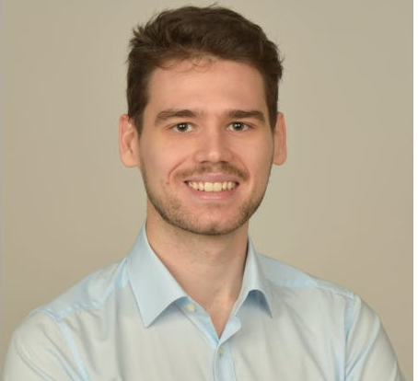




Acknowledgements
Mattia Moroder
Miha Papič
John Goold
Felix C. Binder
François Damanet
J. Phys. A: Math. Theor. 59, 265303 (2026)

Slide 30
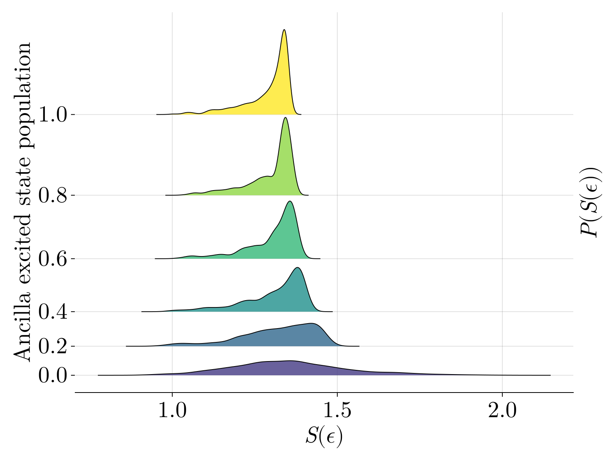
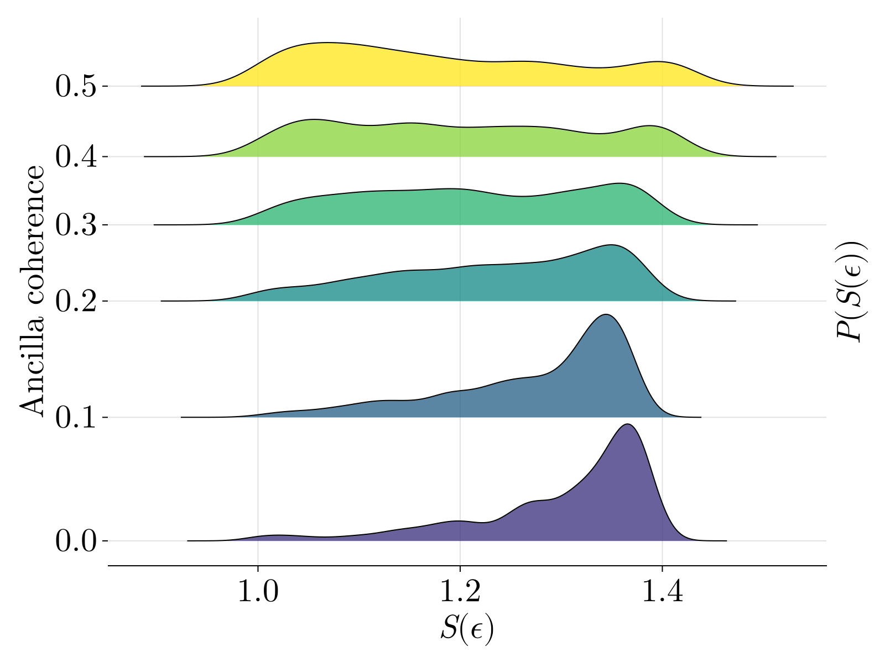
Robustness

Slide 31
Non-Markovian Case
SC qubits are coupled to a bath of TLSs
Good effective model: One strongly coupled TLS to model real hardware noise
Agarwal et al 2024 Quantum Sci. Technol. 9 035017

Slide 32
Non-Markovian Case
SC qubits are coupled to a bath of TLSs
Good effective model: One strongly coupled TLS to model real hardware noise
Agarwal et al 2024 Quantum Sci. Technol. 9 035017

Slide 33
Non-Markovian Case

Slide 34
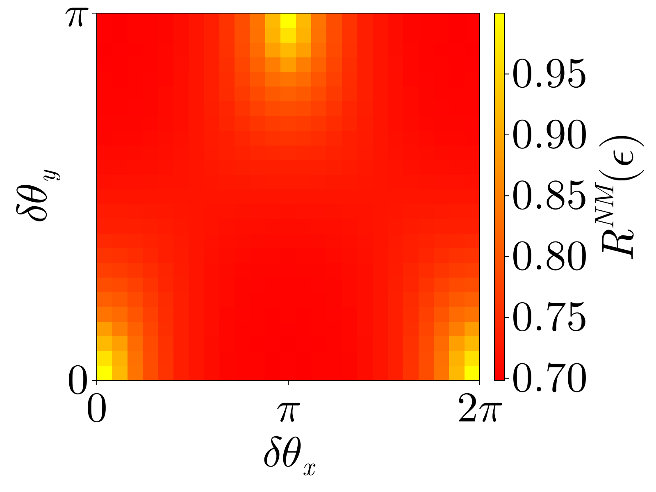
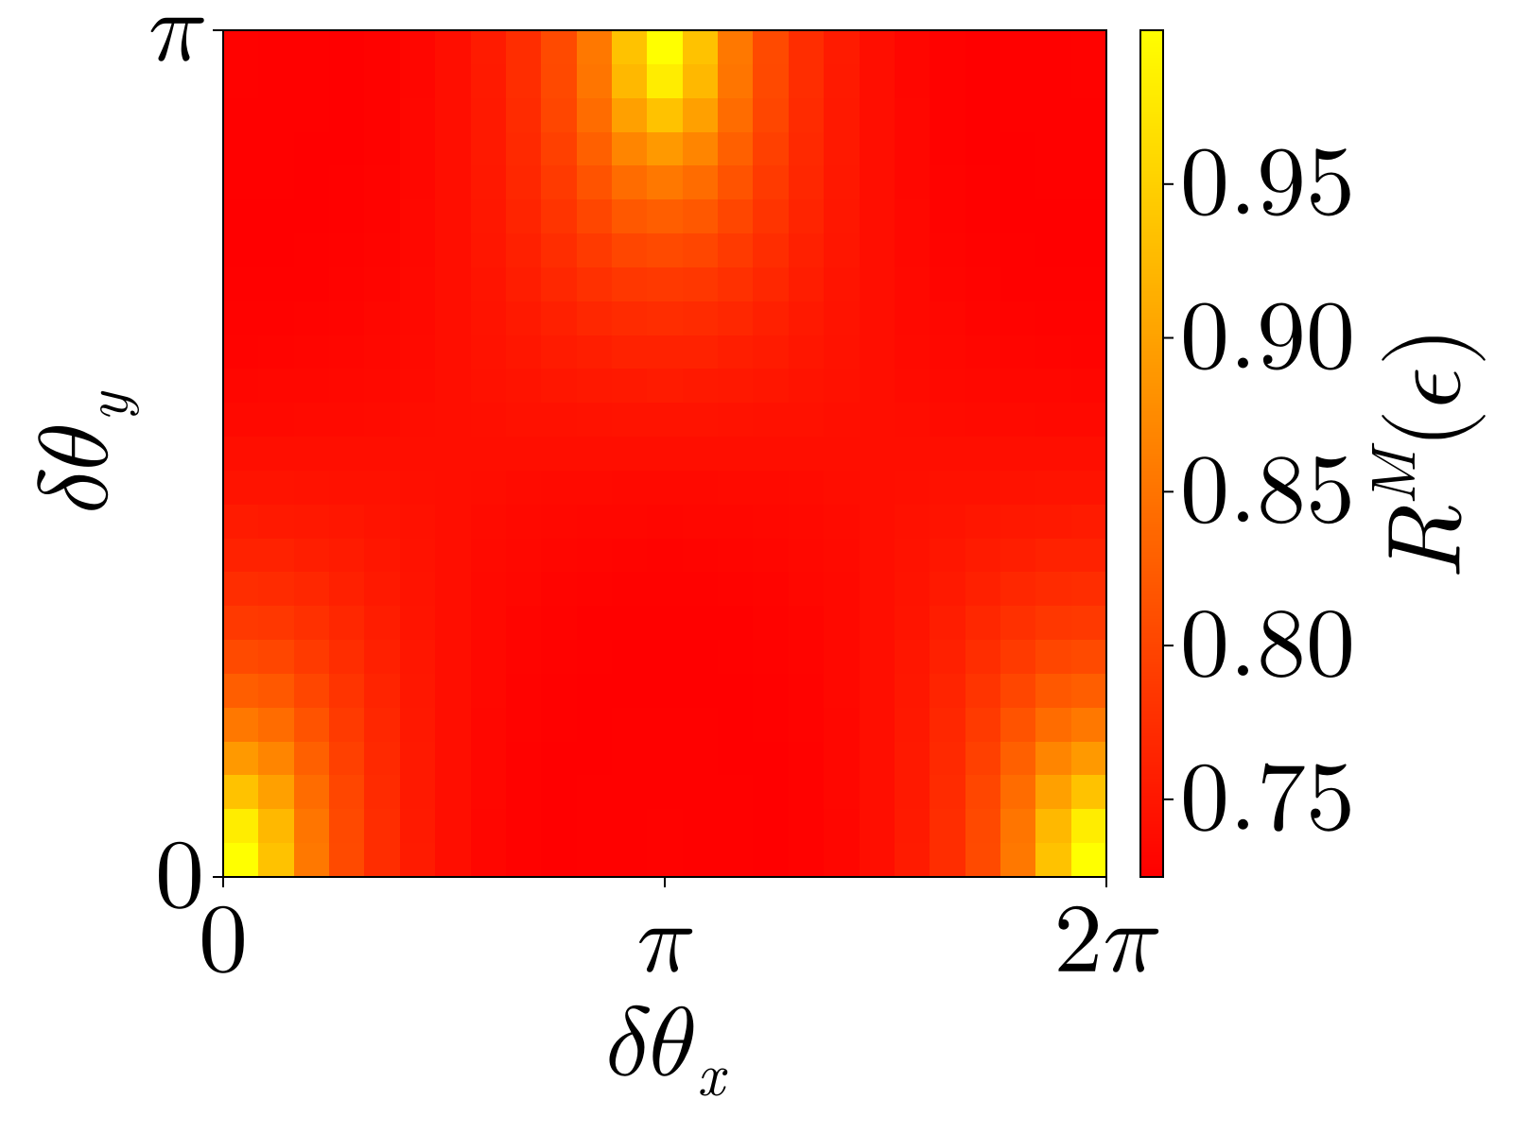
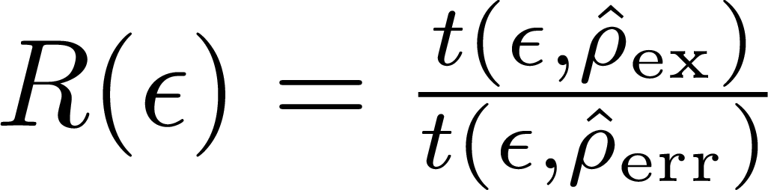
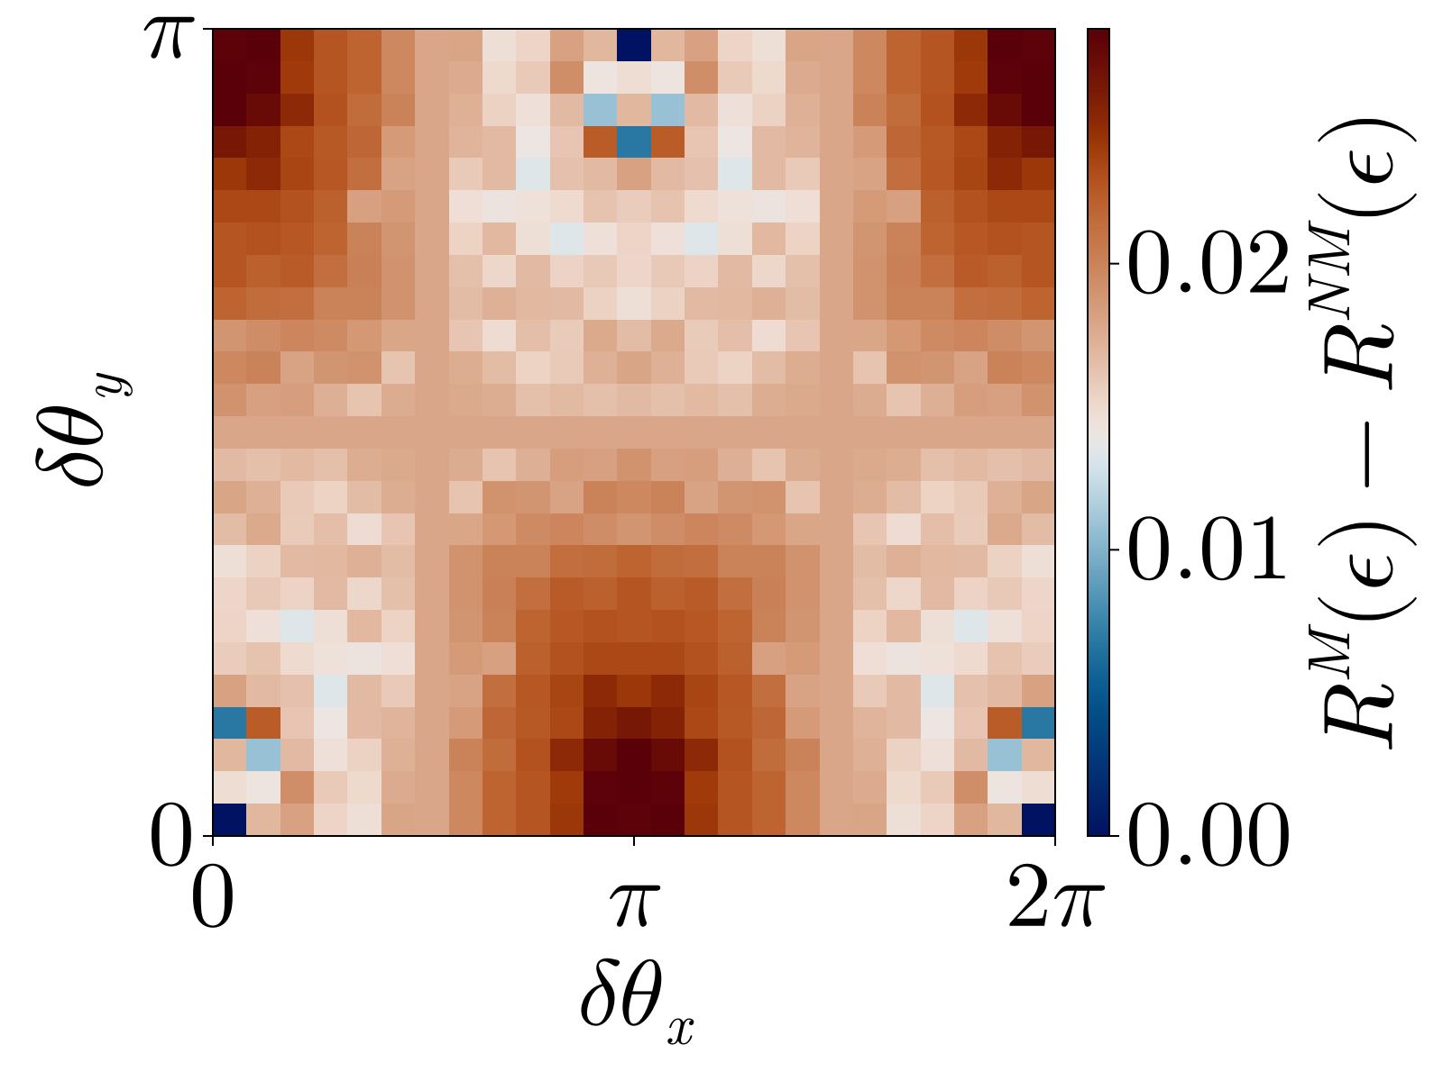
Supplemental material

Slide 35
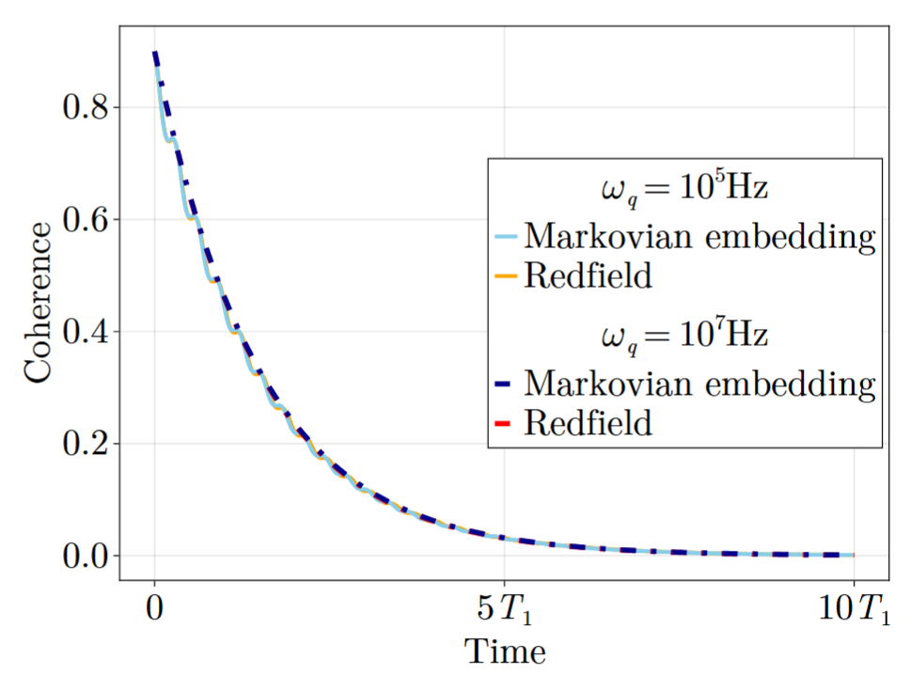
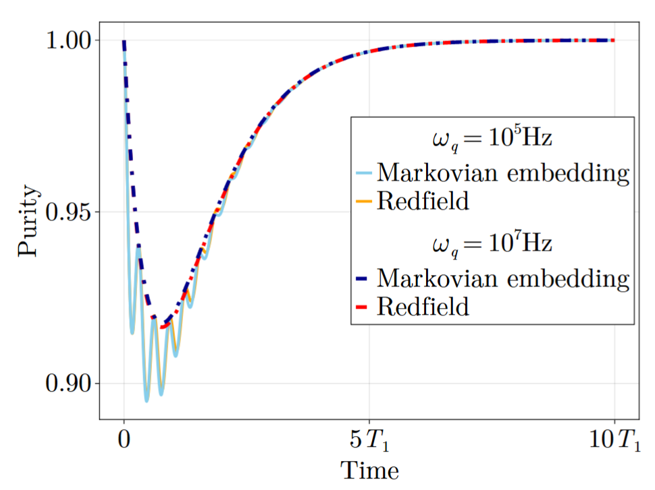
Supplemental material

Slide 36
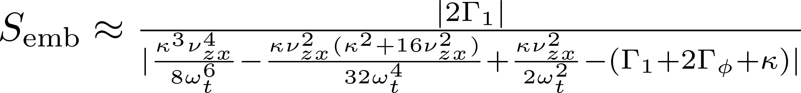
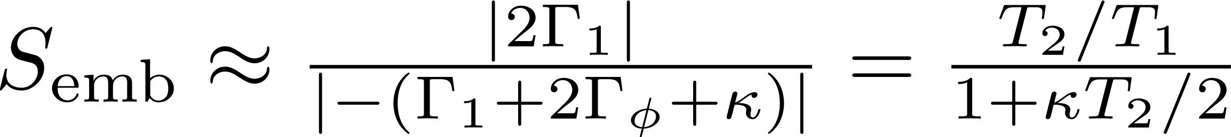
Supplemental material
Fourth order expansion:

