Slide 1


How Do Insomnia and Depression Interact?
A Network Analysis of Symptoms and Transdiagnostic Processes
EABCT 2026- 16-19 Septembre - Bruxelles
Audrey Krings, Charles Morin & Sylvie Blairy

Slide 2

Theoretical framework
Baglioni et al., 2011
Depression
Insomnia
Insomnia
Depression
Sivertsen et al., 2012; Wang et al., 2026
Notes:
Insomnia and depression frequently co-occur.
Importantly, their relationship appears to be bidirectional. Insomnia is not simply a symptom of depression: it is also a risk factor for its onset (Baglioni et al., 2011). And conversely, depression can also predict subsequent insomnia (Sivertsen et al., 2012; Wang et al., 2026).

Slide 3
Theoretical framework
Depression
Insomnia
How are they connected ?
Identify potentially relevant treatment targets
Inform more individualized treatment strategies
Notes:
So the question is not only whether insomnia and depression co-occur — we already know that they do.
The more clinically relevant question is: how are they connected?
If we can identify the symptoms and psychological processes that connect the two, this may help us to identify potentially relevant treatment targets and ultimately inform more individualized treatment strategies.

Slide 4
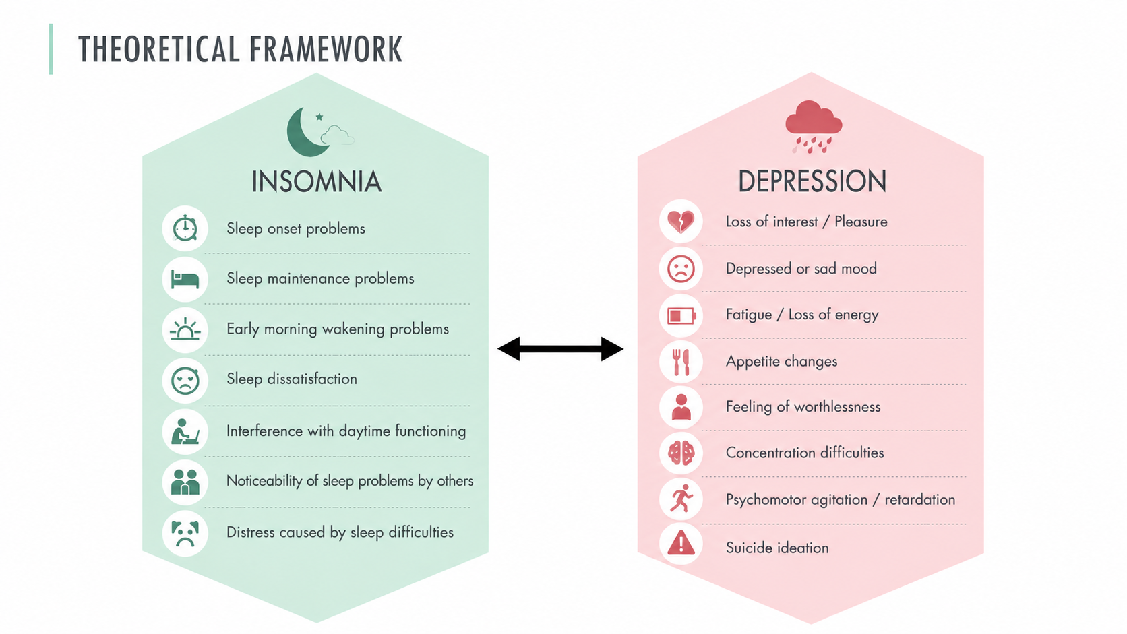
Theoretical framework
Depression and Insomnia Symptoms
Notes:
One way to address this question is to move beyond diagnostic categories and look at individual symptoms, individual mechanisms.
Instead of considering insomnia and depression as two global entities, we can examine how insomnia symptoms are connected to depressive symptoms.
In recent years, a growing number of studies have used network analysis to examine insomnia and depression at the symptom level.

Slide 5
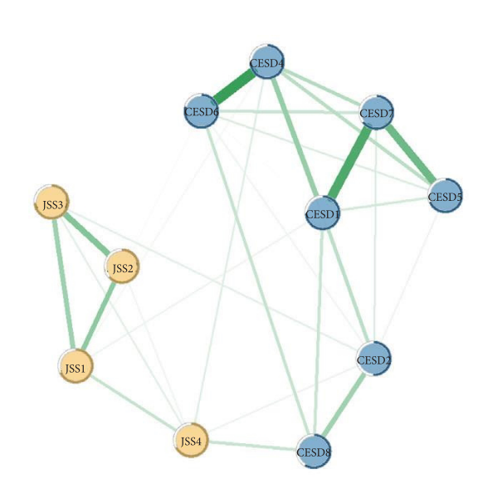
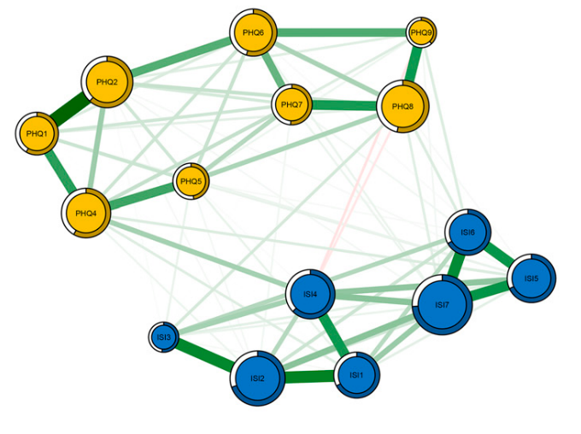
Theoretical framework
Depression and Insomnia Symptoms
Notes:
One way to address this question is to move beyond diagnostic categories and look at individual symptoms, individual mechanisms.
Instead of considering insomnia and depression as two global entities, we can examine how insomnia symptoms are connected to depressive symptoms.
In recent years, a growing number of studies have used network analysis to examine insomnia and depression at the symptom level.

Slide 6
Theoretical framework
Depression and Insomnia Symptoms
Bai et al., 2022; X. Jiang et al., 2025; J. Li et al., 2024; Sun et al., 2025; Tao et al., 2024; Zhao et al., 2023).
Notes:
Across these studies, some symptoms seem to emerge repeatedly as particularly important. Fatigue, or loss of energy, is one of the most consistent findings.
Other symptoms, such as depressed mood, loss of interest, interference with daytime functioning and sleep dissatisfaction, have also been identified as important in the depression and insomnia comorbidity although findings vary across studies.
So, overall, these studies are beginning to show us which symptoms may be particularly important in the relationship between insomnia and depression.

Slide 7
Theoretical framework
Depression and Insomnia Symptoms
Two remaining gaps:
Clinically significant comorbidity
→ Still understudied
Beyond symptoms: psychological processes
→ Still largely unexplored
Notes:
However, there are still some important questions in the literature.
First, fewer studies have examined these connections specifically in people experiencing clinically significant symptoms of both insomnia and depression.
And second, most of the work so far has focused on symptoms. Much less is known about the psychological processes that may also be involved.

Slide 8
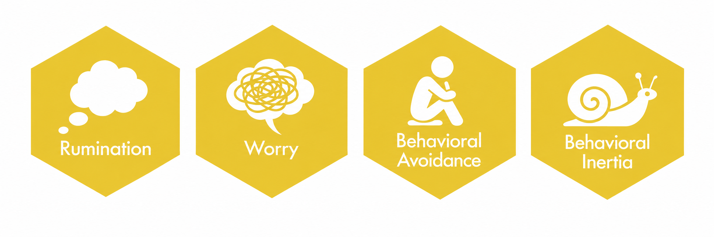
Theoretical framework
Four Transdiagnostic Processes
Cognitive and Behavioral Dimensions
Notes:
This led us to consider several transdiagnostic processes that could potentially contribute to these connections.
We focused on four processes, covering both cognitive and behavioral dimensions.
They are relevant to depression, but they have also been associated with sleep difficulties.
The first two are rumination and worry, two forms of repetitive negative thinking.
The other two are behavioral avoidance and behavioral inertia, which capture difficulties engaging in and sustaining meaningful or goal-directed activities

Slide 9
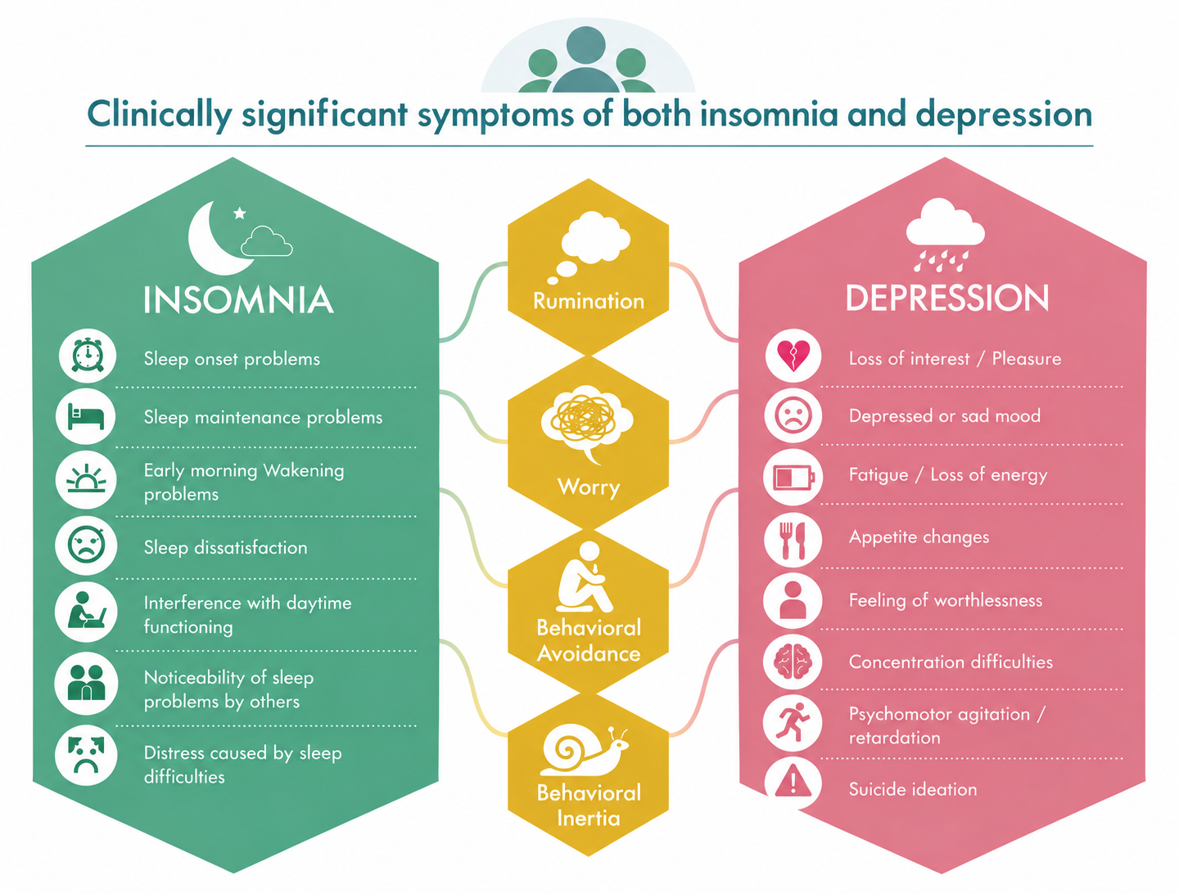
Objectives
Which symptoms may be particularly important in connecting insomnia and depression?
What role do transdiagnostic processes play in the connections between symptoms?
Notes:
So, based on these gaps in the literature, we brought together insomnia symptoms, depressive symptoms, and these four transdiagnostic processes.
Importantly, we examined them specifically in individuals with clinically significant symptoms of both insomnia and depression.
We had three main questions.
First, which symptoms may be particularly important in connecting insomnia and depression?
Second, what role do transdiagnostic processes play in the connections between symptoms? We expected them to play a particularly important role, with strong connections to both insomnia and depressive symptoms.

Slide 10

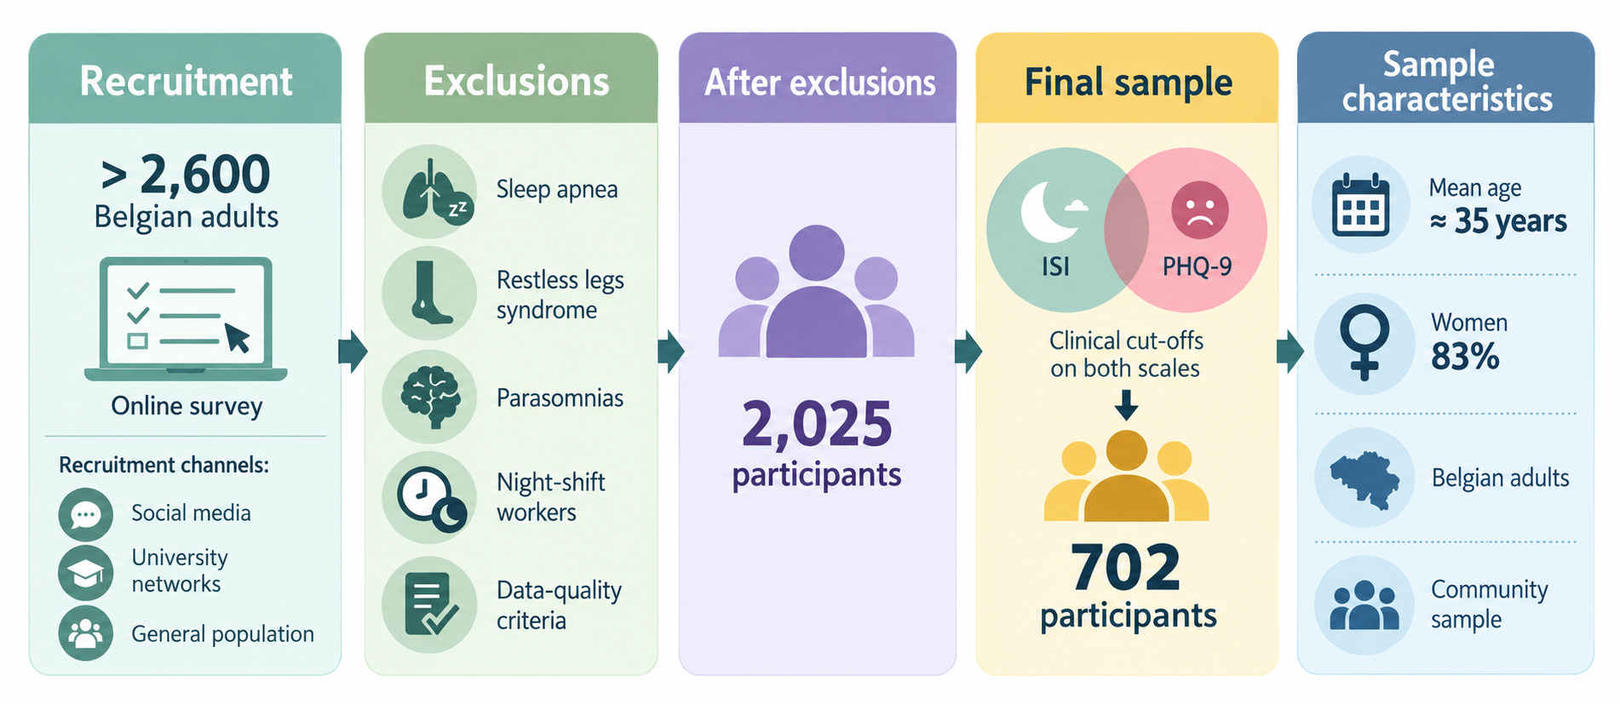
Participants & Procedure
Notes:
We recruited more than 2,600 Belgian adults through an online survey.
We excluded participants with other sleep problems, such as sleep apnea, restless legs syndrome, or parasomnias, as well as night-shift workers. We also applied some data-quality criteria.
After applying our exclusion and data-quality criteria, 2,025 participants remained.
For the present study, we selected those with clinically significant symptoms of both insomnia and depression, resulting in a final sample of 702 participants.
Their mean age was about 35 years, and 83% were women.

Slide 11
Participants & Procedure
Notes:
We recruited more than 2,600 Belgian adults through an online survey.
We excluded participants with other sleep problems, such as sleep apnea, restless legs syndrome, or parasomnias, as well as night-shift workers. We also applied some data-quality criteria.
After applying our exclusion and data-quality criteria, 2,025 participants remained.
For the present study, we selected those with clinically significant symptoms of both insomnia and depression, resulting in a final sample of 702 participants.
Their mean age was about 35 years, and 83% were women.

Slide 12

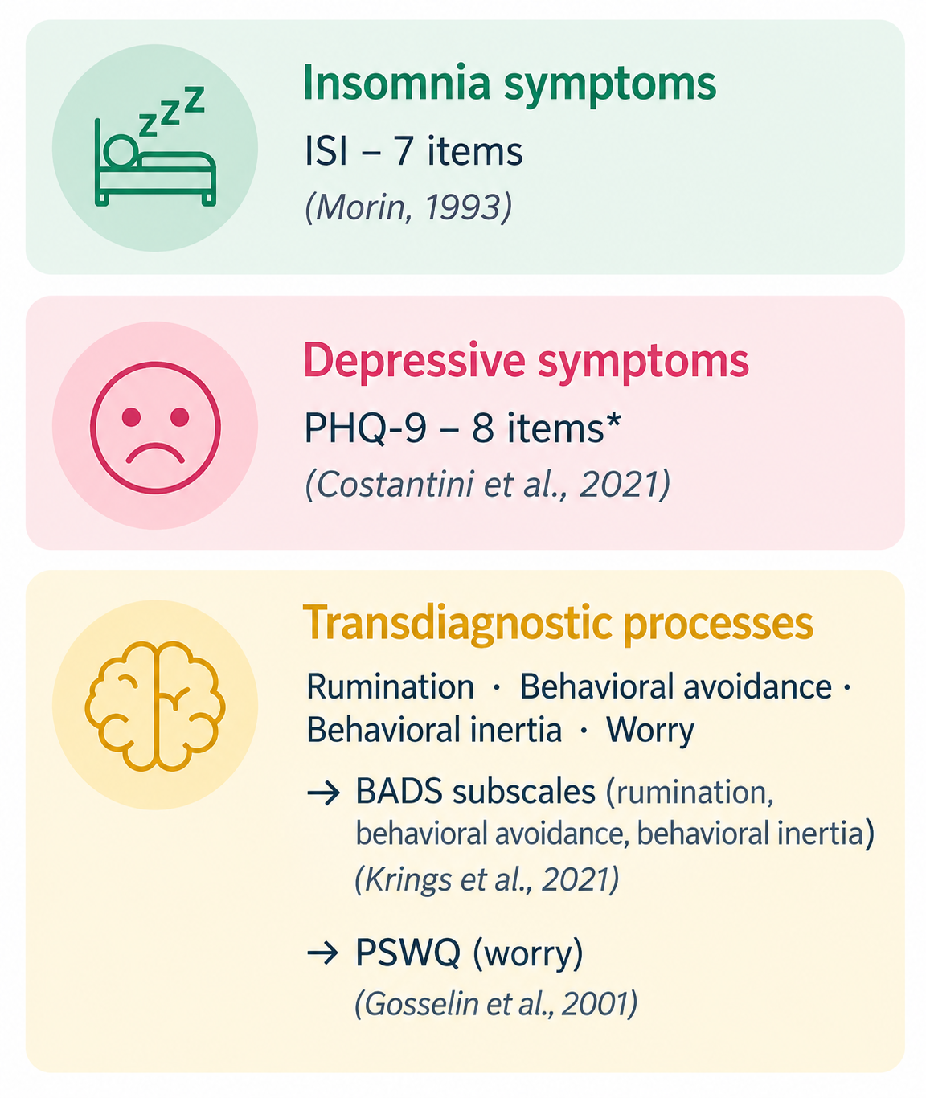
Measures
Notes:
Regarding the measures, insomnia symptoms were assessed with the seven items of the Insomnia Severity Index.
Depressive symptoms were assessed with the PHQ-9. We excluded the sleep item to avoid overlap with the insomnia symptoms, so eight depressive symptoms were included in the network.
For the transdiagnostic processes, rumination, behavioral avoidance, and behavioral inertia were assessed with subscales of the BADS, and worry with the Penn State Worry Questionnaire.

Slide 13
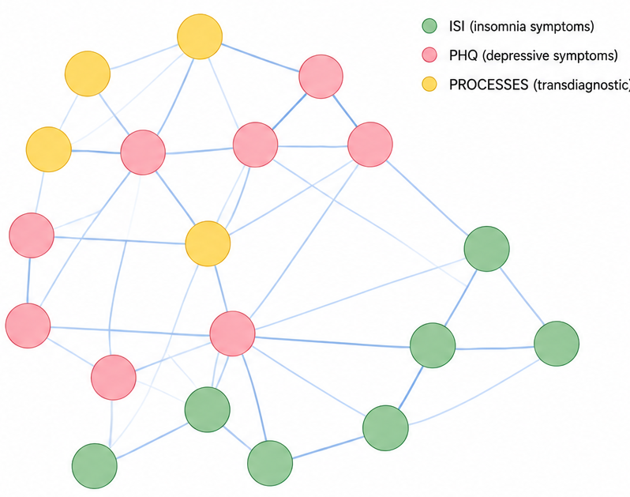
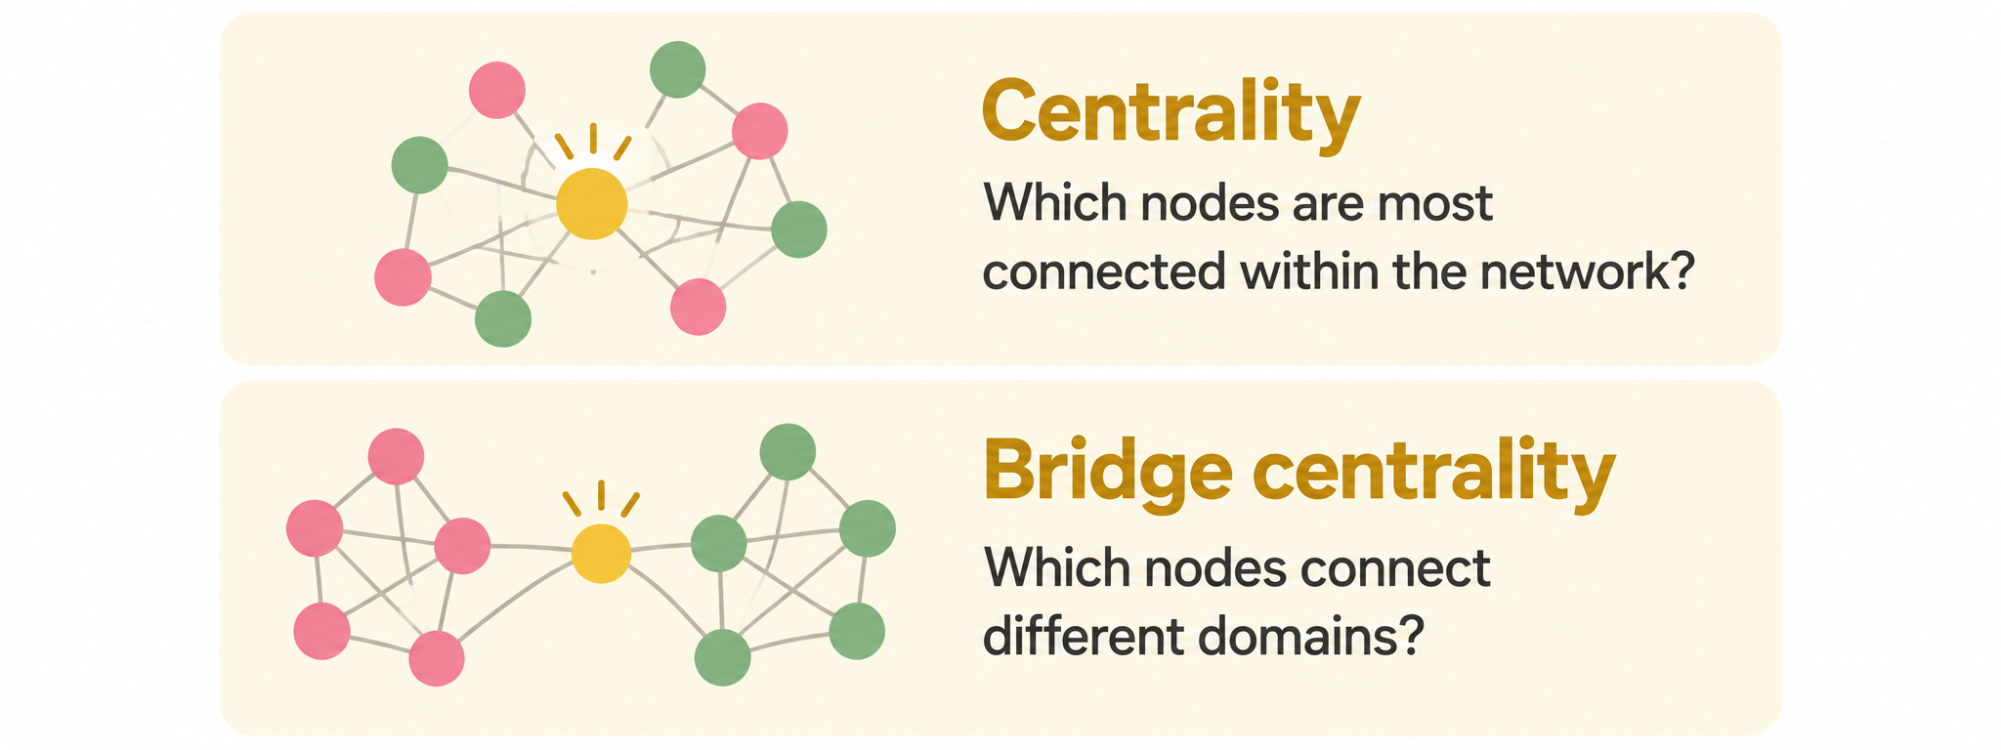
Network Analysis
Regularized partial correlation network
Notes:
We then estimated a regularized partial correlation network including all symptoms and processes.
In this network, each symptom or process is represented by a node, and the connections between them — the edges — represent their unique associations.
The thicker the edge, the stronger the association.
We computed two additional indices.
First, centrality, meaning which nodes are most strongly connected to the rest of the network.
And second, bridge centrality, meaning which nodes are most strongly connected to nodes from the other domains.
Clinically, what does this mean?”
A central node is a node that is strongly connected within the network, based on both the number and the strength of its connections. So, in theory, if we can change this node, this change may spread through the network and have a substantial influence on the network as a whole.
So, clinically, bridge nodes may be particularly interesting because they could represent potential pathways through which difficulties in one domain are connected to difficulties in another.

Slide 14
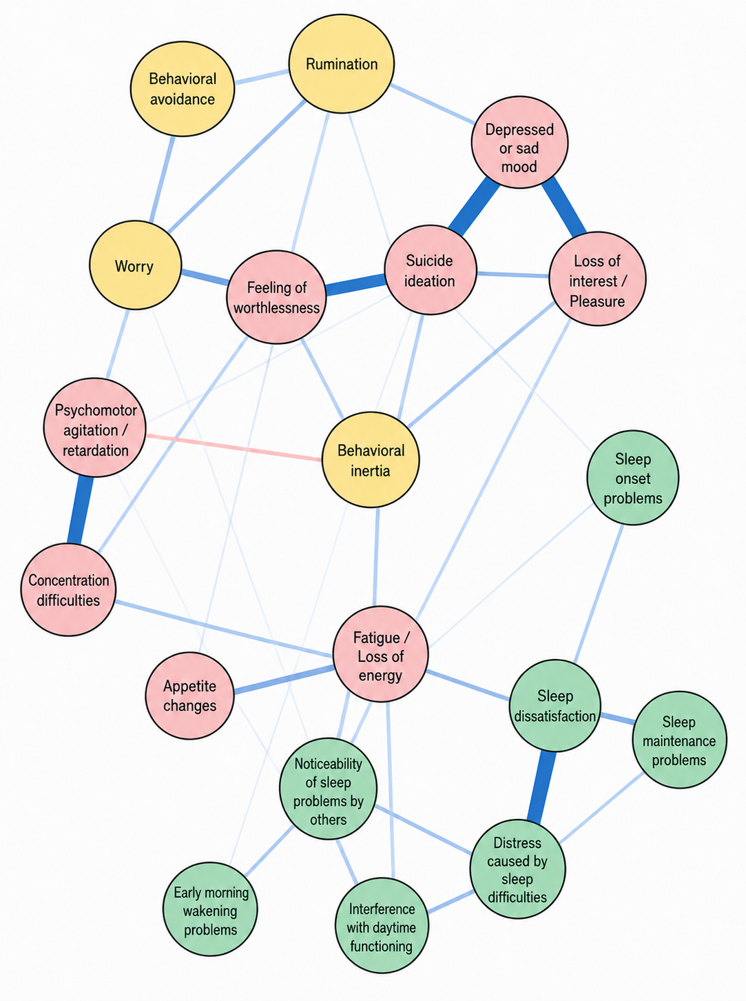
Results
Regularized partial correlation network
Notes:
So, this is the network we obtained. I LET YOU ONE MINUTE EXPLORE THE NETWORK AND LOOK WHAT YOU CAN SEE.
Based on this network, four main patterns can already be observed.
First, the strongest connections were mainly found within the same domains — between insomnia symptoms, between depressive symptoms, and between some of the transdiagnostic processes.
For example, depressed mood was strongly connected with loss of interest and suicidal ideation, while sleep dissatisfaction was strongly connected with distress caused by sleep difficulties.
Second, connections between insomnia and depression were less numerous, although we can already see some connections between the two domains, particularly around fatigue.
Third, contrary to what we might have expected, the transdiagnostic processes were not broadly connected across both symptom domains. Their connections appeared to be quite selective, and stronger with depressive symptoms than with insomnia symptoms.

Slide 15
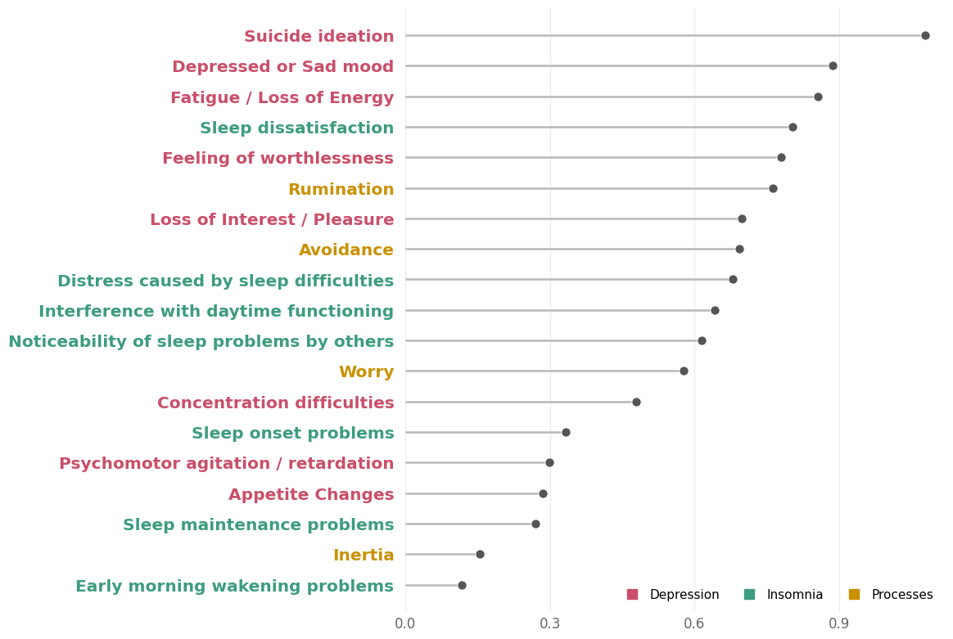
Results
Centrality analyses
Notes:
When we look at centrality, meaning which nodes are most strongly connected to the rest of the network, suicidal ideation was the most central node, followed by depressed mood and fatigue or loss of energy. Sleep dissatisfaction was also among the most central symptoms.
Interestingly, however, the transdiagnostic processes were not among the most central nodes overall.
Among the transdiagnostic processes, rumination showed the highest centrality, followed by behavioral avoidance.
PHQ9 - 1.079
PHQ2- 0.887
PHQ4- 0.855
ISI4- 0.804
PHQ6- 0.779
RUMINATION- 0.763

Slide 16
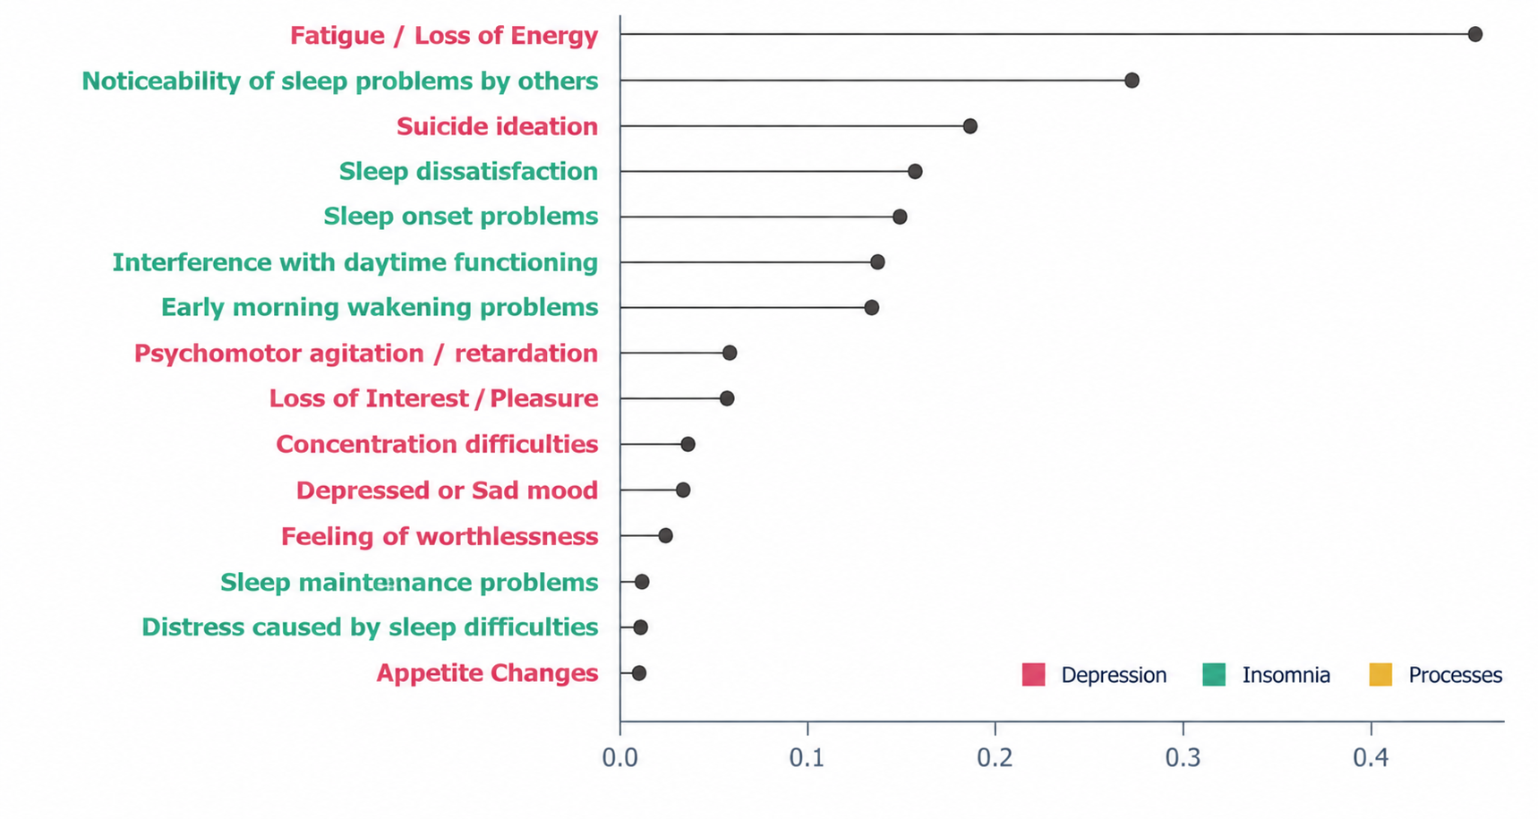
Results
Bridge Analyses
Notes:
When we looked specifically at bridge expected influence, fatigue or low energy clearly emerged as the strongest bridge symptom, with a value of 0.472.
This was followed by the noticeability of sleep problems by others, at 0.254, and suicidal ideation, at 0.184.
Sleep dissatisfaction and sleep onset problems also showed positive bridge values, although these were somewhat lower,
Overall, fatigue clearly stood out as the symptom most strongly connecting the insomnia and depression communities.
PHQ4 – Fatigue / low energy- 0.472
ISI6 – Noticeability of sleep problems by others 0.254
PHQ9 – Suicidal ideation- 0.184
ISI4 – Sleep dissatisfaction - 0.142
ISI1 – Sleep onset problems 0.137

Slide 17

Conclusion
Which symptoms may be particularly important in connecting insomnia and depression?
Fatigue stood out as a key symptom
Highly central and the strongest bridge between insomnia and depression
Connections between the two disorders were relatively limited
Assess and address key symptoms, particularly fatigue
Consider addressing sleep directly when treating patients with comorbid insomnia and depression.
Notes:
So, what can we take from these results clinically?
First, fatigue really stood out. It was both highly central in the network and the strongest bridge between insomnia and depression. So this suggests that fatigue may be a particularly relevant symptom to assess and address in patients presenting with both disorders.
At the same time, the connections between insomnia and depression were relatively limited. The two symptom domains were not as strongly interconnected as we might perhaps have expected.
And clinically, this actually fits quite well with what we already know from the literature. Treating depression does not necessarily mean that insomnia will resolve, and residual sleep difficulties are common. So sleep may need to be addressed directly rather than simply expecting it to improve as depression improves.
So these are not entirely new clinical messages, but our network provides another way of seeing and supporting them at the symptom level.

Slide 18
Conclusion
2. What role do transdiagnostic processes play in the connections between symptoms?
Psychological processes were not the most central nodes
Psychological processes were most closely related to depressive symptoms than insomnia symptoms
Rumination and behavioral avoidance stood out among the processes, mainly in relation to depressive symptoms
Psychological processes may be relevant, but not uniformly across patients
Use case formulation to identify
the most relevant processes
Notes:
Now, what about psychological processes?
Contrary to what we might have expected, psychological processes were not the most central nodes in the network. Symptoms themselves tended to occupy more central positions.
We also found that these processes were more closely related to depressive symptoms than to insomnia symptoms.
Among them, rumination and behavioral avoidance stood out, particularly in relation to depressive symptoms.
And again, this is quite consistent with what we already know from the literature, as both are well-established processes in depression.
What is perhaps more interesting here is what we did not find: these processes did not emerge as broad mechanisms connecting insomnia and depression.
So clinically, rumination and behavioral avoidance may be particularly worth considering when depressive symptoms are prominent. But I would be cautious about systematically targeting the same processes in every patient.
Instead, case formulation may help us identify which processes are actually relevant for a particular patient and therefore may be useful treatment targets.

Slide 19
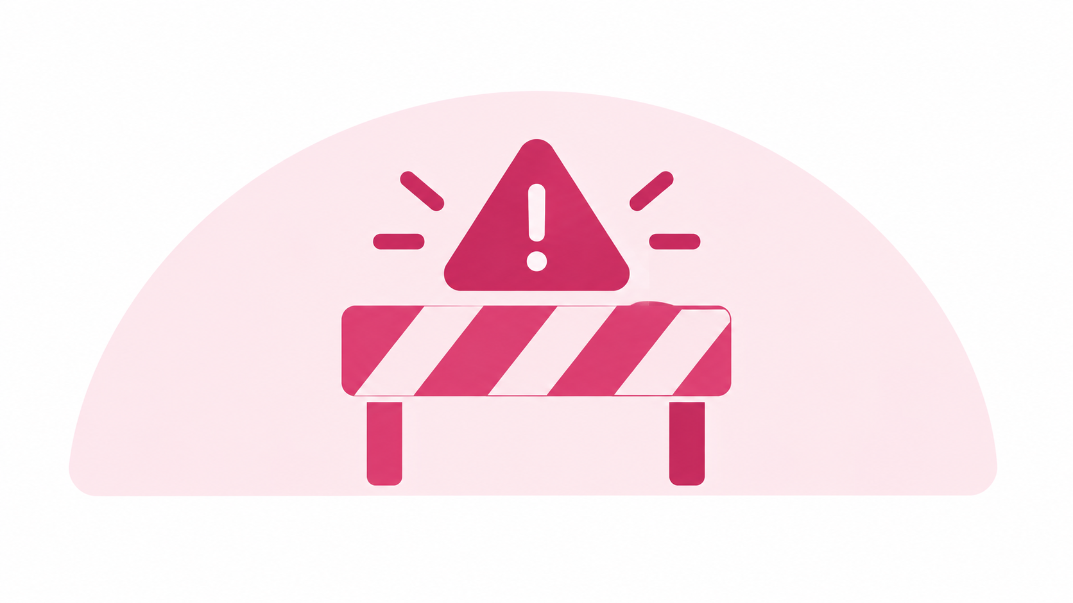
Limitations & next steps
Cross-sectional design
→ No directionality or causality
→ Longitudinal and person-specific networks needed
Community sample
→ Replication in treatment-seeking samples
Predominantly female sample
→ Limited generalizability across genders
Selected transdiagnostic processes
→ Other shared and insomnia-specific processes should be examined
Notes:
Of course, there are some limitations.
First, this is a cross-sectional study, so we cannot draw conclusions about directionality or causality. A particularly interesting next step would be to use longitudinal and person-specific networks, to better understand how symptoms and processes interact over time within the same individual.
Second, although participants met clinical cut-offs for both insomnia and depression, they were recruited from the community. These findings should therefore be replicated in treatment-seeking samples.
Our sample was also predominantly female, which may limit the generalizability of the findings across genders.
And finally, we included only four transdiagnostic processes. Future studies should examine other shared processes, but also more insomnia-specific processes.
Together, these future directions could bring us closer to a more individualized understanding of insomnia and depression.

Slide 20
Thank you for your attention

Slide 21

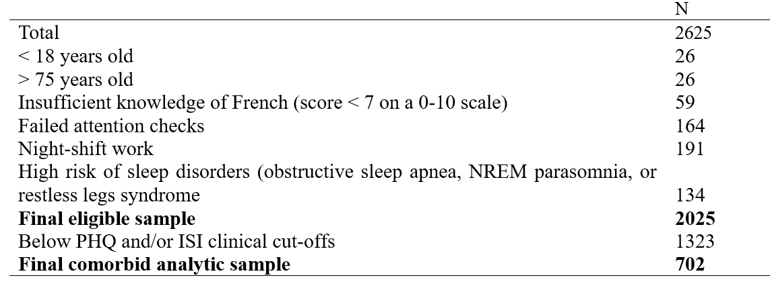
Participants & Procedure
Online survey · France-speaking adults
Mean age: 34.6 years
82.8% women
Notes:
We recruited more than two thousand six hundred Belgian adults through an online survey, using different channels such as social media, or university networks.
We excluded participants with other sleep problems, such as sleep apnea, restless legs syndrome, or parasomnias, as well as night-shift workers. We also applied some data-quality criteria.
After these exclusions, 2,025 participants remained.
For this study, we selected participants with significant symptoms of both insomnia and depression. This resulted in a final sample of 702 participants who met the clinical cut-offs on both the ISI and the PHQ-9.
They were around 35 years old on average, and 83% were women.

Slide 22

Results
The EBIC GLASSO Network
Processus | Σ connexions Insomnia | Σ connexions Depression
Worry | 0.09267819 | 0.2807440
Avoidance | 0.04492562 | 0.1701079
Inertia | 0.01052840 | 0.1439140
Rumination | 0.03883882 | 0.2323090
Notes:
To explore this further, we looked separately at how strongly each transdiagnostic process was connected to insomnia versus depressive symptoms.
And the pattern is actually quite clear: all four processes were more strongly connected to depression than to insomnia. Worry showed the strongest connectivity with both domains, but even for worry, the connection with depression was about three times stronger.
So, rather than acting as broad bridges between insomnia and depression, these processes seem to be more strongly embedded within the depressive symptom domain.”

