Slide 1

URBAN, REGIONAL PLANNING AND TRANSPORTATION • SYDNEY 2026
Behavioural Determinants of Parcel Locker Use in Urban Last-Mile Deliveries
A multi-theoretical analysis
Tanguy Baiwir, Mario Cools and Sabine Limbourg
HEC Liège – University of Liège
Faculty of Applied Sciences - University of Liège

Slide 2
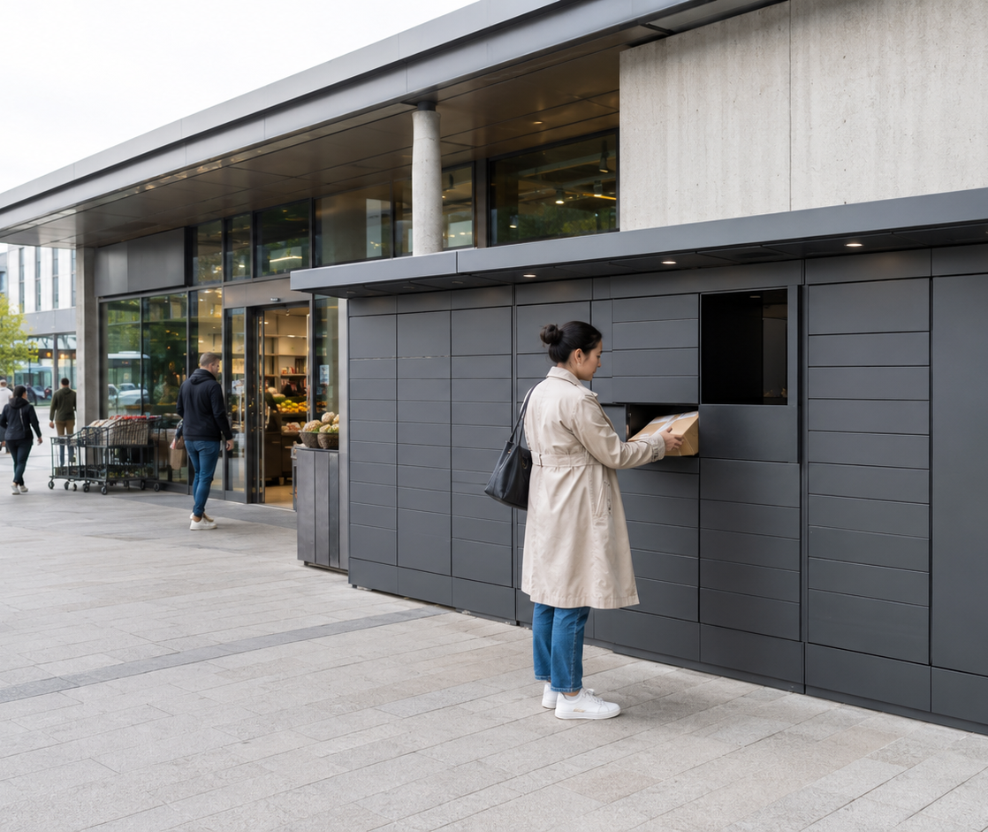
Why Parcel Lockers ?
179M
+5%
online purchases in Belgium in 2024
year-on-year growth
Consolidation
Reduced congestion
24/7 accessibility
Reduced failed deliveries
Tanguy Baiwir, Mario Cools and Sabine Limbourg
2

Slide 3
Multi-theoretical analysis
The study compares complementary behavioural, technological and consumer-context explanations of intention.
TPB
TAM
UTAUT2
Planned behaviour
Technology acceptance
Acceptance & Use
Attitude
Subjective norm
Perceived behavioural control
Perceived ease of use
Perceived usefulness
Attitude
Trust
Performance Expectancy
Effort Expectancy
Trust
Price Value
Facilitating Conditions
Social Influence
BEHAVIOURAL INTENTION TO USE PARCEL LOCKERS
Tanguy Baiwir, Mario Cools and Sabine Limbourg
3

Slide 4
Methodology
327 → 306
initial responses valid questionnaires
Survey
Reliability and Validity
Data Analysis
Tanguy Baiwir, Mario Cools and Sabine Limbourg
4

Slide 5
Theory of Planned Behavior (TPB)
66.5%
3 / 3
variance explained
predictors significant
Intention rises when the service is evaluated positively, feels ready-to-use, and is socially endorsed.
Standardised coefficients (β)
Signif. codes: * p<0.05 ; ** p<0.01 ; *** p<0.001
Tanguy Baiwir, Mario Cools and Sabine Limbourg
6

Slide 6
Technology Acceptance Model (TAM)
62.7%
4 / 4
Perceived usefulness
variance explained
predictors significant
Trust
Intention rises when parcel lockers are evaluated positively, feel easy to use and trustworthy, even though perceived usefulness has a small negative effect.
Perceived Ease of use
Attitude
Standardised coefficients (β)
Signif. codes: * p<0.05 ; ** p<0.01 ; *** p<0.001
Tanguy Baiwir, Mario Cools and Sabine Limbourg
7

Slide 7
Unified Theory of Acceptance and Use of Technology (UTAUT2)
Facilitating conditions
-0.062
72%
3 / 6
Effort expectancy
0.111
variance explained
predictors significant
Performance expectancy
-0.091
Intention rises when parcel lockers are socially endorsed, offer good value and feel trustworthy, while performance, effort and facilitating conditions play a limited role.
Trust
0.149*
Price value
0.242***
Social influence
0.711***
Standardised coefficients (β)
Signif. codes: * p<0.05 ; ** p<0.01 ; *** p<0.001
Tanguy Baiwir, Mario Cools and Sabine Limbourg
8

Slide 8
Results
72,0%
66.5%
62.7%
Broadest lens, strongest fit
UTAUT2 adds explicit social and price-value mechanisms to technological and effort-related beliefs.
Model choice changes emphasis—not the conclusion that intention is highly structured.
Tanguy Baiwir, Mario Cools and Sabine Limbourg
5

Slide 9
Discussion : Behavioural Intention
Intention is social, evaluative and experiential
TPB
TAM
UTAUT2
β = 0.495
β = 0.766
β = 0.711
Subjective norm
Attitude
Social influence
Attitude 0.475
Perceived control 0.253
Ease of use 0.321
Trust 0.182
Usefulness −0.131
Price value 0.242
Trust 0.149
PE, EE and FC n.s.
Tanguy Baiwir, Mario Cools and Sabine Limbourg
7

Slide 10
Discussion : Managerial Insights
01
02
Normalise
Simplify
Treat adoption as social diffusion through visible lockers, usage statistics and social proof.
Reduce cognitive load with intuitive interfaces, clear pickup steps and consistent locker networks.
03
04
Support
Embed
Use assisted onboarding, clearer instructions and human support to reduce perceived barriers.
Place lockers in shopping centres, supermarkets and mobility hubs that already structure daily routines.
Tanguy Baiwir, Mario Cools and Sabine Limbourg
10

Slide 11
Limits & Future Research
01
02
03
Measure better
Observe behaviour
Add spatial context
Validated multi-item scales
Price value α = 0.55
Reduce construct overlap
Longitudinal data
Actual and repeated use
Intention–behaviour transition
Distance and local density
Travel mode constraints
Mobility and routing data
Tanguy Baiwir, Mario Cools and Sabine Limbourg
9

Slide 12
Thank you for your attention !
Questions ?
Tanguy Baiwir, Mario Cools and Sabine Limbourg
HEC Liège – University of Liège
Faculty of Applied Sciences - University of Liège

