Slide 1
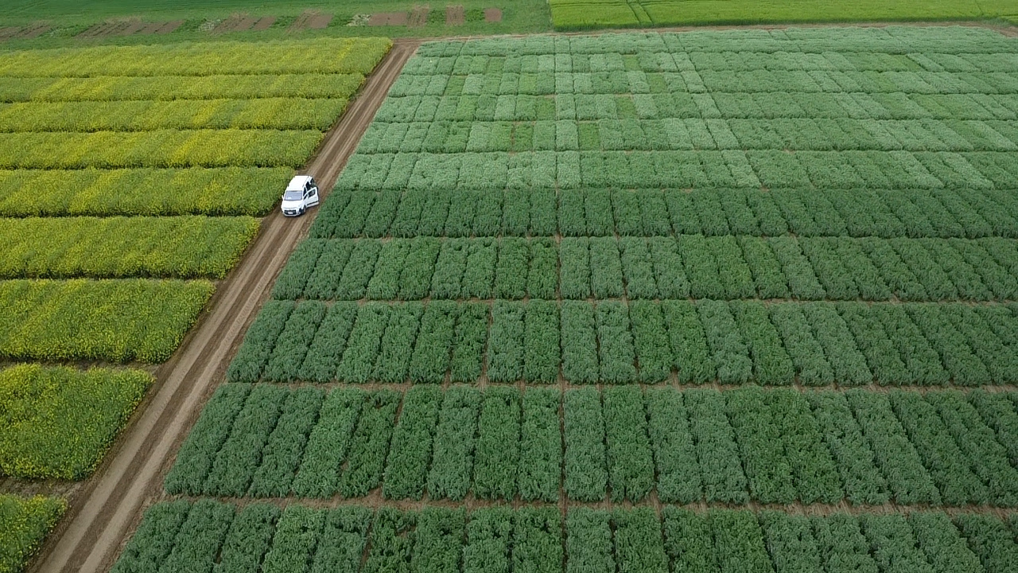




Legume crops as a protein source under current and future climate:
prospects for Southern Belgium
Justine Van Merhaeghe1, Lacroix Christophe1, Audrey Dejonckheere1 and Benjamin Dumont1
1 ULiège–GxABT – Plant Sciences Axis–Crop Science, Gembloux (Belgium)
19th Congress of the European Society for Agronomy - Tartu, Estonia

Slide 2
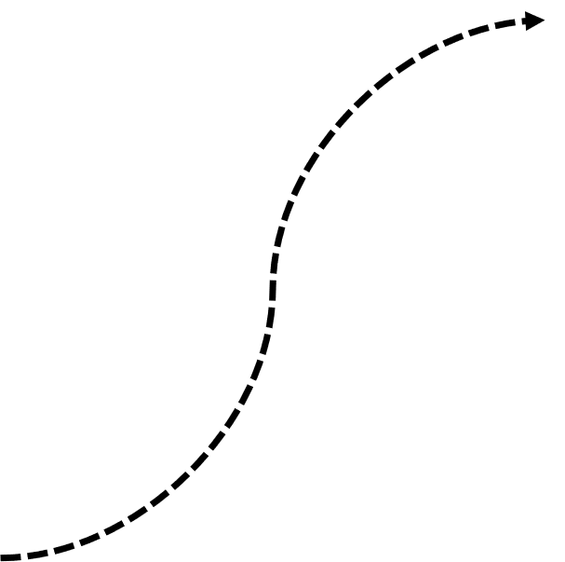



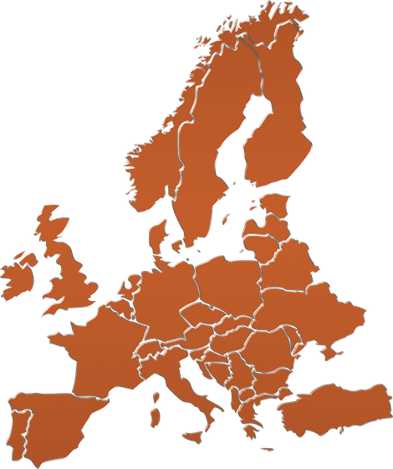
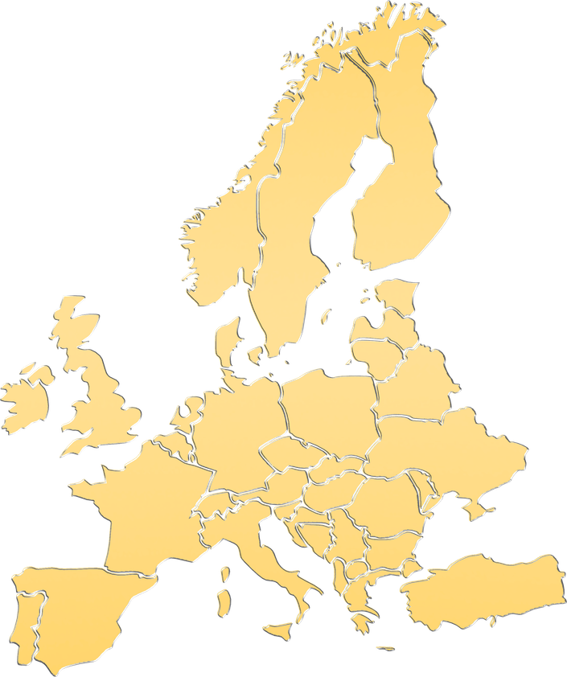
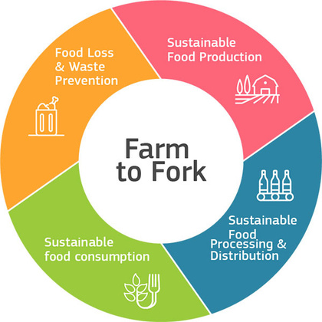
Introduction
Methods
Results
Conclusion
Food System transitions
Concerns
PROTEIN
in human diets
security
grown plants protein
PROTEIN
(BEA, 2020)
1

Slide 3
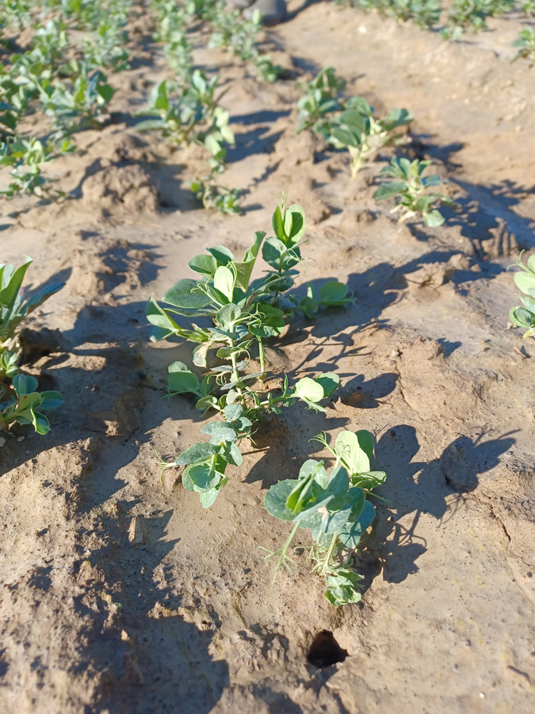

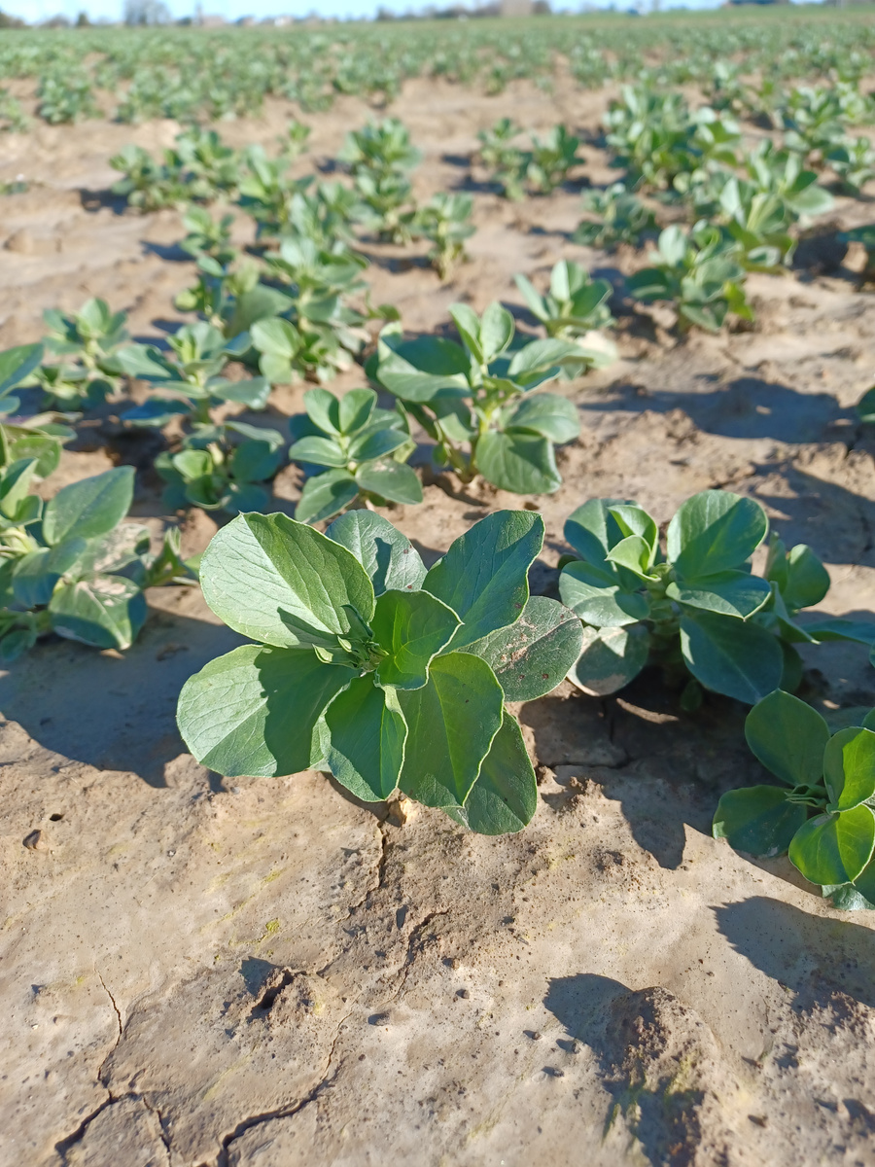
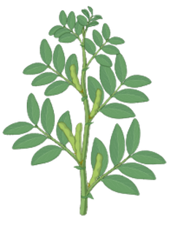
Introduction
Methods
Results
Conclusion
Anxillary data set
Context
  Belgium, Hesbaye
  Temperate climate
  Deep fertile loamy soils
  Field trial : 2024 - 2025 - 2026
    6 varieties
    4 replicates
    Randomized complete block design
Variety trials
Pea
Winter and spring cultivars
Measurements
  Yield components
  Protein
Faba bean
2

Slide 4


Introduction
Methods
Results
Conclusion
Dynamic detailed data set
03/08
1 to15/11
1 to15/04
1/05
1/06
1/07
22/07
Sowing
Sowing
Harvest
Harvest
Harvest
Spring cultivars
Winter cultivars
Pea
Faba bean
3

Slide 5

Introduction
Methods
Results
Conclusion
Dynamic detailed data set
03/08
1 to15/11
1 to15/04
1/05
1/06
1/07
22/07
Sowing
Sowing
Harvest
Harvest
BBCH 55
BBCH 65
BBCH 75
BBCH 89
Plant height
Harvest
Spring cultivars
Number of plants
Winter cultivars
Number of stems
Pea
Number of leaf nodes
Number of flowers or pod/nodes
Faba bean
Number of seeds/pod
BBCH stages
Dry biomass
3

Slide 6

Introduction
Methods
Results
Conclusion
Species | Nb years | Mean yield (kg/ha) | Median yield (kg/ha) | Coefficient of variation (%)
Winter faba bean | 11 | 4187 | 3832 | 23
Spring faba bean | 11 | 3656 | 3676 | 35
Winter pea | 23 | 4169 | 4588 | 56
Spring pea | 23 | 3834 | 3668 | 56
Spring vs winter cultivars
Yield :
>
Shorter growing season
Winter vegetative phase
Later flowering
4

Slide 7
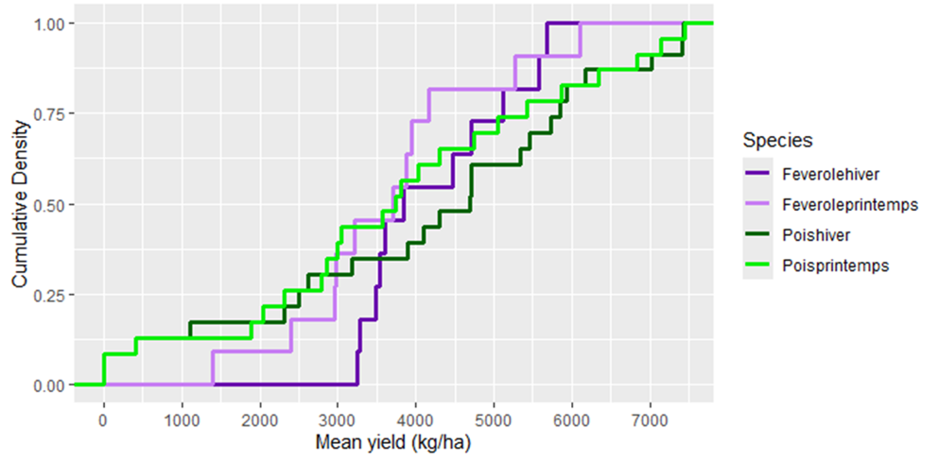
Introduction
Methods
Results
Conclusion
Species | Nb years | Mean yield (kg/ha) | Median yield (kg/ha) | Coefficient of variation (%)
Winter faba bean | 11 | 4187 | 3832 | 23
Spring faba bean | 11 | 3656 | 3676 | 35
Winter pea | 23 | 4169 | 4588 | 56
Spring pea | 23 | 3834 | 3668 | 56
Cumulative distribution curve = probabilities that a random variable is less than or equal to a specific value
Distributions
Medians lower
Winter faba bean
Spring faba bean
Winter pea
Spring pea
5

Slide 8


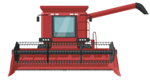
Introduction
Methods
Results
Conclusion
Species | Nb years | Mean yield (kg/ha) | Median yield (kg/ha) | Coefficient of variation (%)
Winter faba bean | 11 | 4187 | 3832 | 23
Spring faba bean | 11 | 3656 | 3676 | 35
Winter pea | 23 | 4169 | 4588 | 56
Spring pea | 23 | 3834 | 3668 | 56
Cumulative distribution curve = probabilities that a random variable is less than or equal to a specific value
Distributions
Winter faba bean
Spring faba bean
Winter pea
Spring pea
Coefficient of variation :
4 years out of 5
5

Slide 9
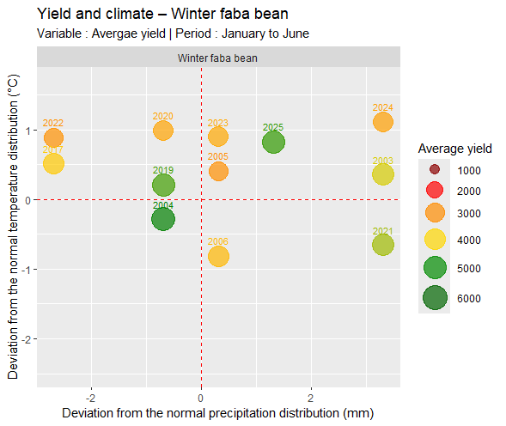
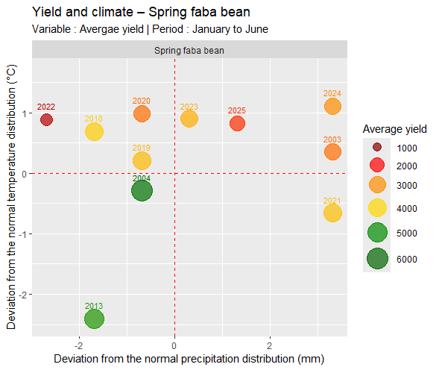

Introduction
Methods
Results
Conclusion
yield
Normal temperature = the average of the annual average temperatures for January–June between 1993 and 2025
Normal precipitaion = the average of the cumulative precipitation totals for January–June between 1993 and 2025
6

Slide 10
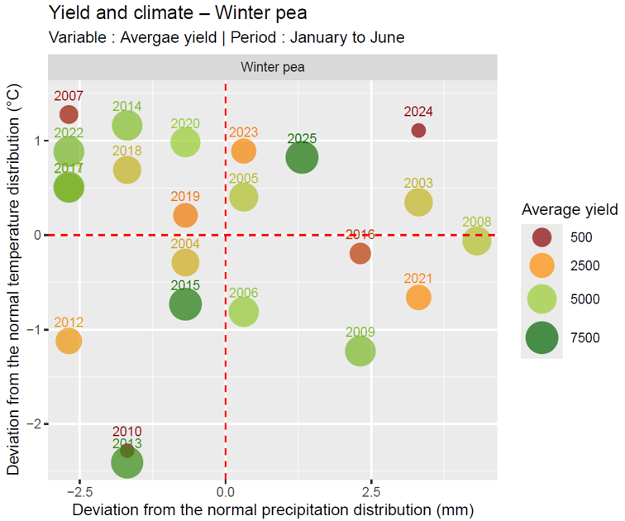
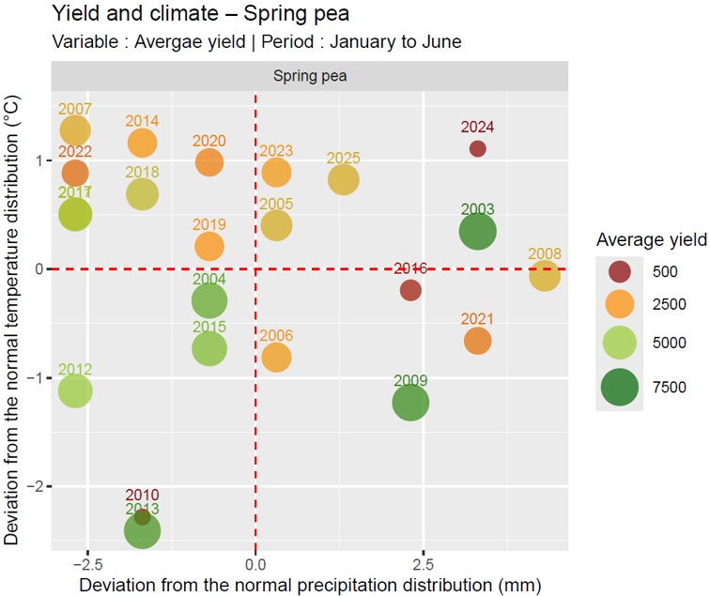

Introduction
Methods
Results
Conclusion
variable tolerances
+
Normal temperature = the average of the annual average temperatures for January–June between 1993 and 2025
Normal precipitaion = the average of the cumulative precipitation totals for January–June between 1993 and 2025
7
Notes:
These events are not necessarily captured in the graphs shown here, which consider only final yield and climate data.

Slide 11
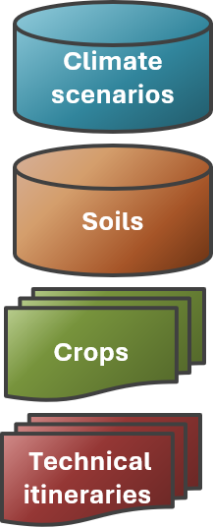
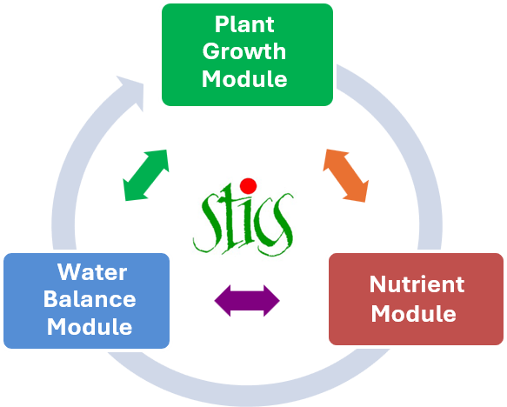
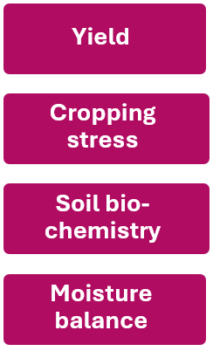
Introduction
Methods
Results
Conclusion
Digital twin = calibrated simulation model that mirrors real field conditions
Data input
Digital twin
Data output
STICS entries
Soil-crop model STICS
Spatialized
variables
Calibrated with measurements from the Wal'Prot project + historical database (2003–2025) from CePiCOP
8
Notes:
To go beyond these field observations, we developed a digital twin — a calibrated simulation model that mirrors real field conditions. At its core is STICS, a mechanistic soil-crop model developed by INRAE.
The dynamic measurements from the Wal'Prot project, together with the historical database (2003–2025) from CePiCOP — a partner of the project — were used to calibrate this digital twin algorithm, coupling STICS with soil databases and climate time series for future scenarios. The model produces spatialised output variables, making it possible to map the results across Wallonia.

Slide 12
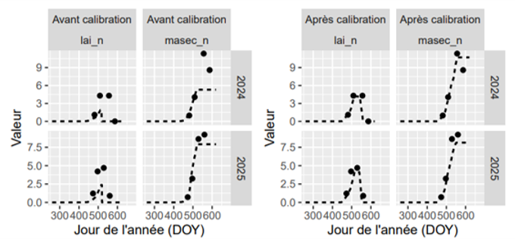
Introduction
Methods
Results
Conclusion
Digital twin output variables
Before
calibration
Before
calibration
After
calibration
After
calibration
Value
Value
Day of the year (DOY)
Day of the year (DOY)
LAI = Leaf Area Index
MASEC = above-ground dry biomass
9
Notes:
Here, for example, is a graph showing two of the model's output variables — LAI (leaf area index) and MASEC (above-ground dry biomass) — before and after calibration against field data, for 2024 and 2025.

Slide 13

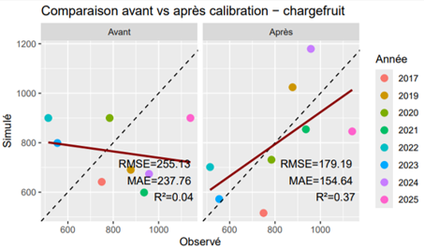
Introduction
Methods
Results
Conclusion
Digital twin output variables
Before
calibration
Before
calibration
After
calibration
After
calibration
Calibration
model’s predictions
Value
Value
Comparison before and after simulation - chargefruit
Before
After
Day of the year (DOY)
Day of the year (DOY)
Year
LAI = Leaf Area Index
Simulated
MASEC = above-ground dry biomass
Chargefruit = fruit load
Observed
9
9
Notes:
In this second graph, we see another output variable from the model, fruit load, along with the observed and simulated values, before and after calibration. Calibration has improved the model's predictions, which now more closely match field data — as shown both graphically and by the evaluation metrics: RMSE, MAE and R², different measures of how well the model's predictions match reality.

Slide 14


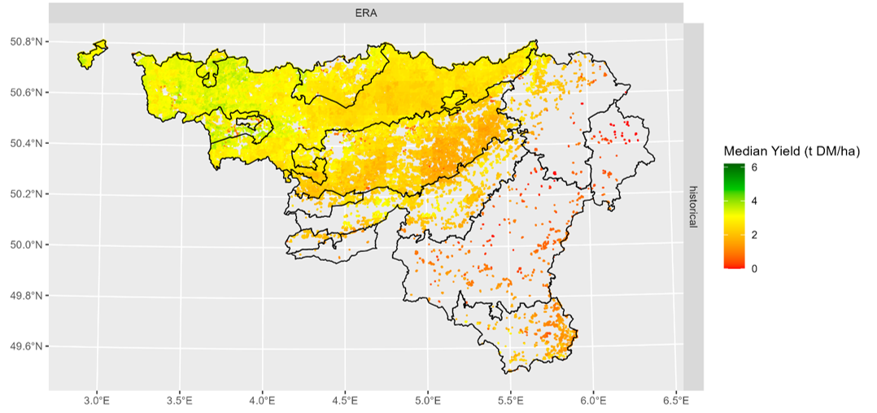
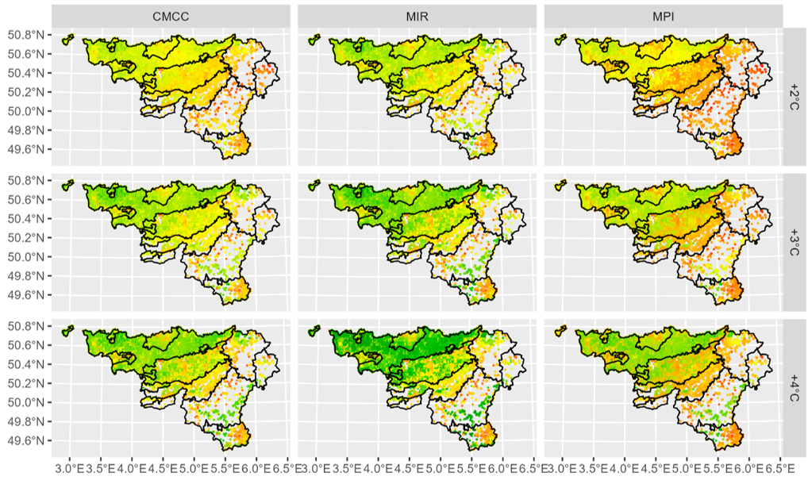
Introduction
Methods
Results
Conclusion
Output of the digital twin
median yield
+
taking into account
+
Historical scenario
Future climate projection
10
Notes:
The output data from the digital twin make it possible to calculate several indicators, taking into account soil and climate variability across Wallonia. One example is the median grain yield, shown in these two maps, where colour shows yield level across Wallonia — darker/lighter zones indicate higher/lower yields, so you can compare the same region between the two maps. The top map shows current yields, based on the ERA5 climate reanalysis, while the bottom map shows yields under the CMCC future climate scenario. It reveals contrasting responses across the different agricultural regions of Wallonia — some zones change colour markedly between the two maps, others barely at all. The results highlight the vulnerability of yields at different spatial scales.

Slide 15
Introduction
Methods
Results
Conclusion
Output of the digital twin
median yield
+
taking into account
+
Historical scenario
Future climate projection
Contrasting responses across the different agricultral regions
Vulnerability of yields at different spatial scales
10
Notes:
The output data from the digital twin make it possible to calculate several indicators, taking into account soil and climate variability across Wallonia. One example is the median grain yield, shown in these two maps, where colour shows yield level across Wallonia — darker/lighter zones indicate higher/lower yields, so you can compare the same region between the two maps. The top map shows current yields, based on the ERA5 climate reanalysis, while the bottom map shows yields under the CMCC future climate scenario. It reveals contrasting responses across the different agricultural regions of Wallonia — some zones change colour markedly between the two maps, others barely at all. The results highlight the vulnerability of yields at different spatial scales.

Slide 16
Introduction
Methods
Results
Conclusion
European Commission promotes
BUT
uncertain
Digital twin
Tool to have a look at the future
Reproduces real conditions accurately
11

Slide 17

Introduction
Methods
Results
Conclusion
European Commission promotes
BUT
uncertain
Digital twin
Tool to have a look at the future
Reproduces real conditions accurately
Key factors
+
+
11
Notes:
Limits :

Slide 18

Thanks for your attention !
Justine Van Merhaeghe
Justine.VanMerhaeghe@uliege.be
The author wish to thank the European Regional Development Fund (FEDER) and the Wal’Prot Project
Notes:
As we have seen, fava beans and peas have shown contrasting responses to climatic conditions. But what would happen if we used these contrasting responses to develop an agronomic strategy aimed at ensuring yield regardless of annual climatic conditions? This is known as species mixing. For the past two years, we have been studying the potential of mixing fava beans and peas to produce satisfactory yields, even if the year is not favorable for one of the two crops.
In 2025, the winter-sown mixture yielded slightly more than pure peas (which was itself an exceptional year for pure pea yields) and significantly more than pure fava beans. For spring sowing, the mixture’s yield fell between those of the two species (LER slightly below 1 = the mixture was less productive than growing the two species separately). To build on our results across different growing years, we repeated the experiment this year. During the growing season, we observed that the pea-field pea mixture showed better resistance to lodging than the pure crops. This was reflected in the yields:

Slide 19
Thanks for your attention !
Justine Van Merhaeghe
Justine.VanMerhaeghe@uliege.be
The author wish to thank the European Regional Development Fund (FEDER) and the Wal’Prot Project
References: BEA, C. (2020, mai 20). CNR BEA | Farm to Fork Strategy – for a fair, healthy and environmentally-friendly food system. https://www.cnr-bea.fr/2020/05/20/farm-to-fork-strategy/
Notes:
As we have seen, fava beans and peas have shown contrasting responses to climatic conditions. But what would happen if we used these contrasting responses to develop an agronomic strategy aimed at ensuring yield regardless of annual climatic conditions? This is known as species mixing. For the past two years, we have been studying the potential of mixing fava beans and peas to produce satisfactory yields, even if the year is not favorable for one of the two crops.
In 2025, the winter-sown mixture yielded slightly more than pure peas (which was itself an exceptional year for pure pea yields) and significantly more than pure fava beans. For spring sowing, the mixture’s yield fell between those of the two species (LER slightly below 1 = the mixture was less productive than growing the two species separately). To build on our results across different growing years, we repeated the experiment this year. During the growing season, we observed that the pea-field pea mixture showed better resistance to lodging than the pure crops. This was reflected in the yields:

Slide 20
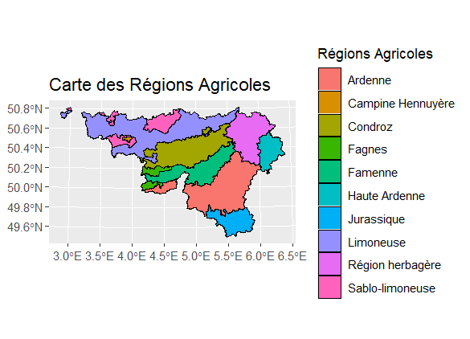
Introduction
Methods
Results
Questions
CMCC-CM2-SR5
Notes:
CMCC-CM2-SR5

Slide 21
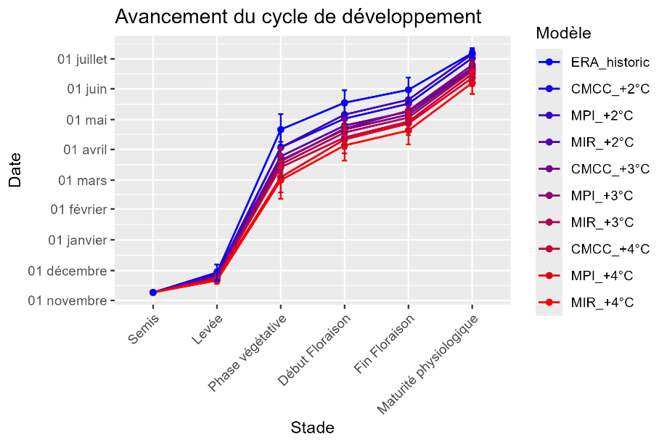
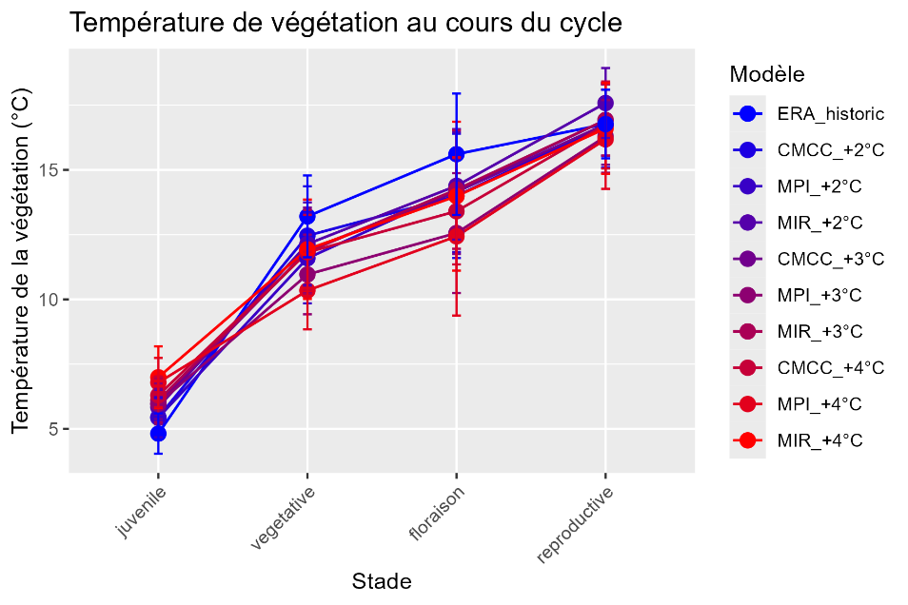
Introduction
Methods
Results
Questions
Development cycle : at an advanced stage
During the reproductive phase, temperatures remain relatively close to those observed historically, with a downward trend below +3°C, which promotes a longer grain-filling period. In fact, unlike previous phases, this one will be significantly longer than in the historical scenario
+ Indicators related to crop stress + related to production

