Slide 1


Climate change impacts on the food self-sufficiency of a diet-aligned agricultural landscape in Wallonia
Tom Desmarez ¹, Mathieu Delandmeter ², Jérôme Bindelle ³, Benjamin Dumont ¹
¹ Liege University, Gembloux Agro-Bio Tech, TERRA Teaching and Research Centre, Plant sciences axis. 5030 Gembloux, Belgium
² Department of Earth and Environmental Sciences, Michigan State University, East Lansing, Michigan, USA
³ Liege University, Gembloux Agro-Bio Tech, TERRA Teaching and Research Centre, Animal sciences axis. 5030 Gembloux, Belgium
Notes:
Hello everyone, thank you for coming to this presentation.
My name is Tom, I’m a PhD student at Gembloux Agro-Bio Tech. Today I’ll talk about how climate change affects the food self-sufficiency of an agricultural landscape designed to feed Wallonia.

Slide 2

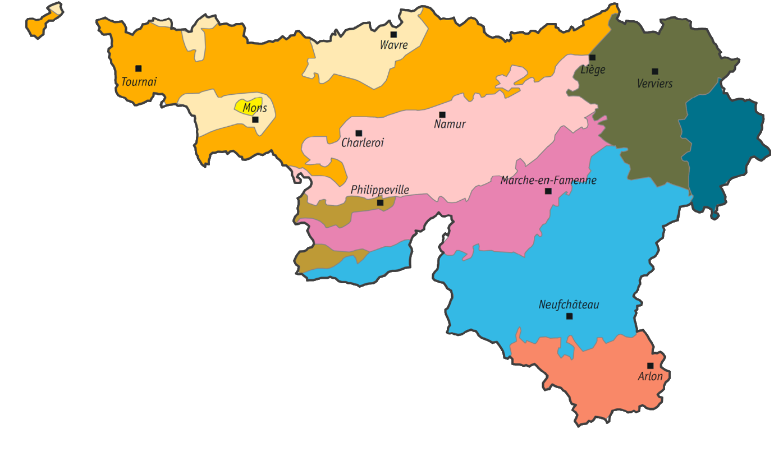
CONTEXT
Wallonia produces only 10 % of what it eats (44 % from Flanders + Brussels, 46 % imported)
5 cash crops = 82 % of arable land
→ Can Wallonia feed itself ?
Notes:
Let me start with the context.
Wallonia has a strong mismatch between agricultural production and the consumption of its inhabitants. Only about ten percent of the food consumed is produced within Wallonia, while just five cash crops occupy around eighty-two percent of the arable land.
So our initial question was: could Wallonia reorganise its agricultural land to feed itself?

Slide 3
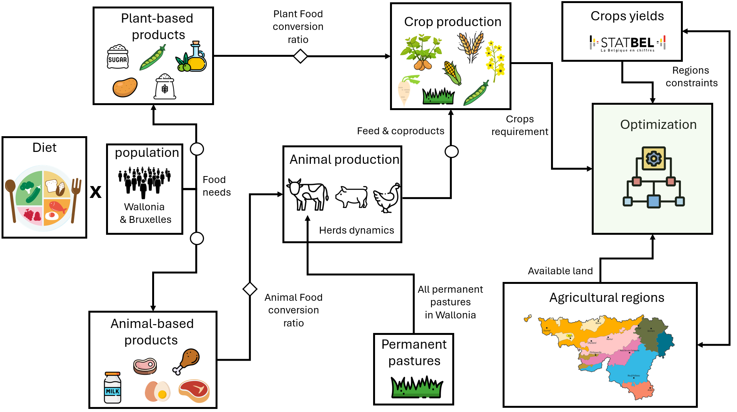
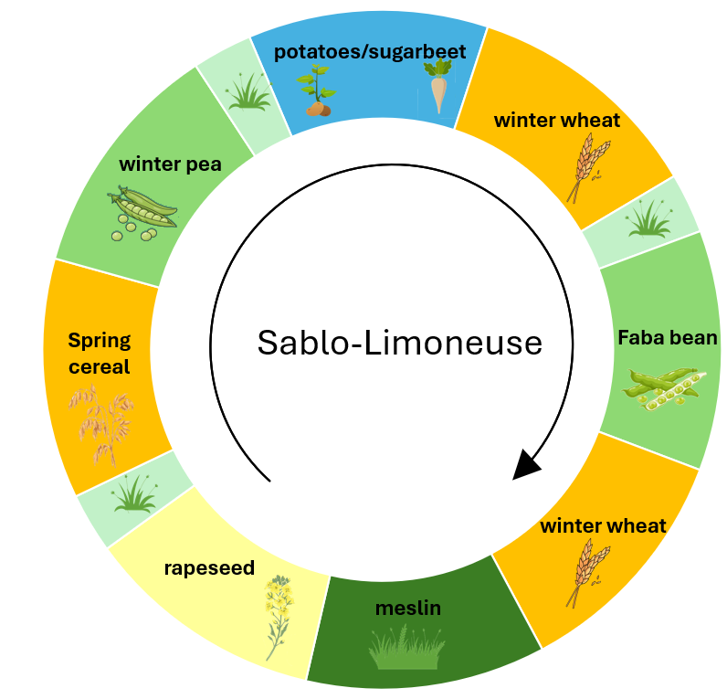
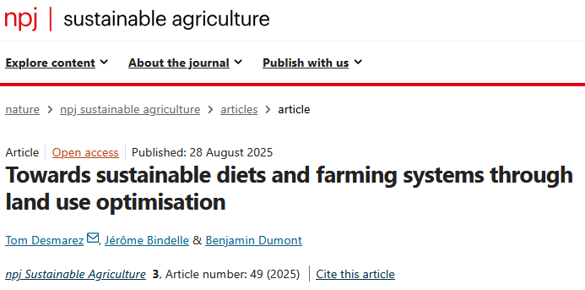
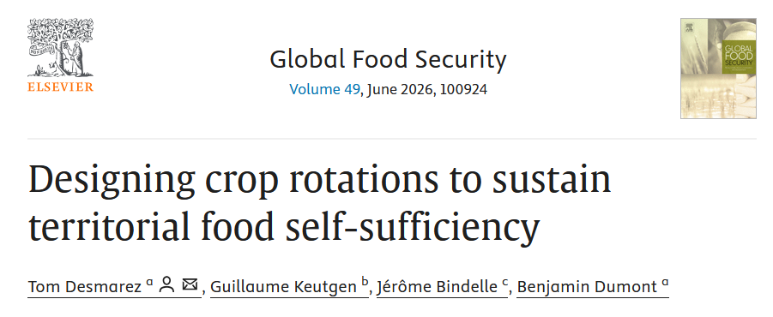
→ Optimisation algorithm for crop allocation in Wallonia’s agricultural regions to achieve full food self-sufficiency
+ Agronomic constraints → realistic, field-ready rotations
Notes:
This question led to two previous studies, which are the starting point for today’s work.
First, we developed an optimisation model that reallocates crops across Wallonia’s agricultural regions to match production with the population’s food needs. We showed that moving toward healthier and more sustainable diets would allow us to be self-sufficient, even in organic farming.
Then we added agronomic constraints, such as crop return times and exclusion rules, to move from an optimal crop allocation to realistic crop rotations that could actually be implemented in the field. If you want more insights about the methodology do not hesitate to read these two papers

Slide 4
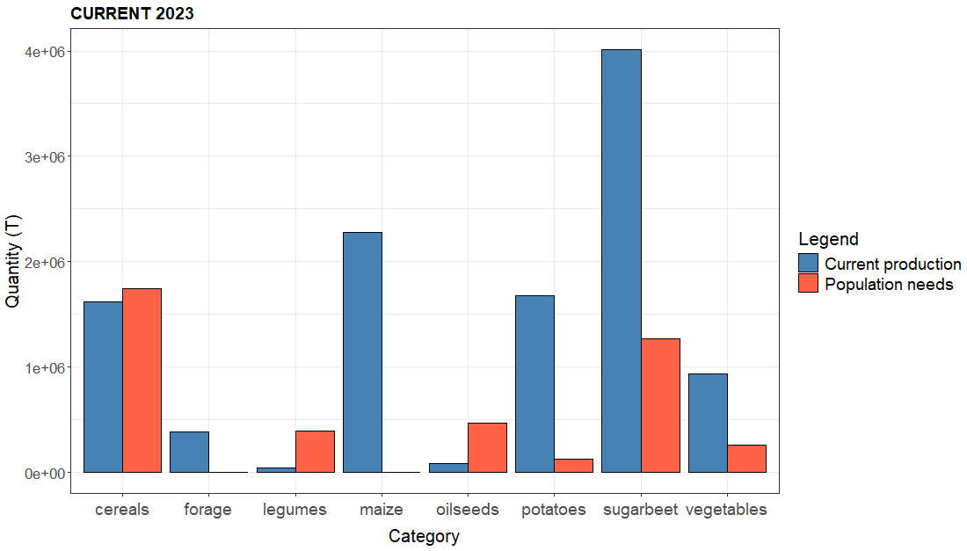
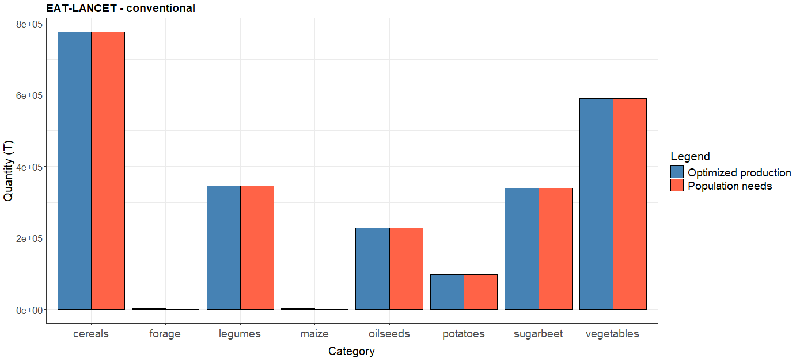









Goal: shift from imports to production matching consumption, category by category
Current
Optimised
Notes:
The idea is to redesign the landscape so that production matches local consumption, food category by food category. In order to pass from this unbalanced situation on the left to this situation where the production perfectly match the consumption
Food self-sufficiency is the average, across food categories, of the production-to-demand ratio of each category, each ratio capped at one.

Slide 5
Designed crop rotations to be self-sufficient
Food self-sufficiency : 106%
Land use : 90%
Notes:
Using the healthy diet scenario, the optimisation generated crop rotations that could make Wallonia self-sufficient while using about ninety percent of the available arable land.
So we now have a concrete agricultural landscape: which crops are grown, in which rotations, and in which pedoclimatic context.

Slide 6
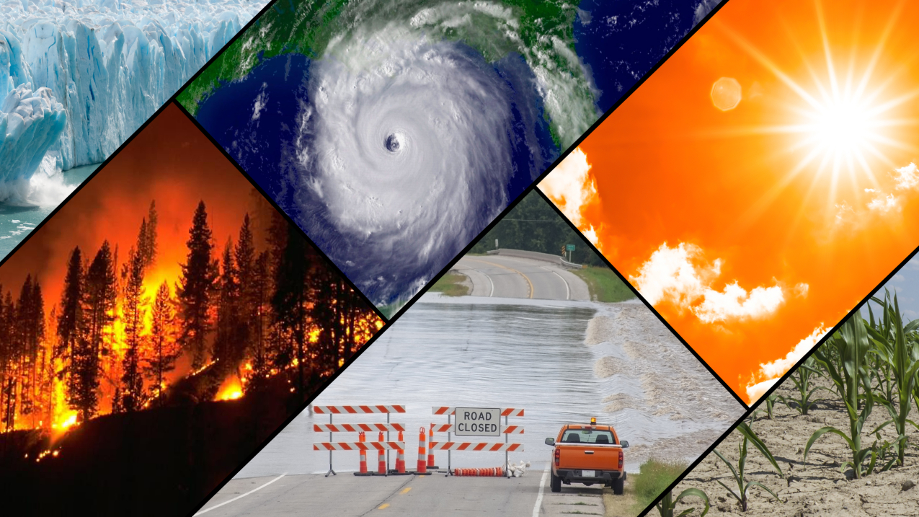
Are we still self-sufficient in the future ?
Notes:
But this design was built under today's climate.
And I think this year has been a pretty good reminder that climate change is not something abstract or distant — we have already experienced particularly hot and dry conditions.
So the real question of this talk is:
if we keep exactly the same crop-rotation design, will it still be self-sufficient under future climatic conditions?

Slide 7

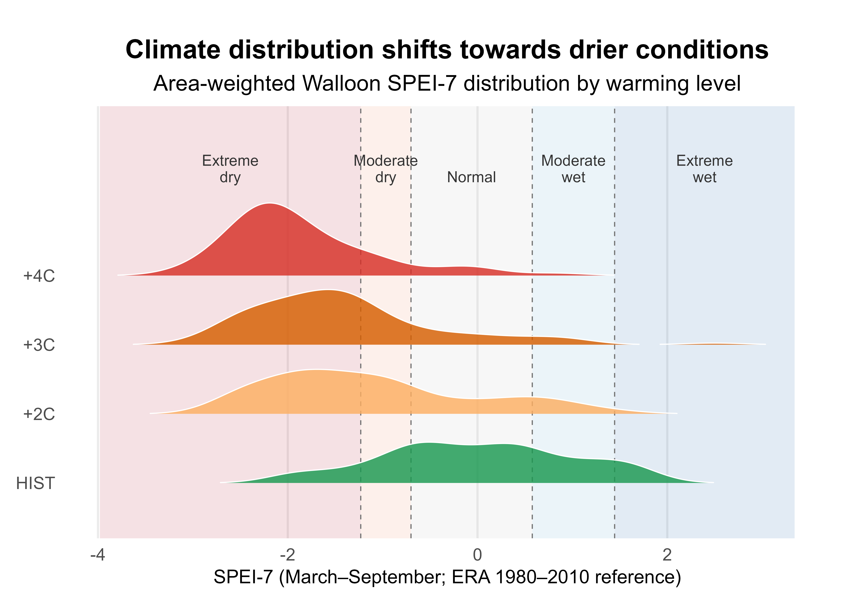
Historical climate data (1980-2010) vs future climatic conditions
Global Climate Models (CMIP6) : CMCC, MIROC, MPI
Climate classified by warming levels (+2, +3, +4 °C) rather than fixed years
Notes:
To test this, we compared the historical climate, from 1980 to 2010, with projections from three climate models: CMCC, MIROC and MPI.
We classified the projections by warming level: plus two, plus three and plus four degrees.
We characterised drought using the SPEI over the March-to-September growing season.
And the climate signal is very clear.
Extreme-dry years represent only about ten percent of the historical period, but increase to fifty-three percent at plus two degrees, sixty-eight percent at plus three, and eighty percent at plus four.
And during these dry years, almost the whole Walloon arable area is affected at the same time.

Slide 8
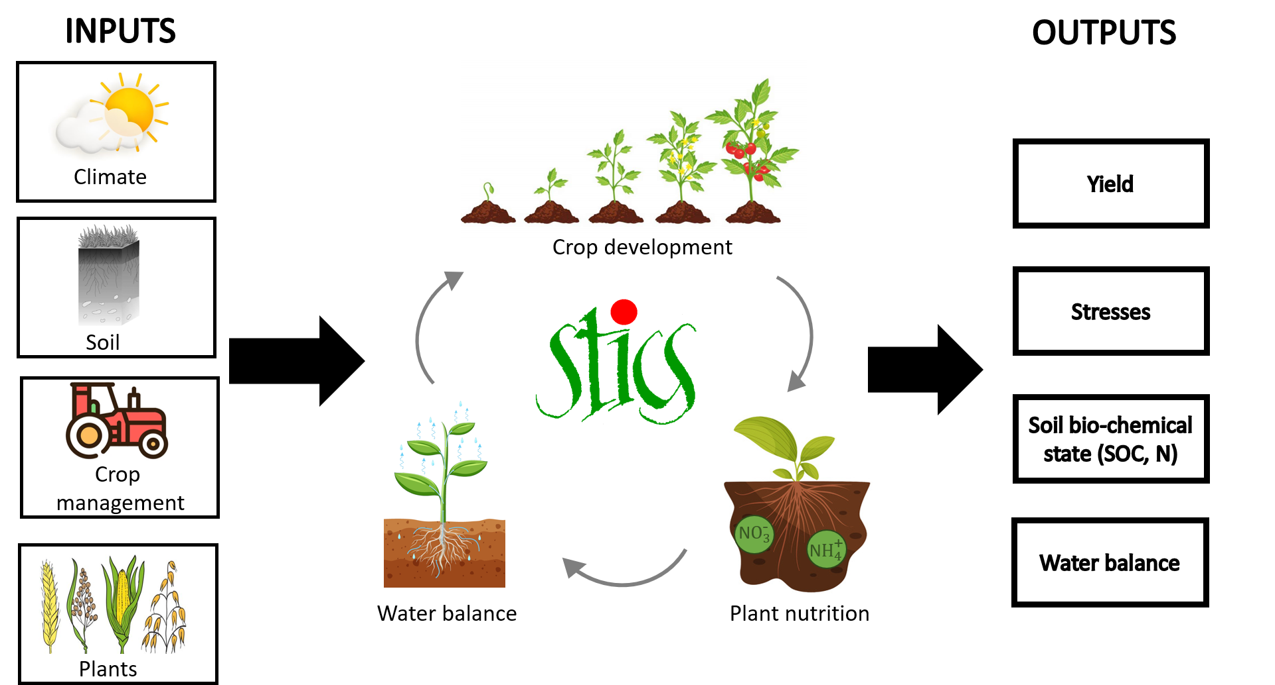
Notes:
To assess the impact of climate change on our optimised crop rotations, we used the soil–crop model STICS
STICS is a mechanistic model that requires several inputs, including local climate data, soil characteristics, crop-management practices, and information about the different crops included in the system.
So, in our case, we used the climate scenarios that I showed you on the previous slide as inputs for the STICS climate files.
And the crop rotations that we had previously designed for food self-sufficiency in Wallonia were used as inputs for the crop-management and plant files.
So basically, we kept our optimised agricultural landscape unchanged, and exposed it to different future climates.

Slide 9
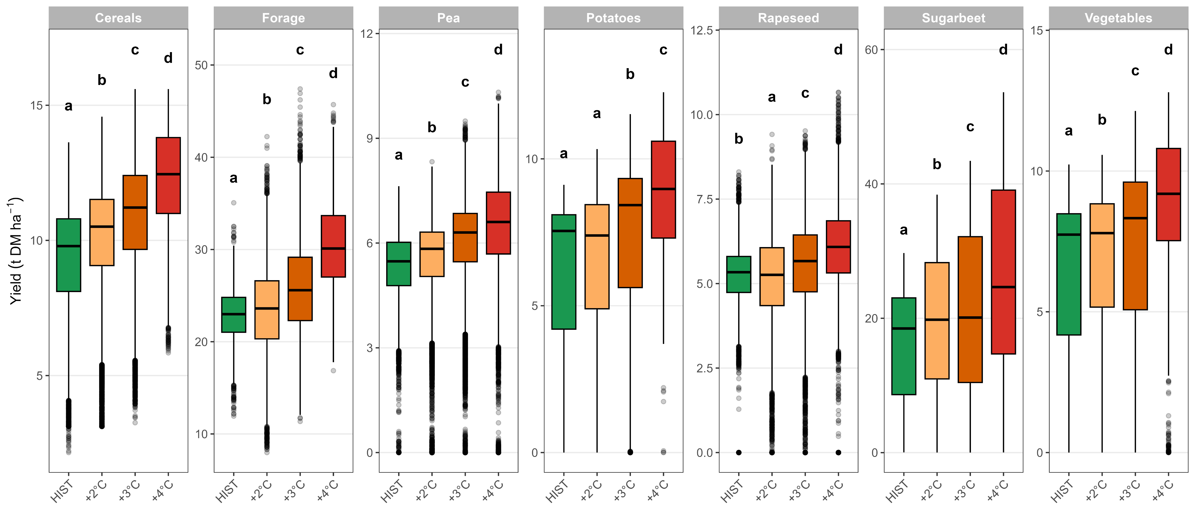
Self-sufficiency holds — with a growing margin
Yields rise for all crops
Total production +5.8 / +16.4 / +33 % vs today
Food self-sufficiency ≈ 1.00 at +2 / +3 / +4 °C
Notes:
So first, let's look at what happens to crop yields.
Perhaps surprisingly, simulated yields increase with warming for almost all crops.
And this increase is mainly explained by two effects in the model: additional thermal resources, and especially CO₂ fertilisation.
This CO₂ effect is particularly important here because most of the crops in our rotations are C3 plants, which respond positively to increasing atmospheric CO₂ through higher photosynthesis and improved water-use efficiency.
So even though the climate becomes much drier, these effects more than compensate for the negative impact of water stress on average yields.
And when we scale these yield changes up to the whole Walloon landscape, total production increases by up to thirty-three percent at plus four degrees.
As a consequence, the food self-sufficiency score remains essentially at one across all three warming levels.
So at first sight, the system looks surprisingly robust to climate change.

Slide 10
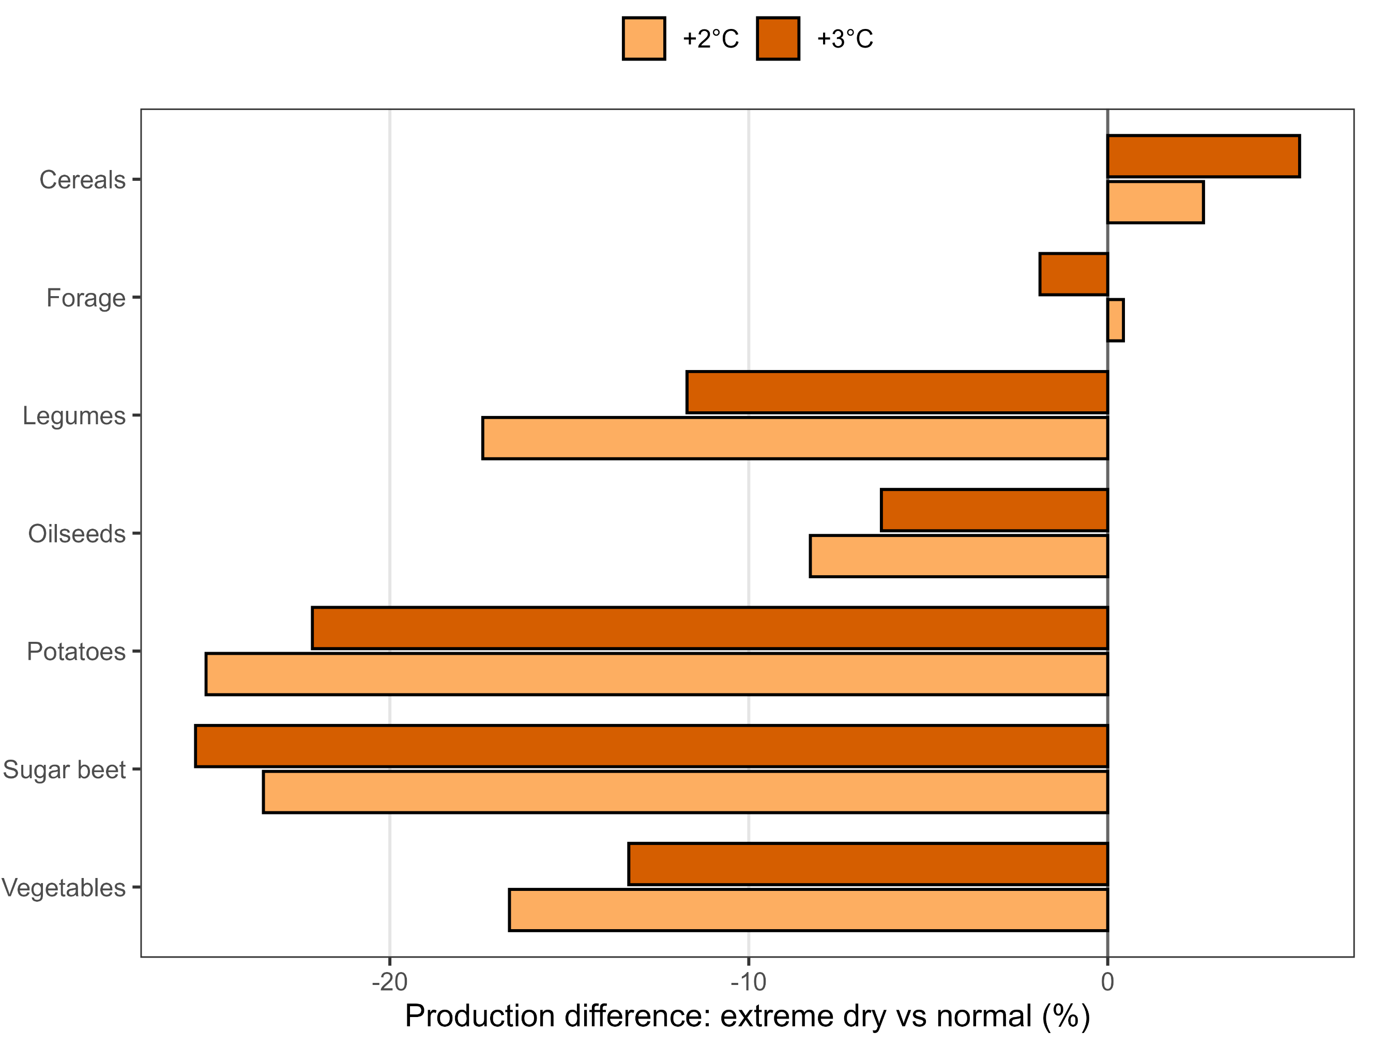
The drought penalty persists — it is offset, not gone
System still loses ~10 % (+2 °C) / ~8 % (+3 °C) in dry years
Overall: FSS ≈ 1.0 up to +4 °C (production +1 to +30 %)
Notes:
Now, that doesn't mean drought stops mattering. If I hold the warming level fixed and compare dry years to normal years, production still drops — around 10% at plus 2, 8% at plus 3. And it's not spread evenly: it's concentrated in the spring-sown, water-demanding crops — potato, sugar beet, legumes, vegetables. The winter crops, cereals and rapeseed, are basically spared, because they finish growing before the summer deficit hits and because they have a deeper root system.

Slide 11
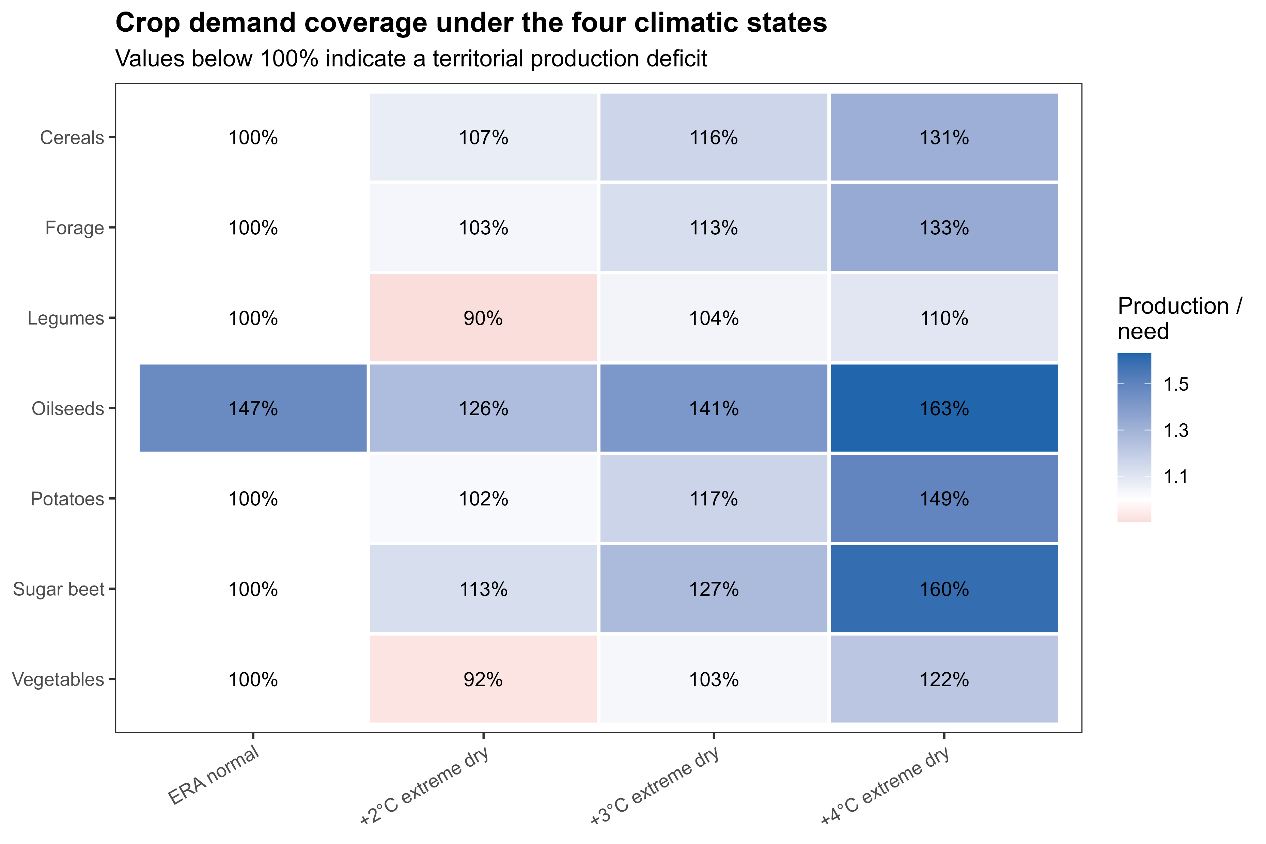
The drought penalty persists — it is offset, not gone
Notes:
And here's where that penalty actually reaches self-sufficiency. This is coverage of each crop's demand, even in the driest state. Almost everything stays above 100%. Only two categories dip below — legumes at 90%, vegetables at 92% — and only at plus 2 degrees. Beyond that, the rising yields pull every crop back above full coverage, so the deficit closes on its own.

Slide 12
Take-home messages
On paper, this frozen landscape stays food self-sufficient up to +4 °C.
But the gains come from CO₂ fertilisation — an optimistic effect ? Likely an upper bound, not a forecast.
Drought doesn't retreat — it spreads to the whole territory at once, hitting crop production hard.
Wallonia is too small to self-insure: resilience is also a question of scale
Notes:
So, four things to take away.
First: on paper, this frozen landscape stays food self-sufficient all the way to plus 4 degrees.
Second — and it's important to notice this — the increased yields are driven by the CO₂ fertilisation effect. And STICS is already known to be rather optimistic about that effect. So this is likely an upper bound, not a forecast: weaken the CO₂ response, and the margin collapses.
Third: drought doesn't retreat, it spreads. Dry years become the norm and hit the whole territory at once, with a strong impact on crop production.
So this becomes a question of scale, not only allocation. Wallonia is simply too small to insure the food self-sufficiency of its population. Resilience means production margins — or thinking beyond a single region's borders.
And that's exactly why our current work moves up a level — testing food self-sufficiency at the European scale, where a drought in one basin can be balanced by another. And where you have also more complementarity in crop production across Europe.

Slide 13
Thank you for your attention !!
Do you have any question ?
tom.desmarez@uliege.be
Notes:
That's the end of my talk — thank you very much for your attention, and I'll be happy to take any questions

Slide 14
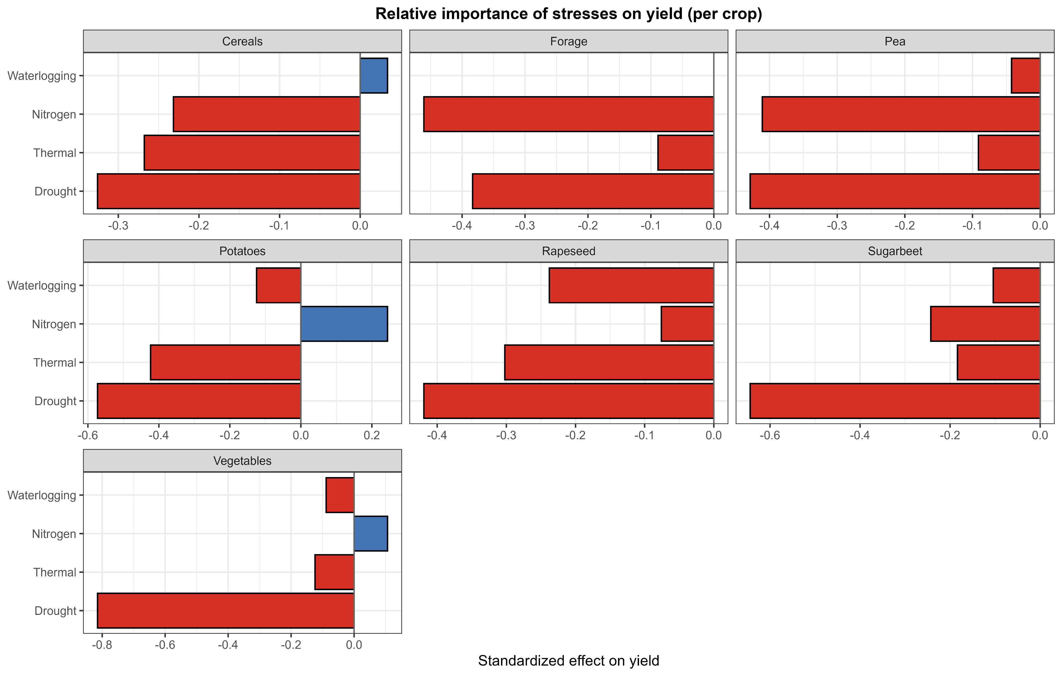

Slide 15
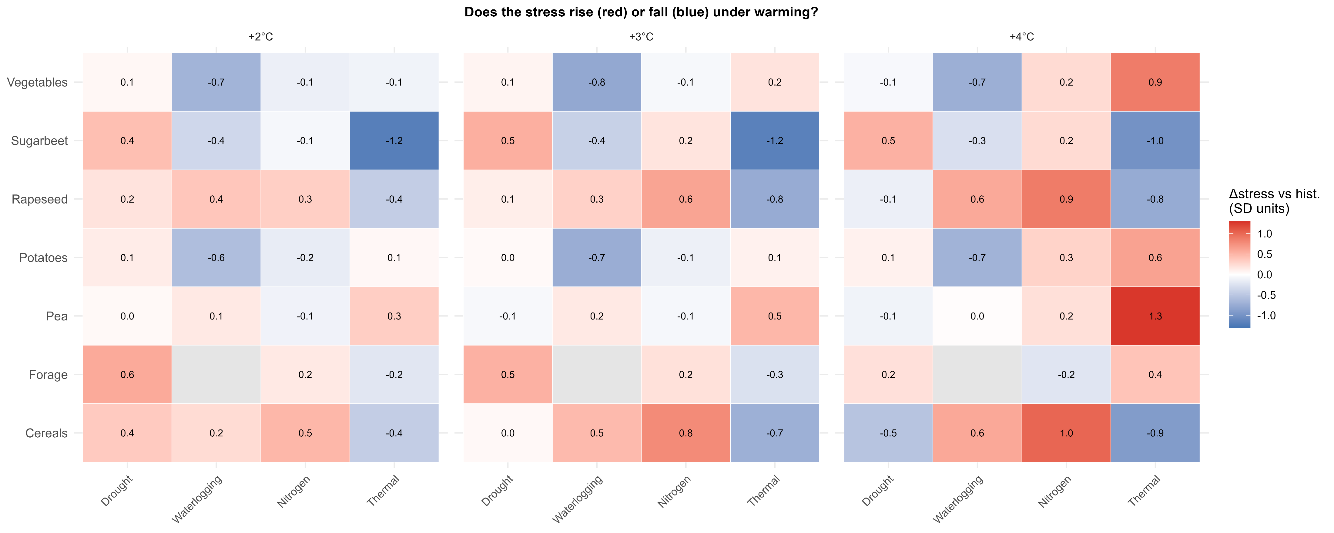

Slide 16
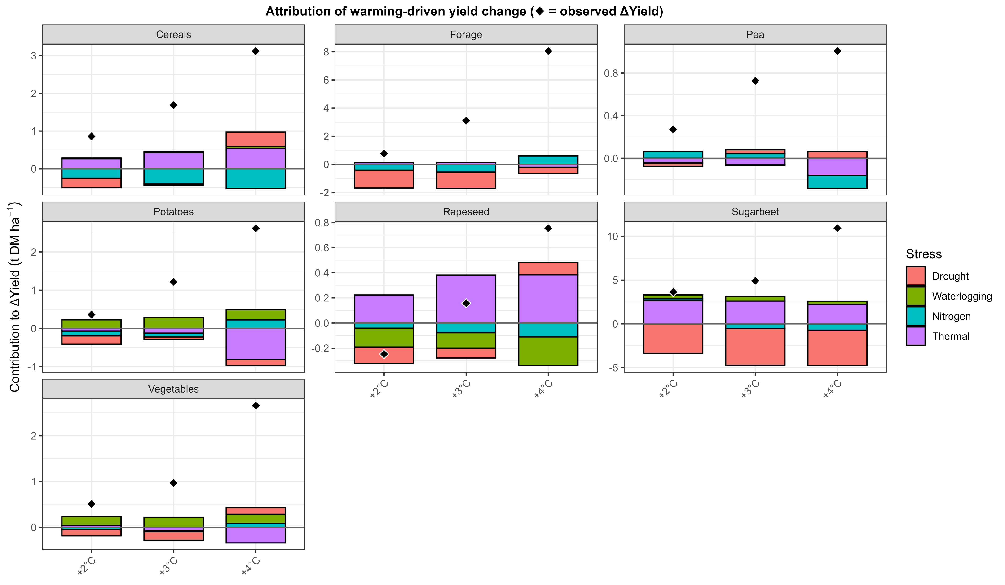

Slide 17
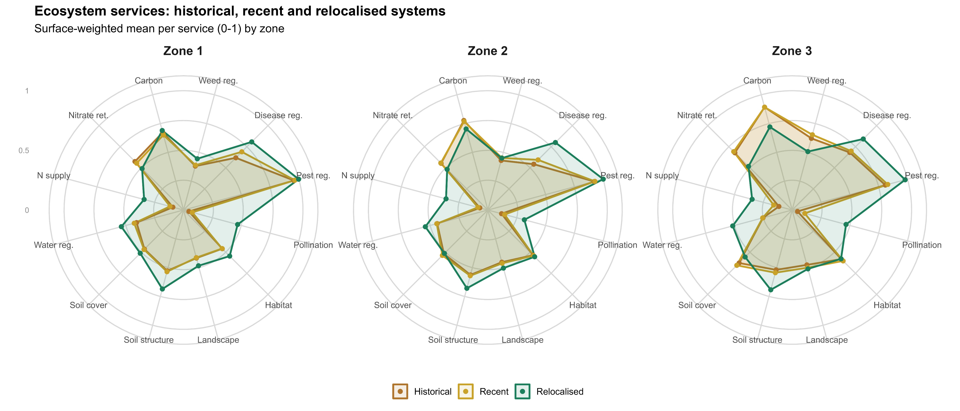

Slide 18
