Slide 1

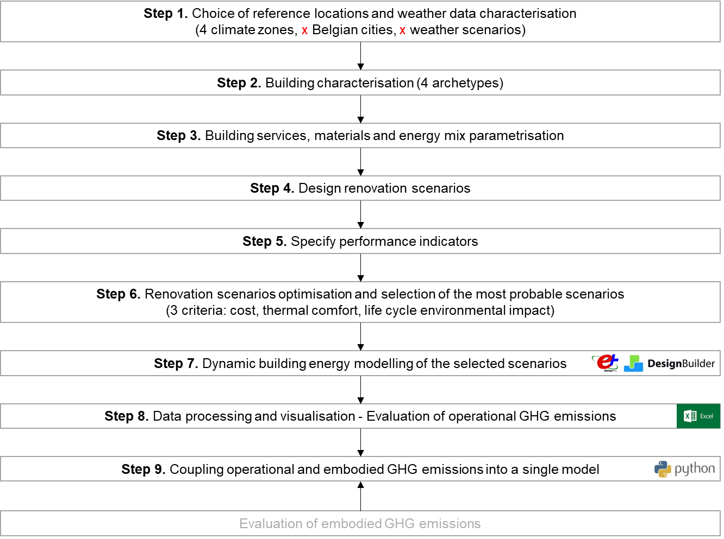
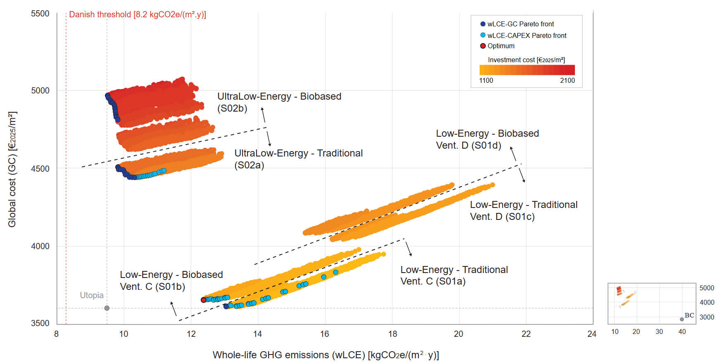

Dynamic whole-life cycle assessment of building renovation strategies
Aurora BERTINI
Aurora.Bertini@uliege.be
ABSTRACT
METHODOLOGY
The project aims to develop a parametric and dynamic life cycle assessment model for residential building renovation, that will couple the evaluation of operational and embodied GHG emissions, in order to rank the possible renovation strategies according to whole-life environmental performance.
KEYWORDS
Residential building renovation, embodied emissions, operational emissions, dynamic whole-life cycle assessment
PROBLEM
During the renovation process, the focus is mainly on decarbonizing heating and cooling energy, without addressing the GHG emissions intensity of buildings. This approach often increases life cycle GHG emissions and the environmental impact of renovations. A life-cycle approach is needed, to consider the GHG emissions spike (i.e., GHG emissions generated in the construction phase) and the high uncertainty of renovation scenarios.
RESULTS
OBJECTIVE/HYPOTHESIS
A model that couples embodied and operational GHG emissions
A dataset of different renovation scenarios for residential buildings
A series of case studies to validate the model
A dynamic and user-friendly dashboard, to support designers in the choice of the most appropriate renovation strategy
Develop a parametric and dynamic life cycle assessment model for retrofitting residential buildings
Data-driven parametrisation and simulation of renovation scenarios
to contribute to the European Renovation Wave Strategy effective application
AUDIENCE
Researchers (e.g., IEA 89); Government, municipalities and regulatory bodies; Future professionals; Homeowners and House tenants.
RESEARCH QUESTION
What is the optimal renovation scenario for residential buildings, considering its economic, and life cycle environmental impacts? How to choose the most appropriate refurbishment strategy according to the location and the building type?
Bertini, A., Amaripadath, D., Gobbo, E., & Attia, S. (2026). Uncertainty analysis for variables affecting the whole life carbon performance of nearly zero energy residential building renovation. Energy and Buildings, 117496.
ORIGINALITY
CONCLUSION
Including time in the model: a long-term approach is adopted, that allows to consider the whole building lifespan, and to develop dynamic modelling scenarios.
Coupling Life Cycle Assessment (LCA) and Building Performance Simulation (BPS) : embodied and operational GHG emissions will be included in the same model.
Including multiple parameters in the model: climatic conditions (including future projections), building geometry, materials, services and energy mix.
Importance of integrating BPS and LCA in a single model
Importance of adopting a dynamic life cycle assessment model in the achievement of zero-carbon buildings
Resources
Sharif, S. A., & Hammad, A. (2019). Simulation-based multi-objective optimization of institutional building renovation considering energy consumption, life-cycle cost and life-cycle assessment. Journal of Building Engineering, 21, 429-445.
Ahmed, A., Ge, T., Peng, J., Yan, W.-C., Tee, B. T., & You, S. (2022). Assessment of the renewable energy generation towards net-zero energy buildings: A review. Energy and Buildings, 256, 111755. https://doi.org/10.1016/j.enbuild.2021.111755
Fahlstedt, O., Temeljotov-Salaj, A., Lohne, J., & Bohne, R. A. (2022). Holistic assessment of carbon abatement strategies in building refurbishment literature—A scoping review. Renewable and Sustainable Energy Reviews, 167, 112636. https://doi.org/10.1016/j.rser.2022.112636

