Slide 1


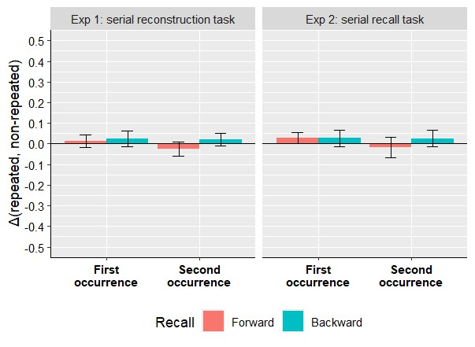
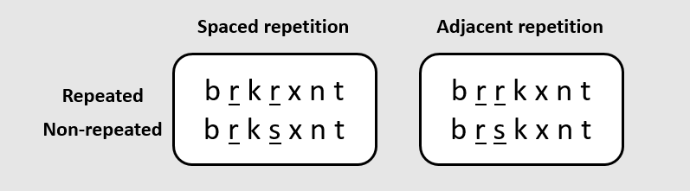
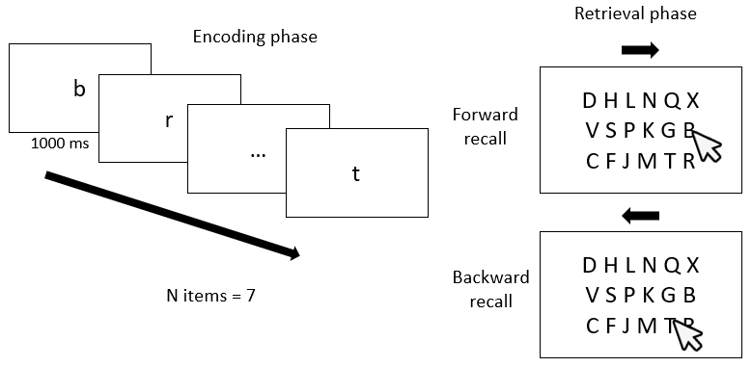
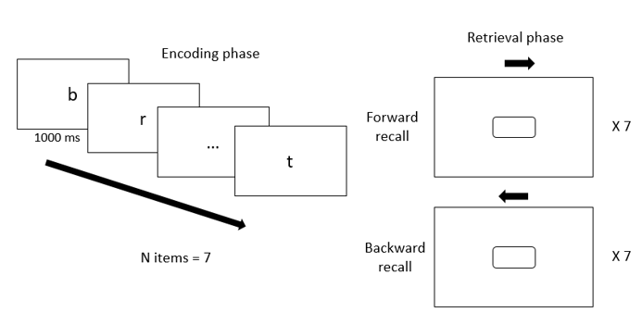

Rethinking the Ranschburg effect
R. REMOUCHAMPS ª, S. MAJERUS ª, B.KOWIALIEWSKI ^{a,b}
ª University of Liège, Belgium
^{b} Fund for Scientific Research – FNRS, Belgium
Introduction
Results
Ranschburg effect: difficulty of recalling the second occurrence of a repeated item.
Commonly explained by response suppression (Henson, 1998a; Lewandowsky, 1999).
To test the response suppression mechanism, participants encoded lists of seven letters and recalled them either in forward or backward order across trials.
Experiment 1 and 2: spaced repetitions only
Hypotheses
BF01 = 2.797
BF01 = 2.457
BF01 = 2.349
BF01 = 2.549
If the Ranschburg effect is explained by response
suppression, it should depend on recall direction rather than item’s order of encoding.
Predictions:
Encoded sequence: b r k r x n t
Forward recall: b r k r x n t
Backward recall: t n x r k r b
In backward recall, recall of the first occurrence of the repeated item should be impaired since it will be recalled second, reversing the typical pattern observed in forward recall.
BF01 = 3.938
BF01 = 2.436
BF10 = 1.641
BF01 = 4.641
Note. Each Bayes factor results from a Bayesian one-sample t-test of the difference scores against a null distribution centered at zero, conducted for each condition.
Experiment 3: adjacent and spaced repetitions
Methods
BF10 = 1,964.106
BF10 = 1,084.533
BF10 = 489.526
BF10 = 1,134.613
Experiment 1: serial reconstruction task
BF01 = 4.892
BF01 = 7.883
BF01 = 4.378
BF01 = 5.032
Note. Bayes factor was computed in the same manner as Exp 2 and 3.
Discussion
We failed to consistently replicate the inhibitory Ranschburg effect. These findings call into question the importance of the Ranschburg effect as a benchmark phenomenon for working memory models. They also question the very existence of response suppression as a plausible WM mechanism (Kowialiewski & Oberauer, 2025).
Experiment 2 and 3: Serial recall
References
Henson, R. N. (1998). Item repetition in short term memory: Ranschburg repeated. Journal of
Experimental Psychology: Learning, Memory, and Cognition , 24 (5), Lewandowsky, S. (1999).
Redintegration and response suppression in serial recall: A dynamic network model. International Journal of Psychology, 34(5 6), 434 446.
Kowialiewski, B., & Oberauer, K. (2025). Testing the response suppression mechanism of working memory. Journal of Experimental Psychology: Learning, Memory, and Cognition, 51(2), 190.
Full article PDF

