Slide 1

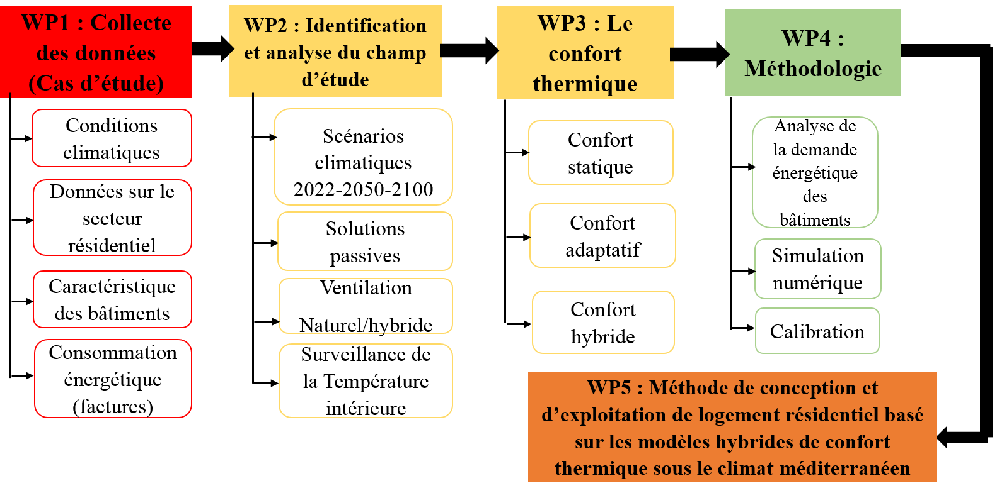
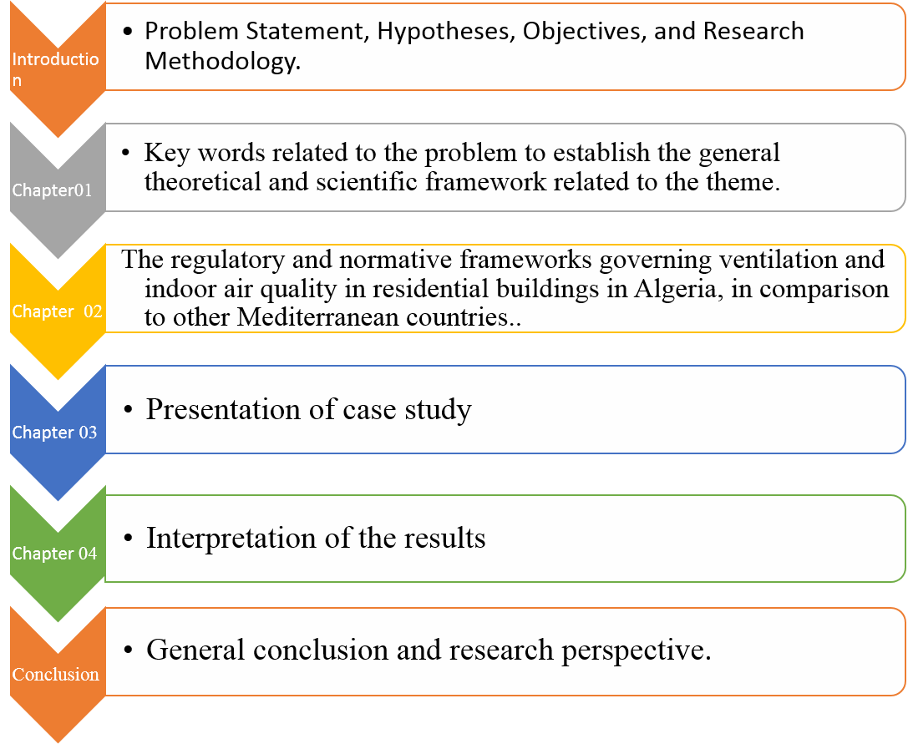

Contribution of mixed-mode ventilation to the energy consumption of residential buildings in a Mediterranean climate
Asmaa Tellache
Asmaa,Tellache@student,uliege,be
This work will address the issue of mixed-mode ventilation and its effect on thermal comfort and building energy consumption in a Mediterranean climate by studying a residential building located in Algiers. At the end of this research, we can deduce a design method for residential housing based on hybrid thermal comfort models for Mediterranean climates, so that we can draw up a list of recommendations and guidelines for future future designers that can help them design efficient buildings based on mixed-mode ventilation.
Recherche appliquée basée essentiellement sur l'étude des cas (les 04 bâtiments résidentiels de l’Aero habitat ) avec différents emplacements et critères afin de toucher tous les aspects possibles
Energy consumption, energy efficiency, high-performance building, thermal comfort, Algiers.
The simultaneous use of static and adaptive thermal comfort models in the same building contributes to the sustainable development of housing, significantly reducing greenhouse gas emissions and our reliance on traditional fossil fuels. Various issues can be addressed by employing appropriate design strategies, techniques, and passive measures, as demonstrated in global initiatives such as the Project Stasio Spring Challenge 2022 (https://projectstasio.com/competition/2022-spring-challenge/, n.d.). The final results of this research will be presented in graphs illustrating the benefits of natural ventilation in terms of annual energy savings and thermal comfort or in tables showing adaptive comfort conditions and energy consumption for each hour throughout the year.
The appropriate and practical use of natural ventilation contributes to reducing energy consumption in residential buildings in a Mediterranean climate but requires consideration of certain conditions.
Mixed-mode ventilation significantly enhances the building's performance in terms of energy consumption and indoor air quality in residential buildings.
The residential sector consumes 36% of global energy production. In Algeria, the building sector is the largest consumer of fossil energy, accounting for 46% of the total national energy bill, with residential buildings comprising the largest share at 37%.
Static comfort models work well in air-conditioned spaces, while adaptive comfort models are suggested for those with natural ventilation. For buildings in Algiers, a combination of both models should be used simultaneously with fixed rules and specific conditions.
Objective: Reducing buildings' dependence on fossil fuels through ventilation.
Hypothesis: The use of both static and adaptive thermal comfort models in the same building contributes to the sustainable development of housing and significantly reduces greenhouse gas emissions, diminishing our reliance on traditional fossil fuel energy sources.
The work will be structured as follows:
The key stakeholders in this study are home builders and researchers associated with the housing and construction sector. Builders include architects, developers, contractors, civil engineers, building supervisors, HVAC engineers, and others.
What is the impact of natural ventilation on electricity consumption for cooling and thermal comfort?
Can we really consider ventilation as a passive cooling strategy for buildings in a Mediterranean climate?
What are the guidelines to be applied or the architectural measures to be used for ventilation to have a better thermal comfort?
Ezzeldin, Sherif, and S. J. R. (2013). The potential for office buildings with mixed-mode ventilation and low energy cooling systems in arid climates. Energy and Buildings 65, 368–38.
Heracleous, C., & Michael, A. (2018). Assessment of overheating risk and the impact of natural ventilation in educational buildings of Southern Europe under current and future climatic conditions. Energy, 165, 1228–1239.
Semahi, Samir, Noureddine Zemmouri, Manoj Kumar Singh, and S. A. (2019). omparative bioclimatic approach for comfort and passive heating and cooling strategies in Algeria. Building and Environment, 161, 106271.
ASHRAE. (2020). Chapter 14, Climatic Design Information, from the 2021 ASHRAE Handbook—Fundamentals.
Centre National d’Etude et de Recherches Intégrées du Batiment. (2016). DTR Réglementation thermique du batiment.
Rahif, R., Amaripadath, D., & Attia, S. (2021). Review on time-integrated overheating evaluation methods for residen
tial buildings in temperate climates of Europe. Energy and Buildings, 252, 111463.
Stambouli, N. (2014). L’Aéro-habitat, avatar d’un monument classé? Livraisons de l’histoire de l’architecture, 27, 117–127.
The work will align with global energy efficiency policies (EU, UN). It will introduce an innovative solution contributing to energy security, energy independence, and energy resilience at the local (Algeria), as well as Mediterranean and global levels in the building sector.

