Slide 1


Prediction of dairy cows’ heat stress response from milk mid-infrared spectra for detection and genetic selection
P. Lemal¹ , K. Wijnrocx¹ , C. Grelet² , F. Dehareng², H. Soyeurt¹ , M. Schroyen¹ , N. Gengler¹
¹Gembloux Agro-Bio Tech, University of Liège, Gembloux, Belgium.
²Walloon Agricultural Research Center (CRA-W), Gembloux, Belgium.

Slide 2
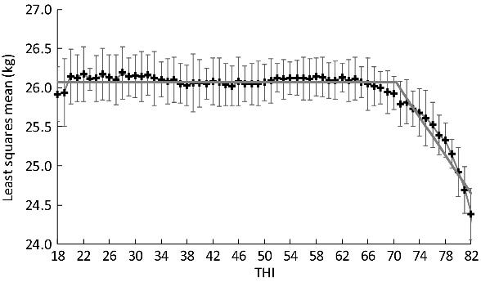
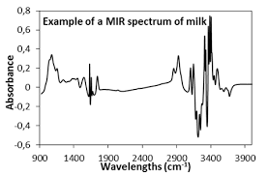

Introduction
Heat stress → production ↘, health ↘, fertility ↘, welfare ↘ …
Large-scale studies → decrease of performances with temperature and humidity index (THI)
MIR spectra also available in routine
→ Prediction equation for the heat stress response
Objective: Development of the prediction + validation
▪︎ 2
Notes:
Performances -> not specific to heat stress
THI -> do not represent the conditions really felt by the cows

Slide 3


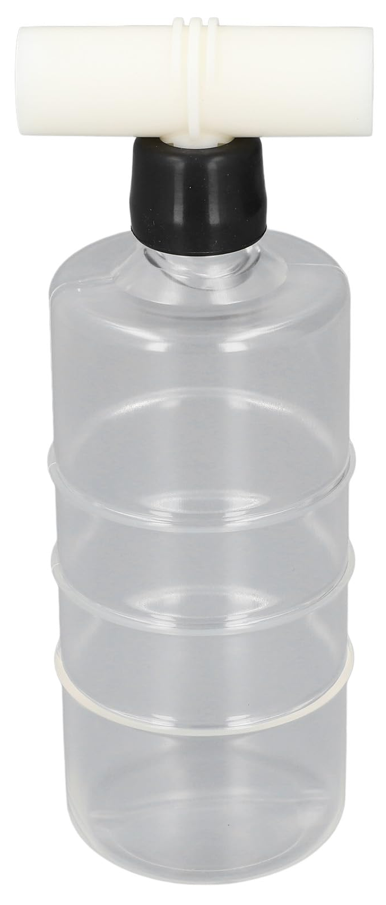
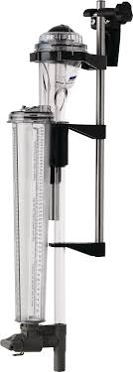
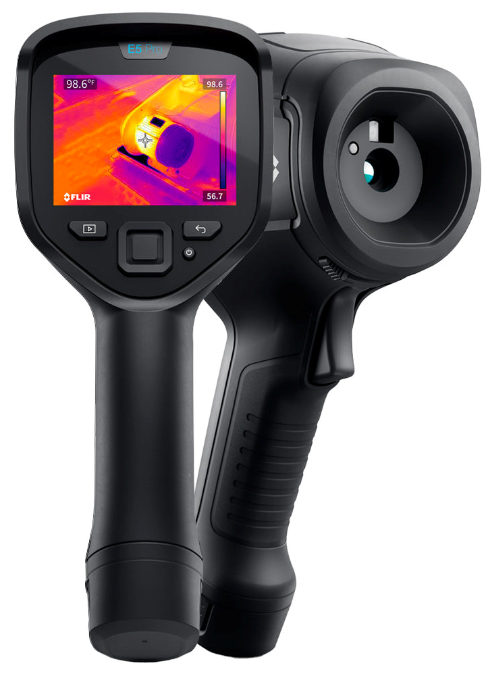
Data
5 farms → 2 visits : heat wave and thermoneutral periods
Milk recording + IR images of the udder
Milk yield, spectra (+ associated predictions), body surface temperature
679 records (350 + 329), 399 cows
+ historical milk recording data
▪︎ 3

Slide 4
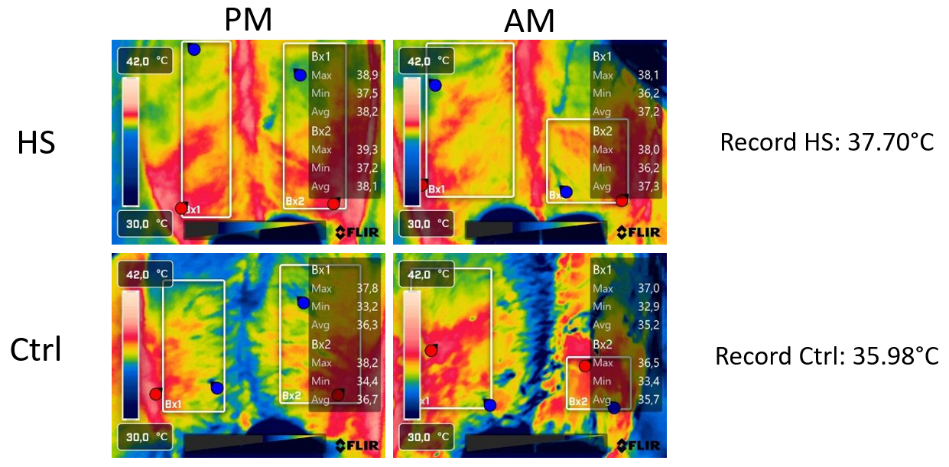
Phenotype definition
1) Only body surface temperature
→ Continuous variable
2) High body surface temperature + negative protein % and Mg [ ] residuals
→ Categorical variable
Protein
Mg
 | Farm 1 | Farm 2 | Farm 3 | Farm 4 | Farm 5 | Total
r protein % | 0.12 | -0.27 | -0.50 | -0.82 | -0.28 | -0.43
r Mg mg/kg | -0.11 | -0.50 | -0.54 | -0.97 | -0.63 | -0.61
▪︎ 4

Slide 5
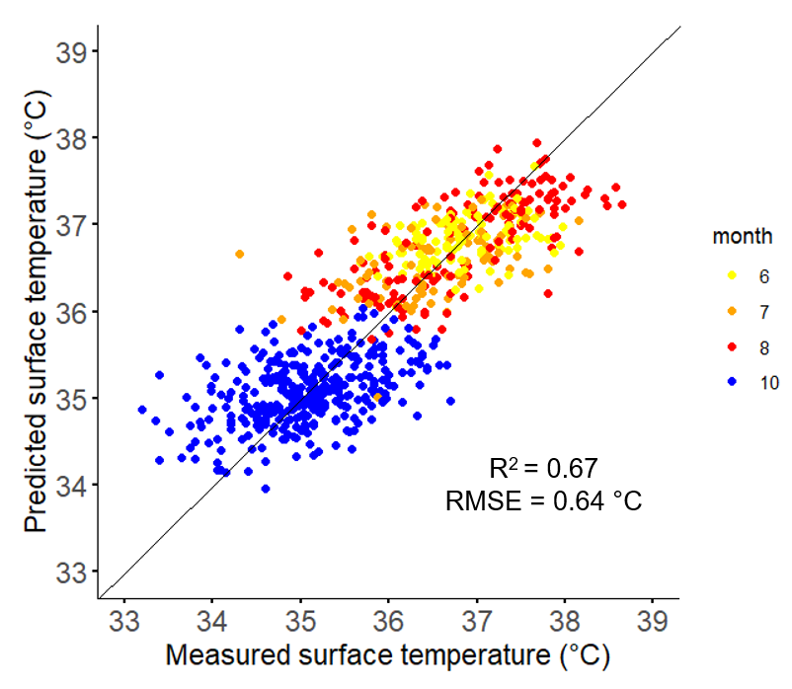
Phenotype 1
First derivative of standardized MIR spectra
212 wavenumbers
Variable pre-selection (Correlation ≥ 0.3)
PLS
679 records
R² cross-validation : 0.67
RMSE cross-validation : 0.64 °C
▪︎ 5

Slide 6
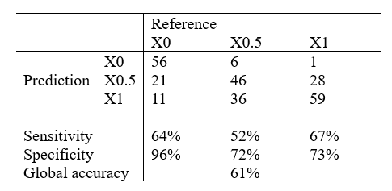
Phenotype 2
RF
RRM to estimate residuals on historical data
350 records during heat waves
88 classified affected by heat stress (X1)
(Temperature > mean + 3SD and negative residuals)
28 classified non-affected by heat stress (X0)
(Temperature < mean + 2SD and positive residuals)
+ 60 from other periods without heat stress
234 classified intermediate (X0.5)
→ 88 randomly selected
▪︎ 6

Slide 7
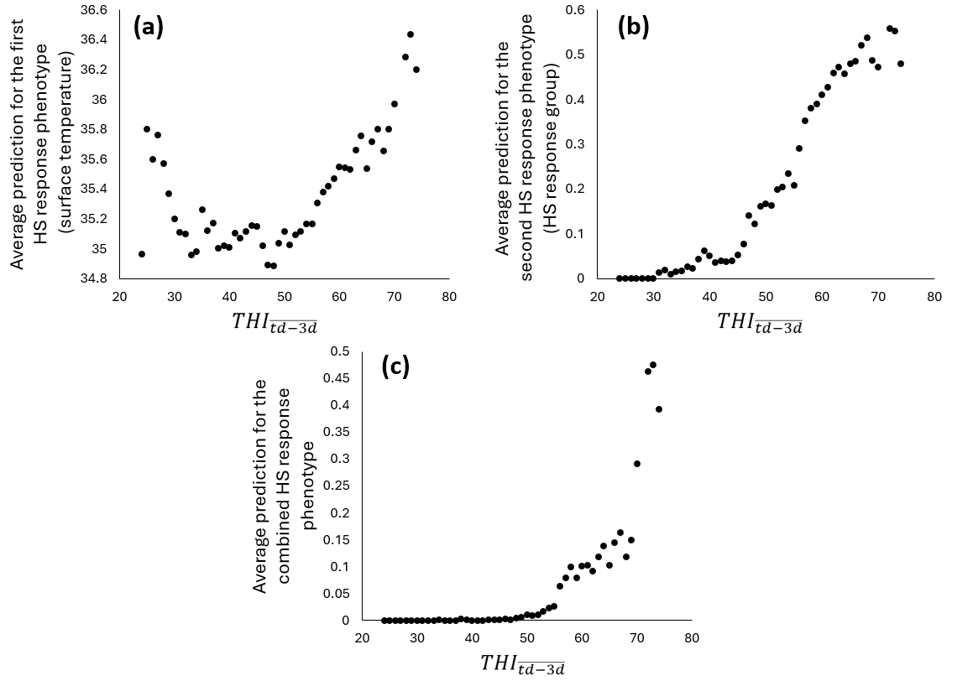
External validation (phenotypic)
Milk recording of Walloon Holstein cows from 2020 to 2022
→ 1,038,149 records
→ Combination
▪︎ 7

Slide 8
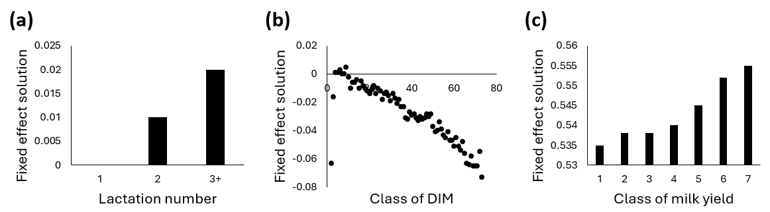
External validation (phenotypic)
Mixed model :
→ Fixed effect solutions
$y_{jklmn}={HTD}_{j}+{lact}_{k}+{DIM}_{l}+{milk}_{m}+a_{n}+{pe}_{n}+e_{jklmn}$
▪︎ 8

Slide 9
External validation (genomic)
THI-independent method :
→ Only HTD with average of at least 0.1
→ Fully THI-independent
Heritability: 0.10
Genetic correlations:
$y_{jklm}={HTD}_{j}+{lact}_{k}+{DIM}_{l}+a_{m}+{pe}_{m}+e_{jklm}$
 | Milk | Fat | Protein | SCS | Longevity | Fertility
HS | 0.15 | 0.04 | -0.14 | 0.16 | -0.33 | -0.39
▪︎ 9
Notes:
Based on the responses of the cows

Slide 10
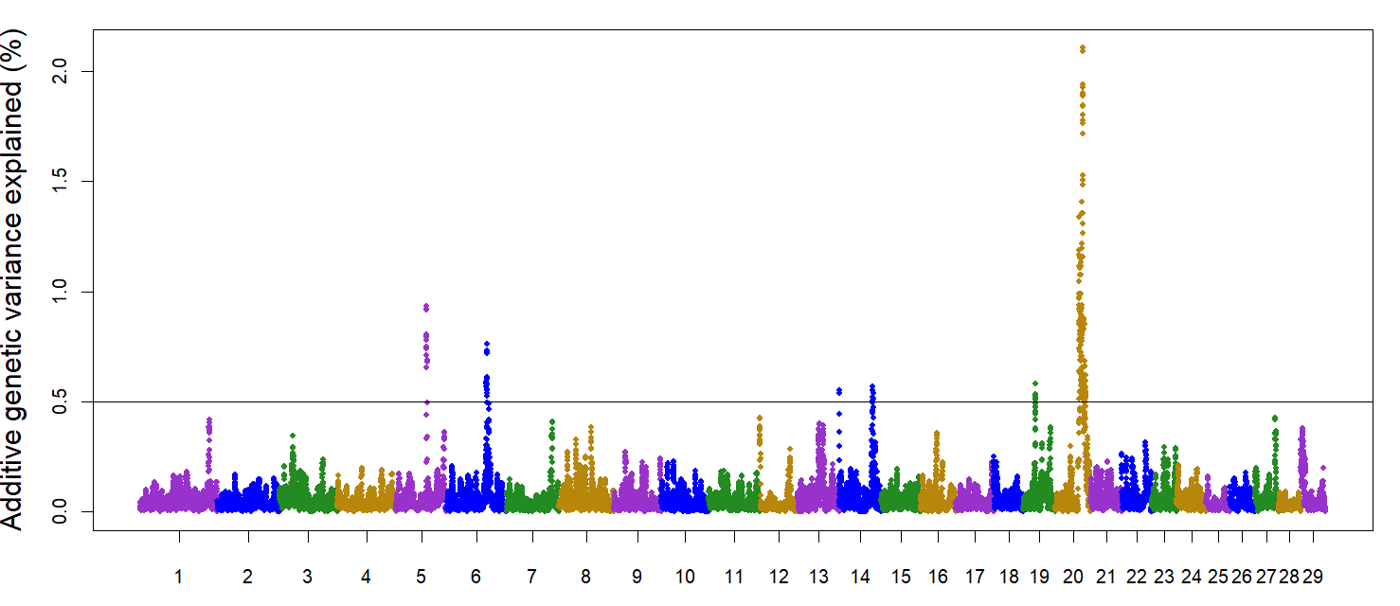
External validation (genomic)
7,170 genotypes animals and 28,442 SNPs
GWAS
→ Windows of 20 SNPs
→ Candidate genes related to heat stress
→ Regions in common with GWAS related to energy balance
▪︎ 10

Slide 11
Conclusion
MIR-predicted heat stress response:
→ Large-scale detection of heat-stressed cows
→ THI-independent genetic evaluation for heat tolerance
Heat stress may be closely linked to energy balance
Notes:
It has potential
Of course, need to imrpove the equation

Slide 12



Thank you for your attention

