Slide 1



Social workers: a care profession in mismatch and dissonance ?
A Belgian perspective.
G. Absil, L. Compère
(UR LABOCS – social work department – HELMo
LABOCS - Laboratoire pour le Changement Social — HELMo )
INTERNATIONAL CONFERENCE
ON SOCIAL WORK PRACTICE, HEALTH AND EDUCATION: BUILDING TRUST AND SOLIDARITY FOR A GOOD SOCIETY
ARAD, 28th -29th of MAY 2024
Notes:
Hi everyone
I'm Gaetan Absil, I work in Belgium, in Liège. I teach at HELMo in the Department of Social Work. Im cultural anthropologist.
I thank the organizers for this invitation to this international conference on social work issues.
I would also like to thank Prof. Gravila-Ardelean with whom I collaborate in European projects.
I thank also my collegue Laure Compere who help me a lot to prepare this communication.
In this communication will expose the problems and crises of social work in Wallonia (southern Belgium) and I will analyze them on the basis of the critical work of the new Frankfurt School. And I hope that this point of view can make sense to all of us.

Slide 2
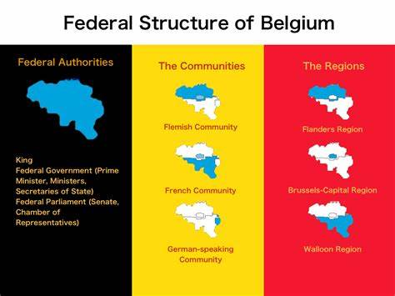
Wallonia
Wallonia
Post industrial poverty
Rapid digitalisation of the society and of social services
Social politics lead by new-management
A culture of performance
Notes:
I begin with, a little framing of the general context in Wallonia.
Wallonia is the south of Belgium, French is spoken there.
The territory of Wallonia has structural characteristics inherited from its industrial past.
The unemployment rate is significantly higher than in the north of the country, as is the number of people in precarious situations (adults and children). 7% in Wallonia against 3% in the north of the country. This creates tensions that threaten social security and solidarity between the North and the South
Wallonia is trying to redevelop its economy with digitalisation and start-ups. It is modernising its social services with digitalisation. But it is being held back by digital iniquities.
Governance, regardless of the parties in power, is rather neo-liberalism. The social services are increasingly driven by new-management techniques.
The culture of performance has infiltrated all levels of society, including social services.

Slide 3

Two researches about actual stakes in social work
Recare
  Resonances and recognitions of the profession of social worker in tension in a context of crisis in the care professions.
  HELMo
Bridge
  Bridging the Social : Social Engineering and Social Innovation across Europe
  Bridge - Bridging the Social : Social Engineering and Social Innovation across Europe (bridge-erasmusproject.eu)
Notes:
We are currently conducting two research projects that question the current issues of social work.
Recare questions the gap between the motivations of young social workers (their ideals) and the new working conditions.
Bridge questions the role of managers in the development of social innovation, as a real bottom-up process

Slide 4
Social work in crisis
The symptoms
  All the profession of the care are in an employement crisis (health care, social care, education)
  Since 2023, social work professions have been in short supply, especially Youngs protection and Public Help Services
  Institutions hire people who are not trained in social work
  Increasing numbers broken careers of burn-out, turn over, professional reintegration, resumption of studies
  Services users complain about accessibility and respect of their Social Rights.
Notes:
These two studies provide a common analysis of the issues at stake for social work
These issues are first of all linked to a series of observations, of symptoms, which we are trying to understand.

Slide 5
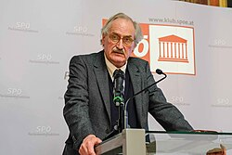
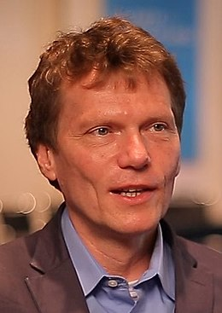
Diagnostic : analytical and criitcal tools
Axel Honneth theory of reckognition
  private sphere,
  legal sphere,
  sphere of solidarity
Rosa Harmutt, theory of resonance
  Everyday sucessful connections to the world
  System create conditions for resonance
Notes:
We decided to use the critical theories of the Frankfurt School to analyze the causes of these symptoms. We combine Axel Honneth's theory of recognition and Rosa Hartmutt's theory of resonance.
Both theories, with differences, speak of the relationship to the world and the feeling of adequacy between people and the world. Between their aspirations and working conditions.
Honneth situates the relationship in the conflict, in the struggle to be recognized.
Rosa situates the relationship in a positive experience with the world, resonance.

Slide 6

Explanations, we are testing
Social workers are questing for resonance
Students seek human centered trainings
Workers figth to preserve human relations in social work
Department managers cope with bottom up injonction to innovate
In a context of disonance and alienation
New management focuses on renability and performance
Neo-liberal ideology focuses on social activation instead of Social right
Transformation of the social caring in individual coaching
Where the true working conditions are hidden
The social workers experience the disdain
The social workers fight more for themselves than for the public
The social workers are constrained to use tactics instead of structural changes
The social workers develop adaptative culture and behaviors
Notes:
Our explanatory hypotheses, which we must test, is a lack of adequacy between the desires of the new social workers and the new working conditions.
These explanations are already documented in our preliminary results, but also in other surveys we have conducted.

Slide 7
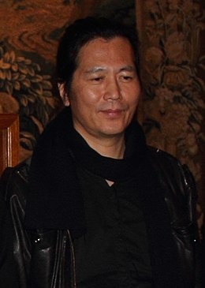
To cope with or to resist the society tiredness ?
Byung-Chul Han
"Today, everyone is an auto-exploiting labourer in his or her own enterprise. People are now master and slave in one. Even class struggle has transformed into an inner struggle against oneself.“
Psychopolitics: Neoliberalism and New Technologies of Power (London & New York: Verso Books, 2017, p. 13)
Notes:
I link my conclusion with a more general statement that may inspire the continuation of the work of this conference.
The Korean philosopher Byung-Chul leads a reflection on the new condition of contemporary man, and I think that this reflection points to a fundamental trend in contemporary societies. And which is also just as valid for social workers as for the beneficiaries of services in all fields of health, employment, housing, etc.
Thank you for your attention.

Slide 8
Bibliography
Ané, C. & S. Cordier. Le secteur du médico-social en pleine crise. Le Monde. 14 octobre 2022 https://www.lemonde.fr/societe/article/2022/10/14/le-secteur-du-medico-social-en-pleine-crise_6145825_3224.html
Ben Mrad, F. (2023). Travailleurs sociaux face au burn-out. Sciences & Actions Sociales, 19, 224-240.
Boucher, M. (2022). Où va le travail social : Contrôle, activation et émancipation. Champ social.
Cercle vulnérabilités et société (2022). Soutenir et piloter l’attractivité des Métiers du care en fluidifiant les trajectoires et les organisations
Compère, L. & A. Philippart (2022), Les pratiques des professionnels avec les dispositifs numériques. Quels enjeux dans la relation avec les usagers. L’observatoire. 110.
Forem (2023). Difficultés et opportunités de recrutement. Métiers/fonctions critiques et en pénurie en Wallonie. Liste 2023.
Haut Conseil du Travail Social en France. (2023). Livre blanc du travail social.
Honneth, A., (2008). La société du mépris. Vers une nouvelle Théorie critique. La Découverte/Poche.
Paturet, J. (2023). Métiers de l’humain : crise de sens ?. VST - Vie sociale et traitements, 160, 20-26.
Martin, C. (2008). Qu'est-ce que le social care ? Une revue de questions. Revue Française de Socio-Économie, 2, 27-42.
Morolli, P. (2023). Malaise dans les métiers de l’humain. VST - Vie sociale et traitements, 160, 53-58.
Noël-Hureaux, E. (2015). Le care : un concept professionnel aux limites humaines ?. Recherche en soins infirmiers, 122, 7-17.
Rosa, H. (2014). Aliénation et accélération : Vers une théorie critique de la modernité tardive. La Découverte.
Rosa, H. (2021). Résonance. Une sociologie de la relation au monde. La Découverte Poche.
Rouzel, J. & Marcellot, G. (2023). Introduction: Qu’est-ce que je fous là ? Une désaffection des professionnels et des résistances à l’œuvre. VST - Vie sociale et traitements, 160, 10-11.
Serré, A. & Vleminckx, J. (2016). Contexte de crise en Belgique francophone : quelles marges de manoeuvre aux marges du social ?. Le Sociographe, 55, 19-32.
Gless, E. L’étudiant Emploi : les jeunes diplômés veulent un bon salaire et un métier de sens. publié le 20 octobre 2022 https://www.letudiant.fr/metiers/emploi-les-jeunes-diplomes-veulent-un-bon-salaire-et-un-metier-de-sens.html

