Slide 1
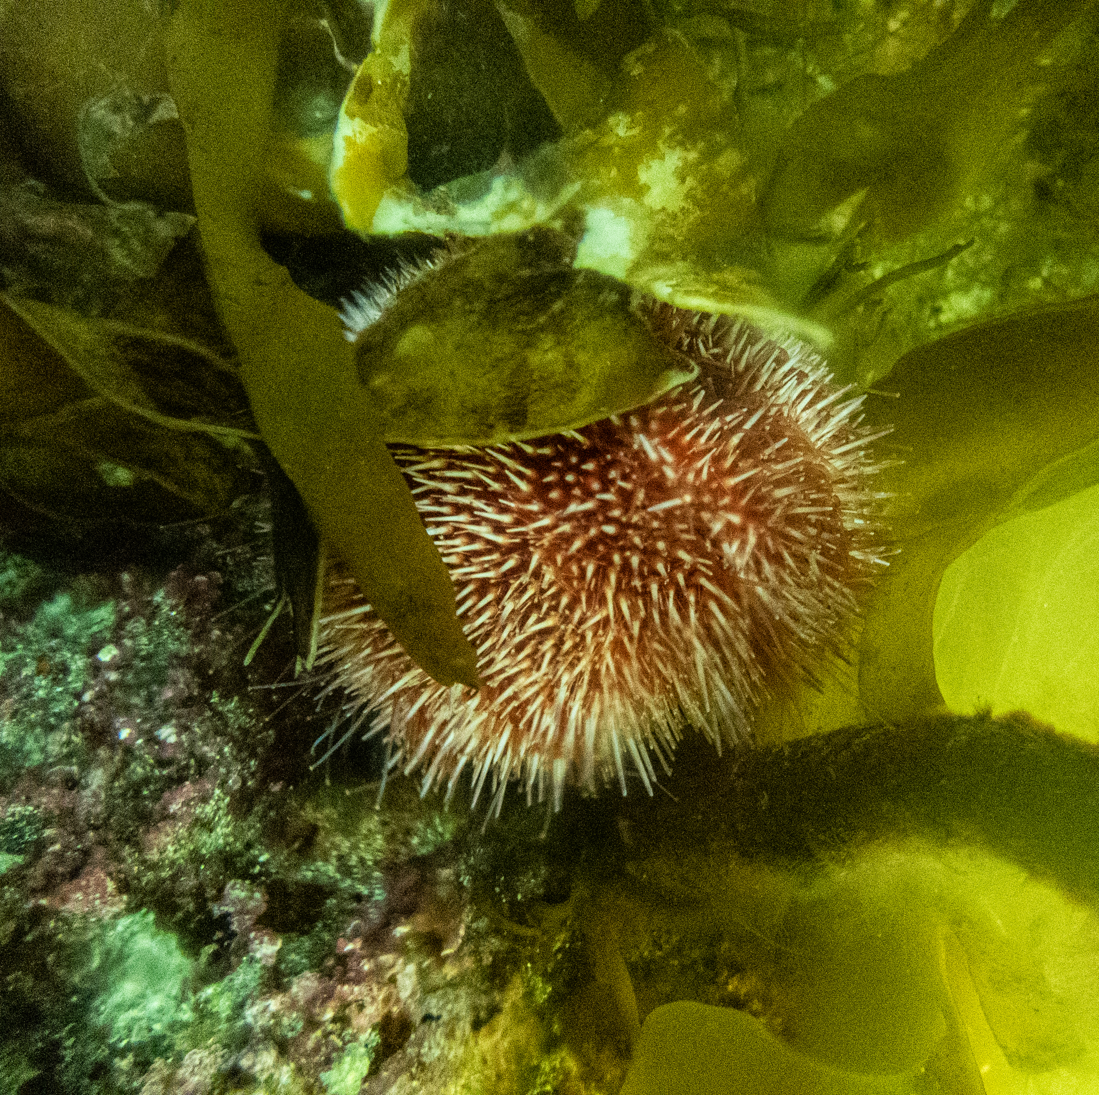
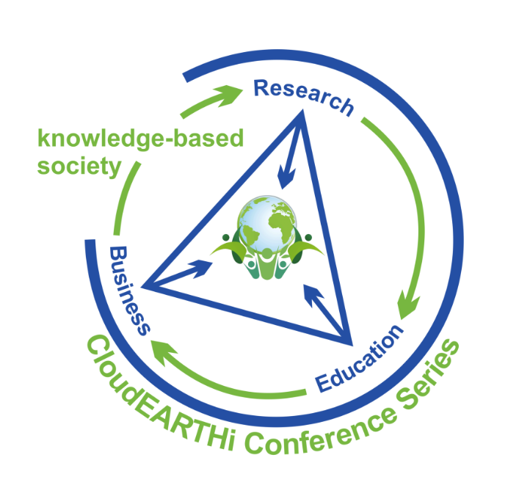
Green sea urchin population trends related to bioclimatic and biogeochemical variables
A spatio-temporal analysis in the North Atlantic and Arctic Ocean
Constance Gosselin^{1,2}
Sophie Bürgi^{2,3}
Tamer Abu-Alam²
Université de Liège, constance.gosselin@student.uliege.be
UiT The Arctic University of Norway, tamer.abu-alam@uit.no
Universität Bern, sophie.buergi@students.unibe.ch
CloudEARTHi Conference
Varna, 28th June 2024
Notes:
Species name: Strongylocentrotus droebachiensis

Slide 2
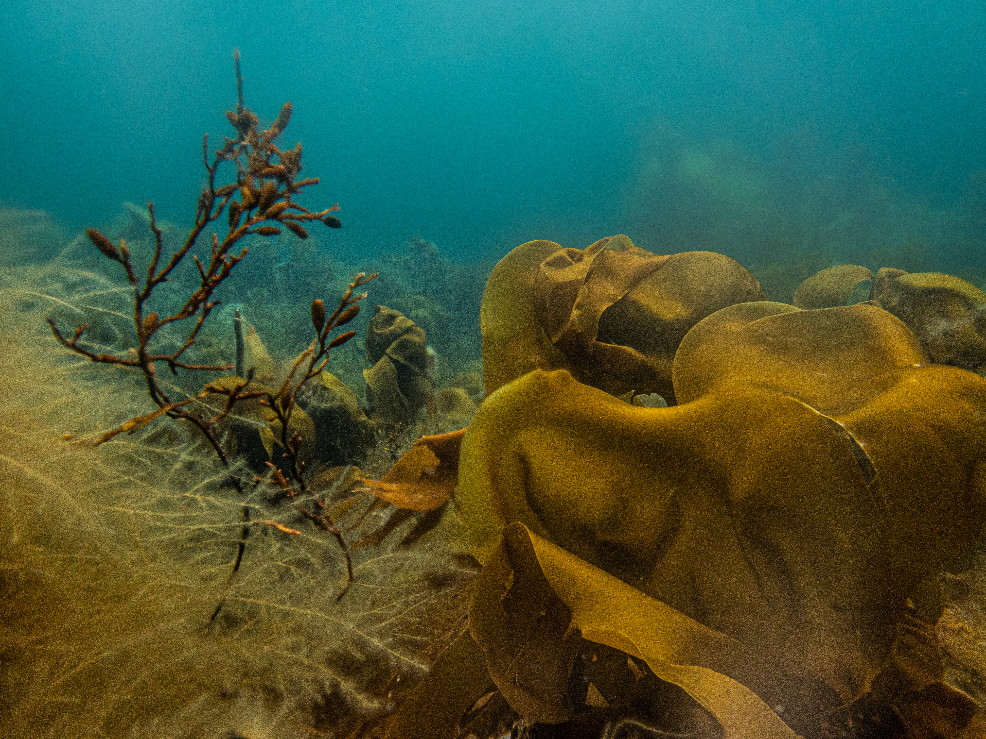

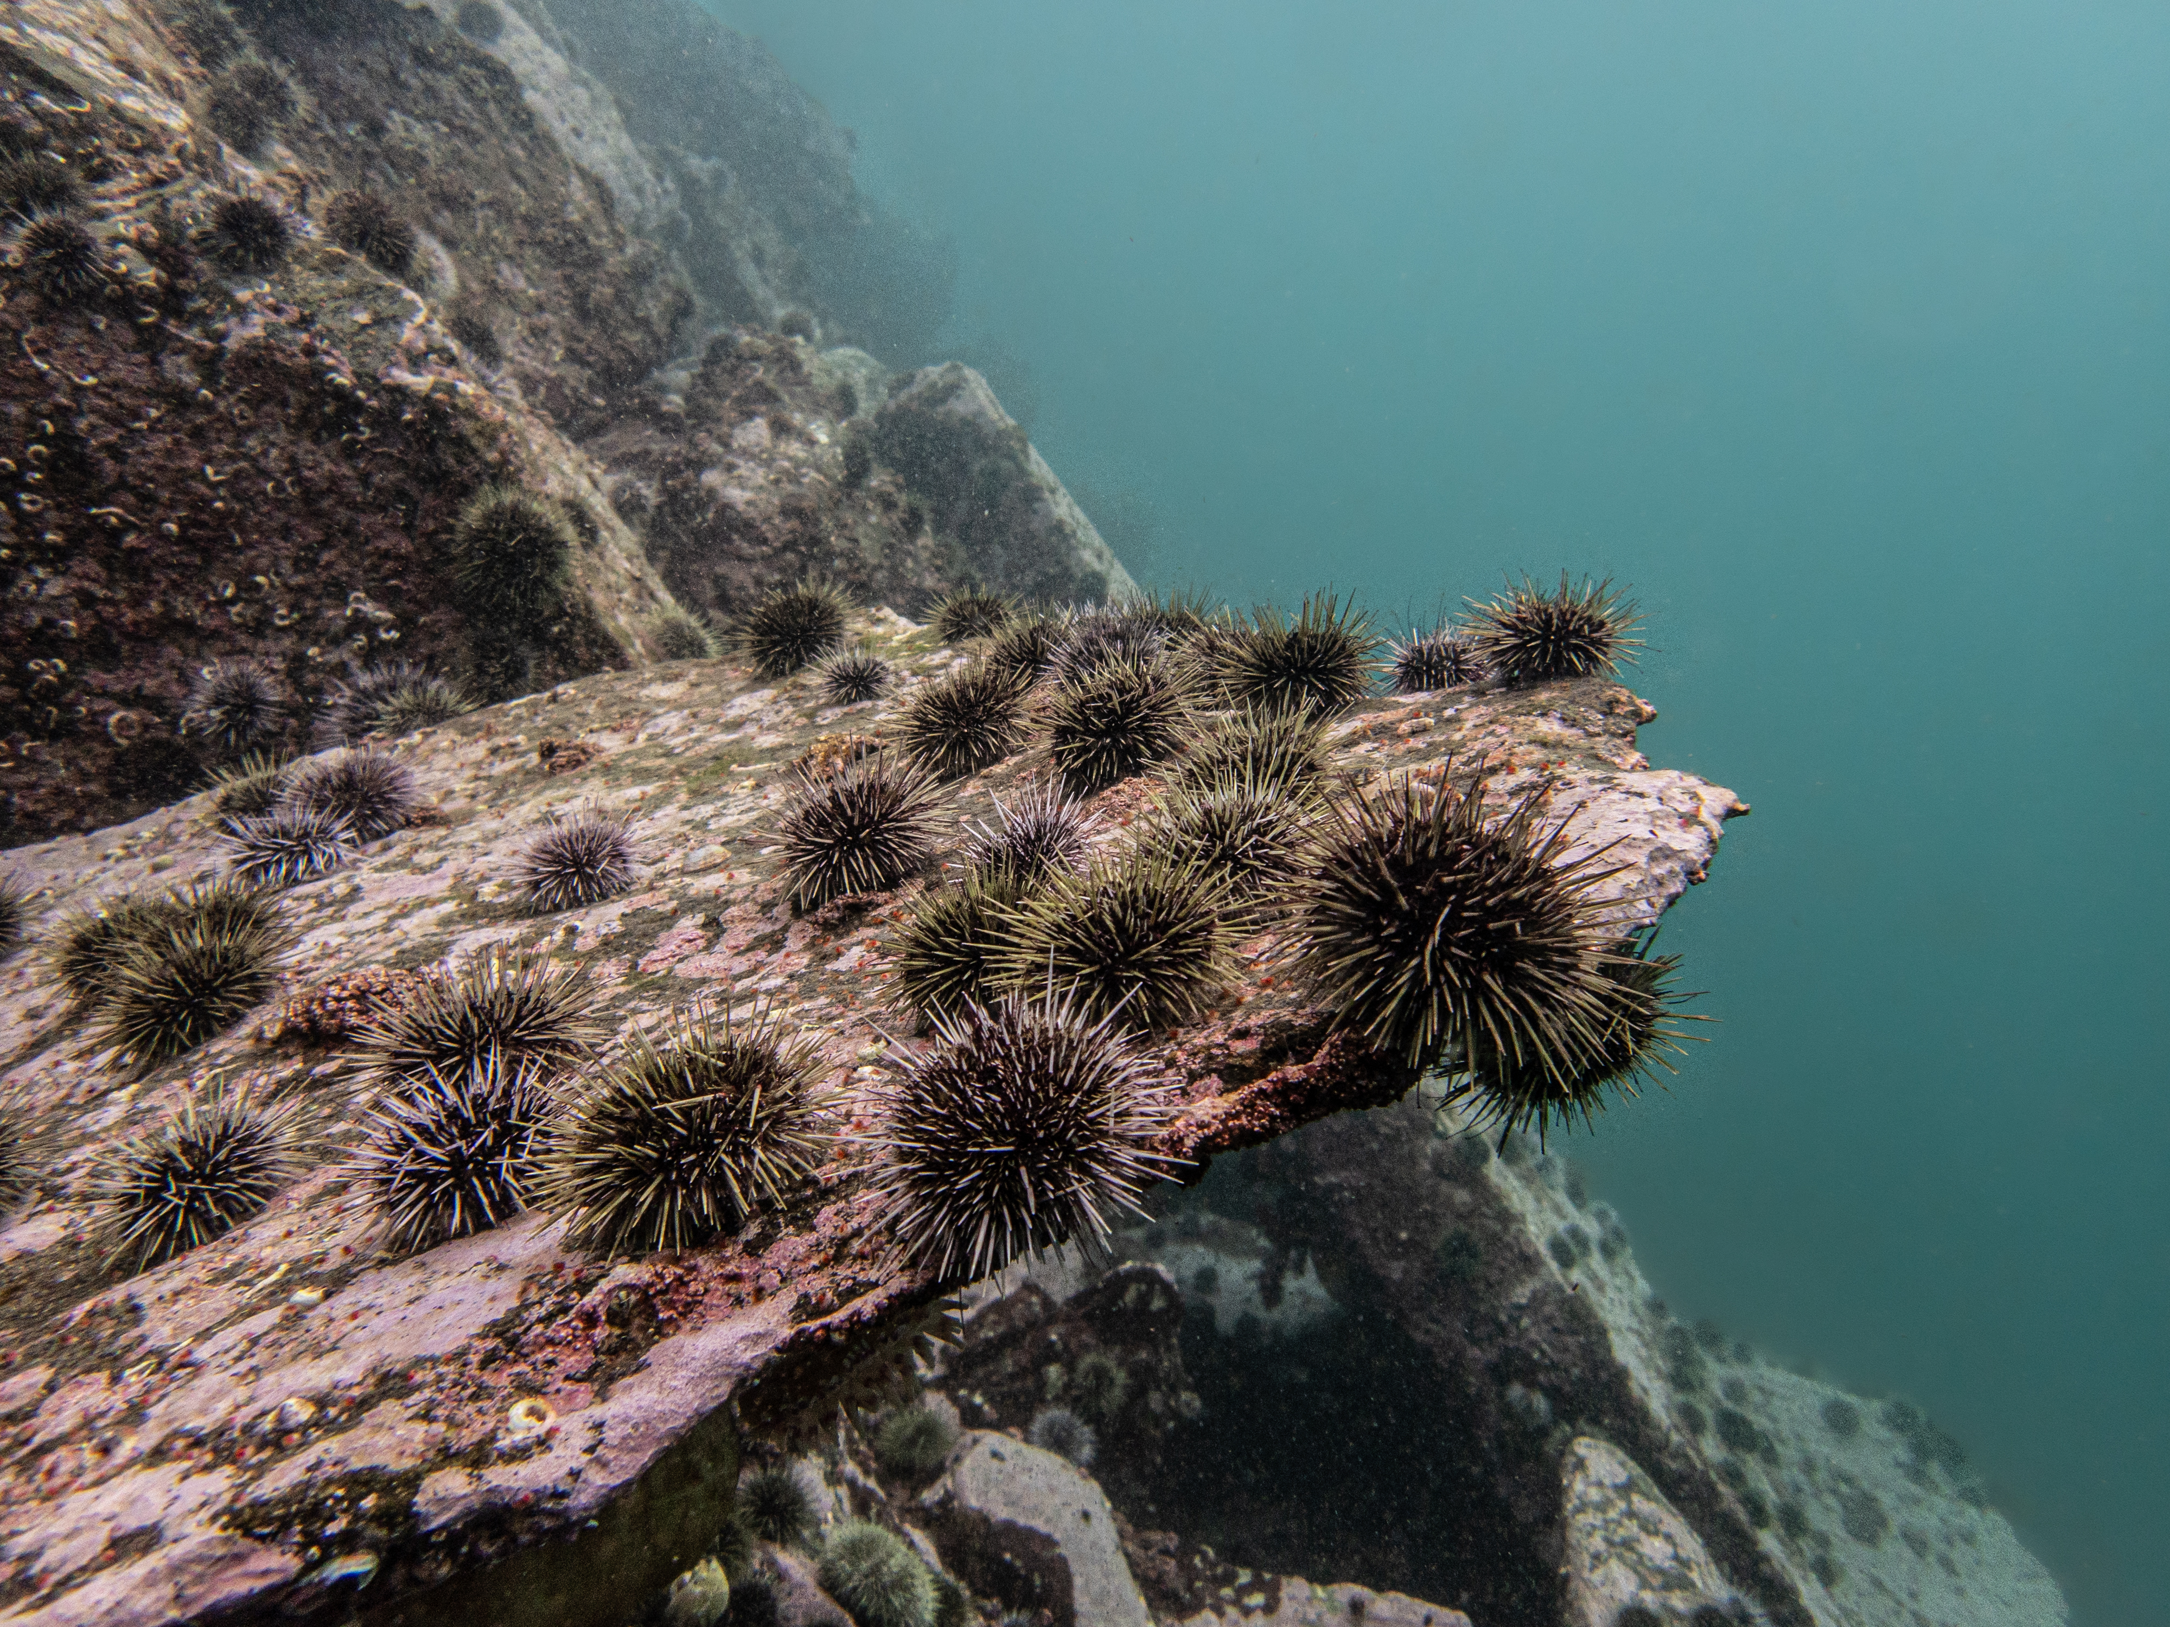


Problem
Productive Kelp Forest
Sea Urchin Barrens
Ecosystem Phase Shift
Notes:
Context
kelp forests = productive ecosystem, offers many benefits & ecosystem services
Norway: kelp forests are hotspots for marine biodiversity as they provide habitat, nursery grounds and food for marine organisms. They support both commercial species (e.g. cod and pollock) and red list species (e.g. Atlantic coastal cod) that in turn support other predators at higher trophic levels such as seals and seabirds.
Play crucial role in carbon sequestering,
Nutrient cycling &
Offer many other cultural services: ...
…
However, sea urchin species such as the green sea urchin are grazing on the kelp, increasing the desertification and leaving barren grounds behind
Sea urchin barrens = areas without seaweed and dominated by sea urchins, considered a collapse of kelp state. They have a much lower productivity and structural complexity compared to kelp forests.
Both in same areas, and transitions between kelp beds and sea urchin barrens have been widely reported over the past 4 decades in Norway.
Other causes of kelp forest loss, but in northern Norway, intense urchin grazing caused extensive losses of both L. hyperborea and S. latissima forests (Gundersen et al., 2011)
-> complex & interesting topic -> references for more information

Slide 3



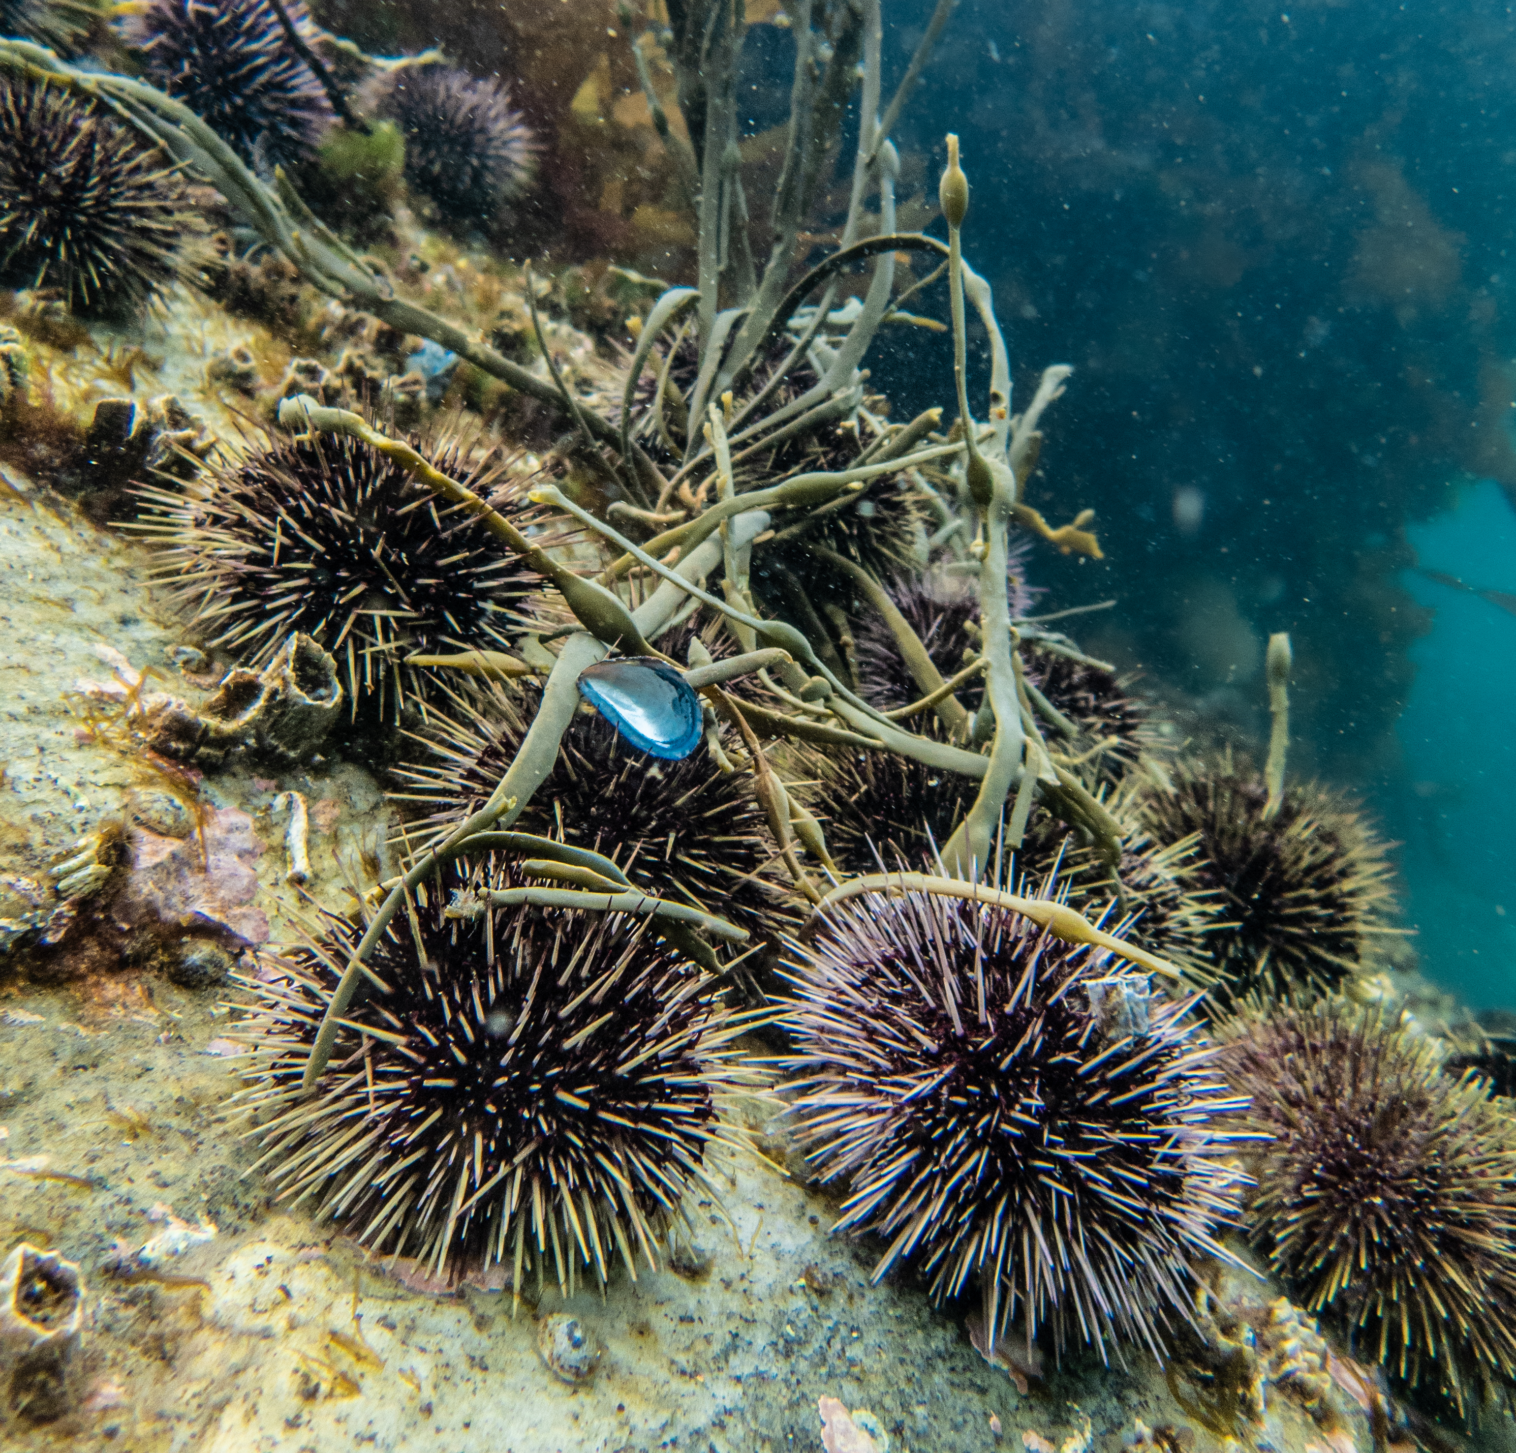



Research Question
Bioclimatic and biogeochemical
drivers
Loss of sea urchin predators
Overfishing
High sea urchin larvae recruitment
Low parasite infection rates
Notes:
Possible causes of sea urchin population growth & subsequent overgrazing events:
loss of sea urchin predators, likely a consequence of overfishing, was suggested cause a population explosion (Norderhaug et al., 2021). Example: Crabs (Cancer pagurus), wolffish
Low infection rates possibly causing an increase in the SU populations (Sivertsen, 2006)
High recruitment of sea urchin larvae in combination with favourable hydrographic conditions (Sivertsen, 2006)
Need to understand what directly and indirectly drives the overgrazing of kelp forests by the green sea urchin.
Research question: what are the bioclimatic and biogeochemical variables influencing the population of the sea urchin in the Troms archipelago?
-> by looking at various locations NA & arctic ocean
We want: see the correlation between sea urchin population development and different marine climate parameters

Slide 4
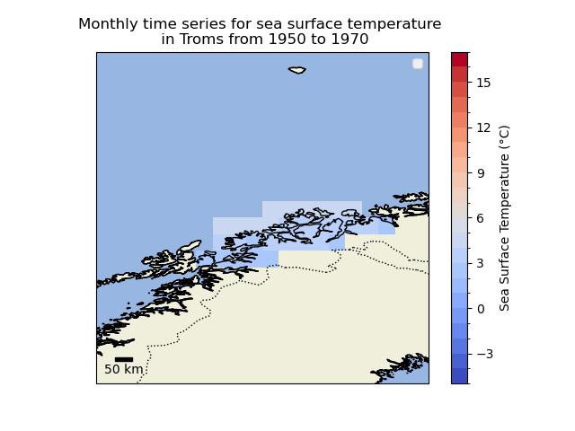





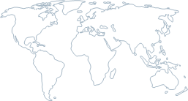
Climate Dataset
Global Ocean ​
Physics Reanalysis
Global Ocean Biogeochemistry Hindcast
Salinity
Nitrate
Chlorophyll
Iron
O₂
Phosphate
Silicate
Biomass
CO₂
Phytoplankton
pH
Global Bioclimatic Indicators
Sea Surface Temperature
Air Temperature
Sea Ice
Notes:
Main points :
- 3 dataset from copernicus platforme. Marine services : 1993-2023. Climate data store : 1950 to 2100.
Netcdf -> cubic data
Monthly
Three datasets
Global Bioclimatic Indicators : From 1950 to 2100 :Reanalysis based on NorESM1-M (NCC, Norway), RCP4.5
https://cds.climate.copernicus.eu/cdsapp#!/dataset/sis-biodiversity-cmip5-global?tab=form
Global Ocean Physics Reanalysis : NEMO platform driven at surface by ECMWF ERA-Interim then ERA5 reanalyses for recent years
https://data.marine.copernicus.eu/product/GLOBAL_MULTIYEAR_PHY_001_030/description
Global Ocean Biogeochemistry Hindcast : PISCES biogeochemical model, FREEGLORYS2V4 ocean physics produced at Mercator-Ocean and ERA-Interim atmosphere produced at ECMWF at a daily frequency
https://data.marine.copernicus.eu/product/GLOBAL_MULTIYEAR_BGC_001_029/description

Slide 5
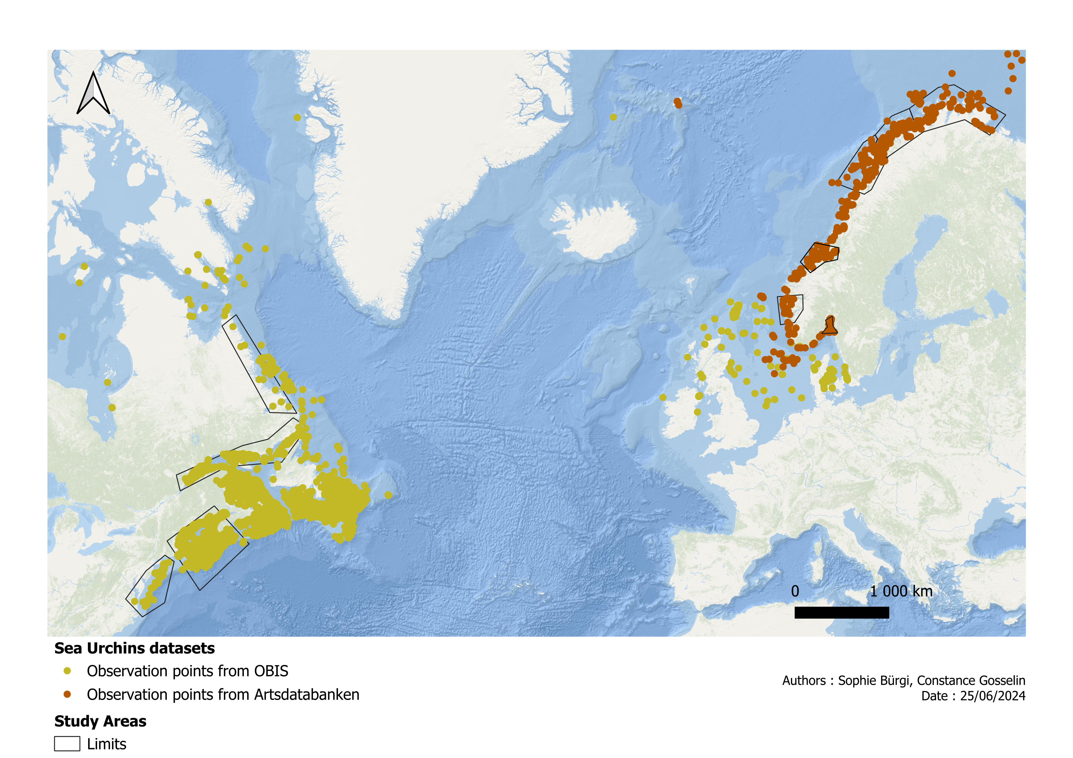
Sea Urchin Dataset
Notes:
Based on this data = choose study areas. Chose areas of interest where many observations had an individual count & decided to use only data from 1950 on
Observational data of this exact species: Green Sea Urchin
Two main dataset used : OBIS and Artsdatabanken
OBIS : Worldwide dataset
Artsdatabanken : National based dataset
Seenable in both datasets: Observation points, some just 'present', some with actual count/number of urchins.
All observations: Date index & geolocalised, both sets have observations & individual counts in some.
Based on this data = choose study areas. Chose areas of interest where many observations had an individual count & decided to use only data from 1950 on

Slide 6
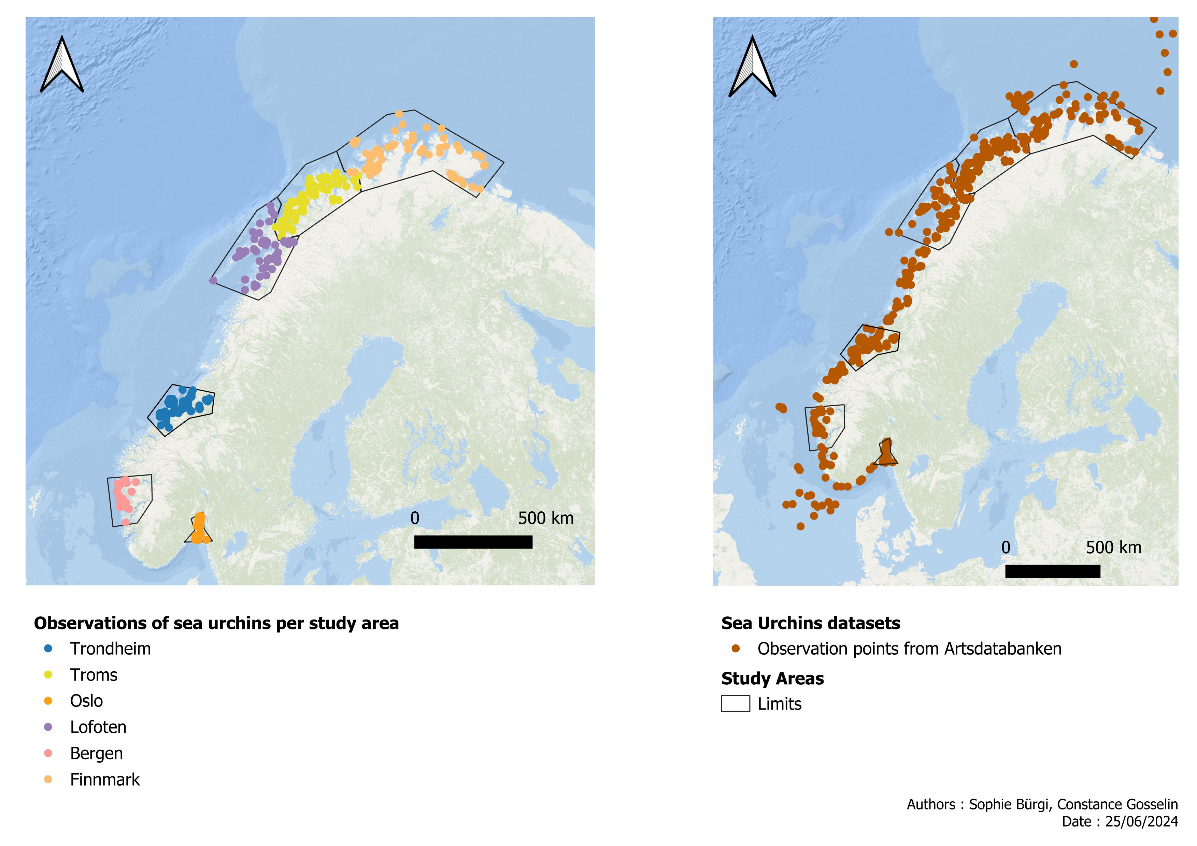
Sea Urchin Dataset
Notes:
Norway: 6 study areas, three in the north, including Troms, the main area
Study is based on Northern Norway conditions. Particular attention to troms and the study area around.

Slide 7
Sea Urchin Dataset

Slide 8
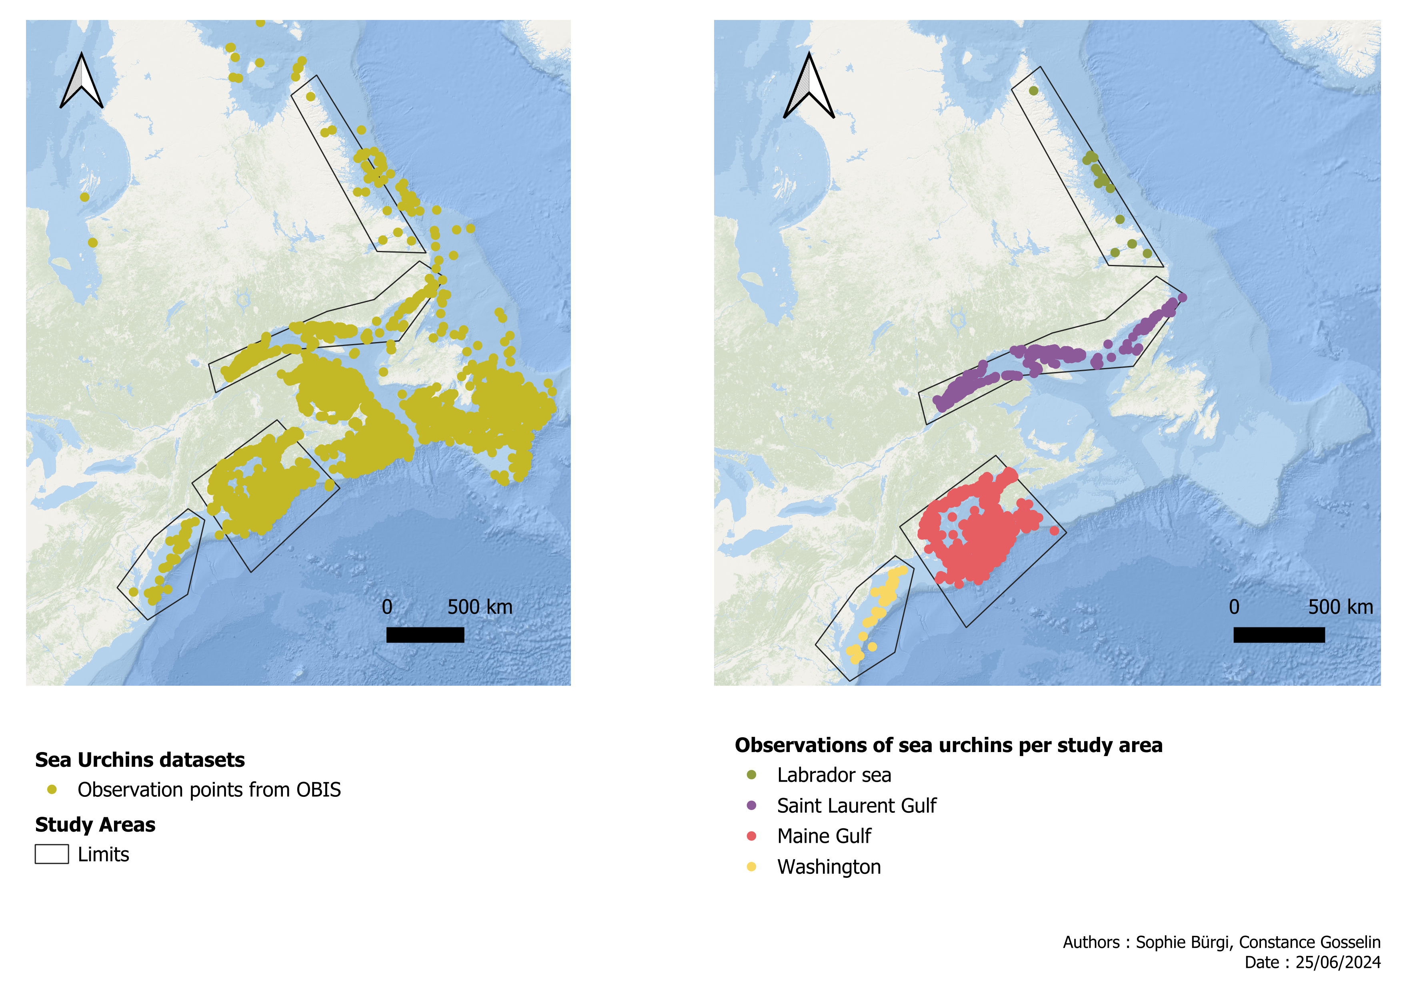
Sea Urchin Dataset

Slide 9
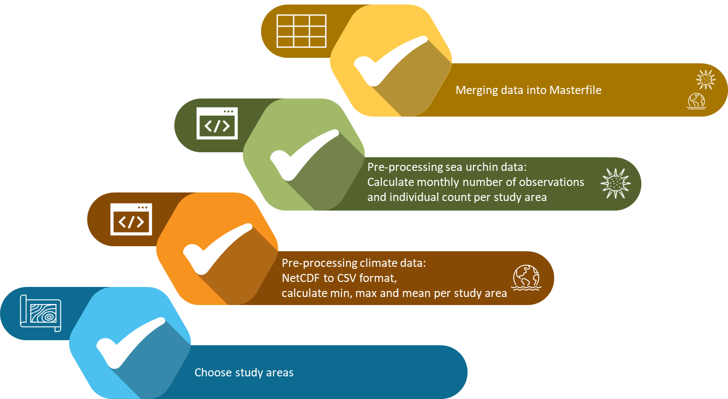
Methodology
Notes:
First steps: involve computing and pre-processing raw data
Select study areas
two different types of data: climate and sea urchins, global/national data had to be cropped to study areas and computed.
For climate: daily data calculated into min, max, mean of each month and study area for the available timespan, which is either from 1950 or 1993 onwards
For SU: monthly number of observations & added up quantity of sea urchin individuals, the ind. count, per study area
created dataframe, including all data of sea urchins and bioclimatic & biogeochemical variables in monthly resolution.

Slide 10
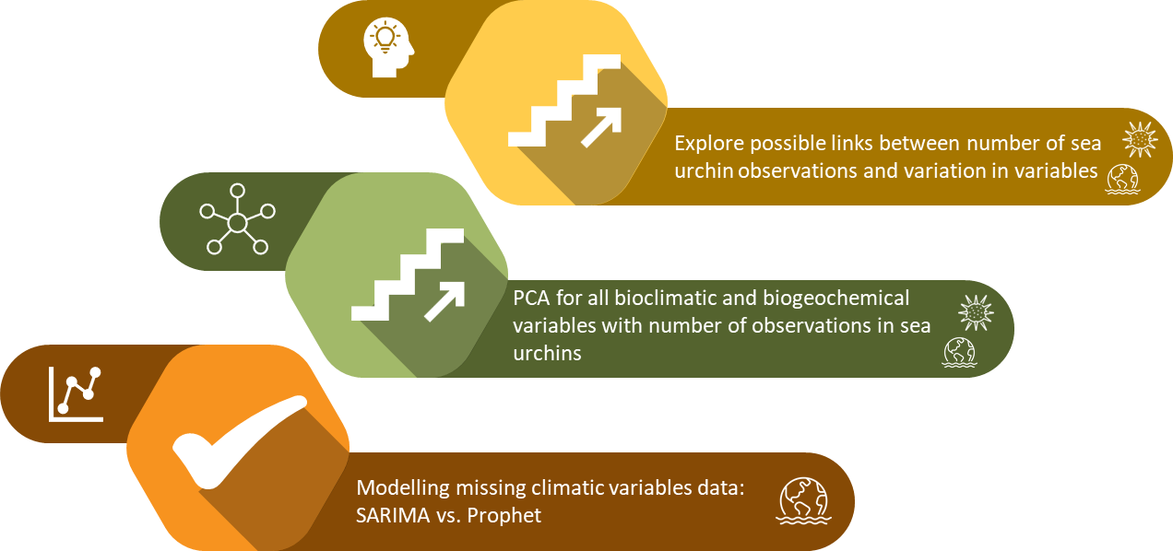



Methodology
10
Notes:
Compare if sea urchin ind. count correlates with the number of observ., separately for each study area
2. Climate data: For most variables we are looking at, we have time series data from 1993-2023, but we want to work with past and future development. To analyse the trends in the past and future, we used linear regression for each variable.
3. it is furthermore possible to model the observational bioclimatic and biogeochemical data we have to extract values and gain a closer look at past and future conditions. There are several modelling approaches, such as SARIMA and Prophet.
Might have noticed we don't have ticks anymore -> ongoing project
-> pending tasks with the results we compiled so far are a statistical analysis of the time series climatic data with sea urchin observational data to explore possible links

Slide 11


Results
 | Spearman Correlation | P-Values (under 0.01)
Oslo | 0.12
Bergen | 0.70
Trondheim | 0.81
Lofoten | 0.75
Troms | 0.48
Finnmark | 0.95
Washington | 0.68
Maine Gulf | 0.88
Saint Laurent Gulf | 0.36
Labrador Sea | 1.0
Notes:
NON Normal distribution -> Spearman
6 out of ten show high correlation
Issue with the lack of correlation linked with low individual counts

Slide 12
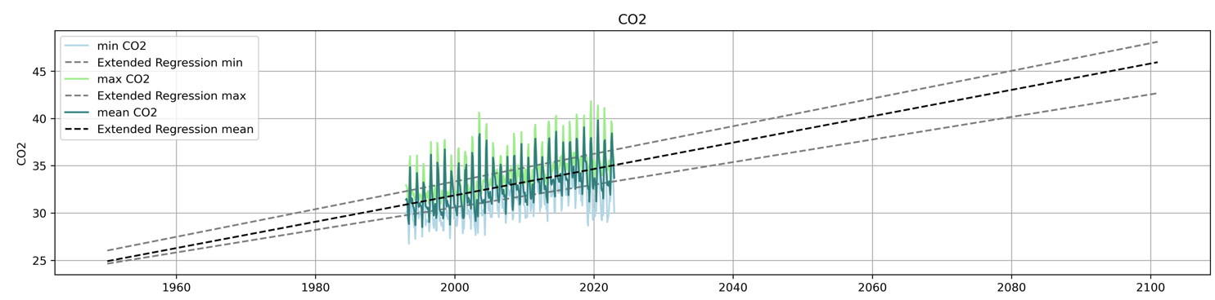
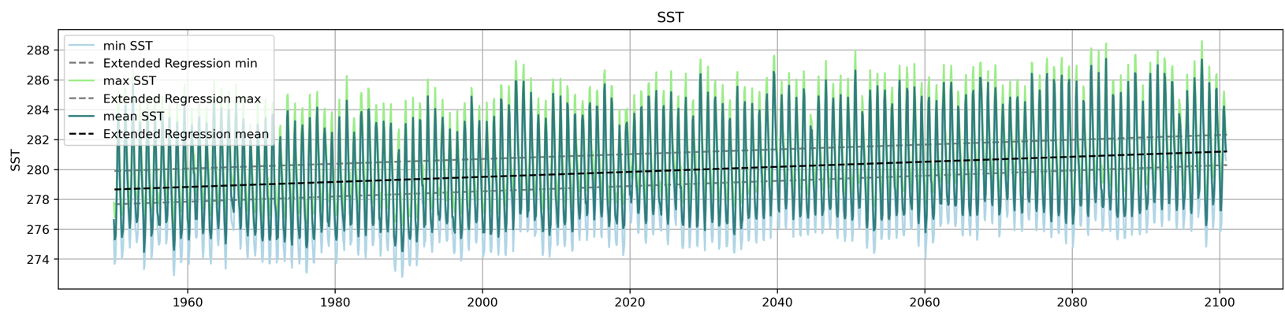
Results
Exemplary variables for study area 'Troms'
Problem | Research Question | Material | Methods | Results | Conclusion​
12
Notes:
Trend analysis of observed climate values
Will help to explore the links between SU and climate data
Main goal: Find links
Goal: Global datasets are useable in study area level and they can be computed together with each other

Slide 13

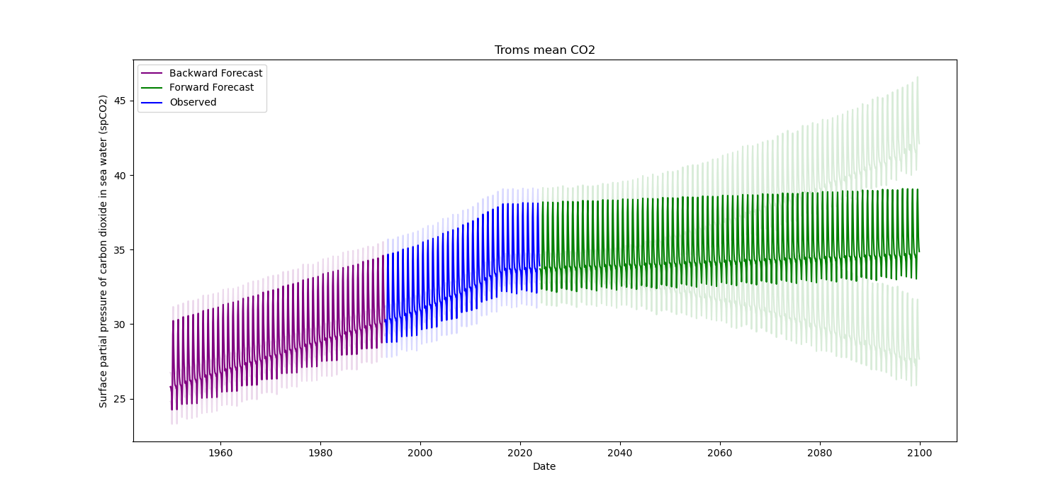
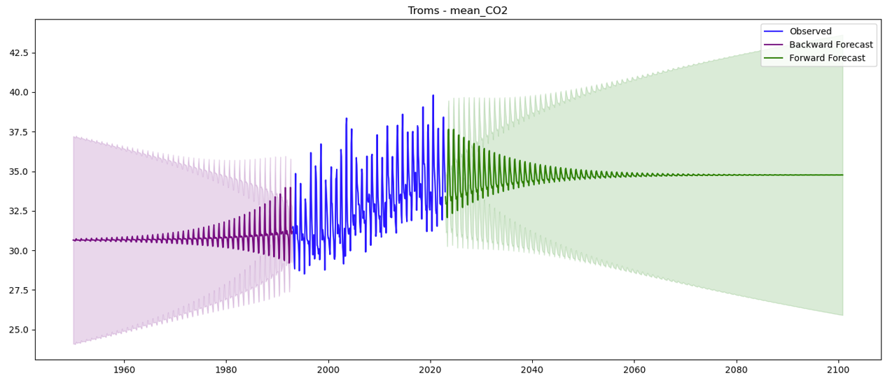

Results
Example: modelled mean CO₂ in study area 'Troms'
Prophet
SARIMA
Notes:
With climate data:
IN ORDER TO FILL UP the missing values
With the observational bioclimatic and biogeochemical data we have from 1993-2023, it is possible to model past and future values. There are several modelling approaches. ARIMA and Prophet are major time series tools used to forecast future values. [show and compare example Troms]
Modelling on study area level. Different results with different modelling approaches for the same observational data. Need of validation through observation data from the past.
(Notes in case of questions)
Key differences:
SARIMA (Seasonal Autoregressive Integrated Moving Average)
Key Characteristics:
Explicit Seasonality Handling: SARIMA explicitly models seasonality by incorporating seasonal autoregressive, differencing, and moving average terms.
Requirement for Stationarity: The model requires the time series data to be stationary, often necessitating differencing to remove trends and seasonality before fitting -> complicated process, many steps, time consuming
Prophet
Key Characteristics:
Automated Seasonality and Trend Detection: Prophet automatically detects and adjusts for seasonal patterns, holidays, and other recurrent events, making it user-friendly and less dependent on manual parameter tuning.
Robust to Missing Data and Outliers: Prophet is designed to handle missing data points and outliers effectively -> suitable for data with irregularities.
Difference:
SARIMA: Provides detailed control over the model parameters (AR, I, MA, and seasonal components), allowing for fine-tuning but also requiring more expertise.
Prophet: Focuses on simplicity and ease of use with automated adjustments, requiring minimal parameter tuning and offering less manual control over model specifics.

Slide 14
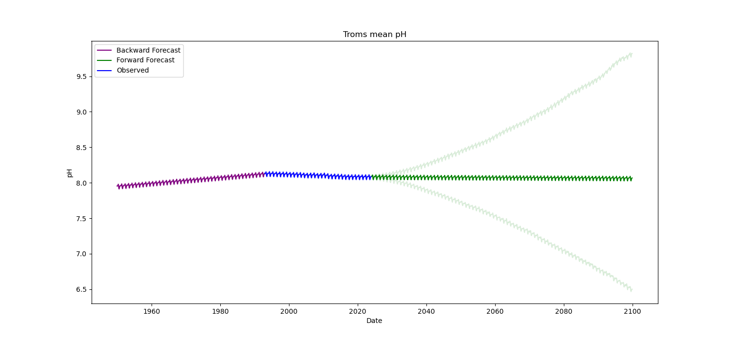
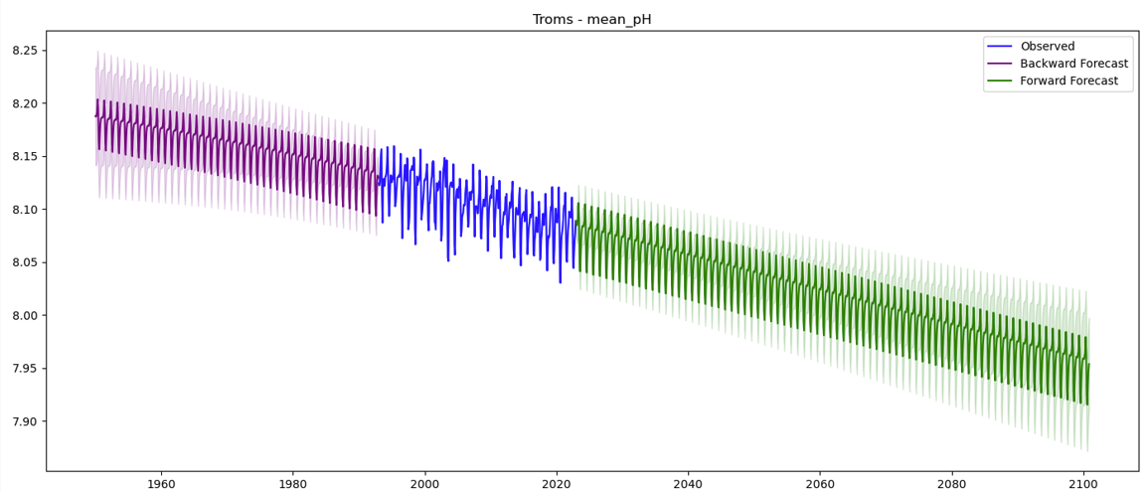
Results
Example: modelled mean pH in study area 'Troms'
Prophet
SARIMA
Notes:
With climate data:
With the observational bioclimatic and biogeochemical data we have from 1993-2023, it is possible to model past and future values. There are several modelling approaches. ARIMA and Prophet are major time series tools used to forecast future values. [show and compare example Troms]
Modelling on study area level. Different results with different modelling approaches for the same observational data. Need of validation through observation data from the past.
(Notes in case of questions)
Key differences:
SARIMA (Seasonal Autoregressive Integrated Moving Average)
Key Characteristics:
Explicit Seasonality Handling: SARIMA explicitly models seasonality by incorporating seasonal autoregressive, differencing, and moving average terms.
Requirement for Stationarity: The model requires the time series data to be stationary, often necessitating differencing to remove trends and seasonality before fitting -> complicated process, many steps, time consuming
Prophet
Key Characteristics:
Automated Seasonality and Trend Detection: Prophet automatically detects and adjusts for seasonal patterns, holidays, and other recurrent events, making it user-friendly and less dependent on manual parameter tuning.
Robust to Missing Data and Outliers: Prophet is designed to handle missing data points and outliers effectively -> suitable for data with irregularities.

Slide 15
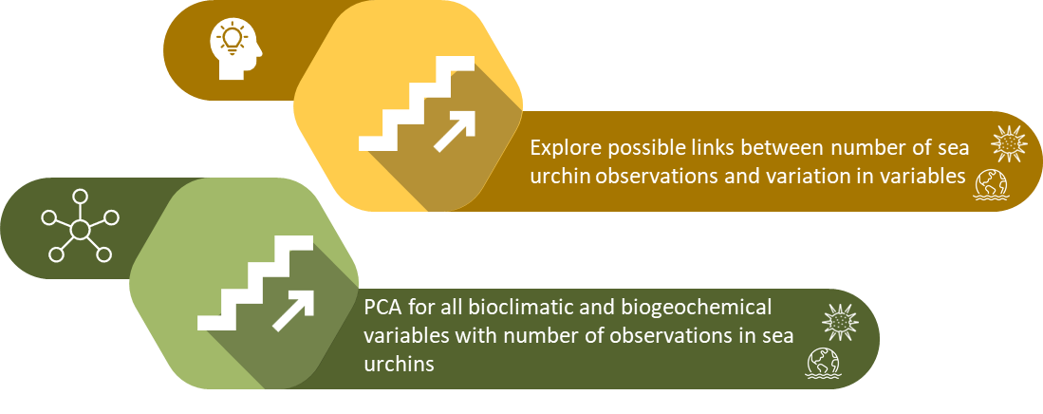





Conclusion
Notes:
In Conclusion:
We could statistically show that it is justified in most study areas to work with number of observations instead of quantity of individuals in the case of sea urchin data
We have been able to compute global time series data into individual study areas
We found two ways to model missing past values of climatic conditions, and will need to further validate the modelling to find the most accurate one
What is pending in this ongoing research is the combination of SU and bioclimatic & biogeochemic variables by means of a principal component analysis. Based on that we'll be able to explore the possibile links and correlations, which will furthermore help to understand overgrazing events and phase shifts between sea urchin barrens and kelp forests.
Takeaway message:

Slide 16
Green sea urchin population trends related to bioclimatic and biogeochemical variables
A spatio-temporal analysis in the North Atlantic and Arctic Ocean
Constance Gosselin^{1,2}
Sophie Bürgi^{2,3}
Tamer Abu-Alam²
Université de Liège, constance.gosselin@student.uliege.be
UiT The Arctic University of Norway, tamer.abu-alam@uit.no
Universität Bern, sophie.buergi@students.unibe.ch
CloudEARTHi Conference
Varna, 28th June 2024
Photos Credits : Juanma Cambeiro​
Instagram : @juanmacambeiro​
Notes:
Thank you for listening
Questions?

Slide 17
References
Gundersen, H., Christie, H., de Wit, H., Norderhaug, K., Bekkby, T., & Walday, M. (2011). Utredning om CO2-opptak i marine naturtyper. NIVA, Report, L.NR. 6070, 2010.
Norderhaug, K. M., Nedreaas, K., Huserbråten, M., & Moland, E. (2021). Depletion of coastal predatory fish sub-stocks coincided with the largest sea urchin grazing event observed in the NE Atlantic. Ambio, 50(1), 163-173
Sivertsen, K. Overgrazing of Kelp Beds Along the Coast of Norway. J Appl Phycol 18, 599–610 (2006).
Verbeek, J., Louro, I., Christie, H., Carlsson, P. M., Matsson, S., Renaud, P. E. (2021). Restoring Norway’s underwater forests. A strategy to recover kelp ecosystems from urchin barrens. SeaForester, NIVA & Akvaplan-niva, Report, 2021.
Design Credits:
www.flaticon.com
www.presentationgo.com
Photos Credits : Juanma Cambeiro
Instagram : @juanmacambeiro

Slide 18
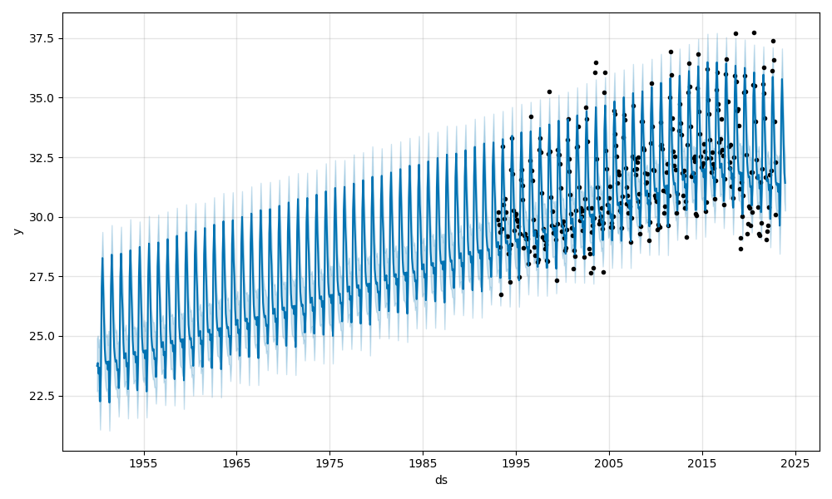

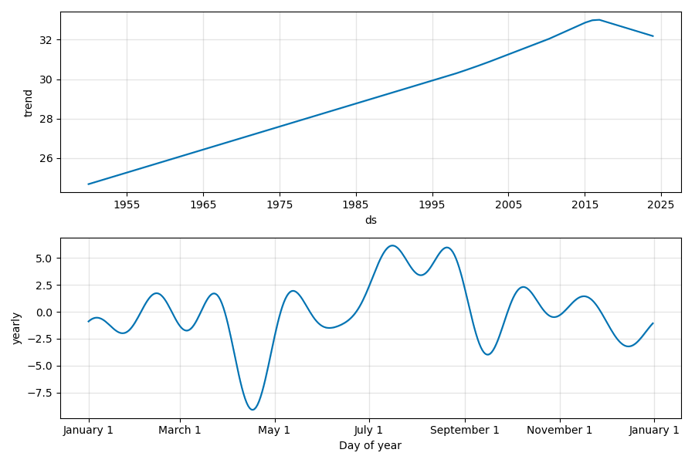
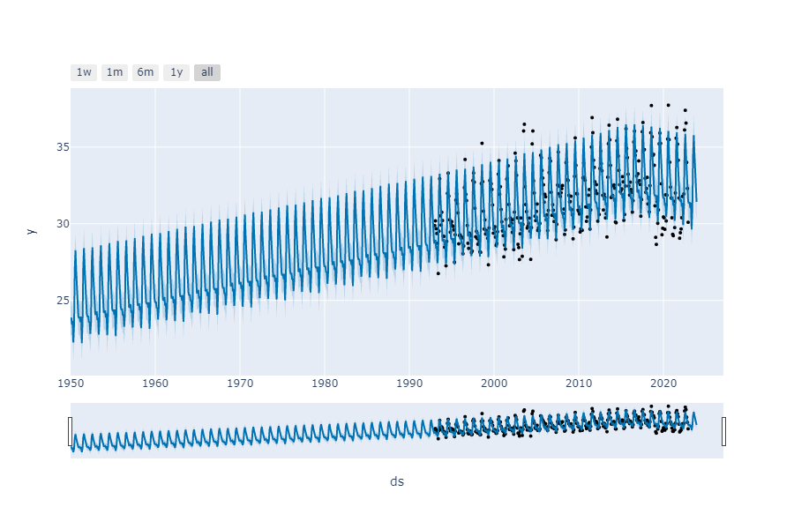
Additional Material

