Slide 1
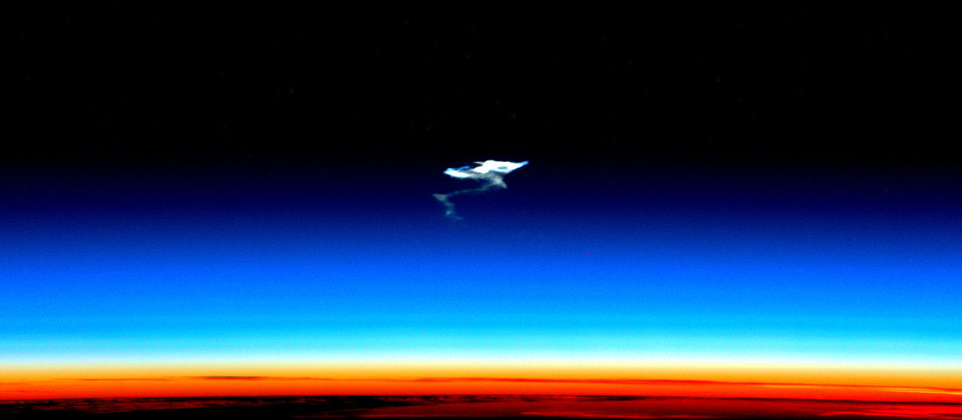





CAIRT AoA capability study
sarah.vervalcke@aeronomie.be
Quentin Errera, Florian Voet, Björn-Martin Sinnhuber, Michael Höpfner, Bernd Funke, Peter Preusse, and Alex Hoffmann

Slide 2
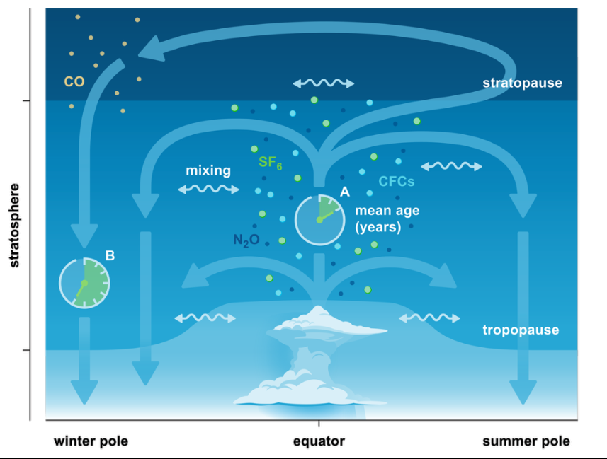
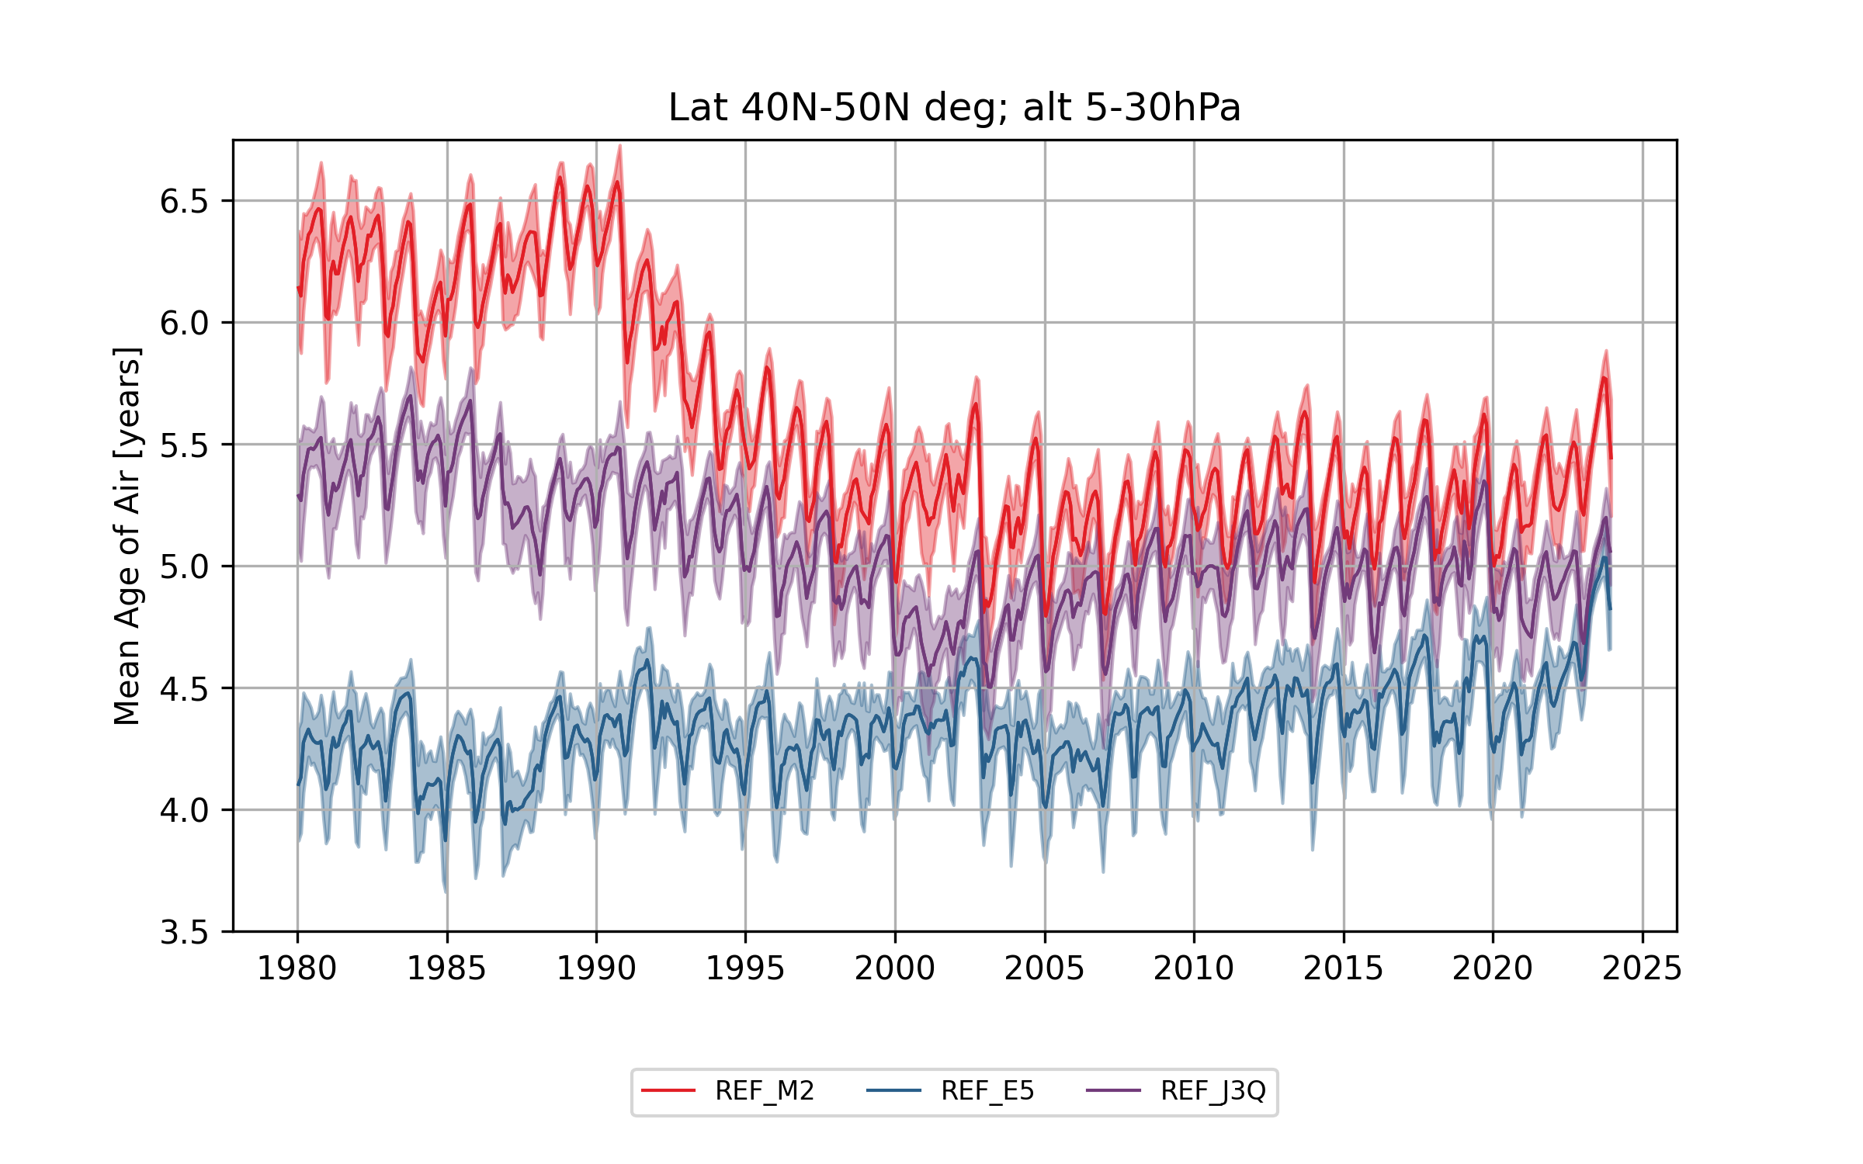
Accelerating stratospheric circulation
Age of air is a transit time scale from troposphere to stratosphere
Age of air trends used as a proxy for circulation changes
Differences in clock tracer age of air between reanalyses (MERRA-2, ERA-5, JRA-3Q)
ESA: Report for Mission Selection: Earth Explorer 11 Candidate Mission CAIRT, https://doi.org/10.5281/ZENODO.15606819, 2025.

Slide 3
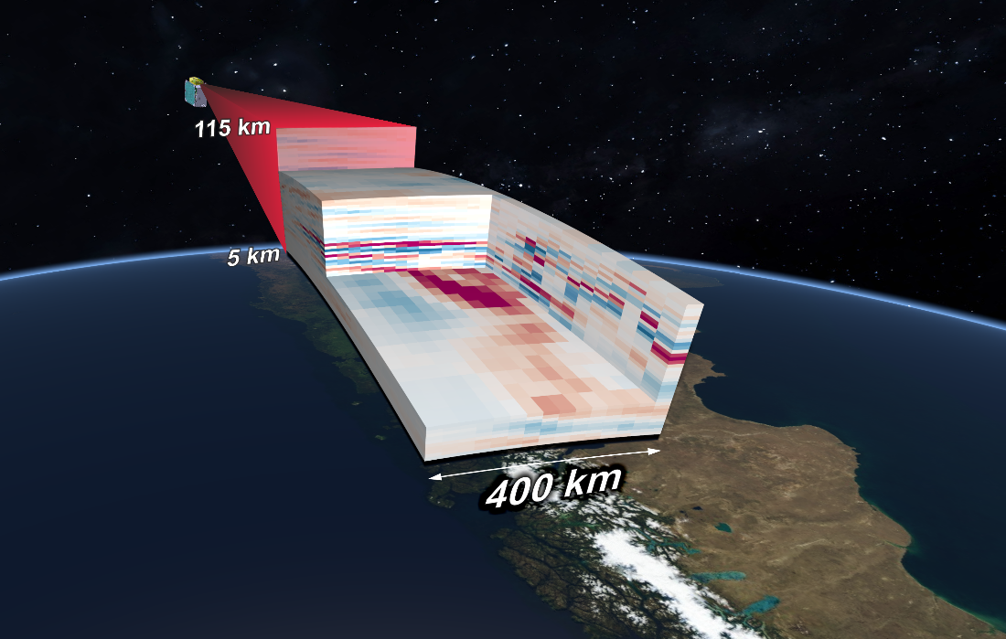
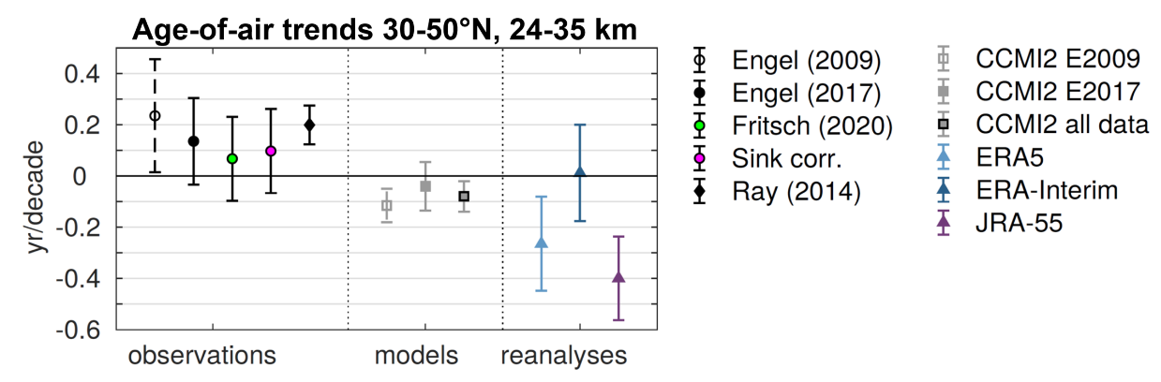
The Changing Atmosphere Infra-Red Tomography (CAIRT) Explorer
High resolution limb imager proposed for ESA’s Earth Explorer 11.
Measurement of long-lived trace gases:
SF₆, N₂O, CH₄, CFC-11, CFC-12, HCFC-22
used to compute age of air and diagnose stratospheric circulation.

Slide 4
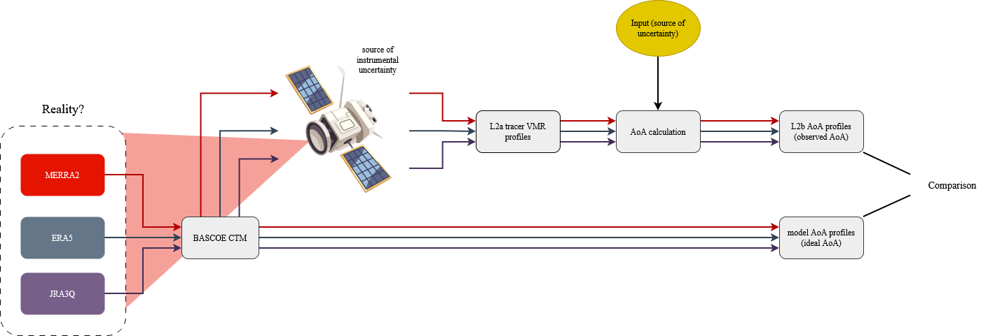
Comparing simulated multi-tracer CAIRT age of air to BASCOE clock tracer age of air
Mission objective: observe age of air profiles with uncertainty less than 0.5 years (or 0.25 years on zonal mean)
Can a CAIRT-like satellite reach the mission objective?
Can CAIRT observations be used to constrain reanalyses?

Slide 5
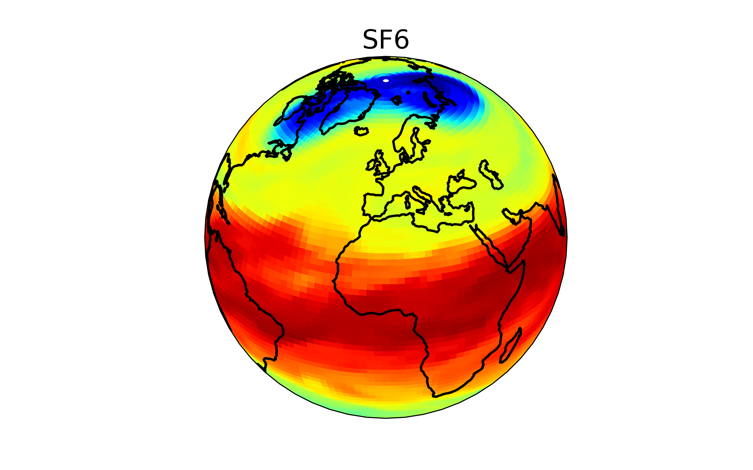
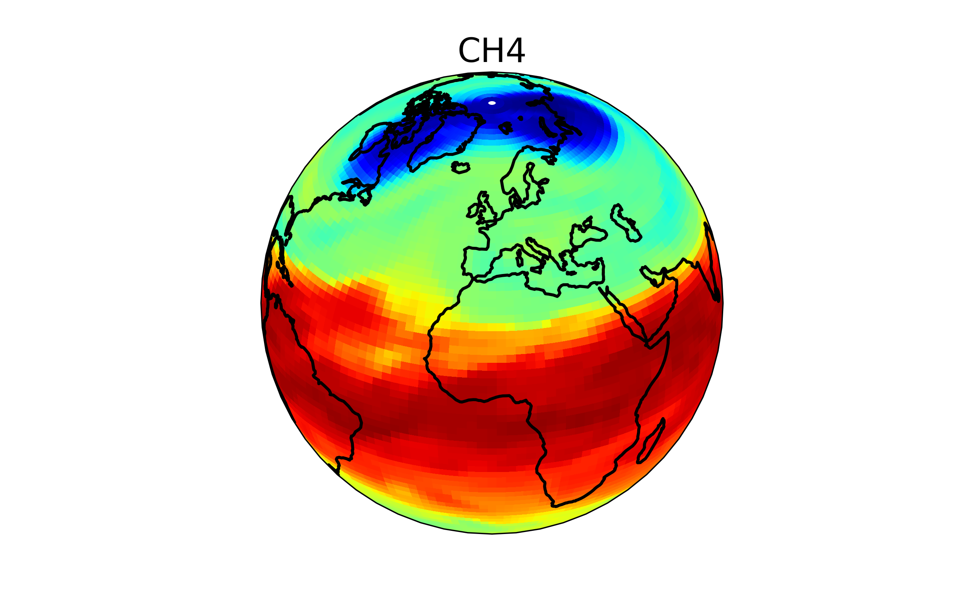
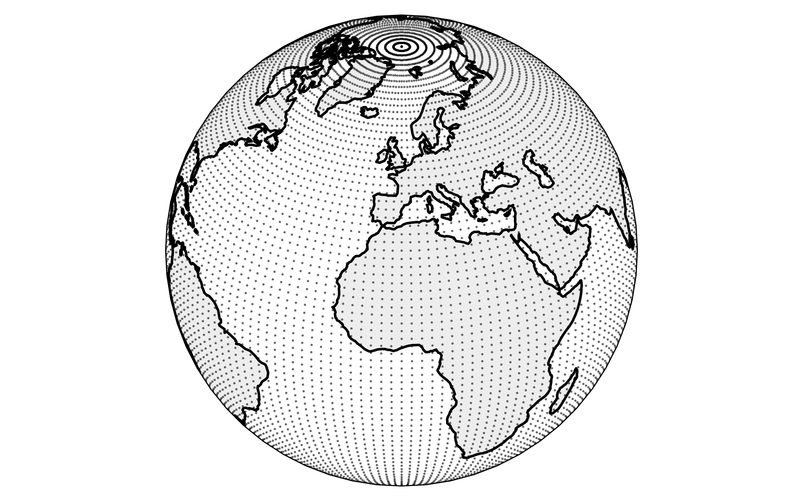
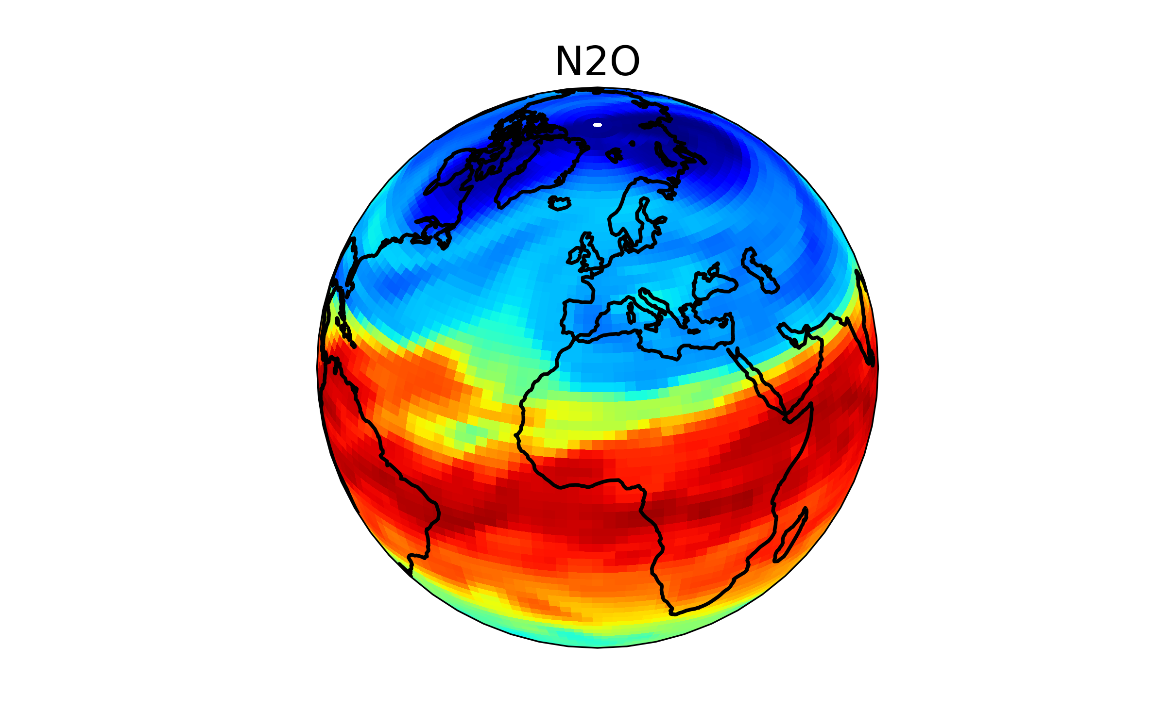
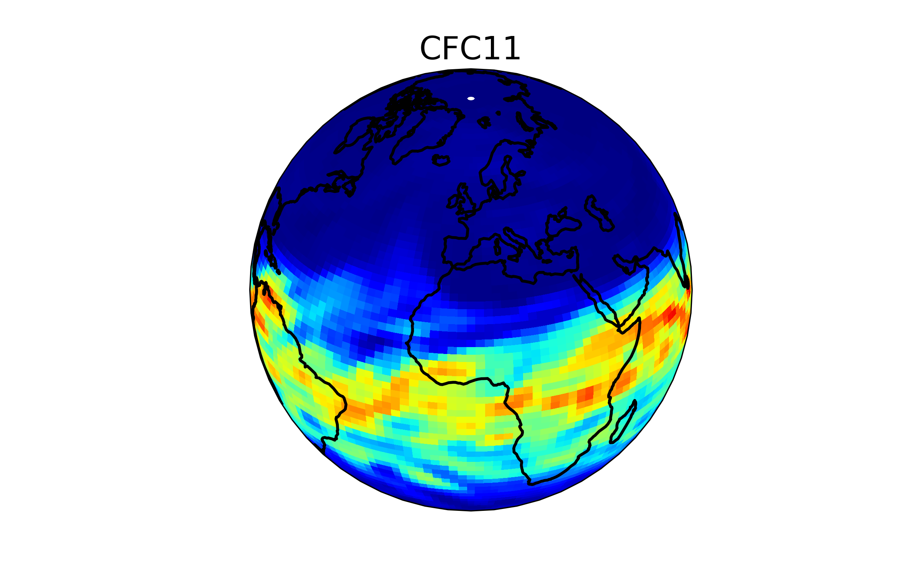
Belgian Assimilation System for Chemical ObsErvations (BASCOE)
3D CTM
INPUT
OUTPUT
Lin-Rood (1996) transport scheme
KPP chemical solver (200 chemical eq., 60+ chemical species)
Winds and temperature
(meteorological reanalysis:
ERA-5, MERRA-2, JRA-3Q)
Volume mixing ratios of trace gases
3x
Initial conditions
Model at observation
geolocations
Boundary conditions
(Meinshausen et al., 2017, Gidden et al. 2019)
Observation locations
3x
Clock tracer & AoA

Slide 6
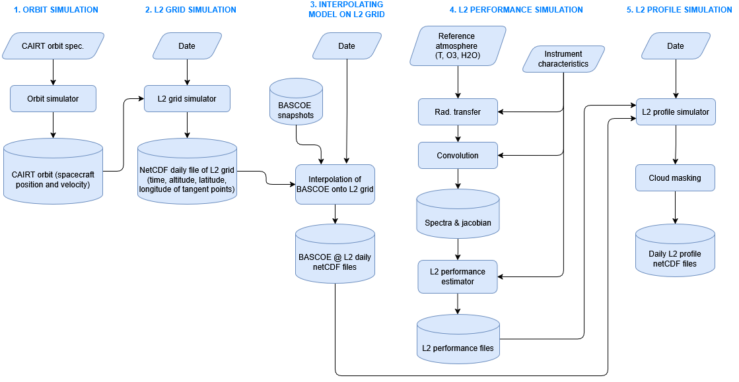
Simulated level-2a CAIRT data
Errera et al., GMT, 2026;
Funke et al. 2026 (in preparation)

Slide 7
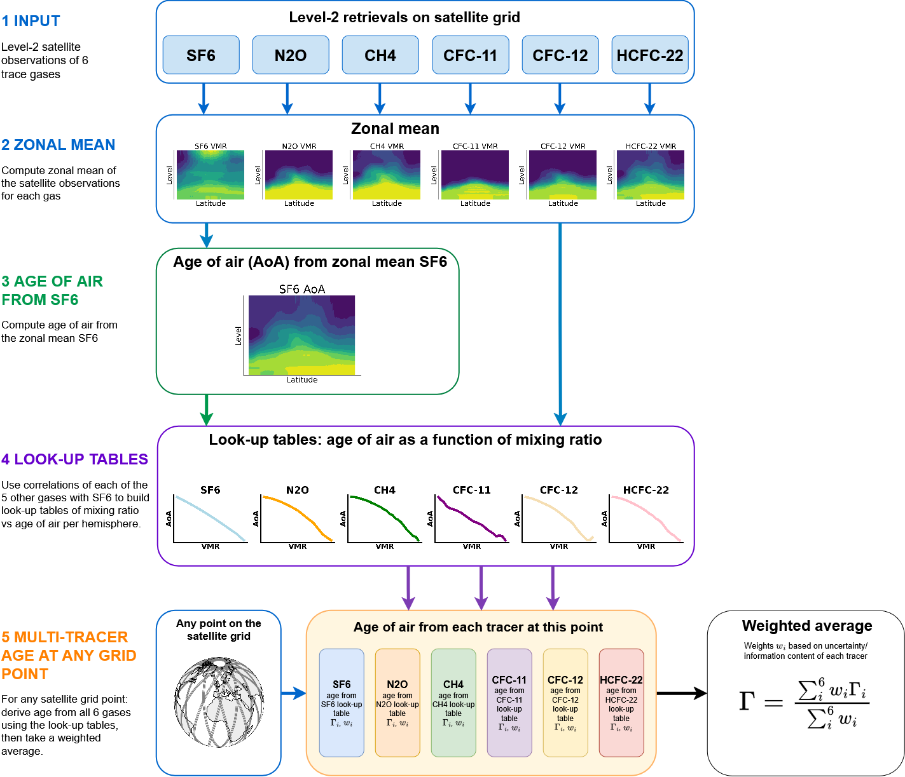
Multi-tracer AoA (Voet et al. 2025)
Used for satellite level-2b retrieval.
Still based on SF₆ AoA!

Slide 8
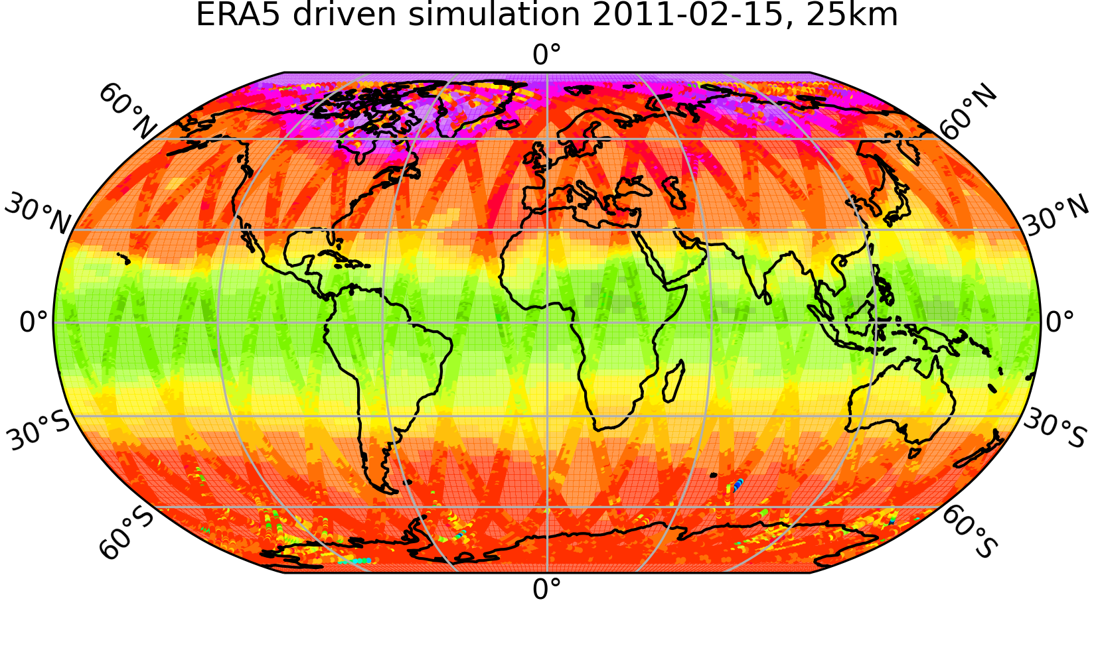
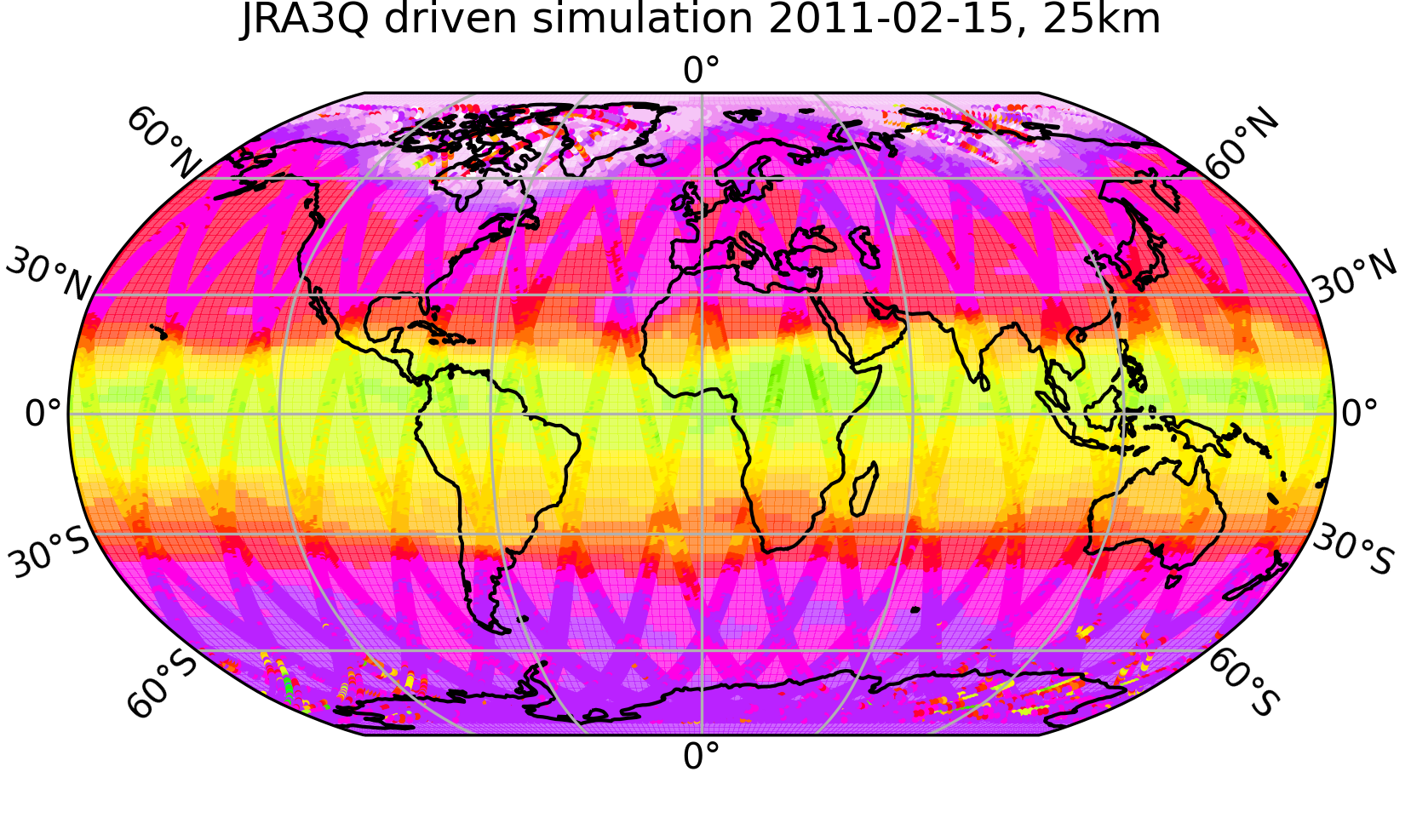
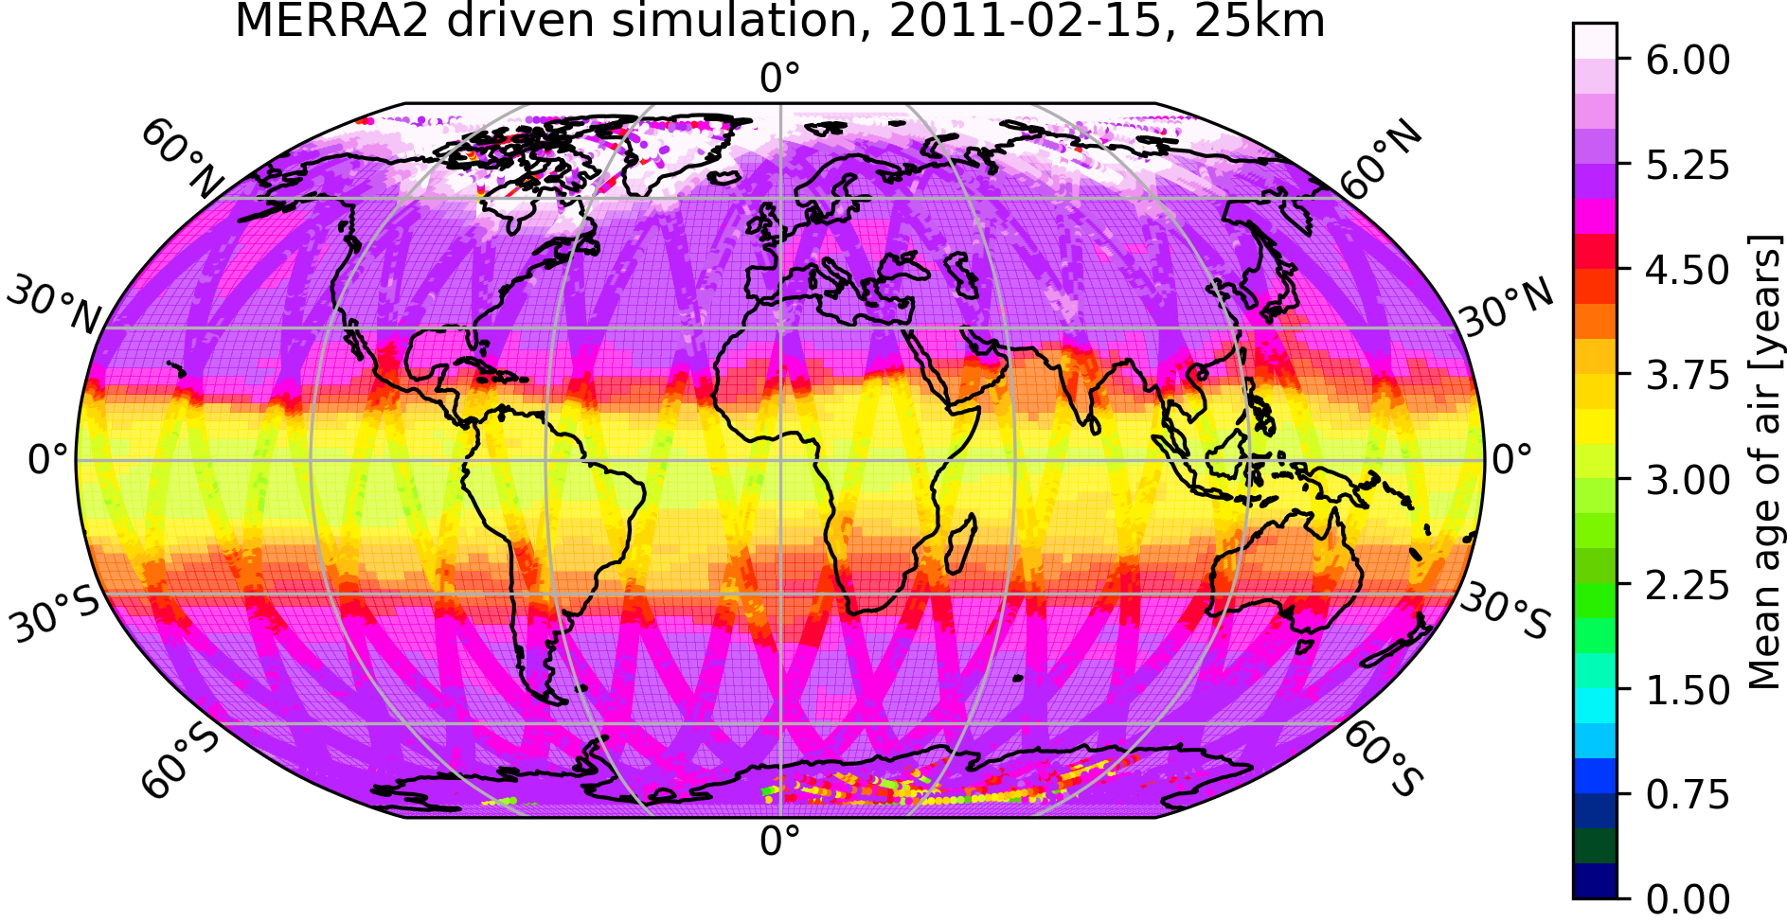
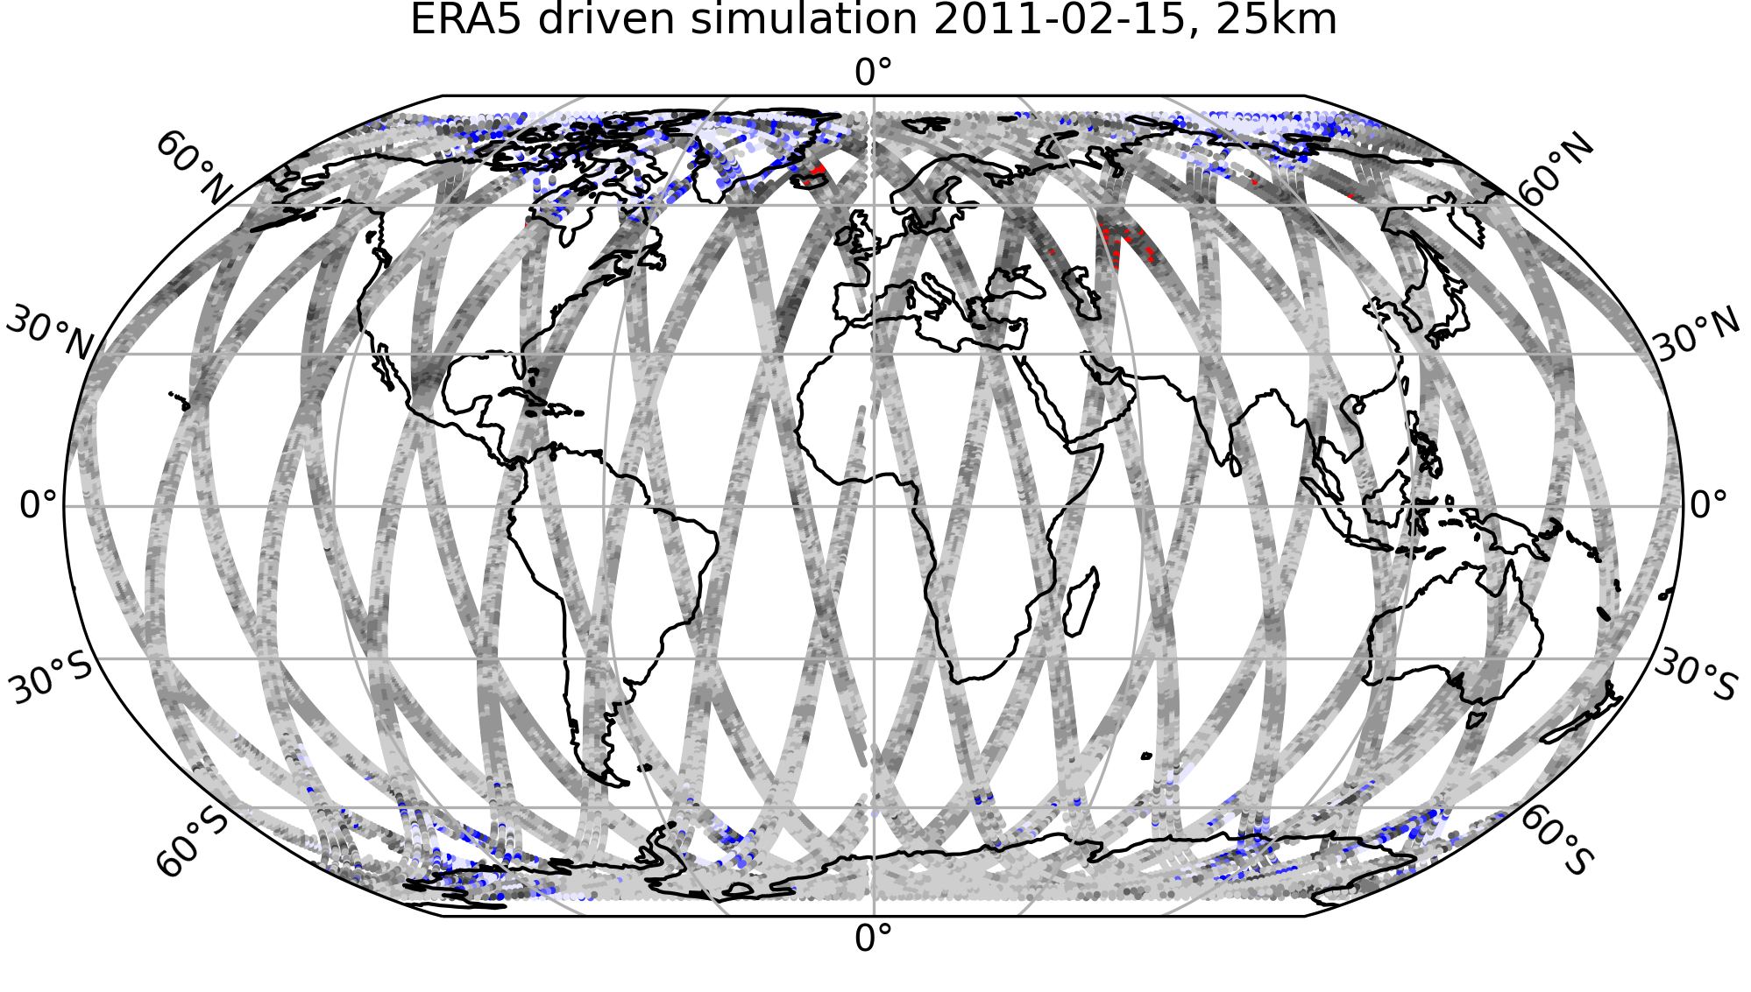
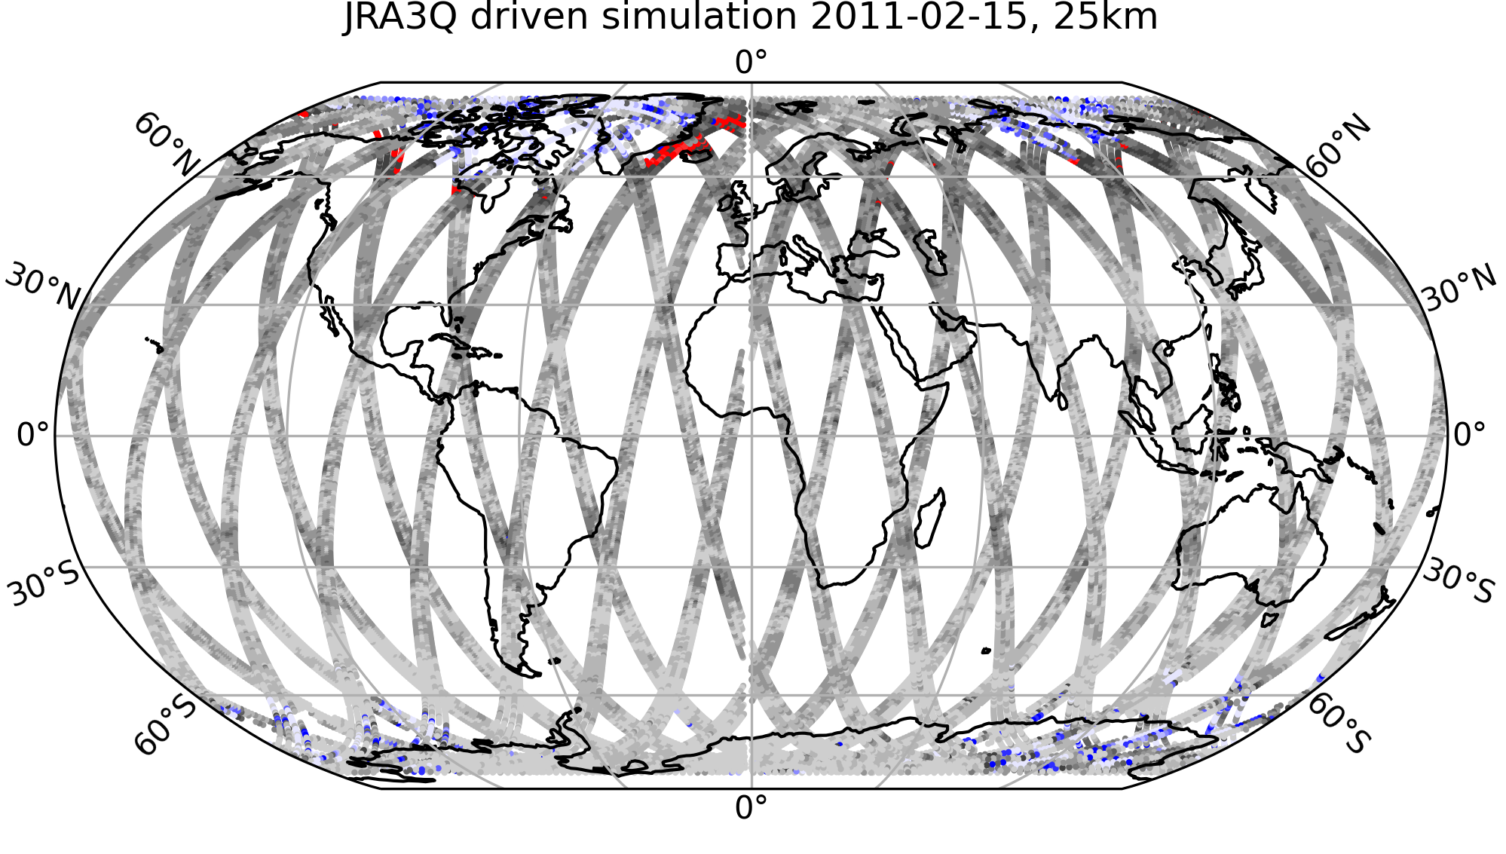
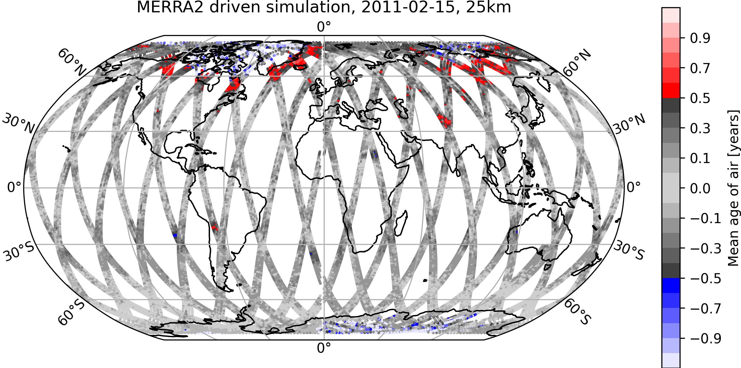
Simulated CAIRT multi-tracer AoA at 25 km
Difference between simulated daily averaged CAIRT AoA at 25 km on 2011-02-15, derived from different driving reanalysis data sets, and the clock tracer AoA from a simulation driven by the same reanalyses.

Slide 9
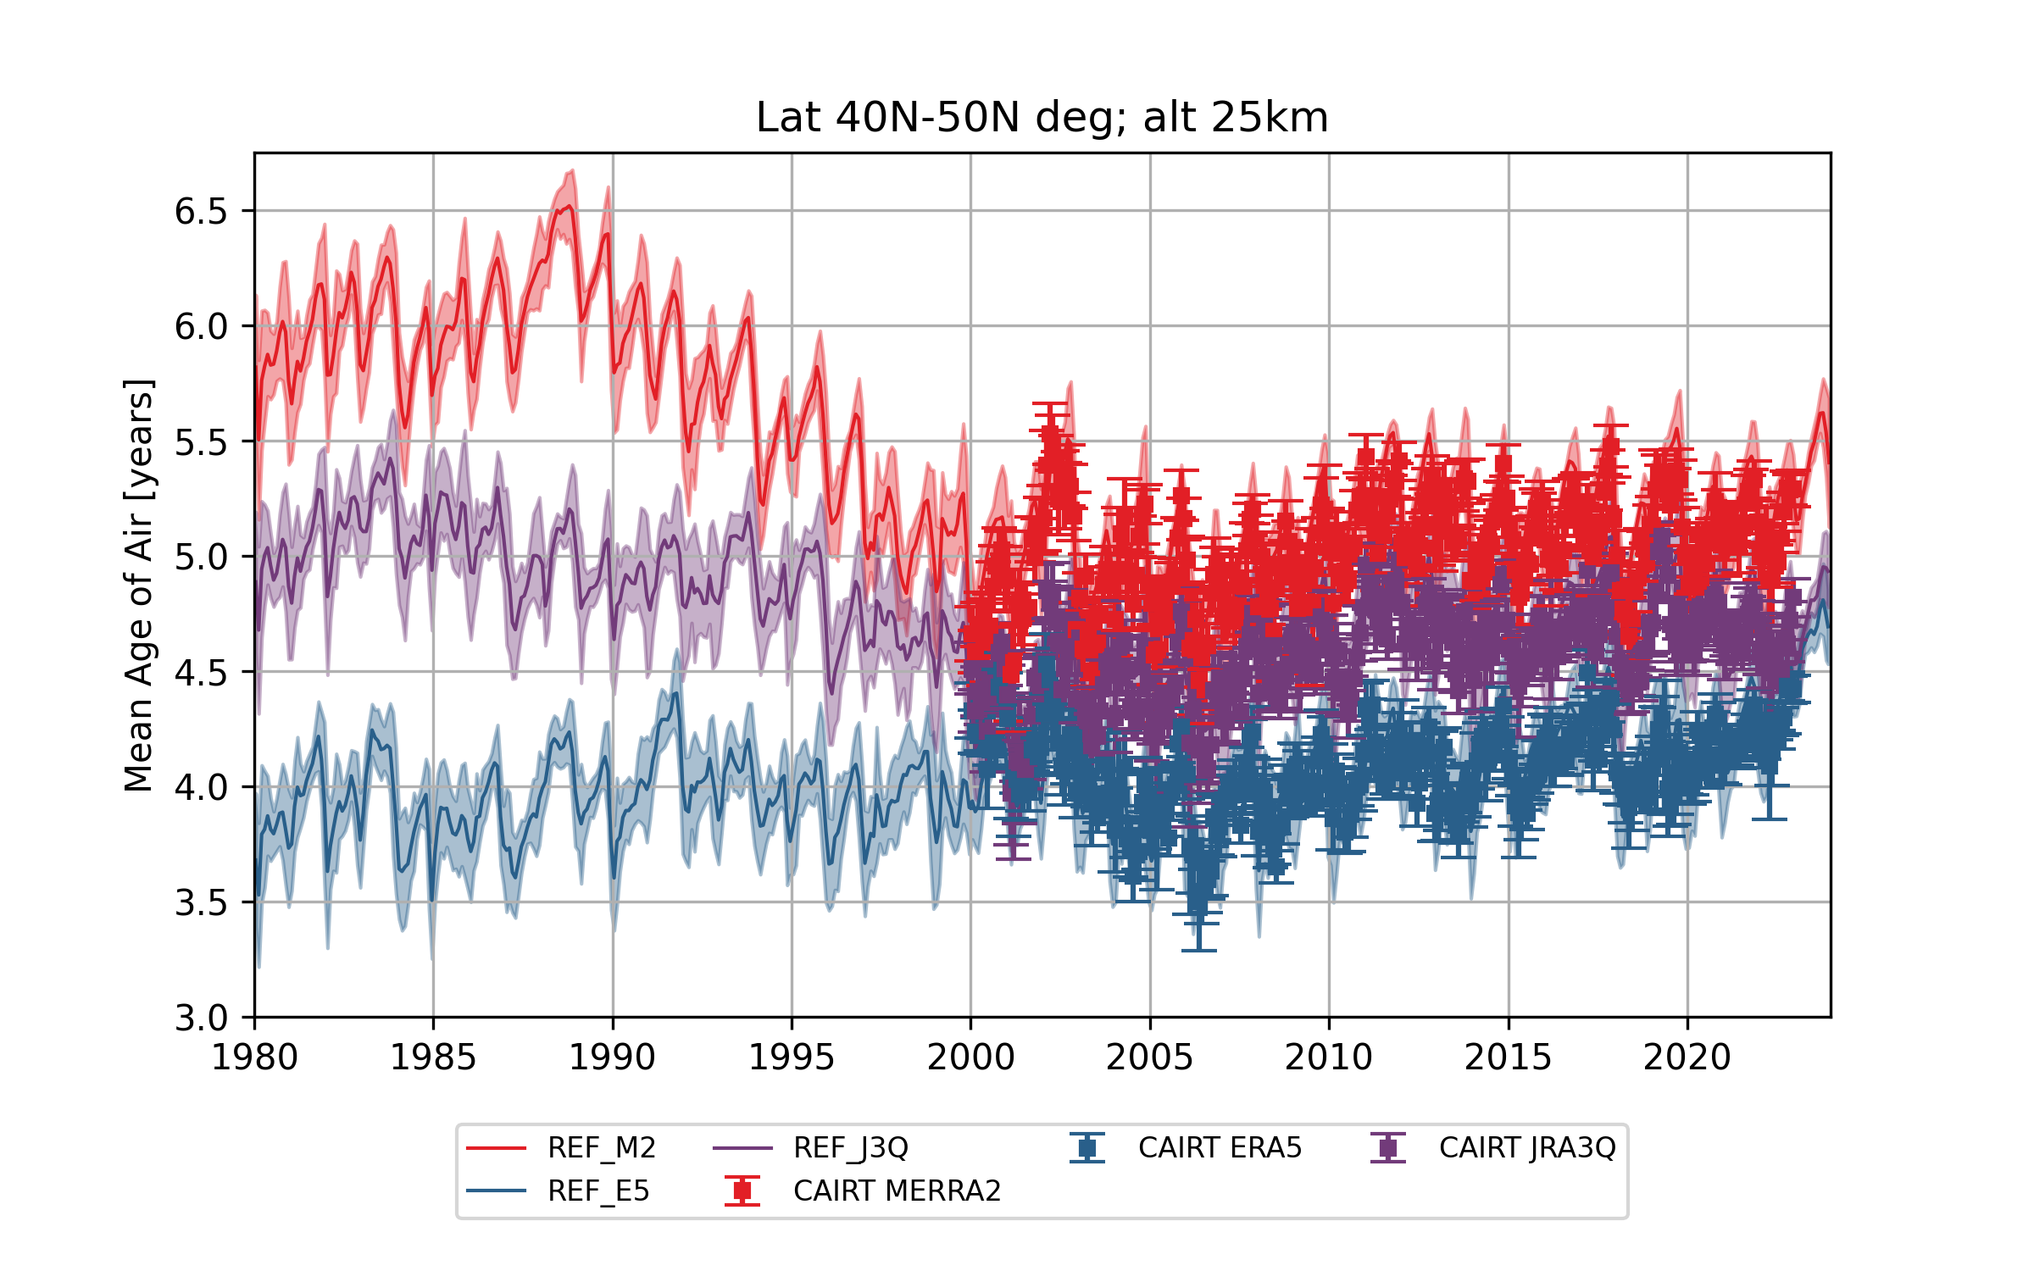
More than 20 years of data processed
mzm clock AoA
Daily CAIRT AoA
mzm clock AoA
Daily CAIRT AoA
mzm clock AoA
Daily CAIRT AoA

Slide 10
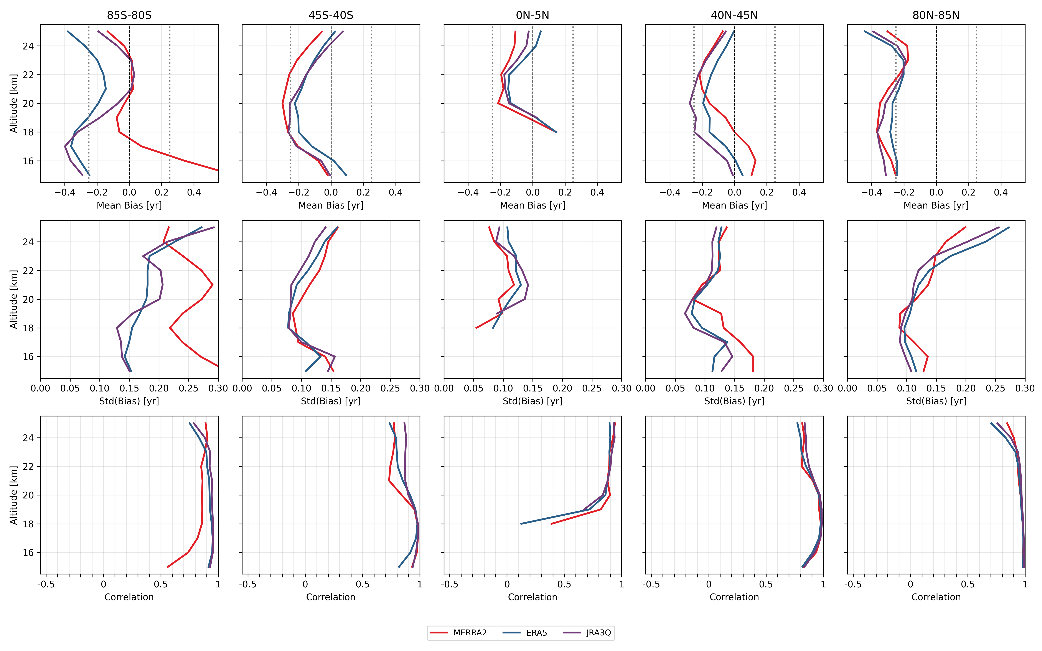

Slide 11
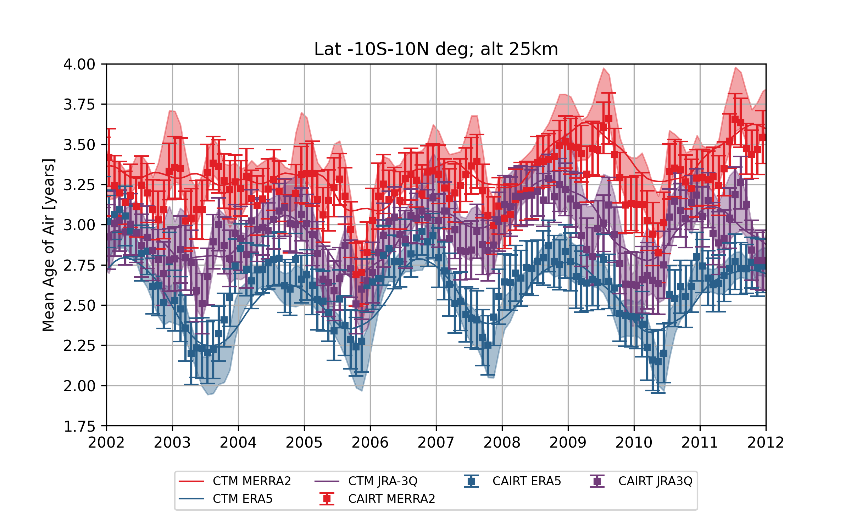
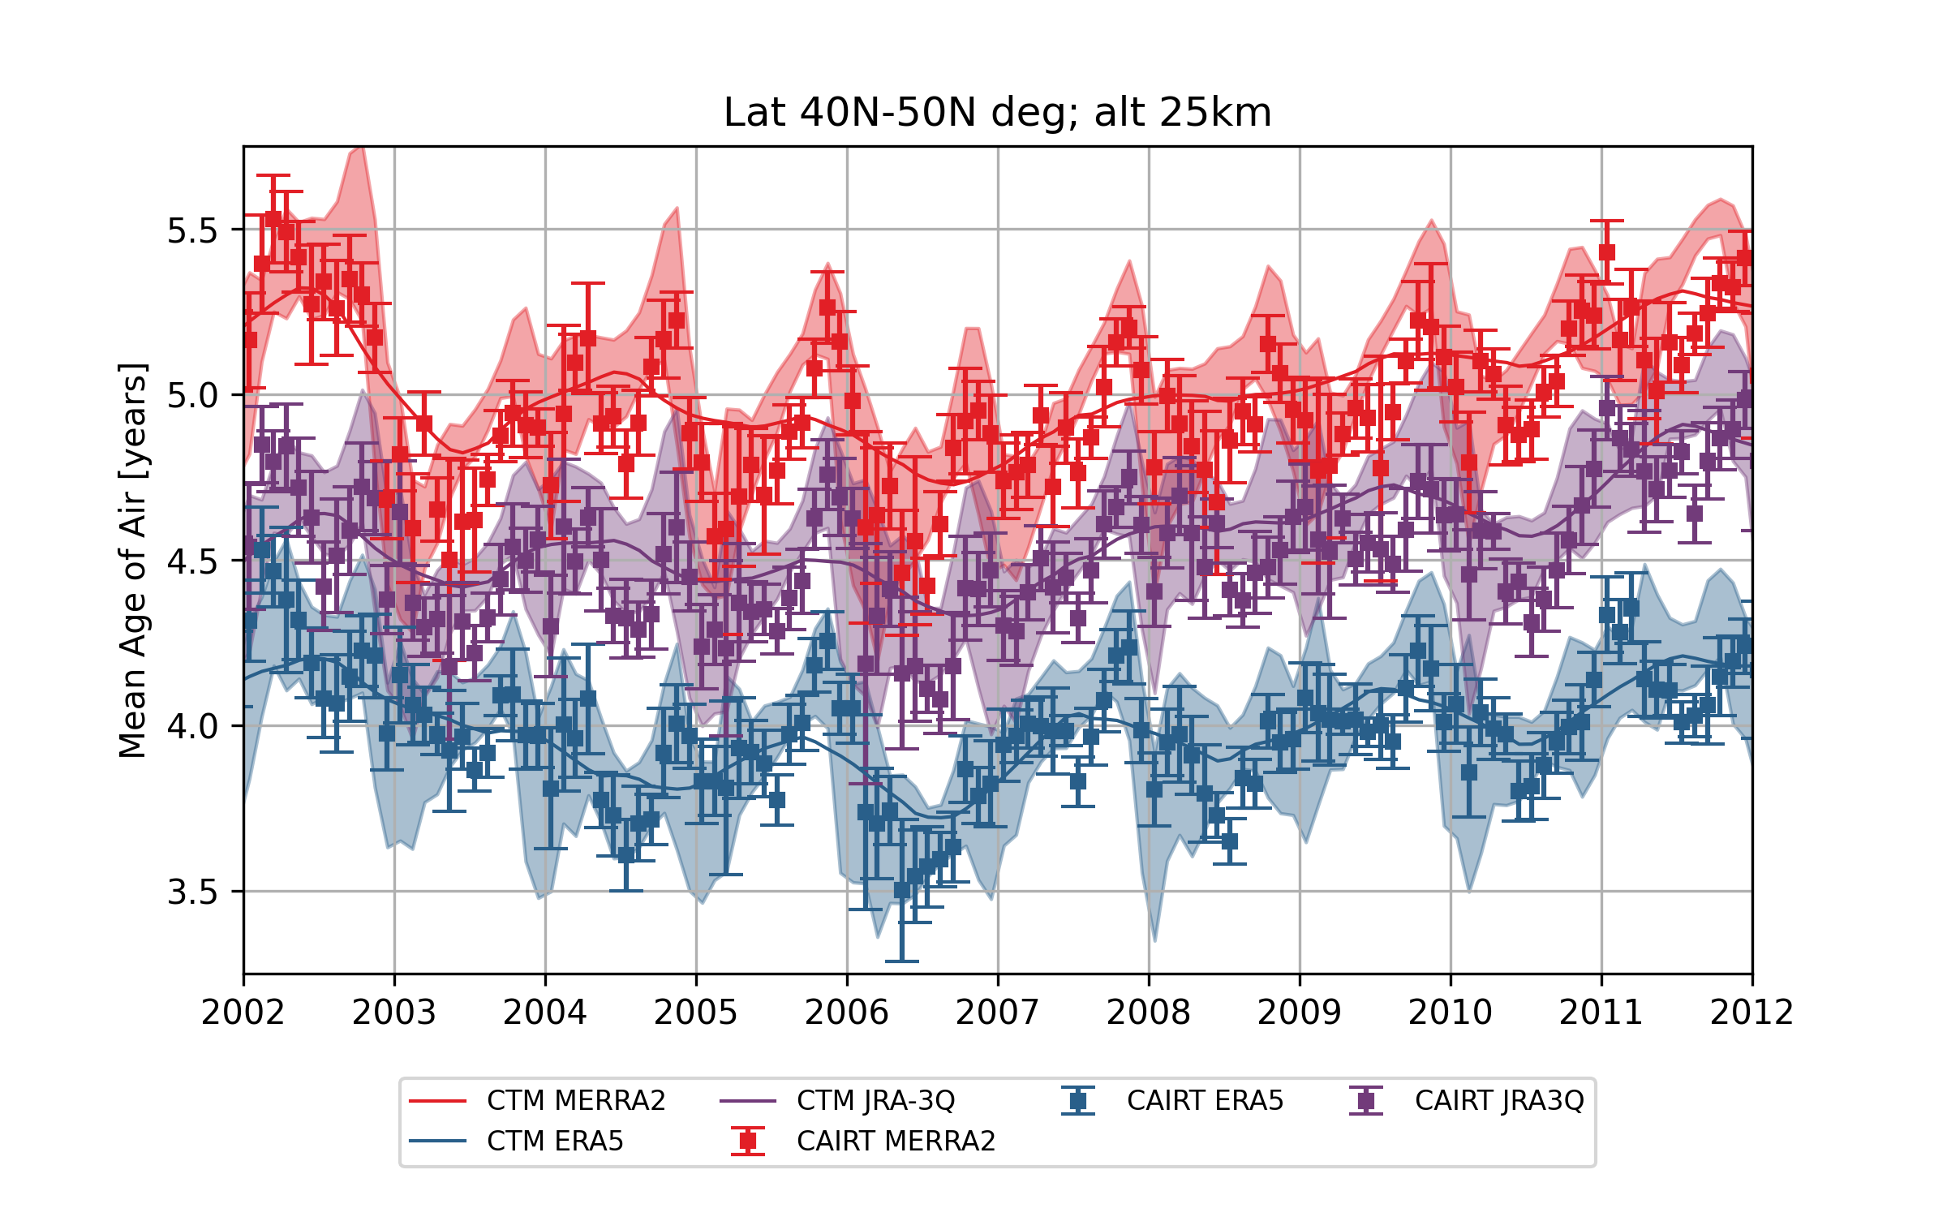
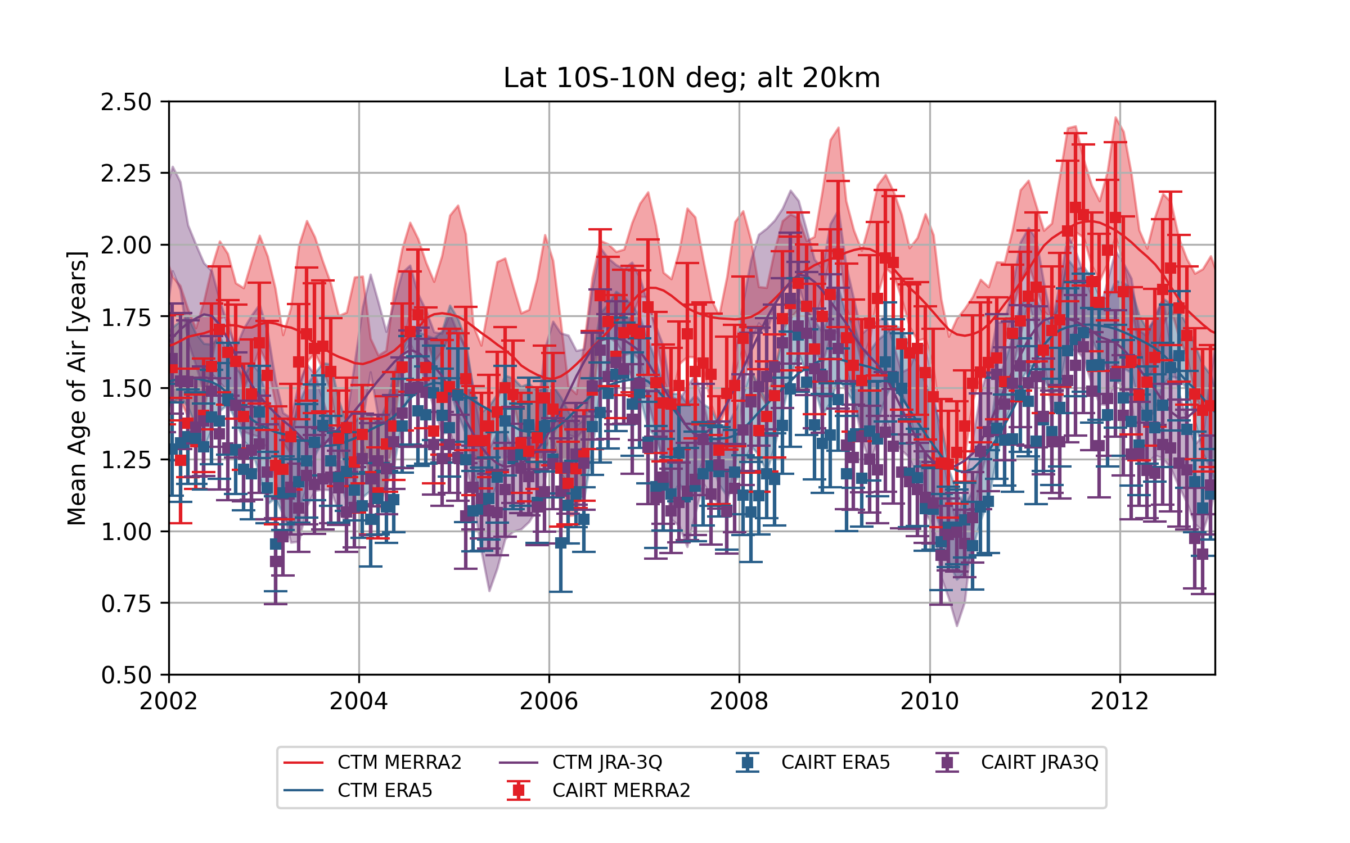
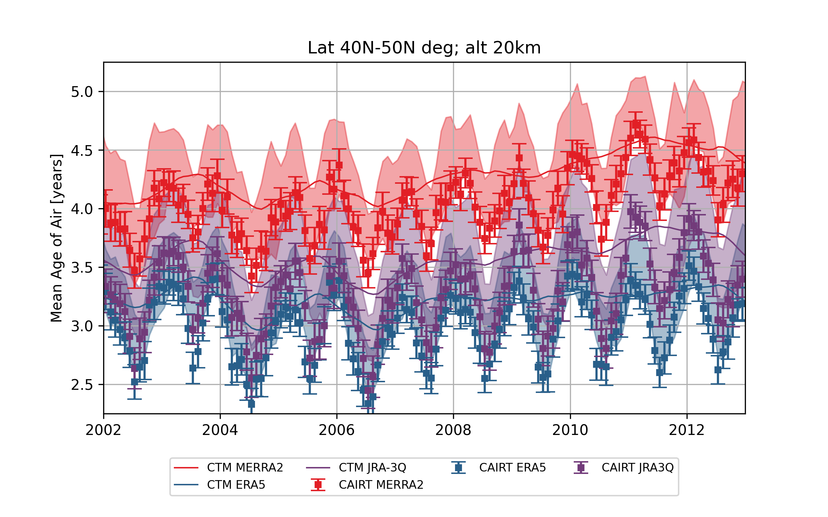
Can we distinguish the reanalyses?
25 km
20 km

Slide 12
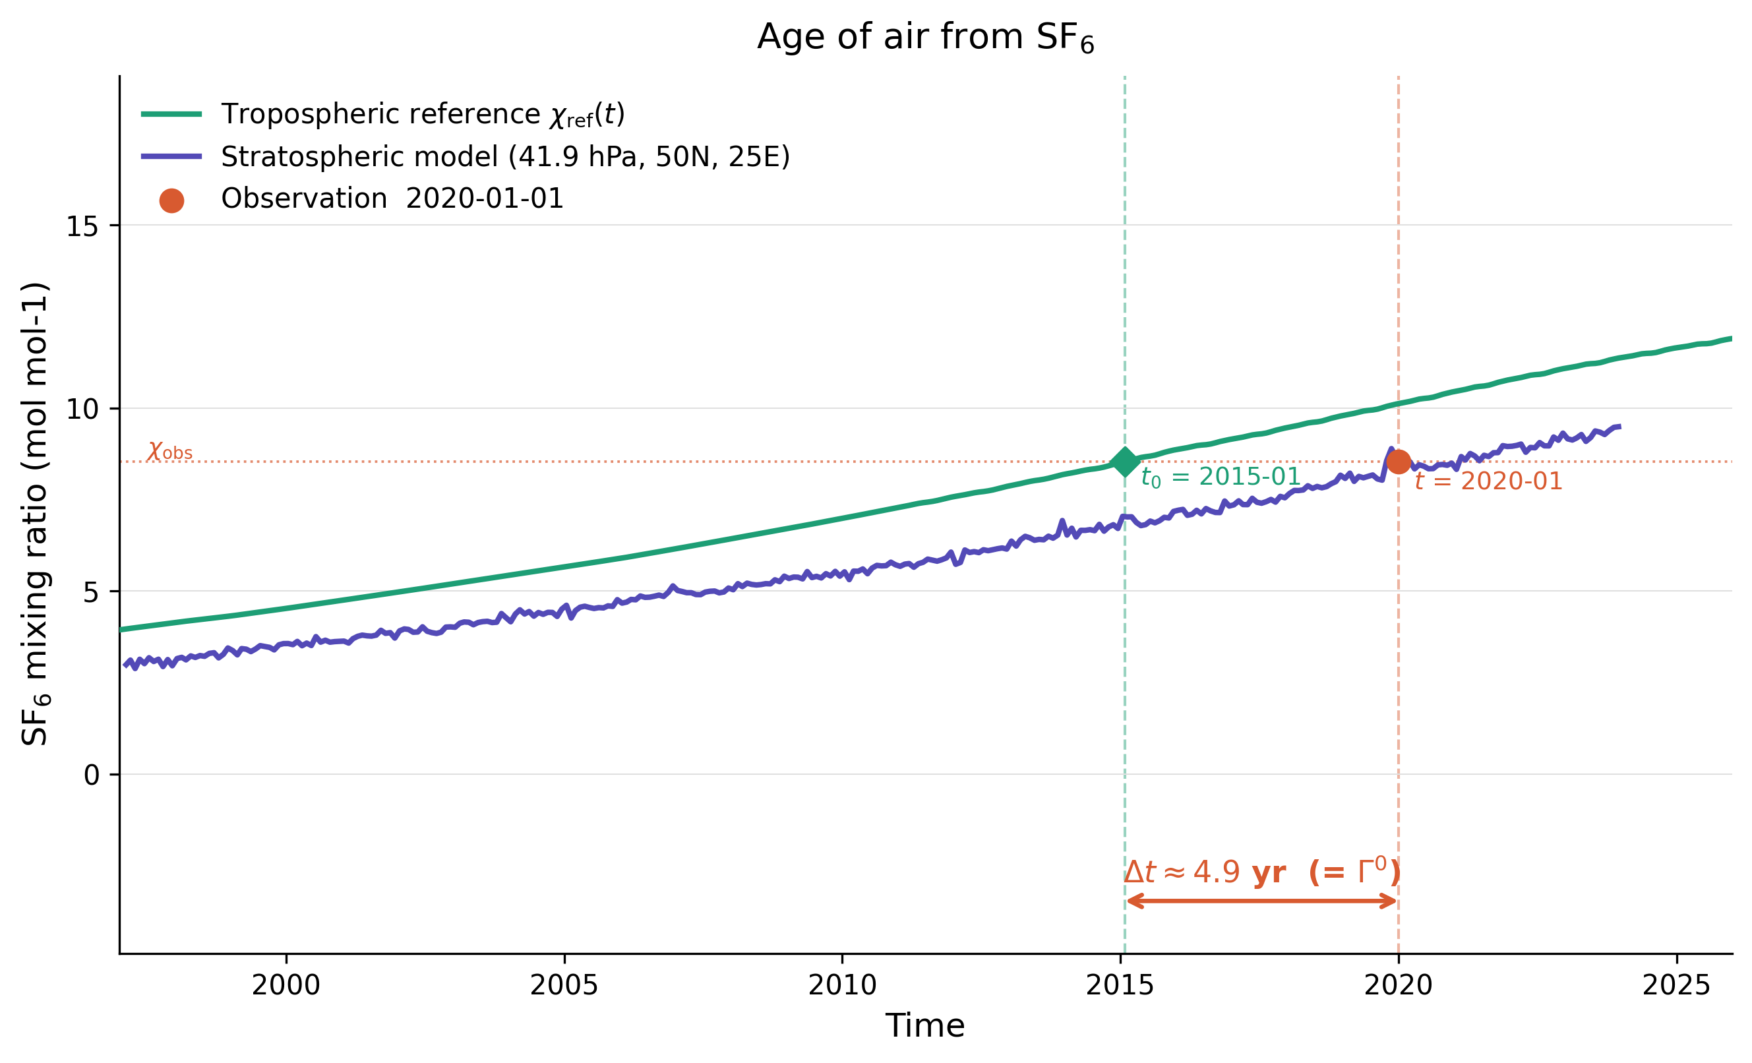
Mean age of air from SF₆
Multi-tracer method is based on SF₆ AoA
Age of air is computed relative to a reference in the troposphere.
Average of the concentrations at the lower boundary of BASCOE in the tropics (7.5°S-7.5°N)
Can be any reference time series

Slide 13
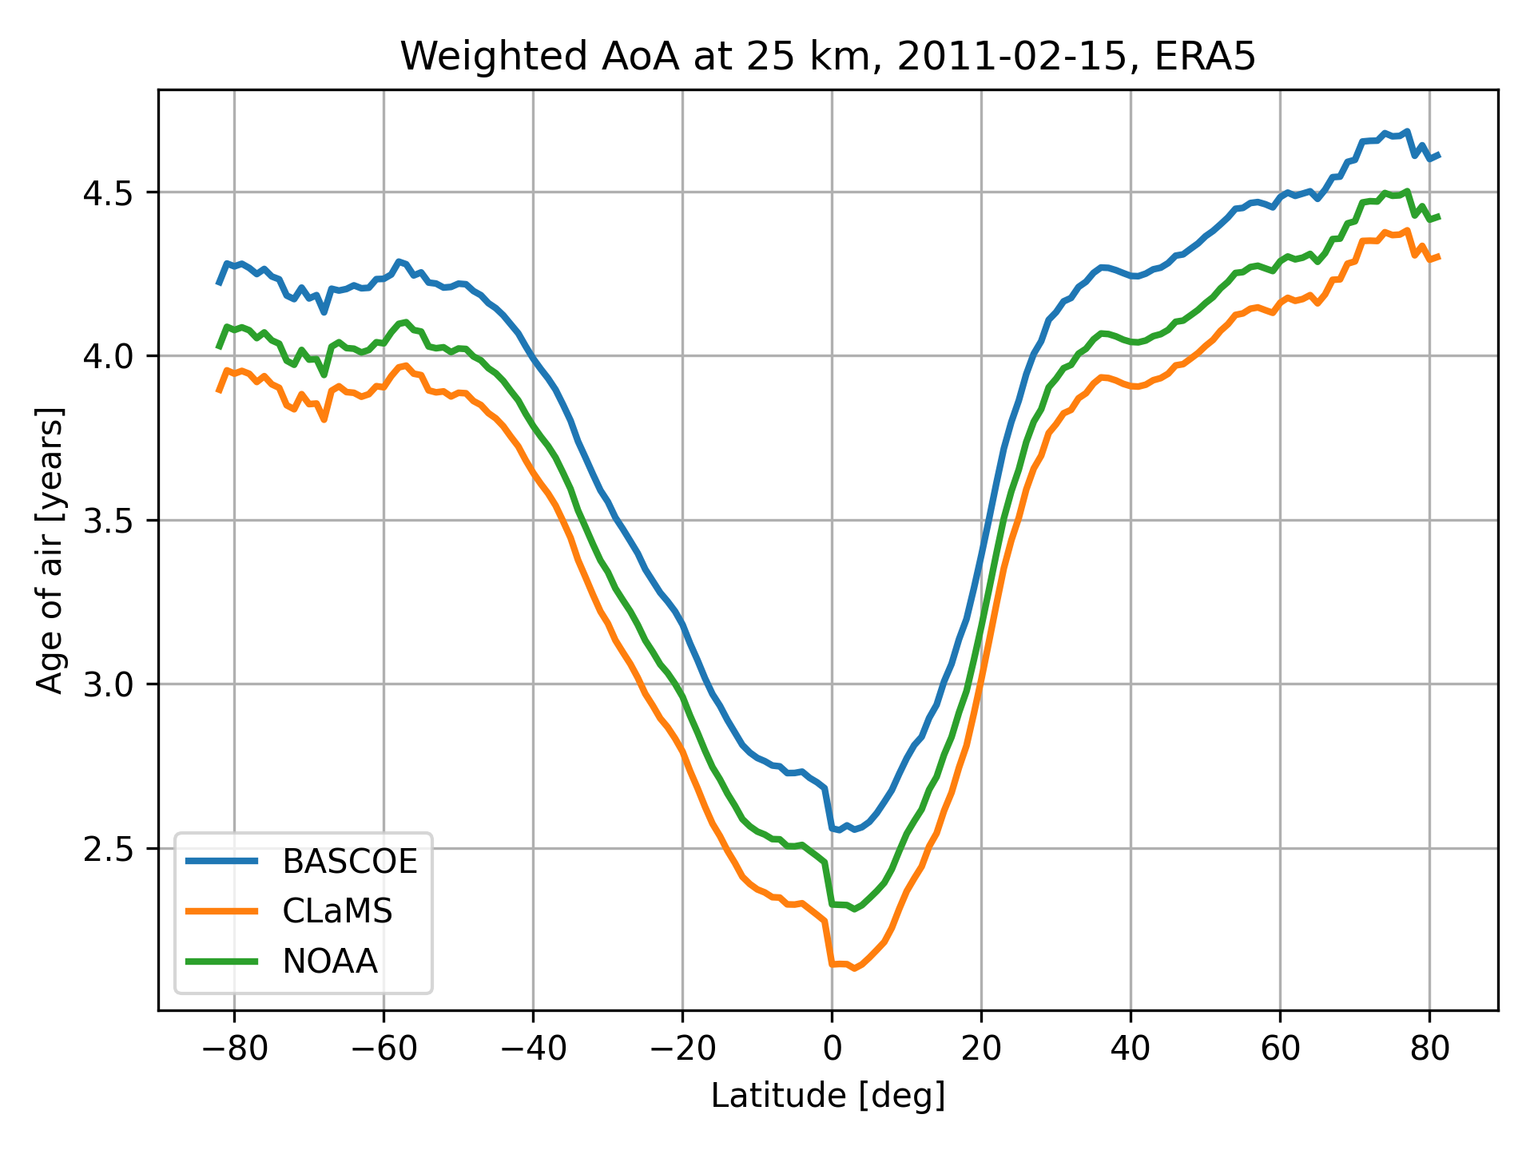
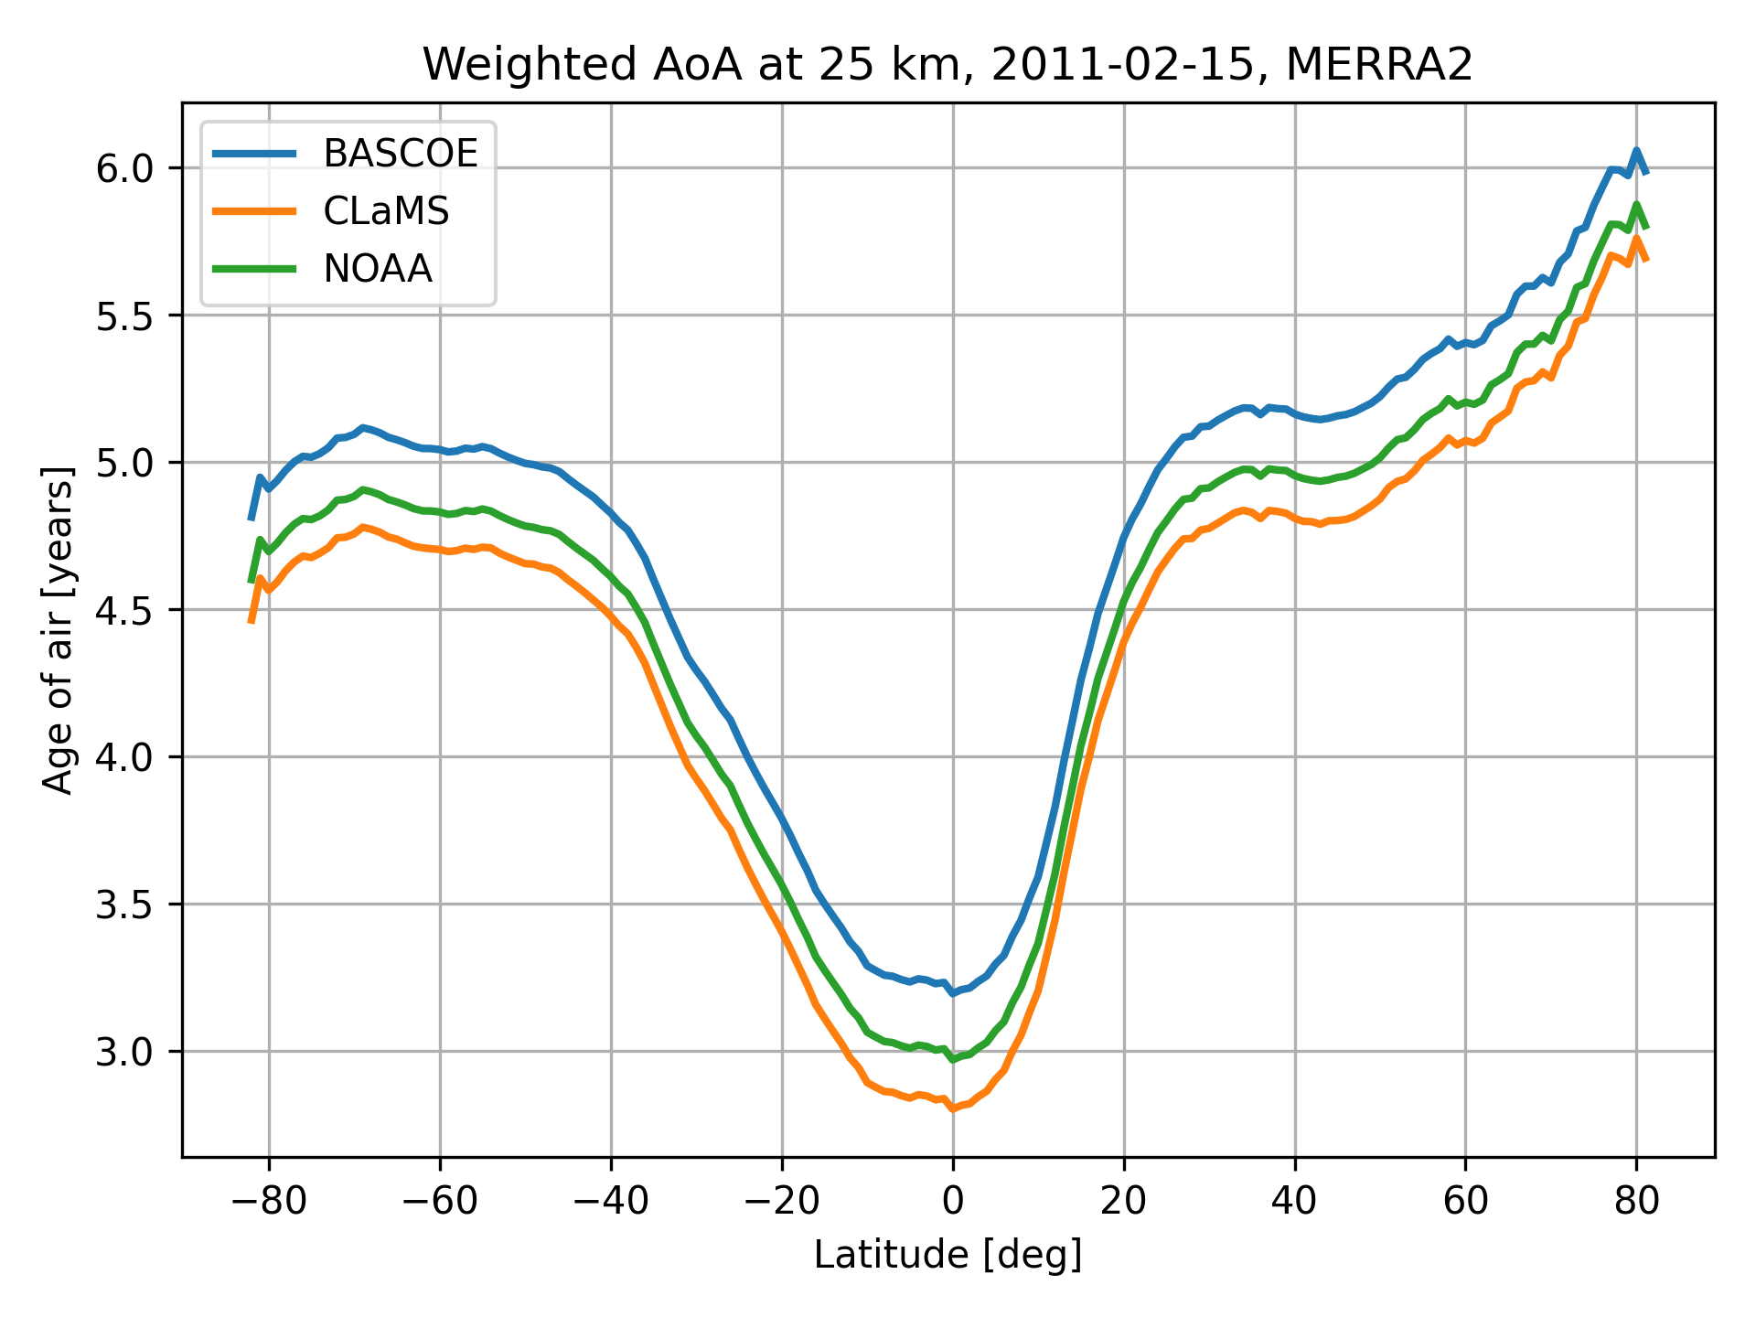
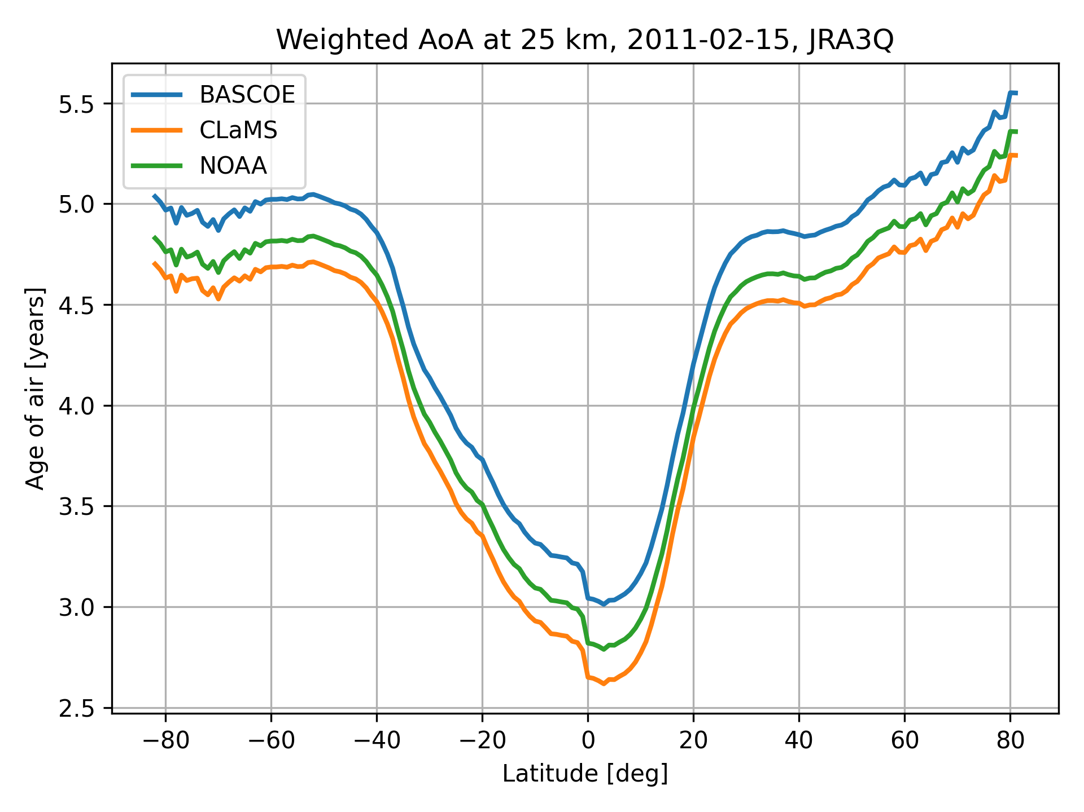
Choice of tropospheric reference time series
Zonal mean SF₆ AoA at 25 km computed using different tropospheric reference time series.
Weighted multi-tracer AoA is derived from SF₆ AoA using multi-tracer method (Voet et al. 2025)
BASCOE uses CMIP6 recommendations as boundary conditions for SF₆. Reference = average between 7.5S-7.5N.
NOAA reference is made up of flask and in-situ observations.
CLaMS (Chemical Lagrangian Model of the Stratosphere) boundary tropical VMR time series.

Slide 14
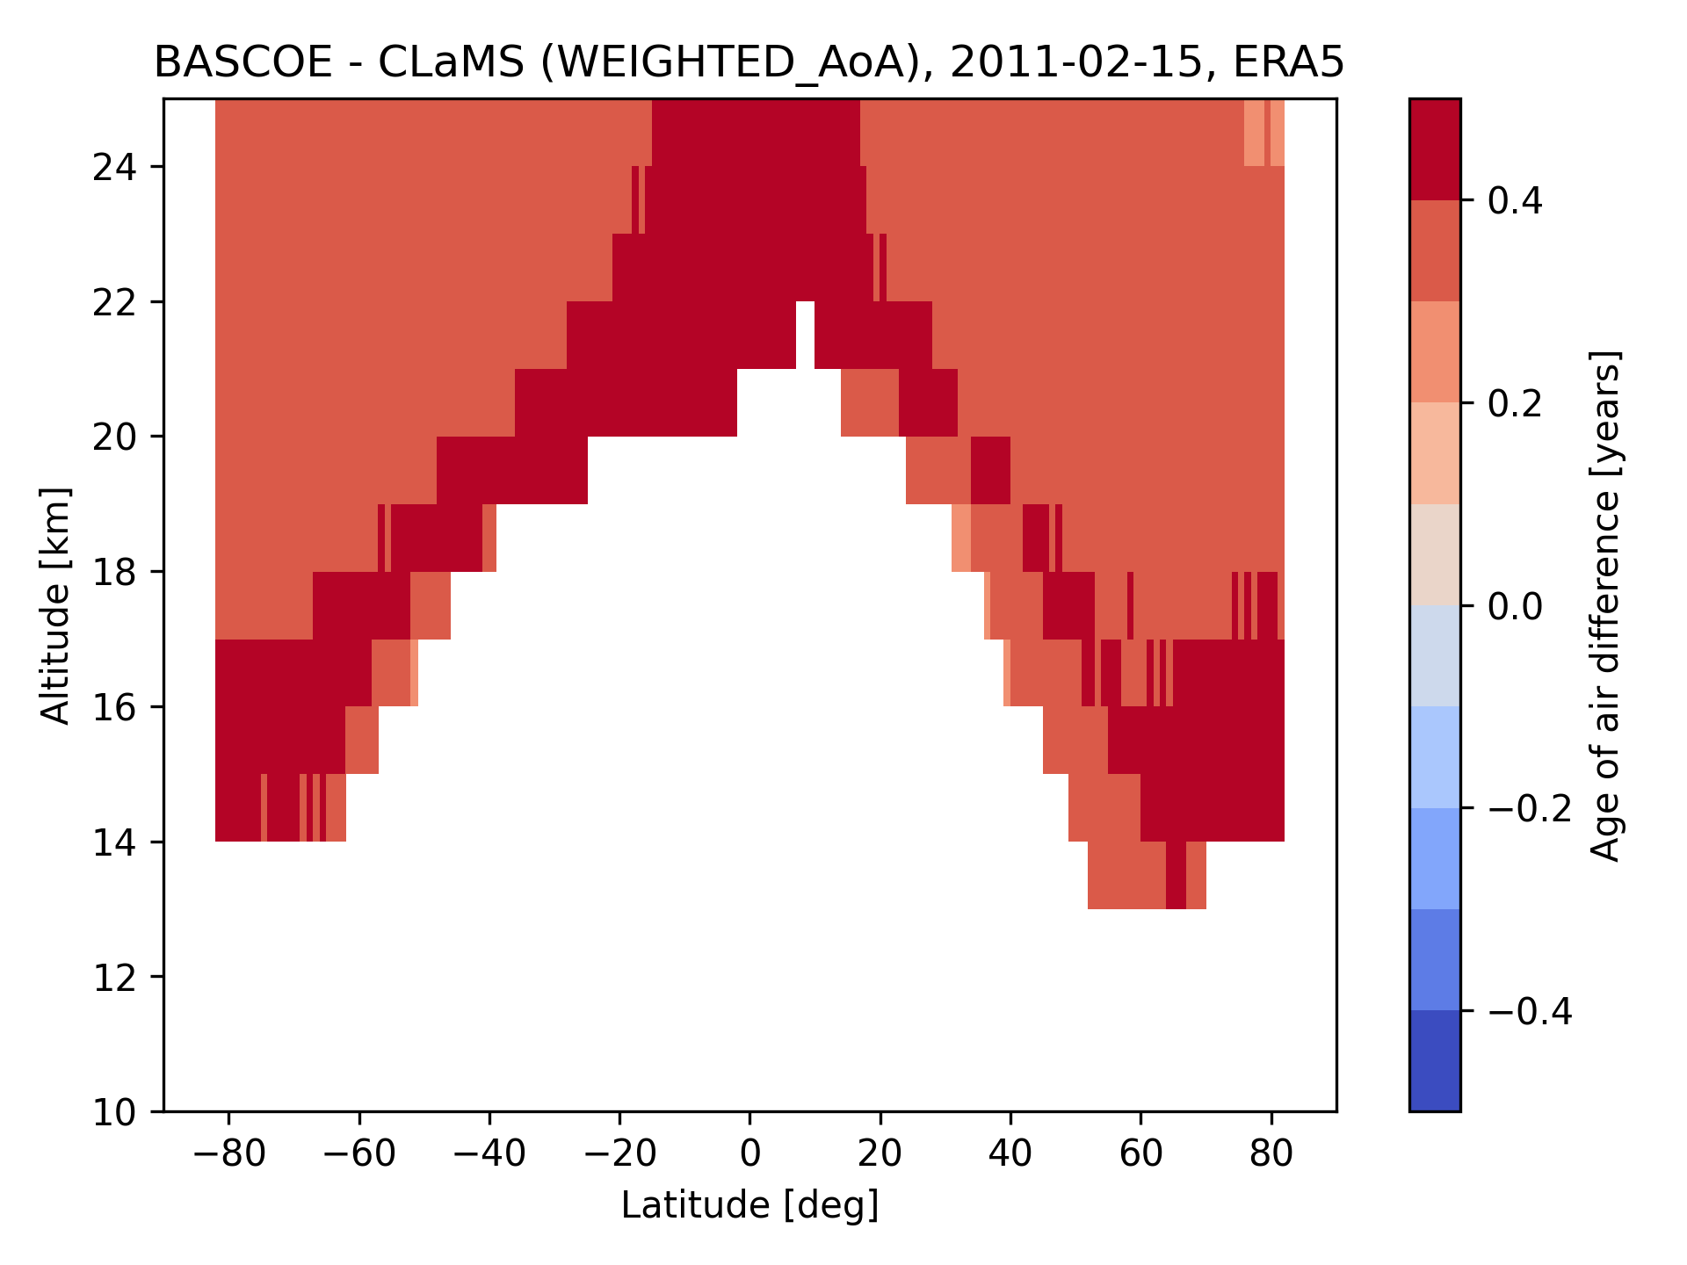
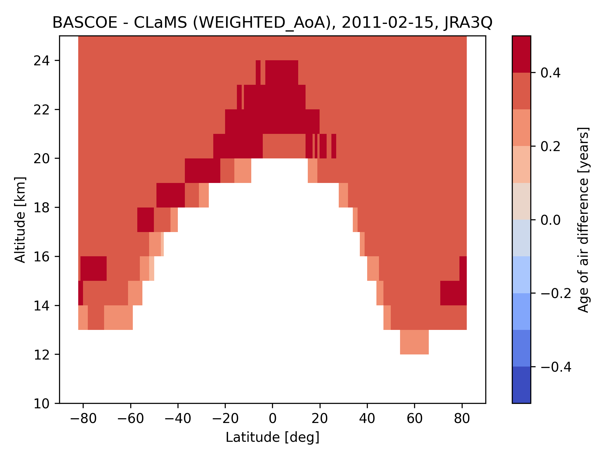
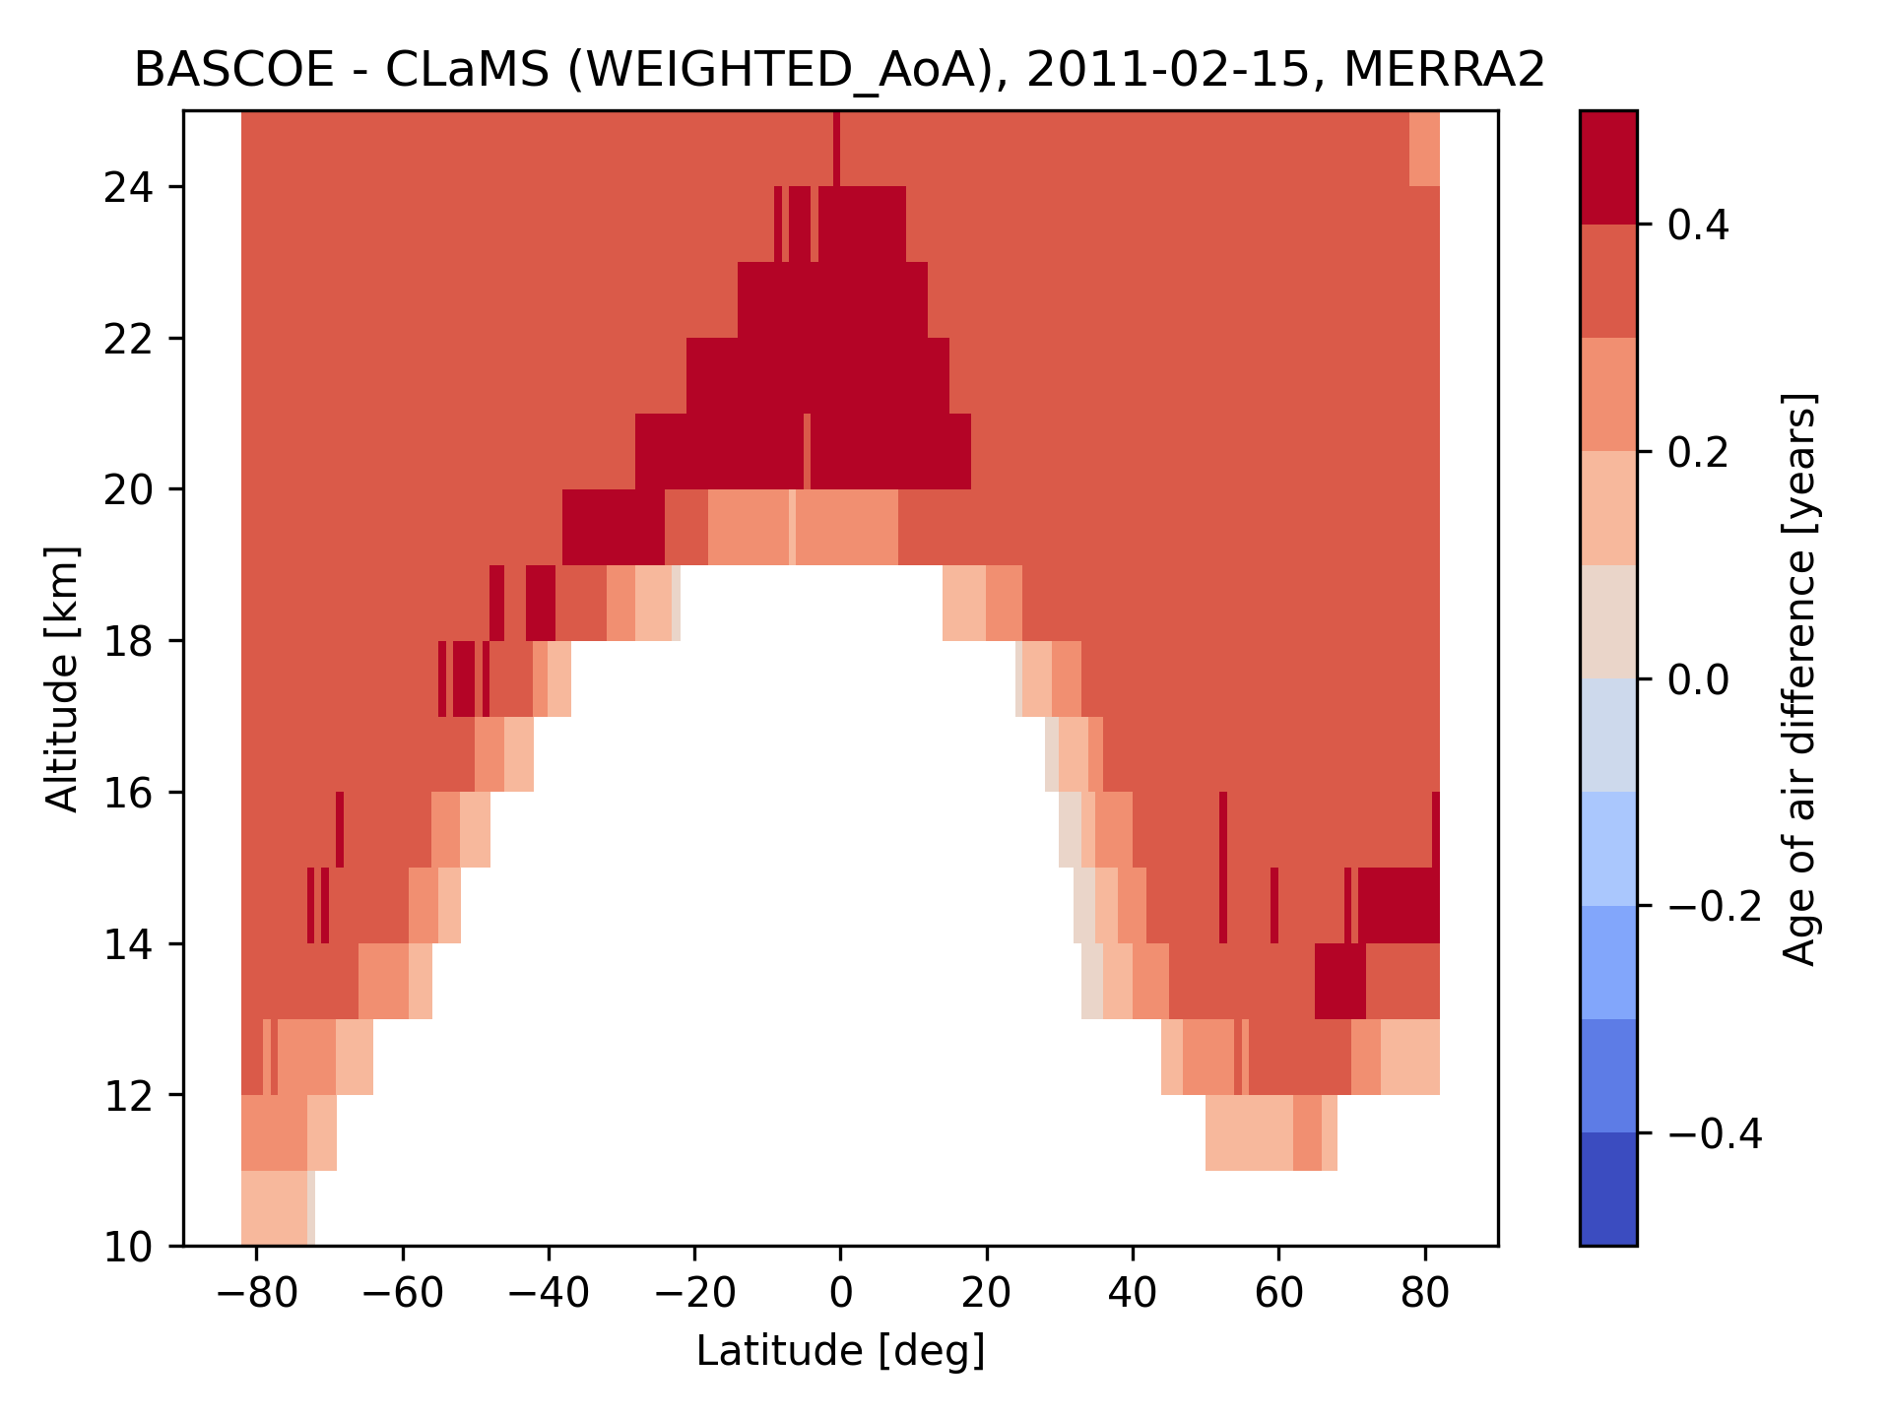
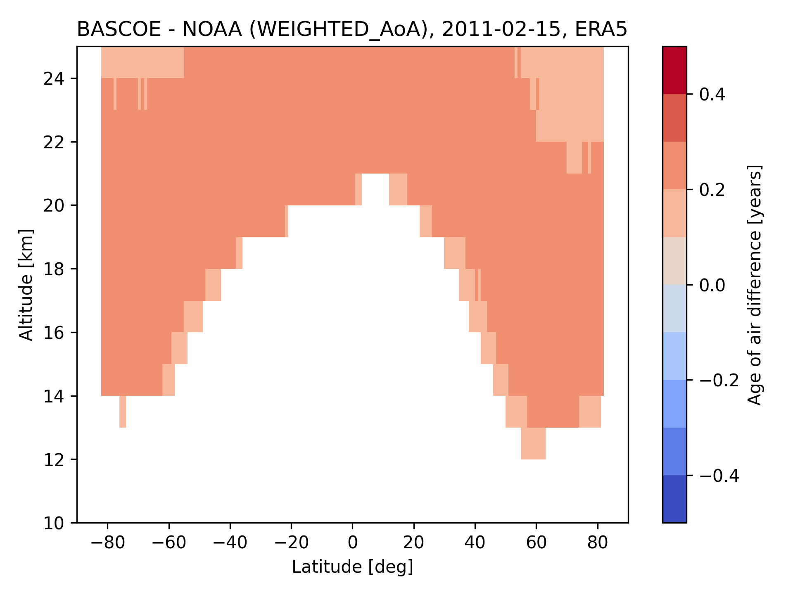
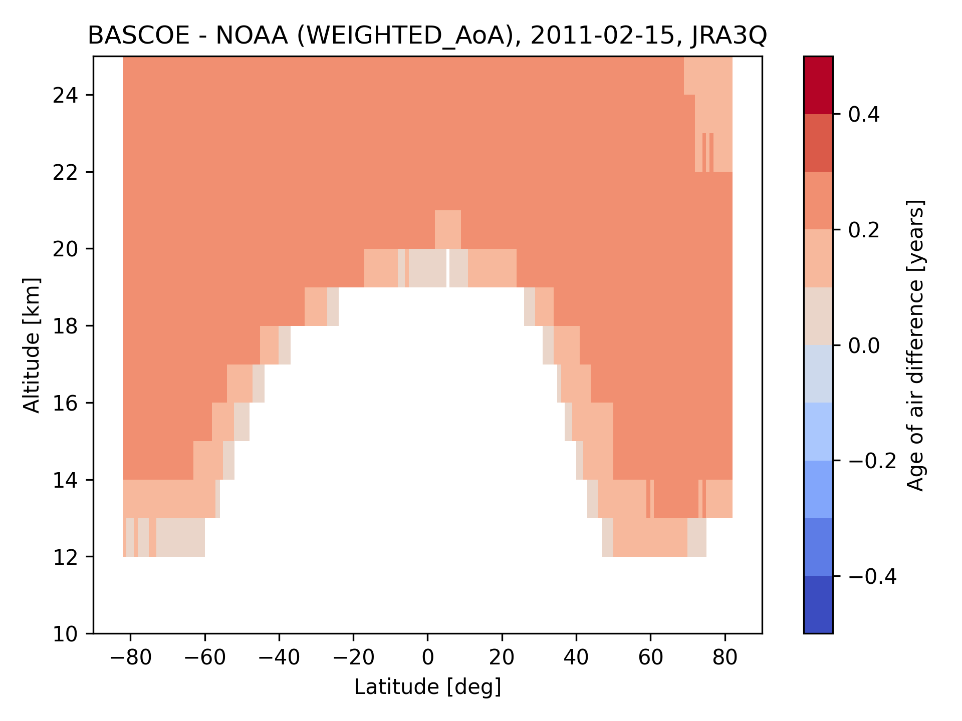
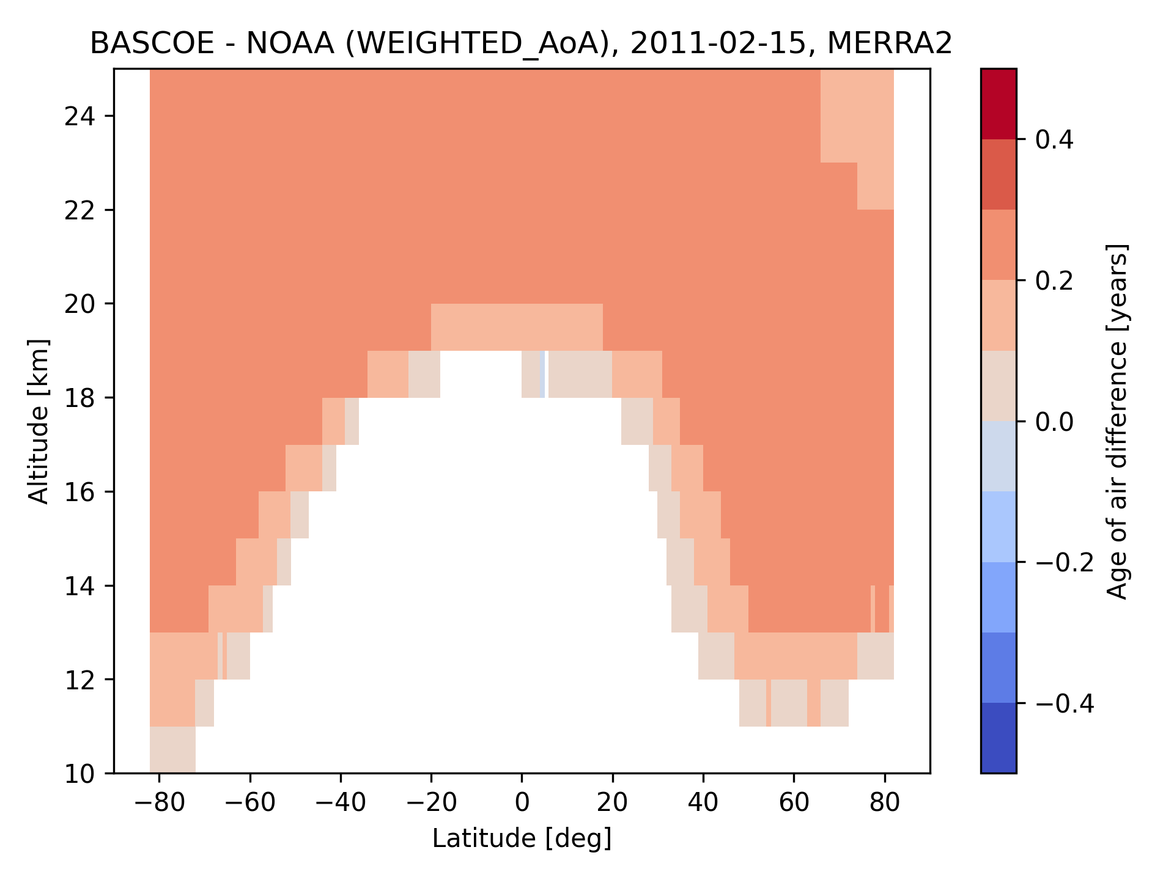
Zonal mean multi-tracer AoA BASCOE ref – zonal mean multi-tracer AoA CLaMS ref
ERA-5
JRA-3Q
MERRA-2
0.4-0.5 yrs difference
Zonal mean multi-tracer AoA BASCOE ref – zonal mean multi-tracer AoA NOAA ref
ERA-5
JRA-3Q
MERRA-2
0.1-0.3 yrs difference

Slide 15
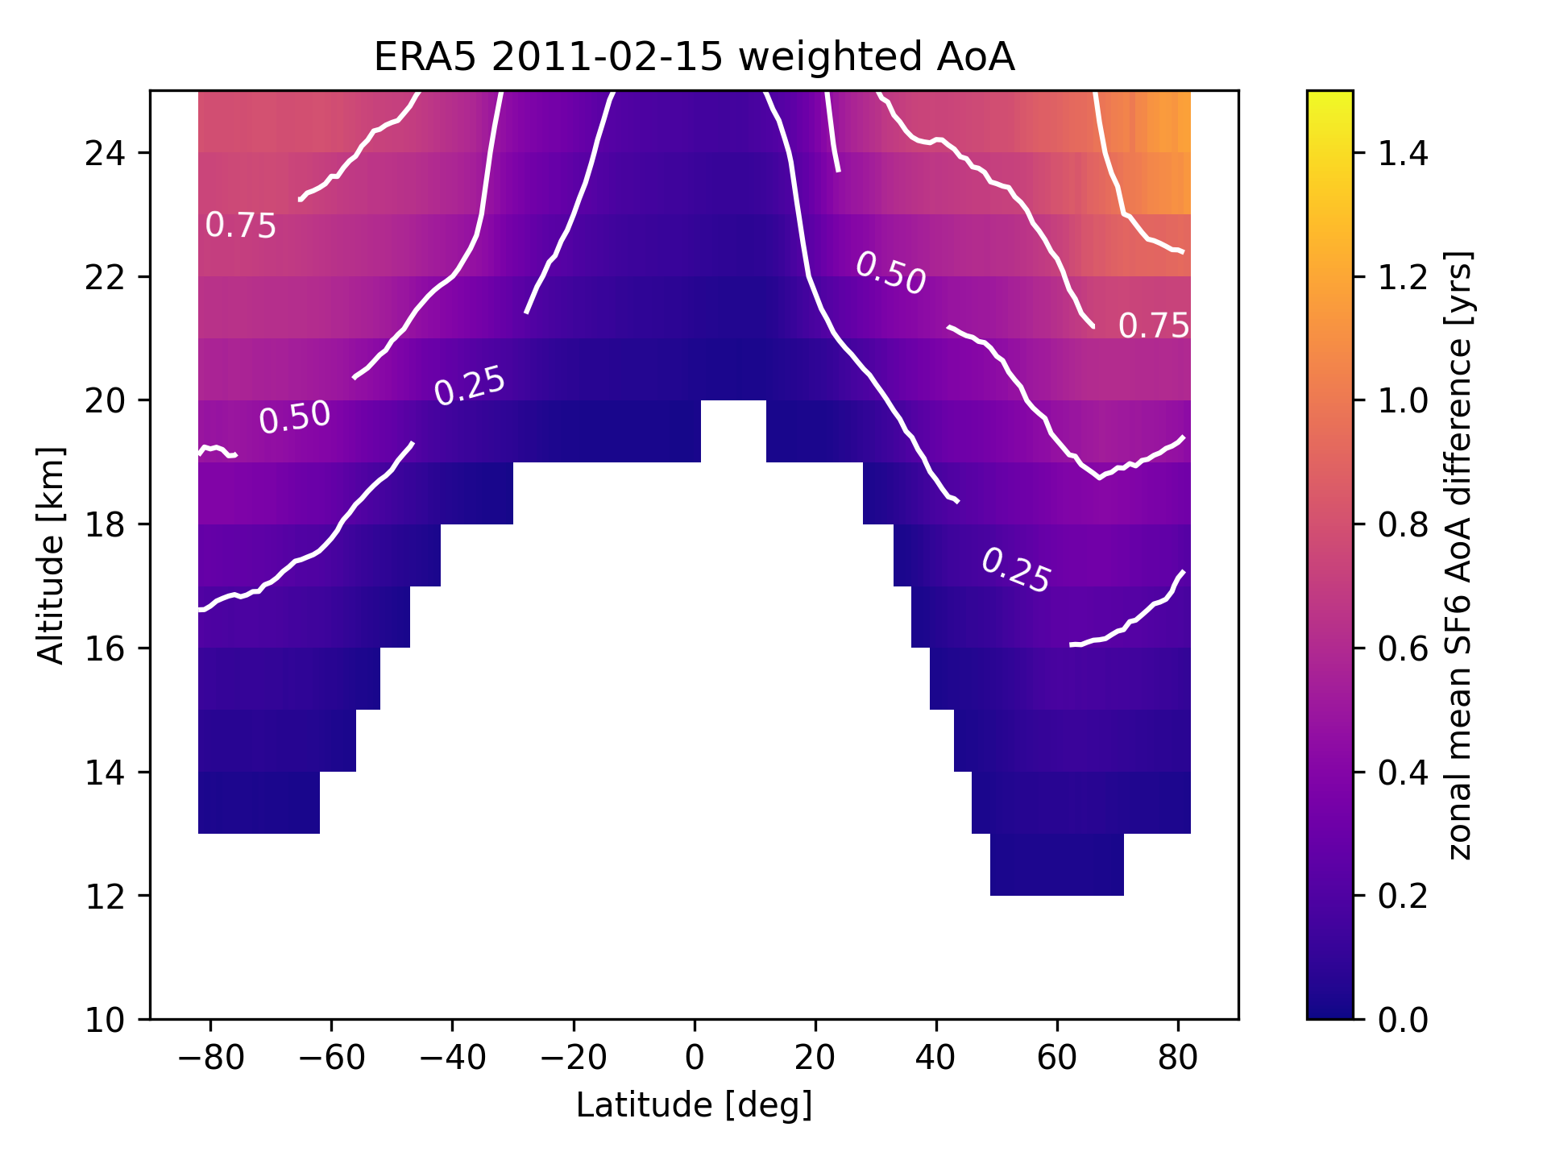
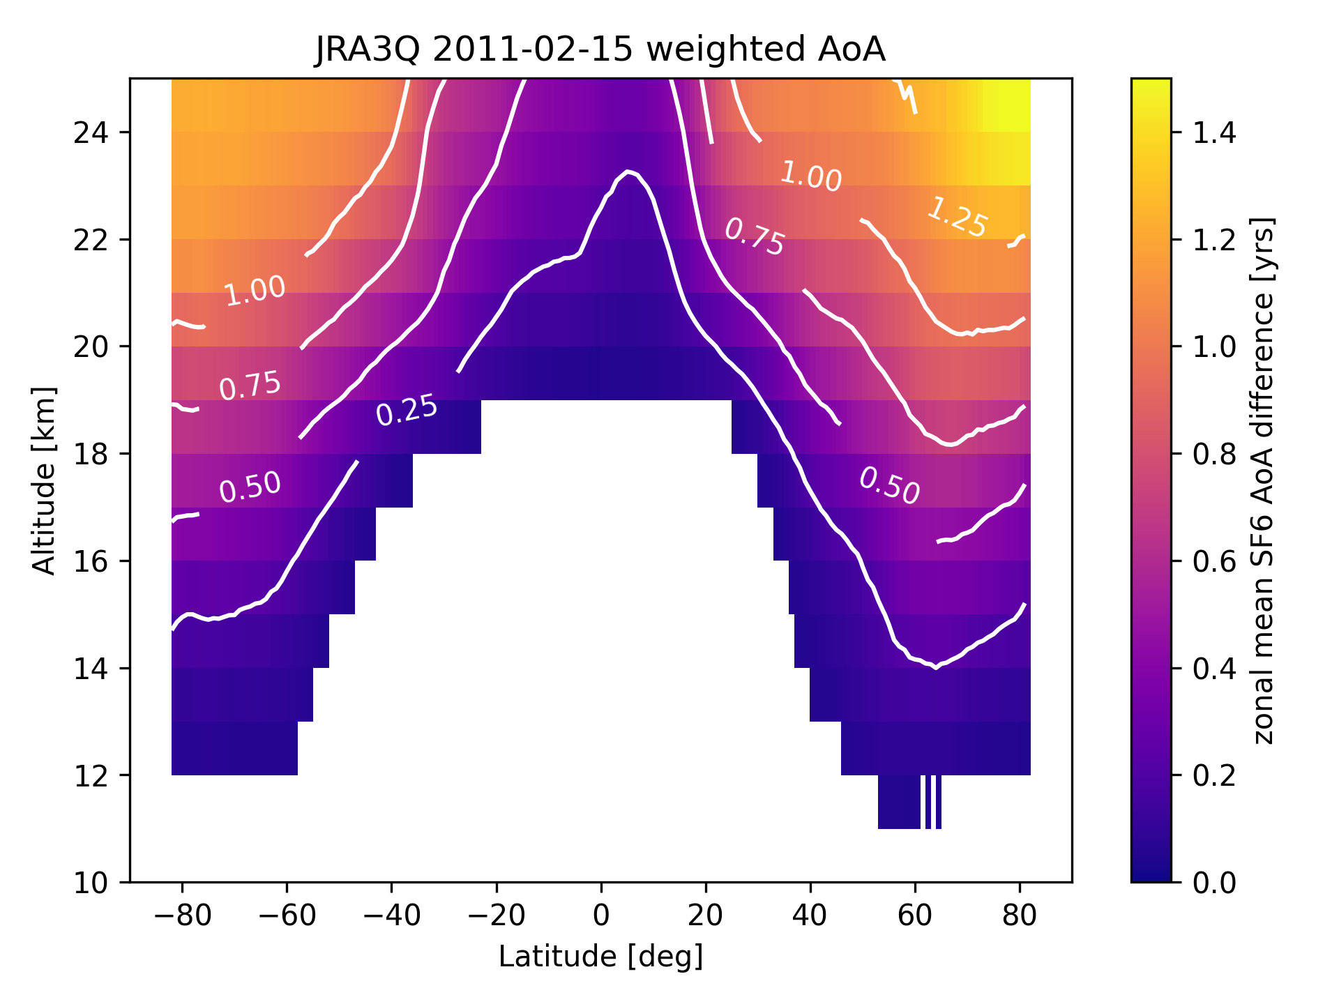
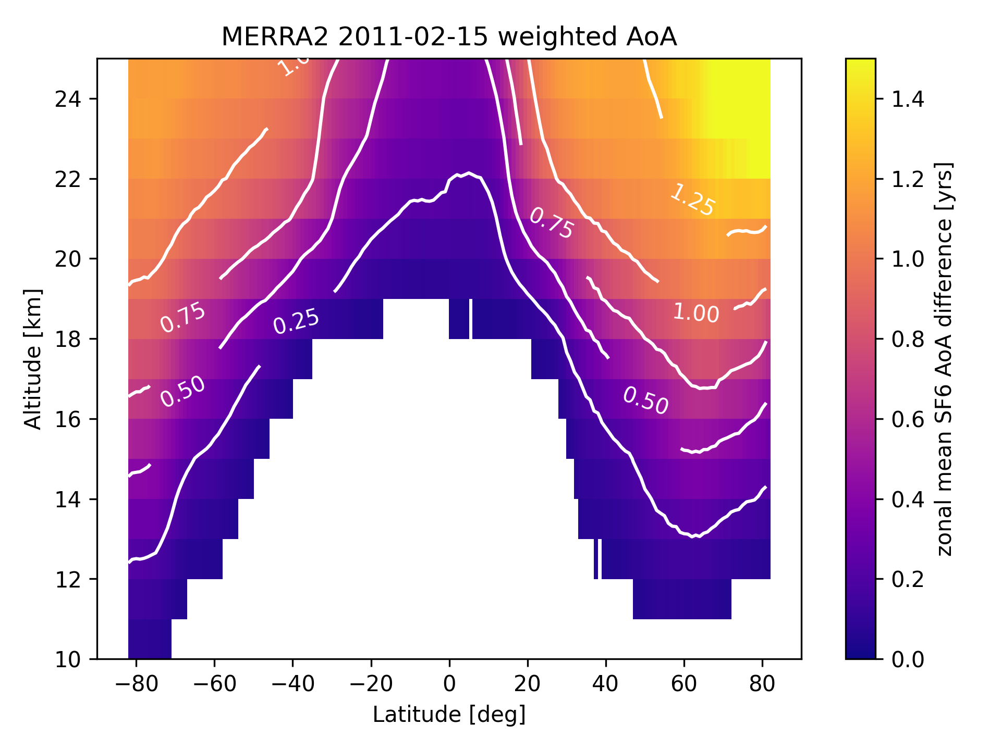
Correction for mesospheric SF₆ loss
SF₆ is destroyed by electrons in the mesosphere
Correction derived from annual mean model profiles (Garny et al., 2024)
Here we test the sensitivity to the use of a sink correction vs no sink correction
A sink correction was computed from the three BASCOE simulations, driven by ERA-5, JRA-3Q and MERRA-2 respectively
Difference between zonal mean multi-tracer AoA with and without inclusion of the mesospheric sink correction
ERA-5
JRA-3Q
MERRA-2
More than 1 year difference at 25 km.

Slide 16
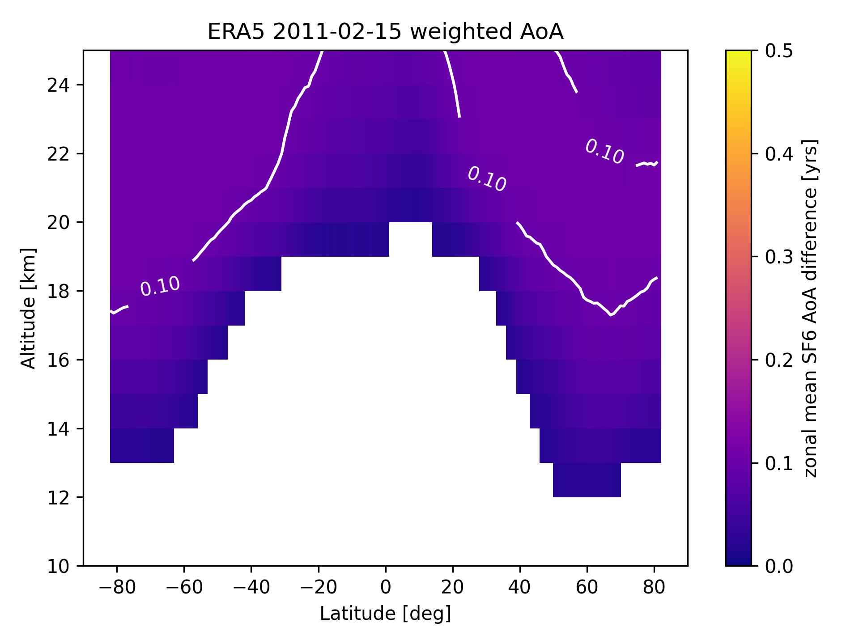
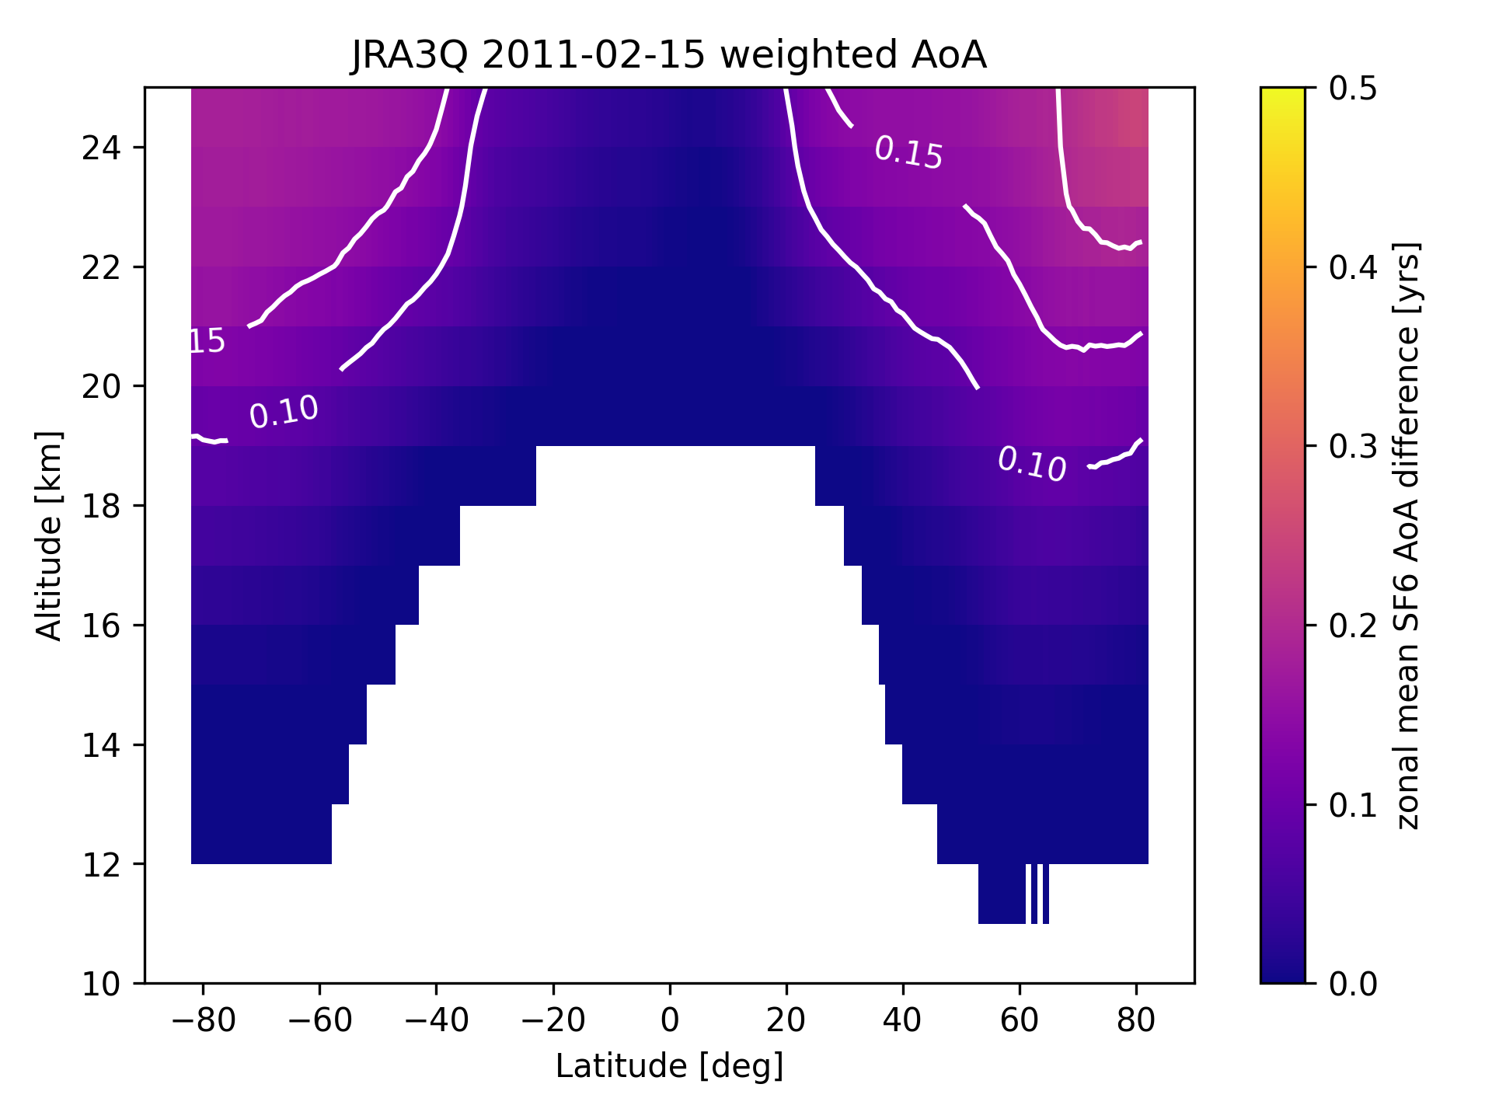
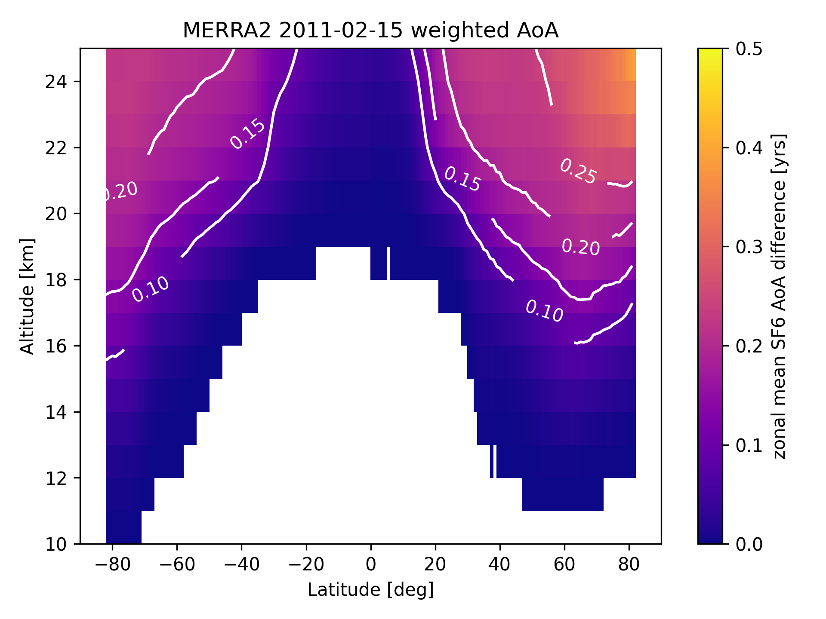
Correction for mesospheric SF₆ loss
Here we test the sensitivity to sink corrections derived from two different models.
We use the same BASCOE correction as in the previous slide and compare with a correction derived from the EMAC chemistry-climate model.
Difference between zonal mean multi-tracer AoA with sink correction derived from BASCOE and from EMAC. Depends on latitude, level and reanalysis.
ERA-5
JRA-3Q
MERRA-2
0-0.25 years difference.

Slide 17

Conclusions
CAIRT AoA uncertainty is generally around the mission requirements, but target accuracy is not uniformly reached in the stratosphere.
CAIRT AoA errors small enough to diagnose reanalyses at 25 km and constrain stratospheric transport.
This study highlights potential sources of bias in the retrieved satellite AoA.
  Choice of tropospheric reference 0-0.5 years on zonal mean multi-tracer AoA.
  Mesospheric sink correction 0-0.25 years on zonal mean multi-tracer AoA.

Slide 18
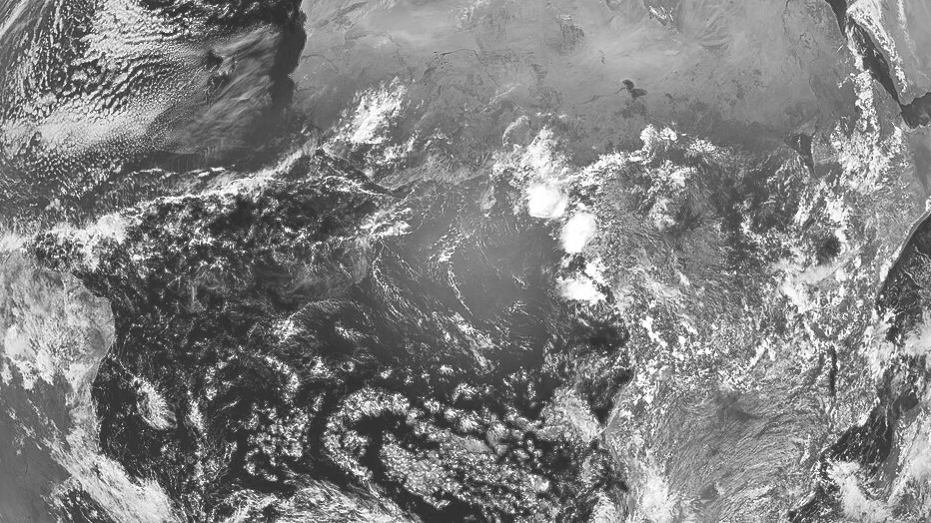

Back-up
slides

Slide 19
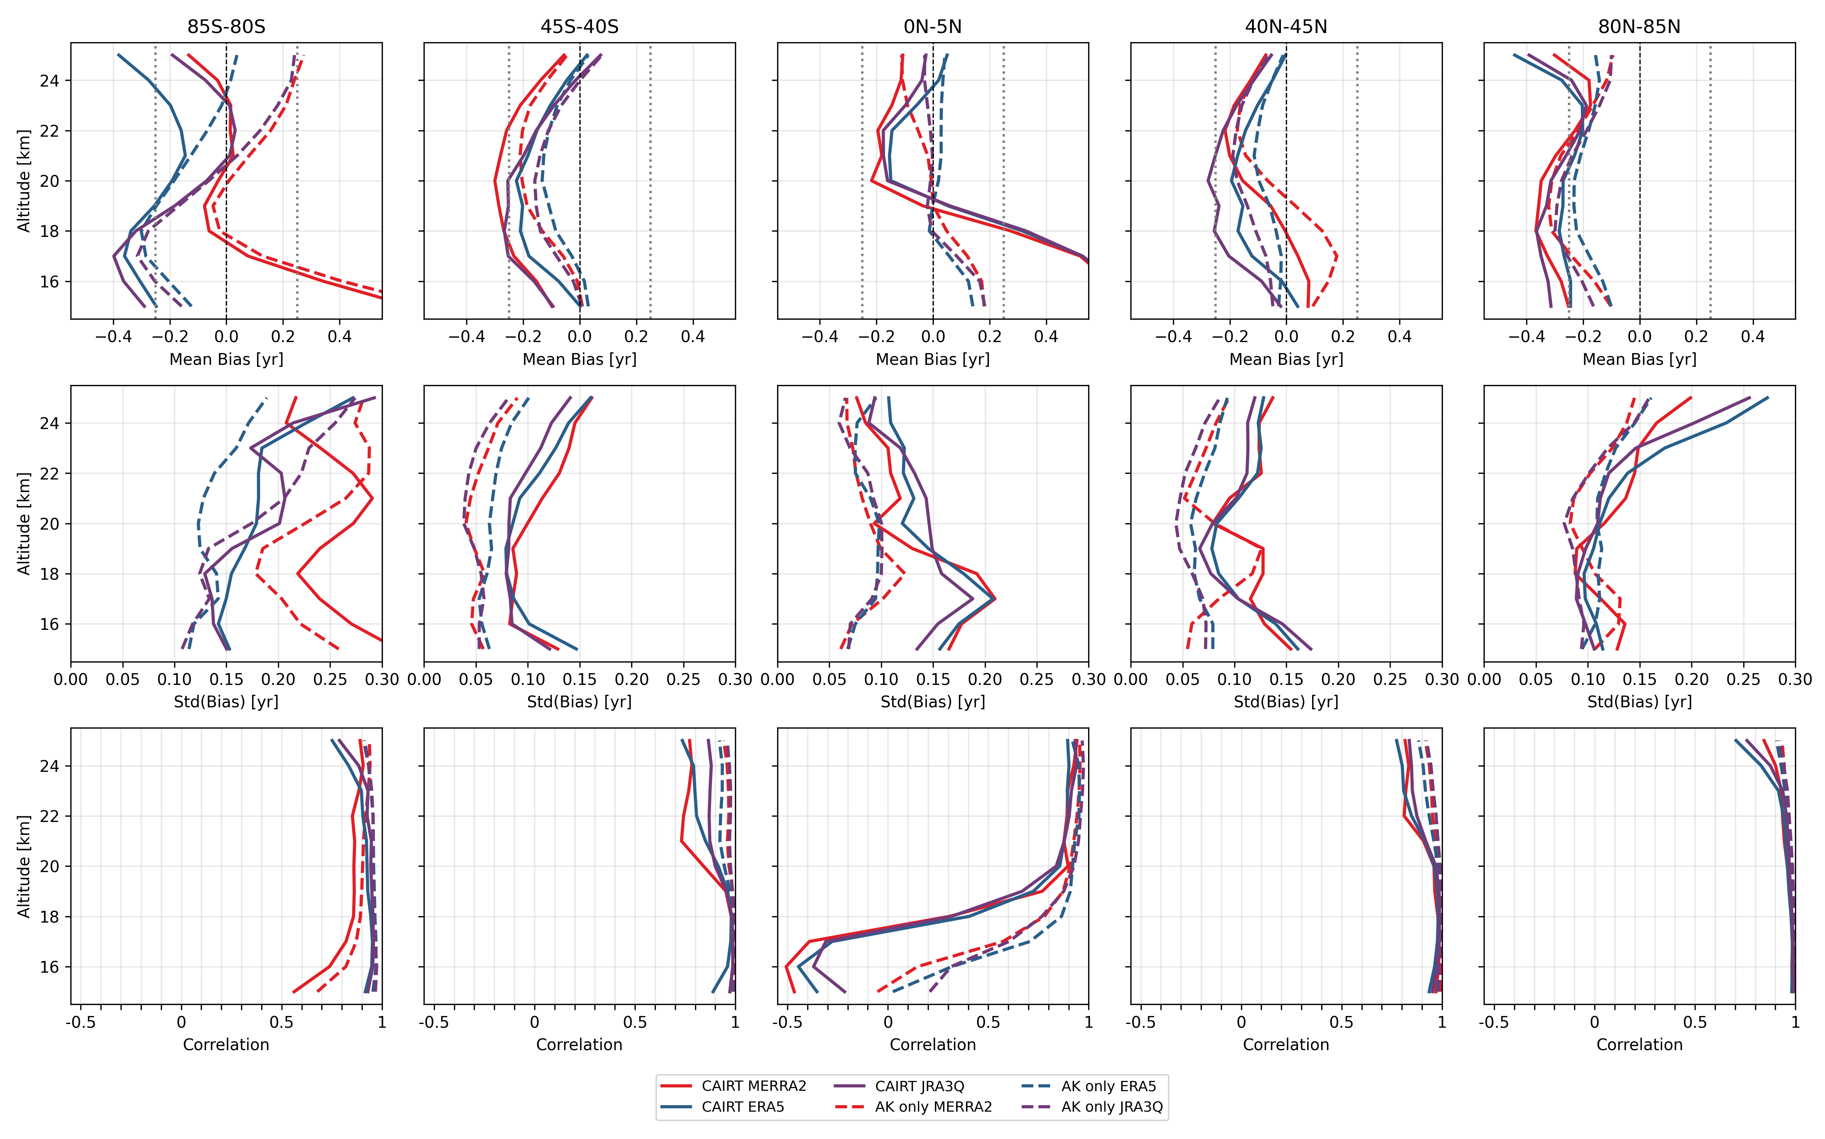

Slide 20
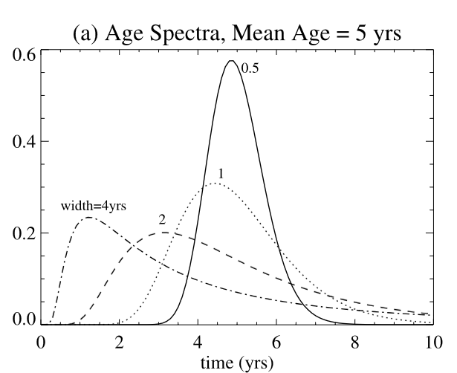
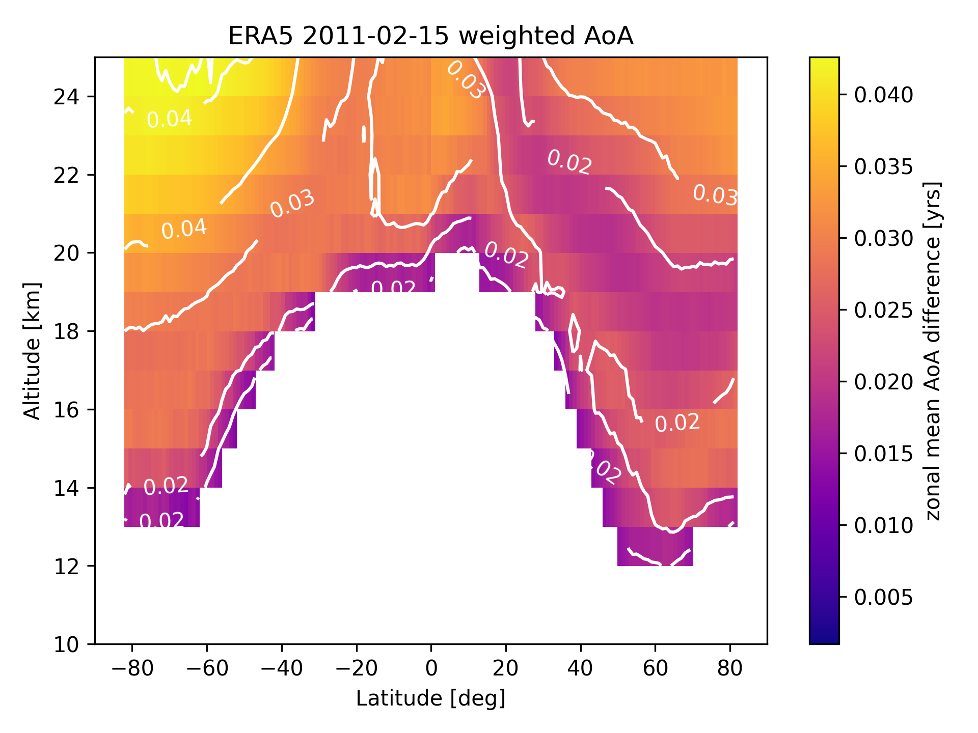
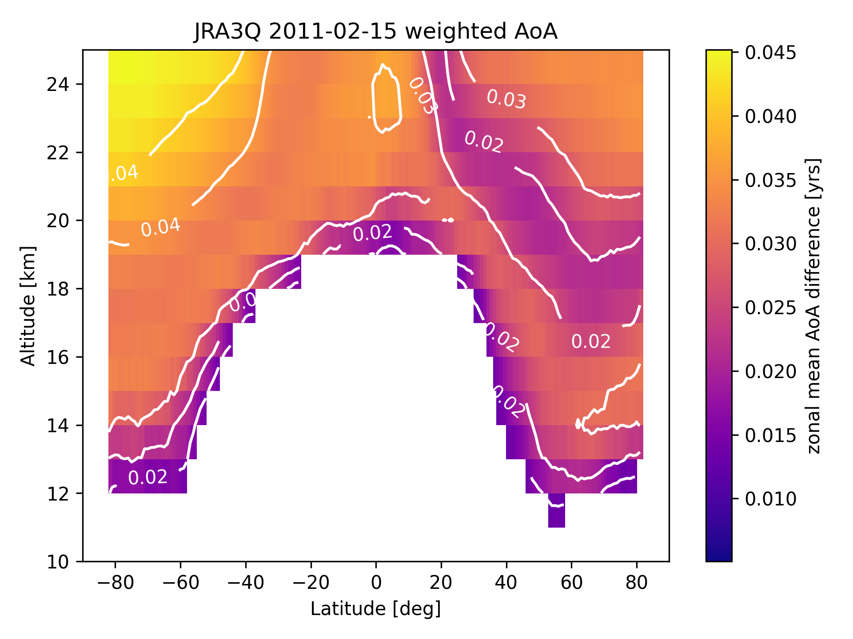
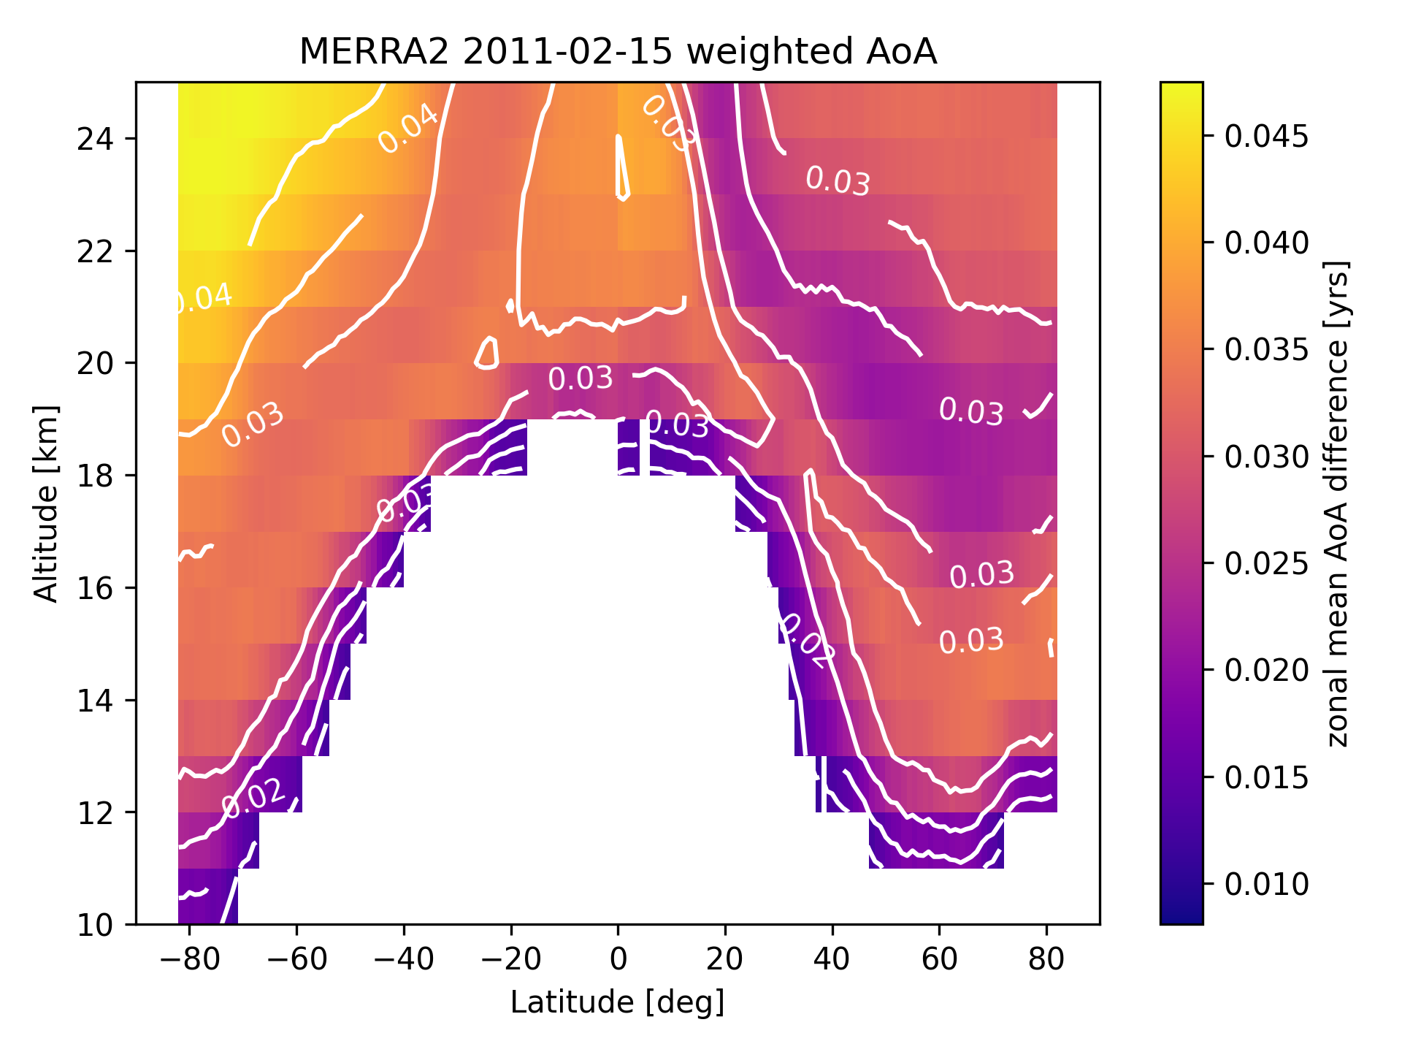
Correction for non-linearity of surface concentrations
Convolution of age spectrum and tropospheric reference
Contains parameter that defines the width of the spectrum called ratio of the moments, ROM(lat,lev)
Derived from CLaMS simulations driven by ERA-5 or ERA-Interim
Differences negligible ~0.04 yr

Slide 21
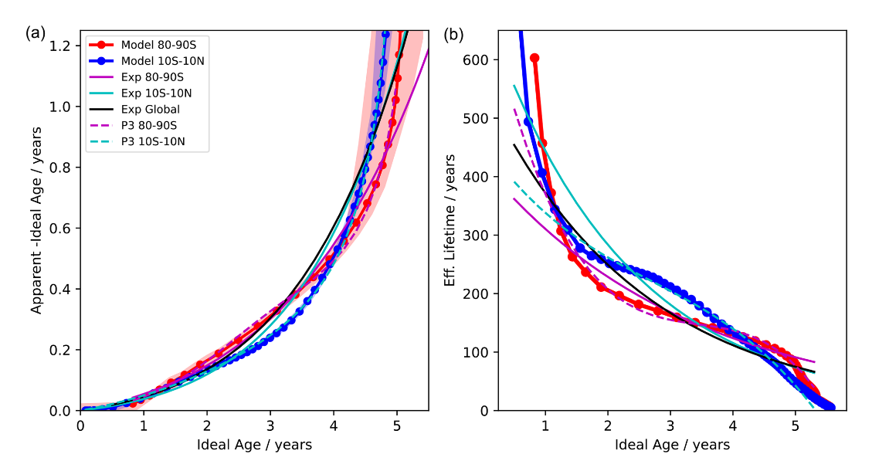

Correction for mesospheric SF₆ loss
$$τ_{eff}=t{\left(\frac{apparent}{ideal}−1\right)}^{−1}$$
Computation of correction parameters: fit to effective lifetime, computed from model data.
Garny et al. 2024

