Slide 1
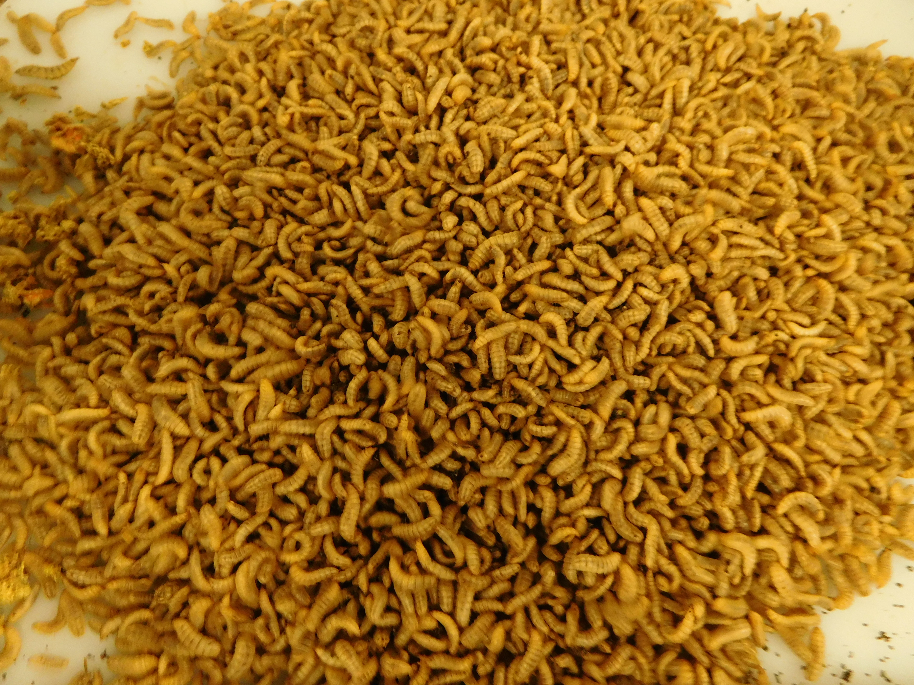
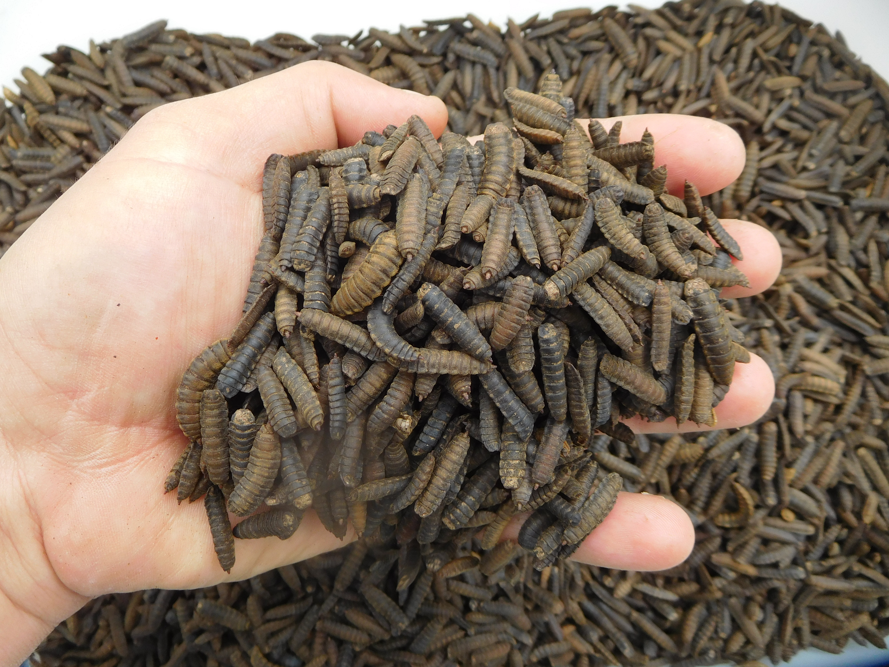




Deuterium labelling of fatty acids in Hermetia illucens larvae
Hoc B., Fauconnier M-L., Purcaro G., Lognay G., Francis F. & Caparros Megido R.
Notes:
Dear Colleagues, it is my pleasure to share with you today our study entitled

Slide 2
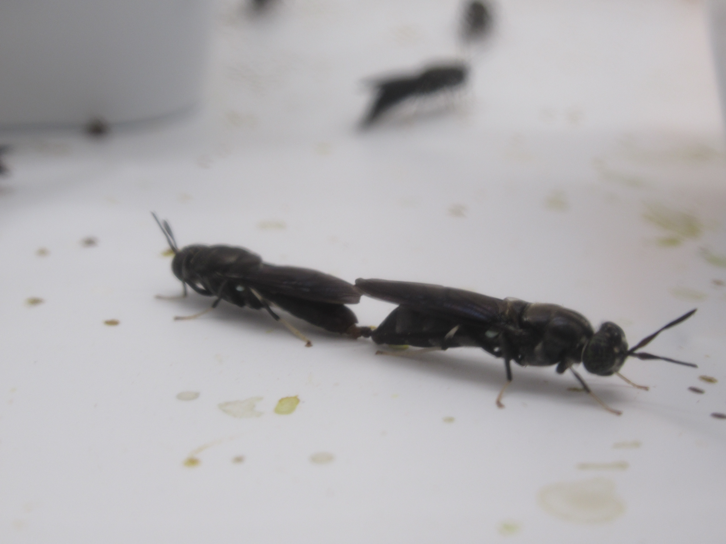
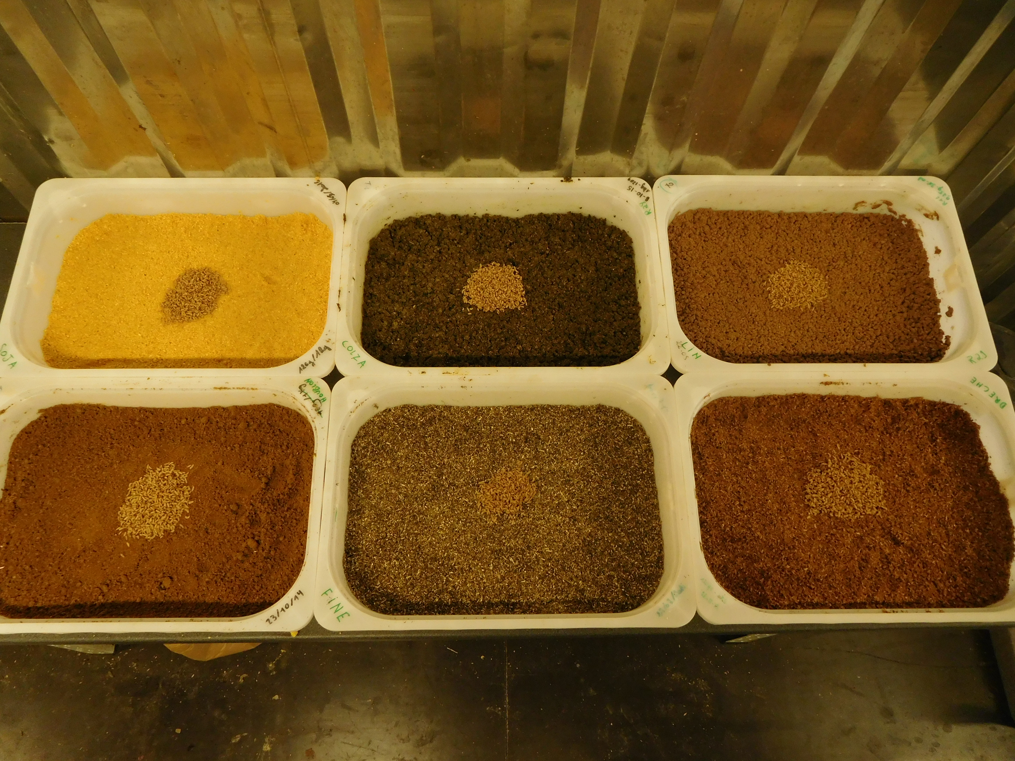
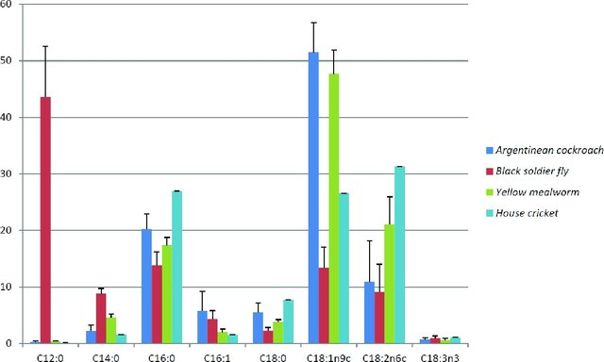
Introduction
Mat & Meth
Conclusion
Results
Oonincx et al., 2019. Feed Conversion, Survival and Development, and Composition of Four Insect Species on Diets Composed of Food By-Products
Notes:
As you probably know, larvae or prepupae of black soldier fly emerges for the feed sector by their ability to develop rapidly and extensively on a wide range of decomposing material. As BSF fatty acid profile is known to be related with the one of their diet, several experiments have tried to manipulate their fatty acid profile with enriched feed formulation. First of all, it appeared that BSF larvae contain a high level of saturated fatty acids (lauric acid or myristic acid) not found in their diet. Moreover, when BSF diets were rich in unsaturated fatty acids, it seemed that BSF larvae could bioaccumulate some of them as oleic, linoleic acid or α-linolenic acid in small proportion as they probably metabolize them principally into lauric acid. Consequently, we decided to find a way to track BSF fatty acid production and we hypothesized that a complete replacement of water by deuterated water in diets will allow us to identify which fatty acid is completely/partially biosynthesized by BSF and which one is simply bioaccumulated from their feed

Slide 3
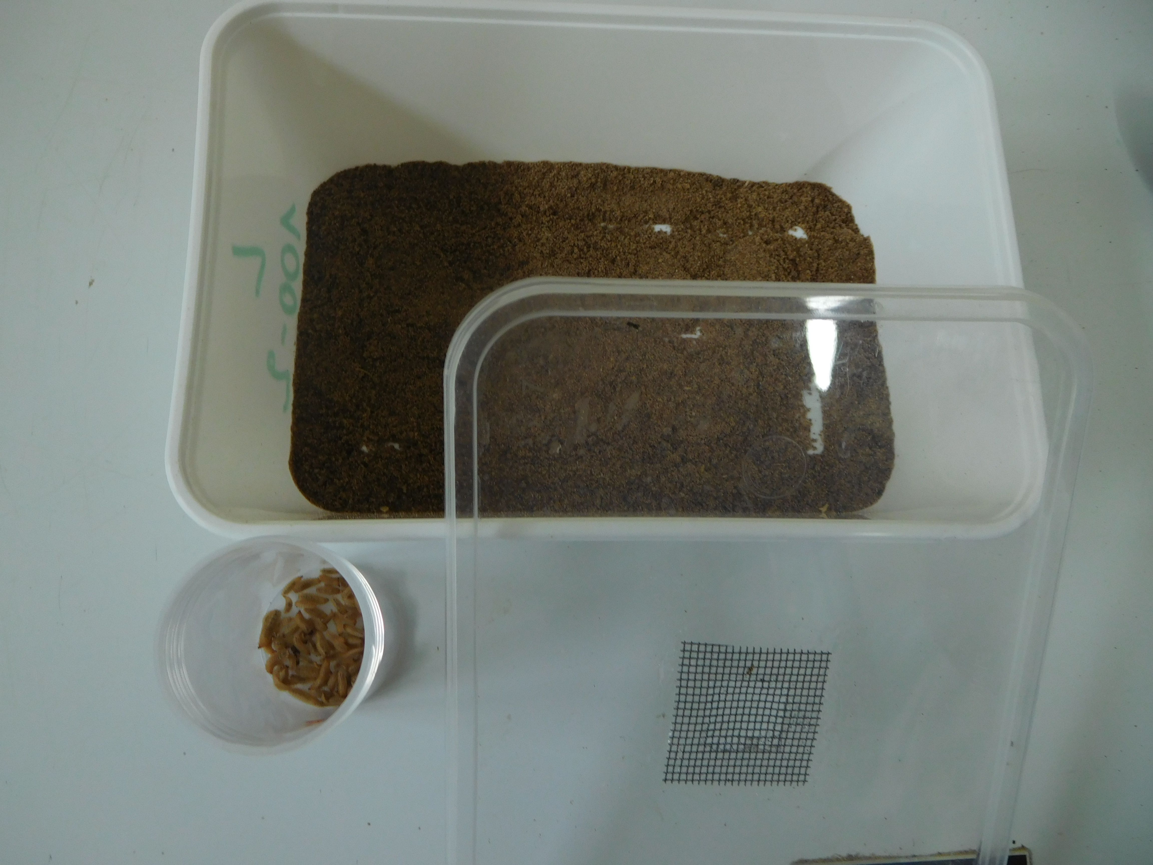
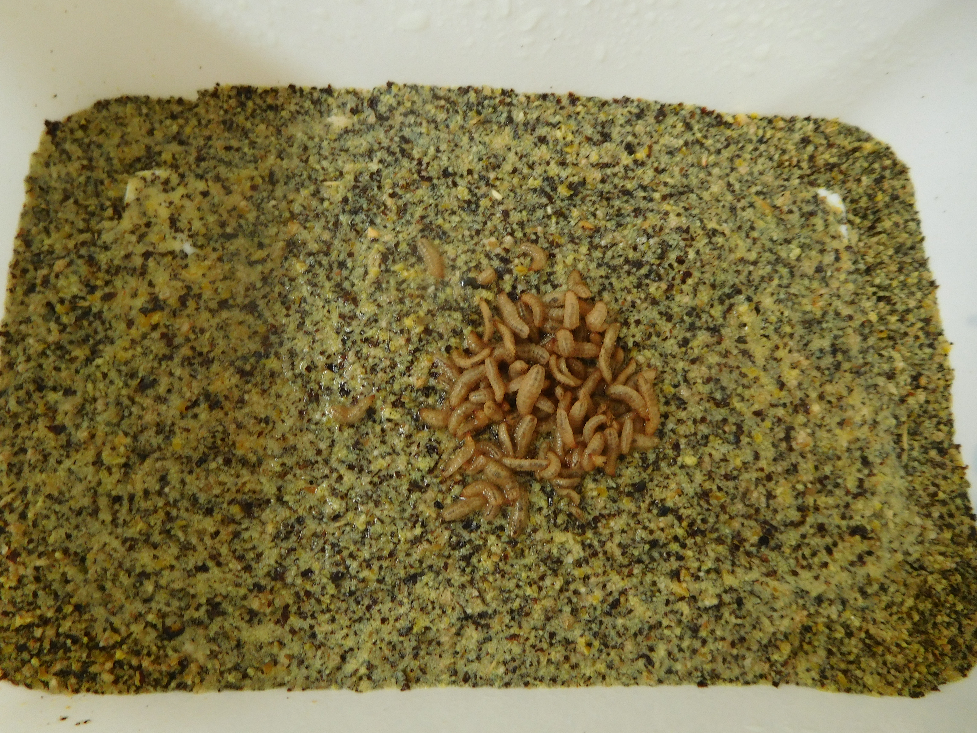
Conclusion
Results
Mat & Meth
Introduction
Chicken feed
Chicken feed (40%) + flax cake (60%)
3 batches of 50 larvae of 7 days old
+ water
or
+ deuterated water
+ water
or
+ deuterated water
Notes:
Chicken feed and flax cake mechanically extracted were grinded for diet formulation. Four different diets were produced based on these two ingredients: A fully chicken feed diet with 40% of water or deuterated water and a diet made of 40% of chicken feed and 60% of flax cake with 40% of water or deuterated water.

Slide 4
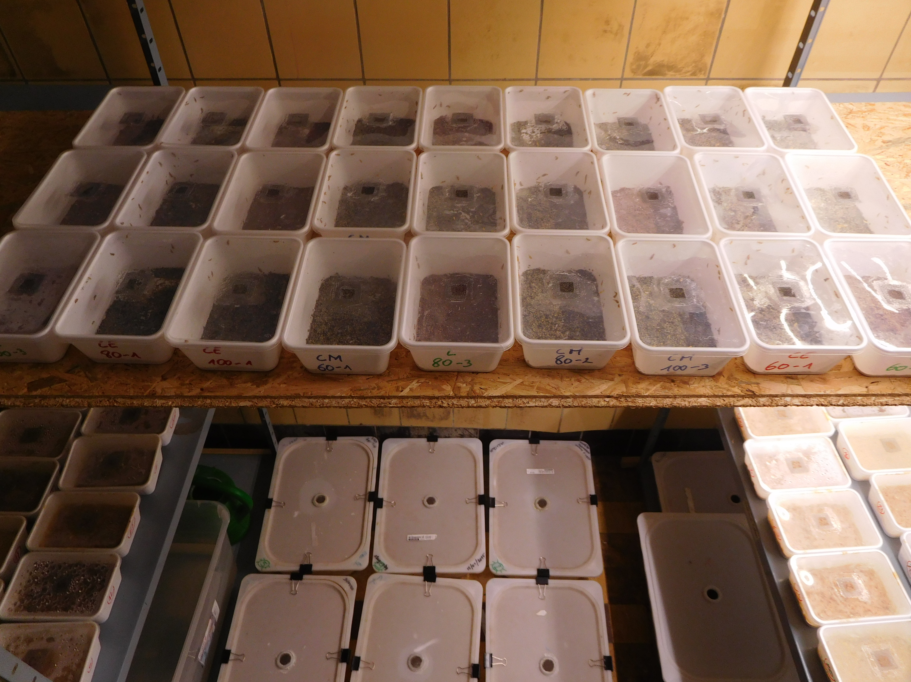
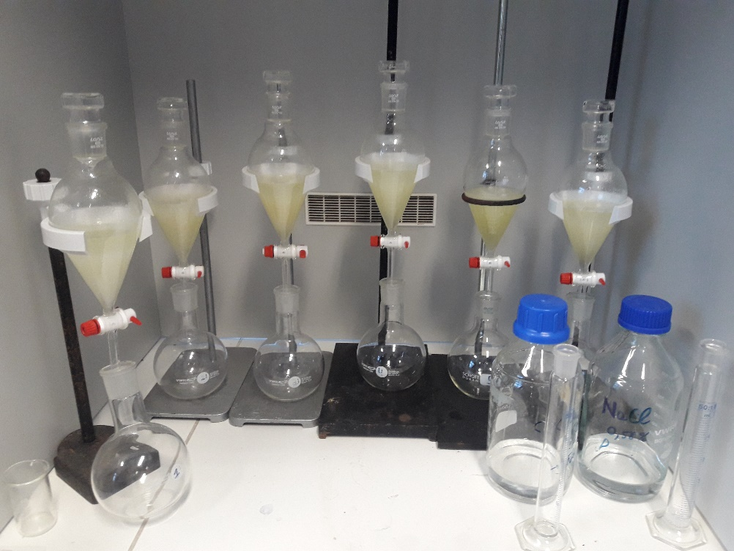
Conclusion
Results
Mat & Meth
Introduction
27 ± 1°C and 65% RH
Notes:
Following a developmental period of 15 days under laboratory conditions, larval batches were collected, fasted for 24 hours, washed, dried on paper and frozen at -20°C. Lipid were extracted using folch method and fatty acid composition were determind by GC-MS

Slide 5
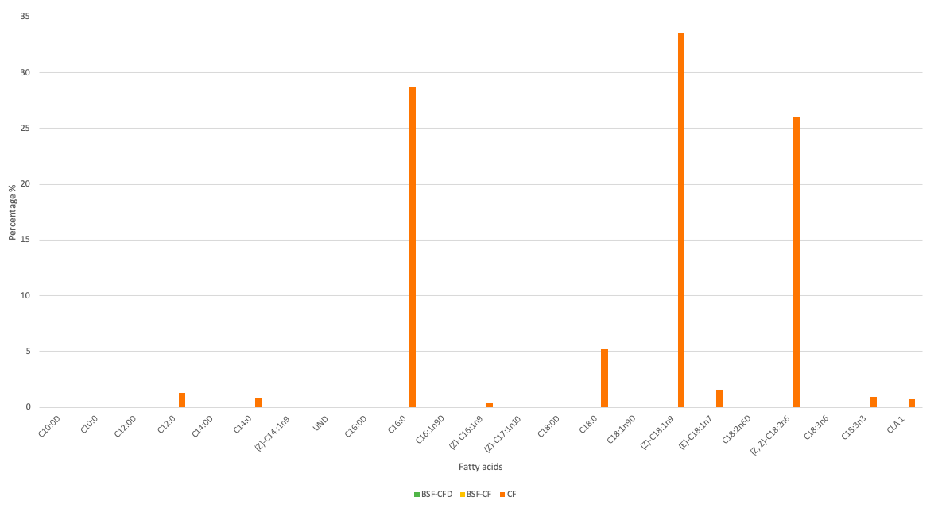
Conclusion
Introduction
Results
Mat & Meth
Notes:
Chicken feed diet showed high proportions of PUFAs principally oleic acid and linoleic acid and very small proportions of alpha-linolenic acid. SFAs are also present with a great proportion of palmitic acid and stearic acid

Slide 6
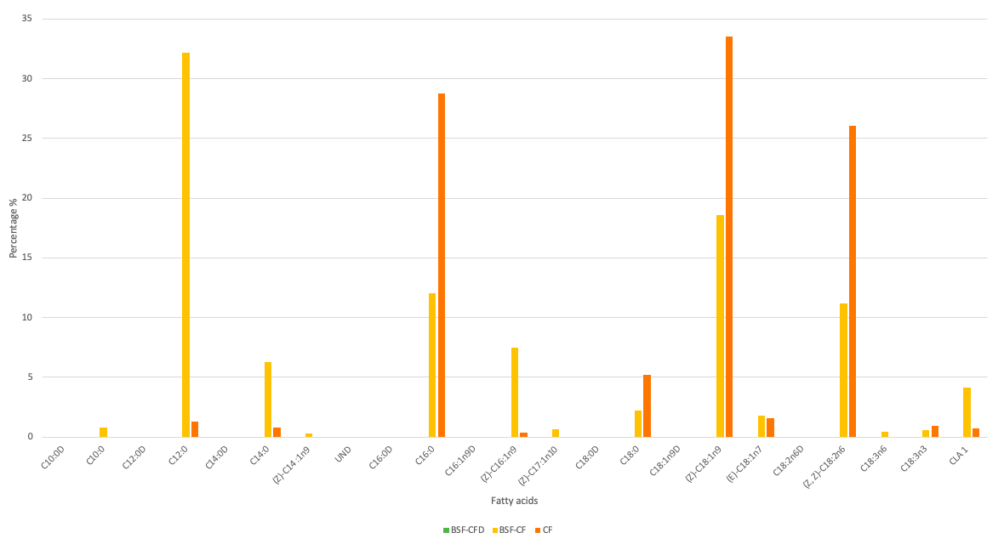
Conclusion
Introduction
Results
Mat & Meth
Notes:
The fatty acid profile of BSF reared on CF with normal water showed high level of SFAs (Lauric, myristic and palmitic acid) followed by MUFAs as palmitoleic acid and oleic acid. Finally, about fifteen percent of PUFAs were found, principally linolenic acid and conjugated linolenic acid

Slide 7
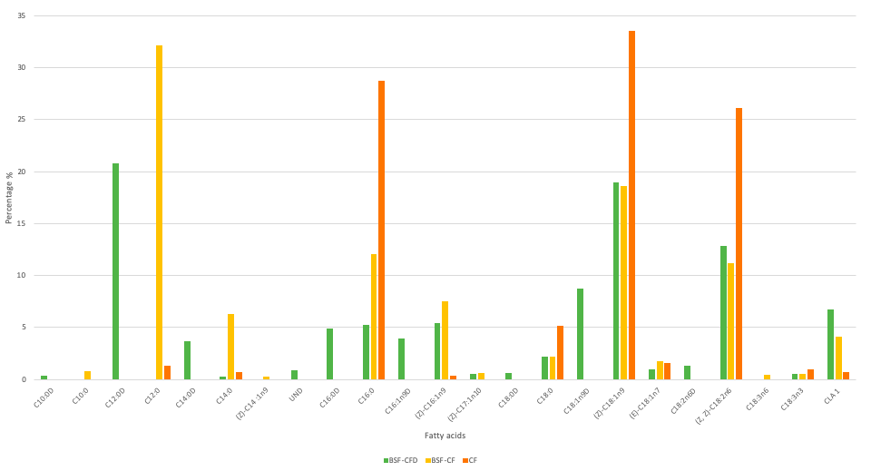
Conclusion
Introduction
Results
Mat & Meth
Notes:
Here is the FA profile of BSF reared on CF with deuterated water. The global fatty acid profile followed the same pattern as BSF fed on CF with normal water excepted for the appearance of deuterated fatty acids. As expected, decanoic acid (C10:0), lauric acid (C12:0) and myristic acid (C14:0) were almost entirely found in deuterated form as they were not found or in very low proportion in the chicken feed. These results confirmed our hypothesis since fatty acids supposed to be fully produced by insects were only present in their deuterated form. BSF larvae also produced some proportions of palmitic acid. As natural and deuterated palmitic acid were found, the present results showed that, despite a high level of this fatty acid in chicken feed, BSF biosynthesized approximately 50% of the palmitic acid found in their whole body instead of a simple accumulation. Palmitoleic acid ((Z)-C16:1n9) and oleic acid (Z)-C18:1n9 are the most represented MUFAs and are both found in natural and deuterated forms. The larger proportion of natural oleic acid within BSF fatty acids revealed a direct bioaccumulation of this molecule from chicken feed lipids. Nevertheless, it was more surprising to identify natural Palmitoleic acid since it was nearly absent from the insect diet. This result suggests the potential presence of a Δ-9-desaturase gene in BSF larvae coding for a transmembrane fatty acid desaturase using the corresponding saturated homologues to synthesize Palmitoleic acid ((Z)-C16:1n9) and oleic acid as already described for Drosophila melanogaster and Musca domestica. During this desaturation step, no hydrogen will be introduced in the fatty acid. Depending on the source of the SFA (deuterated or not), a natural or deuterated MUFA will be produced during the desaturation process and the use of bioaccumulated SFAs (i.e. non-deuterated) to produce MUFAs explain the differences in C16:0 and C18:0 levels between BSF larvae and their diet.

Slide 8
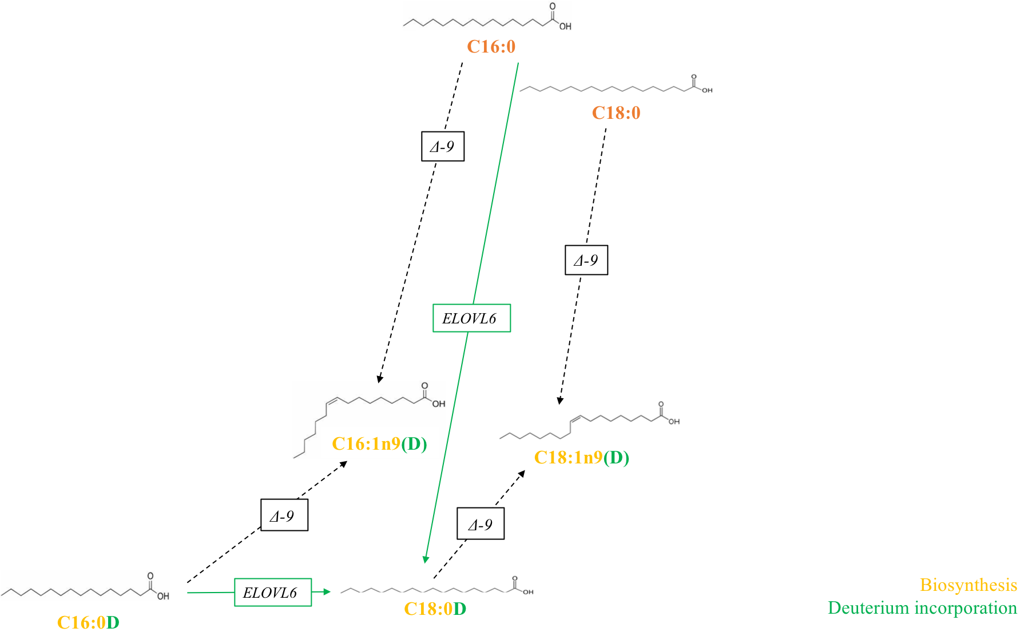
Conclusion
Introduction
Results
Mat & Meth
Notes:
This result suggests the potential presence of a Δ-9-desaturase gene in BSF larvae coding for a transmembrane fatty acid desaturase using the corresponding saturated homologues to synthesize Palmitoleic and oleic acid as already described for Drosophila melanogaster and Musca domestica. During this desaturation step, no hydrogen will be introduced in the fatty acid and then, depending on the source of the SFA (deuterated or not), a natural or deuterated MUFA will be produced during the desaturation process

Slide 9
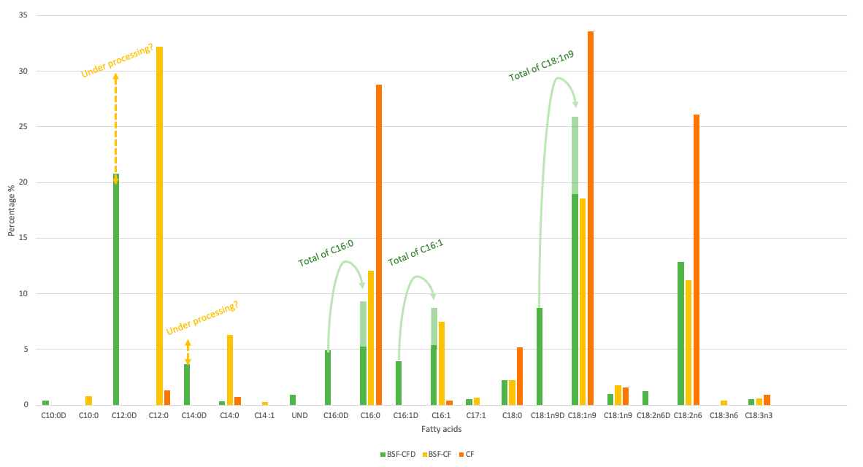
Conclusion
Introduction
Results
Mat & Meth
Notes:
Finally, SFAs’ levels were lower in BSF fed with deuterated water. This result can be justified by the decrease in overall reactivity caused by the occurrence of deuterium in metabolic pathways which reduces the typical production of these fatty acids; the replacement of an hydrogen atom by deuterium has an influence on enzyme activities by reducing their specificities and/or kinetic parameters for example. Some Mono and PUFAs seems to be overaccumulated than in the control. In line with a potential decreased biochemical reactivity caused by deuterium incorporation, we hypothesized that these accumulated unsaturated fatty acids should have been metabolized to produce lauric or palmitic acid if we didn’t stop the insect development at the same time.

Slide 10
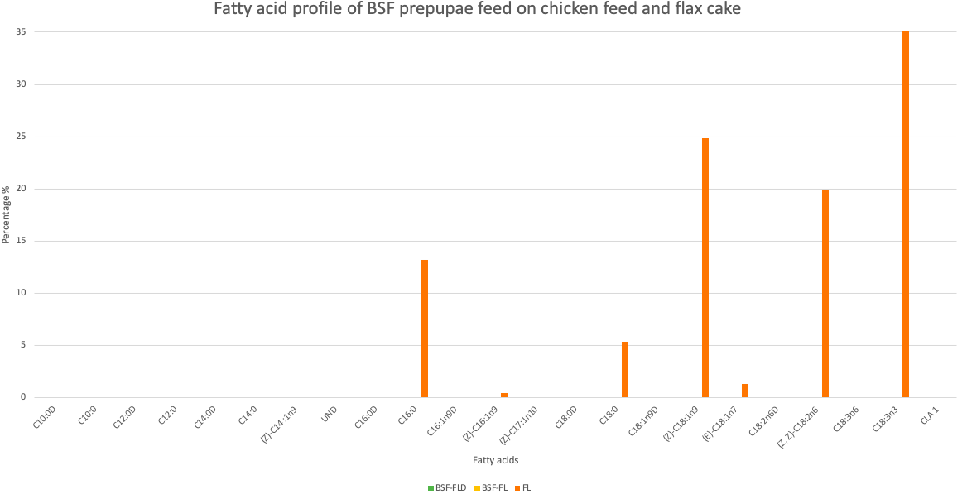
Conclusion
Introduction
Results
Mat & Meth
Notes:
The second part of this study focused on the incorporation of 60% of flax cake into chicken feed for its alpha-linolenic acid supply and in order to evaluate any possible modification of BSF fatty acid profile. As you can see,flax seed based diet is principally composed PUFAs as alpha-linolenic acid, linoleic acid; oleic acid. SFAs are also present with a great proportion of palmitic acid and stearic acid

Slide 11
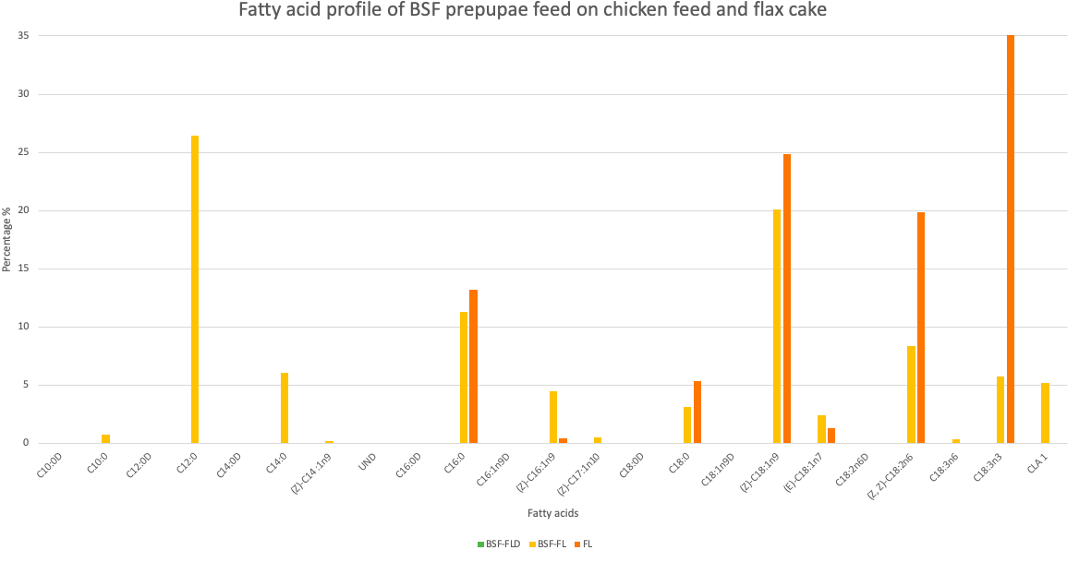
Conclusion
Introduction
Results
Mat & Meth
Notes:
Here we add the bsf profile produced on flaxseed diet with water. Some compounds not found in the diet or in very low proportion appeared such as Lauric and Myristic acid as well as Palmitoleic acid. The proportion of PUFAs are still high but lower than the proportion found in the diet. The Alpha-linolenic is poorly accumulated by larvae and is around 5% of the total FA

Slide 12
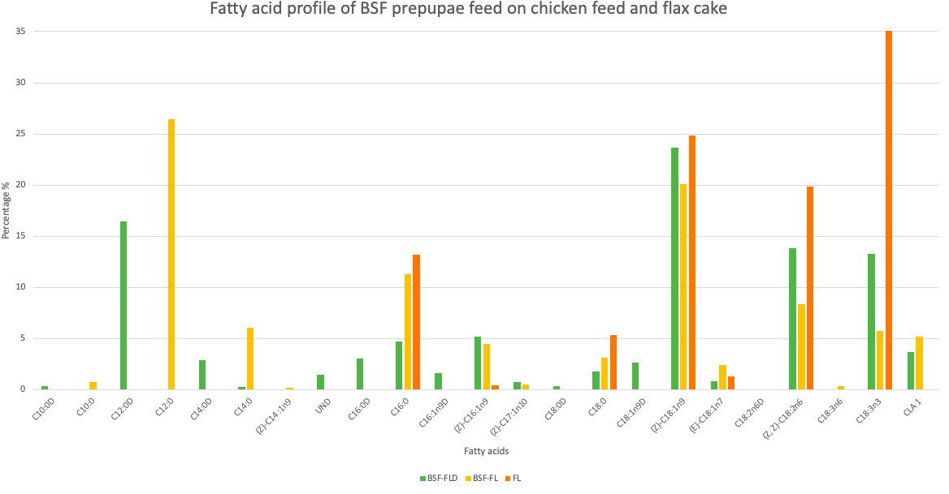
Conclusion
Introduction
Results
Mat & Meth
Notes:
Finally, here is the FA profile of BSF fed on flaxseed diet with deuterated water. Decanoic, lauric and myristic acid were still entirely found in deuterated form as they were not found or in very low proportion in the diet. BSF larvae still produced some proportions of palmitic acid. When looking at the PUFAs’ levels, it could be assumed that PUFAs are properly bioaccumulated by larvae up to almost fifteen percent but are finally metabolized in order to synthetize SFAs (i.e. C12:0, C14:0 and C16:0).

Slide 13
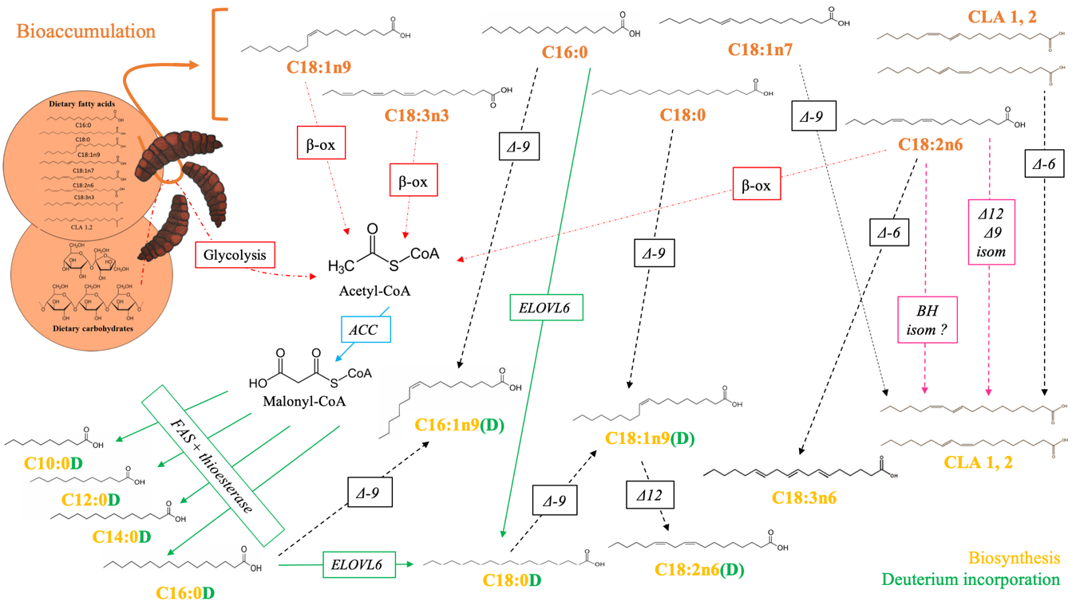
Conclusion
Introduction
Results
Mat & Meth
Notes:
This slide represents all the hypothesis made on the fatty acid metabolism of BSF. I’m not going to describe all the arrows but something i found important to speak about, is the palmitic acid synthesis. This fatty acid were found to be produced by larvae while high proportions of this fatty acid were found in the diet and it is probably because this fatty acid is a basis for the production of other fatty acids. To produce palmitic acid, acetyl-co enzyme A are mandatory and could be produced from the beta-oxidation of other Fatty acids or from the glycolysis of carbohydrates.

Slide 14
Conclusion
Introduction
Results
Mat & Meth
Notes:
Two particular isomers of C18:2 were detected after the alpha-linolenic acid peak in chromatograms and could be identify as conjugated linoleic acids (CLA 1 and 2). The occurrence of CLA remains challenging to explain but leads to various hypotheses. Firstly, the presence of (E)-vaccenic acid in low proportion can be linked to the occurrence of CLA by the action of a Δ9-desaturase. Nevertheless, this metabolic pathway, typical in ruminants and in humans, cannot by itself explain the proportions of CLA found in the present study. Secondly, CLA should also have been produced from microbial biohydrogenation (BH) of PUFAs as it has already been demonstrated in ruminant and suggested by Oonincx et al. 2019 for BSF. A third possible hypothesis to explain CLA occurrence might be the presence of enzymes such as Δ12 or Δ9 isomerase in BSF that allows the isomeric change from linoleic acid to CLAs

Slide 15
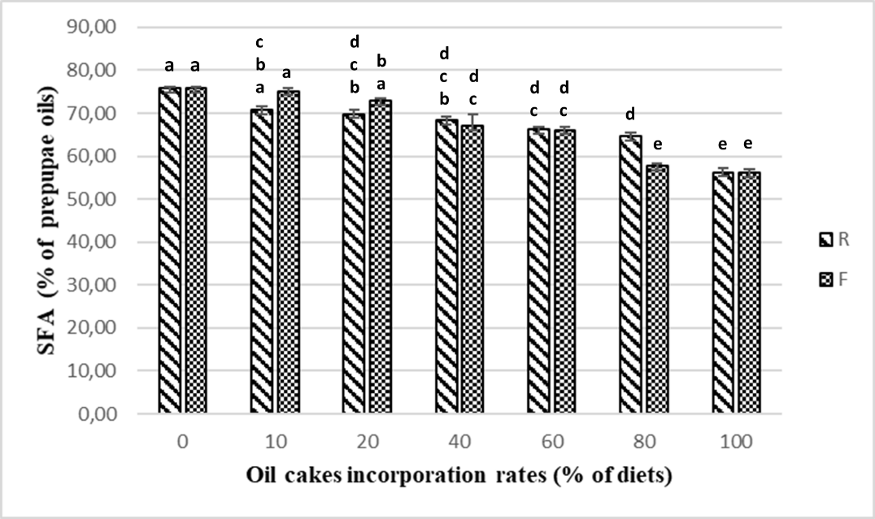
Introduction
Conclusion
Mat & Meth
Results
A strict comparison of fatty acid profiles between the insect and its diet is an oversimplified approach
It is mandatory that further studies also focus on the role of carbohydrate level in BSF diets as they are an essential source of acetyl-CoA, a critical molecule in the biosynthesis of fatty acids.
Notes:
Here is a graphic from our lab (it is not important), it is just to tell you that we also have done that before but now, we all need to change our way of thinking. As for example, fatty acids as palmitic acid thought to be merely bioaccumulated from diets were also produced by the BSF itself

Slide 16
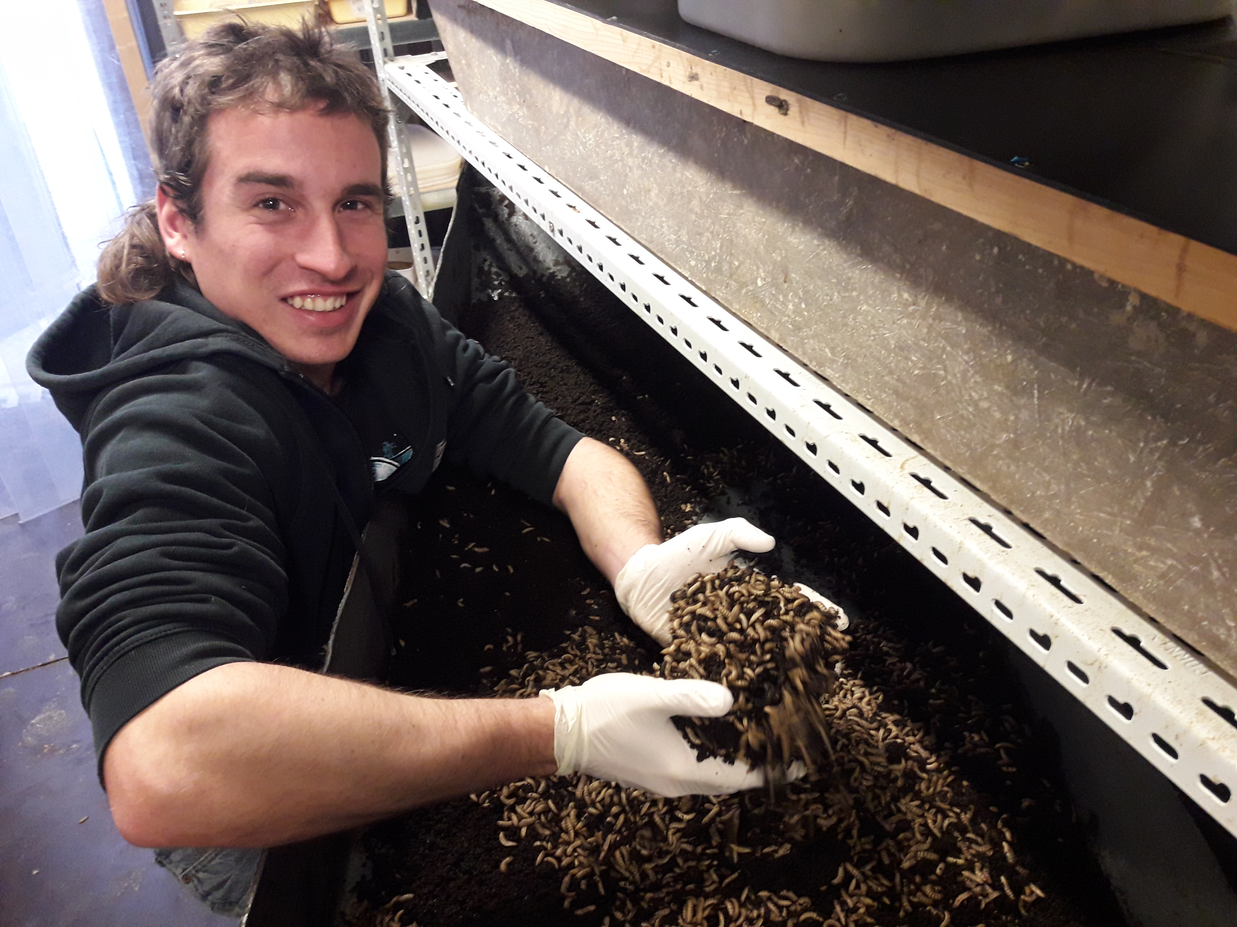
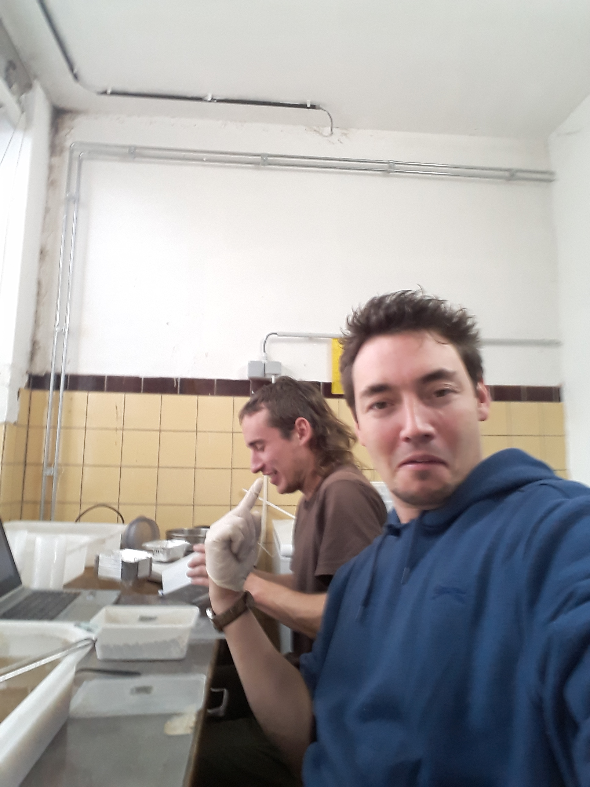
Introduction
Conclusion
Mat & Meth
Results
Thank you for your attention and thank you to the BSF team for their work

