Slide 1
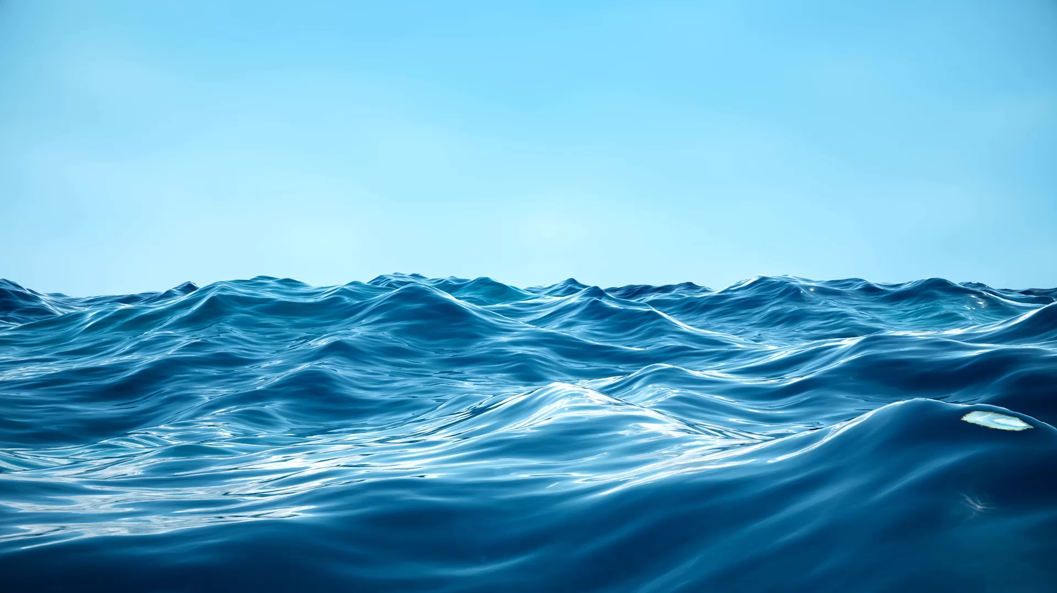



Floating marine plastic debris detection with a convolutional neural network and using multispectral satellite images
Adrien Gérard¹ – André Valente² – Aida Alvera-Azcárate¹ - Alexander Barth¹
¹ GeoHydrodynamics and Environment Research (GHER), University of Liège, Liège, Belgium
²Atlantic International Research Centre (AIR Centre), Portugal

Slide 2
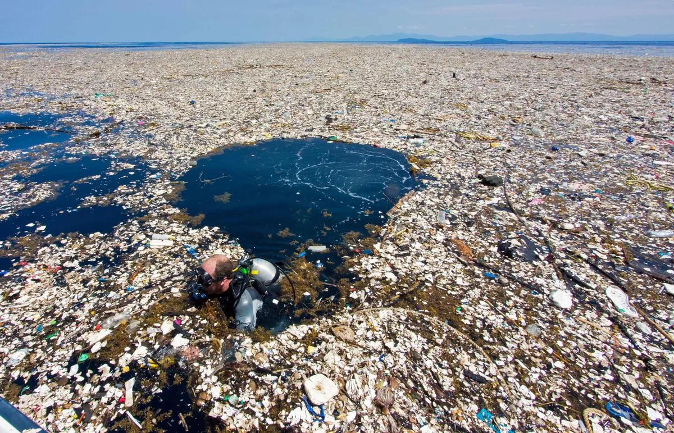
Marine plastic, a growing and urgent problem
ISSUE
OBJECTIVE
METHODOLY
RESULTS
CONCLUSIONS
~ 1.7 Mt/year transported to coastal waters
According to Lebreton et al. (2019), the amount of plastic on the ocean's surface could quadruple by 2050 if no effort is made to reduce plastic production or release
It is a problem because :
  it is harmful to the marine and coastal environment, water and food quality, human health and economies
  It degrades very slowly (duration: decades – centuries)
  It breaks down into microplastic (<5 mm)
OECD Global Plastic Outlook (2022)
1
Image: AFP (Agence France Presse)
Roatan Island, Honduras
Notes:
Each year, an estimated 1.7 million metric tons of plastic is released into the ocean, which is currently believed to contain more than 30 million metric tons
And in a scenario where plastic production continues to grow at the current rate (doubling every 15 years) and no efforts are made to eliminate our plastic waste in the ocean, the amount of plastic in the ocean could quadruple by 2050.
Why is this a problem? Plastic is an urgent problem because it is harmful to the marine and coastal environment, water and food quality, human health, and our economies, among other things. Furthermore, in addition to our ever-increasing production of plastic, it takes decades or even hundreds of years for it to degrade. Moreover, due to UV radiation, erosion, or biological factors, macroplastics break down into microplastics, which are much more difficult and costly to recover and pose enormous problems for marine organisms.
In its resolution of March 15, 2019, the United Nations Environment Assembly had already stressed the urgency of “improve understanding of the fate, distribution and impact of marine litter, including plastic litter and microplastics, on the marine environment”

Slide 3
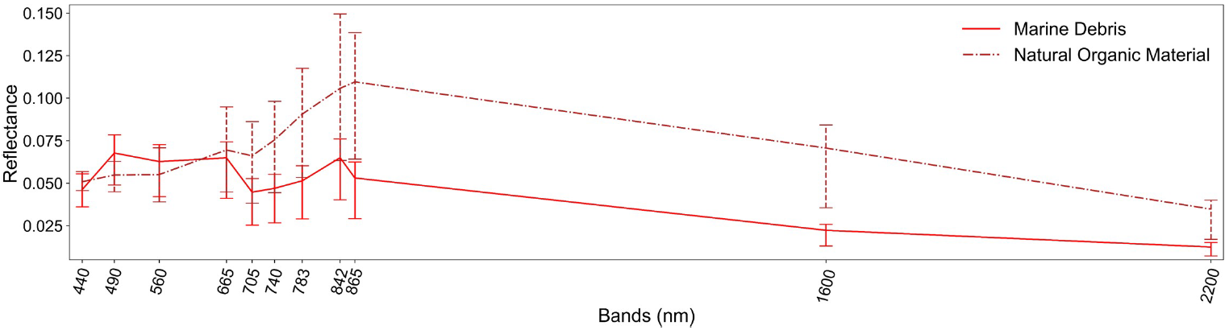
Automated satellite detection
ISSUE
OBJECTIVE
METHODOLOGY
RESULTS
CONCLUSIONS
Recognition using spectral signatures
Sentinel-2 multispectral images:
  High spatial resolution (10m)
  Low spectral resolution (11 bands)
Reflectance
Bands
Kikaki et al. 2022.
Clusters of macroplastics are detectable at sub-pixel scales. (Biermann et al. 2020.)
It is still complex to distinguish plastic from natural materials, which have very similar spectral signatures.
2
Notes:
So the first step in studying this pollution is to detect it. An effective way to detect macroplastic over large areas is through satellite imagery. To date, the vast majority of satellite-based detection of plastic debris has relied on Sentinel-2 images with high spatial resolution (10 m). But the problem is the low spectral resolution of Sentinel-2 images, which makes it difficult to differentiate between objects that have similar spectral signatures, as is the case with plastic and organic matter. And that is why it is important to study them together.

Slide 4
Objective
ISSUE
OBJECTIVE
METHODOLOGY
RESULTS
CONCLUSIONS
Improve the detection and discrimination between marine plastic debris and organic material using high spatial resolution satellite data and by training a neural network detection algorithm applicable to a large variety of coastal areas.
3

Slide 5
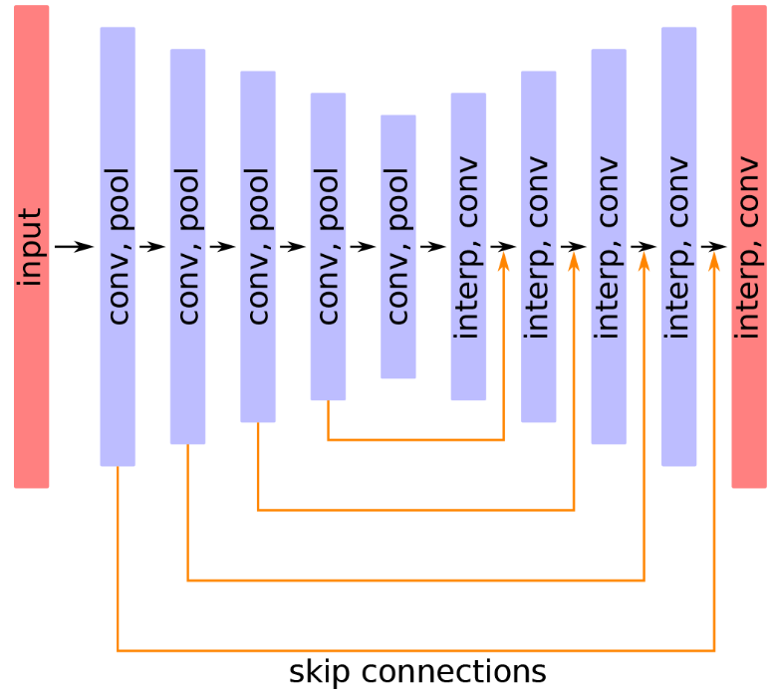
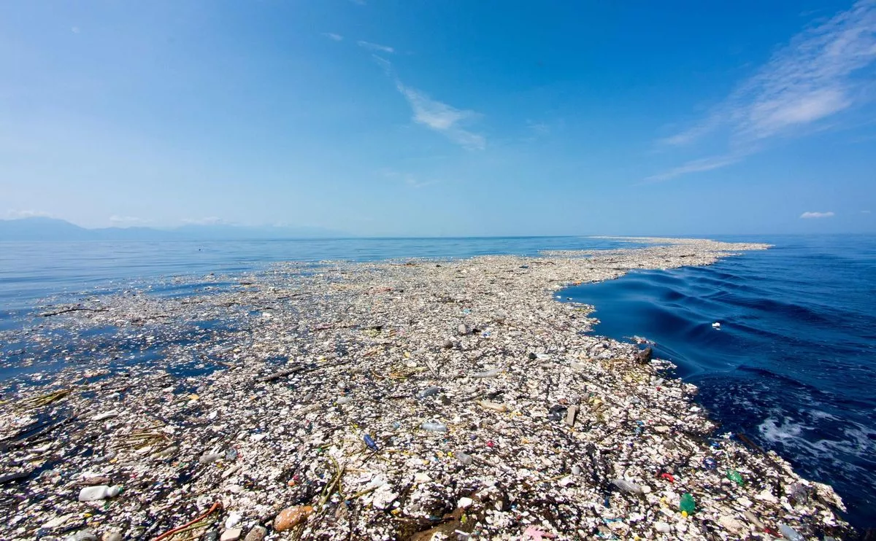
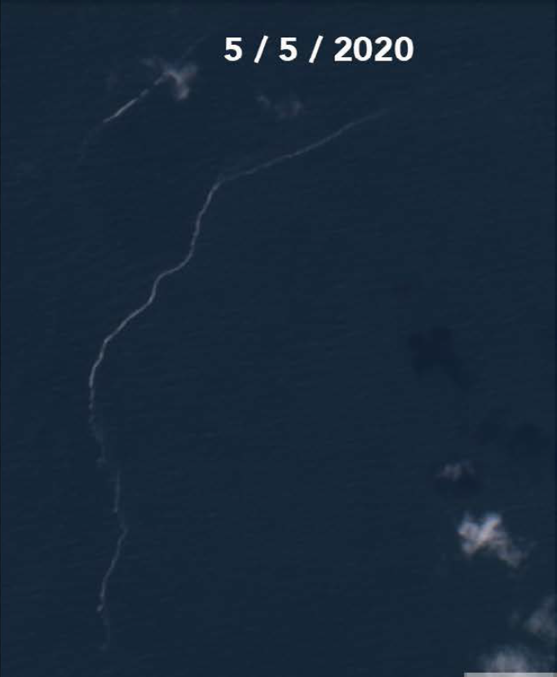
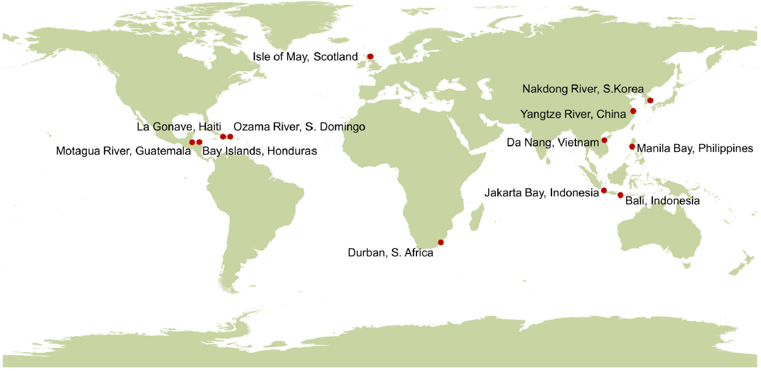
Automated satellite detection
ISSUE
OBJECTIVE
METHODOLOGY
RESULTS
CONCLUSIONS
U-Net structure
MARIDA (Marine Debris Archive)
Marine plastic debris
Roatan Island, Honduras
Image: AFP (Agence France Presse)
P. Globosa foam (Scheveningen, Netherlands)
Dimitry Van der Zande & Kevin Ruddick. 2020.
Kikaki et al. 2022.
Barth et al. 2022.
Here is proposed a machine learning approach (U-Net) to extract meaningful information from large amount of data (Sentinel-2 images from MARIDA database).
U-Net's great strength is its ability to capture structures at different spatial scales, which is very useful for detecting plastic agglomerations and foam that form structures like filaments.
(Mifdal et al. 2021; Kikaki et al. 2022; Barth et al. 2022; Booth et al. 2023)
4
Notes:
I use the U-Net neural network, a deep learning architecture primarily used for image segmentation tasks. The algorithm is trained to recognize what is on the water’s surface based on the spectral signatures of the image pixels provided as input. But U-Net’s greatest strength is its ability to perceive structures at different spatial scales, which is very well suited for detecting clusters of plastic or foam that form filament-like structures. As you can see, we end up with very similar images, but the one on the right is clearly foam, not plastic.

Slide 6

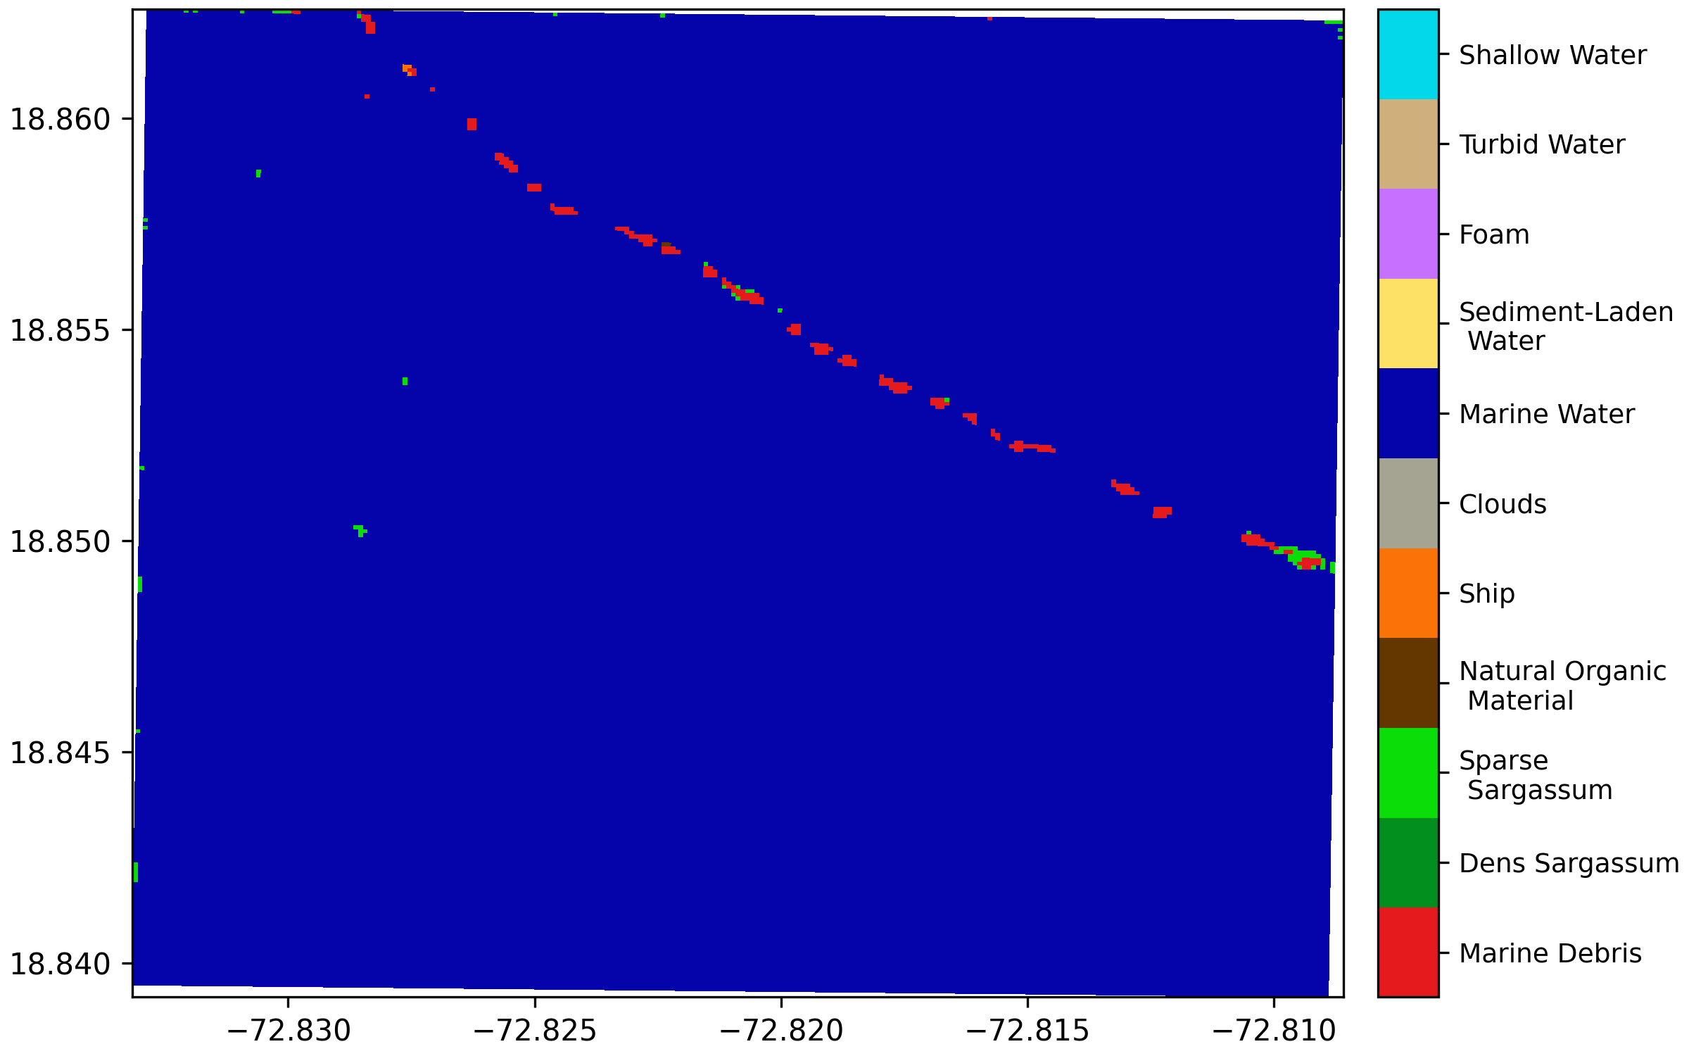
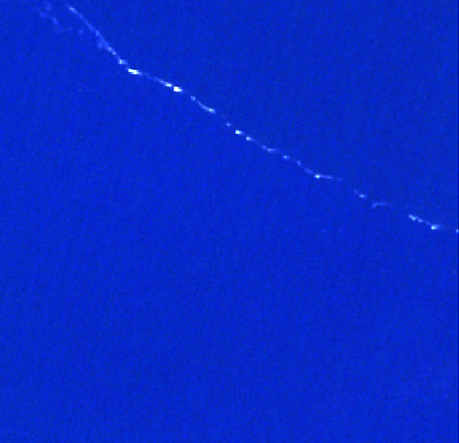
ISSUE
OBJECTIVE
METHODOLOGY
RESULTS
CONCLUSIONS
Input : Sentinel-2 images
  Pixels assigned to classes
  Classes : Marine Debris, Water, Ship, Organic matter, …
MARIDA (Marine Debris Archive)
Verified data :
Classe 1 (Marine Debris)
Sentinel-2:
Schematic U-Net structure
Prediction :
Classes:
Shallow water
encodeur
decodeur
Turbid water
Foam
Sediment-Laden Water
Marine Water
Clouds
Ships
Natural Organic Material
Sparse Sargassum
Dense Sargassum
Input : 11 spectral bands
Marine Debris
4
Barth et al. 2022.
Output
Notes:
U-Net consists of two main parts: the Encoder, which, in my case, takes Sentinel-2 images as input. The encoder consists of several convolutional blocks that reduce the image resolution and extract increasingly abstract features from the image. Next comes the Decoder, which, starting from a compressed representation of the image, gradually reconstructs the image by increasing the resolution. At the decoder’s output, an image with the same spatial resolution as the input image is obtained, where each pixel in the image is assigned a certain probability of belonging to each of the predefined classes. This prediction is compared with verified data, in which some pixels have been assigned a class based on in-situ observations and image interpretation experts. The goal is that, as training progresses, the difference between the verified data and the prediction is minimized. The reference model here is trained using the Marine Debris Archive database built by Kikaki.

Slide 7
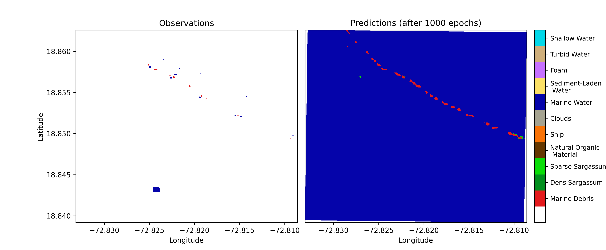
ISSUE
OBJECTIVE
METHODOLOGY
RESULTS
CONCLUSIONS
Labeled pixels from MARIDA
Classes:

Slide 8
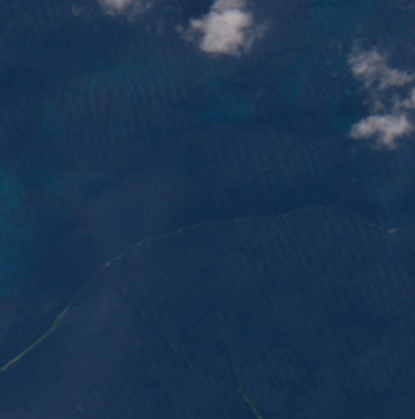
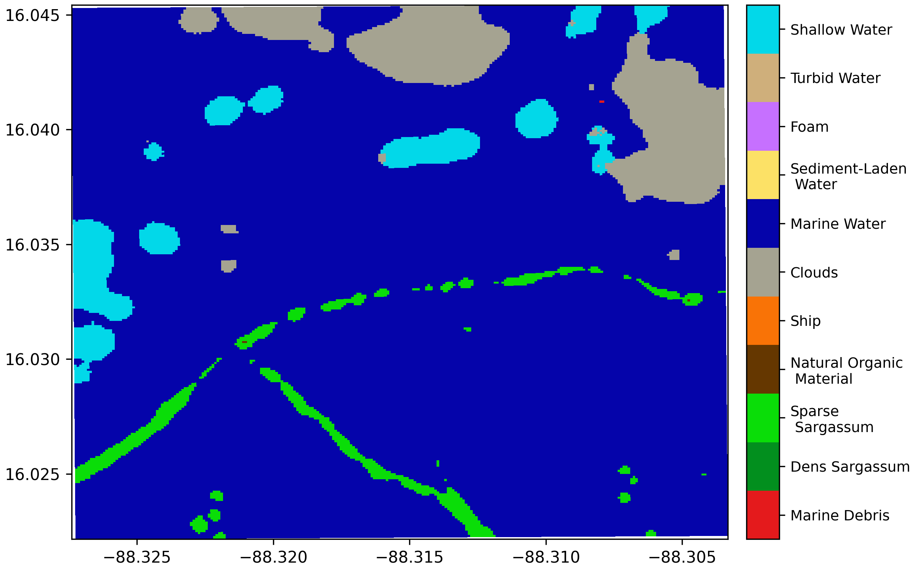
ISSUE
OBJECTIVE
METHODOLOGY
RESULTS
CONCLUSIONS

Slide 9


Some results
ISSUE
OBJECTIVE
METHODOLOGY
RESULTS
CONCLUSIONS
Intersection over Union (IoU)
$$IoU=\frac{ }{ }$$
= ensemble averaging
Everingham et al. 2015.
Predictions
True data
Predictions
True data
10
Notes:
The baseline model’s performance is reflected here by the intersection over union. This metric is defined as the intersection of the predictions and the human-annotated data, divided by their union. This metric ranges from 0 to 1, where 1 represents perfect covering. Using the baseline model as a starting point, I then tested various modifications. (Additions such as normalizing the weights at each layer, giving more weight to the plastic debris class, accounting for the confidence level in the MARIDA data, or adding noise to the training data.) I also performed ensemble averaging, which involves combining multiple models to produce a joint prediction, and we can see that for each version of the model, this significantly improves the performances. Thus, I applied the same method to different versions of the model and achieved the current highest score of 73%.

Slide 10
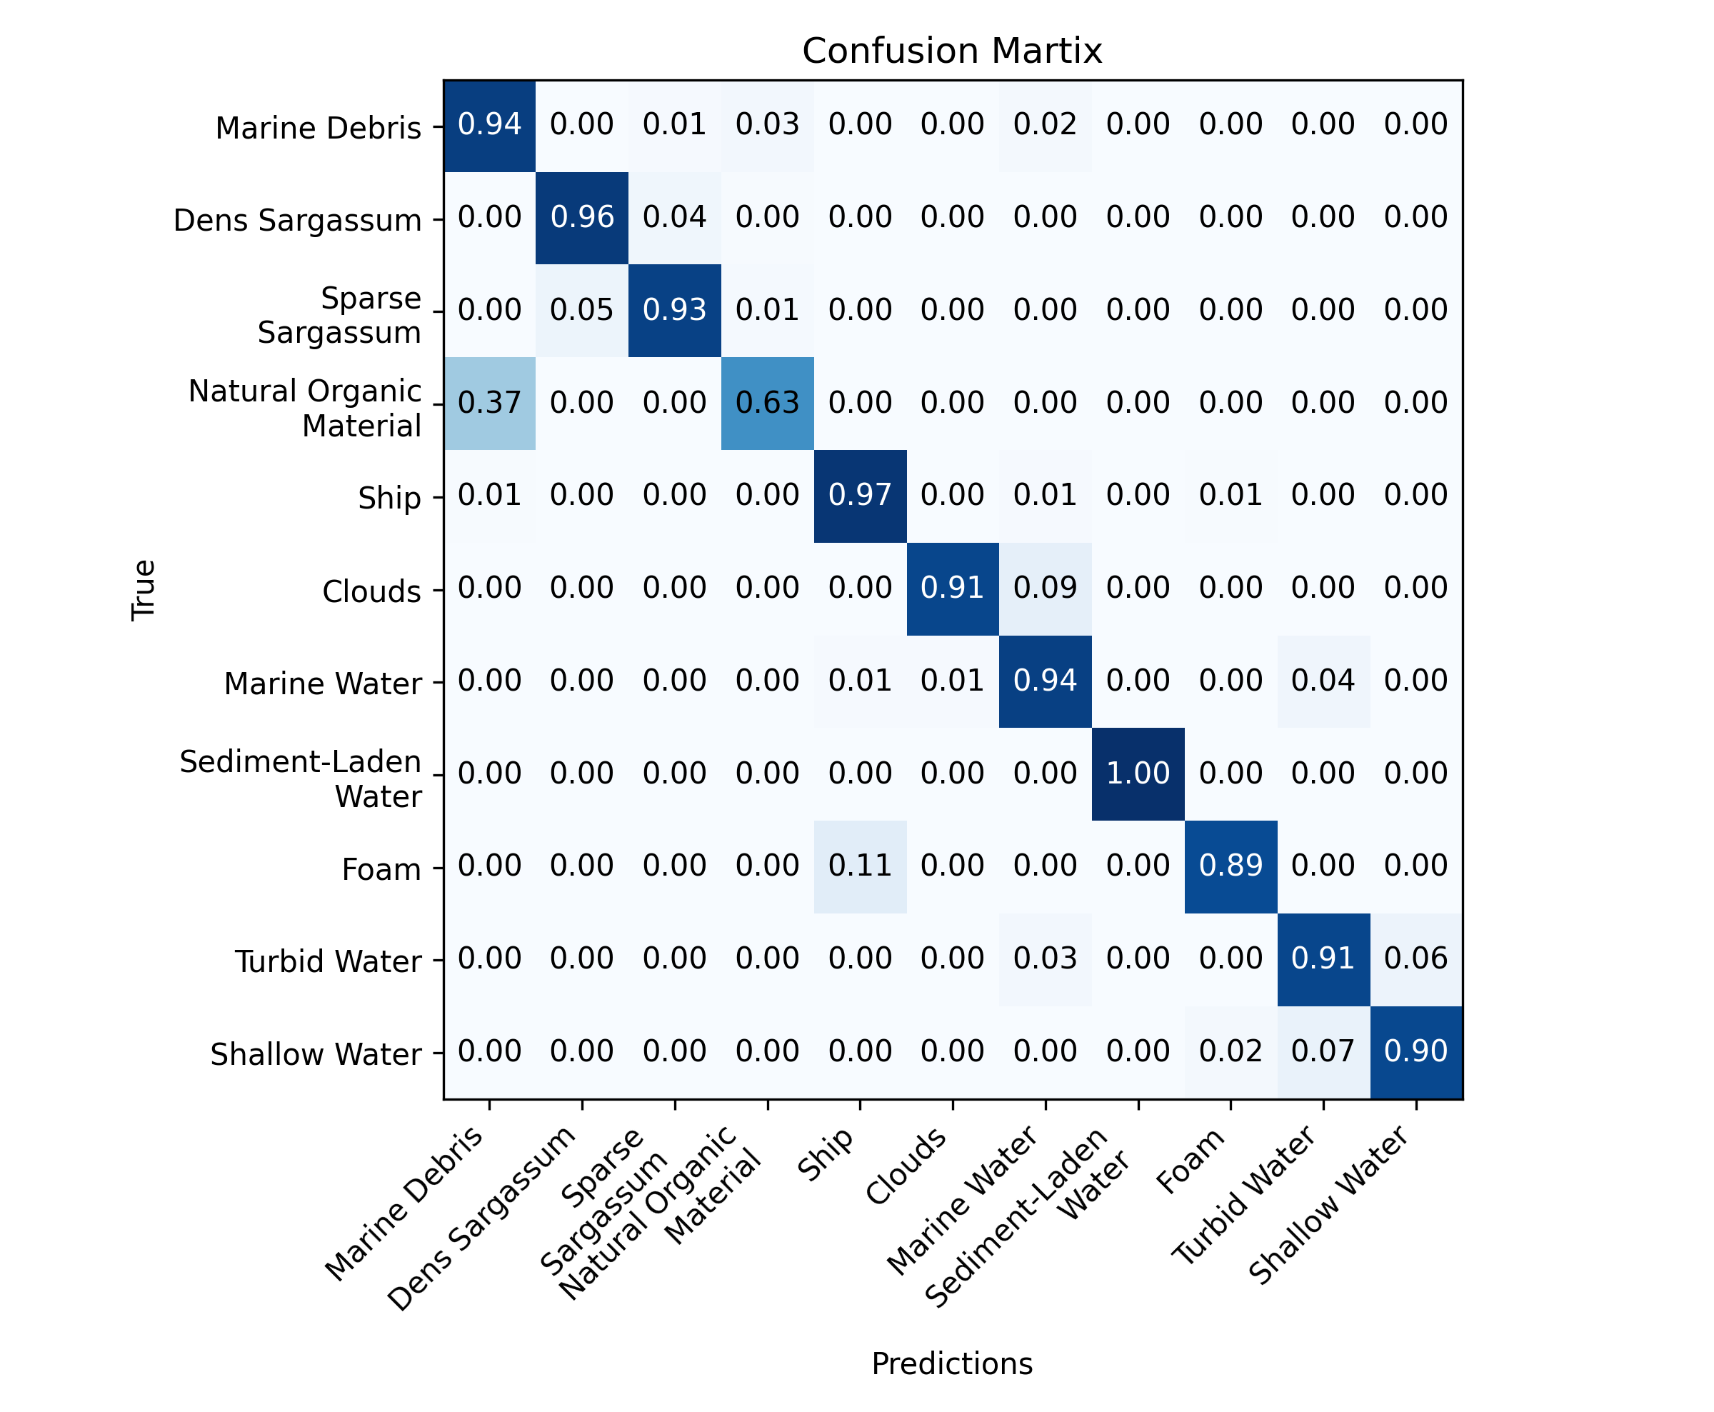
ISSUE
OBJECTIVE
METHODOLOGY
FIRST RESULTS
CONCLUSIONS
Mean metrics on test dataset
IoU | F1-score | Precision | Recall
0.777 | 0.863 | 0.832 | 0.909
$$IoU= \frac{True Positive (TP)}{TP+False Positive \left(FP\right)+False negative (FN)}$$
$$F1score=\frac{2∗Precision∗Recall}{Precision+Recall}$$
U-Net shows good results for most classes.
False-positive plastic detections are still due to the presence of natural organic matter.
MARIDA pixels are not pure : training with mixed spectral signatures
Notes:
The matrix of confusion represents the predicted pixels and the true pixels, so the observations. We ca see that the U-Net model show good performanes for most of the classes but still a lot of false-positive are still detected due to organic matter. It is important to remember that in nature, plastic and organic matter accumulate in the same convergence zone like fronts. So thath means that marida pixels are not pure neither and that we train the model with mixed spectral signatures.
Results of best runs 09-10-25 sur test dataset

Slide 11
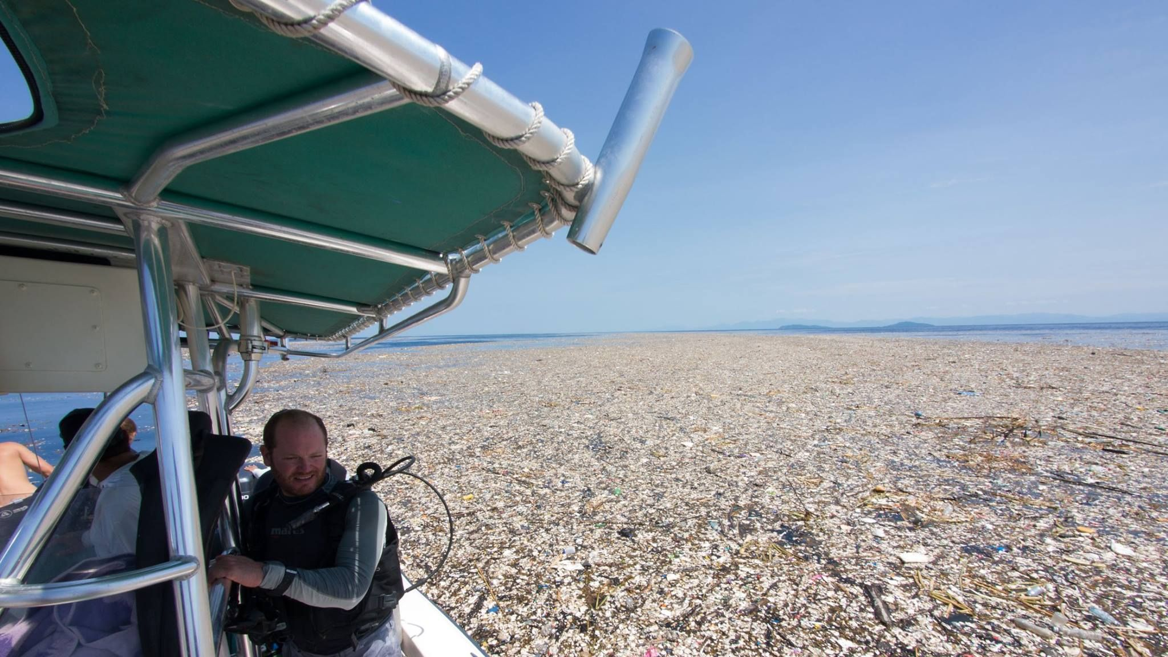
ISSUE
OBJECTIVE
METHODOLOGY
RESULTS
CONCLUSIONS
Urgent need for action
Great Potential for Automating Satellite Remote Sensing
Analysis of Long-Term Trends
Open-Source Code Available
Photo: Caroline Power Photograpahy
Plastic and vegetation. Roatan Island, Honduras (2017)
11
Notes:
Given this urgent situation, it is necessary to develop policies for the sustainable management of the coastal environment. To this end, the automation of satellite-based detection of such pollution holds enormous potential for protecting the environment. Ultimately, the code will be made available as open source and can be used by others in their regions of interest.

