Slide 1


Characteristics and didactical foundations of a game-based learning approach for chemistry teaching
Maxime Hansen
PRESS START
Notes:
Hi everyone! I am Maxime Hansen, a PhD student and teaching assistant for the department of chemistry at the University of Liège and today, I am going to talk about my PhD project that tries to encapsulate the game-based learning approaches for chemistry teaching.
As you can understand, I am a chemist, but I am also a gamer (mainly video games). That is what inspired me to develop this project that I am going to talk with you today.

Slide 2
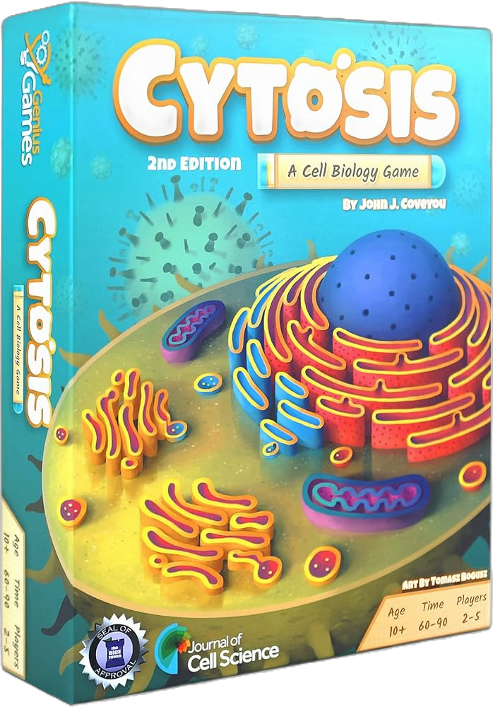
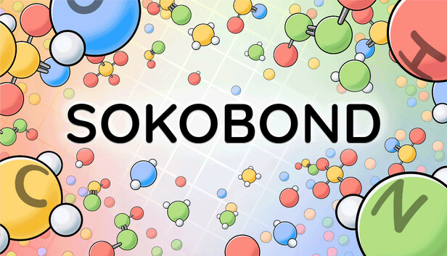



Game, Sciences and learning
Natural Sciences
Biology
Chemistry
Physics
Earth Science
Astronomy
Notes:
When we try to look out for games about natural sciences, we can find a large amount of games, either entertainment or educational games. Some are specific to one of the 5 main branches of natural sciences, such as Cytosis, Sokobond, or KSP. But all those branches are not equivalently represented, and some fields (such as biology or physics) present a larger amount of available games compared to other topics like chemistry.
This raises quite a few questions: why chemistry is less represented ? Maybe this topic is less suited for a game ? Maybe chemistry is an unknown field for game developers ? Maybe chemistry is seen as not compatible with games ?

Slide 3
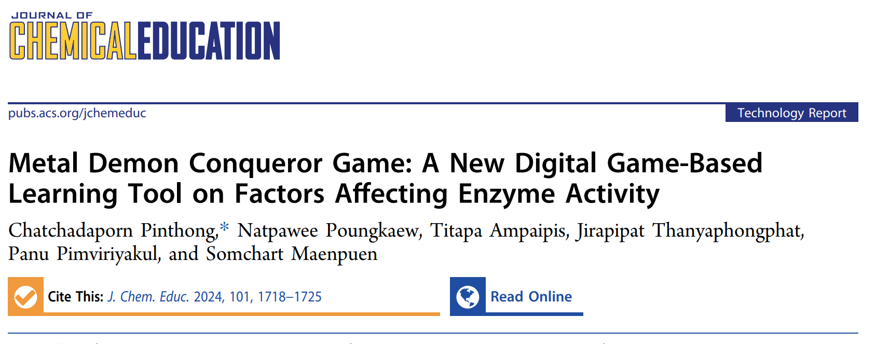
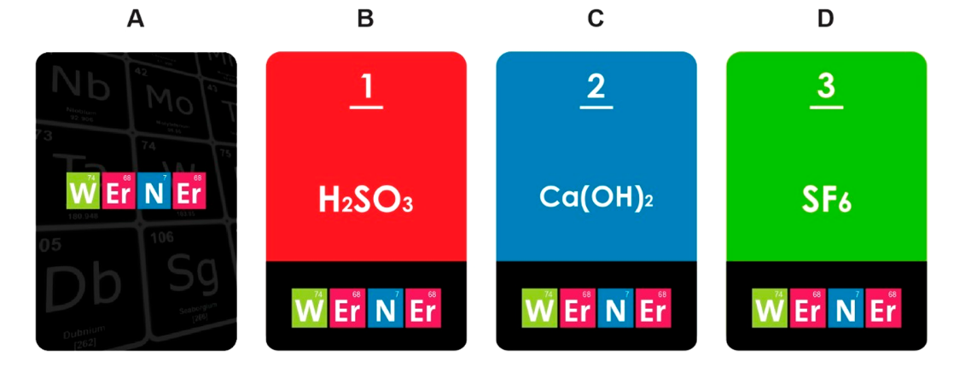

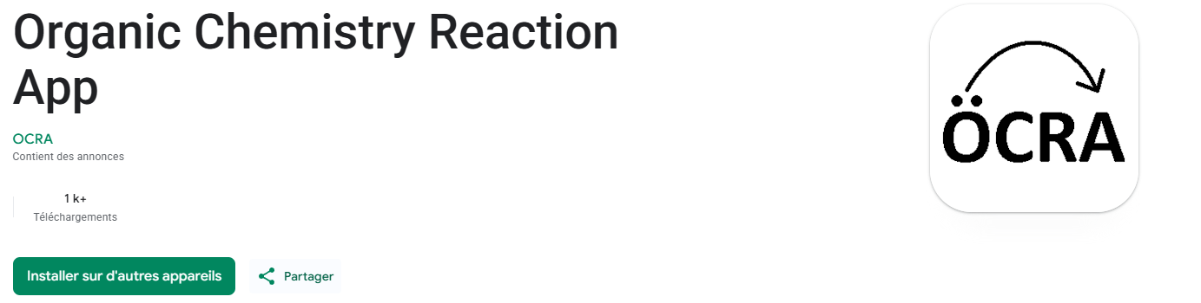
Games, chemistry and learning
(Pinthong et al., 2024)
(Buendía-Atencio et al., 2022)
https://ocradev.itch.io/organic-chemistry-reaction-app/devlog/477872/introducing-ocra
(Engstler & Marohn, 2025)
Notes:
When we try to look out for games developed for chemistry education, we can find a large amount of educational games.
There is also a significiant body of scientific literature about games in chemistry education. However, those are mainly primary studies, and review articles such as systematic reviews are not common.

Slide 4
Games, Sciences and learning
A systematic literature review of game-based approaches in chemistry education (2014-2024) (Elmali et al., 2026)
Game-based learning approach on students’ motivation and understanding of chemistry concepts: A systematic review of literature (Byusa et al., 2022)
Game-Based Learning Application in Chemistry Learning: A Systematic Literature Review (Putri et al., 2022)
Chemistry Game Cards as an Alternative Media for Learning: A Literature Review (Nadila et al., 2024)
Systematic Literature Review: A Fun Organic Chemistry Learning Experience with Educational Games (Satari et al., 2024)
Game-based learning has good chemistry with chemistry education: A three-level meta-analysis (Hu et al., 2022)
Effects of Game-Based Learning on Students’ Motivation in Chemistry: A Meta-analysis (Xu et al., 2025)
Notes:
Within the few different systematic reviews available, some look at different game-based approach used in chemistry games, or the available types games for chemistry education. But within those studies, only 2 meta-analyses are found that concentrate specifically on the effect of chemistry games on motivation or emotion. As those papers tend to be general, focused on a small period of time (5 to 10 years) or specific to a type of media, this gave the impression of a research field that that goes in many directions and has still a lot to explore.
The available literature also tend to present flaws in methodology. As an example, within this list of paper, some studies focus on a game-based learning approach but included papers about gamification! Others simply confuse a GBL and a gamification approach.
Primary papers on the other hand only try to developed games without investigating the impact of specific game mechanics… This led to the hypothesis that this field of research is more concentrated on the production of games rather than the study of such tools (Hu et al., 2022)

Slide 5
Triforce of this research
Educational studies
Chemistry
games
Chemistry didactics
Game studies
Notes:
My thesis will therefore try to approach those games with a broader view, not solely focused on the production.
Of course, this kind of research is at the intersection of 3 fields: game studies, educational studies and chemistry didactics. As current research in the field of chemistry game mainly rely on the didactical component, this research tries to have a transversal component and use what is already explored by other fields.

Slide 6
And then?
From ideas to a research framework

Slide 7
Steps for this research
Systematic review (with/without MA) concentrated on a digital game-based learning approach
  Recommended by the current literature (Elmali et al., 2026; Byusa et al., 2022; Hu et al., 2022)
  RQ1: “What is the available body of literature about Digital Game-Based Learning (DGBL) practices for chemistry education from secondary through higher education?”
  RQ2: “What are the characteristics of DGBL practices in chemistry education from secondary through higher education?”
Notes:
The first step for my research is of course to have an idea of what was already done about this topic. Therefore, the main primary step is to developed a systematic review focused on a digital game-based learning approach. Those choices of game approach and media type is recommended by the literature but is also a personal choice (I have the chance of choosing!)
The development of such studies is based on 2 main questions:

Slide 8
Steps for this research
Systematic review (with/without MA) concentrated on a digital game-based learning approach
  RQ3: “What is the efficacy of a DGBL approach in chemistry education compared to traditional teaching methods for students from secondary through higher education? (media comparison) ”
  RQ4: ” Which elements of DGBL in chemistry education have the greatest impact on students from secondary through higher education? (value-added comparison)”
Notes:
The MA analysis part is also based on 2 main questions

Slide 9
Steps for this research
Systematic review (with/without MA) concentrated on a digital game-based learning approach
  PRISMA framework (Page et al., 2021)
Identification
Screening
Eligibility
Inclusion
Analysis
Notes:
The development of this systematic review uses the PRISMA framework, as it is generally the most used within the field of education.

Slide 10
Steps for this research
Systematic review (with/without MA) concentrated on a digital game-based learning approach
  PRISMA framework
    Databases: ERIC, SCOPUS, EBSCO
    Journals: JCE, CERP
    Grey literature
Identification
Screening
Eligibility
Inclusion
Analysis
(Chemical OR Chemistry OR descriptor:(Chemistry)) AND ("Game-based Learning" OR Gamification OR "Educational Games" OR "Video Games" OR "Computer Games" OR “Serious Game”) AND ("Electronic Learning" OR "Educational Technology" OR "Handheld Devices" OR "Technology Integration" OR "Technology Used in Education" OR "Computers")
Notes:
For the identification part of the framework, different database and journals were used. The research included also grey literature, as there is a large number of game developed withtout the aim of scientific publication.
Example of a research string is shown. This string tries to include most of the term used to describe games, chemistry and a digital media. It is essential to note that because there is a confusion between GBL and gamification, those terms have to appear in the research string!

Slide 11
Steps for this research
Systematic review (with/without MA) concentrated on a digital game-based learning approach
  PRISMA framework
    Large and general research keys → 2929 records
    Duplicate removed → 2240 records
    Pre-screening only for chemistry education and game approaches
    Current phase of the research
Identification
Screening
Eligibility
Inclusion
Analysis
Notes:
First research led to 2929 records, and 2240 with elimination of duplicates. This total number will be screened using only title or abstract to exclude non-relevant literature that does not talk about chemistry education or game approaches. This is the current phase of the research

Slide 12
Steps for this research
Systematic review (with/without MA) concentrated on a digital game-based learning approach
  PRISMA framework
    Game-based learning approach
    Digital or mixed media
    Primary research
    Language
    Accessibility
    …
Identification
Screening
Eligibility
Inclusion
Analysis
Notes:
Following the PRISMA framework, eligibility of the retained articles will be evaluated using different inclusion criteria. This is at this stage that the distinction between GBL and gamification takes place. Other criteria will focus on type of media, type of research, language, …

Slide 13

Steps for this research
Systematic review (with/without MA) concentrated on a digital game-based learning approach
  PRISMA framework
Identification
Screening
Eligibility
Inclusion
Analysis

Slide 14
Steps for this research
Other purposes of a systematic review
  Game mechanics of game-based learning
  Topics of chemistry, teaching scenarios,…
  Didactical models
  Database for available games
Notes:
One of the advantages of pursuing a systematic review is that is has allowed me to have an overview of the topic investigated by the literature. At the end of this research, it also help me to have an idea of different subjects that I wanted to explore during this thesis.

Slide 15
Steps for this research
Systematic review (with/without MA) concentrated on a digital game-based learning approach
Exploration of the impact of DGBL on
  Motivation or emotion
  Cognition
  Misconceptions

Slide 16

More information
Stay in touch!
Download this presentation
Notes:
Si vous souhaitez en savoir plus, je vous redirige vers mes travaux en scannant le QR code suivante, qui vous permettra de télécharger cette presentation mais également de consulter mon poster qui développe plus les aspects discutés aujourd’hui.

Slide 17
References
Buendía-Atencio, C., Pieffet, G. P., & Lorett Velásquez, V. P. (2022). Werner: A card game for reinforcement learning of Inorganic Chemistry nomenclature. Journal of Chemical Education, 99(5), 2198–2203. https://doi.org/10.1021/acs.jchemed.2c00166
Byusa, E., Kampire, E., & Mwesigye, A. R. (2022). Game-based learning approach on students’ motivation and understanding of Chemistry Concepts: A systematic review of literature. Heliyon, 8(5). https://doi.org/10.1016/j.heliyon.2022.e09541
Elmali, S., Freund, L., & Tiemann, R. (2026). A systematic literature review of game-based approaches in Chemistry Education (2014–2024). Chemistry Education Research and Practice, 27(1), 31–44. https://doi.org/10.1039/d5rp00248f
Engstler, V. L., & Marohn, A. (2025). Designing effective educational escape games: Results from the design-based research project chemical [esc]ape. Journal of Chemical Education, 102(10), 4498–4507. https://doi.org/10.1021/acs.jchemed.5c00761
Hu, Y., Gallagher, T., Wouters, P., van der Schaaf, M., & Kester, L. (2022). Game‐based learning has good chemistry with Chemistry Education: A three‐level meta‐analysis. Journal of Research in Science Teaching, 59(9), 1499–1543. https://doi.org/10.1002/tea.21765
Introducing OCRA - organic chemistry reaction app by ocradev. (n.d.). https://ocradev.itch.io/organic-chemistry-reaction-app/devlog/477872/introducing-ocra
Nadila, N., Enawaty, E., Erlina, E., & Masriani, M. (2024). Chemistry Game Cards as an alternative media for learning: A literature review. Hydrogen: Jurnal Kependidikan Kimia, 12(5), 1058. https://doi.org/10.33394/hjkk.v12i5.13130
Page, M. J., McKenzie, J. E., Bossuyt, P. M., Boutron, I., Hoffmann, T. C., Mulrow, C. D., Shamseer, L., Tetzlaff, J. M., Akl, E. A., Brennan, S. E., Chou, R., Glanville, J., Grimshaw, J. M., Hróbjartsson, A., Lalu, M. M., Li, T., Loder, E. W., Mayo-Wilson, E., McDonald, S., … Moher, D. (2021). The prisma 2020 statement: An updated guideline for Reporting Systematic Reviews. BMJ. https://doi.org/10.1136/bmj.n71
Pinthong, C., Poungkaew, N., Ampaipis, T., Thanyaphongphat, J., Pimviriyakul, P., & Maenpuen, S. (2024). Metal demon conqueror game: A new digital game-based learning tool on factors affecting enzyme activity. Journal of Chemical Education, 101(4), 1718–1725. https://doi.org/10.1021/acs.jchemed.3c01212
Putri, I.Y.V.S., Dasna, W., & Rahayu, S. (2022). Game-based learning application in Chemistry Learning: A systematic literature review. Jurnal Pendidikan MIPA, 23(1), 1–12. https://doi.org/10.23960/jpmipa/v23i1.pp01-12
Satari, C., Wiji, W., Widhiyanti, T., & Mulyani, S. (2024). Systematic literature review: A fun organic chemistry learning experience with educational games. Jurnal Penelitian Pendidikan IPA, 10(7), 377–487. https://doi.org/10.29303/jppipa.v10i7.6855
Xu, J. J., Sun, X. F., Liu, Y. N., Zhang, S. Y., & Zhou, Q. (2025). Effects of game-based learning on students’ motivation in Chemistry: A meta-analysis. Journal of Chemical Education, 102(3), 1117–1128. https://doi.org/10.1021/acs.jchemed.4c01304

