Slide 1


Intervenir sur le craving au jeu d’argent
Mise à l’épreuve de la méthode de l’interférence
A. Cornil & J. Billieux
Laboratoire de Psychopathologie Expérimentale
GREPACO 2017, Lille

Slide 2
Introduction
Craving au jeu d’argent
Pas un critère diagnostique dans le DSM-5 (American Psychiatric Association, 2013)
Rôle dans le maintien et la rechute(e.g., Ashrafioun & Rosenberg, 2012; Hormes, 2017; Young & Wohl, 2009)
Déclenché par des indices externes et internes (e.g., Smith et al., 2013; Potenza et al., 2003)
Notes:
Gambling disorder has recently been aligned to other addictions in DSM 5. Craving is now recognized as a diagnostic criterion for substance related and addictive disorders. Although, it was surprisingly not proposed as such for gambling disorder, even if its role in maintenance and relapse of gambling disorder is well established. Other research show gambling craving might be triggered by internal and external cues, as in models of craving related to substances.

Slide 3
Introduction
Un modèle cognitif du craving: la théorie de l’intrusion élaborée du désir (TIE – Kavanagh et al., 2005)
Pensées liées au désir
Influences Automatiques
Attribution de la mémoire de travail / attentionnelle
Plaisir / Soulagement
Sentiment de manqué associé
État subjectif de désir
Notes:
craving or desire: "an emotionally charged mental state where an urge or desire to engage in a particular behaviour is maintained in focal attention" (May et al., 2010)
To have a better understanding of this theory, I’ll take examples related to gambling. Intrusive thoughts (verbal) related to the object of desire (how nice it would be to gamble) but also imagery on one or several sensorial modalities (visual, olfactory, auditive…). And as you satisfy your desire in a lesser extent, it induces pleasure and relief that reinforce the desire thoughts elaboration
The pleasure/relief also increases the sense of associated deficit → difference between the thoughts and reality
The experience consist of those two vicious spirals of craving is located in this box and has a retroactive effect on the triggers.

Slide 4
Introduction
Mécanisme de l’interférence
Pensées liées au désir
Influences automatiques
Attribution de la mémoire de travail / attentionnelle
Influences automatiques
Attribution de la mémoire de travail / attentionnelle
Plaisir / Soulagement
Sentiment de manque associé
I
N
T
ER
F
ERENCE
État subjectif de désir
Tâche concurrente requérant des ressources
Notes:
The interference is the transfer of resources from a detrimental cognitive process to another cognitive task

Slide 5

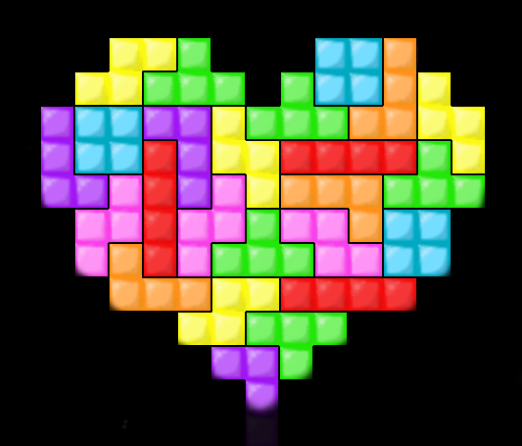
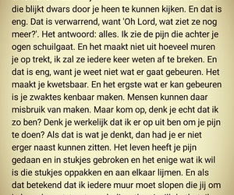
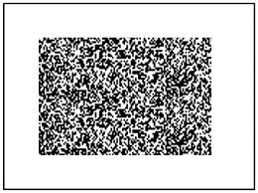
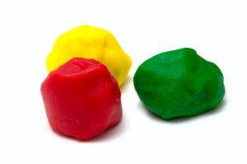
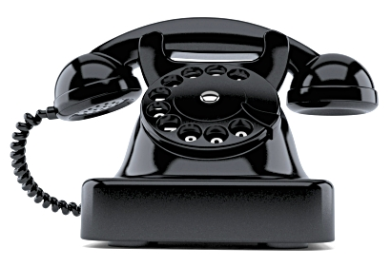
Introduction
Exemples d’études utilisant l’interférence
Study | Target | Interference Task
Kemps, Tiggeman & Hart (2005) | Induced Chocolate Craving | ● Dynamic Visual Noise ● Irrelevant Speech
Steel, Kemps & Tiggeman (2006) | Induced Food Craving | ● Dynamic Visual Noise
May, Andrade, Panabokke & Kavanagh (2010) | Induced Craving for Cigarettes | ● Auditory Mental Imagery ● Visual Mental Imagery
 |  | ● Auditory Mental Imagery and Dynamic Visual Noise ● Visual Mental Imagery
 |  | ● Auditory Mental Imagery ● Visual Mental Imagery
 |  | ● Clay Modeling
Andrade, Pears, May & Kavanagh (2012) | Induced Chocolate Craving | ● Clay Modeling
 |  | ● Clay Modeling
Skorka-Brown, Andrade, Whalley & May (2014) | Naturally-occuring Food, Drink, Caffeine or Nicotine Craving | ● Puzzle Video Game "Tetris“
Notes:
Dynamic Visual Noise
Irrelevant Speech
Auditory Mental Imagery
Visual mental imagery
Clay Modeling
Puzzle Video Game Tetris
Different tasks aiming at monopolizing cognitive resources

Slide 6
Introduction
Présentation de l’étude
Cette étude a pour but de
  Tester l’efficacité d’une intervention basée sur l’interférence sur le craving au jeu d’argent
  Comparer son efficacité avec une tâche contrôle

Slide 7
Méthodologie – Design (1)
Recrutement –Questionnaire en ligne
  Données démographiques, Jeux favoris, Impulsivité (UPPS-P), Symptômes de Jeu (ICJE), Compétences d’Imagerie(Psi-Q)
  Fréquence des Cravings au Jeu (CEQ-F)
Notes:
Recent studies shows a link between impulsivity and craving
Score at CPGI allows to differentiate at risk gamblers from non risky gamblers
Imagery abilities as they are involved in the elaboration of mental images

Slide 8
Méthodologie - Échantillon
38 joueurs occasionnels (minimum une fois/mois)
  16 hommes, 22 femmes
  Âge moyen 29 ans, tranche d’âge18-59 ans
Cartes à gratter | Loterie | Paris | Slot machine | Poker | Poker en ligne | Autres
26 | 23 | 15 | 6 | 3 | 3 | 3
Notes:
To answer this question, we conducted a qualitative study with 38 people that gamble at least once a month.
15 at risk gamblers (CPGI ≥ 3) & 23 non-risky gamblers (CGPI < 3)
As you can see, the participants had different gambling habits.

Slide 9
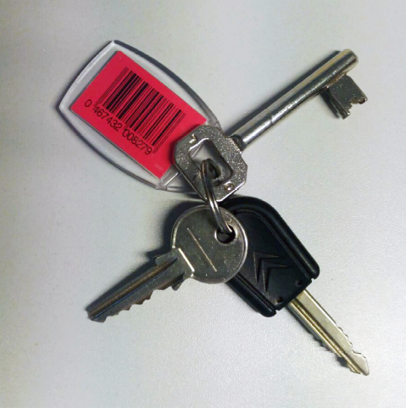
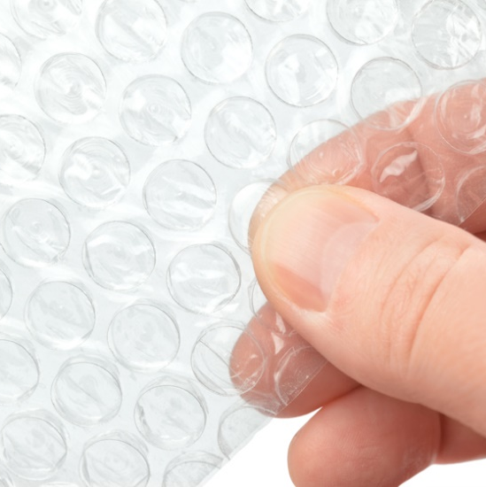
Méthodologie – Design (2)
 | Manipulation |  | Mesures
Ligne de Base |  |  | Affect (PANAS) Anxiété (STAI-Y) Intensité du craving(CEQ-S)
Induction | Imagerie + Tâche de Jeu |  | Intensité du craving(CEQ-S)
Réduction | Interférence: | Control: | Intensité du craving(CEQ-S)
Notes:
3 phases: baseline, induction and reduction
CEQ: Strength: How much Frequency: How often
Intensity of the desire Imagery is the quality, vividness of mental images Intrusiveness in the thoughts
Audio scenario for visual imagery and gambling task and win of 5 scratching tickets
Optional Short Mindfulness Session to avoid carry-over effect

Slide 10
Résultats : Comparaison des groupes
Groupes Expérimental et Contrôle sont identiques sur les variables
  Sexe et Age
  Symptômes de Jeu Problématique (ICJE)
  Compétences d’imagerie (Psi-Q)
  Anxiété (STAI-Y)
  Émotions Positive et Négatives(PANAS)
  Fréquence des cravings au jeu d’argent (CEQ-F)
  Impulsivité (UPPS-P)
Groupes Expérimental et Contrôle diffèrent sur
  Urgence (UPPS-P)
n.s.
Notes:
Studies show important relations between impulsivity and craving
Control Group scored higher on urgency [and stress] but those dimensions did not correlate significantly with the craving measures
I will present you the results with a graphic approach and with the results of tests.

Slide 11
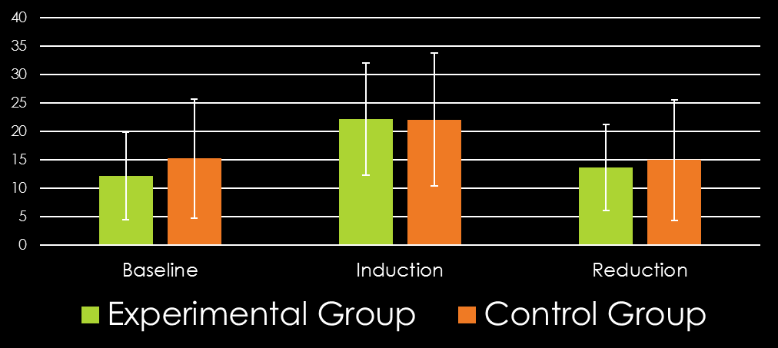
Résultats : Comparaison du craving entre les groupes contrôle et expérimental
Intensité
Imagerie
Caractère Intrusif
n.s.
n.s.
n.s.
n.s.
n.s.
n.s.
n.s.
n.s.
n.s.
*
*
*
*
*
*
* p < .05
Notes:
Independant samples T-test to compare groups and Paired-Samples T-test to investigate the 3 phases fluctuations
Standard deviation

Slide 12
Résultats: Que savons-nous jusqu’ici?
L’induction de craving a fonctionné
Les deux manipulations réduisent le craving
Tâche Interférence = Contrôle
Notes:
Induction increased Intensity, Imagery and Intrusiveness
Manipulations in both groups (expérimental and control) decreased induced craving
BUT Interference-based intervention effect is not bigger that the effect of the control task
ANOVA (with Welch’s correction in case of variance inequality) to compare the 4 groups for Intensity, Imagery and Intrusiveness and ANOVA for repeated measures to investigate the 3 phases variations
Because of the size of the samples, we chose to favour a graphical approach

Slide 13
Les résultats diffèrent-ils si l’on sépare les joueurs à risque des joueurs récréatifs?
 | Joueurs à risque | Joueurs récréatifs
Groupe Expérimental | 7 | 12
Groupe Contrôle | 8 | 11
Notes:
Present the results between groups
Between phases for each subscale

Slide 14
Résultats : Variations entre phases
XP vs CTRL x NRG vs RG - Intensité
NRG = Joueurs récréatifs
RG = Joueurs à risque
XP = Expérimental
CTRL = Contrôle
n.s.
*
*
*
* p < .05
Notes:
Bonferroni Corrections for compairisons.

Slide 15
Résultats : Variations entre phases
XP vs CTRL x NRG vs RG - Imagerie
NRG = Joueurs récréatifs
RG = Joueurs à risque
XP = Expérimental
CTRL = Contrôle
n.s.
*
*
*
* p < .05

Slide 16
Résultats : Variations entre phases
XP vs CTRL x NRG vs RG – Caractère intrusif
*
NRG = Joueurs récréatifs
RG = Joueurs à risque
XP = Expérimental
CTRL = Contrôle
n.s.
n.s.
n.s.
* p < .05

Slide 17
Discussion
Conclusion, Limitations ET PerSpectives
Interférence est une intervention pertinente pour gérer le craving chez les joueurs à risque
Répliquer sur de plus larges échantillons
Tester d’autres interventions basées sur l’interférence
Utiliser une autre tâche contrôle
Tester sur des joueurs problématiques
Notes:
Relevant on Intensity and Imagery
e.g. Tetris
(multiple single case)

Slide 18
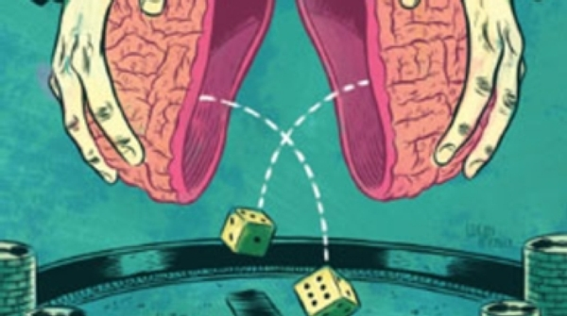
Thank you for your attention!
Avez-vous des questions?

Slide 19
Results : Variations between groups XP vs CTRL x NRG vs RG - Intensity
n.s.
*
*
*
* p < .05
Notes:
ANOVA with Welch’s correction in case of variance inequality [also non-paramatric Kruskal Wallis test as small sample → same results]
On 3 times in 4 groups for Intensity, Imagery and Intrusiveness

Slide 20
Results : Variations between groups XP vs CTRL x NRG vs RG - Imagery
n.s.
n.s.
* p < .05
Notes:
[Phase 3 was significant but as the variances were not equal, Welsh correction was applied and the result was not significant]

Slide 21
Results : Variations between groups XP vs CTRL x NRG vs RG - Intrusiveness
n.s.
n.s.
* p < .05
Notes:
[Phase 3 was significant but as the variances were not equal, Welsh correction was applied and the result was not significant]

Slide 22
INTRODUCTION
Modèles cognitifs du craving dans les troubles liés à une substance
Théorie de l’Intrusion Élaborée du désir (TIE; Kavanagh et al., 2005)
Réponses anticipatrices
Pensées associées
Indices externes
Influences
Automatiques
Allocation de l’Attention / de la Mémoire de travail
Pensées liées au désir
Rapport aux buts
Potentiel de maîtrise
Accord avec les normes
Plaisir / Soulagement
Tendance à l’action
Sentiment d’un déficit associé
État Subjectif de Désir
Affects négatifs
Déficit physiologique
Scherer (1984, 1999)
Arnold (1960), Frijda (1986)
Philippot (2011)
Notes:
Validé pour les substances
I’ll start to explain the potential triggers or sources of information and then we’ll see what is the subjective state of desire (the craving experience).
External Cues: to see some lump sugar
Anticipatory Responses: Salivation
Associated thoughts: Thinking about Jane with whom I drank a coffee this morning (which disappear unless reactivated, transitory events)
Triggers Desire thoughts
Negative affect: boredom, tiredness
Physiological deficit: difficulty to keep eyes open
Association classically conditioned or semantic or episodic
Those induce a sense of deficit Another trigger of desire thoughts
Then appear subsequent intrusive thoughts related to the object of desire (how nice it would be to have a coffee now) and as you satisfy your desire in a lesser extent, it induces pleasure and relief that reinforce the desire thoughts elaboration of imagery on one or several sensorial modalities (visual, olfactory, auditive…) → vicious spiral
This elaboration has retroactive influence on anticipatory responses, associated thoughts and sense of associated deficit.
The pleasure/relief also increases the sense of associated deficit → difference between the thoughts and reality
The experience of craving is located in this box and has a retroactive effect on the triggers.
This model allows process oriented psychological interventions and is consistent with the dual process model of addiction with distinction automatic – reflexive processes
I added to this model two components from a model of craving created by De Wildt and colleagues (2005). It is based on the Obsessive-Compulsive Drinking scale. It is not craving anymore but what comes out. And I think it is important to remind craving does not imply directly the behavior but an intention that is influenced by self-efficacy. A strong craving may not necessarily imply a consumption and a low craving may not involve abstinence.
I combined the EIT with Scherer’s theory of emotional appraisal. There are 5 dimensions: novelty, valence, goal significance, coping potential and compatibility with santards. The 2 first are, in my opinion, included in the subjective state of desire as memories are activated in desire thoughts (for novelty) and valence is positive (pleasure and relief).
To get out of the subjective state of desire, before acting (gambling), one should
Evaluate the relevance of this action regarding his goal
Evaluate if he is able to cope with acting or not (gambling or not)
Evaluate if his action is compatible with the standards
[Regarding Leventhal’s levels of processing, I consider that they are included in the process]

Slide 23
Introduction
Interference Studies examples
Study | Target | Interference Task
Kemps, Tiggeman & Hart (2005) | Induced Chocolate Craving | ● Dynamic Visual Noise ● Irrelevant Speech
Steel, Kemps & Tiggeman (2006) | Induced Food Craving | ● Dynamic Visual Noise
May, Andrade, Panabokke & Kavanagh (2010) | Induced Craving for Cigarettes | ● Auditory Mental Imagery ● Visual Mental Imagery
 |  | ● Auditory Mental Imagery and Dynamic Visual Noise ● Visual Mental Imagery
 |  | ● Auditory Mental Imagery ● Visual Mental Imagery
 |  | ● Clay Modeling
Andrade, Pears, May & Kavanagh (2012) | Induced Chocolate Craving | ● Clay Modeling
 |  | ● Clay Modeling
Skorka-Brown, Andrade, Whalley & May (2014) | Naturally-occuring Food, Drink, Caffeine or Nicotine Craving | ● Puzzle Video Game "Tetris“
Notes:
Dynamic Visual Noise
Irrelevant Speech
Auditory Mental Imagery
Visual mental imagery
Clay Modeling
Puzzle Video Game Tetris
Different tasks aiming at monopolizing cognitive resources

