Slide 1
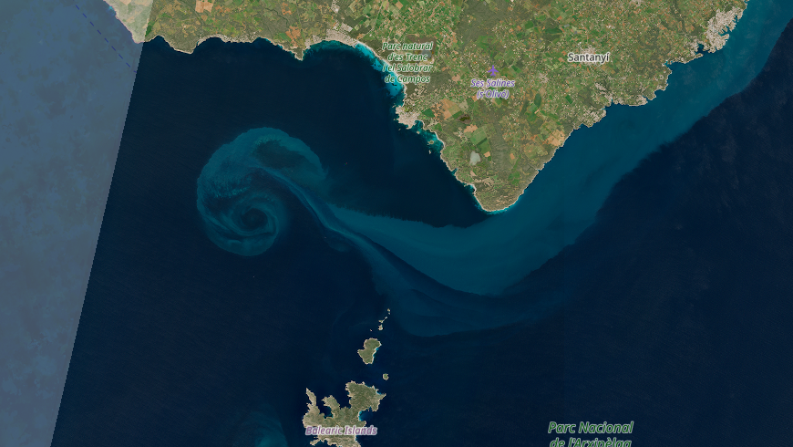



Fast-SWOT & DIVAnd
High resolution surface currents interpolation
Abel Dechenne¹, Ananda Pascual², Aida Alvera-Azcarate¹, Alexander Barth¹
¹ULiege | University of Liege, GeoHydrodynamics and Environment Research (GHER), Liege, Belgium
²IMEDEA | Mediterranean Institute for Advanced Studies

Slide 2
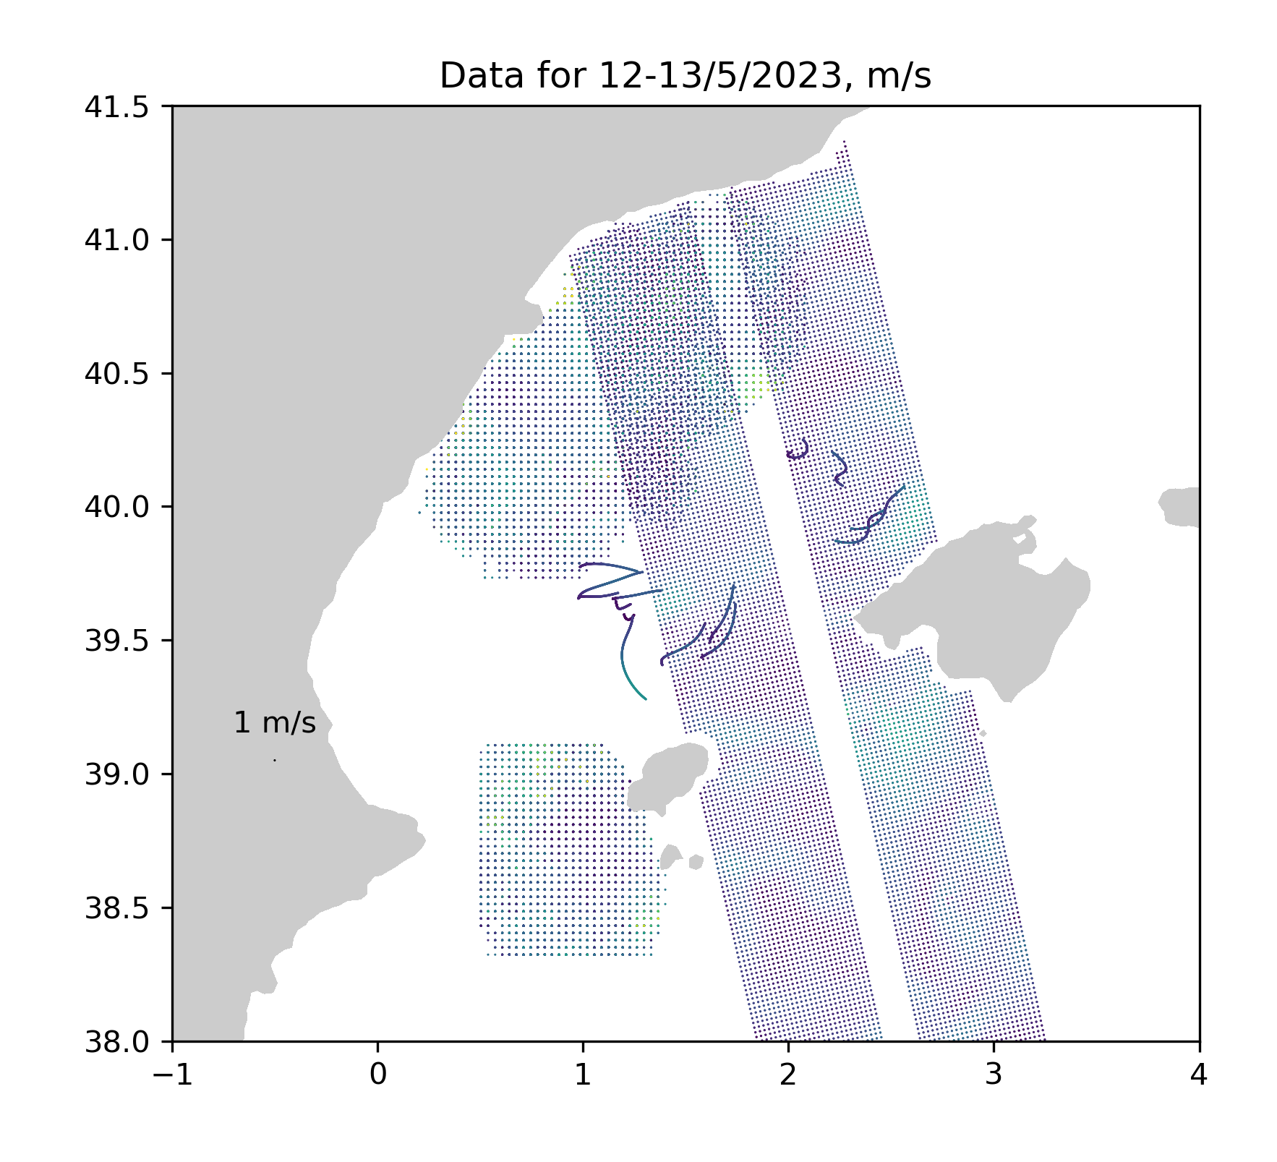
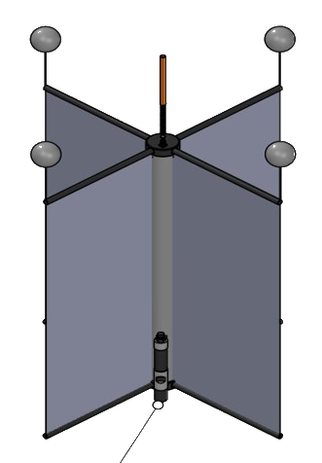

Surface currents: Balearic Sea
Surface current observations (12-13 May 2023)
Transport heat, salinity, nutrients, planktons
  River runoff
  Bloom dispersal
  environmental monitoring and protection
Numerical tools are based on remote and in-situ observations
  model forcing
  marine debris & oil spill forecast
Spain
Mallorca
Ibiza
Scattered data require estimating values at unsampled locations

Slide 3
Which observations are used?
How does the interpolation operate?
What are the resolution and the parameters?
How do we validate the results?

Slide 4
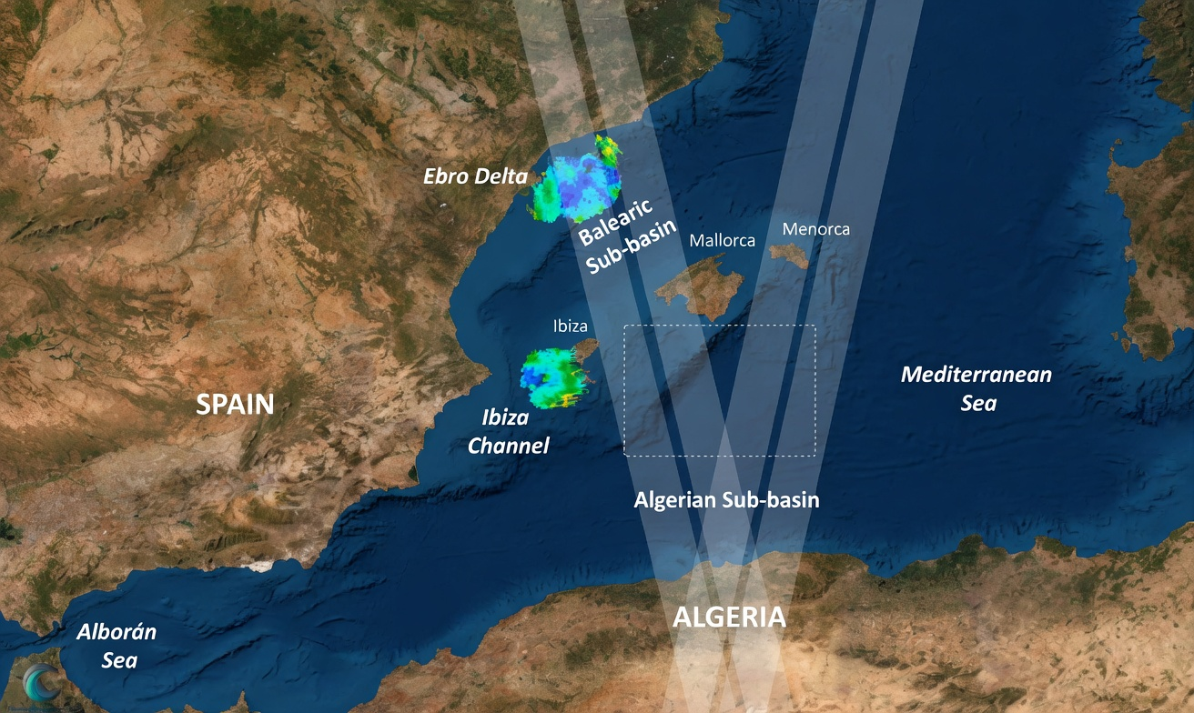
FAST-SWOT campaign
Oceanographic cruise during Fast-SWOT phase (April – July 2023)
  IMEDEA & SOCIB
In-situ observations to support the initial fast sampling phase of SWOT satellite
Large amount of dataset for a restricted area during a controlled period
Objective :
Evaluate the surface currents interpolation capabilities based on the FAST-SWOT oceanographic campaign
https://www.swot-adac.org/campaigns/fast-swot/

Slide 5
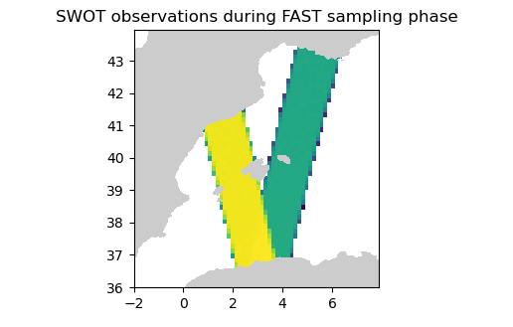

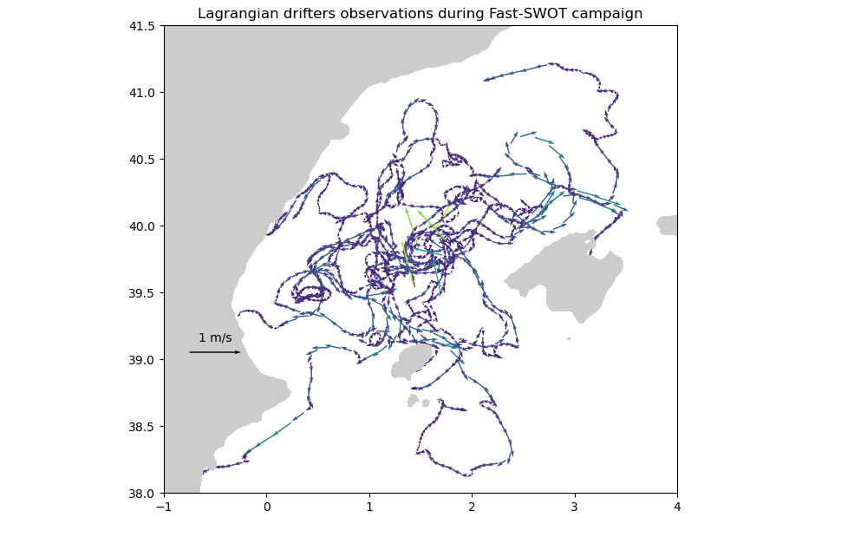
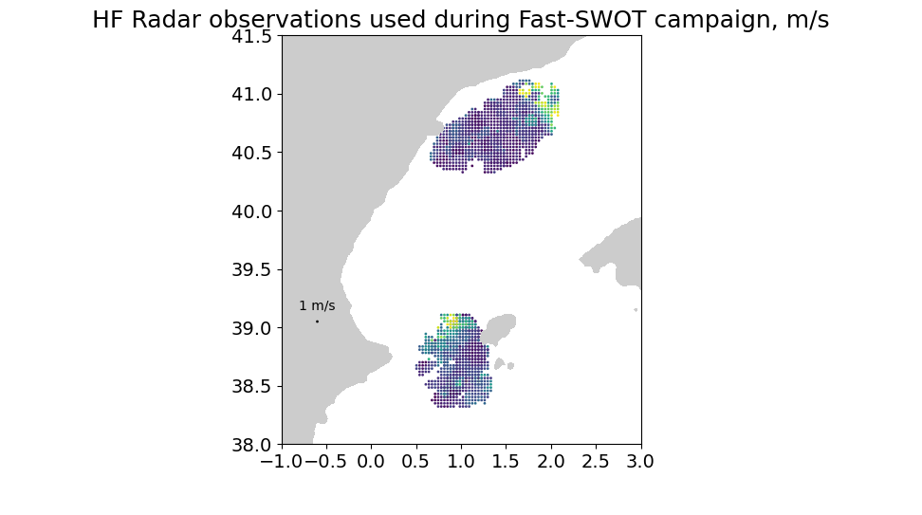
Collected dataset

Slide 6

Which observations are used?
How does the interpolation operate?
What are the resolution and the parameters?
How do we validate the results?

Slide 7
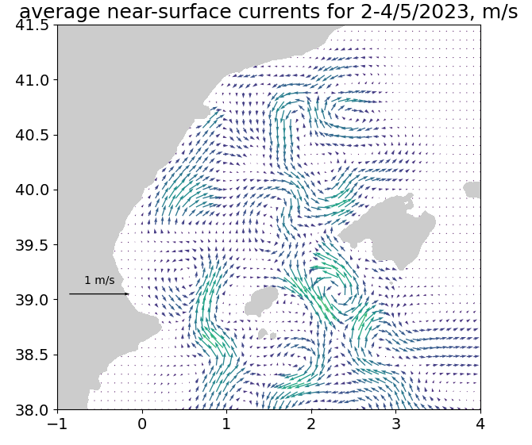
Interpolation method
Level3 dataset
(scattered)
Level4 dataset
(gridded)
Surface current observations (2-4 May 2023)
DIVAnd

Slide 8
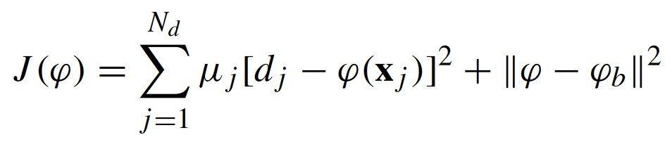
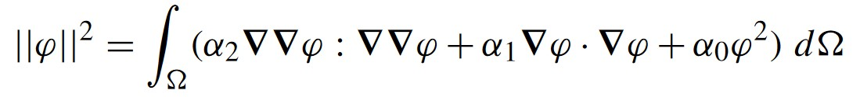
Interpolation method
Variational inverse method
It penalizes the abrupt variations of the interpolated field
Ocean field
Observations – Predicted field
Predicted field - Background estimate
Laplacian
Gradient
Anomalies
We add various constraints to our cost function!

Slide 9
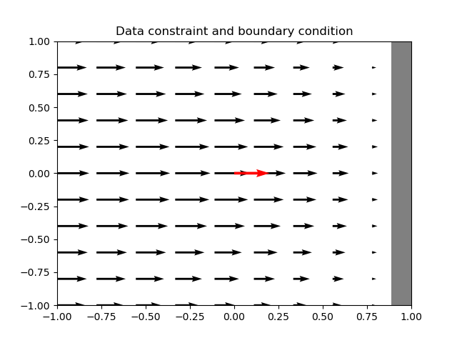
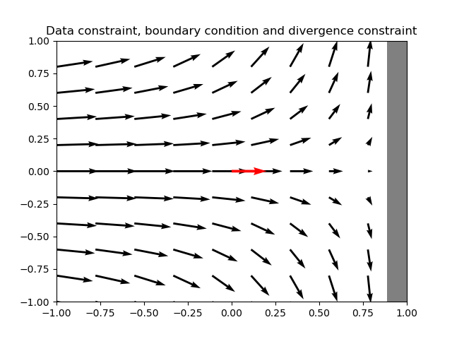
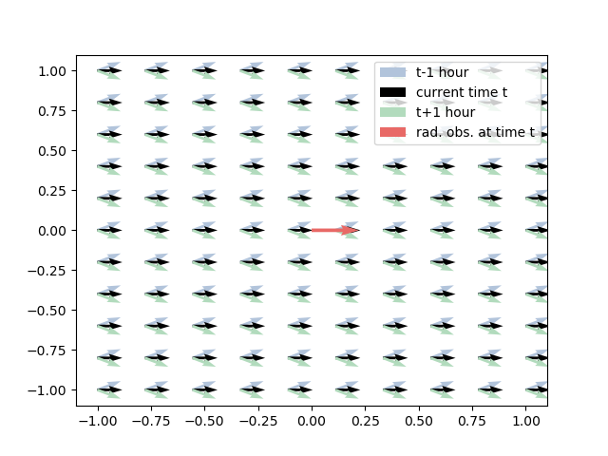
Interpolation method
1.
2.
Type of interpolation
DIVAnd (data interpolating variational analysis in n dimensions)
Penalizes abrupt variations
Several constraints are considered:
3.
Presence of the coastline (1)
Horizontal divergence (2)
Temporal coherence (3)
Momentum balance (including Coriolis force)

Slide 10


Which observations are used?
How does the interpolation operate?
What are the resolution and the parameters?
How do we validate the results?

Slide 11
Resolution
Legend
= One day
= Observations
DIVAnd
1
2
3
4
5
6
7
8
9
10
Days
Time resolution : 2 days

Slide 12
Resolution
Legend
= One day
= Observations
DIVAnd
1
2
3
4
5
6
7
8
9
10
Days
Time resolution : 2 days

Slide 13
Resolution
Legend
= One day
= Observations
DIVAnd
1
2
3
4
5
6
7
8
9
10
Days
Time resolution : 2 days

Slide 14
Resolution
Legend
= One day
= Observations
DIVAnd
1
2
3
4
5
6
7
8
9
10
Days
Time resolution : 2 days
Space resolution : 0.08° (~8.9km x 6.9km)

Slide 15
Parameters
Legend
= One day
= Observations
DIVAnd
1
2
3
4
5
6
7
8
9
10
Days
Time resolution : 2 days
Space resolution : 0.08° (~8.9km x 6,9km)
Relative errors
  Drifters
  HF Radars
  SWOT satellites

Slide 16

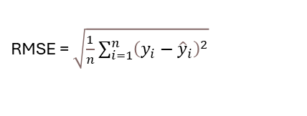
Which observations are used?
How does the interpolation operate?
What are the resolution and the parameters?
How do we validate the results?
RMSE = $\sqrt{\frac{1}{n}\sum_{i=1}^{n}{{\left(y_{i}−{\hat{y}}_{i}\right)}^{2}}}$

Slide 17
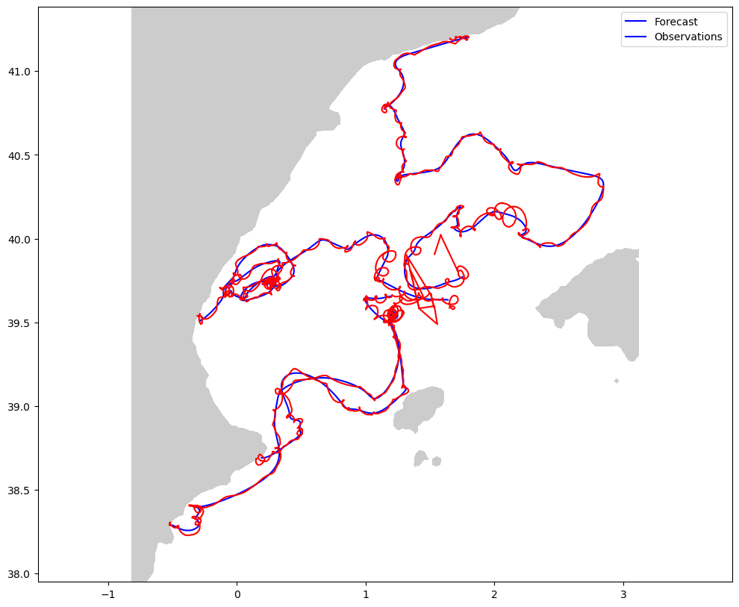
Cross-validation
Filtered and raw validation dataset
Raw dataset
Filtered dataset
Randomly chosen drifters (~25% of the initial set)
In-situ, sample several locations

Slide 18
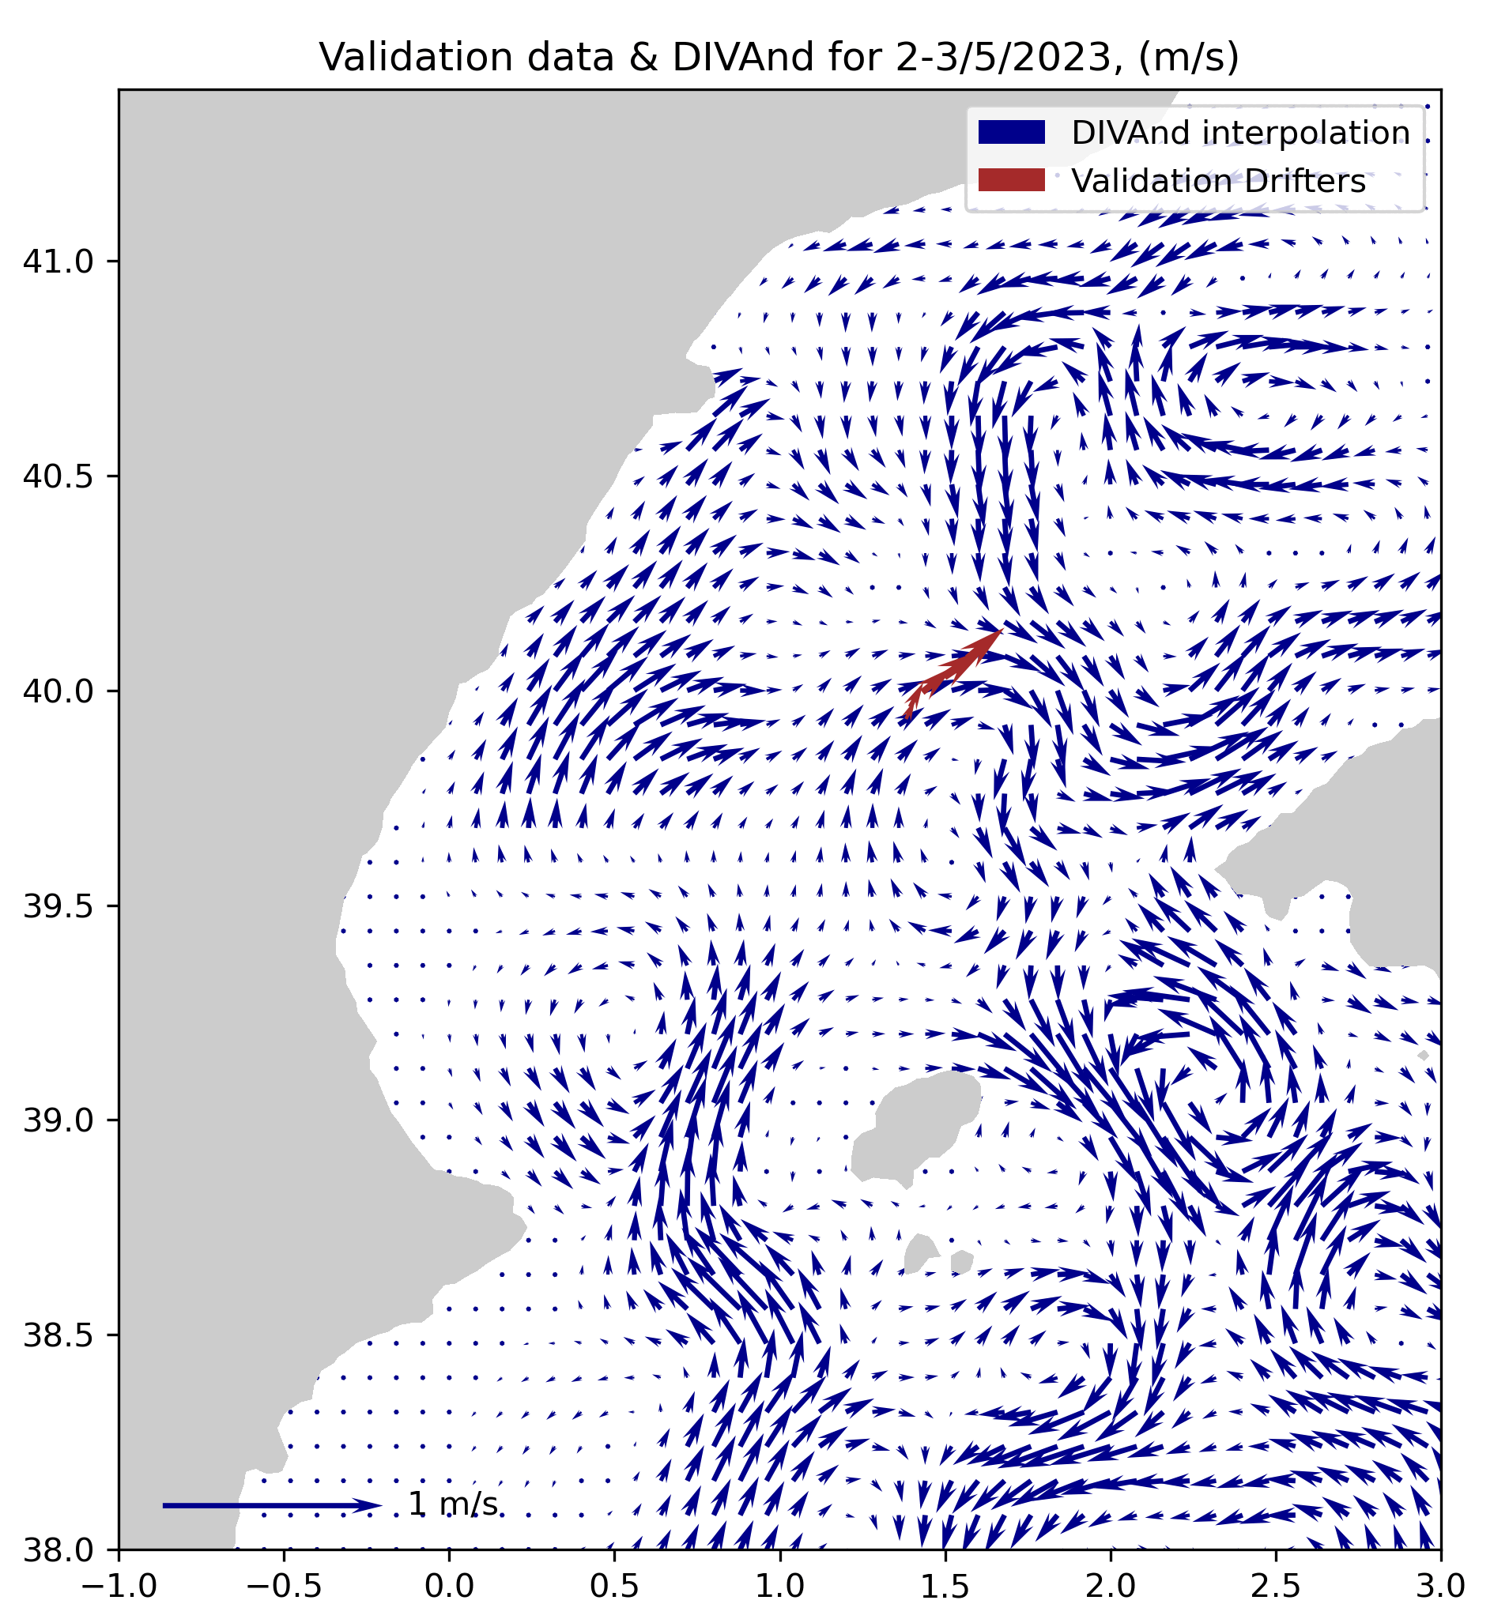
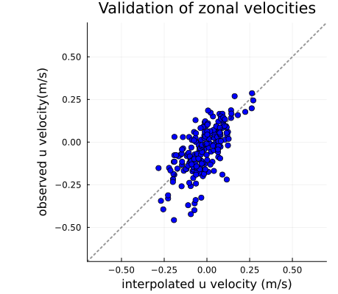
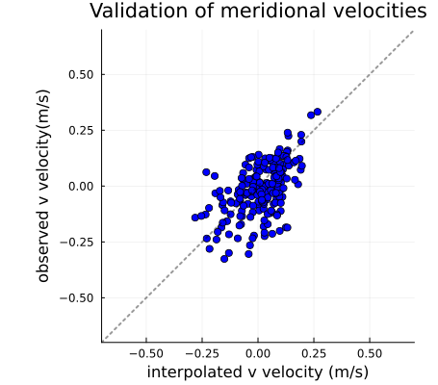

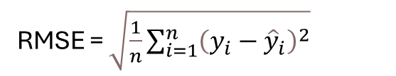

Validation
RMSE = $\sqrt{\frac{1}{n}\sum_{i=1}^{n}{{\left(y_{i}−{\hat{y}}_{i}\right)}^{2}}}$
$$f\left(x\right)=0,898x − 0,027$$
$$f\left(x\right)=0,62x − 0,02$$
$$f\left(x\right)=y$$
$$f\left(x\right)=y$$
RMSEu = 0,0908 (m/s)
RMSEv = 0,0988 (m/s)
Corr u = 67 (%)
Corr v = 54 (%)
Validation metrics along with parametrization
Help of the temporal coherence to lower the RMS
Best parametrization and what it tells on the dataset

Slide 19
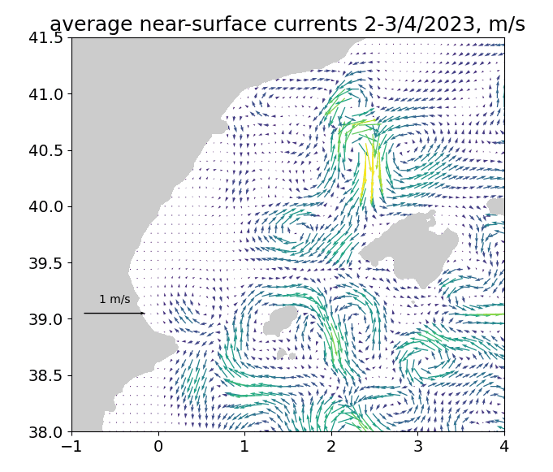
Results
Optimal parameters obtained from the validation
 | Relative error var
HF Radars | 0.148
Drifters | 0.0515
SWOT | 0.01277
 | Correlation
Space | 150.124km
Time | 0.5 Day
0
10
20
30
40
50
(cm/s)

Slide 20
Conclusion
Oceanographic campaign & SWOT observations
Variational inverse method
SWOT dataset has the lower relative error variance
General method is presented within Blue Cloud
RMSE < 10 cm/s

Slide 21
Further steps
Define a background estimate based on the average or MDT field
Compare the field with temperature, salinity or chlorophyll data
Decompose the field into orthogonal functions
Extend the work with « science sampling phase »

Slide 23
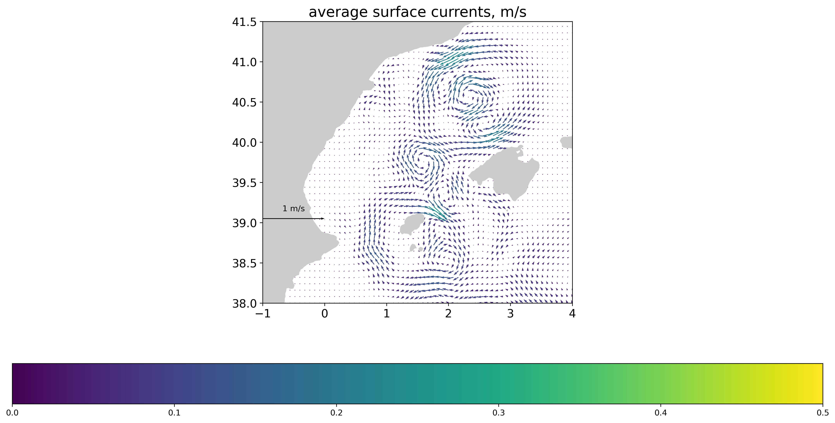
Results

Slide 24
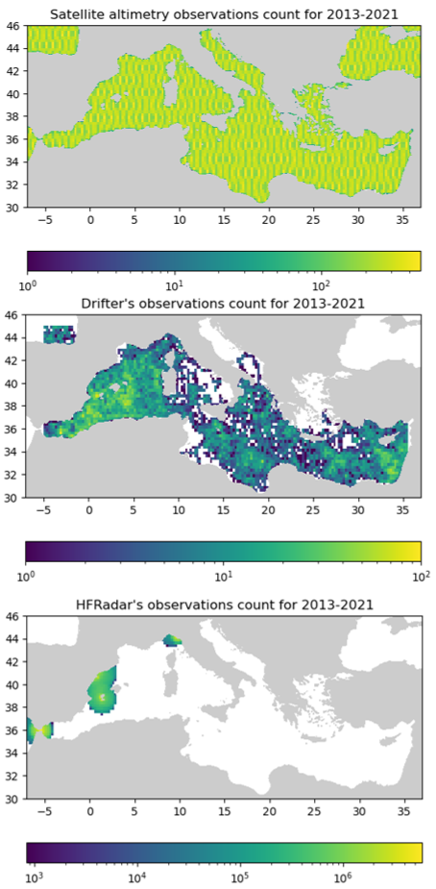
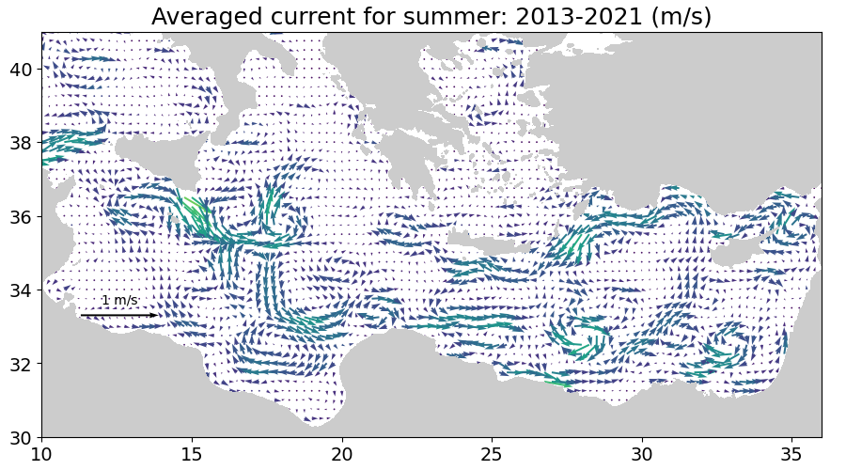
Large scale interpolation of surface currents:
Example with the Mediterranean Sea
Carried at the basin scale
  ¼° space res
  1 month time res
Supported by the extensive cover from satellites and drifters
Carried on a 9 years analysis
Validated with different methods
  in-situ dataset,
  temperature dataset
(m/s)

Slide 25
Notes annexes
Réduire time corr
  Augmente le field smooth
  Perte de variabilité
  Diminue les vitesses DIVAnd
  Augmente la valeur des observations par rapport à DIVAnd
  Pour des valeurs similaires d’erreurs
Drifter (in-situ)
Satellite (remote)
High Frequency Radar (direct measurement)

Slide 26
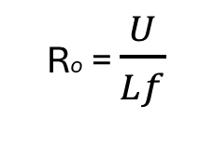
Large & small scale interpolation
Accurate on large time and space scales
Smaller areas have lower observation coverage
Smaller amount of dataset for validation
Exhibits larger uncertainties to interpolate with confidence
The smaller currents patterns have stronger non linearities => harder to predict with a linear interpolation method
Mesoscale interpolation (<100km, weeks)
Sub-mesoscale interpolation (>10km, days)
Satellite coverage is often sufficient with conventional altimeters
Satellite data must be supplemented by other observations
>>>>
Geostrophic assumption explains most of the surface dynamics
Ro = $\frac{U}{Lf}$
Small resolution pattern has stronger non-linearities
>>>>
>>>>

Slide 27
Define a background estimate based on the average or MDT field
(avoid the variability related to the missing data)
Compare the field with temperature and salinity data
Evaluation of spatial coherence using a variogram
Extend the work with « science sampling phase »
Decompose the field into orthogonal functions

