Slide 1

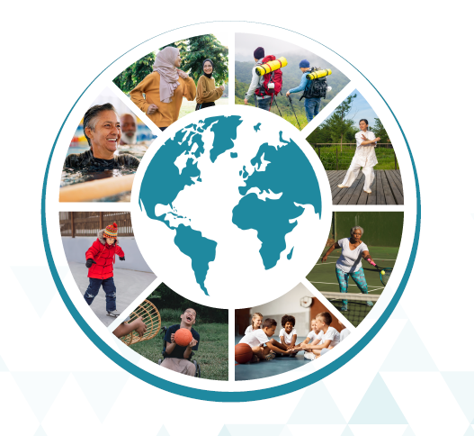

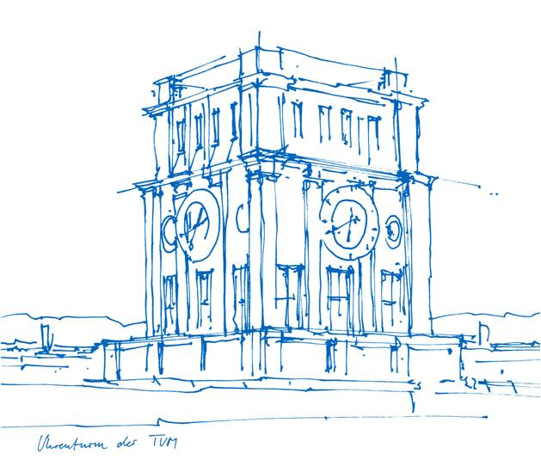



Le Global Physical Literacy Action Framework (GloPL) :
un consensus mondial pour renforcer l’éducation physique de qualité
et les expériences motrices tout au long de la vie
Alexandre Mouton¹, Lisa M. Barnett², Alethea Jerebine², Emiliano Mazzoli², & Johannes Carl³
au nom du consortium GloPL
¹University of Liège, Department of Physical Activity and Rehabilitation Sciences, RUCHE, Liège, Belgium
²Deakin University, Institute for Physical Activity and Nutrition, School of Health and Social Development, Geelong, Australia
³Technical University of Munich (TUM), TUM School of Medicine and Health, Munich, Germany

Slide 2
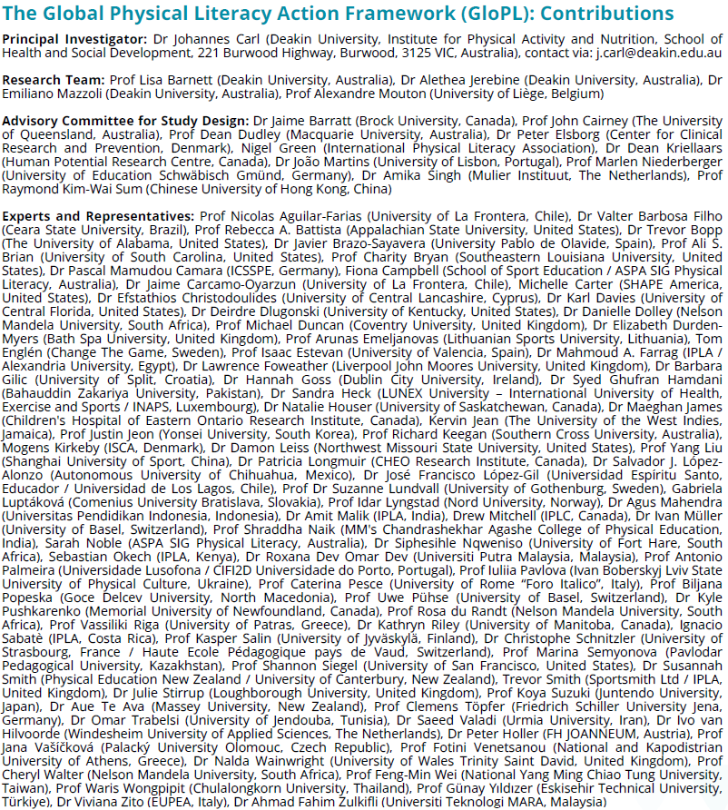
Notes:
Raymond Sum, Joao Martins, Kasper Salin, Christophe Schnitzler, …

Slide 3
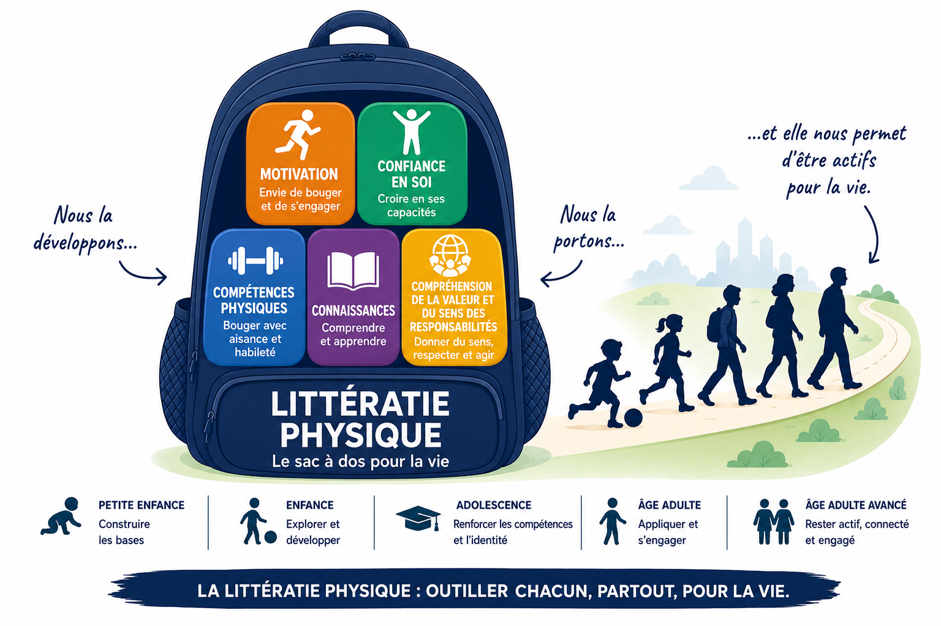
La littératie physique: un sac à dos pour la vie
Mouton (2026) – AI generated picture
3

Slide 4

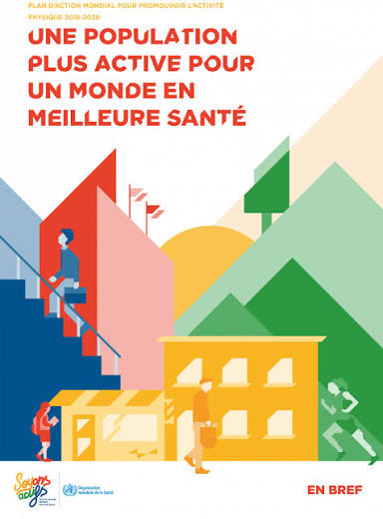
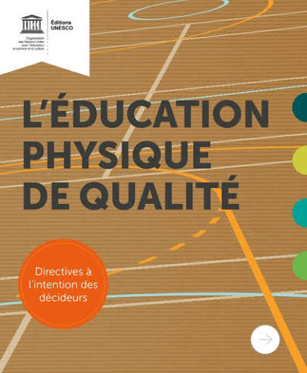

La littératie physique, un cadre d’action holistique
De quelles experiences avons nous besoins afin d’être actifs pour la vie ?
Compétences physiques et motrices
(Engel et al., 2018; Graham et al., 2022; Liu et al., 2023;
Holfelder & Schott, 2014; Aleksovska et al., 2019; Ramsey et al., 2021)
Motivation, confiance et plaisir
(Owen et al., 2014; French et al., 2014; Stevens et al., 2020)
Littératie physique: “l’intégration des ressources physiques, psychologiques, sociales et cognitives permettant de soutenir une pratique du mouvement et de l’activité physique à la fois épanouissante et bénéfique pour la santé, tout au long de la vie.” (Keegan et al., 2019)
Support/soutien social
(Lindsay Smith et al., 2017; Van Luchene & Delens, 2021)
Connaissances, compréhension et sens
(Fredriksson et al., 2018; Wafi et al., 2024; Pinto et al., 2025)
4

Slide 5
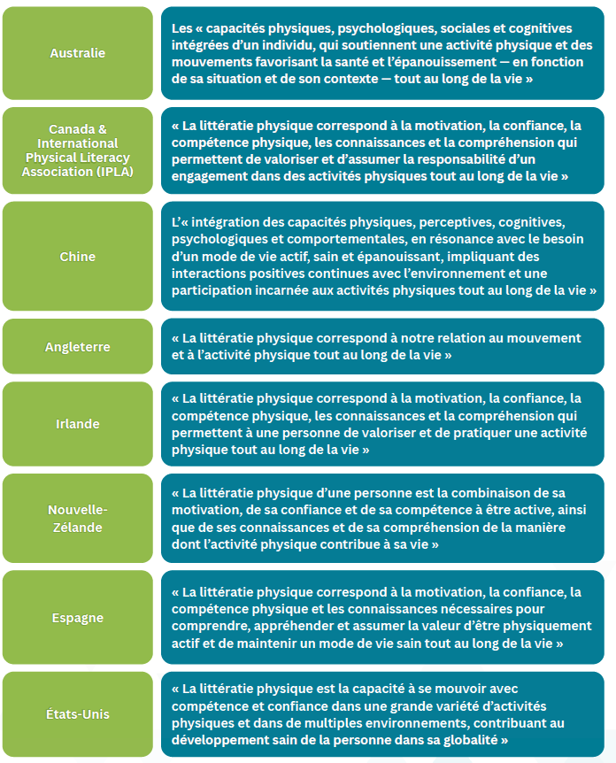
GLOPL (2025)
5

Slide 6
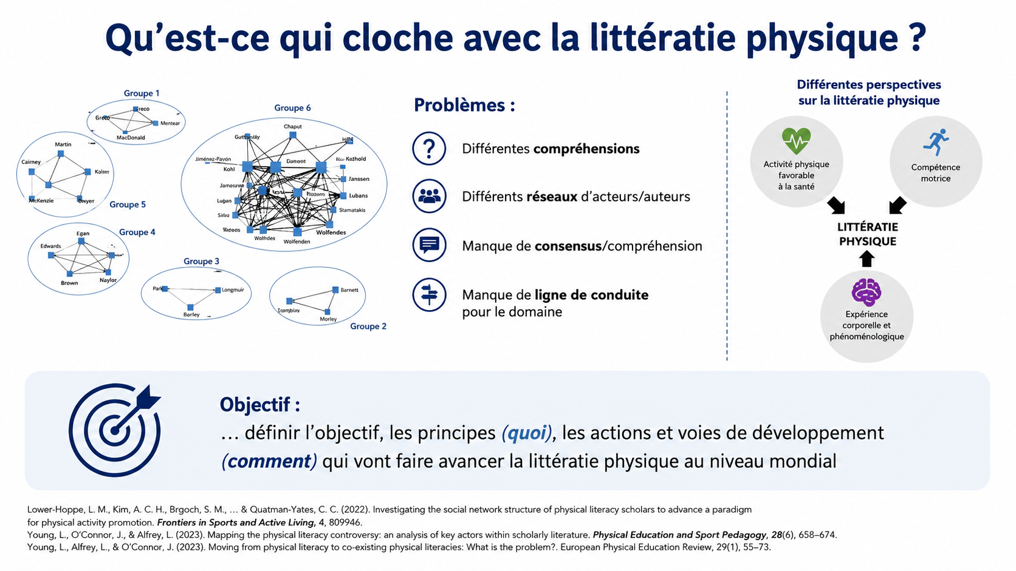
6
Notes:
Monisme : Contrairement au dualisme (qui sépare le corps et l'esprit), le monisme affirme que le corps et l'esprit sont indivisibles et forment une seule et même entité. Le mouvement n'est pas une simple commande mécanique, c'est une façon d'être et d'expérimenter le monde. [1, 2, 3, 4]Existentialisme : Ce courant postule que l'être humain se définit par ses actions et ses interactions avec l'environnement. Dans le cadre de la littératie physique, l'individu n'est pas un simple spectateur : il façonne son développement, son identité et sa santé à travers ses choix de mouvement et ses expériences vécues. [1, 2, 3]

Slide 7
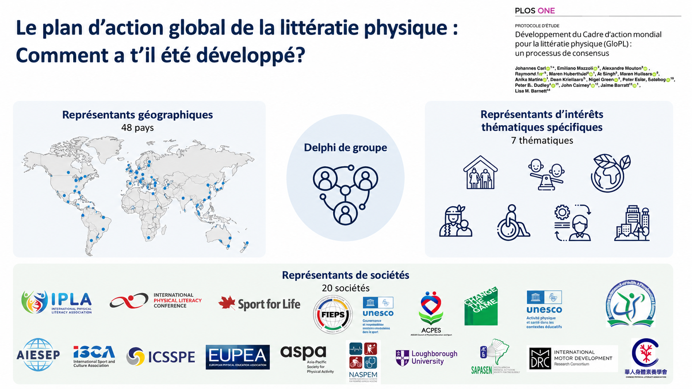
Notes:
59 individuals from 48 countries providing culture- and
language-sensitive perspectives on physical literacy (see the map).
(2) Representatives of special thematic interest: Experts of seven topics demonstrating
evidence of missing attention within the physical literacy field.= advocates for older
adults, persons with diseases and disabilities, individuals of low socioeconomic status, as well as
indigenous people, as researchers have yielded relatively few perspectives for these target groups
[8, 23, 30, 63–66]. We intend to include an expert for urban design to gain inspiration about
opportunities to promote PL through the environment [67]. PL in relation to the threat of climate
change has only just emerged in the research literature [68] but has not yet influenced the
discussion of the field, so we reserve one representation for highlighting the value of integrating
ecological aspects for action. For identifying expertise in these niche themes, we also scan PL
publication activities in the literature. In accordance with the goal to stress practical perspectives,
we finally include one expert who has a strong portfolio in translating PL into real-life
applications.
(3) Representatives of academic societies: Members from 19 societies in the realm of
physical activity, sport, health and education.
In the first phase, all representatives were invited to participate in an individual idea
generation on “what moves the field of physical literacy

Slide 8
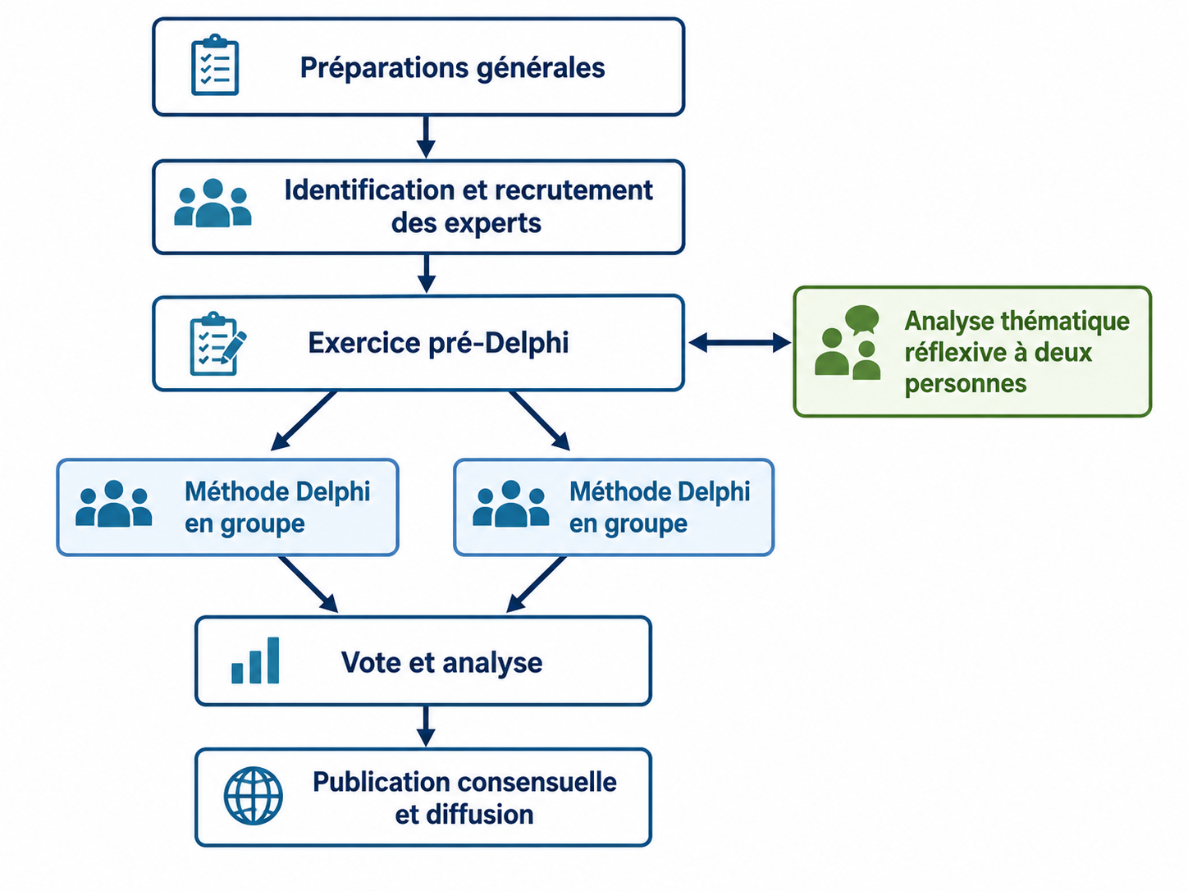


Méthode: Delphi study
69 contributions reçues
49 représentants géographiques (84%)
7 représentants de thématiques (100%)
13 représentants de sociétés savantes (65%)
Analyse thématique réflexive
Analyse de fidélité/validité inter-analyste
857 codes
→ Groupement en thématiques
34 sujets potentiels
19 sujets directement inclus
15 sujets à discuter

Slide 9
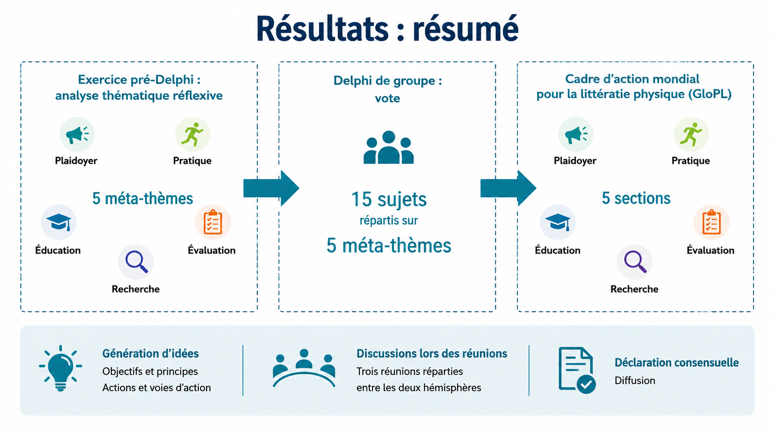

Slide 10
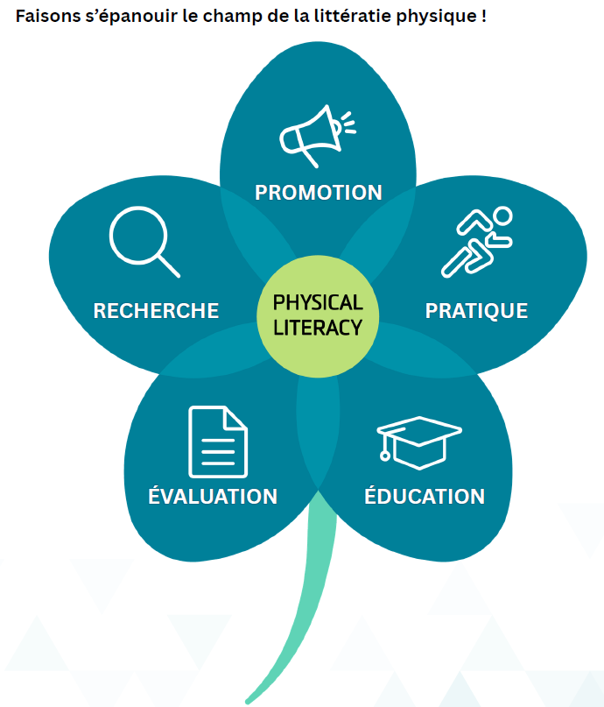



Slide 11











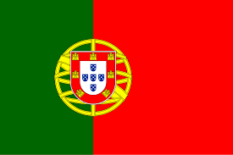


Dissémination: traductions
Publication: Février 2026
Publication: Mars 2026

Slide 12
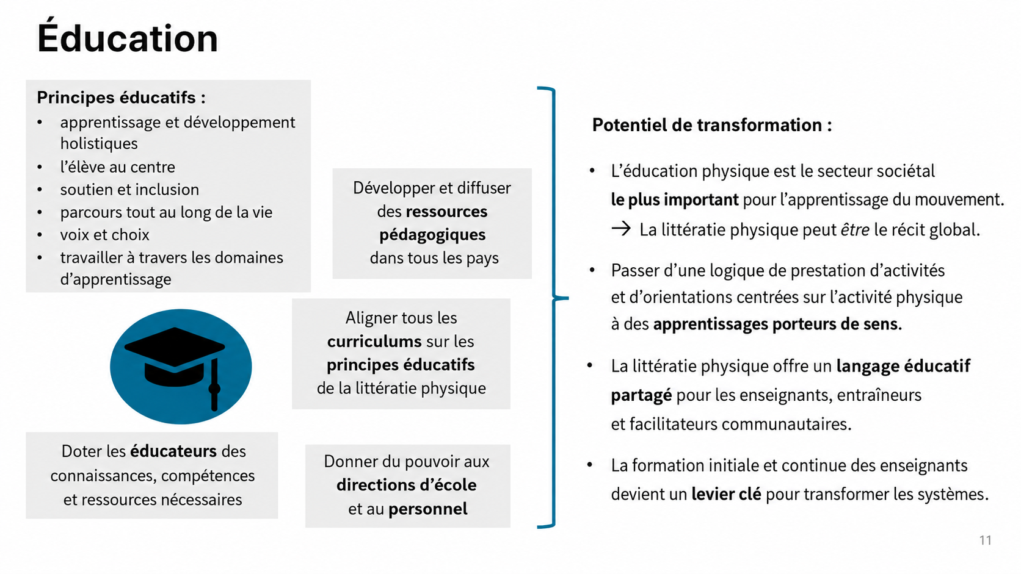
Notes:
primary societal driver of physical literacy

Slide 13
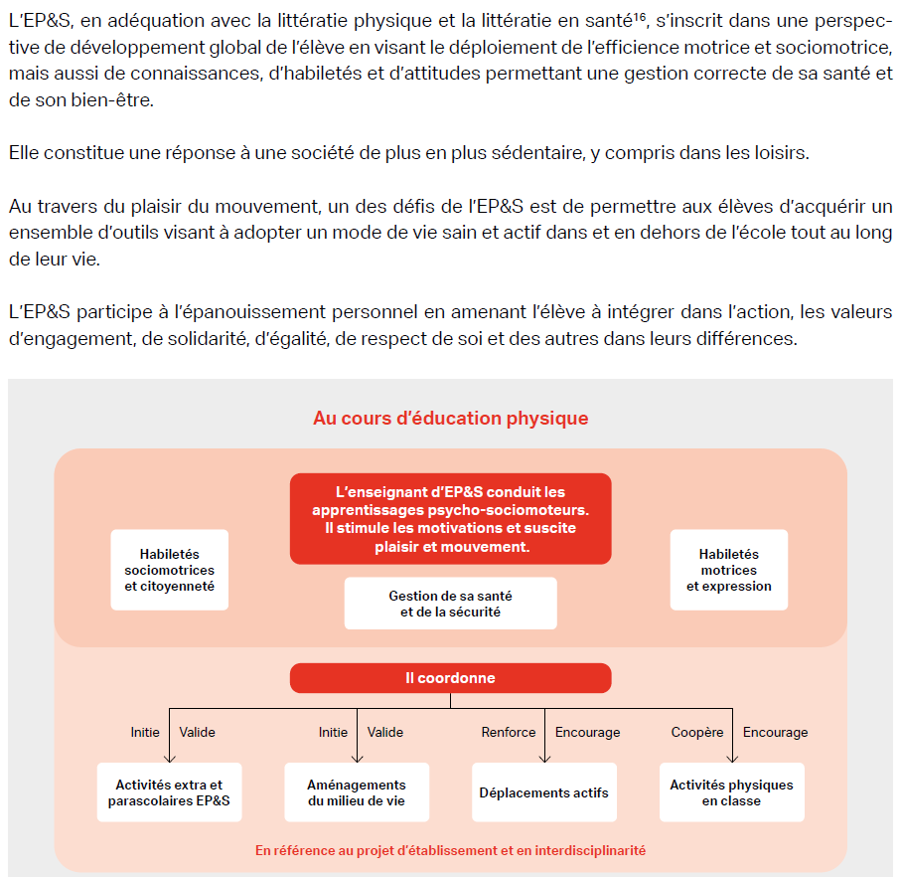
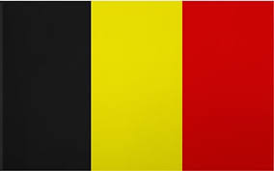
Curriculum d’education physique & à la santé
FWB (2023)
D’un concept “parapluie”
= Considération implicite de la
littératie physique…

Slide 14


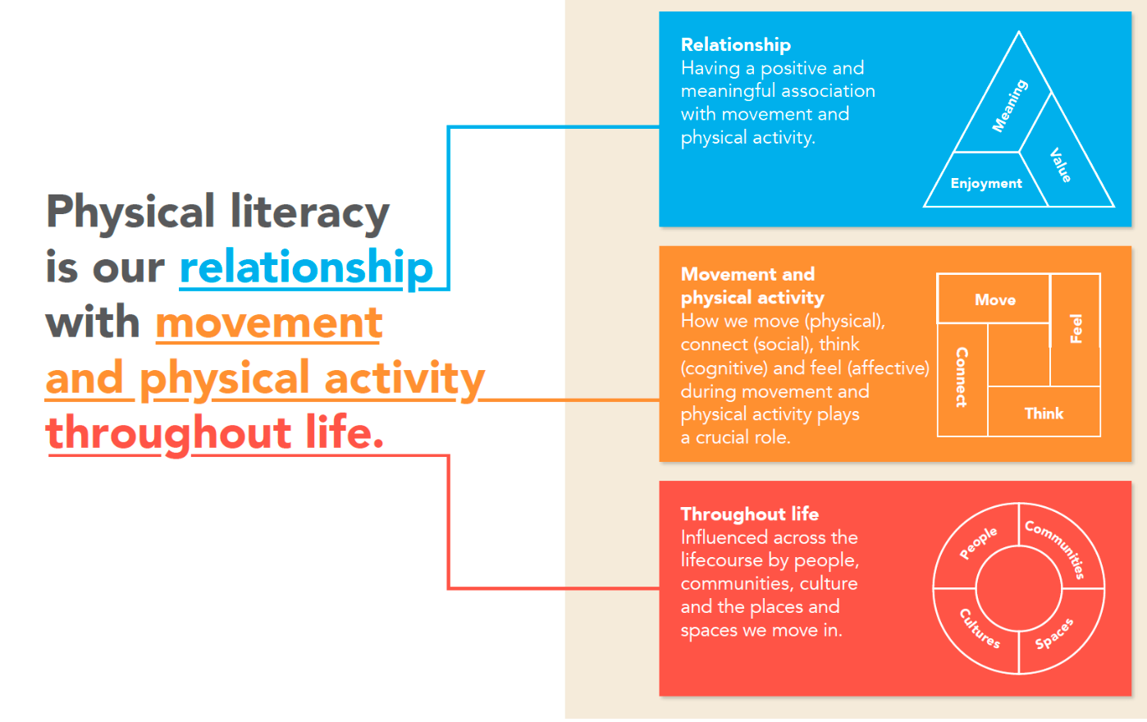
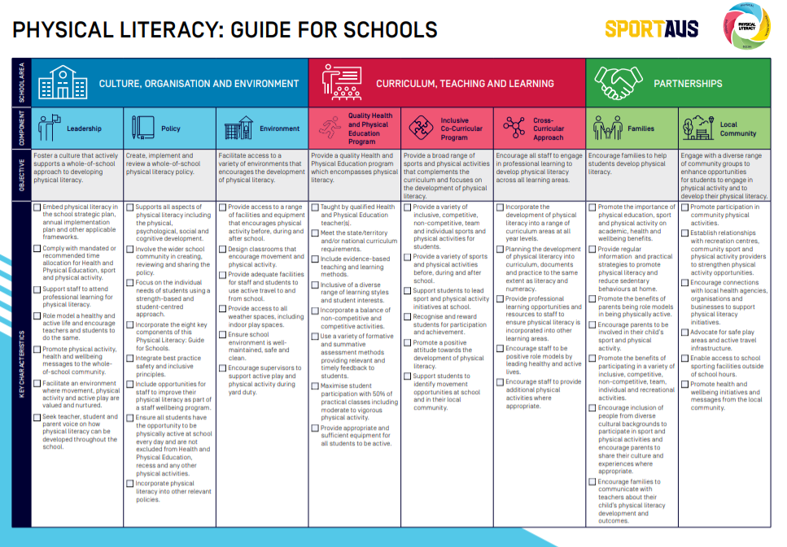
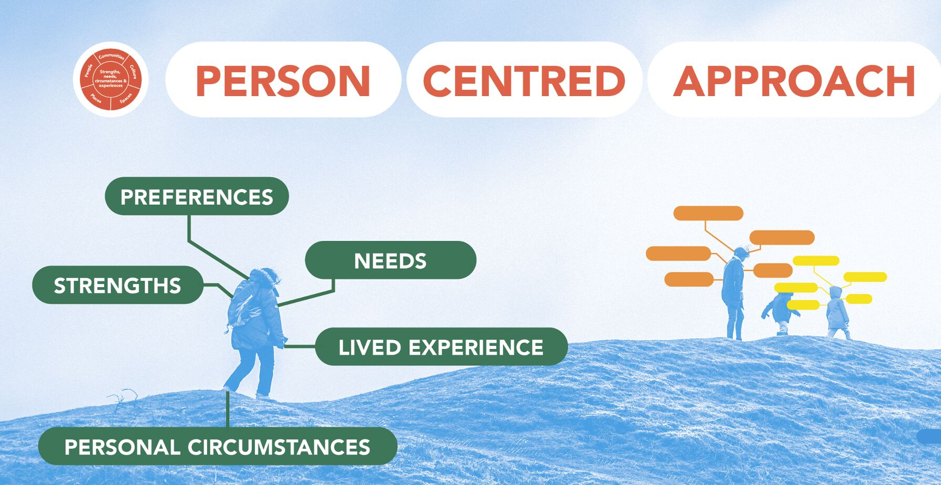
Sport England
…Vers une mention explicite dans certains curricula
https://www.ausport.gov.au/physical_literacy/resources/schools
Notes:
Own the Podium
Community Sport for all

Slide 15
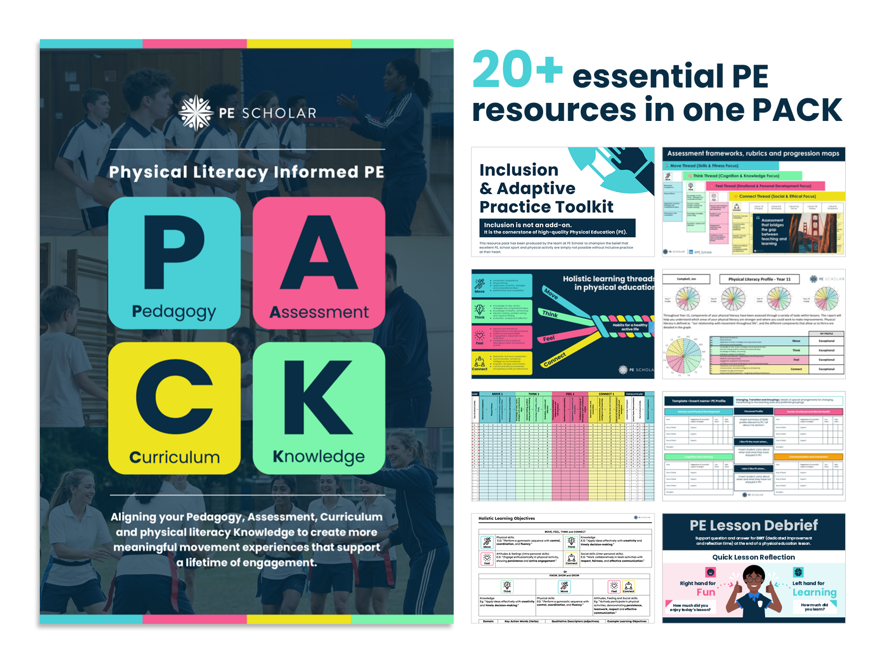

Durden-Myers, L. (Ed.). (2026).
Handbook of Physical Literacy (1st ed.)
Routledge. https://doi.org/10.4324/9781032703466
https://www.pescholar.com/store/schemes-of-work/physical-literacy-informed-pe-pack/

Slide 16
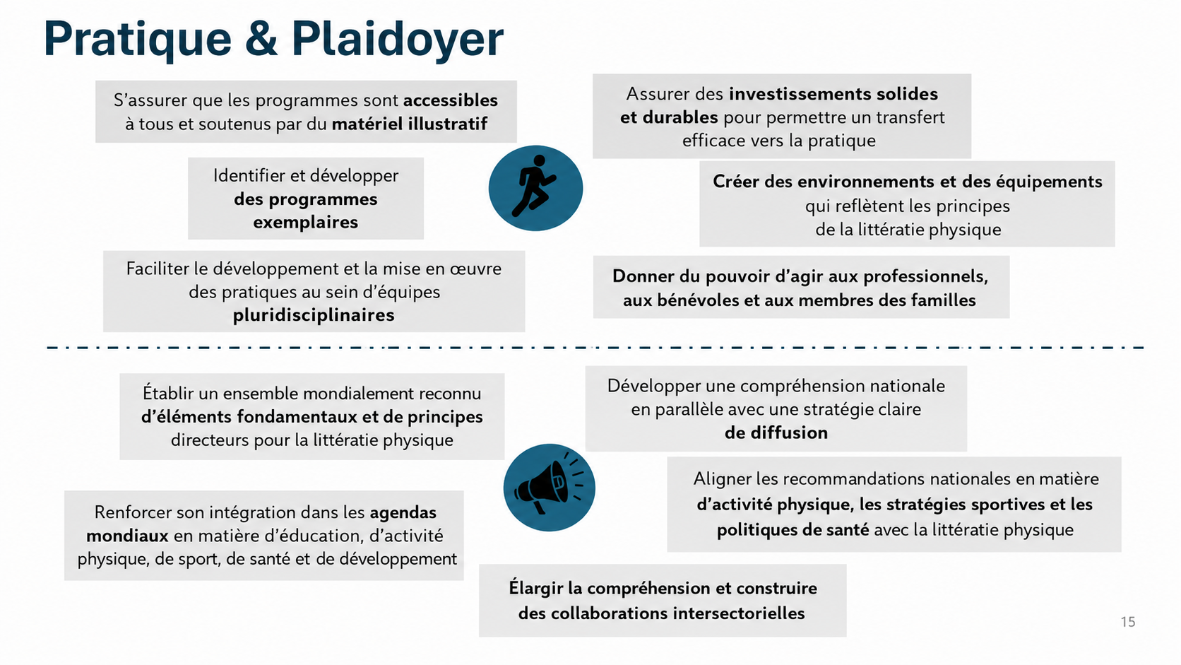
Notes:
Practice transformation potential:
Schools are the largest infrastructures for physical literacy development
Learning environments are not neutral
Move beyond fixed norms and performance standards
Inclusive and accessible practice
Teachers, school leaders and support staff must be empowered to align their practices with physical literacy
Sustained investment in pedagogical innovation and teacher support
Advocacy translation potential:
Strengthen physical literacy on the agenda of global education
Align PE curricula, teacher standards, school wellbeing strategies and education
policy frameworks with physical literacy
Physical literacy provides an integrative narrative linking education, health, physical activity and social development
Strengthen cross-sector collaboration (education – health – sport – community)

Slide 17

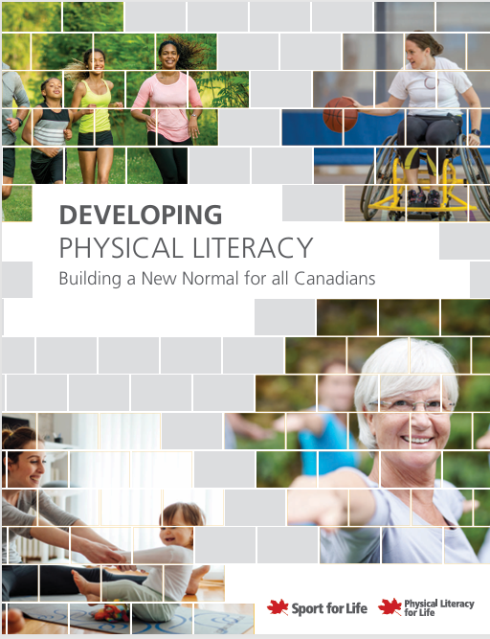

Canada (depuis 2015)
Sport Canada
Canadian Olympic Commitee (COC)
→ „Own the podium“
Sport for Life
Notes:
Own the Podium
Community Sport for all

Slide 18

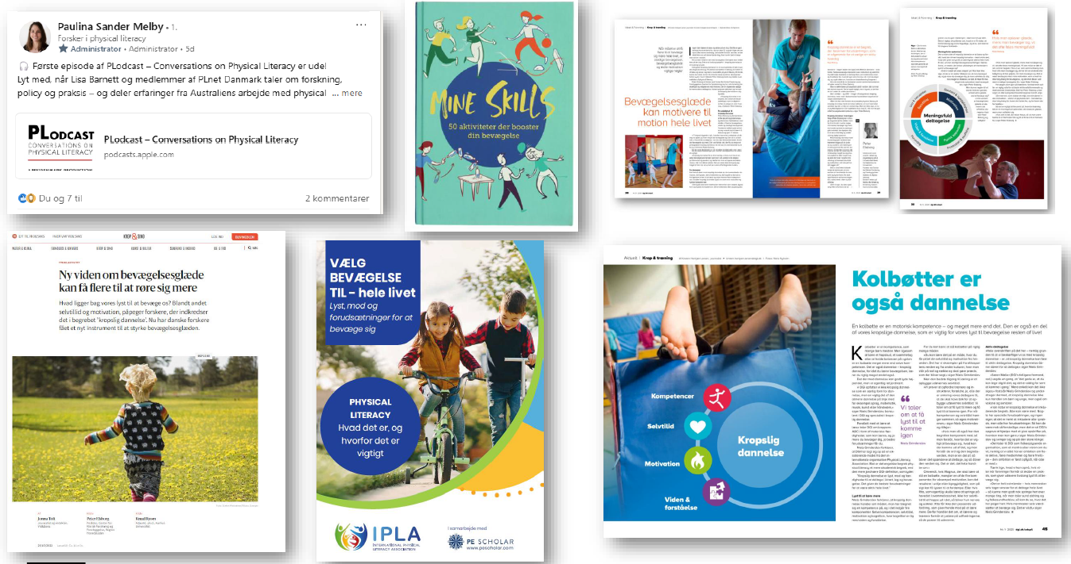


Du sport vers la littératie physique au Danemark

Slide 19
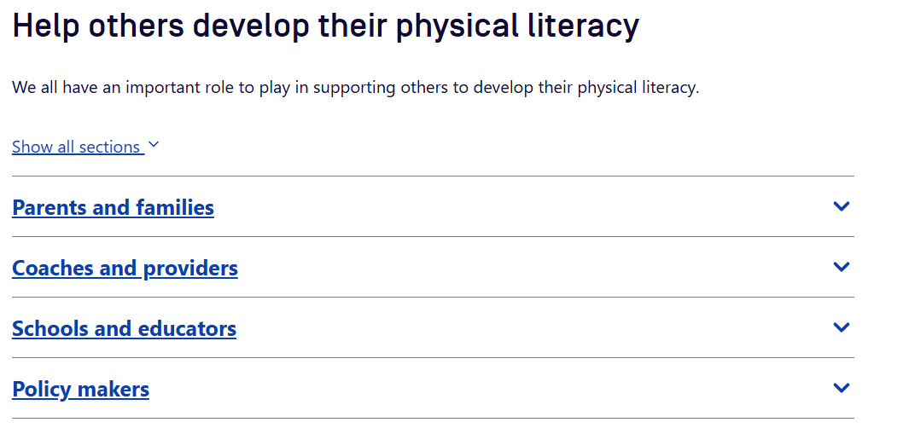
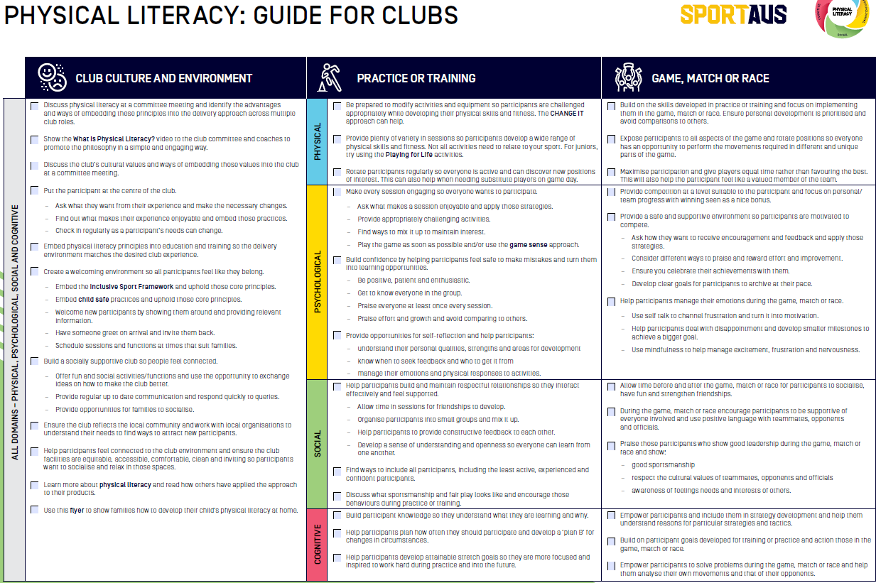
L’Australie: un précurseur en milieu sportif

Slide 20


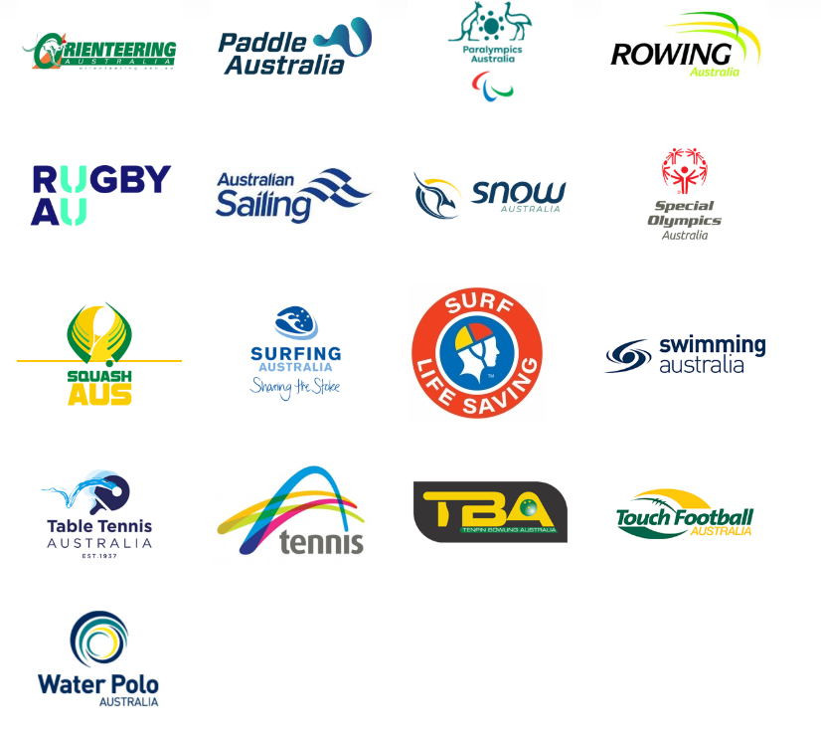
L’Australie: un précurseur en milieu sportif
National Sport Organisation | Analysis of websites | Analysis of coaching education
Hockey | 50.00% | 34.25%
Paralympic | 22.70% | 43.25%
Table Tennis | 77.30% | 45.00%
Lacrosse | 68.20% | 49.25%
Rugby League | 59.10% | 50.00%
Special Olympics | 86.40% | 50.75%
Australian Football | 72.70% | 51.75%
Sailing | 27.30% | 54.25%
Bowls | 31.80% | 55.75%
Boxing | 45.50% | 66.75%
Snow Australia | 81.80% | 68.25%
Basketball | 68.20% | 72.50%
Rugby | 59.10% | 76.75%
Motorcycling | 63.60% | 77.50%
Athletics | 36.40% | 79.25%
Orienteering | 72.70% | 80.00%
Netball | 40.90% | 84.25%
Tennis | 72.70% | 85.00%
Waterball | 54.50% | 87.50%
Disability winter sport | 31.80% | 98.25%
Notes:
57.1% der Webseitenkriterien
64.2% der Trainerinnenbildung

Slide 21
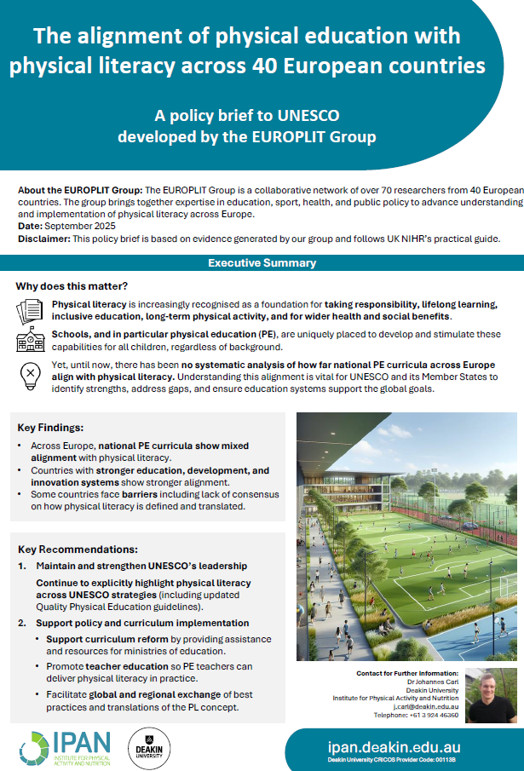
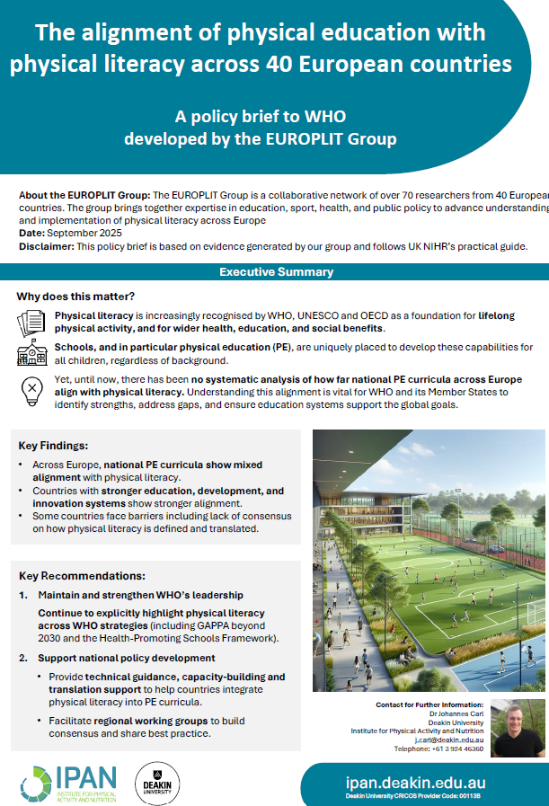
UNESCO
&
OMS
Policy Briefs

Slide 22
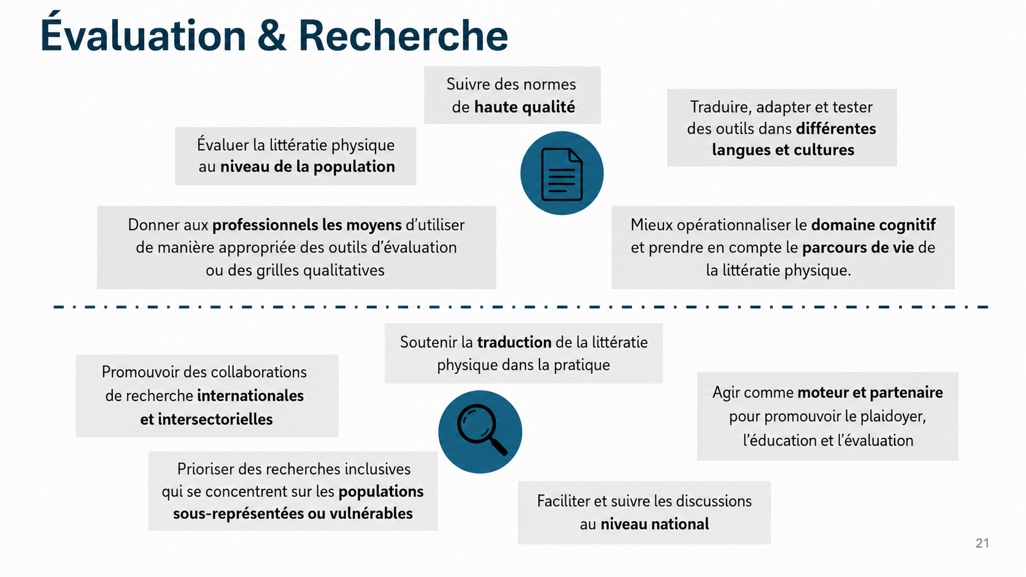
Notes:
Assessment transformation potential:
Not only participation rates, medals, club memberships
Confidence, motivation, belonging, positive experiences, retention, inclusion, lifelong trajectories
Research transformation potential:
Research has an important and responsible role
From the ‘silo‘ to real-world change

Slide 23
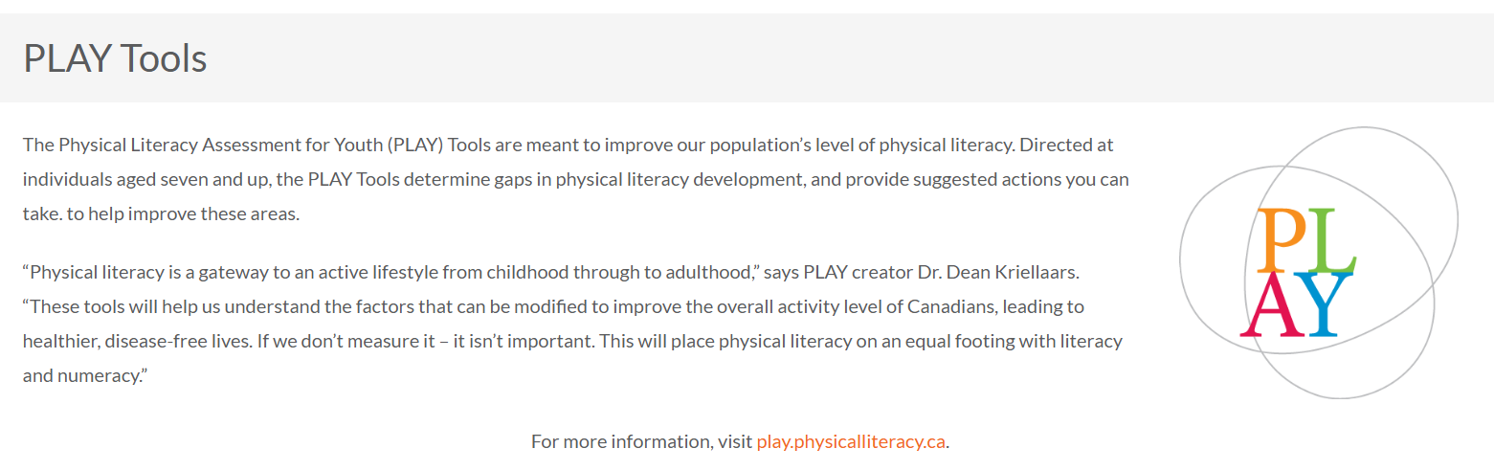
Les outils d’évaluation Canadiens (2015)
Sport for Life (2025). Physical Literacy. Zugriff am 08.12.2025 unter https://physicalliteracy.ca/

Slide 24
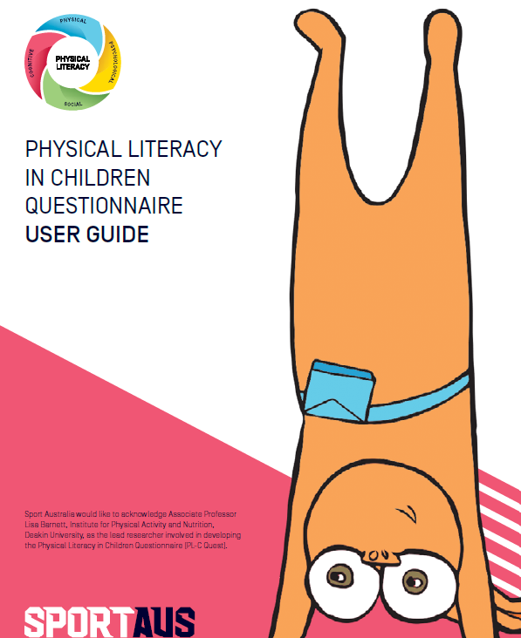




Les outils d’évaluation Australiens
Barnett, L. M., Mazzoli, E., Hawkins, M., Lander, N., Lubans, D. R., Caldwell, S., ... & Salmon, J. (2022). Development of a self-report scale to assess children’s perceived physical literacy. Physical Education and Sport Pedagogy, 27(1), 91-116.
https://plquest.com.au/about/physical-literacy
Notes:
Own the Podium
Community Sport for all

Slide 25
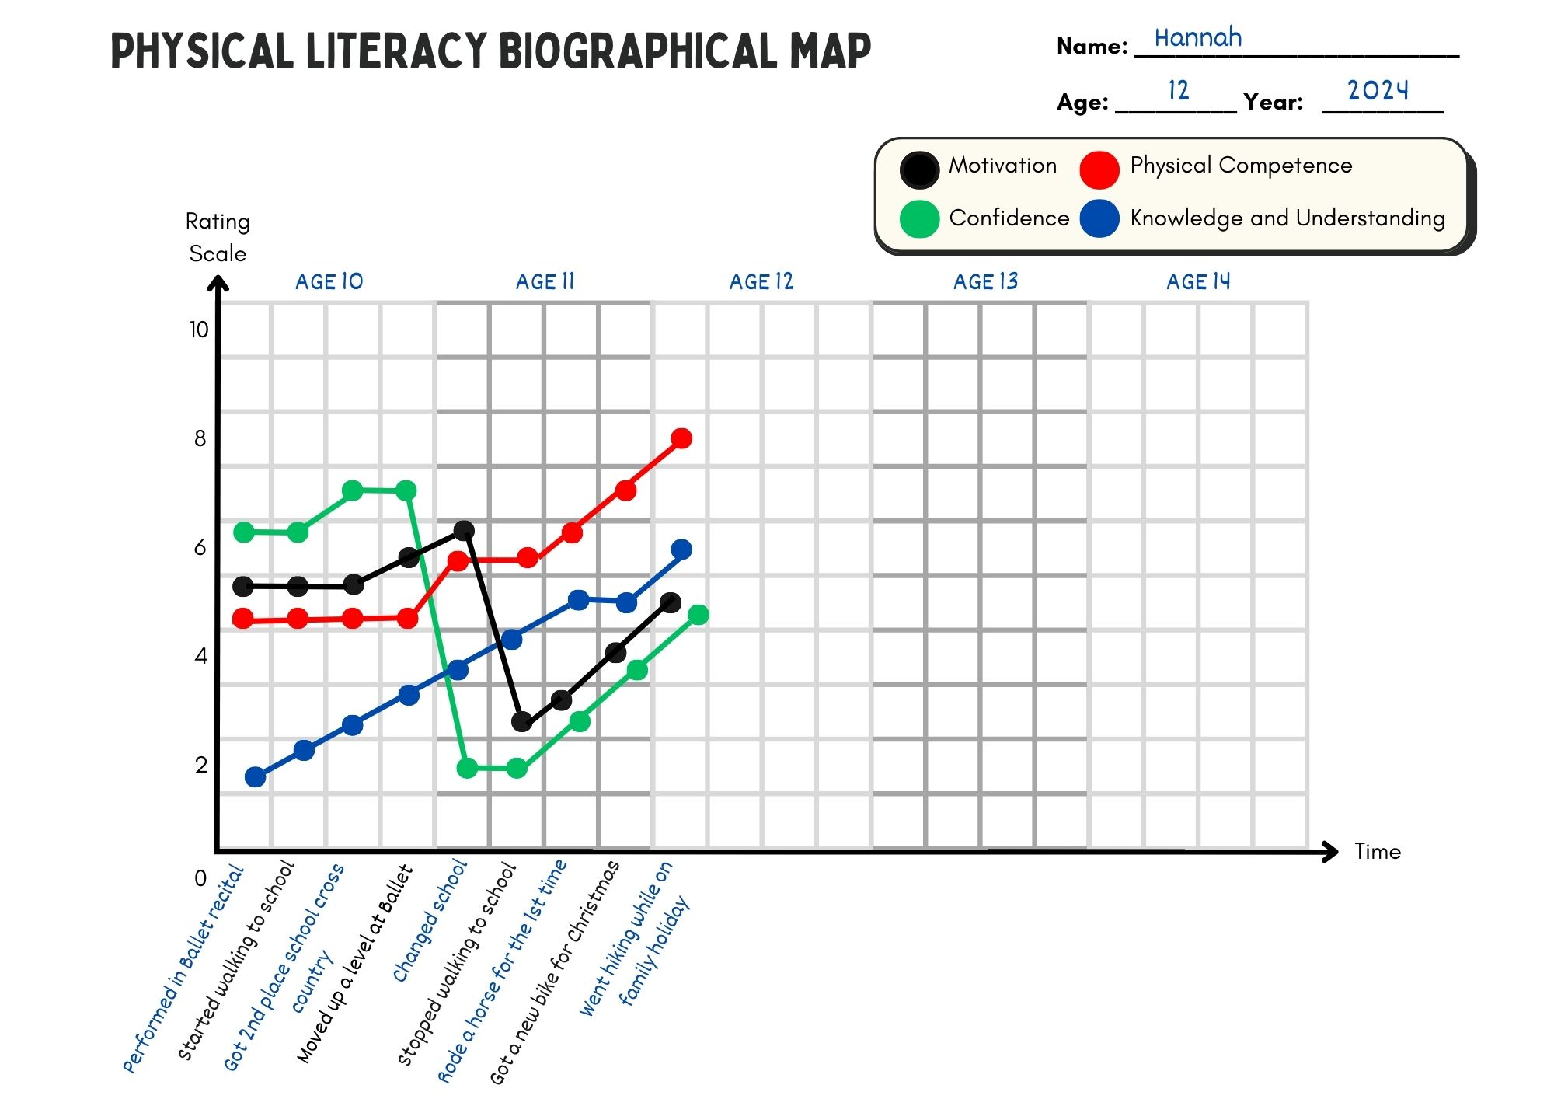
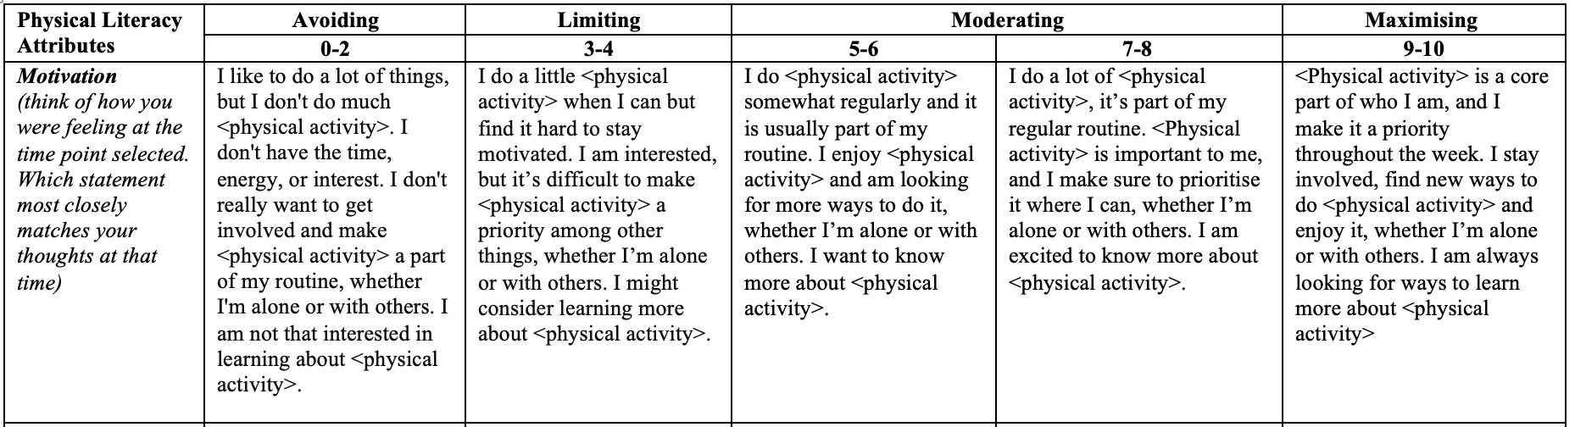
Une carte biographique de suivi de la littératie physique (BMAP-PL)
Young, L., O’Connor, J., Mouton, A., Jaunig, J., & Carl, J. (2025). Assessing Physical Literacy in Health and Physical Education Through Biographical Mapping. Journal of Teaching in Physical Education, 1(aop), 1-11.

Slide 26
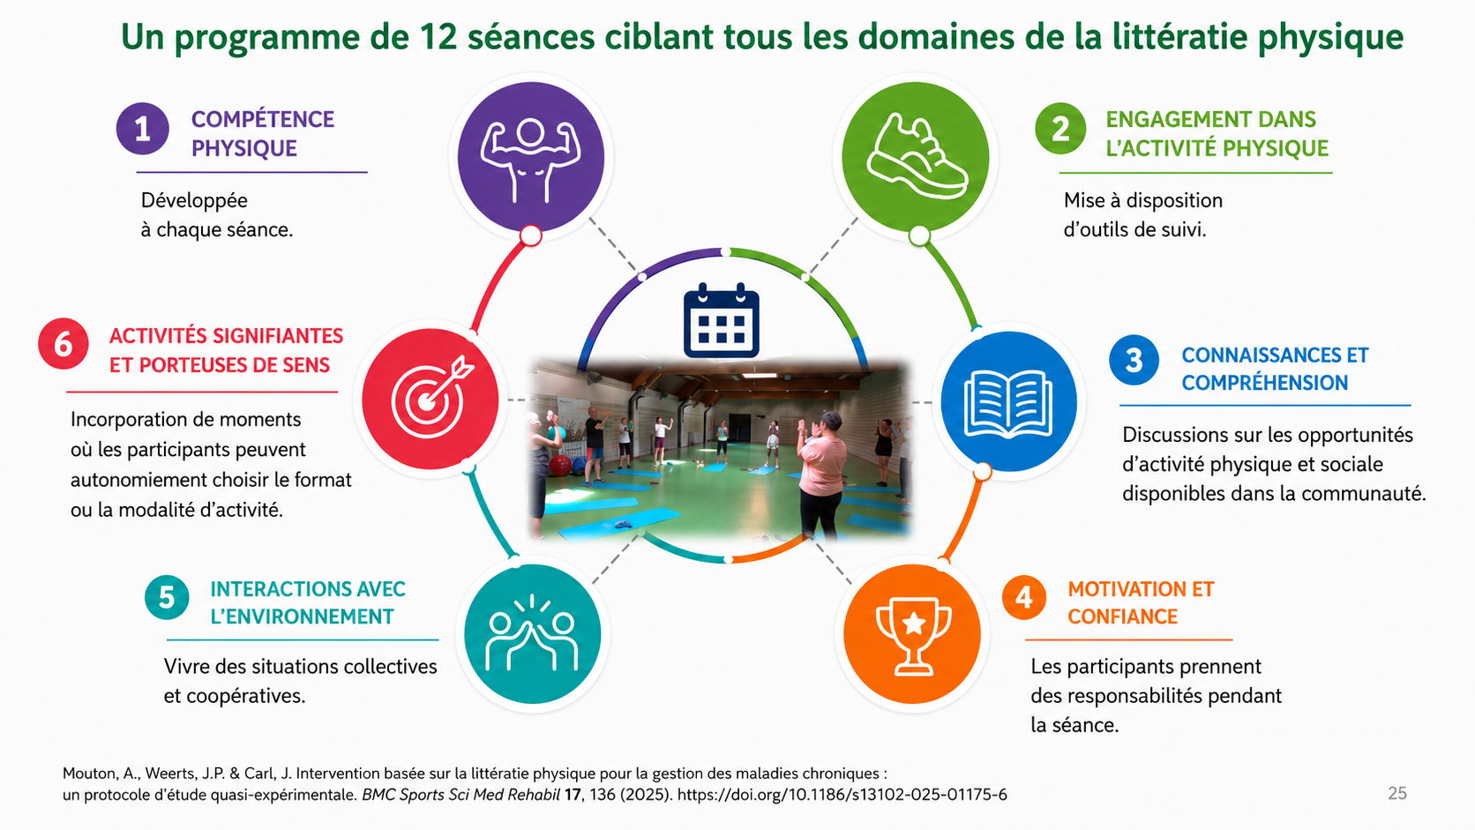
Mouton, A., Weerts, JP. & Carl, J. Physical literacy-based intervention for chronic disease management: a quasi-experimental study protocol.
BMC Sports Sci Med Rehabil 17, 136 (2025). https://doi.org/10.1186/s13102-025-01175-6

Slide 27
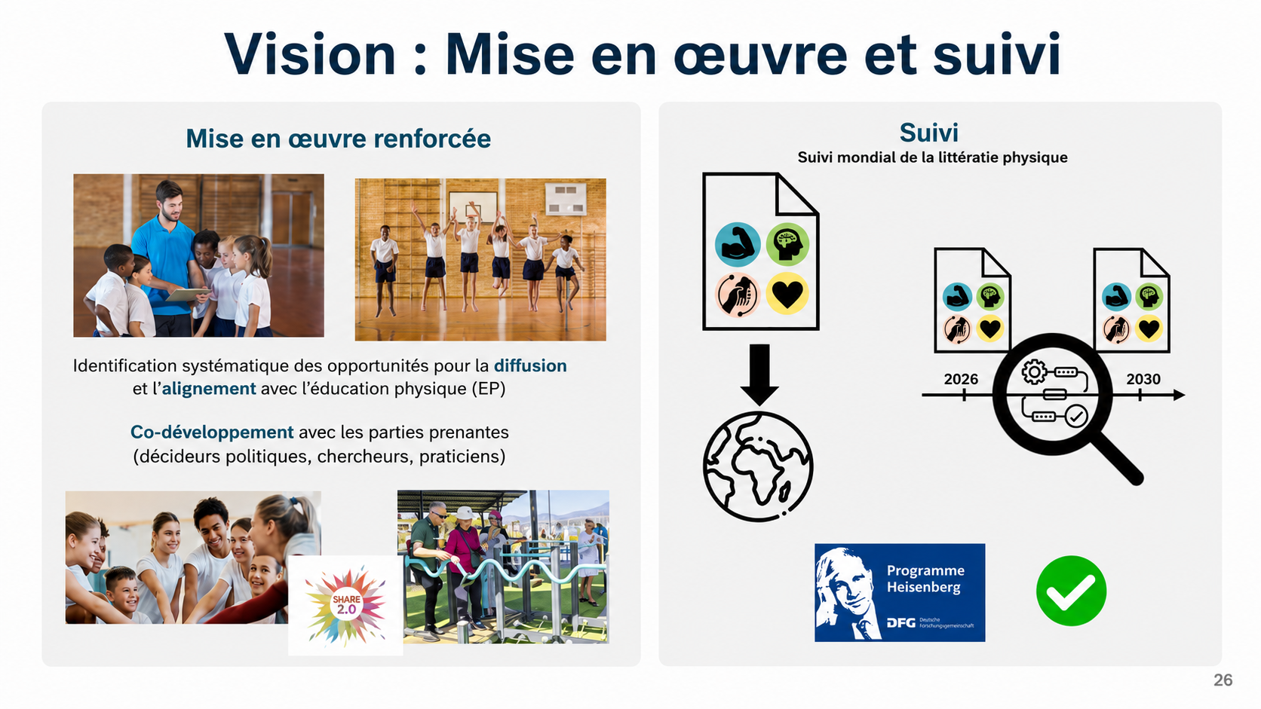
Vision: Implementation and Monitoring
Notes:
Also National Action Plan Health Literacy:
“„Gesundheitskompetenz basiert auf allgemeiner Literalität und umfasst das Wissen, die Motivation und die Fähigkeiten von Menschen, relevante Gesundheitsinformationen in unterschiedlicher Form zu finden, zu verstehen, zu beurteilen und anzuwenden, um im Alltag in den Bereichen der Krankheitsbewältigung, Krankheitsprävention und Gesundheitsförderung Urteile fällen
und Entscheidungen treffen zu können, die ihre Lebensqualität während des gesamten Lebensverlaufs erhalten oder verbessern“
VISION!

Slide 28

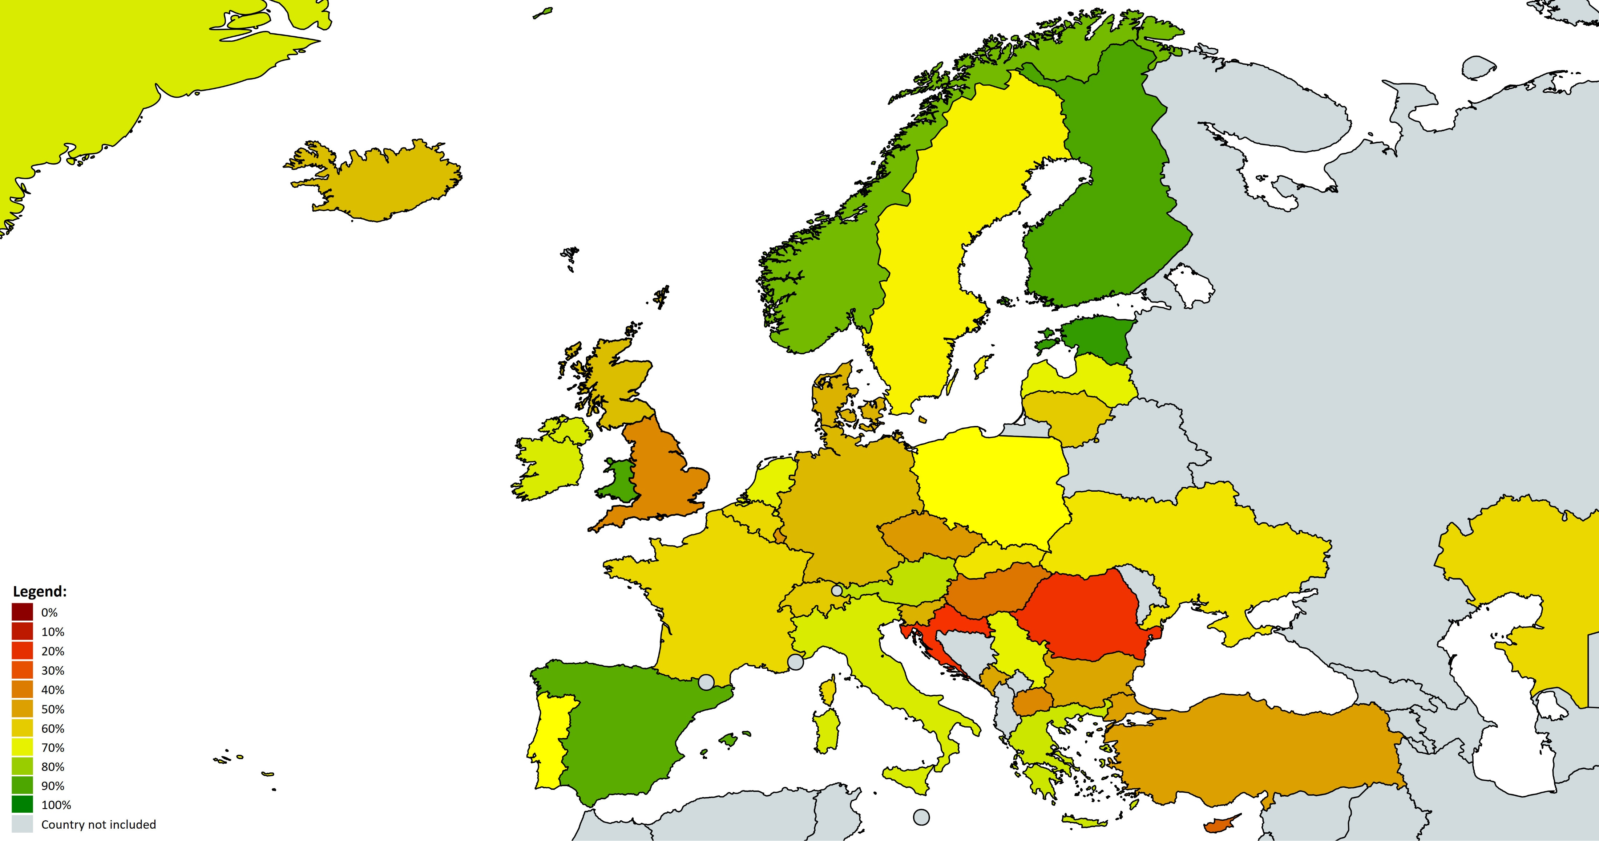
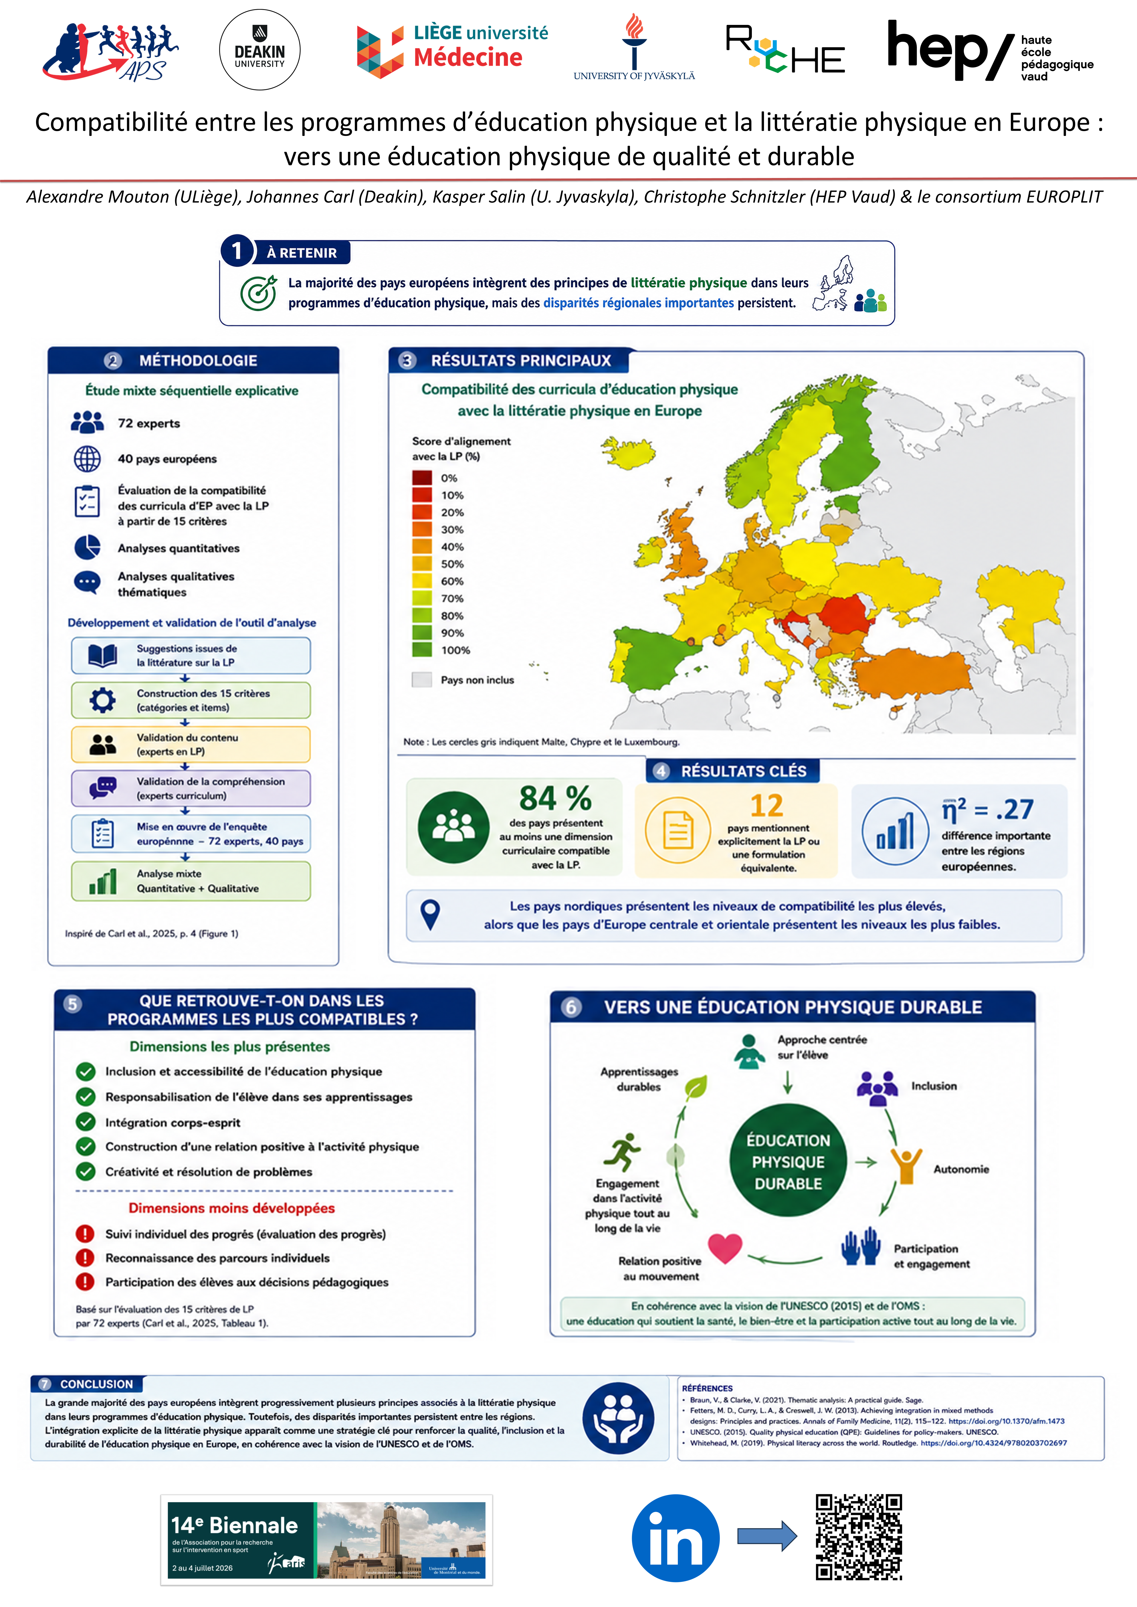
Alignement de l’éducation physique avec la littératie physique
Carl, J., Bryant, A. S., Edwards, L. C., Bartle, G., Birch, J. E., Christodoulides, E., ...Mouton, A. & Elsborg, P. (2023). Physical literacy in Europe: The current state of implementation in research, practice, and policy. Journal of Exercise Science & Fitness, 21(1), 165-176.
Carl, J., Salin, K., Barnett, L. M., Foweather, L., Jurak, G., ..Mouton, A,, . & Yıldızer, G. (2026). Alignment of physical education curricula with physical literacy across Europe: an observational mapping study with country-level predictors. The Lancet Regional Health–Europe, 65, 101641.
Notes:
Ausdruck einer innovativen Haltung

Slide 29
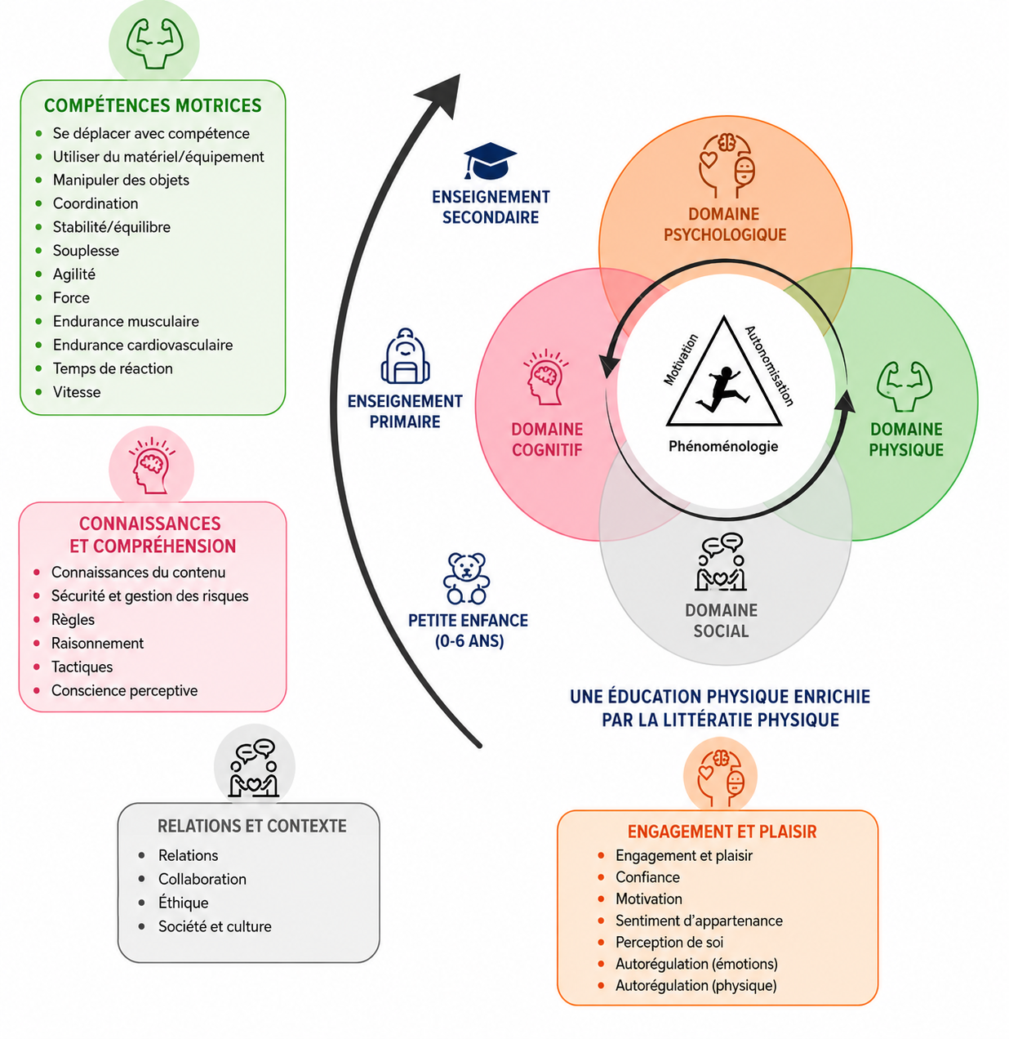
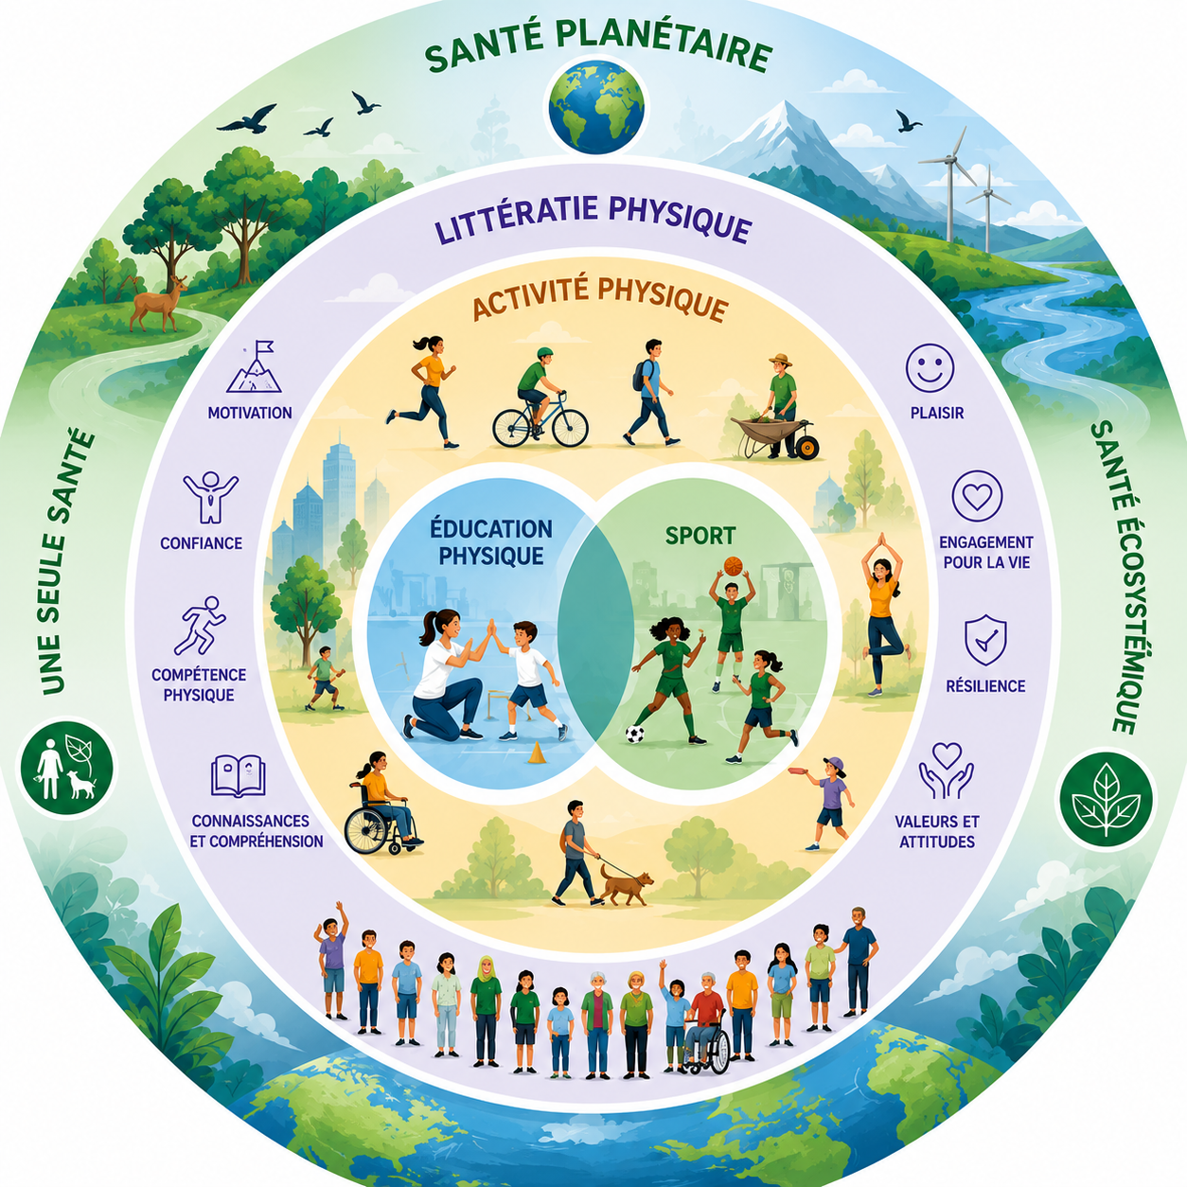
Vers une integration durable de la littératie physique
Traduit de: Valle-Muñoz, V. M., Mendoza-Muñoz, M., & Villa-González, E. (2025). Physical Literacy as a Pedagogical Model in Physical Education. Children, 12(8), 1008. https://doi.org/10.3390/children12081008
Inspiré de : Schnitzler, C., Royet, T., Derigny, T., & Cece, V. (2025). Physical education for a sustainable future: Merging promotion of health through physical literacy with global environmental responsibility. Australian Journal of Environmental Education, 41(1), 91-105
Luguterah, A.W. Integration of physical literacy into physical education (PE) curricula to align with the United Nations Sustainable Development Goals (SDGs). Discov Sustain 7, 547 (2026). https://doi.org/10.1007/s43621-026-02719-7
.
Notes:
Sustainable
Development Goals (SDGs), encompassing their social, economic, and environmental
dimensions. Specifically, these include ‘Good Health and Well-being’ (SDG-3), ‘Quality
Education’ (SDG-4), ‘Gender Equality’ (SDG-5), ‘Reduced Inequalities’ (SDG-10) and
‘Sustainable Cities and Communities’ (SDG-11). Le Capitalocène est un concept critique qui désigne la crise écologique actuelle non pas comme l'œuvre de l'humanité entière (l'Anthropocène), mais comme le résultat direct du capitalisme en tant que système économique mondial, caractérisé par l'accumulation infinie de capital et l'exploitation des ressources naturelles

Slide 30


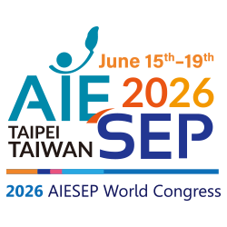

Le Global Physical Literacy Action Framework (GloPL) :
un consensus mondial pour renforcer l’éducation physique de qualité
et les expériences motrices tout au long de la vie
Alexandre Mouton¹, Lisa M. Barnett², Alethea Jerebine², Emiliano Mazzoli², & Johannes Carl³
au nom du consortium GloPL
¹University of Liège, Department of Physical Activity and Rehabilitation Sciences, RUCHE, Liège, Belgium
²Deakin University, Institute for Physical Activity and Nutrition, School of Health and Social Development, Geelong, Australia
³Technical University of Munich (TUM), TUM School of Medicine and Health, Munich, Germany
Merci pour votre attention

Slide 31
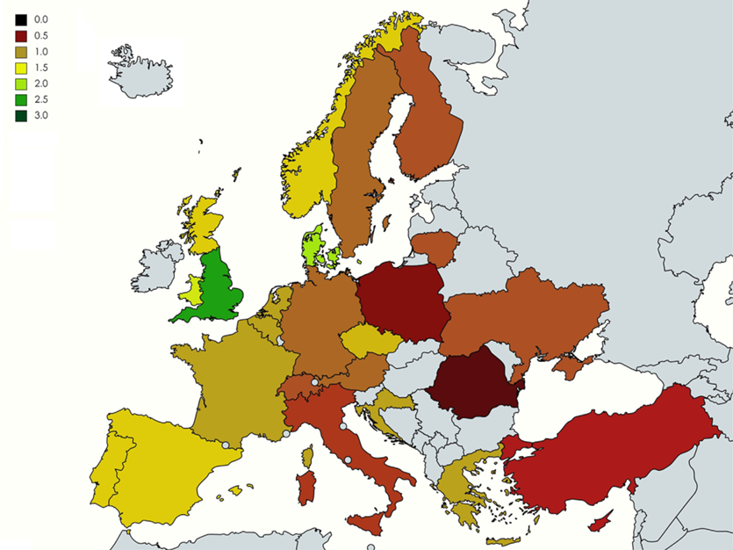
Physical literacy in Europe: Consideration in research, practice and policy
Carl, J., Bryant, A. S., Edwards, L. C., Bartle, G., Birch, J. E., Christodoulides, E., ... & Elsborg, P. (2023). Physical literacy in Europe: The current state of implementation in research, practice, and policy. Journal of Exercise Science & Fitness, 21(1), 165-176.
Notes:
Also National Action Plan Health Literacy:
“„Gesundheitskompetenz basiert auf allgemeiner Literalität und umfasst das Wissen, die Motivation und die Fähigkeiten von Menschen, relevante Gesundheitsinformationen in unterschiedlicher Form zu finden, zu verstehen, zu beurteilen und anzuwenden, um im Alltag in den Bereichen der Krankheitsbewältigung, Krankheitsprävention und Gesundheitsförderung Urteile fällen
und Entscheidungen treffen zu können, die ihre Lebensqualität während des gesamten Lebensverlaufs erhalten oder verbessern“
VISION!

Slide 32
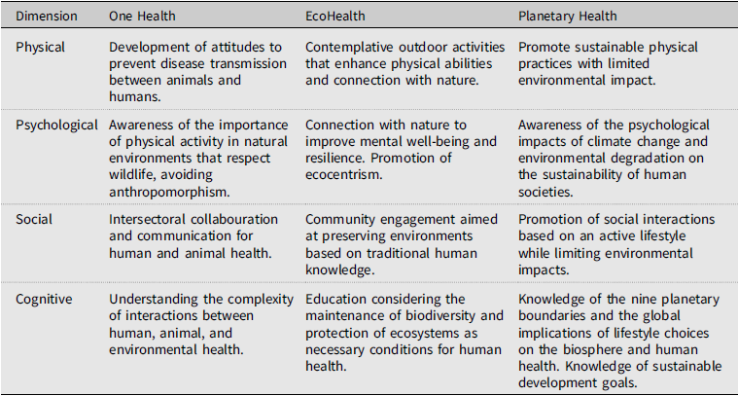
Vision: “moonshot is better than roofshot” (Chambers, 2026)
Schnitzler, C., Royet, T., Derigny, T., & Cece, V. (2025). Physical education for a sustainable future: Merging promotion of health through physical literacy with global environmental responsibility. Australian Journal of Environmental Education, 41(1), 91-105.

Slide 33
References for PL tools reviews (from Salin, 2026)
Barnett, L. M., Jerebine, A., Keegan, R., Watson-Mackie, K., Arundell, L., Ridgers, N. D., ... & Dudley, D. (2023). Validity, reliability, and feasibility of physical literacy assessments designed for school children: a systematic review. Sports Medicine, 53(10), 1905-1929.
Boldovskaia, A., Dias, N. M. G., Silva, M. N., & Carraca, E. V. (2023). Physical literacy assessment in adults: A systematic review. PLoS One, 18(7), e0288541.
Jean de Dieu, H., & Zhou, K. (2021). Physical literacy assessment tools: a systematic literature review for why, what, who, and how. International Journal of Environmental Research and Public Health, 18(15), 7954.
Ryom, K., Hargaard, A. S., Melby, P. S., Maindal, H. T., Bentsen, P., Ntoumanis, N., ... & Elsborg, P. (2022). Self-reported measurements of physical literacy in adults: a scoping review. BMJ open, 12(9), e058351.
Salin, K., Carl, J., & Elsborg, P. (2026).Physical literacy assessment, current situation and future prospects. In: L. Durden-Myers (Eds.): Routledge Handbook of Physical Literacy. 570-579.

