Slide 1


${43}^{rd}$ Benelux Meeting on Systems and Control
Fractal regulation of electroencephalography fluctuations during wake and sleep
C. Dejace, G. Hammad, C. Schmidt, G. Vandewalle, P. Sacré

Slide 2
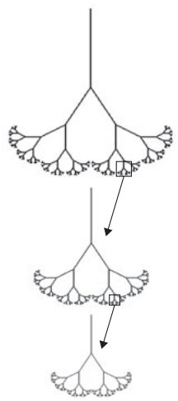
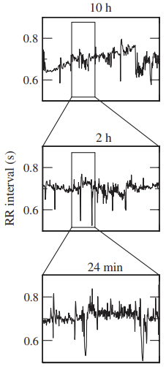
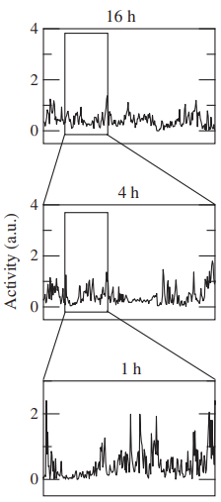
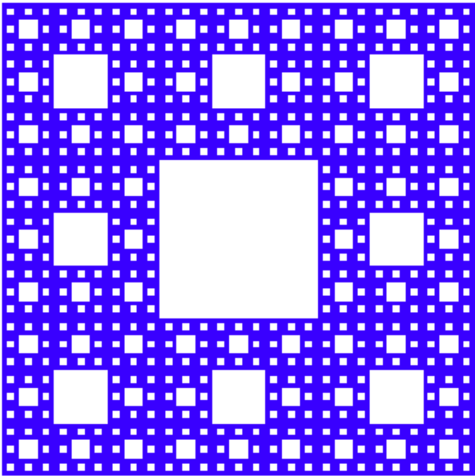
https://www.karlin.mff.cuni.cz/~pyrih/e/e2001v2/c/ect/node29.html
[Pittman-Polletta 2013]
Notes:
Von Koch Sierpinski Mandelbrot set

Slide 3
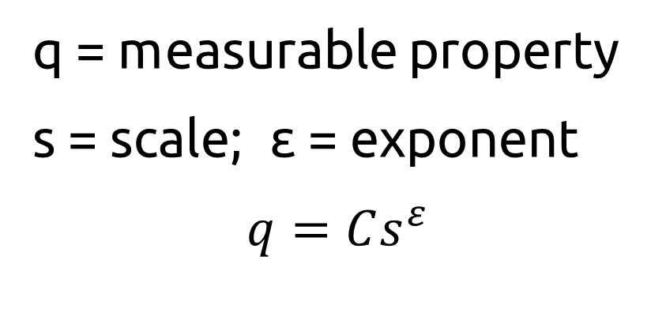
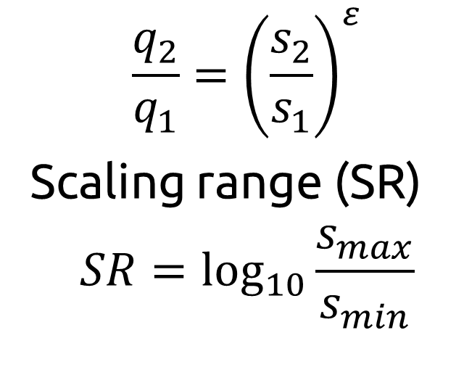
How to identify fractals? A look at their properties
Self-similarity
Power-law scaling
Scale invariance
  “Pieces when enlarged are similar to larger pieces or to the whole”
  q = measurable property
  s = scale; ε = exponent
  $$q=Cs^{ε}$$
  $$\frac{q_{2}}{q_{1}}={\left(\frac{s_{2}}{s_{1}}\right)}^{ε}$$
  Scaling range (SR)
  $$SR=\log_{10}{\frac{s_{max}}{s_{min}}}$$
Notes:
Self-similarity: EXACT (math) or STATISTICAL (natural; equality in distribution)
Power-law scaling:
C = proportionality constant;
negative exponent usually, determined as slope of linear regression on log-log graph
Scale invariance:
RELATIVE ratio matters rather than the absolute values of scales
ideal case SR = infinity (holds on each and every scale)
s_max in range of size of the structure itself; s_min in range of size of the smallest structural elements

Slide 4
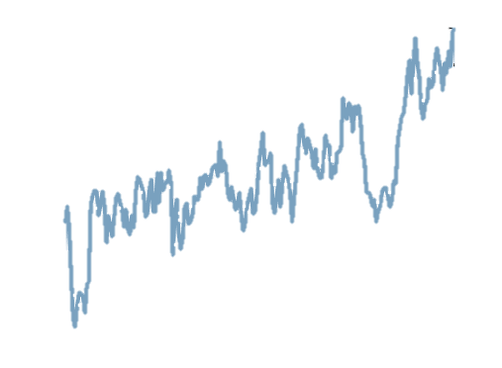
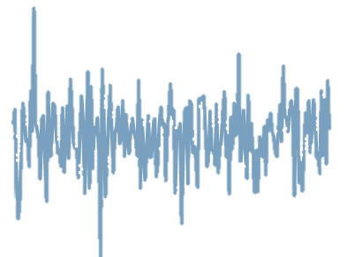
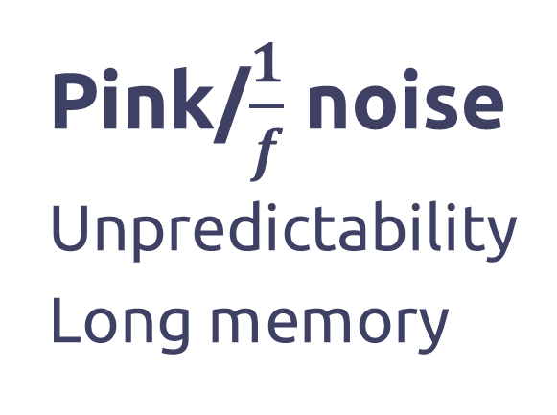
Classification of fractal signals
Stationary
fGn
Non Stationary
fBm
Pink/$\frac{1}{f}$ noise
Unpredictability
Long memory
White noise
Random
Uncorrelated
Red/Brownian
noise
Regular
Correlated
[Eke et al. 2002; Pittman-Polletta et al. 2013]

Slide 5
How to measure fractality?
  $$q=Cs^{ε}$$
Stationary | Non Stationary
Rescaled range (R/S) analysis [Hurst 1951] | Scaled Windowed Variance (SWV) [Cannon 1997]
Autocorrelation (AC)
Dispersional analysis (Disp)
Linear system analysis
Power Spectral Density (PSD)
Detrended Fluctuation Analysis (DFA) [Peng 1994]
[Eke et al. 2002]

Slide 6
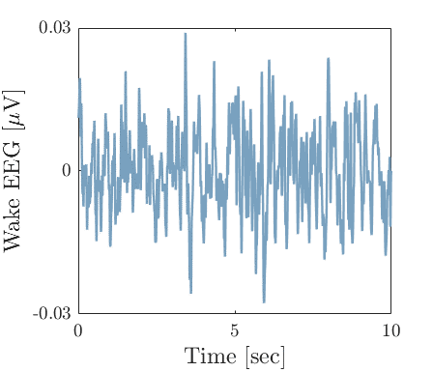
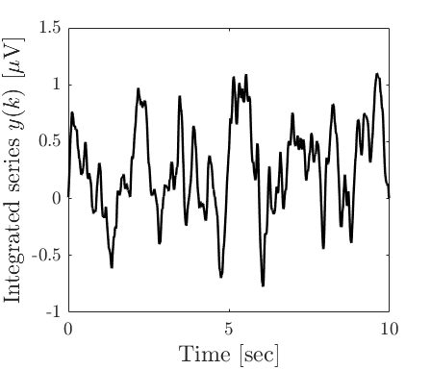
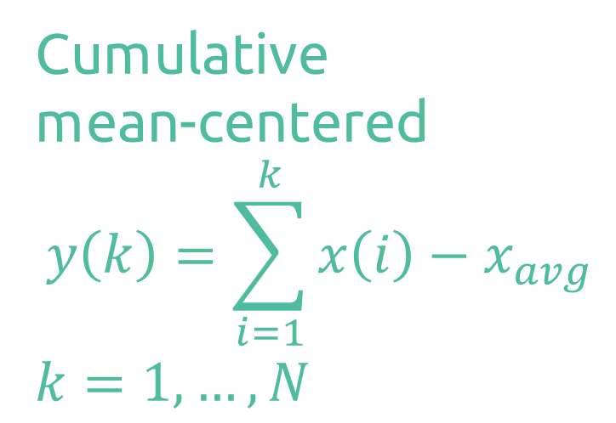
Understanding the DFA algorithm
Cumulative
mean-centered
$$y\left(k\right)=\sum_{i=1}^{k}{x\left(i\right)−x_{avg}}$$
$$k=1,…,N$$
Notes:
DFA = modified RMS analysis
Signal length = N samples

Slide 7
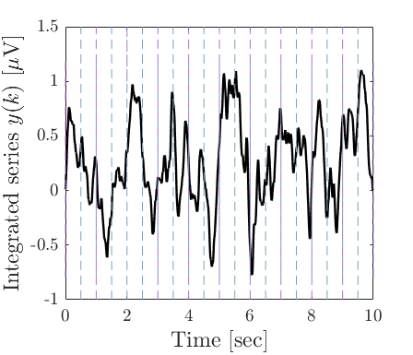
Understanding the DFA algorithm
Divide into boxes of size n
Notes:
Boxes = SCALES
!!! Min scale = 10 samples, max scales = N/10 !!!
Purple: n = 500 samples / 1 sec
Gray: n = 250 sample / 0.5 sec

Slide 8
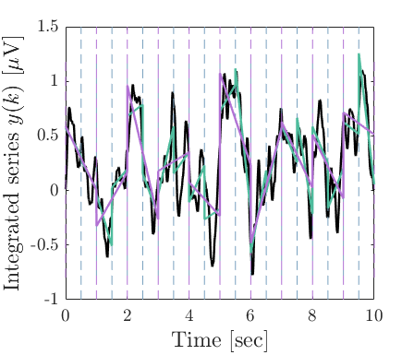
Understanding the DFA algorithm
Compute trends
Remove them from y(k)
Notes:
Trends = global evolution of the time series over a window
= best fit over a time/scale window (usually linear but can be higher order)
Removing trends = detrending (only keep fluctuations of interest so-called « noise »)

Slide 9
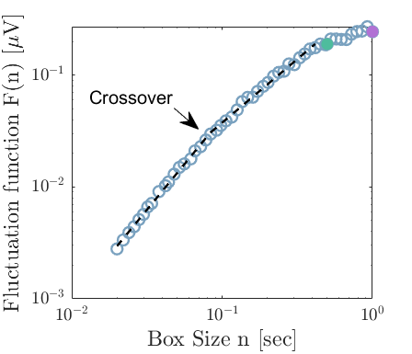
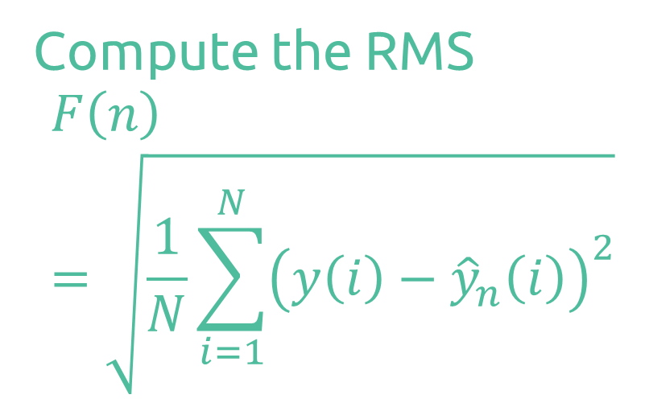
Understanding the DFA algorithm
Compute the RMS
$$F\left(n\right)=\sqrt{\frac{1}{N}\sum_{i=1}^{N}{{\left(y\left(i\right)−{\hat{y}}_{n}\left(i\right)\right)}^{2}}}$$
Notes:
Plot log F(n) against log n
Slope of line regression = DFA exponent = alpha
Trouver crossover (findchangepts in MATLAB):
Chooses a point and divides the signal into two sections.
Computes best linear fit for each section.
At each point within a section, measures how much the property deviates from the empirical estimate. Adds the deviations for all points.
Adds the deviations section-to-section to find the total residual error.
Varies the location of the division point until the total residual error attains a minimum

Slide 10
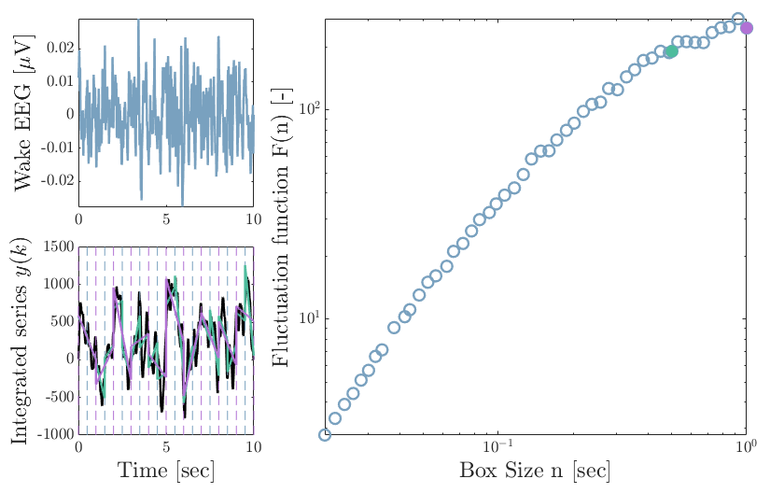
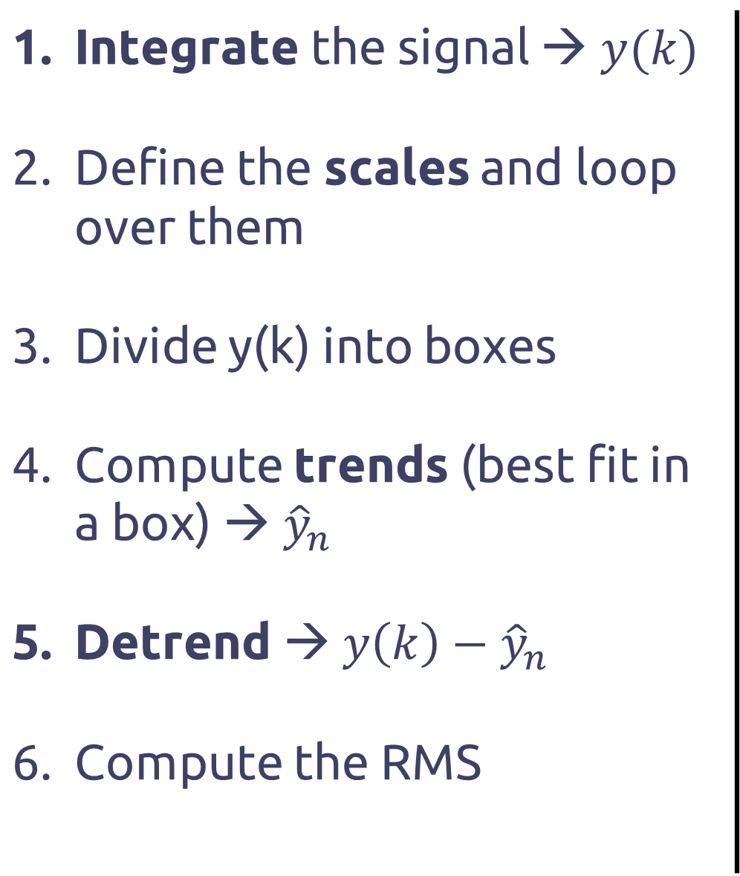
Full algorithm
Integrate the signal → $y(k)$ Define the scales and loop over them Divide y(k) into boxes Compute trends (best fit in a box) → ${\hat{y}}_{n}$ Detrend → $y\left(k\right)−{\hat{y}}_{n}$ Compute the RMS
[Goldberger 2002; Peng 1995]

Slide 11
DFA on EEG
Is there a change in fractality in young and healthy EEG during a wake-to-sleep transition?

Slide 12
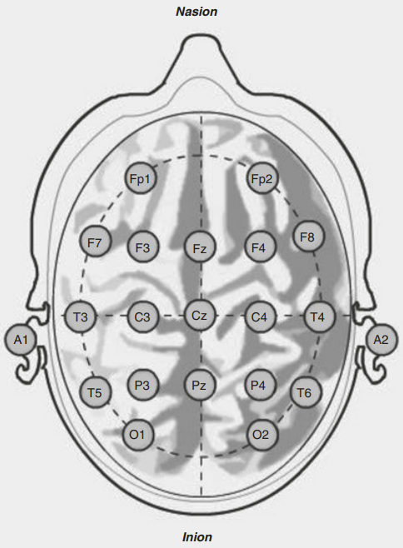
We focus on frontal, central, parietal and occipital electrodes
[Mecarelli 2019]
Notes:
Frontal for K-complexes: Fz (BACKUP = F3, F4)
Central for spindles: C4 (BACKUP = C3, Cz)
Occipital for alpha waves O1 (BACKUP = O2)
Ref: A1

Slide 13
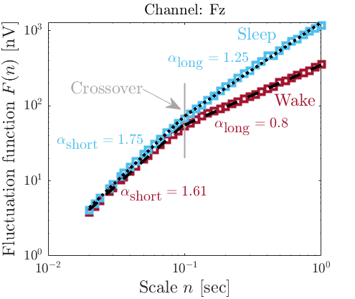

Fractal patterns are modulated with physiological states: $α_{sleep}> α_{wake}$
Protocol
24 subjects
Wake
Sleep
15min
15min
Notes:
Sleep NREM N2, N3 → SLOW WAVE
# valid subjects = 24

Slide 14
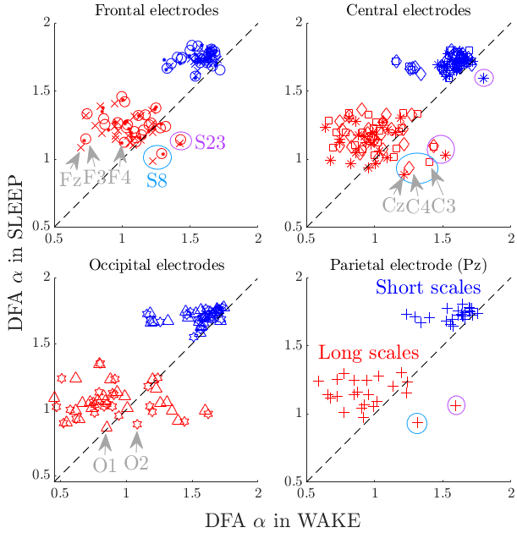
Two different scaling regimes appear
Notes:
Crossover exists
Short > Long (Sleep > Wake)
Short = Brownian-type (highly correlated and regular) → Consistent with endogenous activity
Long = 1/f-type (still long memo but unpredictable)
More variability in wake than in sleep → Consistent with high irregularity
High correlation with recent past (i.e. within a decade of samples/max 0,1 second), less correlation with distant past (> 0,1 sec)

Slide 15
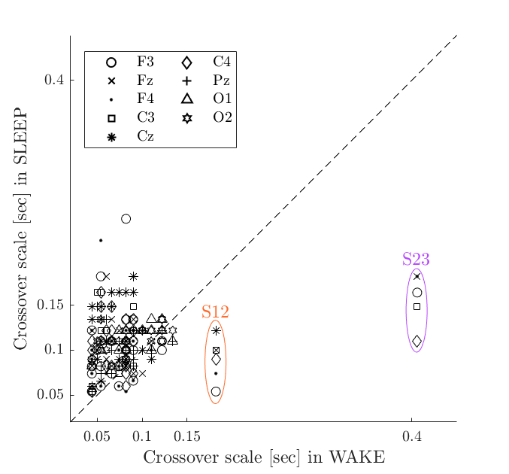
Crossover phenomenon almost always occurs
on the same scale
Notes:
Crossover scale does not depend on physiological state

Slide 16
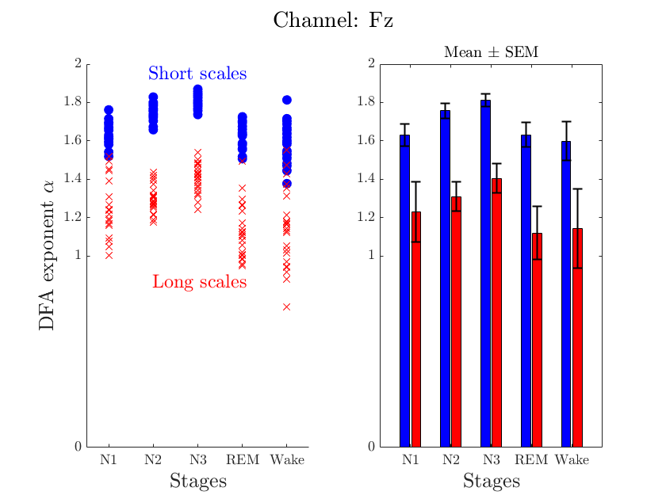
The deeper the sleep stage is,
the higher the DFA exponent is
Notes:
Short > Long again
DFA exponent increases with sleep stage. REM +- = Wake
Less variability in short scales.
Highest variability in wake

Slide 17
Take – home messages
Fractal signal properties: self-similarity, power-law scaling, scale-invariance
Detrended Fluctuation Analysis (DFA) algorithm:
Integrate, Divide into boxes, Compute trends, Detrend, Compute RMS
DFA on EEG:
Sleep > Wake;
The deeper the sleep stage, the higher the DFA exponent
Two distinct scaling regimes associated with specific behaviors

Slide 18

Thank you!
Any questions?
cdejace@uliege.be

Slide 19
Bibliography
Campbell, I.G. (2009) ‘EEG Recording and Analysis for Sleep Research’, Current Protocols in Neuroscience, 49(1), p. 10.2.1-10.2.19. Available at: https://doi.org/10.1002/0471142301.ns1002s49.
Cannon, M.J. et al. (1997) ‘Evaluating scaled windowed variance methods for estimating the Hurst coefficient of time series’, Physica A: Statistical Mechanics and its Applications, 241(3), pp. 606–626. Available at: https://doi.org/10.1016/S0378-4371(97)00252-5.
Eke, A. et al. (2002) ‘Fractal characterization of complexity in temporal physiological signals’, Physiological Measurement, 23(1), pp. R1–R38. Available at: https://doi.org/10.1088/0967-3334/23/1/201.
Goldberger, A.L. et al. (2002) ‘Fractal dynamics in physiology: Alterations with disease and aging’, Proceedings of the National Academy of Sciences, 99(suppl_1), pp. 2466–2472. Available at: https://doi.org/10.1073/pnas.012579499.
Hurst, H.E. (1956) ‘The Problem of Long-Term Storage in Reservoirs’, International Association of Scientific Hydrology. Bulletin, 1(3), pp. 13–27. Available at: https://doi.org/10.1080/02626665609493644.
Ivanov, P.C. et al. (1999) ‘Sleep-Wake Differences in Scaling Behavior of the Human Heartbeat: Analysis of Terrestrial and Long-Term Space Flight Data’, Europhysics Letters (EPL), 48(5), pp. 594–600. Available at: https://doi.org/10.1209/epl/i1999-00525-0.

Slide 20
Mecarelli, O. (2019) ‘Electrode Placement Systems and Montages’, in O. Mecarelli (ed.) Clinical Electroencephalography. Cham: Springer International Publishing, pp. 35–52. Available at: https://doi.org/10.1007/978-3-030-04573-9_4.
Peng, C.-K. et al. (1994) ‘Mosaic organization of DNA nucleotides’, Physical Review E, 49(2), pp. 1685–1689. Available at: https://doi.org/10.1103/PhysRevE.49.1685.
Peng, C.-K. et al. (1995) ‘Quantification of scaling exponents and crossover phenomena in nonstationary heartbeat time series’, Chaos: An Interdisciplinary Journal of Nonlinear Science, 5(1), pp. 82–87. Available at: https://doi.org/10.1063/1.166141.
Pittman-Polletta, B.R. et al. (2013) ‘The role of the circadian system in fractal neurophysiological control’, Biological Reviews, 88(4), pp. 873–894. Available at: https://doi.org/10.1111/brv.12032.

