Slide 1



BIO-BASED LICL-CONTAINING HYDROGEL ELECTROLYTES FOR SUSTAINABLE ENERGY STORAGE: STRUCTURE–EFFICIENCY RELATIONSHIPS
Presented by Quentin De Roover
CatScience 2026, Palazzo Corrado Alvaro, Reggio Calabria, Italy

Slide 2
Context: the energy transition & the challenge of storage
📈 A rapidly expanding market
⚠️ The limitations of conventional electrolytes
Global LIB market : 150 Md$ in 2025
🔥
Security
Flammable, volatile carbonate-based solvents (EC, DMC) → risks of fire and thermal runaway
+20% vs 2024
6 times since 2020
Source : IEA, 2026
💀
Toxicity
1 500 TWh by 2035
Fluorinated salts (e.g., LiPF₆) sensitive to humidity → decomposition into HF, hazardous by-products
Electric vehicle (EV) demand is projected to increase
(6 times higher than in 2025)
Source : IEA Global EV Outlook 2026
⛏️
Ressources
Dependence on fossil fuels and critical raw materials (Li, F) → price volatility, fragile supply chain
Distribution of battery demand
⚖️
Regulation
EV > 70% + stationary storage > 15%
Electronics < 5% (vs. ~50% in 2015)
Source : IEA, 2026
Increasing pressure from regulators (EU Battery Regulation, etc.) for sustainable alternatives and a controlled lifecycle
2

Slide 3
Towards bio-based hydrogel electrolytes
Conventional Electrolytes
Bio-based
Polymers
Ionic Hydrogels
(with LiCl)
Sustainable Energy Storage
→
→
→
High-performing but flammable, toxic, and not durable
Polysaccharide and/or protein:
Abundant, renewable, rich in –OH (or binding site)
Conductive aqueous network, flexible, non-flammable, biodegradable
Flexible electronics, flexible sensors, “green” electrolytes
The scientific challenge
How to reconcile high ionic conductivity and mechanical integrity in a multi-biopolymer network, and how do Li⁺ ions interact with a matrix rich in –OH, -COOH, -NH groups to govern this trade-off?
Approach : the SGPL system (Starch / Gluten / PVA / LiCl)
Valorization
Double network
Systemic approach
Starch and gluten, abundant co-products of European agri-food industry, find here a high value-added outlet in a biorefining logic
Physical (citric acid) + reversible ionic (COO⁻ - Li⁺) crosslinking: an adjustable conductivity ↔ rigidity compromise
Impact of the number of charge carriers and network rigidity → multi-technique characterization
3

Slide 4
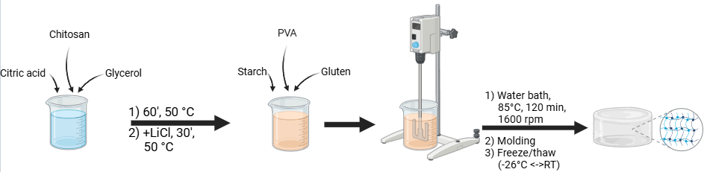
Materials & Methods
🧪 Composition
Unmodified starch
PVA (98% hydrolyzed, Mw_{approx.} 50–85k)
Gluten (0, 3, 6, 9, 12% w/w_{starch})
Chitosan + glycerol + citric acid
LiCl (0, 0.5, 1, 1.5, 2 mol/L)
Fig. 1 – Schematic representation of the synthesis protocol of SGPL hydrogels
🔬 Characterization techniques
ATR-FTIR
DRX
DSC
Rheology
PEIS / Conductivity
Chemical composition – functional group
400–4000 cm⁻¹, 32 scans; 4 cm⁻¹ resolution
Crystallinity
Cu-K_{α} radiation, 1,5406 nm, 40 kV, 5-55° (2ϑ)
Glass transition temperature (Tg)
0 → 80 °C, 5 °C/min, isothermal ramp
Mechanical properties
Frequency sweep : 0.02 → 80 Hz, 0,1% strain (cst)
Ionic conductivity
10⁻¹ → 7.10⁶ Hz, 10 mV
4

Slide 5
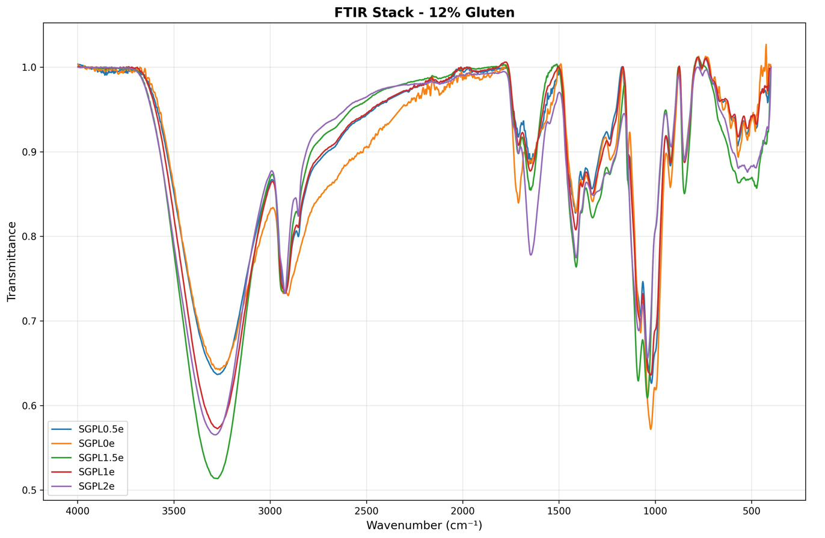
Results – Chemical Composition (ATR-FTIR)
3300–3200 cm⁻¹
O–H / N–H
Broadening with [LiCl] → perturbation of H-bond by Li⁺ (high charge density)
1650–1640 cm⁻¹
Amide I (gluten)
Broadening → Li⁺ coordination with C=O groups of the peptide skeleton
~1411 cm⁻¹
–COO⁻ carboxylate
↑ intensity with [LiCl] → formation Li⁺–carboxylate sites = reversible ionic bonds
Double reticulation : citric acid + reversible ionic
(COO⁻–Li⁺)
Fig. 2 – Spectra ATR-FTIR SGPL
5

Slide 6
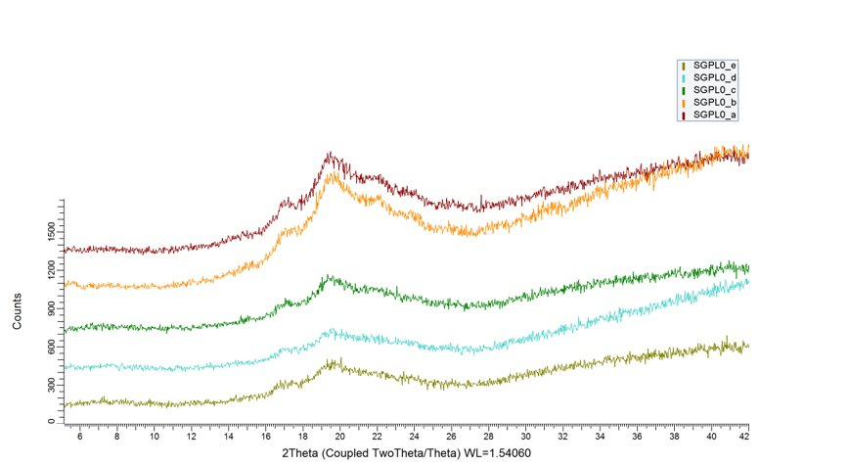
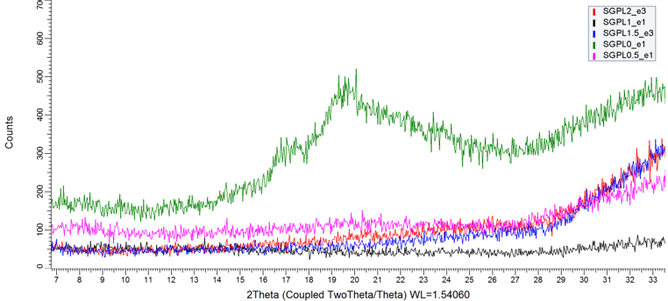
Results – Structure (XRD)
Fig. 3 – LiCl-free DRX hydrogels (variable gluten content)
Keys observation
Amorphous matrix
Large halo centered et 2ϑ ≈ 19–20° in all formulations without LiCl → starch gelatinization + glycerol plasticizing effect
Gluten effect
↑ gluten → ↑ amorphization → protein network prevents the reorganization of starch chains (and PVA)
LiCl effect
Adding LiCl does not induce any knew crystalline phase; enhances amorphization→ insertion of Li⁺ into the network
Ionic involvement
Amorphous zones = preferential transport pathways for Li⁺ via diffusion mechanism
Fig. 4 – DRX hydrogels with 12% gluten (variable LiCl content)
6

Slide 7
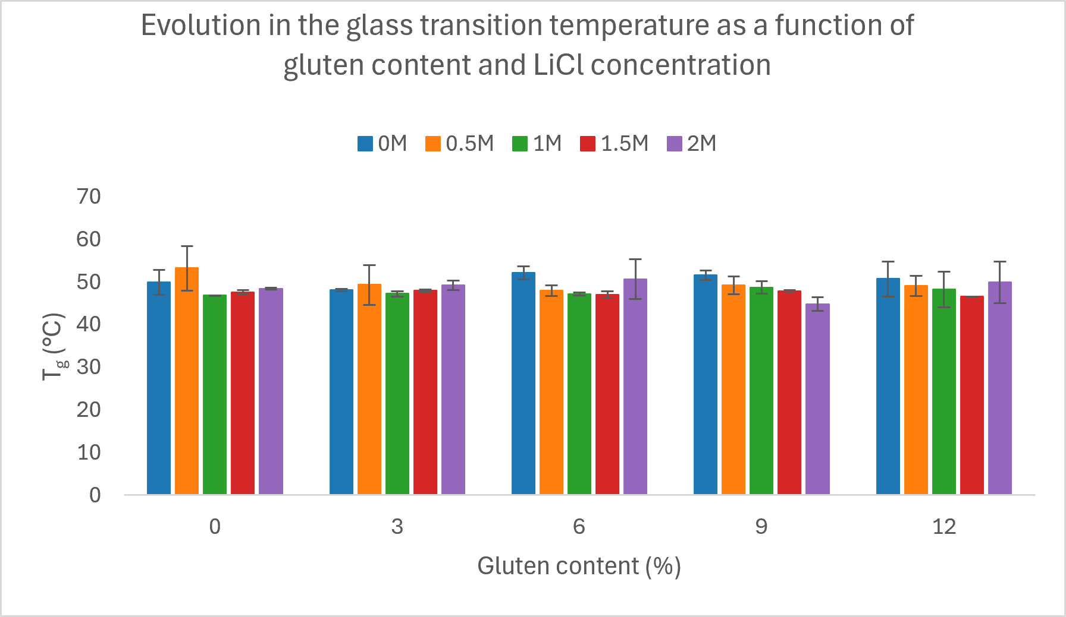
Results – Thermal properties (DSC)
44 – 53 °C
Tg range (all formulations)
Tg remains stable despite variations in LiCl and gluten
Glycerol = dominant factor (plasticization, ↓Tg vs. pure starch ~65°C)
LiCl tends to slightly ↓Tg via disruption of inter-chains H-bond
Analogous to the plasticizing effect of ionic species in polyelectrolyte systems
Fig. 5 – Tg as function of gluten content and LiCl concentration
7

Slide 8
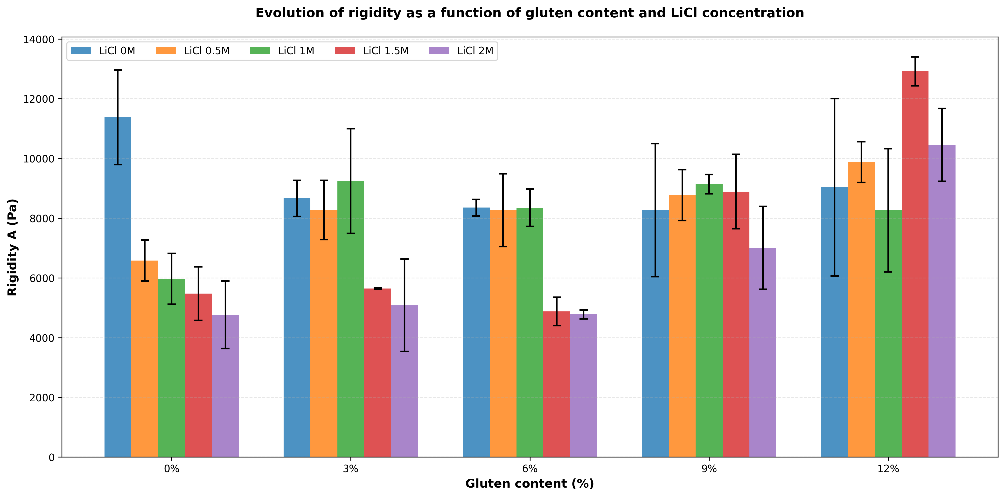
Results – Frequency sweep – Mechanical prop.
Rigidity A
Power-law G’ = A.ωⁿ
A correspond to extrapolated value of G’ used as a network rigidity index as a function of the formulation
LiCl effect
0% of gluten → ↘ in rigidity
Disruption of inter-/intramolecular bonds
Gluten effect
↗ gluten → ↗ rigidity
Gluten counteracts the effect of LiCl by increasing network rigidity
LiCl – Gluten relationship
The combination of LiCl & gluten % allows for decoupled control of stiffness and ionic conductivity → a key advantage for material optimization
Fig. 6 – Rigidity as function of gluten content & [LiCl]
8

Slide 9
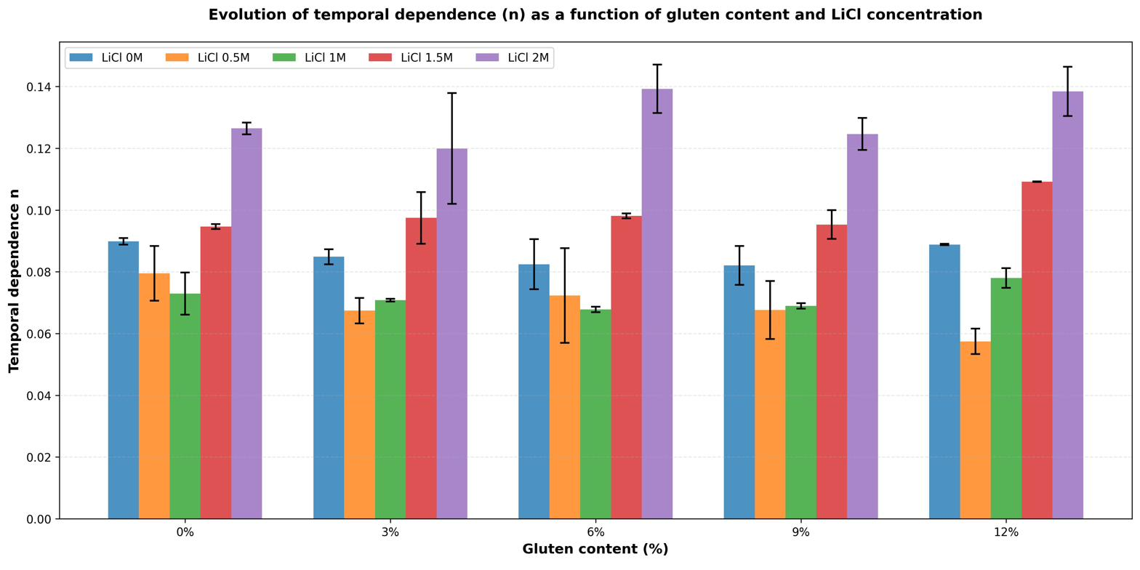
Results – Frequency sweep – Mechanical prop.
What is n ?
n = time dependence (G’ = A.ωⁿ)
n → 0 : purely elastic network (strong gel)
n > 0 : viscoelastic behavior/ network relaxation (weak gel)
0.5 M LiCl
n at the lowest→ quasi-elastic network
Double cross-linking preserves rigidity across the entire frequency range
2 M LiCl
Highest n → network dominated by transient interactions
More visible chaotropic effect (Cl⁻ screening)
Gluten
n independent of gluten content at fixed [LiCl]
→ The protein network does not contribute to frequency relaxation
Fig. 7 – Time dependence (n) as a function of gluten content and [LiCl]
9

Slide 10
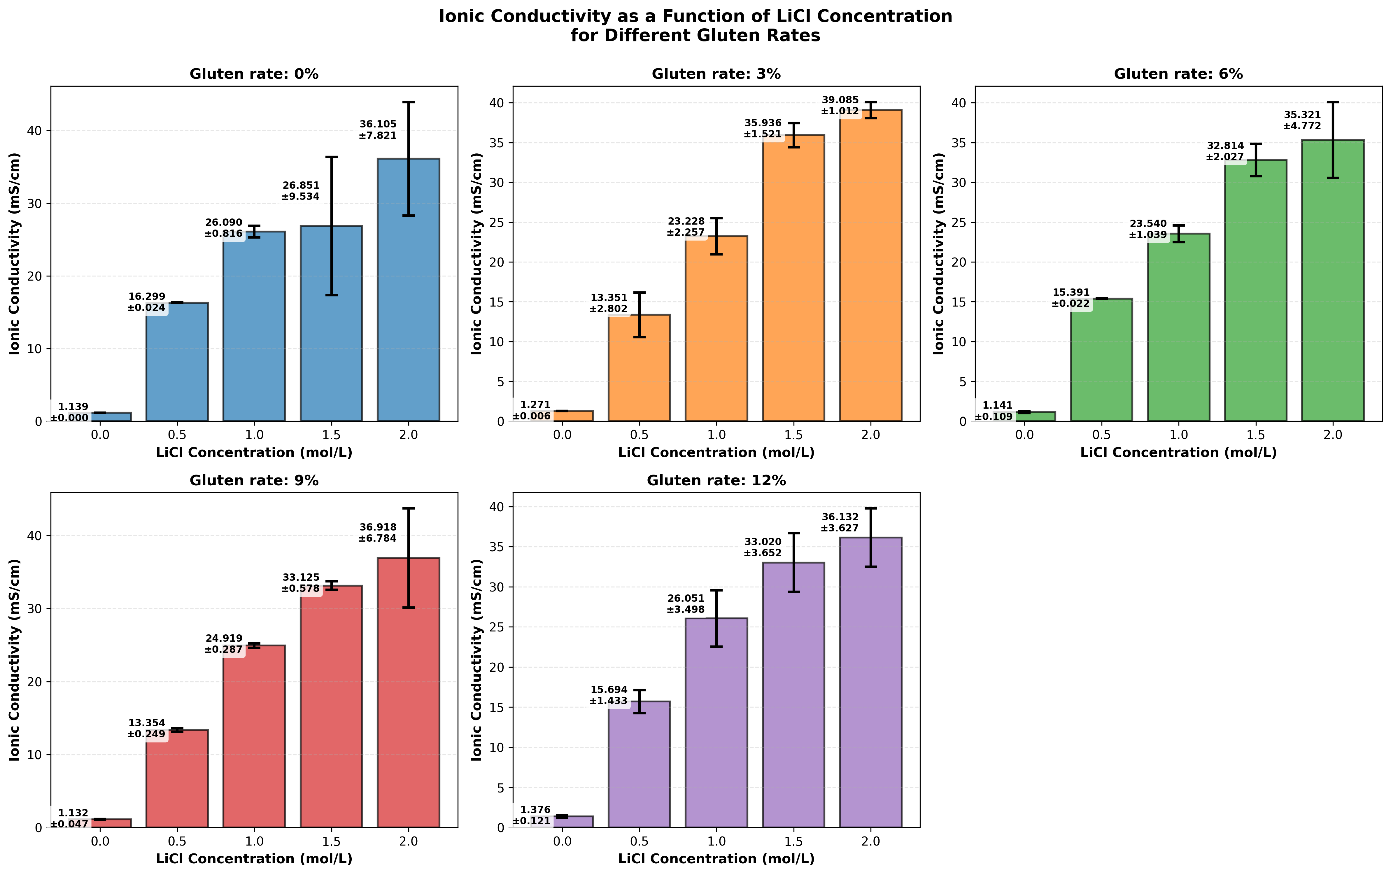
Results – Ionic conductivity
Conventional electrolytes 1M LIPF₆ : ~10 mS/cm
Trend of relative increase (Δσ)
0 → 0.5 M
+1040%
0.5 → 1 M
+66%
Saturation observed beyond 1.5 M (ion-pair formation)
+9%
1 → 1.5 M
+27%
1.5 → 2 M
+9%
Fig. 8 – Ionic conductivity vs [LiCl]
10

Slide 11
Structure-property correlations
DSC ↔ Conductivity
Tg stable (45–54°C) slight effect of [LiCl] while σ varies → LiCl act as charge carrier and as ionic plasticizer → slight modification of segmental dynamics of the matrix
FTIR / DRX ↔ Rheology
Disruption of H-bond (3300–3200 cm⁻¹) → plasticization → ↓ rigidity. Formation COO⁻–Li⁺ (~1411 cm⁻¹) → reversible cross-linking → partial stiffening at 0.5 M
Amorphous matrix (DRX) → obstacle-free network = ion transport pathway
Mechanical (n) ↔ Network
The time dependence (n) increases from 0.5 M (quasi-elastic) to 2 M (viscoelastic) consistent with the saturation of coordination sites and the dominance of transient physical interactions
n independent of gluten → the protein network does not contribute to frequency relaxation
11

Slide 12
Conclusion
The issues
Our response
⚠️ Security
100% aqueous matrix
✓
Flammable organic solvents (EC, DMC) → Thermal hazards
Non-flammable, non-volatile
💀 Toxicity
LiCl – Simple inorganic salt
→
✓
LiPF₆ → Hydrolysis in HF, hazardous by-products
No toxic decomposition, compatible with bio-based matrices
⛏️ Critical resources
Starch + Gluten + PVA + Chitosan
✓
Dependence on complex salts and fossil solvents
Renewable resources, European agro-industrial by-products
🎯 Conductivity ↔ Rigidity / Structure
Yes – Two independent levers
✓
Can these two properties be decoupled in a bio-based network ?
[LiCl] → σ up to ~36 mS/cm | Gluten → adjustable stiffness
12
Optimal widow : 1–1.5 mol/L LiCl, maximum conductivity ↔ Preserved mechanical integrity → Bio-based approach

Slide 13

Thank you for your attention
Any questions ?
Contact me : Quentin.DeRoover@uliege.be or

