Slide 1
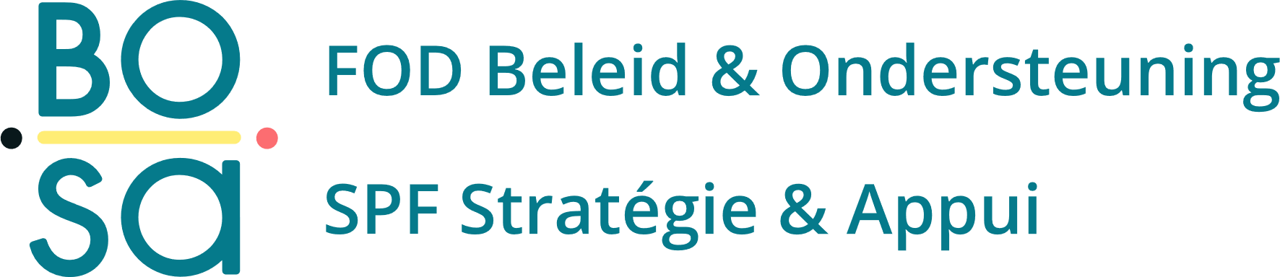

Constraint-Based Contact Modeling for
Predictive Simulation of Gait
Léonore Foguenne, Valentin Sonneville, Benjamin Moreno,
Cédric Schwartz, Pierre Sacré, Olivier Brüls
Notes:
Good morning, everyone. My name is Léonore Foguenne, and I am a researcher at the University of Liège within the LAM Motion Lab. Today, I will be presenting our work on 'Constraint-Based Contact Modeling for Predictive Simulation of Gait'. This research was developed in collaboration with my colleagues and supervisors—Valentin Sonneville, Benjamin Moreno, Cédric Schwartz, Pierre Sacré, and Olivier Brüls.
This work is supported by BOSA through the aidwear project. To understand why we are diving so deeply into the complex mathematics of contact modeling today, we first need to look at the broader clinical application driving this research.

Slide 2
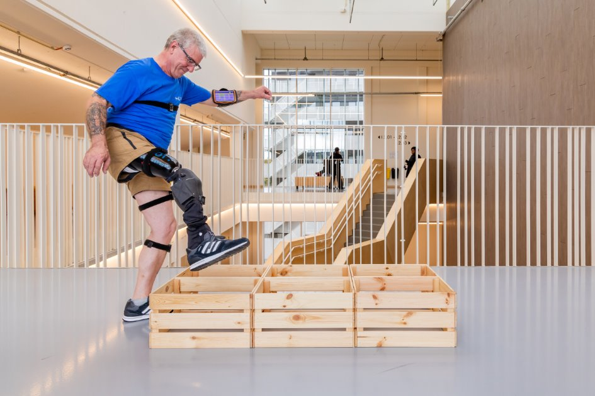
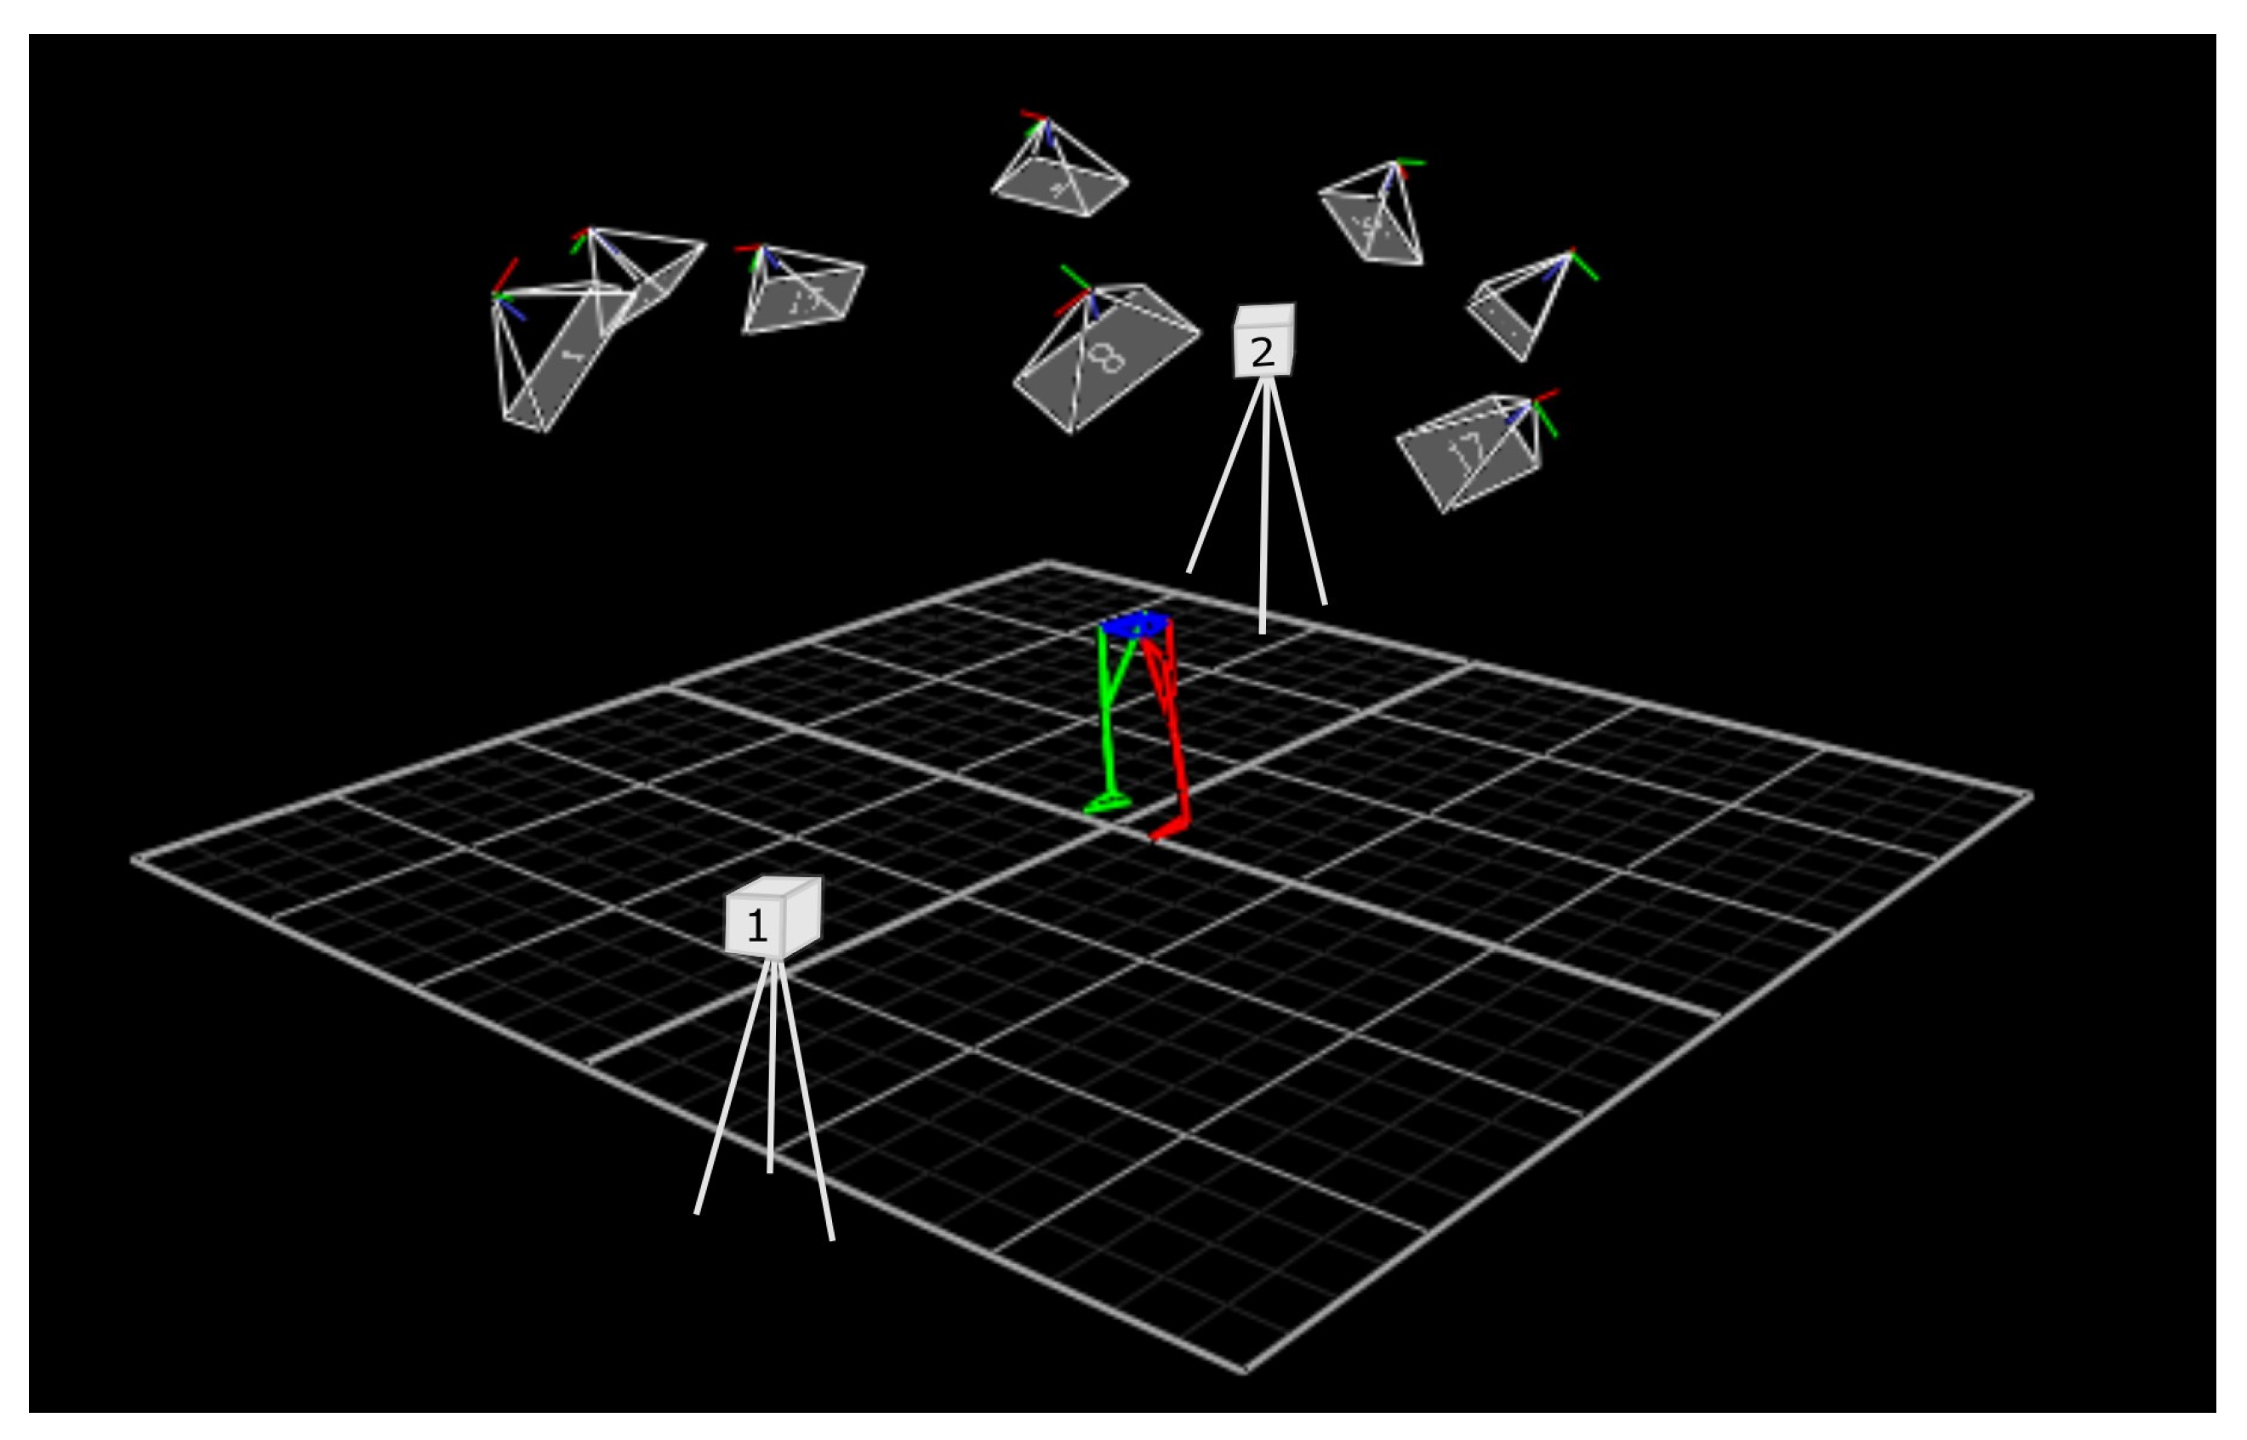
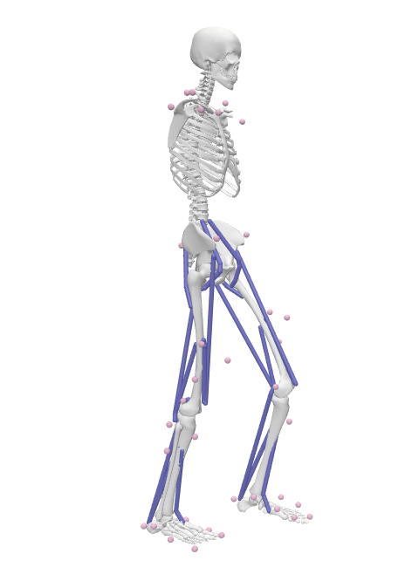
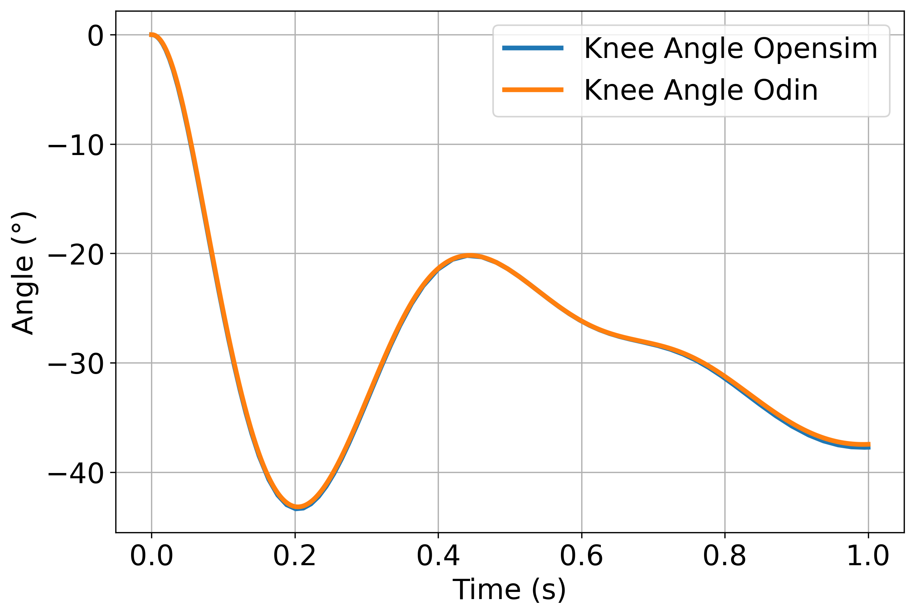
Motivation: Predictive gait simulation for AI intention detection
AIDWEAR project : Advancing AI frameworks for Robotic Assistive Devices (active prosthetics) to restore quality of life for amputee patients.
Problem: Require massive amount of data.
→ Use predictive simulation to produce data.
Lab measurements
Musculoskeletal model
Motion data
Predictive Simulation
Predictive Simulation
Equations of motion
+
Optimization problem
→ Physiological objective
Notes:
The ultimate goal of the AIDWEAR project is to restore natural mobility for amputee patients using robotic assistive devices. To do this smoothly, these active prostheses rely on AI algorithms for 'intention detection’, essentially predicting whether the patient is about to walk, climb a stair, or stop.
The bottleneck in this process is data. Training robust AI requires massive amounts of human movement data across highly diverse scenarios. We cannot realistically, or safely, keep patients in a motion capture lab for thousands of hours, especially to test extreme scenarios like stumbling.
Our solution is to synthesize this data from scratch. As you can see in the pipeline here, instead of recording motion, we use predictive simulation. We rely purely on the equations of motion and physiological objectives to let the computer 'discover' how to walk.

Slide 3
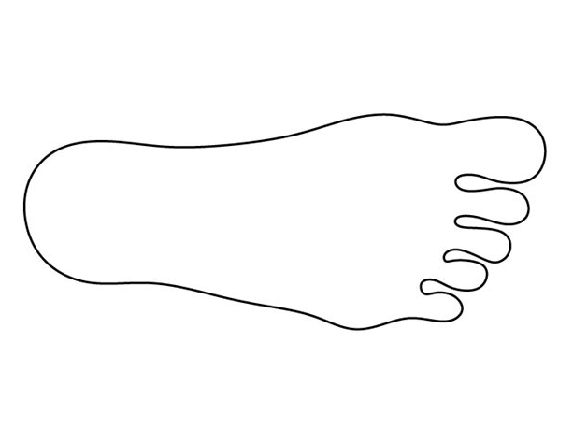
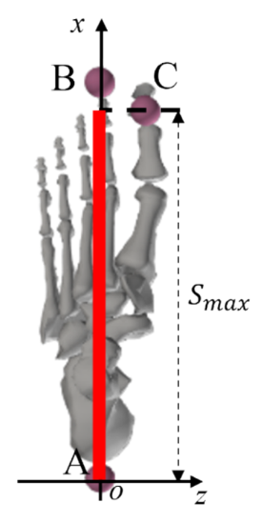
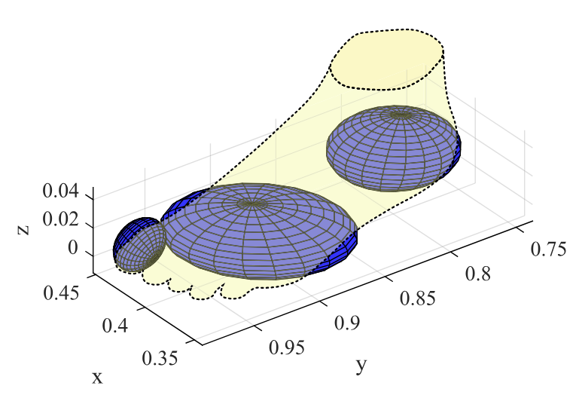
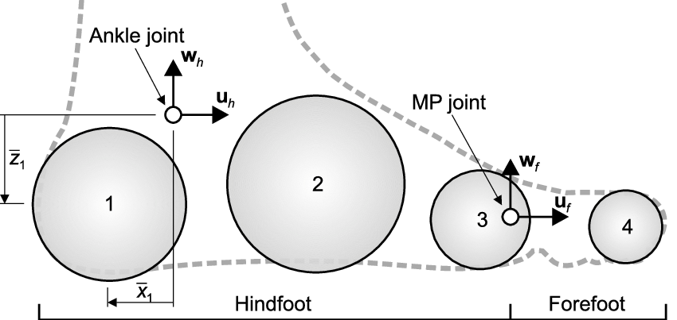
Foot/ground contact geometry
Introducing contact requires defining the boundaries of the foot and the floor.
Balance between anatomical realism and computational tractability for the NLP solver
Continuous volumetric models
Moving center of pressure
Multi-sphere approach
Multi-sphere approach
Pros Highly realistic
Cons Highly complex constraint gradients
Pros Excellent for analyzing recorded data, simplifies equations
Cons Requires predefined trajectory, complex dynamic constraints to predict from scratch
Pros Geometric tractability
Cons Discrete transition chatter
Brown & McPhee (2018), Van Hulle et al. (2020), Gao et al. (2024), Millard & Mombaur (2019), Saraiva et al. (2022)
Notes:
But before we can calculate that mathematical force, we have to define the physical boundaries creating it. How do we model a human foot for an optimizer?"
The Trade-off (The Open Discussion):
"We face a strict balance between anatomical realism and computational tractability.
We could use Continuous Volumetric Models [cite: 1.1.3]. They are highly realistic, but calculating the exact constraint gradients for complex 3D meshes at every integration step is often too slow for massive predictive optimization loops.
We could use a Moving Center of Pressure. This is excellent for inverse dynamics when you have lab data, but since we are trying to predict motion from scratch, we don't know the CoP trajectory beforehand."
The Choice & The Consequence:
"Therefore, we use a Multi-sphere approach, placing five discrete spheres under the anatomical landmarks of the foot. This gives our Non-Linear Programming (NLP) solver perfect geometric tractability.
But it introduces a major physical problem. As the foot rolls over the ground, the contact doesn't smoothly transfer. It 'chatters' as discrete spheres independently strike and leave the floor."
The Transition (Setting up Smooth vs. Rigid):
"This means our simulation will be dominated by hundreds of independent, sudden impact events. So, the next architectural choice we have to make is: how do we mathematically calculate the forces when these spheres hit the floor?"

Slide 4
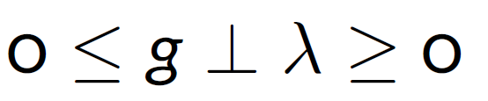
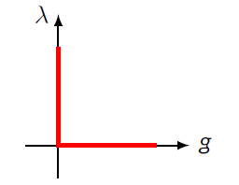

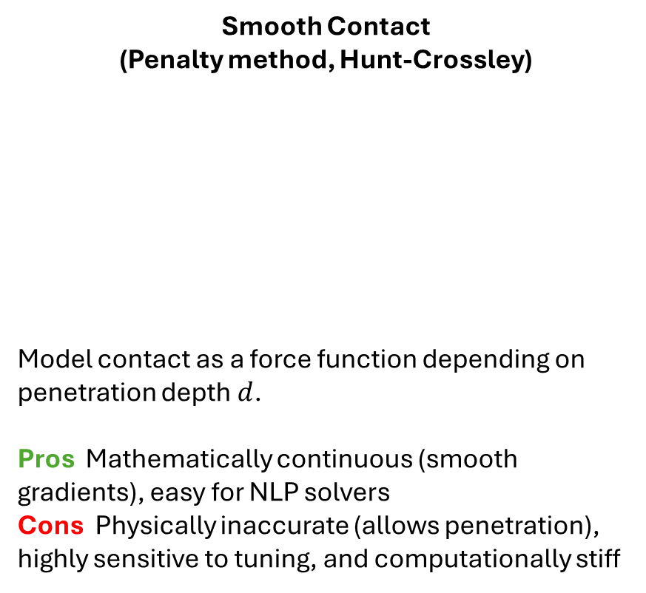


Formulating the impact: Smooth vs. Rigid contact
Smooth Contact
(Penalty method, Hunt-Crossley)
Model contact as a force function depending on penetration depth $d$.
Pros Mathematically continuous (smooth gradients), easy for NLP solvers
Cons Physically inaccurate (allows penetration), highly sensitive to tuning, and computationally stiff
Rigid Contact (Non-Smooth LCP)
Rigid Contact (Non-Smooth LCP)
$$F_{n}$$
$$F_{n}=k{\max\left(0,−d\right)}^{n}+c \dot{d}$$
$$d$$
g
-λ
c
k
λ
Model contact as a unilateral geometric constraint.
Pros Exact non-penetration, robust, and allows much larger integration time steps
Cons Velocity jumps and gradient discontinuities at impact
→ Dominant in gait simulations
→ Emerging for forward dynamics
Hunt & Crossley (1975), Millard & Mombaur (2019), Saraiva et al. (2022), Bruls et al. (2023), Khadiv (2017), Flores (2018)
Notes:
Historically, the biomechanics community splits into two principles to handle this.
Smooth Contact, such as Penalty or Hunt-Crossley methods.
These act like highly non-linear springs.
Because they mathematically continuous, gradient-based solvers like IPOPT can navigate them easily.
However they allow unphysical penetration into the ground,
their parameters are notoriously difficult to tune,
and they induce extreme numerical stiffness.
This stiffness forces the forward integrator to take microscopic time steps, drastically inflating computation time.
Rigid Contact, formulated as non-smooth Linear Complementarity Problems.
This approach is geometrically exact, it strictly enforces non-penetration and
allows for much larger, stable integration time steps.
However, from an optimal control perspective, it introduces a critical flaw. At the exact moment of rigid impact, we lose continuity due to velocity jumps. The gradients shatter, creating a discontinuous landscape that traditional NLP solvers are not designed to handle.

Slide 5
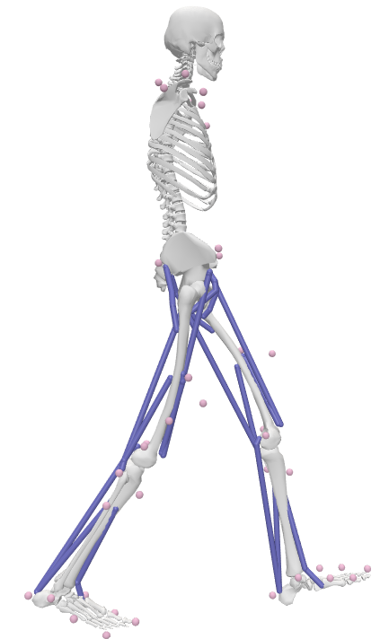
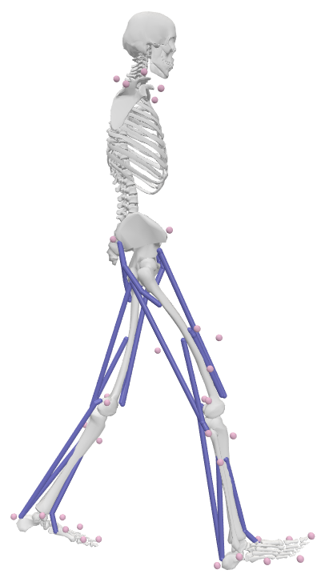
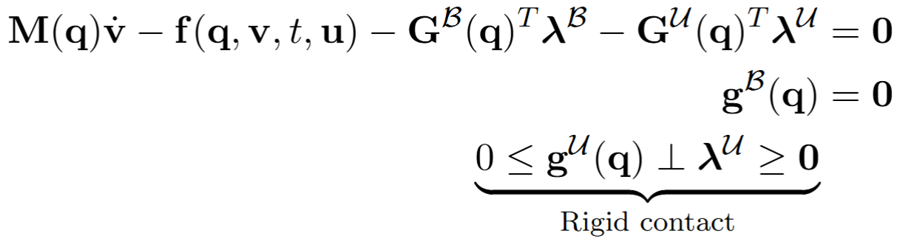
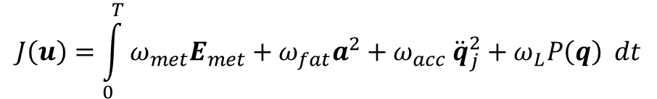




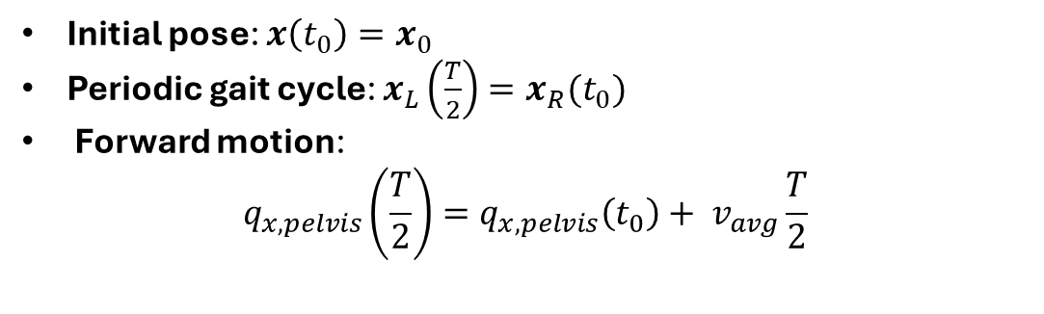
Mathematical formulation: Predictive gait as an OCP
Objective function:
$$J\left(u\right)=\int_{0}^{T}{ω_{met}E_{met}+ω_{fat}a^{2}+ω_{acc} {\ddot{q}}_{j}^{2}+ω_{L}P\left(q\right) dt}$$
$$q_{x, pelvis}$$
Metabolic cost, muscle fatigue: drive the motion, physiological parameters
Joint acceleration: avoid jittery motion
Joint limit penalty: ensure realistic motion in the r.o.m. of the articulations
$$t=0$$
$$t=\frac{T}{2}=t_{f}$$
$$\min{J(u)}$$
Subject to:
Equations of motion:
Initial pose: $x\left(t_{0}\right)=x_{0}$
Periodic gait cycle: $x_{L}\left(\frac{T}{2}\right)=x_{R}(t_{0})$
Forward motion:
$$q_{x,pelvis}\left(\frac{T}{2}\right)={q_{x,pelvis}\left(t_{0}\right)+ v}_{avg}\frac{T}{2}$$
Notes:
To translate these rigid contact principles into a functional predictive simulation, we must frame human walking as an Optimal Control Problem, or OCP.
Our primary goal here is to find the muscle excitations—our controls, denoted as $\mathbf{u}$—that minimize a specific objective function, $J(\mathbf{u})$. As you can see in the top right, this is a physiological objective. It balances metabolic cost and muscle fatigue to drive a natural motion, while penalizing joint accelerations to prevent jittery, unphysical movements, and enforcing joint limit penalties to ensure the skeleton stays within a realistic range of motion.
Of course, to generate a walking gait, this minimization is subject to task-level boundary constraints. We enforce a specific initial pose, require the model to achieve a target x positon using the average forward velocity imposed at the pelvis, and mandate a periodic gait cycle—meaning the state at the end of the half-stride ($T/2$) must mirror the initial state.
But the core of this formulation lies in the physics: the constrained equations of motion. Because we chose the rigid contact approach rather than smooth penalty forces, our system cannot be described by simple ODEs; it is governed by a system of Differential-Algebraic Equations, or DAEs.
In these equations, alongside our standard mass matrix and internal/external force vectors, we have two sets of constraint forces. We have bilateral constraints ($\mathbf{G}^{\mathcal{B}}$) that hold the anatomical joints together, and crucially, we have the unilateral constraints ($\mathbf{G}^{\mathcal{U}}$) that model the foot-ground interaction.
Notice the linear complementarity condition at the bottom right: $0 \le \mathbf{g}^{\mathcal{U}} \perp \boldsymbol{\lambda}^{\mathcal{U}} \ge 0$. This is the exact mathematical embodiment of the rigid contact we discussed on the previous slide. It dictates that the contact distance ($\mathbf{g}$) and the contact force ($\boldsymbol{\lambda}$) must be non-negative and orthogonal. It perfectly guarantees zero ground penetration, but as I mentioned earlier, this complementarity is exactly what injects the non-smoothness and velocity jumps into our system.
So, we are left with a continuous-time, infinite-dimensional optimal control problem governed by non-smooth DAEs. To actually solve this complex problem using an NLP solver, we have to discretize it. In our architecture, we tackle this by using a Single Shooting method

Slide 6
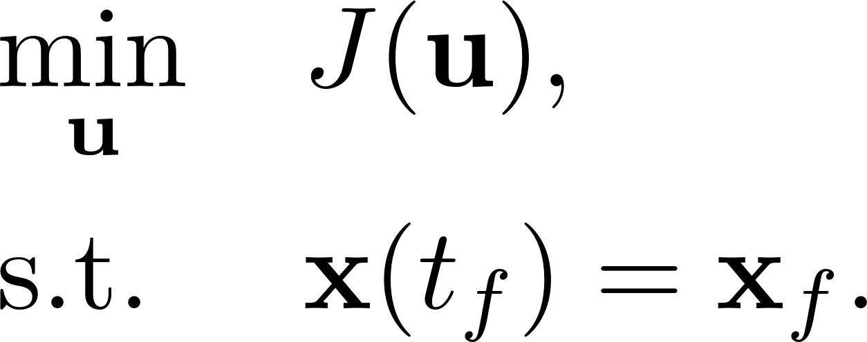
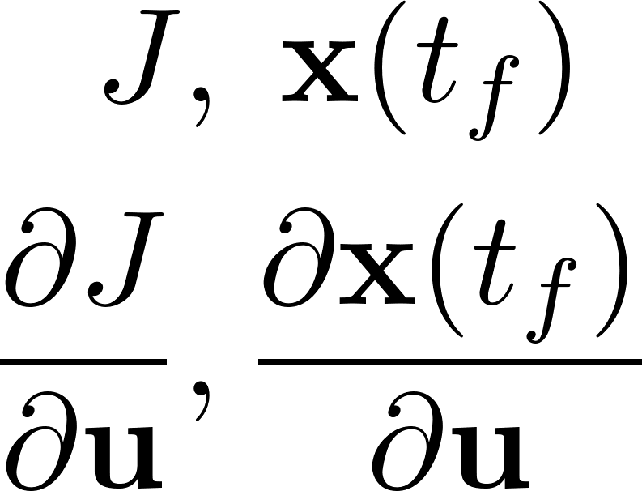

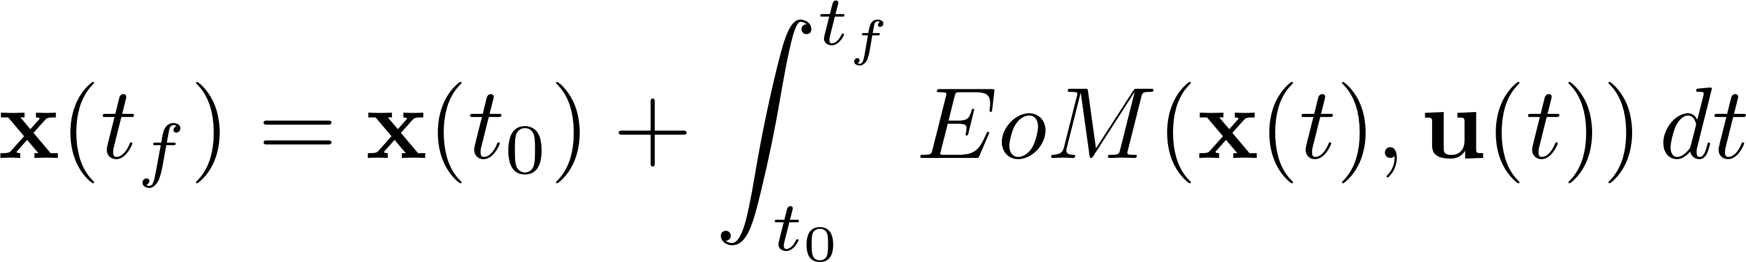










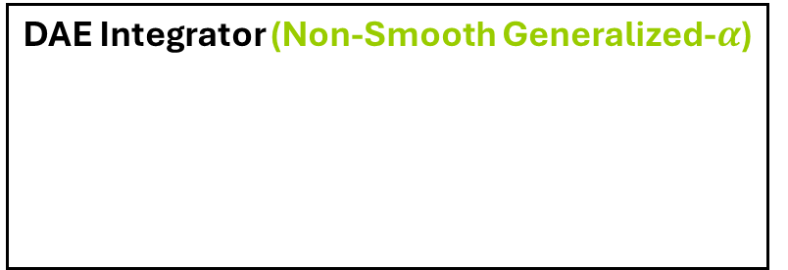


OCP resolution: Single shooting via non-smooth time-stepping
Optimizer (IPOPT)
$$u(t)$$
$$u_{3}$$
$$u_{1}$$
Controls
$$u_{2}$$
$$u_{0}$$
$$u_{4}$$
$$t_{0}$$
$$t_{1}$$
$$t_{2}$$
$$t_{3}$$
$$t_{4}$$
$$T$$
DAE Integrator (Non-Smooth Generalized-$α$)
Time
Computed with finite difference, direct sensitivity and adjoint sensitivity method
Notes:
strict line between the optimizer, IPOPT, and the physics simulator.
optimizer is only allowed to search for the optimal control inputs, which we call {u}.
These controls, = our joint torques or muscle excitations,
U discretized over time.
optimizer guesses a set of controls and hands them over to the integrator
We use a Non-Smooth Generalized-$\alpha$ time-stepping scheme for this
simulator acts as a 'black box.’ -> takes those controls, applies them to multibody equations, and integrates the dynamics forward in time -> generate the full state trajectory, q and costs
end of the movement, it calculates the cost and constraint gradients (: finite differences, direct sensitivity and adjoint sensitivity), -> sends to optimizer
Optimizer only receives the gradients to updates its guess for the controls and the loop repeats.

Slide 7













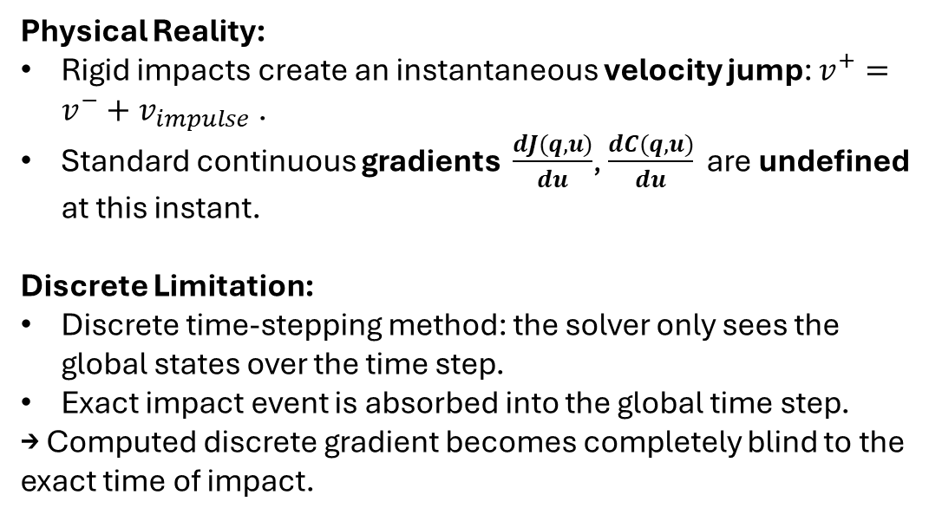



The issue of rigid contact formulation
$$u(t)$$
$$u_{3}$$
Physical Reality:
Rigid impacts create an instantaneous velocity jump: $v^{+}=v^{−}+v_{impulse}$.
Standard continuous gradients $\frac{dJ(q,u)}{du}$, $\frac{dC(q,u)}{du}$ are undefined at this instant.
Discrete Limitation:
Discrete time-stepping method: the solver only sees the global states over the time step.
Exact impact event is absorbed into the global time step.
→ Computed discrete gradient becomes completely blind to the exact time of impact.
$$u_{1}$$
Controls
$$u_{2}$$
$$u_{0}$$
$$u_{4}$$
$$t_{0}$$
$$t_{1}$$
$$t_{2}$$
$$t_{3}$$
$$t_{4}$$
$$T$$
$$q(t)$$
$$x_{0}$$
States
$$x_{T}$$
$$t_{0}$$
$$t_{1}$$
$$t_{2}$$
$$t_{3}$$
$$t_{4}$$
$$T$$
$$\dot{q}(t)$$
Velocities
  → How wrong are the gradient?
  → How does it influence the optimizer ?
$$t_{0}$$
$$t_{1}$$
$$t_{2}$$
$$t_{3}$$
$$t_{4}$$
$$T$$
Time
Brüls (2023)
Notes:
Our non-smooth Generalized-$\alpha$ scheme can successfully integrate forward across a rigid impact. But let's look at what happens when the optimizer asks for the gradient to be sent back."
The Physical Reality:
"Look at the graphs here. Physically, a rigid impact causes an instantaneous velocity jump—the red dashed line. Because of this harsh discontinuity, the exact analytical gradient is mathematically undefined at that specific instant."
The Discrete Limitation (The crucial addition):
"To get around this, our solver relies on discrete approximations. And this is where our fundamental problem lies: because we use a discrete time-stepping method, we do not evaluate the physics continuously. The solver only looks at the world at fixed, predetermined grid points—here at $t_2$ and $t_3$.
The actual physical impact happens somewhere in between. It gets completely trapped inside this discrete time step. I call this our 'discrete blind spot'."
The Consequence:
"Because the algorithm only sees the average global states over that fixed step, the computed gradient is completely insensitive to the exact time the impact occurred. The time of impact, $t_{impact}$, is essentially erased from the sensitivity data."
The Transition:
"This brings us to our core hypothesis: we are feeding our optimizer a discrete gradient that is mathematically blind to the exact moment of collision. So, how wrong are these gradients? And more importantly, do they still hold enough information to guide the optimizer, or do they break it entirely? To answer this, we need to compare our discrete time-stepping approach against a continuous, event-driven baseline."

Slide 8
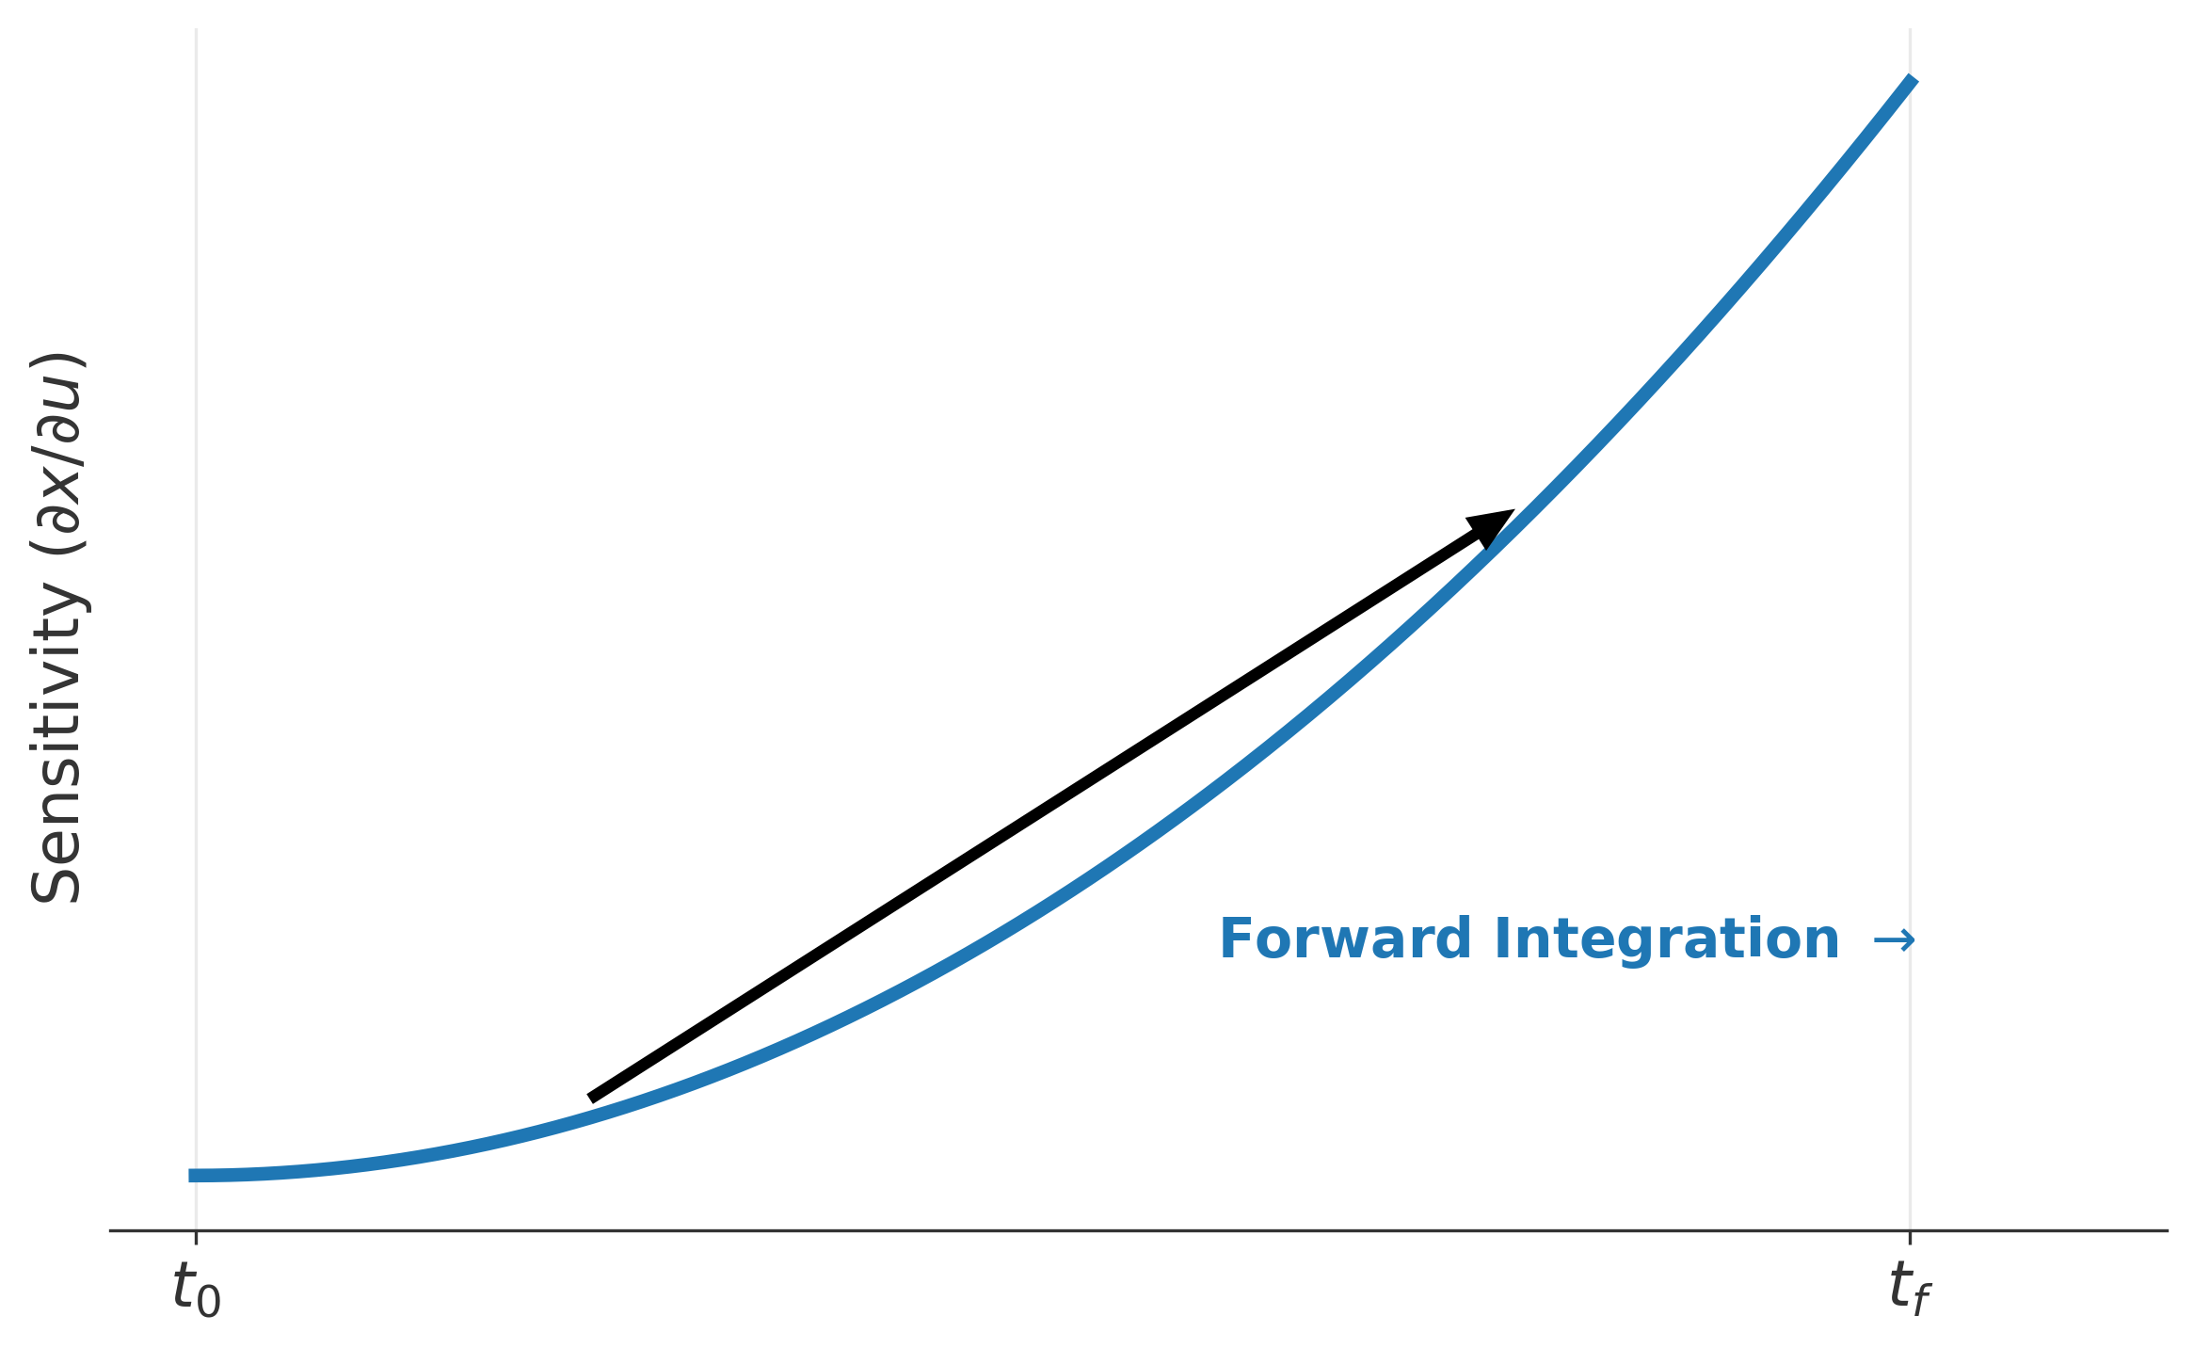
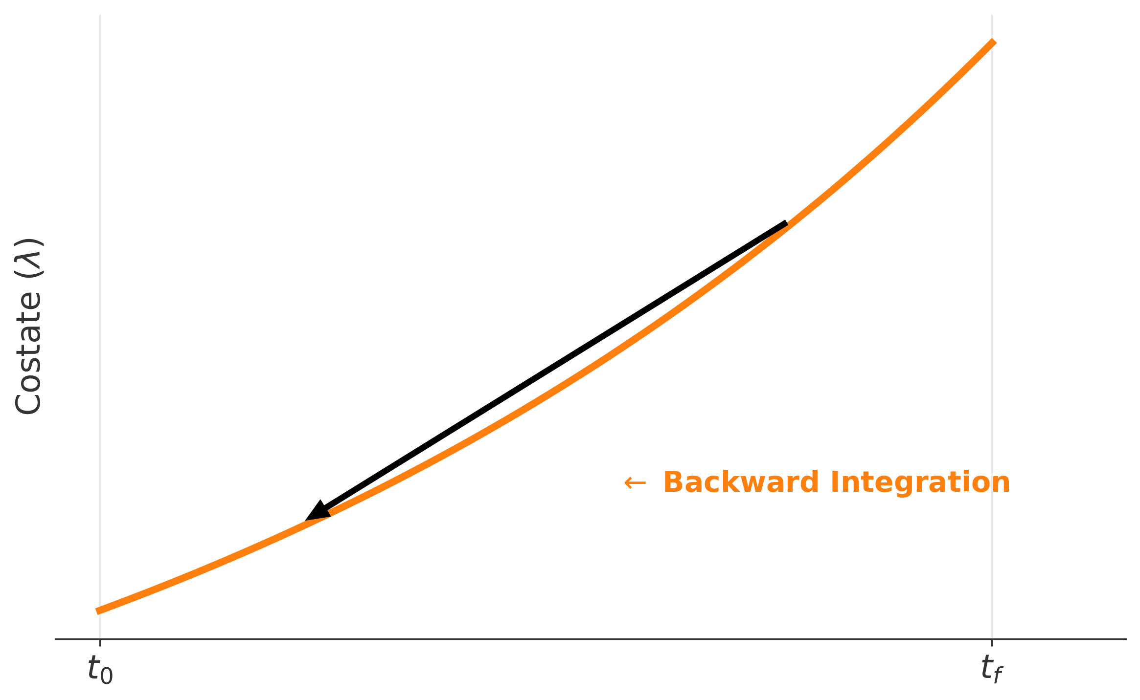
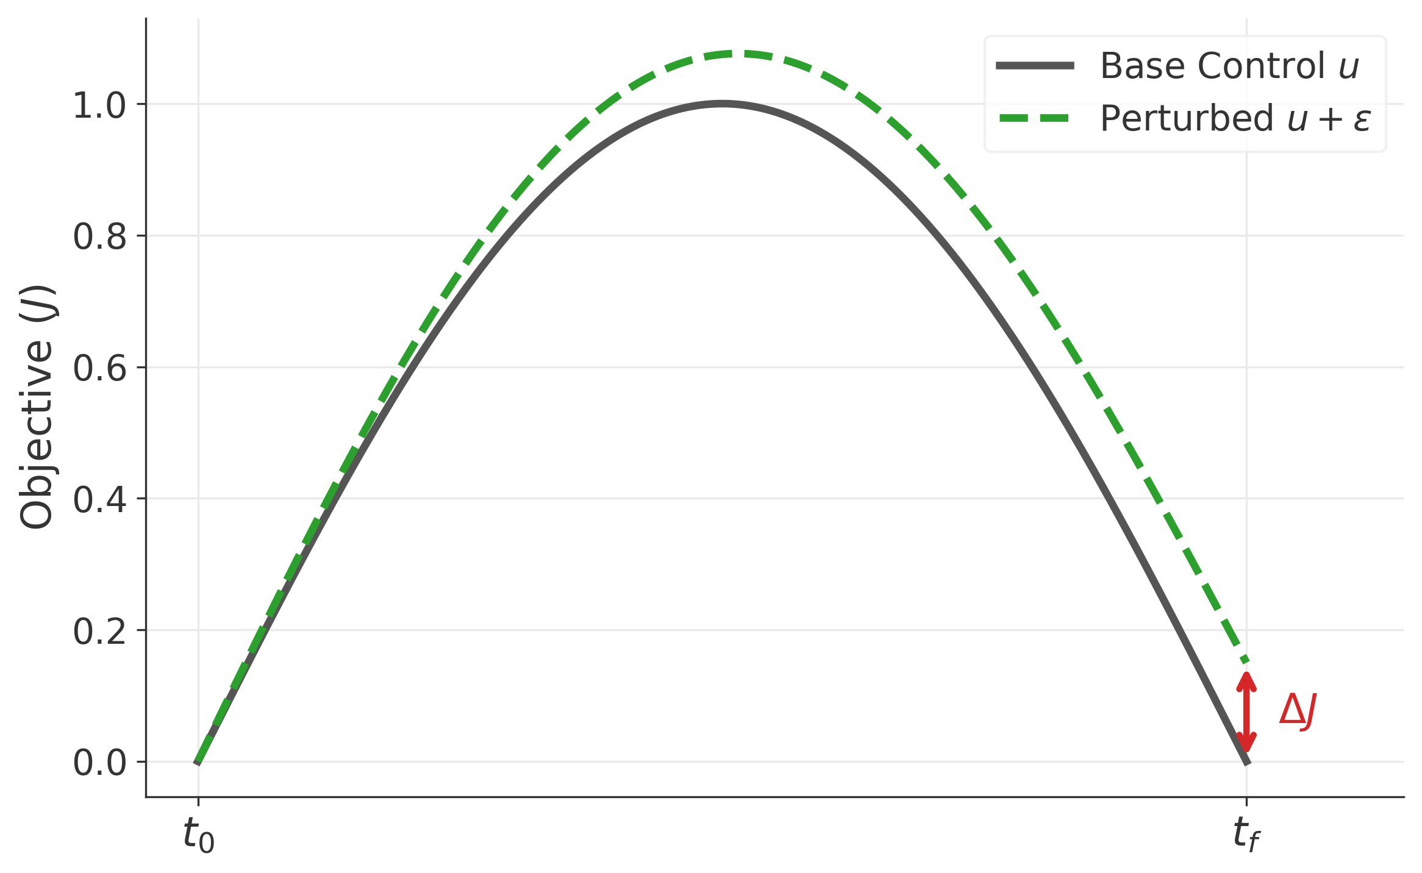
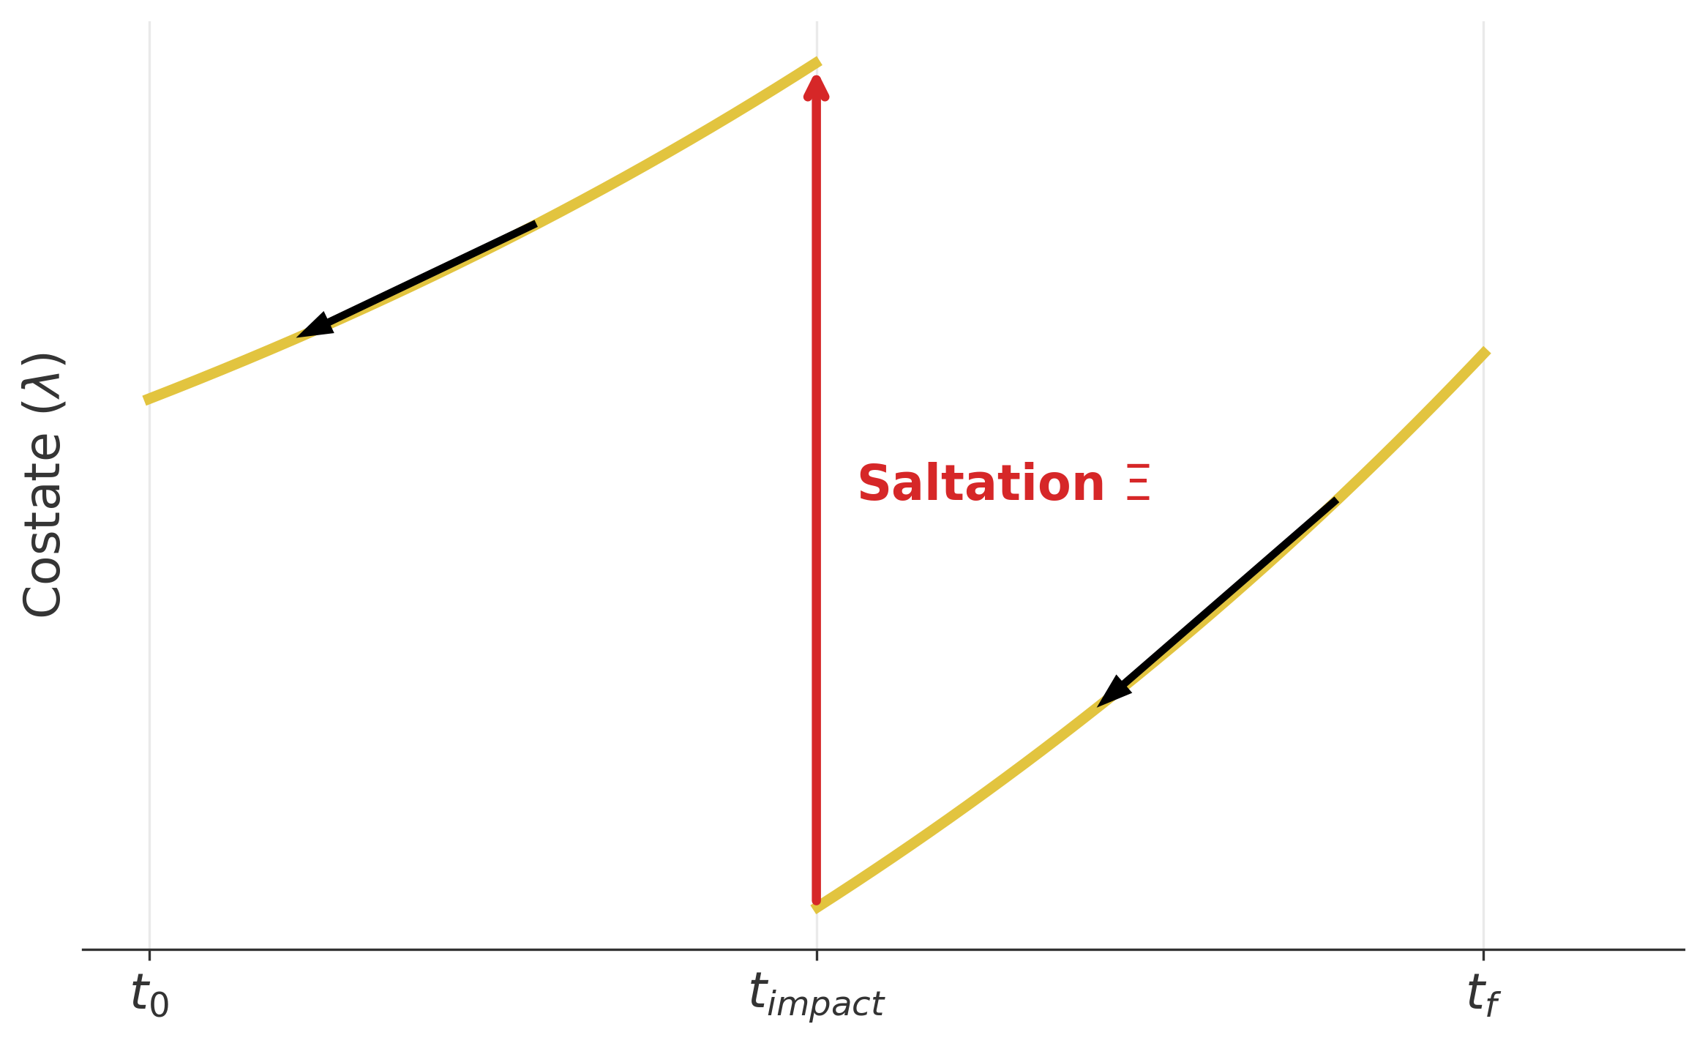
Extracting sensitivities: Four evaluation methods
Direct Sensitivity (DS)
Forward analytical propagation.
Adjoint Sensitivity (Without Saltation)
Backward analytical propagation.
Finite Differences (FD)
Numerical perturbation.
Adjoint with Saltation
Backward propagation with explicit event handling.
Notes:
To understand how the optimizer behaves around these discrete blind spots, we need to extract the gradient. We benchmarked four specific methods to calculate this sensitivity."
1. Finite Differences:
"The first method is Finite Differences. Here, we extract the gradient numerically. We perturb the control input by a tiny scalar, $\epsilon$, rerun the entire physical simulation over our discrete grid, and calculate the resulting change in our cost function."
2. Direct Sensitivity:
"The second method is Direct Sensitivity. This is an analytical, forward-propagating method. We differentiate the equations of motion and integrate these tangent linear equations forward in time, exactly alongside our physical states."
3. Adjoint Sensitivity:
"The third method is the Adjoint method. Instead of moving forward, this approach moves backward. We define a set of costate equations based on the final error at the end of the simulation, and we integrate them backward through time to find the sensitivity with respect to the initial controls."
4. Adjoint with Saltation:
"Finally, we have the Adjoint method combined with a Saltation matrix. This method also integrates backward, but it operates in an event-driven framework. The integration strictly stops at the exact continuous time of the collision. It then applies the saltation matrix—an analytical operator that forces the sensitivities to jump correctly across the physical discontinuity—before it continues moving backward."
The Transition:
"These are the four mechanisms we used to extract the gradient. Now, let's look at the data. We applied all four of these methods to a rigid pendulum impact to see exactly what gradients they return."

Slide 9
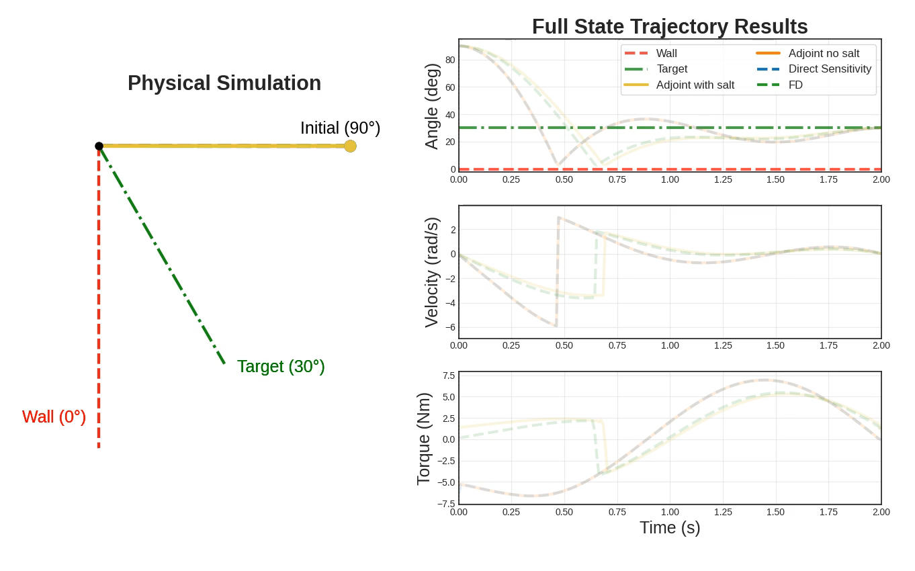
Preliminary results: Simple pendulum (restitution=0.5)
Notes:
In this simulation, we have a simple task: take a pendulum starting at 90 degrees and bring it to rest at exactly 30 degrees, using the minimum amount of motor torque possible. But there is a rigid wall at 0 degrees.
2. The "Contact-Blind" Methods (Point to the Blue and Orange lines)
Let’s first look at standard continuous gradients, Direct Sensitivity (in Blue) and the Adjoint method without saltation (in Orange). Watch their physical trajectory on the left. They drop rapidly and slam into the wall.
Because these standard methods lack the saltation matrix, they are mathematically blind to the sensitivity of the impact timing. They don't 'plan' for the bounce; they experience it as an unexpected physical shock. If you look at the bottom right panel—the Torque—you see the consequence. Their control strategy is purely reactive. After the collision, the optimizer realizes it has massive unwanted momentum and has to slam on the brakes, demanding huge, erratic swings in motor torque (from -6 to +6 Nm) to brute-force the pendulum back to the target."
3. The "Contact-Aware" Methods (Point to the Yellow/Gold and Green lines)
"Now look at the Event-Driven Saltation method (in Yellow) and our numerical ground-truth, Finite Differences (the dashed Green line). These trajectories also hit the wall, but they do so on purpose. Because the Saltation matrix perfectly translates the physics of the bounce into smooth, usable gradients, the optimizer can 'see' the collision during its planning phase. Look at the Torque panel for the Yellow line. It requires a fraction of the effort. The control strategy here is proactive. It intentionally holds the pendulum back slightly, preparing for the exact right impact velocity so that it can use the energy of the bounce to naturally reach the 30-degree target.“
Add jump velocity comment

Slide 10
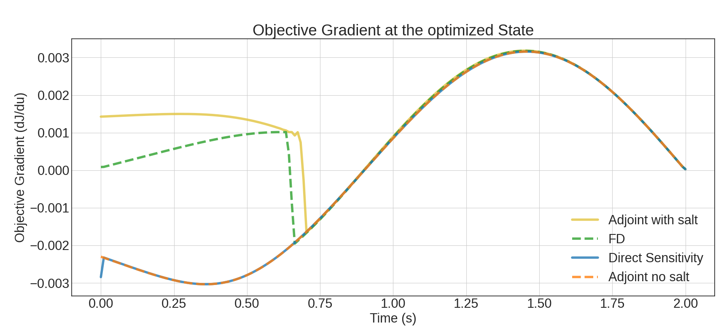
Preliminary results: Simple pendulum (restitution=0.5)
Notes:
In the previous slide, we saw the what: the contact-blind methods reacted violently to the wall, while the contact-aware Saltation method proactively used the wall to its advantage. But to understand why the optimizer chose those strategies, we need to look under the hood. We need to look at the gradients it was actually calculating. That brings us to this plot."
What you are looking at is the Objective Gradient over time for the final, optimized trajectories. In simple terms, this curve represents the optimizer's 'foresight'. It tells the optimizer: 'If I apply a tiny bit more motor torque right now at time t, how much will it change my final error at the end of the simulation?
The "Blind" Methods (Point to the Blue and Orange lines)
Let’s look at the contact-blind methods first—Direct Sensitivity in solid blue, and the standard Adjoint in dashed orange. Notice how perfectly smooth they are, and how they completely overlap. If you look at this curve, you would think nothing interesting happened during this two-second simulation. These methods completely ignore the impact. Because they are mathematically blind to the collision, they assume pushing the pendulum at 0.2 seconds will just smoothly swing it through the air. They have zero mathematical awareness that applying torque early will change the timing and energy of a violent collision later. This is exactly why they had to rely on reactive, brute-force torque in the video—their mathematical map of the world is completely missing the wall.
The "Proactive" Math (Point to the Yellow line)
Now, look at the Event-Driven Saltation method in yellow. At roughly 0.70 seconds—the exact moment the pendulum hits the wall—there is a massive, discrete jump in the gradient. This is the Saltation Matrix actively injecting the physics of the energy transfer into the math. But the most important part of this entire graph is what happens before the impact. Look at the massive gap between the yellow line and the blue/orange lines from 0 to 0.65 seconds. Because the Saltation method uses the Adjoint formulation to pass information backward through time, the optimizer knows about the wall before it hits it. It understands that a small change in torque at the very beginning of the simulation will dictate exactly how hard the pendulum bounces later. This gap is the mathematical root of the proactive control we saw in the video.
The Conclusion (Point to the right side of the graph)
Finally, notice what happens after 0.7 seconds. Once the bounce is over and the pendulum is just swinging in free space again, all four methods perfectly converge and agree. The physics are smooth again. The entire difference between the chaotic, high-energy failure of standard methods, and the elegant, low-energy success of our method, comes down entirely to how accurately we bridge that single split-second of contact.

Slide 11
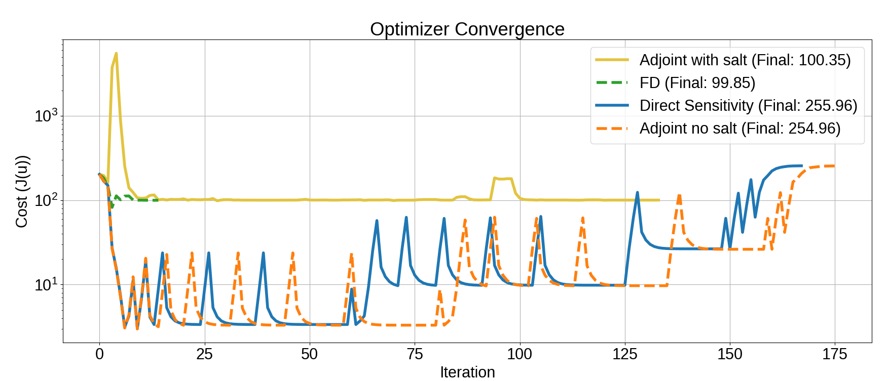
Preliminary results: Simple pendulum (restitution=0.5)
Notes:
"Let’s look at the catastrophic effect that this mathematical blindness has on the optimization process itself. This graph tracks the Objective Cost on a log scale as the solver tries to find the best trajectory over 175 iterations."
2. The Success of Contact-Awareness (Point to the Yellow and Green lines)
"First, look at the Event-Driven Saltation method in yellow, alongside our Finite Difference baseline in dashed green. After an initial exploration phase, they smoothly and stably drop to a highly optimized cost. Because their gradients correctly map the physical reality of the contact, the optimizer can simply walk downhill to the solution."
3. The Anatomy of a Spike (Point to the Blue and Orange lines)
"But look at the contact-blind methods—Direct Sensitivity and the standard Adjoint. They are trapped in a violent, failing cycle. To understand these massive spikes, we have to look at what happens inside the optimizer when it ignores the physics of impact:
Step 1: The False Prediction: The blind optimizer calculates its gradient, which tells it that applying a little more torque will smoothly lower the cost. It confidently takes a step forward.
Step 2: The Digital Boundary: However, physically, that tiny change in motor torque causes the pendulum to hit the wall a fraction of a second later. This micro-shift in timing pushes the continuous impact event across one of the solver's fixed, digital time-steps.
Step 3: The Panic (The Spike): Instantly, the solver registers a completely different discrete state. The cost skyrockets. The optimizer realizes its smooth gradient was a lie. Its internal math breaks down, and to prevent a total crash, it triggers an emergency 'Restoration Phase'—throwing out its progress and randomly jumping to a safe state. That emergency reset is the massive vertical spike you see here.
"The blind optimizer spends 175 iterations stuck in this loop: making a false prediction, crossing a digital time boundary, panicking, and resetting. Eventually, it gives up. It doesn't avoid the wall—it still hits it—but because it cannot mathematically comprehend the bounce, it gets trapped in a highly sub-optimal local minimum.

Slide 12
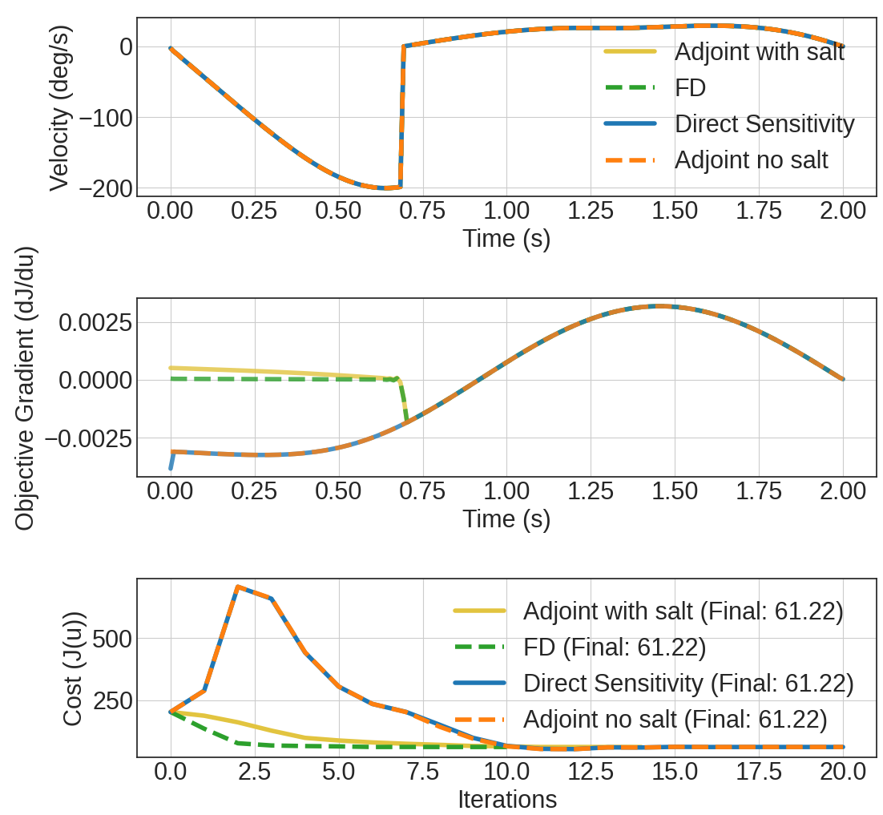
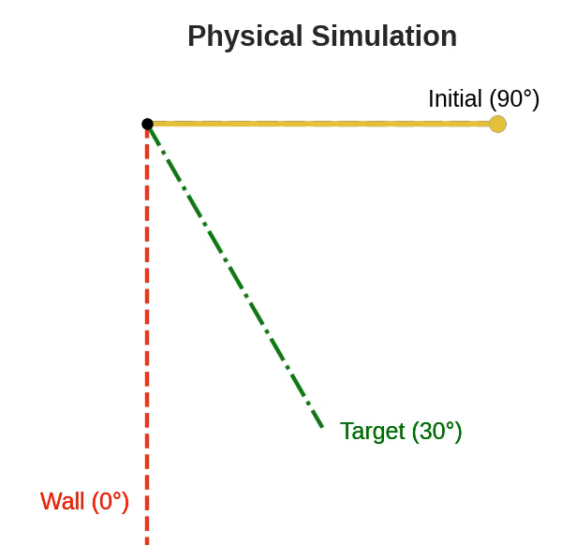
Preliminary results: Simple pendulum (restitution=0.0)
Notes:
We've seen how standard gradients fail catastrophically when a robot bounces. But to be fair, let's look at a scenario where standard gradients actually succeed."
(Show the Trajectory/Velocity plot) "In this simulation, the pendulum hits the wall, but it doesn't bounce, the restitution is 0. The velocity drops to zero, and it rests against the barrier. The wall acts as an 'information sink.' Because the pendulum comes to a complete halt, the exact micro-second it hit the wall no longer affects its future trajectory. The system's momentum is entirely reset."
(Show the Gradient and Convergence plots) "Because the timing of the impact no longer dictates the final energy of the system, the missing timing sensitivity in the standard methods doesn't punish them. all optimizers converge to the exact same cost of 61.22.

Slide 13
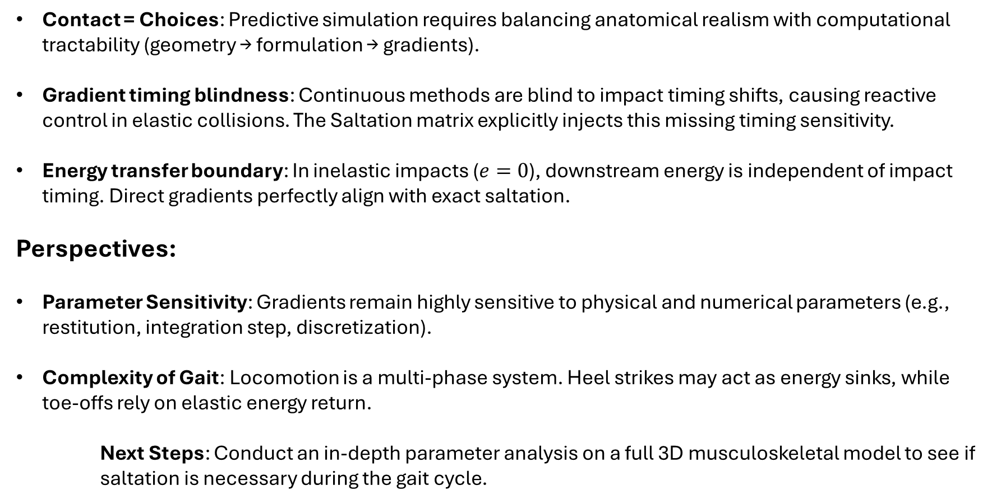
Conclusion and Perspectives
Contact = Choices: Predictive simulation requires balancing anatomical realism with computational tractability (geometry → formulation → gradients).
Gradient timing blindness: Continuous methods are blind to impact timing shifts, causing reactive control in elastic collisions. The Saltation matrix explicitly injects this missing timing sensitivity.
Energy transfer boundary: In inelastic impacts ($e=0$), downstream energy is independent of impact timing. Direct gradients perfectly align with exact saltation.
Perspectives:
Parameter Sensitivity: Gradients remain highly sensitive to physical and numerical parameters (e.g., restitution, integration step, discretization).
Complexity of Gait: Locomotion is a multi-phase system. Heel strikes may act as energy sinks, while toe-offs rely on elastic energy return.
Next Steps: Conduct an in-depth parameter analysis on a full 3D musculoskeletal model to see if saltation is necessary during the gait cycle.
Notes:
To conclude, we've seen that contact optimization for predictive gait is fundamentally a sequence of design choices—first defining the foot geometry, then choosing the contact formulation. But as our work shows, regardless of those initial choices, the success of the simulation ultimately comes down to the quality of the gradients we feed the optimizer.
Methods like Direct Sensitivity and the standard Adjoint are mathematically blind to how control inputs shift the exact timing of an impact. When a collision involves energy return—like a bounce—this blindness creates severe gradient inconsistencies. The optimizer receives a false map of the cost landscape, leading to high-energy, reactive control strategies. Applying the Adjoint method with the Saltation matrix fixes this by explicitly injecting the sensitivity of that impact timing.
However, our analysis revealed a very pragmatic boundary for this blindness: it depends entirely on the transfer of energy. When an impact is a complete energy sink—the $e=0$ case—the exact timing of the impact no longer dictates the downstream energy. The timing sensitivity becomes mathematically zero. In this specific regime, the raw discrete gradients perfectly align with the exact saltation gradients.
What this highlights is that these gradients are highly sensitive to many underlying parameters—such as the coefficient of restitution, the integration step size, and the control discretization. Therefore, to successfully apply these findings, a much more in-depth analysis has to be made, particularly as we map this back to human gait.
Human locomotion is not just a single, simple impact. It is a highly complex sequence of contact phases. A heel strike might act largely as an energy sink, while the subsequent push-off relies heavily on elastic energy return from the tendons. Because the effective parameters of gait are constantly shifting throughout a stride, our next step is to scale this rigorous sensitivity analysis to a full 3D musculoskeletal model. We need to map these exact gradient behaviors across a full walking cycle to determine precisely if the computational cost of the saltation matrix is strictly required, or if the discrete gradients are sufficient.

Slide 14
Constraint-Based Contact Modeling for
Predictive Simulation of Gait
Léonore Foguenne, Valentin Sonneville, Benjamin Moreno,
Cédric Schwartz, Pierre Sacré, Olivier Brüls
Thank you for your attention!
We thank FOD BOSA for the financial support through the AidWear project.

Slide 15
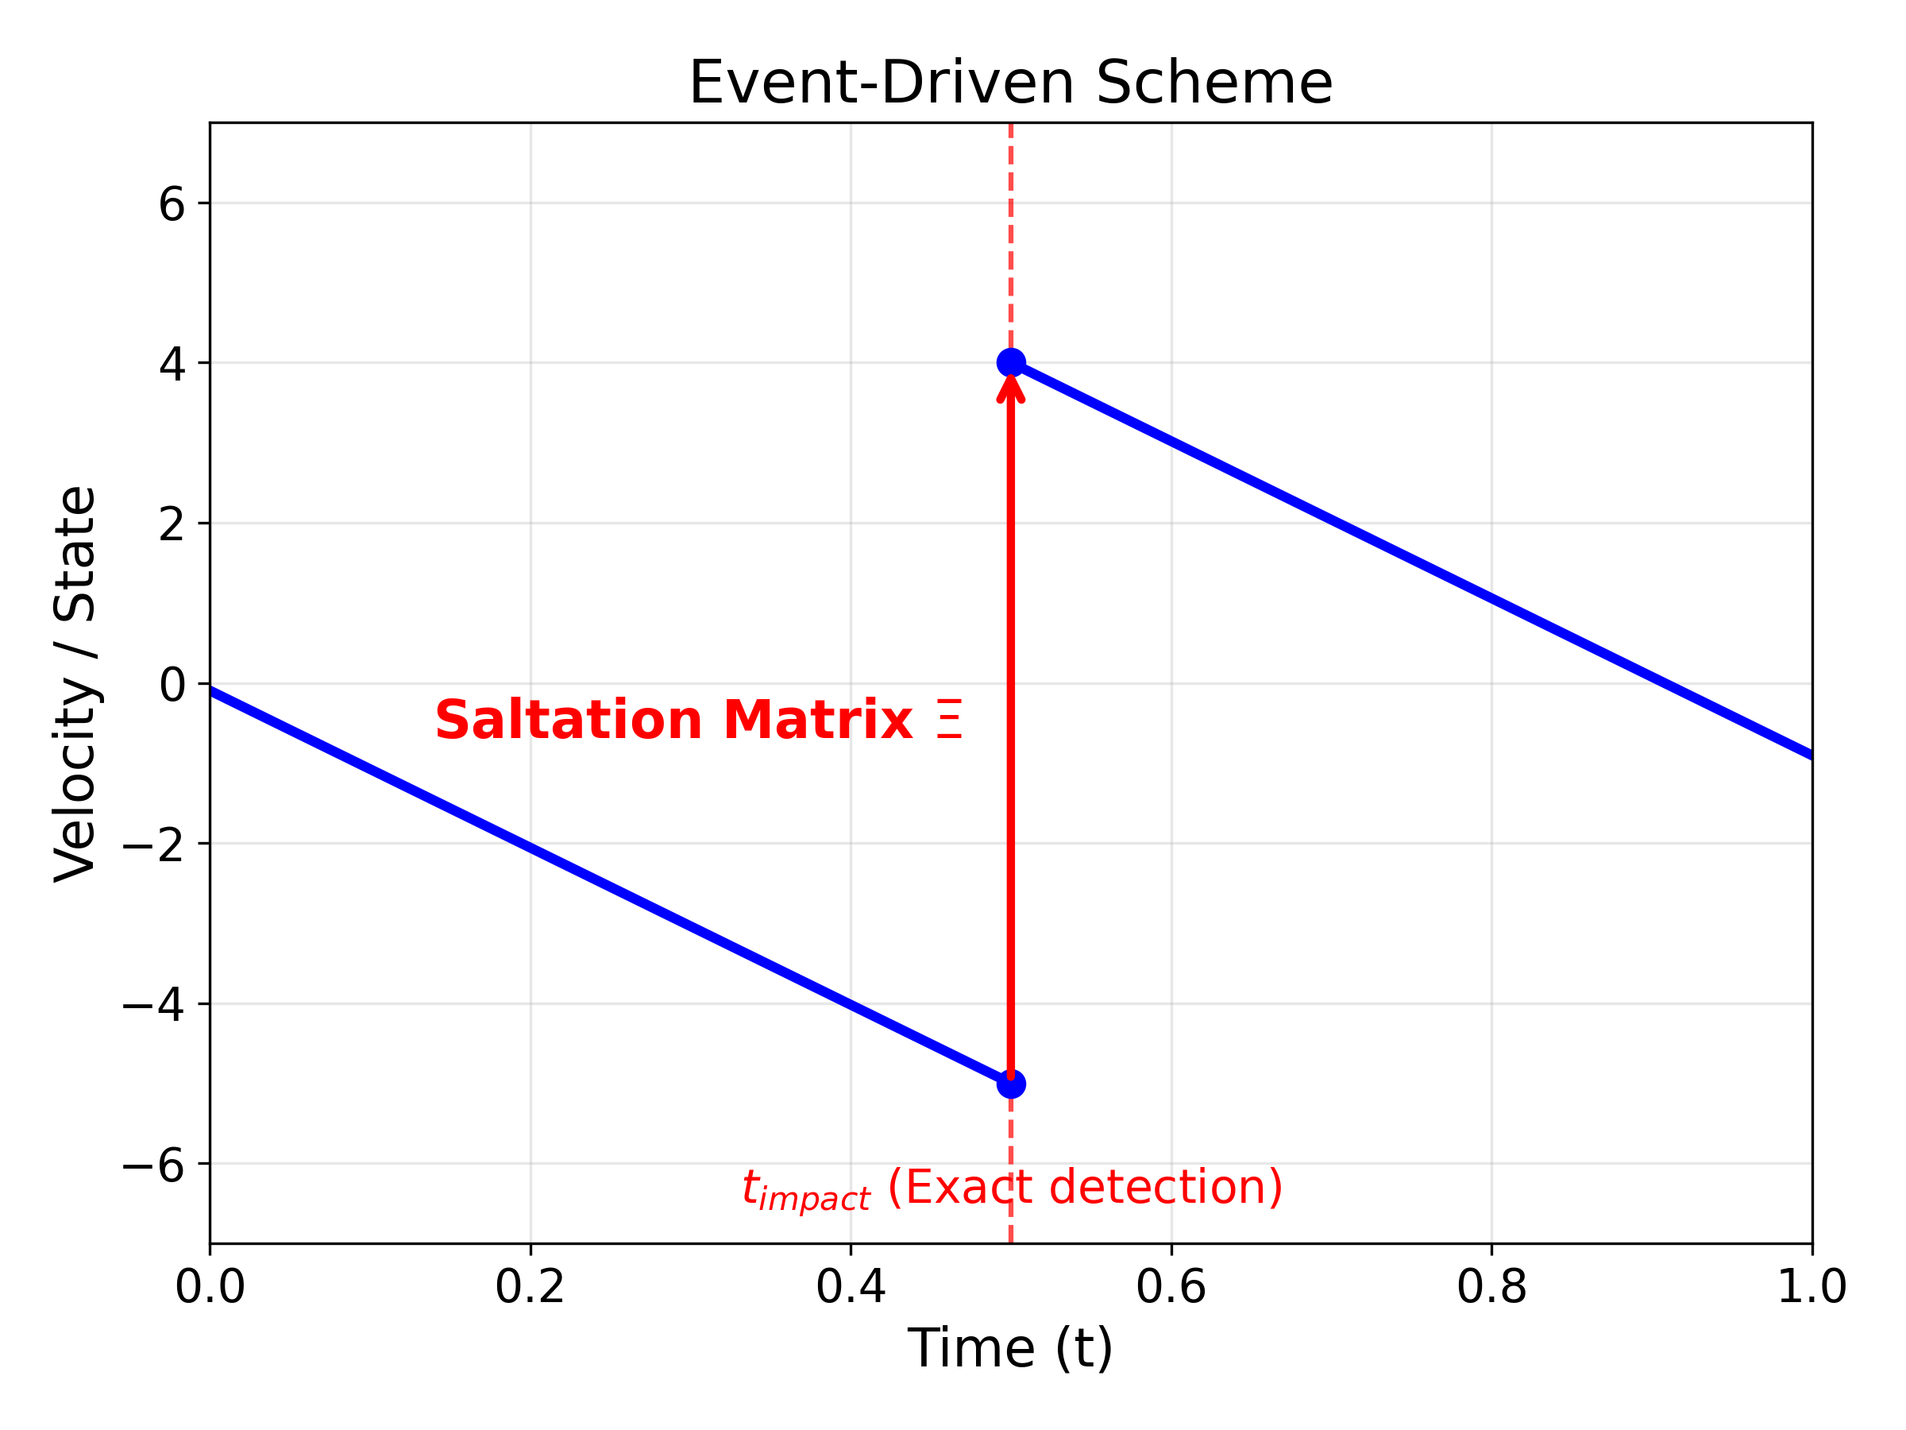
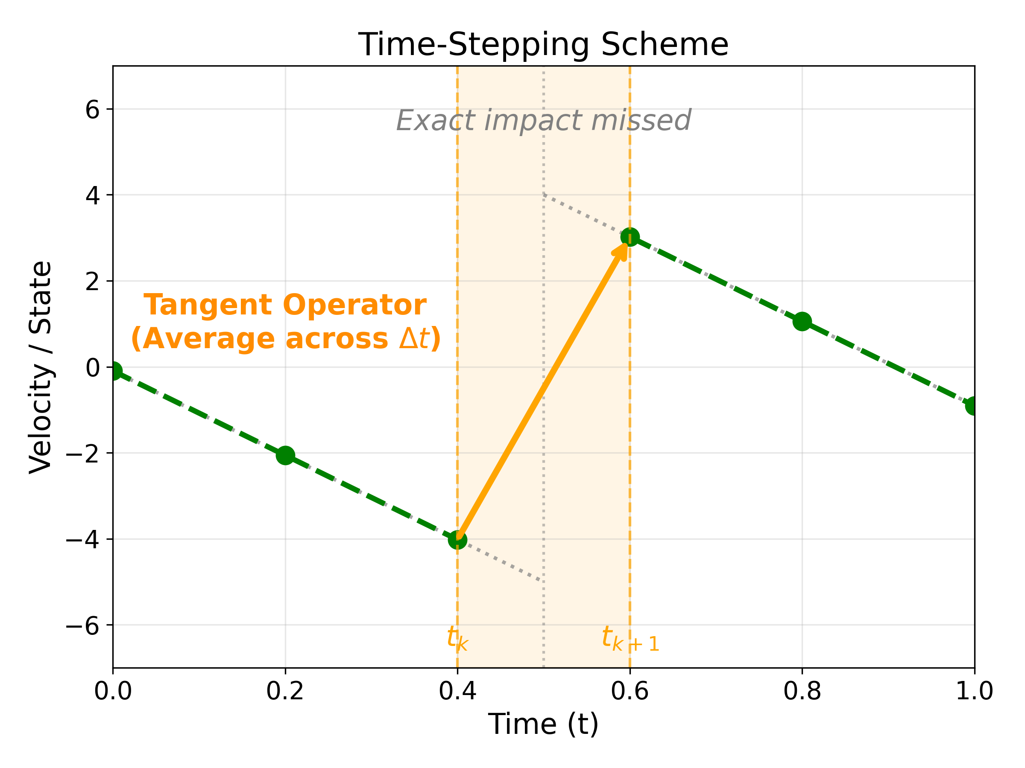
Event driven vs. Time stepping scheme
Event driven
Time stepping
Method: Integrates forward, stops precisely at the impact event, resolves the velocity jump, and restarts.
Method: Evaluates the average physics over the fixed time step, absorbing the impact into an impulsive force without stopping the clock.
Kong (2024)

