Slide 1

Thank You
This PowerPoint document contains the images that you requested.
Copyright Notice
All materials on this Site are protected by United States copyright law and may not be reproduced, distributed, transmitted, displayed, or otherwise published without the prior written permission of Wolters Kluwer. You may not alter or remove any trademark, copyright or other notice.
However, provided that you maintain all copyright, trademark and other notices contained therein, you may download material (one machine readable copy and one print copy per page) for your personal, non-commercial use only. Please refer to this link for further information on how to apply for permission for re-use
Any information posted to discussion forums (moderated and un-moderated) is for informational purposes only. We are not responsible for the information or the result of its practice.

Slide 2
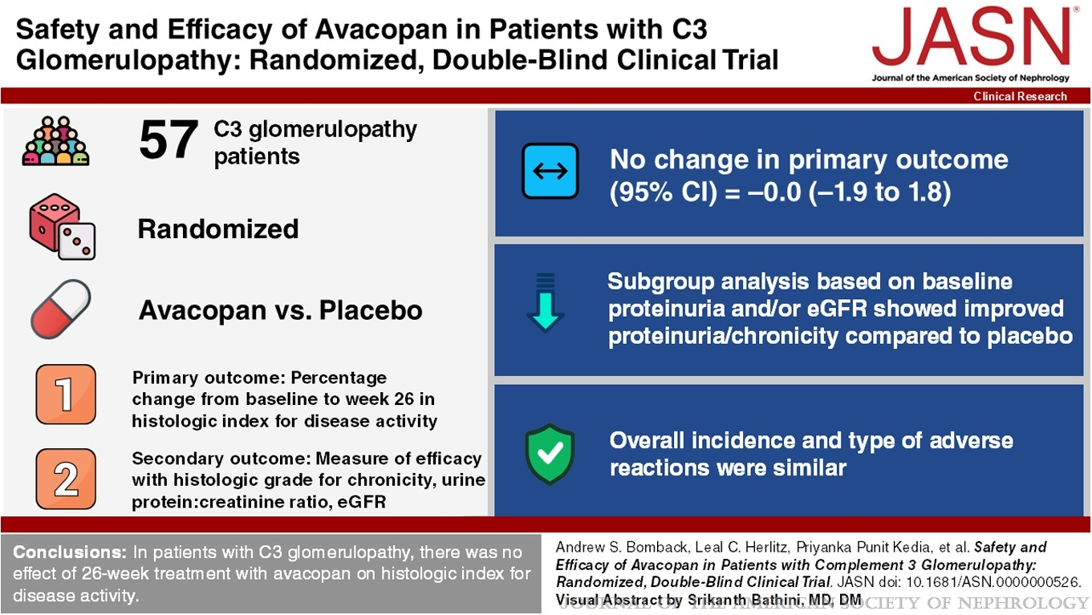
Safety and Efficacy of Avacopan in Patients with Complement 3 Glomerulopathy: Randomized, Double-Blind Clinical Trial
Bomback, Andrew S.; Herlitz, Leal C.; Kedia, Priyanka Punit; Petersen, Jeffrey; Yue, Huibin; Lafayette, Richard A.; on behalf of the ACCOLADE Study Group
Journal of the American Society of Nephrology36(3):487-499, March 2025.
doi: 10.1681/ASN.0000000526

