Slide 1
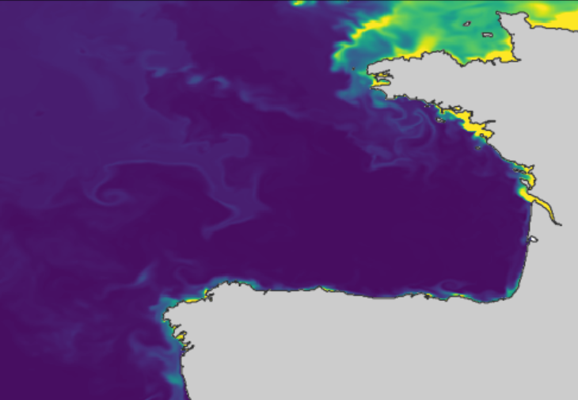





Reconstructing mesoscale surface circulation in the Bay of Biscay using an advection-based neural network
Juan Manuel López Contreras, Alexander Barth(ULg), Aida Alvera-Azcárate(ULg), Ganix Esnaola (UPV/EHU)
ISOBAY 19
June 16th, 2026

Slide 2
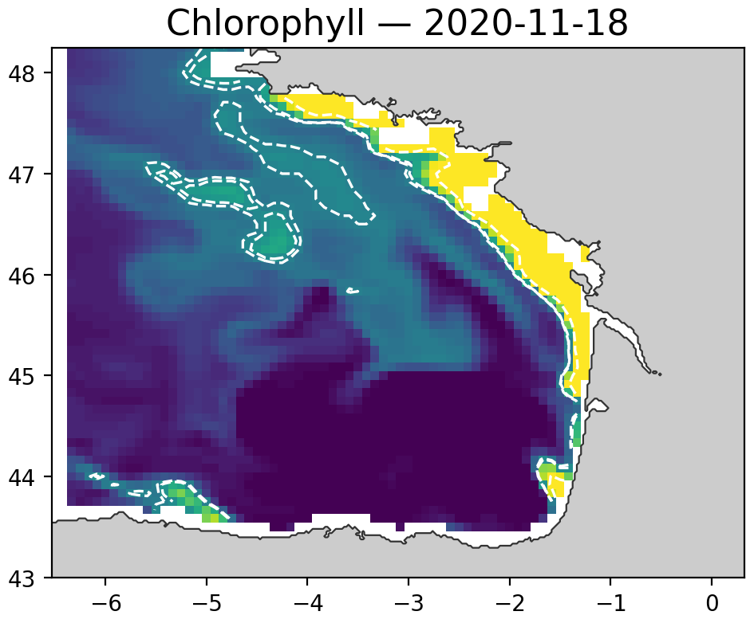
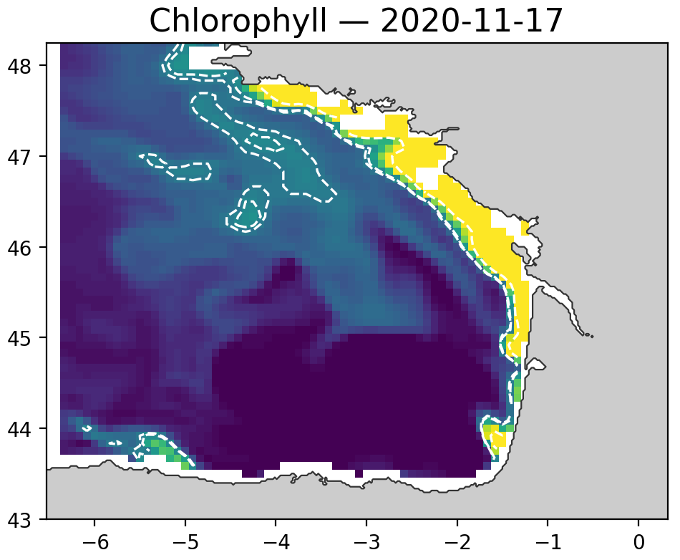
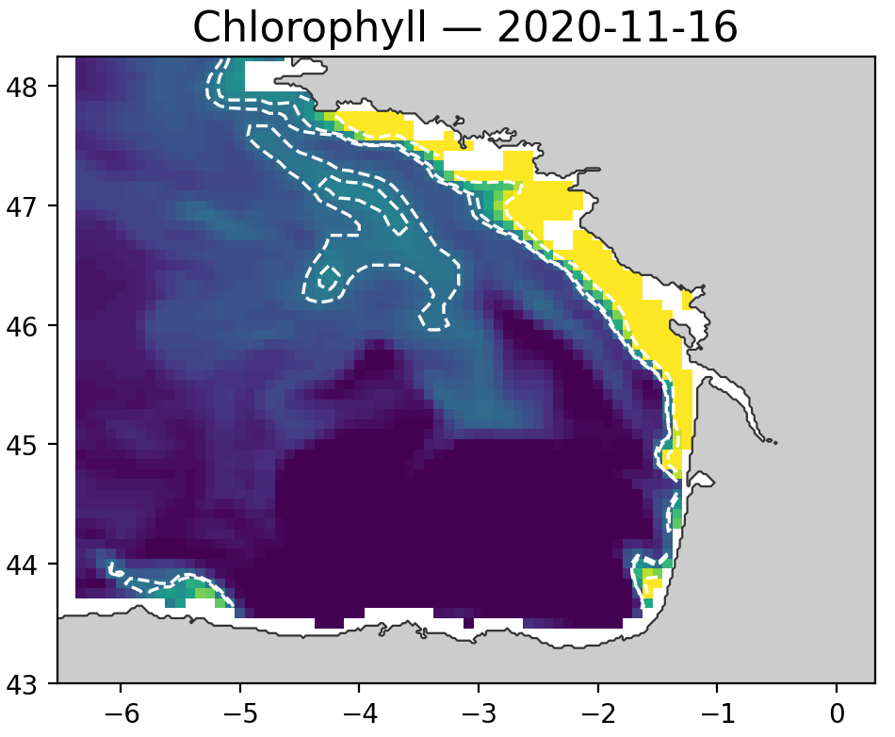
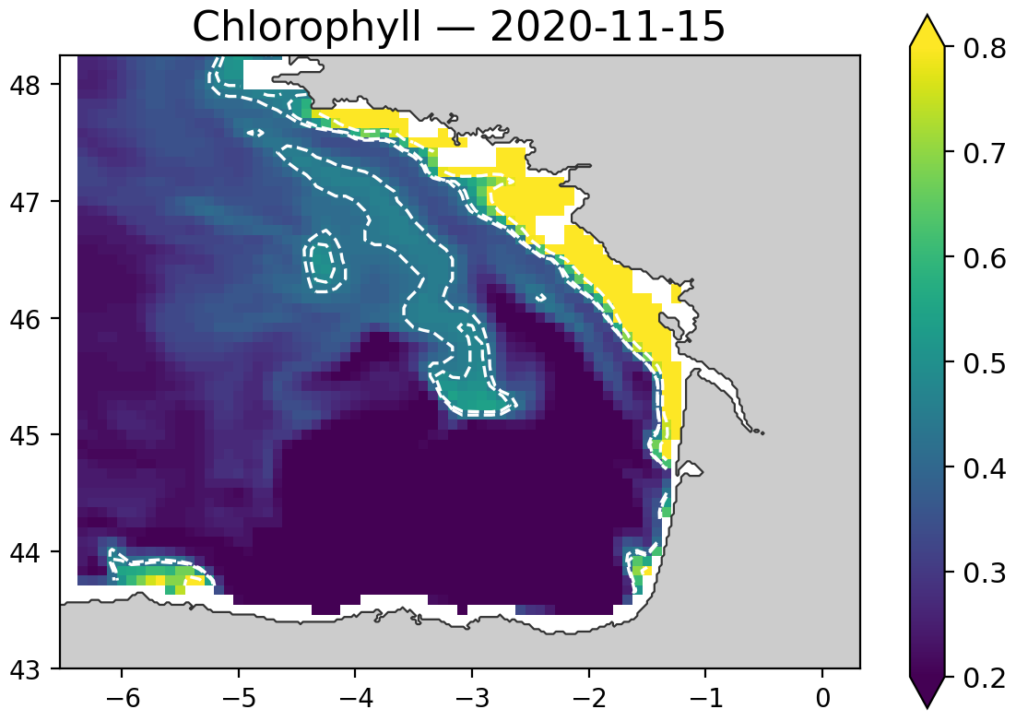


Can tracers reveal the currents beneath them?
Tracer fields contain information about surface transport, but surface currents remain difficult to observe at fine scales.
$$\frac{∂C}{∂t}+u∙∇C= diffusion + sources/sinks$$
$$C_{1}≈ 𝓐_{\hat{u}\hat{,v}}(C_{0})$$

Slide 3
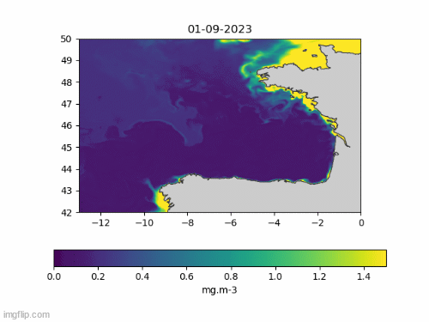
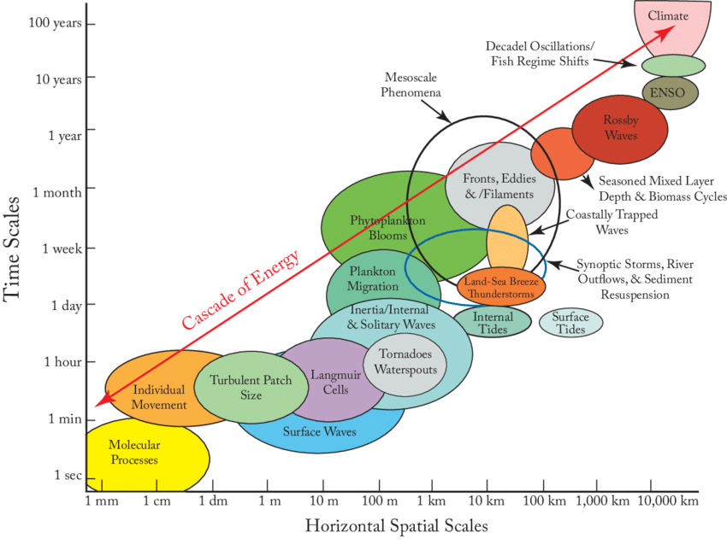
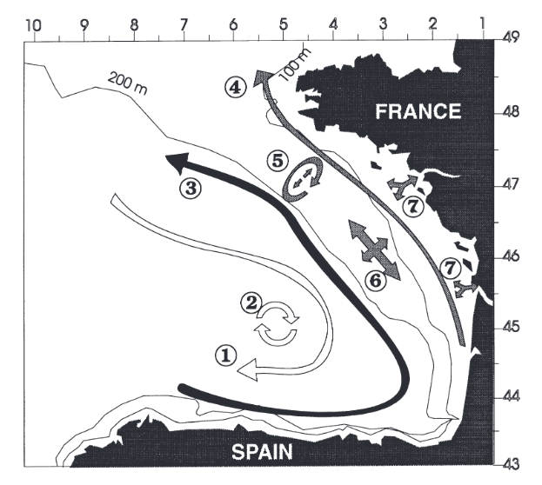
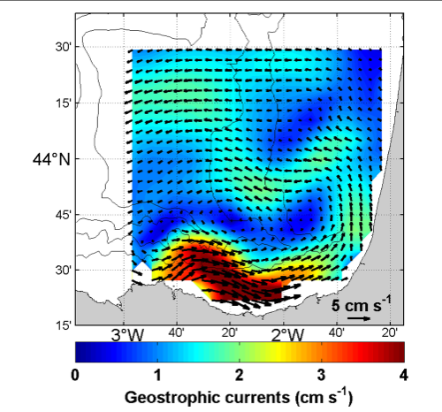
Patterns and phytoplankton distribution
Nichols, C. R., & Raghukumar, K. (2020)
Fill a gap in the surface mesoscale field by retrieving flow motion from high resolution satellite tracer observations
Koutsikopoulos & Le Cann (1996)
Caballero et al. (2020)
Physical forcings
Notes:
Satellite images
Justification
I want to start with a bring of context on the justification and what is the main source of this work. During the master thesis I was able to work with remote sensed data, I became interested in large scale ocean processes, but mostly on chlosophyll dynamics and how remote sensing was a source to explore and answer to a lot of questions tahta came to my mind, When crafting this scientific question I took into account that curiosity about phytoplankton distribution assess using chlorophyl a concentration and the influence of the physical processes behing this dristribution and dynamics. Then some gaps were found over the road, by focusing on what happens on the surface we could see that there is plenty of forcings but among the most dynamical we have the surface currents, governed by a large set of aprameters, from wind driven currents, Ekman currents, as agestrophy elements (there are more), and also the most common source of obtaining the sea surface currents, by relying on altimetry and using the gestrophic assumption to extract currents related to pressure gradients. Then in this specific apart there are gaps, or better, scales that are not yet well understood at least in some regions. So I wanted to proposed a euqstion and objective that both satisfies my curiosity and answers or looks to reduce a gap in terms of the understanding of the mesoscale processes by analysing the sea surface current signal but from a different perspective, posing an inverse probleme where not only the source of information regarding currents is the altimetry but using this phytoplanlton distribution and other variables that can work as tracers and assess the flow of these particles to extract the surface currents. And observe what patters and what elements of the circulation would we obtain by extracting information from this source.

Slide 4
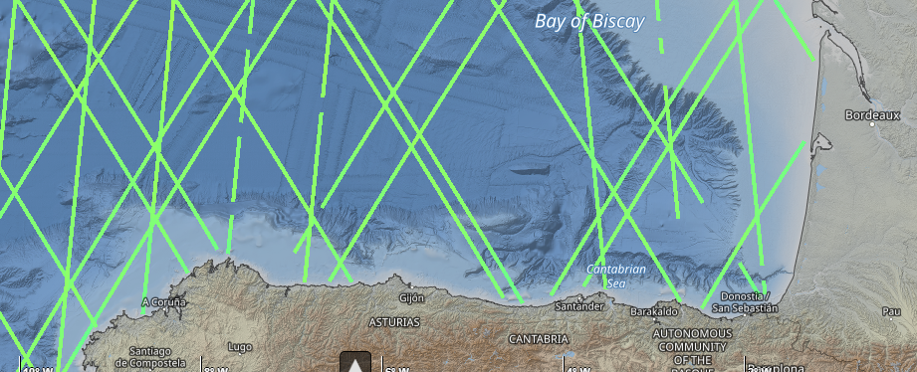
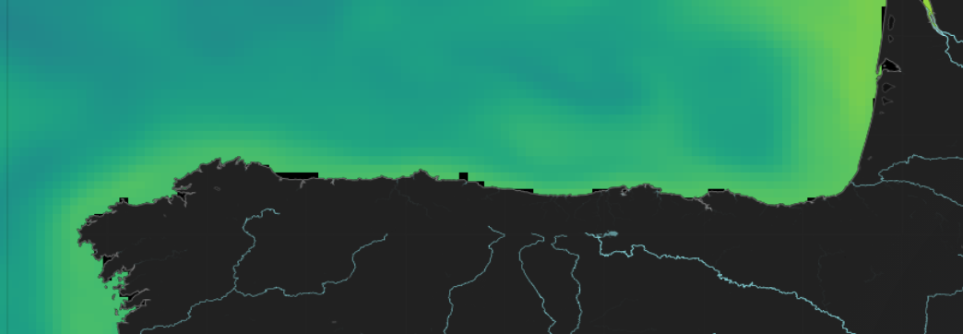
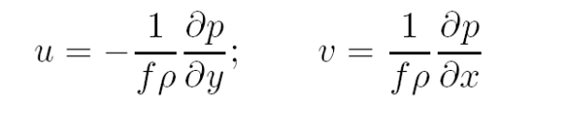
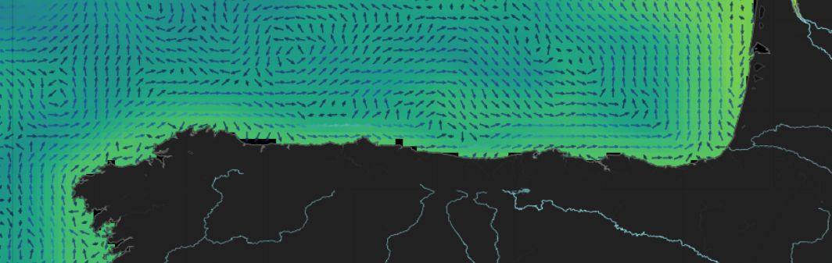
Surface current retrieval
Other methods
Data assimilation
Along track altimetry
Absolute dynamic topography (ADT) with respect to geoid
Interpolated ADT maps
Geostrophic approximation
Surface currents
Along track altimetry
Use of a background field as input
High Frequency radar
Gridded ADT
Surface current map
Caballero et al. (2020)
Notes:
Since 1900 satellite observations of absolute dynamic topography in along-tracks have allowed the extraction of sea surface currents using interpolation of these tracks and using the geostrophic approximation (Ciani et al., 2025)
Ciani, D., Fanelli, C., & Buongiorno Nardelli, B. (2025). Estimating ocean currents from the joint reconstruction of absolute dynamic topography and sea surface temperature through deep learning algorithms. Ocean Science, 21(1), 199–216. https://doi.org/10.5194/os-21-199-2025

Slide 5
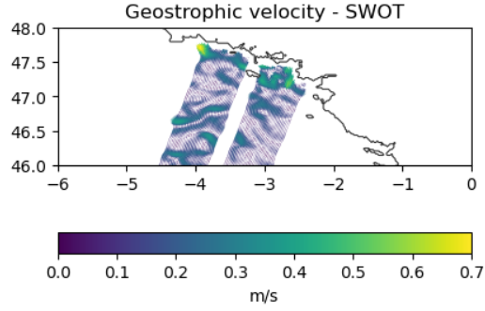
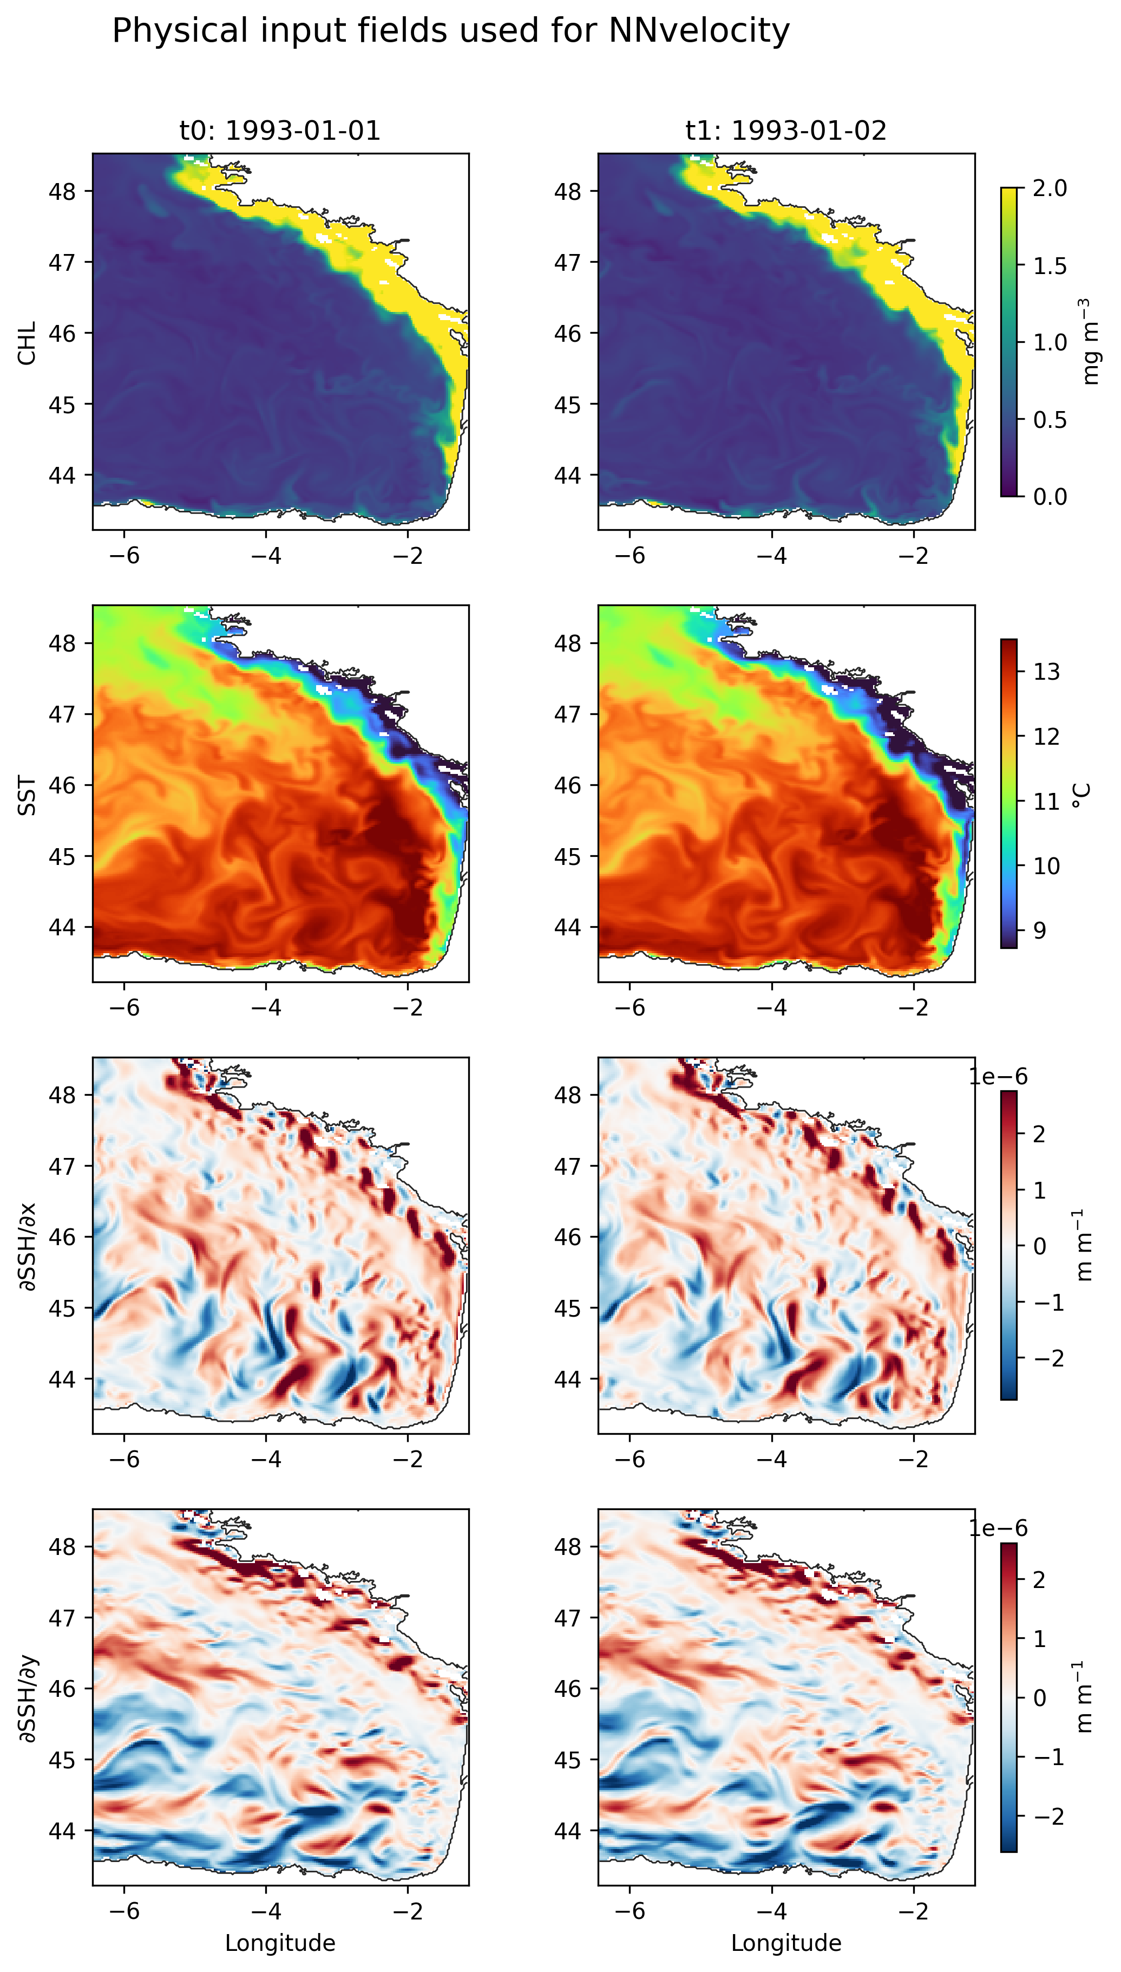
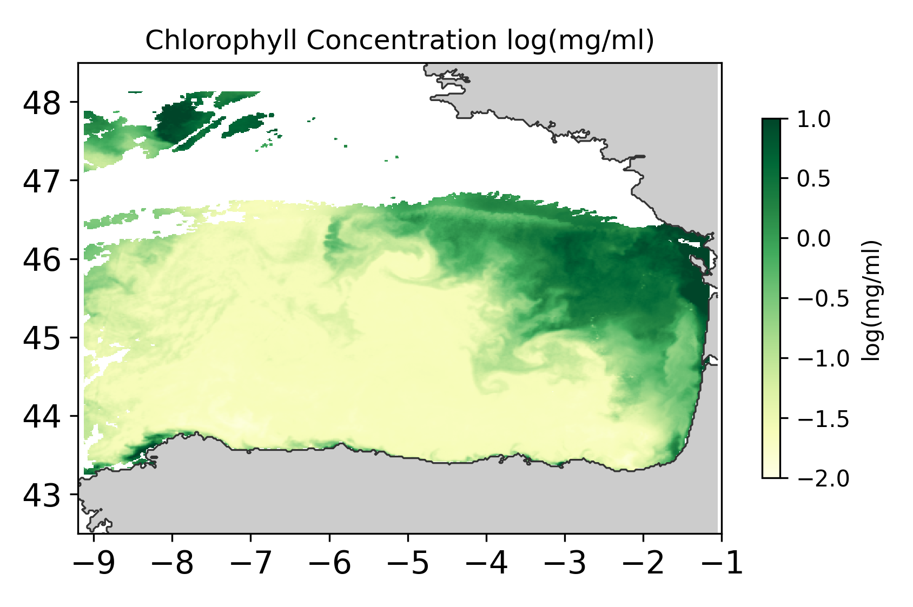
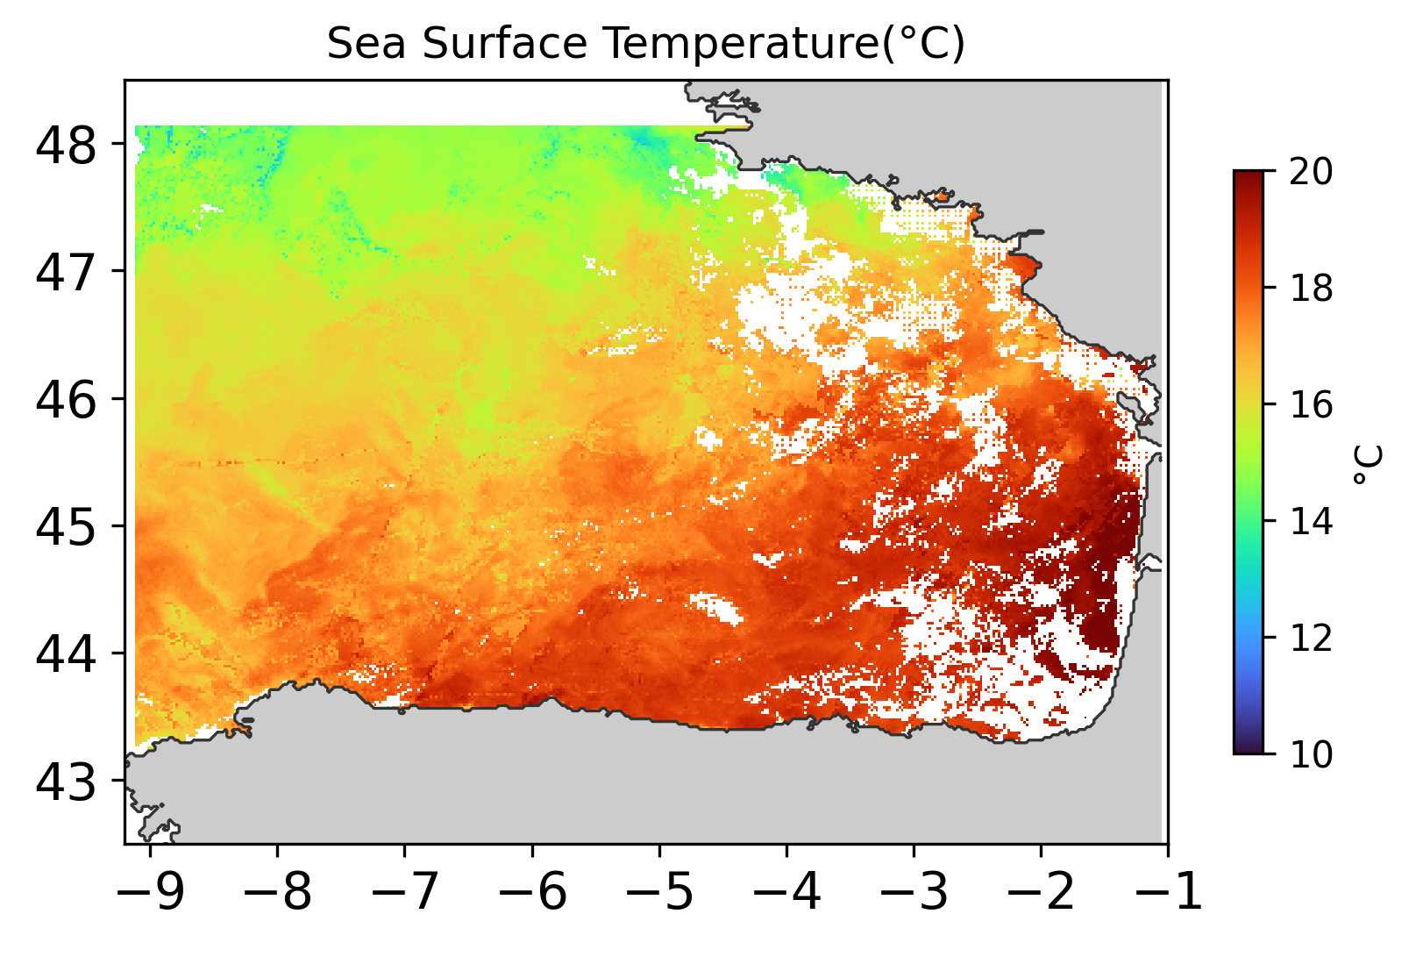
Objective
1. Develop and test a neural-network framework to obtain a high-resolution estimation of the surface velocity fields from tracer evolution.
Train the network on observational data
Globcolour L3 – SST L3 Products - SWOT
Controlled validation using IBI MFC model fields
Currently
Aim
Notes:
Since it is the first time for the two new members I decided to start with the objectives just to set a bit of context before entering details. The proposed objectives are to
This will be done using a neural network that Alexander has designed and I have been working on it, improving
Mentioning the importance of satellite data as an input

Slide 6


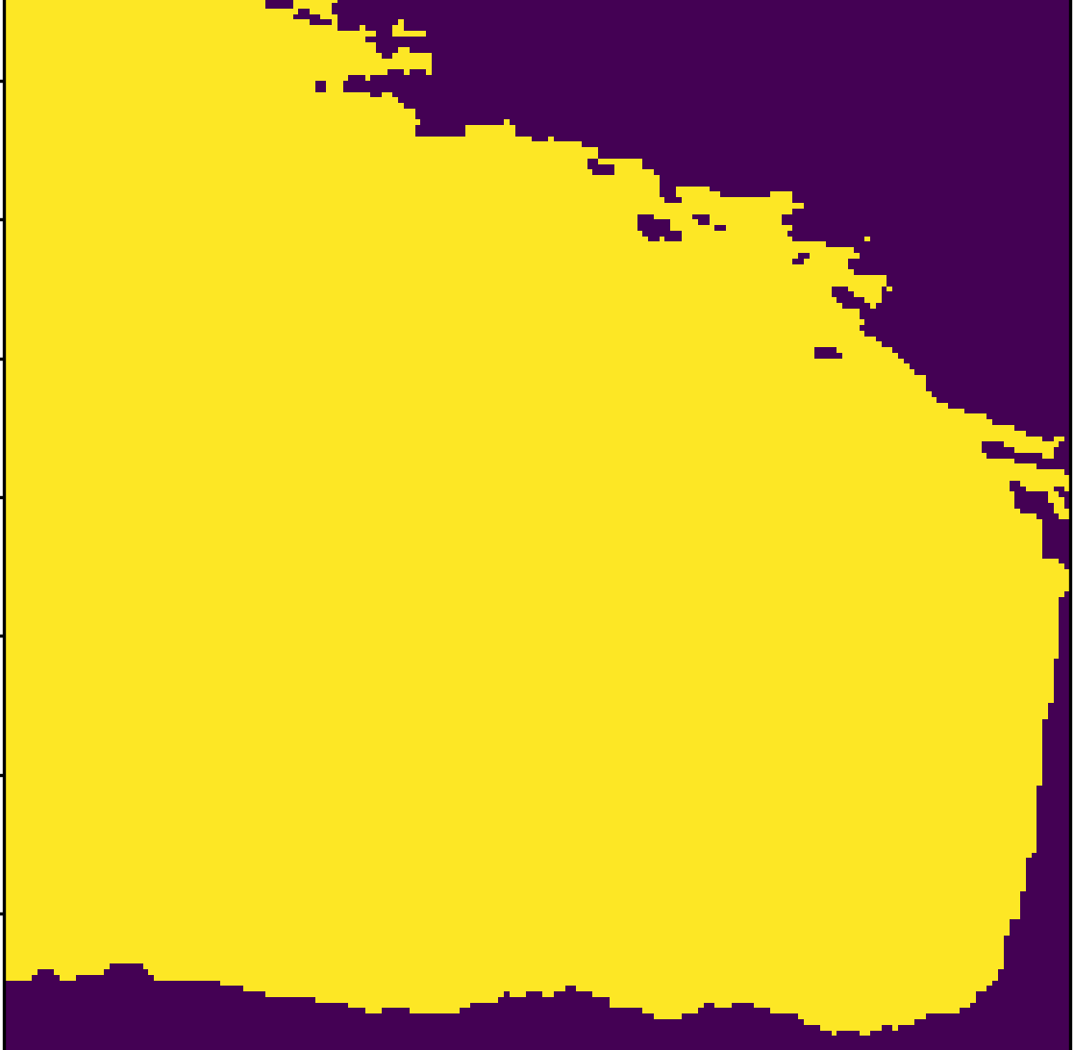




METHODOLOGY
$$f_{0}$$
$$f_{1}$$
INPUTS
CHL
Tracer
Data splitting [a] [b] (1993 -2025)
Training : from 01-01-1993 to 31-12-2023
Development : From 01-01-2024 to 31-12-2024
Test : From 01-01-2025 to 07-10-2025
SST
Multivariable approach
Chlorophyll
Sea Surface Temperature
Sea Surface Height
Zonal and meridional Gradients
22 Total parameters
$$\frac{∂SSH}{∂y}$$
$$\frac{∂SSH}{∂x}$$
Spatial
Coordinates
Land sea
Mask
Time
[a] https://doi.org/10.48670/MOI-00027 [b] https://doi.org/10.48670/moi-00028
Notes:
To tackle this objective, we propose the following methodology. As inputs we use chlorophyll and temperature as testing tracer fields, using a multi variable approach

Slide 7


s
INPUTS
Summarized Architecture
U-Net Encoder-Decoder
Skip connections
$$f_{0}$$
$$f_{1}$$
CHL
Conv
32
Conv
32
Tracer
Input
Conv
64
Conv
128
Conv
128
Conv
64
Bottleneck256
$$\hat{u}$$
SST
$$\hat{v}$$
$$\frac{∂SSH}{∂y}$$
192 × 192 × 2
$$\frac{∂SSH}{∂x}$$
192 × 192 × 26
Skip connections
Encoder
Decoder
Spatial
Coordinates
Land sea
Mask
Data splitting [a] [b] (1993 -2025)
Training : from 01-01-1993 to 31-12-2023
Development : From 01-01-2024 to 31-12-2024
Test : From 01-01-2025 to 07-10-2025
Time
[a] https://doi.org/10.48670/MOI-00027 [b] https://doi.org/10.48670/moi-00028
Notes:
To tackle this objective, we propose the following methodology. As inputs we use chlorophyll and temperature as testing tracer fields, using a multi variable approach

Slide 8


s
INPUTS
Summarized Architecture
U-Net Encoder-Decoder
Skip connections
$$f_{0}$$
$$f_{1}$$
Output
CHL
Conv
32
Conv
32
Tracer
Input
Conv
64
Conv
128
Conv
128
Conv
64
$$\hat{u}$$
Zonal and meridional components of the velocity
$$\hat{u}$$
Bottleneck256
SST
$$\hat{v}$$
$$\hat{v}$$
$$\frac{∂SSH}{∂y}$$
192 × 192 × 2
Daily fields
0.027° resolution
$$\frac{∂SSH}{∂x}$$
192 × 192 × 26
Skip connections
Encoder
Decoder
Spatial
Coordinates
Land sea
Mask
Data splitting [a] [b] (1993 -2025)
Training : from 01-01-1993 to 31-12-2023
Development : From 01-01-2024 to 31-12-2024
Test : From 01-01-2025 to 07-10-2025
Time
[a] https://doi.org/10.48670/MOI-00027 [b] https://doi.org/10.48670/moi-00028
Notes:
To tackle this objective, we propose the following methodology. As inputs we use chlorophyll and temperature as testing tracer fields, using a multi variable approach

Slide 9
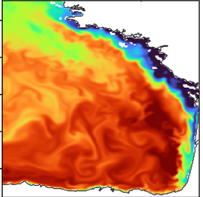
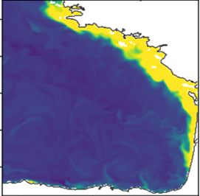







INPUTS
$$f_{0}$$
$$f_{1}$$
Advection Operator
CHL
Conv
32
Conv
32
Output
Tracer
Input
Conv
64
Conv
128
Conv
128
Conv
64
$$f_{0}$$
tracer
fields
$$\hat{u}$$
Bottleneck256
$$\hat{u}$$
SST
$$\hat{u}$$
$$\hat{v}$$
$$\hat{v}$$
$$\frac{∂SSH}{∂y}$$
$$∙$$
$$\hat{v}$$
192 × 192 × 2
Daily fields
0.027° resolution
$$\frac{∂SSH}{∂x}$$
192 × 192 × 26
Skip connections
Encoder
Decoder
$$u∙∇C$$
Spatial
Coordinates
Land sea
Mask
Data splitting [a] [b] (1993 -2025)
Training : from 01-01-1993 to 31-12-2023
Development : From 01-01-2024 to 31-12-2024
Test : From 01-01-2025 to 07-10-2025
Time
[a] https://doi.org/10.48670/MOI-00027 [b] https://doi.org/10.48670/moi-00028
Notes:
To tackle this objective, we propose the following methodology. As inputs we use chlorophyll and temperature as testing tracer fields, using a multi variable approach

Slide 10

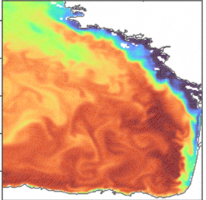
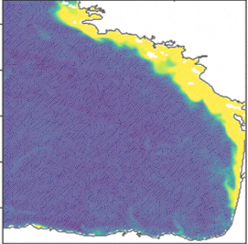
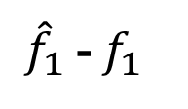
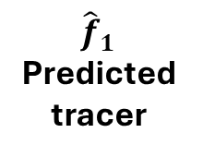
INPUTS
$$f_{0}$$
$$f_{1}$$
Advection Operator
CHL
Conv
32
Conv
32
Output
Tracer
Input
Conv
64
Conv
128
Conv
128
Conv
64
$$f_{0}$$
tracer
fields
${\hat{f}}_{1}$
Predicted tracer
$$\hat{u}$$
Bottleneck256
$$\hat{u}$$
SST
$$\hat{u}$$
$$\hat{v}$$
$$\hat{v}$$
$$\frac{∂SSH}{∂y}$$
$$∙$$
$$\hat{v}$$
192 × 192 × 2
Daily fields
0.027° resolution
$$\frac{∂SSH}{∂x}$$
192 × 192 × 26
Skip connections
Encoder
Decoder
$$u∙∇C$$
${\hat{f}}_{1}$ - $f_{1}$
Spatial
Coordinates
Land sea
Mask
Data splitting [a] [b] (1993 -2025)
Training : from 01-01-1993 to 31-12-2023
Development : From 01-01-2024 to 31-12-2024
Test : From 01-01-2025 to 07-10-2025
Loss function
Time
[a] https://doi.org/10.48670/MOI-00027 [b] https://doi.org/10.48670/moi-00028
Notes:
To tackle this objective, we propose the following methodology. As inputs we use chlorophyll and temperature as testing tracer fields, using a multi variable approach

Slide 11



Loss function
$$𝓛={\left\|f_{1}−{\hat{f}}_{1}\right\|}_{Ω}^{2}+α_{s}({{\left\|\hat{\text{u}}\right\|}^{2}{+ L}^{2}\left\|∇\hat{\text{u}}\right\|}^{2})+α_{diν}{\left\|∇.\hat{\text{u}}\right\|}^{2}+α_{bc}{\left\|M^{c}\hat{\text{u}}\right\|}^{2}$$
Misfit term
Regularization
Divergence
Boundaries
Observation – Predicted field
Penalization of unrealistic velocities
Penalizes divergence on the horizontal flow.
$$α_{s}$$
Provides a boundary on coast
$$α_{diν}$$
$$α_{bc}$$

Slide 12
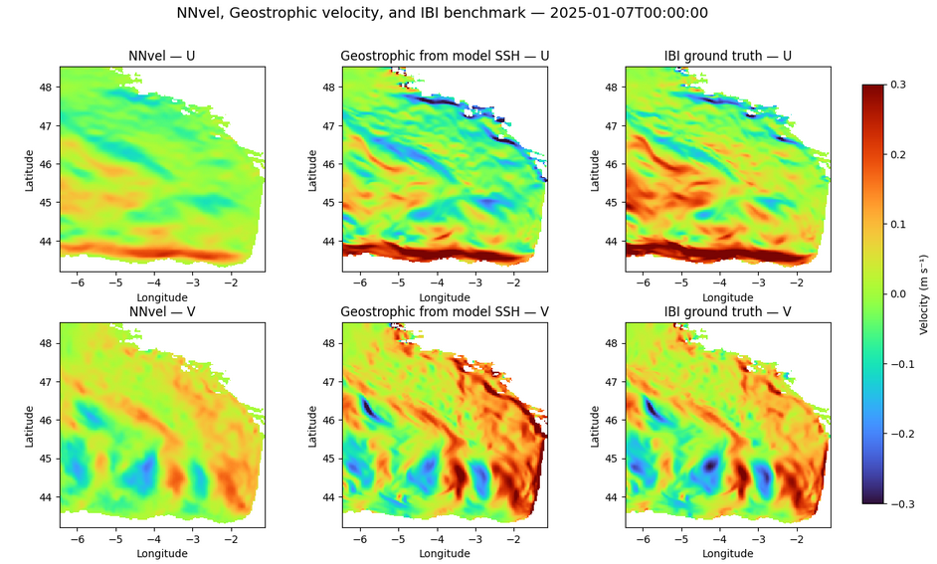
Geostrophic velocity baseline – Ground truth
Baseline field of velocity components by using the geostrophic approximation and the sea surface height from the IBI model
Zonal
Meridional
Comparing output against a baseline and a ground truth field
Output
Baseline
Ground truth

Slide 13
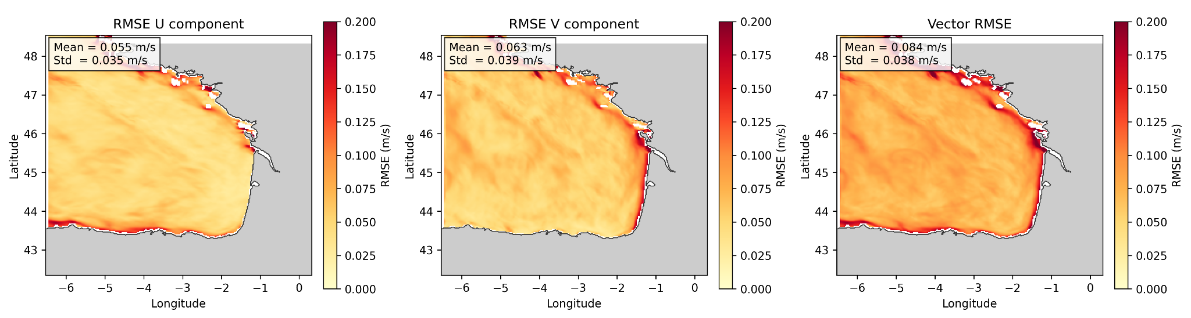
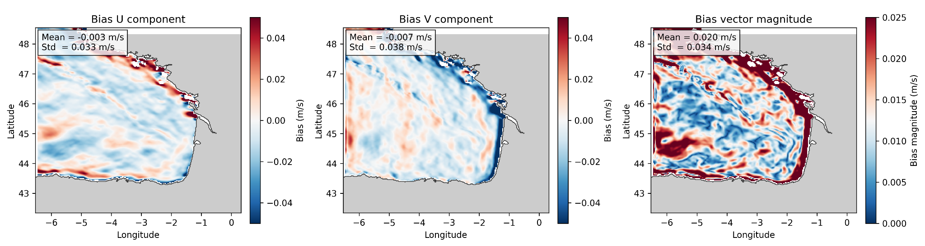


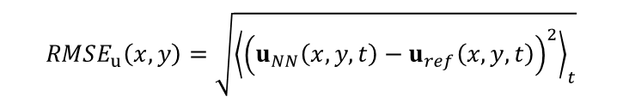


RMSE - BIAS
$$RMSE_{u}\left(x,y\right)=\sqrt{{\left\langle {\left(u_{NN}\left(x,y,t\right)−u_{ref}\left(x,y,t\right)\right)}^{2}\right\rangle }_{t}}$$
$$Bias_{u}\left(x,y\right)={\left\langle u_{NN}\left(x,y,t\right)−u_{ref}\left(x,y,t\right)\right\rangle }_{t}$$
Pointwise RMSE (m/s)
Heatmap shows error concentration along
  The coast
  In the slope
Bias show that largest persistent errors are concentrated near the eastern boundary.
Setting up divergence and boundaries constraint.
$\hat{u}$ RMSE
$\hat{v}$ RMSE
u RMSE
$\hat{u}$ Bias
$\hat{v}$ Bias
u Bias
Notes:
RMSE identifies where the model differs most from the benchmark, while bias identifies where those differences are systematic. In these results, the largest and most persistent errors are concentrated along the eastern boundary of the Bay of Biscay, suggesting that coastal/boundary dynamics remain more difficult for NNvel to reconstruct than the offshore flow.
Pointwise RMSE and bias maps were used to evaluate the spatial structure of the velocity reconstruction errors. RMSE measures the typical magnitude of the error independently of sign, while bias represents the temporal mean signed error and therefore indicates systematic overestimation or underestimation. The RMSE maps show average errors of approximately 0.055 m/s for the zonal component, 0.063 m/s for the meridional component, and 0.084 m/s for the vector velocity. Errors are spatially structured, with enhanced values along the eastern boundary of the Bay of Biscay and near coastal regions. The bias maps show relatively small domain-mean biases, especially for the zonal component, but reveal localized positive and negative patterns that compensate in the spatial average. The bias vector magnitude further indicates that the largest persistent mean errors are concentrated near the eastern boundary. This suggests that NNvel captures the offshore velocity field more consistently, while boundary and coastal regions remain more challenging, likely due to sharper gradients, coastline constraints, bathymetric effects, or unresolved coastal dynamics

Slide 14
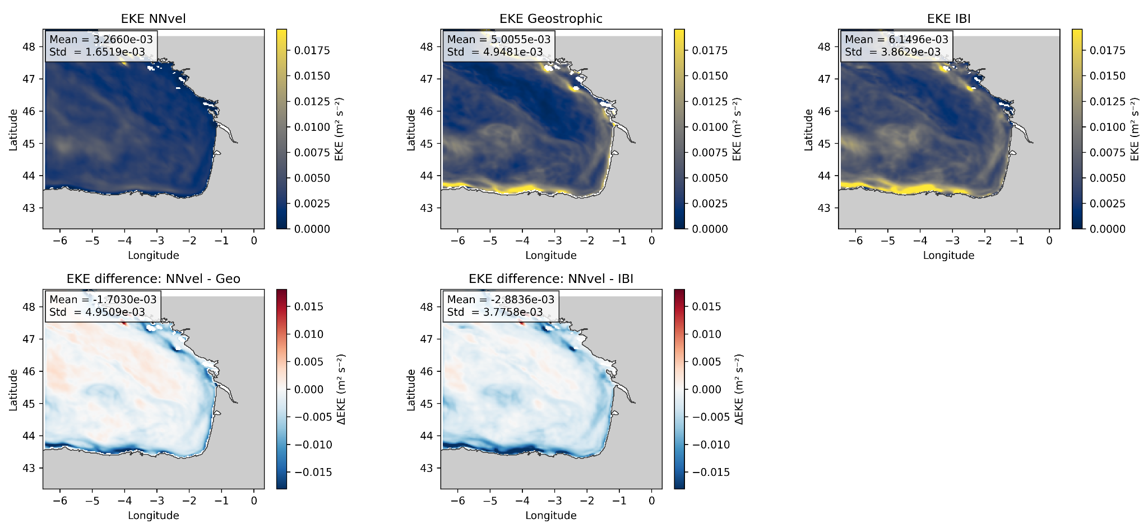

Metrics assessment – Eddy Kinetic Energy
Bias obtained per component and per total velocity magnitude
Outputs of the network show lower
Mean EKE than both geostrophic and IBI fields.
Underestimation of velocity variability and eddy activity.
Smoothing of energetic structures in boundary regions
$$EKE\left(x,y\right)=\frac{1}{2}{\left\langle u^{′}{\left(x,y,t\right)}^{2}+v^{′}{\left(x,y,t\right)}^{2}\right\rangle }_{t}$$
Notes:
A widely used metric to characterize mesoscale activity and evaluate its intensity and variability is the Eddy Kinetic Energy (EKE) (Wilkin and Morrow, 1994), which quantifies the energy associated with time-varying flow. Recent studies have reported a robust global intensification of EKE, particularly in high-energy regions such as the western boundary currents, based on satellite observations (Martínez-Moreno et al., 2021; Barceló-Llull et al., 2025) and model simulations (Hu et al., 2020).

Slide 15
Conclusions
Next steps
Tracer evolution can provide useful information for surface-current estimation.
NNvel reproduces part of the main circulation patterns without any velocity background input.
Current intensity and EKE are still underestimated, especially near coast/slope regions.
Model-data tests remain necessary before robust application to satellite observations.
Tune physical loss terms.
Add geostrophic consistency term from SSH.
Consolidate observational pipeline: CHL, SST, SSH/SWOT (HFR validation).
Baseline definition using smoothed SSH
Notes:
A widely used metric to characterize mesoscale activity and evaluate its intensity and variability is the Eddy Kinetic Energy (EKE) (Wilkin and Morrow, 1994), which quantifies the energy associated with time-varying flow. Recent studies have reported a robust global intensification of EKE, particularly in high-energy regions such as the western boundary currents, based on satellite observations (Martínez-Moreno et al., 2021; Barceló-Llull et al., 2025) and model simulations (Hu et al., 2020).

Slide 16
Questions?
Juan Manuel López Contreras
Thank you!
Contact: j.lopezcontreras@uliege.be
ISOBAY 19
June 16th, 2026
The present research benefited from computational resources made available on Lucia, the Tier-1 supercomputer of the Walloon Region, infrastructure funded by the Walloon Region under the grant agreement n°1910247.
This work benefits financial support of the F.R.S-FNRS (Fonds de la Recherche Scientifique de Belgique, Communauté Française de Belgique) through funding the FRIA grant R.FNRS.6066-J-F (FRIA 1.E.088.24F).

Slide 17
References
Koutsikopoulos, C., & Le Cann, B. (1996). Physical processes and hydrological structures related to the Bay of Biscay anchovy. Scientia Marina, 60, 9-19.
Caballero, A., Mulet, S., Ayoub, N., Manso-Narvarte, I., Davila, X., Boone, C., Toublanc, F., & Rubio, A. (2020). Integration of HF Radar Observations for an Enhanced Coastal Mean Dynamic Topography. Frontiers in Marine Science, 7. https://doi.org/10.3389/fmars.2020.588713
Nichols, C. R., & Raghukumar, K. (2020). Marine environmental characterization. Morgan & Claypool Publishers.

