Slide 1




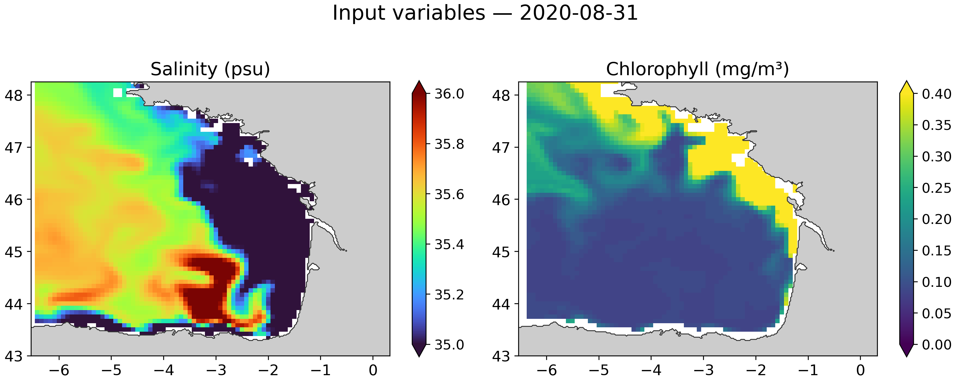
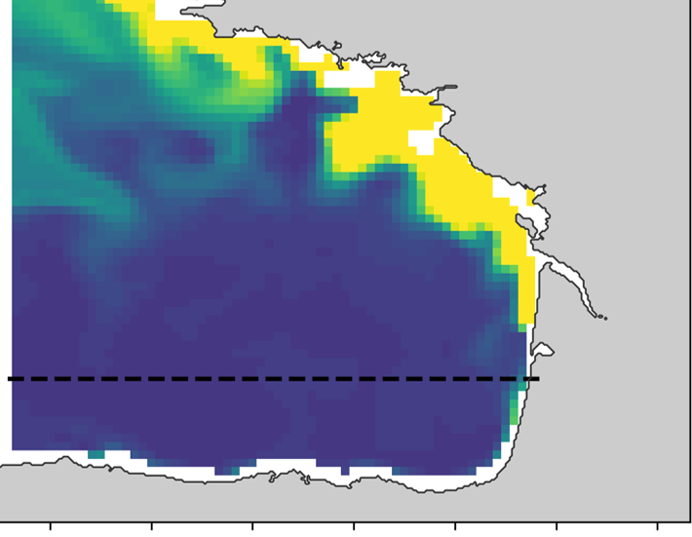
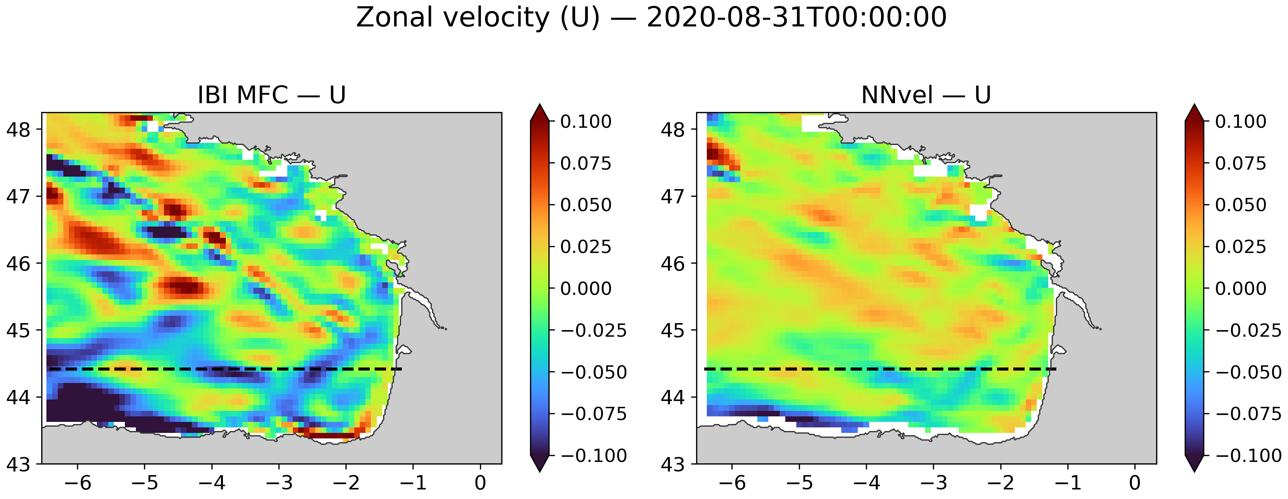
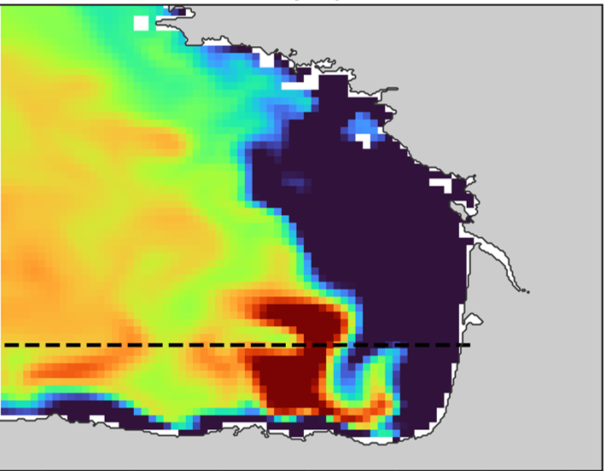
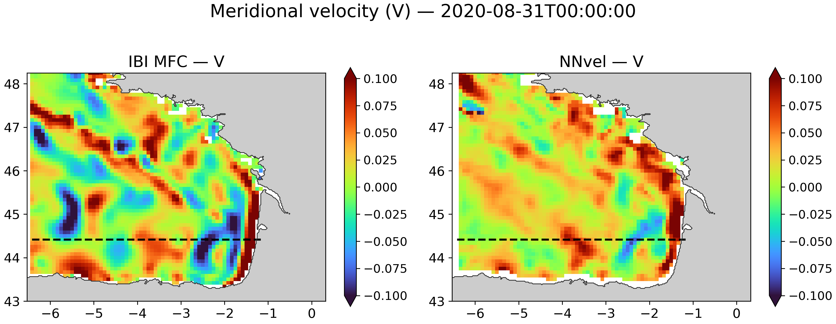
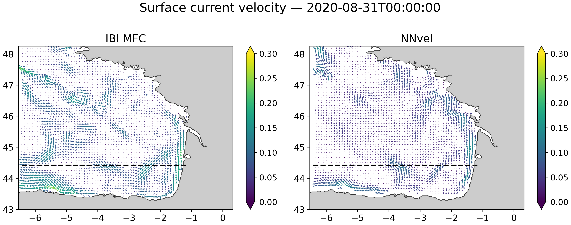
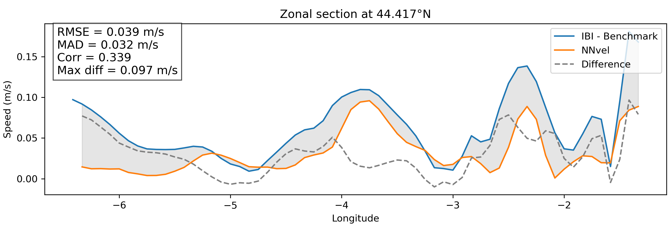
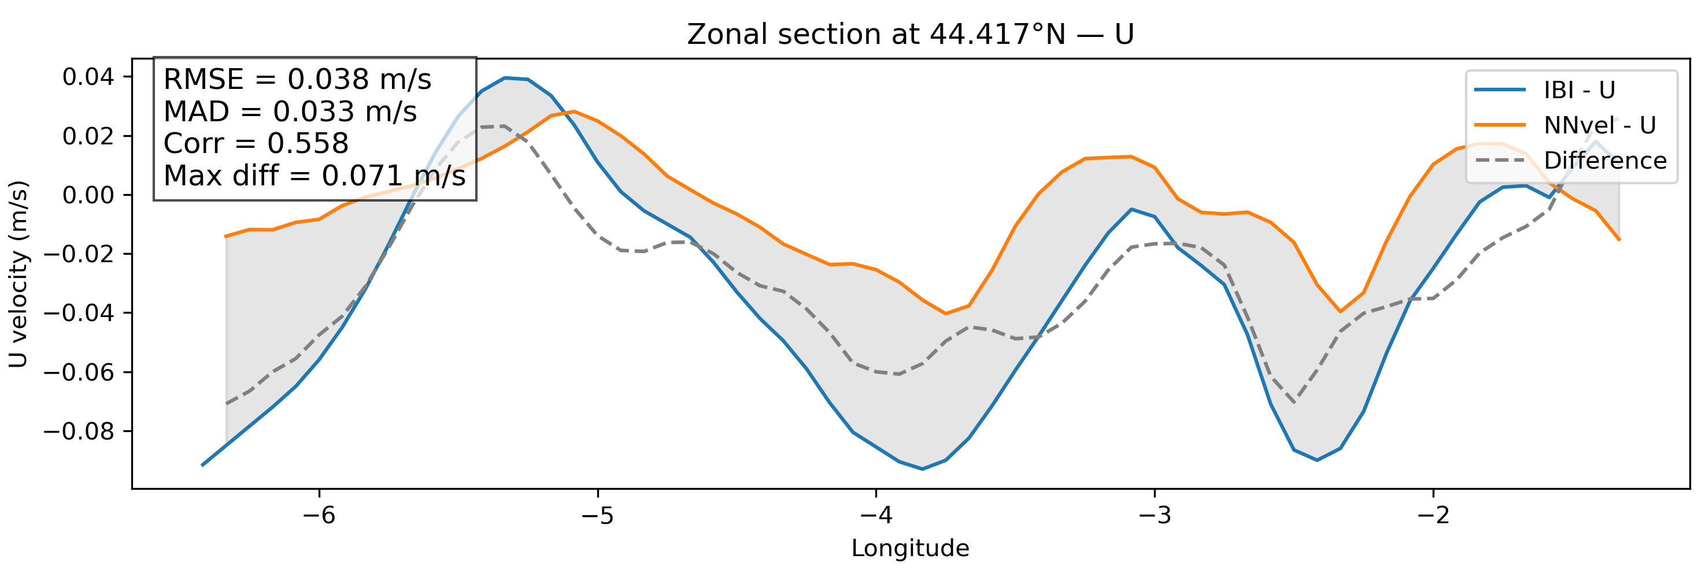
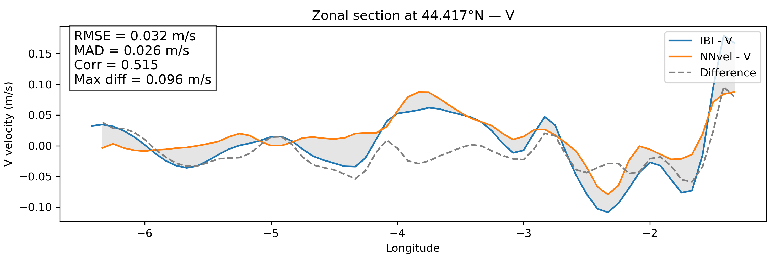

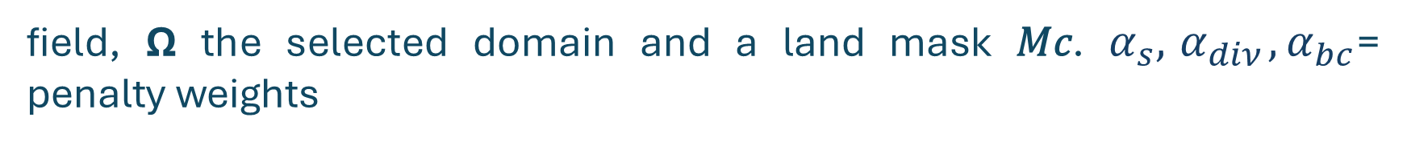
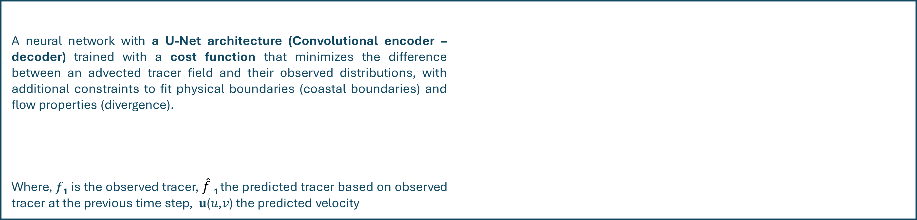
Ocean colour as a tracer for surface current reconstruction
An approach using a physics informed neural network
Authors
Juan Manuel López Contreras
Alexander Barth (ULg)
Aida Alvera-Azcárate (ULg)
Ganix Esnaola (UPV)
Contact
j.lopezcontreras@uliege.be
INTRODUCTION
Surface currents are a key element in global oceanic circulation, they transport several elements, ranging from chlorophyll, sediments and others, enhancing phenomena such as productivity or climate change [1, 2].
Neural networks have been used as a tool to retrieve effectively sea surface current maps [3].
Chlorophyll and other tracers
Current sensors used to retrieve ocean color indirect variables (Chlorophyll) provide high spatial resolution images of approx. 300 m
Salinity, and Temperature also been used as a source for extracting information relevant to the surface dynamics of the ocean, providing less cloudy images (Microwave radiation).
Bay of Biscay
Located in the intergyre zone of the North Atlantic. It is characterized by a strong continental slope, and it is influenced by the adjacent dynamics [5].
High mesoscale activity and constant Eddie formation at the cross-shelf area in
different seasons [4], the intrusion of the Iberian Poleward current (IPC Navidad) influences the formation of SWODDIES in wintertime [4,5].
OBJECTIVES
METHODOLOGY
- Obtain a high-resolution estimation of the surface currents based on ocean color remote sensing and other tracers.
- Evaluate the performance of an advection operator in the retrieval of velocity fields.
A neural network with a U-Net architecture (Convolutional encoder – decoder) trained with a cost function that minimizes the difference between an advected tracer field and their observed distributions, with additional constraints to fit physical boundaries (coastal boundaries) and flow properties (divergence).
Where, 𝑓₁ is the observed tracer, $\hat{f}$₁ the predicted tracer based on observed tracer at the previous time step, 𝐮(𝑢,𝑣) the predicted velocity
field, Ω the selected domain and a land mask 𝑀𝑐. $α_{s},{ α}_{diν},α_{bc}$= penalty weights
Chl
Schematic representation of the neural network
Chl
Chl
Chl
u
Estimated velocity
Advection operator
$$𝓛={\left\|f_{1}−{\hat{f}}_{1}\right\|}_{Ω}^{2}+α_{s}{\left\|∇\hat{\text{u}}\right\|}^{2}+α_{diν}{\left\|∇.\hat{\text{u}}\right\|}^{2}+α_{bc}{\left\|M^{c}\hat{\text{u}}\right\|}^{2}$$
Chl
Encoder
Decoder
u
Estimated velocity
Loss
$$𝓛$$
Chl
Chl
Misfit term
Regularization
Divergence
Boundaries
Sal
Input(s)
Encoder
Bottleneck
Decoder
Advection
Loss
minimization
Output (u,v)
RESULTS
We trained the neural network using normalized chlorophyll and salinity from 1993 to 2019, with 2020 as the test year. The fields were extracted from the IBI MFC Atlantic-Iberian Biscay Irish- Ocean Physics Analysis and Forecast [a], and the BioGeoChemistry NON-ASSIMILATIVE Hindcast [b] with a 0.083 resolution.
First tests were performed using single variables as inputs, furthermore, data architecture was modified to include multiple variables. For present results the network was trained for 300 epochs. All tests were performed on a NVIDIA A100-SXM4-40GB GPU.
On the left, plots comparing independent data “benchmark” (zonal and meridional fields from the IBI model), against the model outputs for a specific date.
1a
1b
2a
2b
3a
2c
Benchmark
Independent IBI-MFC fields
NNvel model outputs
Comparison between the IBI-MFC retrieved total surface current, zonal and meridional components 1a, 2a, 3a vs. the neural network model outputs 1b, 2b, 3b.
DICUSSION AND FURTHER WORK
REFERENCES & DATASETS
First outputs of the neural network capture specific features from the sea surface circulation.
The use of 2 variables as inputs, in this case chlorophyll and salinity improves the quality of the retrieved outputs by including the complex patterns of the chlorophyll, and the conservative behavior of salinity.
Physical constraints are key for the minimization of the cost function. In the present results the use of a boundary constraint improve the features along the coast of Spain. Optimization of the parameters is yet to be tested.
Among the next steps, we are planning to use a third tracer (Temperature), to evaluate the impact of it on the outputs.
Further tests will use satellite images from different sensors, including Sentinel -3 OLCI. To overcome possible constraints as the presence of clouds, we will include temperature and salinity and its availability from microwave sensors.
Use of Sea surface height fields from SWOT, as a physical forcing to the model, improving convergence of the loss.
[1] https://doi.org/10.1016/j.rse.2017.10.037
[2] https://doi.org/10.1002/2013JC009728
[3] https://doi.org/10.3390/rs13163162
[4] https://doi.org/10.5194/os-9-655-2013
[5]https://doi.org/10.24400/527896/A01-2023.018
[a] https://doi.org/10.48670/MOI-00027
[b] https://doi.org/10.48670/moi-00028
ACKNOWLEDGEMENTS
This work benefits financial support of the F.R.S-FNRS (Fonds de la Recherche Scientifique de Belgique, Communauté Française de Belgique) through funding the FRIA grant R.FNRS.6066-J-F (FRIA 1.E.088.24F).
The present research benefited from computational resources made available on Lucia, the Tier-1 supercomputer of the Walloon Region, infrastructure funded by the Walloon Region under the grant agreement n°1910247.
Notes:
Undertermined problem
Make sure
Predict velocity based on tracers
Another parameter can be sea surface height

