Slide 1

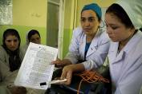

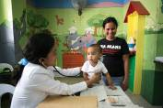
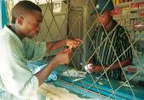
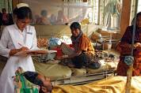
The EU-WHO UHC partnership:
Supporting Policy Dialogue on National Health Policies, Strategies and Plans
and Universal coverage
European Union Regional Health and Education Seminar
5 November 2013, Addis Ababa, Ethiopia
Notes:
World Health Organization
31 October 2013
1

Slide 2
Why such a partnership?
At Country Level
Dissatisfaction with fragmentation
Dissatisfaction with inequalities and slow progress
Backlash with state withdrawal
Dissatisfaction with policy dialogue
At Global Level
Failure to reach MDGs
Limitations of cost-effective interventions / vertical programmes
Recognition of HS bottlenecks and adverse effects of fragmentation
Recognition of the importance of broad policy directions
Country interest in developing pro-poor and more equitable policies towards UHC, through better policy dialogue
Global interest in more effective aid and better coordination along with the «One» aid effectiveness mechanisms
Notes:
Benin 2009. Burkina Faso 2009. Burundi 2007. Cambodia 2007. Democratic Republic of Congo 2009. Djibouti 2009. Ethiopia Kenya Madagascar 2007, Mali Mozambique 2008 Nepal Niger 2009. Nigeria 2008. Rwanda 2009. Senegal 2009. Sierra Leone 2010. Togo 2010. Uganda 2009. Vietnam (intent, not signed) Zambia 2007.
2

Slide 3



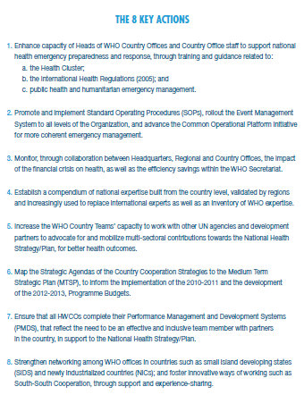

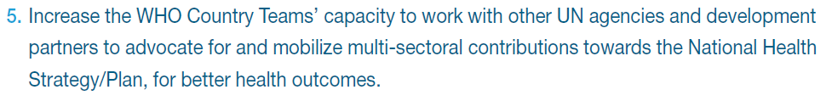
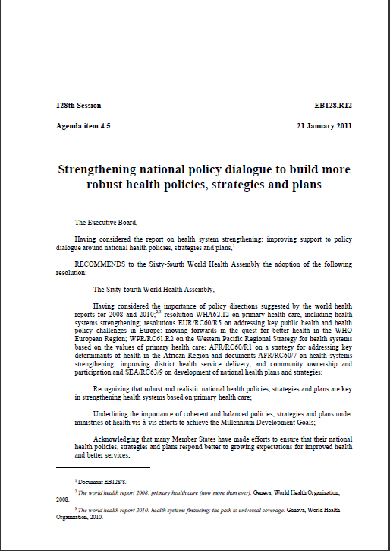

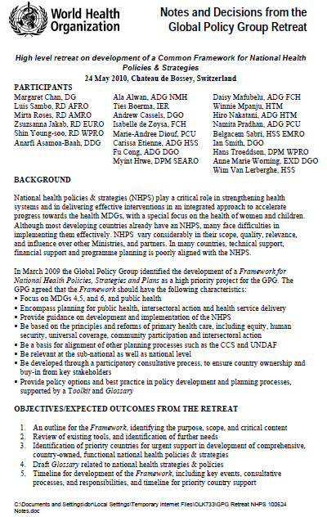
WHO response
5th WR MEETING 2009
Resolution
May 2011
GPG may 2010

Slide 4
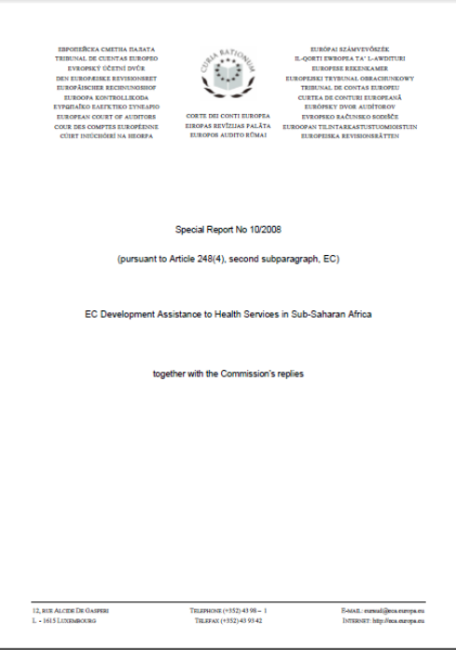
EU response
No 3: The Commission should ensure it has sufficient health expertise to adequately implement its health sector policies and interventions and play an effective role in health sector dialogue. To this end it should, as a minimum, ensure that all Delegations where health is a focal sector have health specialists. It should assess how far the following options are feasible for ensuring adequate support to other Delegations:
establishing health expertise in regional Delegations to support Delegations without health specialists;
working more closely in post-conflict countries with ECHO health advisers;
forming closer partnerships with World Health Organisation Country Offices to draw on their expertise;
entering into formal agreements with EU Member States to use their expertise, such agreements to be based on a mandate which ensures the Commission retains responsibility and clearly defines the operating modalities.
European Court of Auditors
Report 2008 on EC Development Assistance to Health Services in Sub-Saharan Africa
EC response on c): "The cooperation with the WHO, already important, could indeed be reinforced with its country offices whenever this is possible" (reply of the commission, page 13)

Slide 5
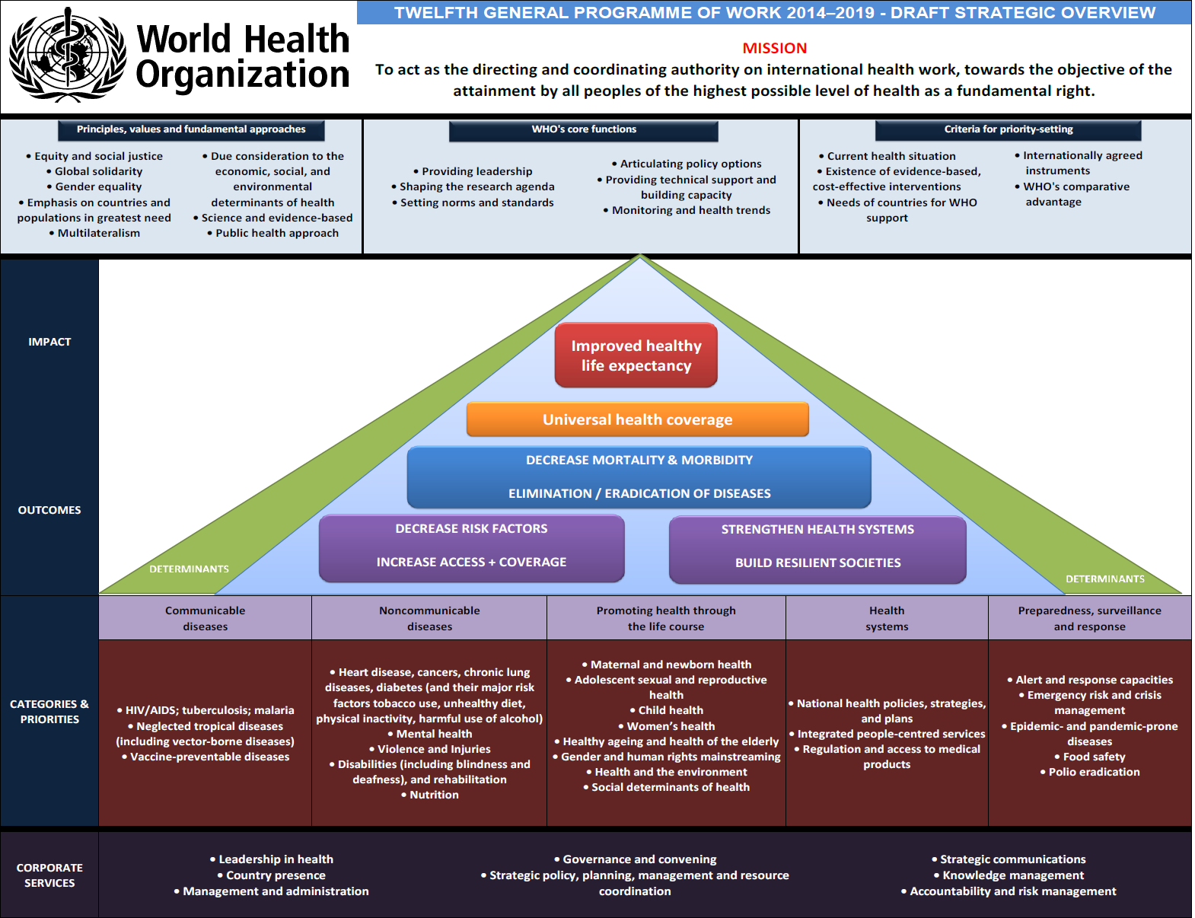
a response
in line
with
WHO
Priorities

Slide 6


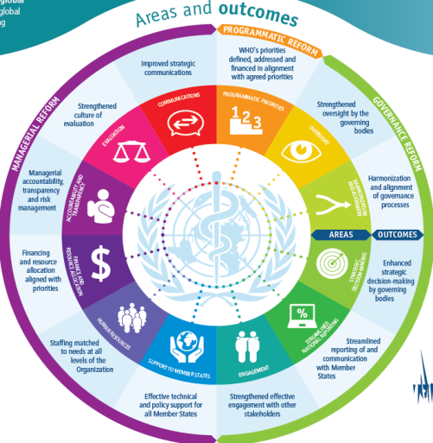
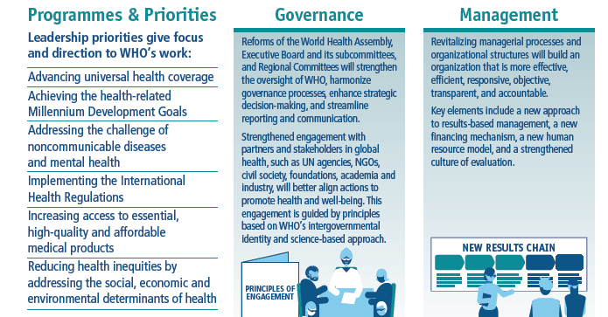
Reform

Slide 7
The response: a coherent programme of work
Universal health coverage values and principles
Paris declaration principles and IHP+
NHPSP / Policy Dialogue as a foundation
Global learning programme to increase WHO response capacities
Development of a partnership programme to strengthen WHO capacities to facilitate health sector dialogue at country level (EU-WHO-LUX partnership)

Slide 8
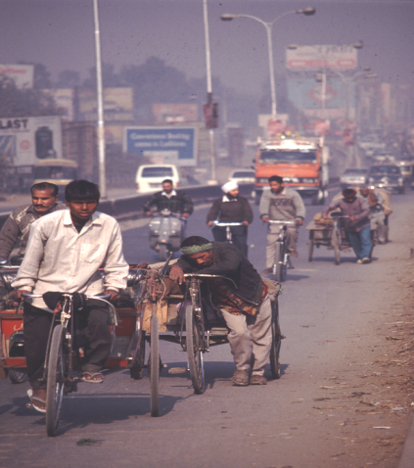
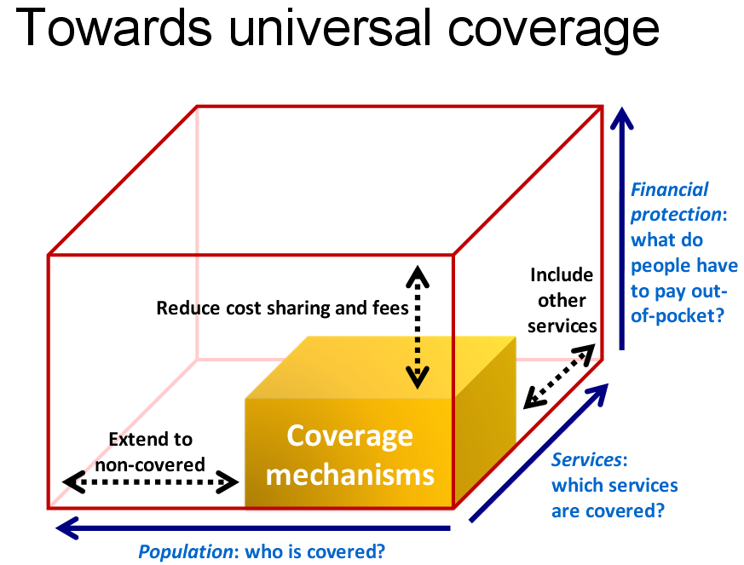
Resp1: Universal Health Coverage
Notes:
8
8

Slide 9
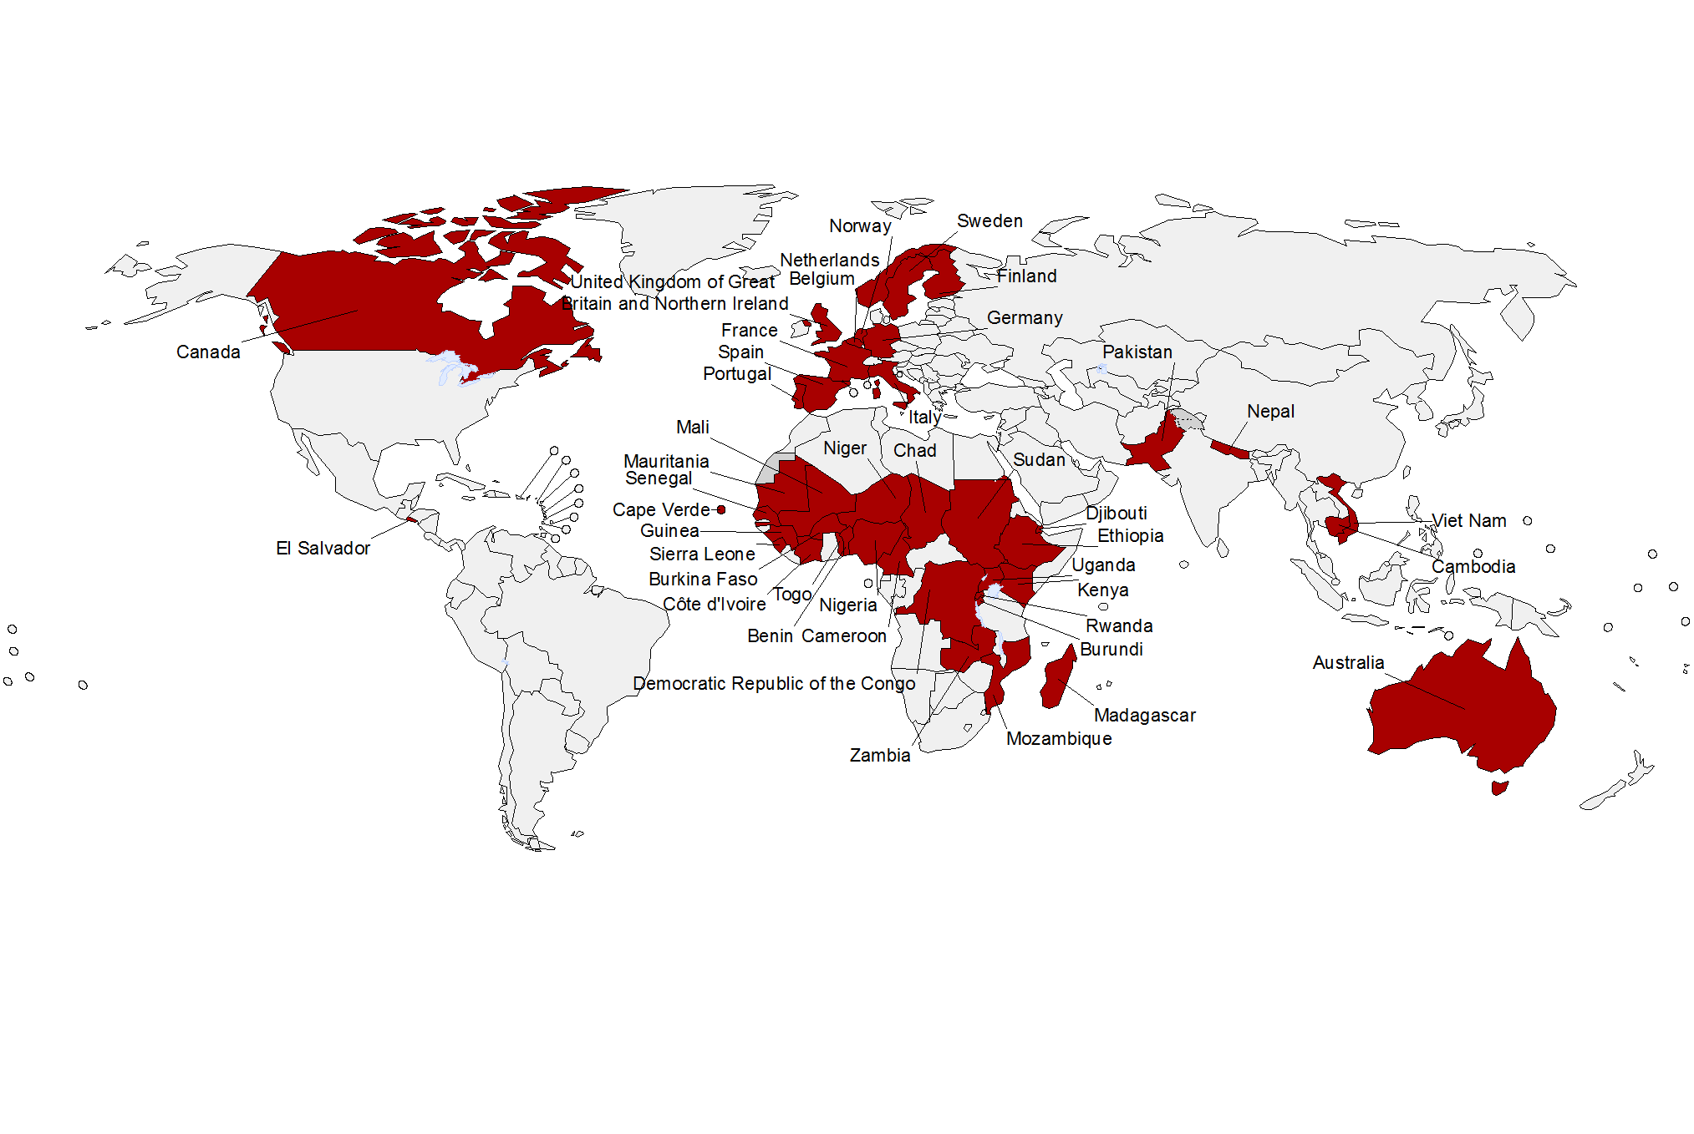
Resp 2: IHP+
*African Development Bank, Bill and Melinda Gates Foundation, European Commission, GAVI Alliance, Global Fund, International Labour Organization, UNAIDS, UNICEF, UNDP, WHO, UNFPA, World Bank
Civil society also plays a key role in IHP+
Nairobi Dec 2012: Key messages
2007 2012
Developing countries: 8 31
Bilateral donors: 8 13
Int'l agencies and foundations*: 11 12
TOTAL 27 56

Slide 10
Response 3: NHPSP
Country "plans" are different, …
Legend:
National Health Strategic Plan
Programme

Slide 11

Resp 3 (cont'd): NHPSP
COMPREHENSIVENESS
COHERENCE
COHERENCE
COHERENCE
BALANCE
SCOPE
BALANCE
DEPTH
11 |
Country Health Intelligence Portal (CHIP) | 31 October 2013

Slide 12
Res 3(cont'd): Policy Dialogue
Theory
Medium Term
5 years
Strategic Plan
Medium Term
5 years
Strategic Plan
NHP preparation
NHP preparation
Annual
Review
Annual
Review
Annual
Review
Annual
Review
Final
Evaluation
Practice
Partners
NGOs
Elections
Government
Plan
Political
Programmes
Medium Term
5 years
Strategic Plan
CSO
GHIs

Slide 13
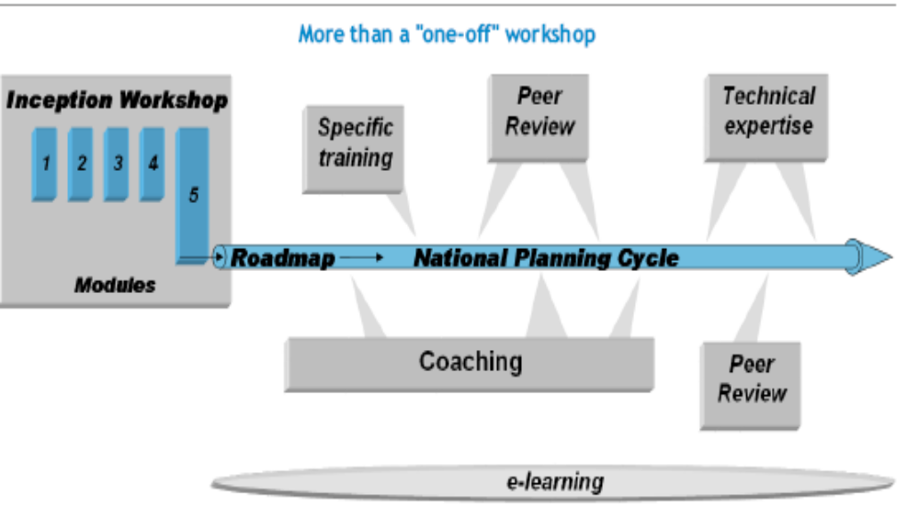
Res 4: WHO capacity building
WHO Global Learning Programme
Notes:
The ROADMAPS!
Sets out a process for the entire WCO team jointly to take action, based on lessons, to improve engagement with national policy processes – as an integrated team….
→ Self assessment: how are we doing?
→ Upcoming actual opportunities to engage with NHPSP processes
→ Identification of needed actions to improve how WCO engages (eg, coaching, trainings, skills etc)
→Support needed from RO, HQ, other sources

Slide 14
Resp 5: EU-WHO-LUX partnership
EU – WHO partnership (27 M€ - 14 pays)
7 first priority countries started in 2012
  Liberia, Moldova, Sierra Leone, Sudan, Togo, Tunisia, Vietnam
7 additional countries in 2013
  Chad, DRC, Guinea, Mozambique, South-Sudan, Timor Leste, Yemen
LUX-WHO partnership (5 M€ - 5 pays)
5 countries in West Africa
  Burkina Faso, Cabo Verde, Mali, Niger, Senegal
WHO support target: 40 countries
Notes:
Programme starting in 7 countries in Oct 2011; 12 additional countries in 2013
Technical assistance and flexible money to support the Policy Dialogue process
Tailored support according to the Country Planning Cycle (light and full modes)
Need for intensive collaboration EU-WHO-LUX and collaboration with all partners (IHP+)

Slide 15
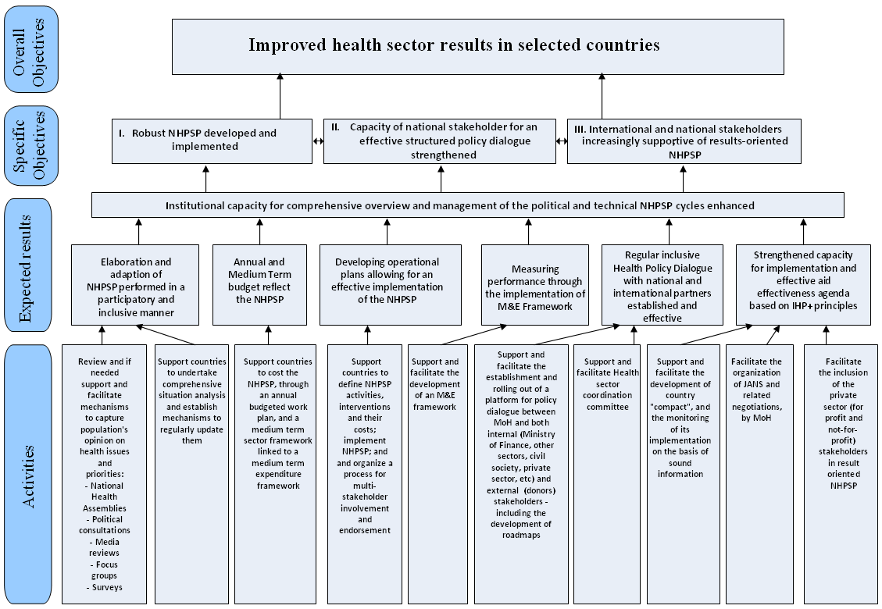
Logframe

Slide 16
UE programme. Expected results
ER 1. Countries will have prepared/developed/updated/adapted their NHPSP through an inclusive policy dialogue process leading to better coverage with essential health services, financial risk protection and health equity;
ER 2. Countries will have put in place expertise, monitoring and evaluation systems and annual health sector reviews;
ER 3. Countries requesting health financing (HF) support will have modified their financing strategies and systems to move more rapidly towards universal coverage (UC), with a particular focus on the poor and vulnerable:
ER 4. Countries receiving HF support will have implemented financing reforms to facilitate UC;
ER 5. Accurate, up-to-date evidence on what works and what does not work regarding health financing reforms for universal coverage is available and shared across countries.
ER 6. At country level, alignment and harmonisation of health aid according to national health plans is consolidated and accelerated.

Slide 17
UE programme. Activities
Review and if needed support and facilitate mechanisms to capture population's opinion on health issues and priorities
Support countries to undertake comprehensive situation analysis and establish mechanisms to regularly update them
Support countries to cost the NHPSP, through an annual budgeted work plan, and a medium term sector framework linked to a medium term expenditure framework
Support countries to define NHPSP activities, interventions and their costs
Support countries in the implementation and management of NHPSP
Support and facilitate the development of a Monitoring and Evaluation framework
Support and facilitate the organization of a process for multi-stakeholder involvement and endorsement
Support countries to communicate national health sector improvements and results to the general public
Facilitate the establishment and rolling out of a platform or support to existing platforms for policy dialogue and health sector coordination.
Collate, analyse and disseminate best available evidence to participating countries on what has worked in other settings
Facilitating South-South learning and sharing of experience
Support regular assessment of where countries stand in terms of UC and how (well) the HF system is functioning through country-led analysis of the institutional design, organization and operation of country HF systems
Assist selected countries in their HF policy analysis
Support countries to establish mechanisms for evidence-informed planning and resource allocation (i.e. to ensure that additional investments generate the 'most health for the money')
Support the design and evaluation of innovative approaches for universal coverage where these are being developed
Support and facilitate the development of the country 'compact', and the monitoring of its implementation
Facilitate the organization of the Joint Assessment of National Strategies (JANS) or equivalent agreed mechanisms, and related negotiations
Support and facilitate a process to establish a single monitoring and evaluation mechanism

Slide 18
Way of working
All levels: WCO + RO + HQ
Using WHO tools (Situation analysis, National Health Assemblies, Priority setting, costing – OneHealth, e-learning, etc.)
Acting as brokers – interface with national and international partners
Facilitation
"one WHO" resources mobilization at all levels

Slide 19
Major areas of work
AREAS of ACTIVITIES
LEVELS of ACTIVITIES
TYPE of ACTIVITIES
MoH Capacity Building
Major focus
Strategic National Planning
National level
IHP+
Decentralization
National Policy/Political
objectives
Health Financing
Financial Management Systems
Provincial level
Strategic work
Human Resources for Health
Health Information Systems
Technical support
Monitoring & Evaluation
Local level
Medicines
Visibility
Others (legislation, regulation,…)

Slide 20
AREAS of ACTIVITIES
Examples
MoH Capacity Building
Key Programme Activities | DR Congo | South Sudan | Timor-Leste | Guinea | Chad
MoH Capacity Building | Improve capacitiy of the MoH to conduct a JAR and MTR of the NHPlan (2013) | Support the construction of a framework for JAR * (2013-2015) | Strengthen MoH for inter-sectoral activities * Developing regulations of private sector and PPP * Strengthening health sector coordination Supporting the development of Code of Conduct (2014-2015) Support MoH capacity to develop M&E * (2013-2015) |  | Co-ordinating MoH and partners for Integration of health with other sectors (social protection) (2013)

Slide 21
19 Countries
Key Programme Activities | DR Congo | South Sudan | Timor-Leste | Guinea | Chad | Liberia | Sierra Leone | Togo | Tunisia | Sudan | Vietnam | Moldova | Burkina Faso | Cabo Verde | Mali | Niger | Senegal
MoH Capacity Building |  | Support the construction of a framework for JAR * (2013-2015) | Strengthen MoH for inter-sectoral activities * Developing regulations of private sector and PPP * Strengthening health sector coordination Supporting the development of Code of Conduct (2014-2015) Support MoH capacity to develop M&E * (2013-2015) | Coordination of MoH with other sectors and communities | Co-ordinating MoH and partners within health Integration of health with other sectors (social protection) (2013) |  |  | Support to MoH in coordinating health sector committees | Support to MoH for policy dialogue during implementation of National Health Policy | NH Strategy drafted | Support to MoH to take over coordination and leadership role for technical working groups and Health Partners Forum | Sector coordination & coherent policy development |  | Coordination with different health sector actors (2013-2015) Policy dialogue between public and private sector (2013-2015) | Development of plans and training of district management teams in Public Hospital Establishments | Introduction of PPP (2013-2015) | Support leadership building, monitoring and evaluating activities (2013) * Co-ordination with other sectors (2013,2014) * Strengthen hospital governance and PPP (2014-2015) *
Strategic National Planning |  | Engaging planning at a central level * (2014-2015) | Developing annual operational plan, costing and budgeting (2013-2015) | - Situation analysis (summary reports of CHPP) - Developing National Health Policy - Drafting and evaluating National Health Development Plan * - Development of 1st triennal plan (2014-2016) - Preparation for the Annual Operational Plan 2014 - Policy dialogue, training and committee meetings across different levels | Post 2015 planning * Situation anaysis * (2014) Support for finalising the National Health Development Plan II * (2013) |  |  |  | Programme road map Situation analysis National Health Assembly Support for National Health Policy formulation Support for operational and strategic plans | Policy dialogue on future of Darfur |  | Health forum Policy studies on selected health issues | Developing guidelines for regional and district levels health development plan, five-year plans * Situation Analysis* (2013-2015) National Health Development Plan * | Updating strategic plan across all levels (2014) Trianing module revision (2013) Staff training (2014) Health framework reviewed (2014) National Health Forum (2014) | Situation Analysis Developing central and regional level plans for the PDSS and PRODESS Preparation and validation of operational plans across all levels | Health development plan Develop a communication plan (2014) | Revising national consulting framework (2014-2015) * National strategy for universal coverage (2014) * Situation analysis - updating CHPP (2013-2014) and OneHealth (2013) *
Decentralization | - Province-level policy dialogue * - Facilitating steering commitees at provincial levels * - Capacity building of teams at provincial level | Capacity building for state and county planning (National Health Plan) * (2014-2015) |  |  | Adoption of Regional Health Plan * (2013) |  |  | District/regional-level policy dialogue |  | Institutionalisation of decentralisation | Sub-national planning | Sub-national workshops on health policy | Meetings, workshops, to co-ordinate the different levels * (2014-2015) Work visits (2013-2015) * |  | Training policy dialogue management at district, regional and central levels |  | Decentralization of qualified health managers * (2014-2015)
Monitoring & Evaluation | - M&E: annual and mid-term review (using JANS and situation analysis) | Information collection for JAR * Content development for JAR (2013-2015) |  | - M&E - registration system for births and deaths, national database for health, NHO, JAR | JAR * (2014,2015) Satisfaction survey (2014) | M&E | M&E | M&E | M&E |  | M&E |  | Monitoring committee meetings, mid-term and annual reviews * (2013-2015) Joint-midterm review of national health development plan (2015) | Staff training (2014) Development of a M&E plan (2014) Potential PPPs (2015) SARA (2013-2015) | Revising framework National Development Plan for monitoring and evaluation Joint annual review JANS Coordination with other bodies to monitor PRODESS/PDSS at different levels | Joint evaluation of new health development plan (JANS) (2015) Monitoring and supervision of health informatics system Revising monitoring framework (2014) | Mid-term review of National Health Development Plan (2014) * Revising monitoring plan (2014) SARA
Health Financing | - Support guidelines for MoH funding partners - Round table discussions with FTP |  | Support the development of: 1. Situation analysis and financing strategies for universal coverage 2. National Health Accounts (2013-2015) | Support the developement of: 1. Health financing strategy for universal health coverage and UHC promotion activities 2. Innovative Financing Mechanisms 3. National Health Accounts 4. Institutionalized MoH/MoF dialogue throughout the budget cycle. | Support to the developement of: 1. Situation analysis and health financing strategy for universal health coverage 2. National Health Accounts | 1. Planning and budgeting 2. Operationalization of health financing | Costing |  |  | Health financing policy |  | Dialogue on health insurance fund | National strategy for health financing * (2013-2015) | Introduction of National Health Accounts (2013,2014) National strategy for health financing (2014,2015) | Finalizing the national policy for health financing Costing health plans using OneHealth Implementation of National Health Accounts | Social health fund (2013-2015) OneHealth - cost health development plan (2014-2015) | National Health Accounts (2013-2014)*
Financial Management Systems |  |  |  |  |  |  | Financial management assessment | Joint financing agreement |  |  |  |  | Medium-term expenditure framework* (2014) | Disseminating medium-term expenditure framework (2014) | Developing a medium-term expenditure framework
Health Information Systems |  |  | Developing Health Management Information System strategic plan and capacity* |  |  |  |  |  |  |  |  |  |  | Preparation of HIS (2015) | National strategic plan for national health informations system | Quality control of data Development of an online portal (2014-2015) Training of data managers (2014)
Human Resources for Health |  | Supporting development of health systems * (2013-2015) | Health workforce plan (2014-2015) Developing code of medical ethics Training courses * (2013-2015) |  |  |  | HRH database Finalization of HRH policy Strategic Plan |  |  | Policy dialogue on retention strategies for HRH
Visibility |  | Documentation and media coverage of major health policy events (2013-2015) | Media coverage and regular updates (2013-2015) | #NAME? |  | Media, news flash, MoH newsletter & web site to raise visibility of EU/LUX-WHO collaboration | Mobilize and communicate with communities on policy dialogue for health | Documentation and media coverage of key debates and health policy events | Documentation and media coverage of key debates and health policy events |  |  | Documentation and media coverage of key debates and health policy events | Communication plan, media coverage, forums, work trips * | CHPP installation African Health Observatory (2014-2015) Media coverage, policy dialogue process documentation (2013-2015) | Documentation of policy dialogue in Mali Media coverage Support exchange of best practices across South-South | Documenting policy dialogue experience Exchange of best practices South-South (2013-2015) | Documentation of health policy dialogue process (2014) * Meetings - South-South exchanges (2014-2015)*
Medicines |  |  | Establishing drug regulatory committees (2013-2015) | Updating strategies against counterfeit drugs and illegal markets |  |  |  | Policy dialogue on generic essential medicines |  | Drug pricing |  | Medicine policy development |  | Development of drug policies (2014,2015)
IHP+ |  |  |  | - Implementing COMPACT * -Training for JANS and ONEhealth costing tool |  | IHP+ adherence | JANS |  |  |  | JANS |  | Implementing and monitoring COMPACT (2013-2015) * |  | Second generation COMPACT | Establishing accountability of COMPACT (2013-2015) | Implementation of COMPACT
Others | Health laws for universal coverage |  |  |  |  | Health component of Poverty Reduction Strategy II Responsiveness of health services to people's needs and demands | National Health Observatory |  |  | Health laws and regulatioon

Slide 22
Constraints, challenges and mitigation
Many countries are "difficult countries"
  > adapted / flexible responses
"The beauty is in diversity" – however variety of activities echoes the variety of expectations and of ways of understanding the policy dialogue issue/concept
  > agreement on the concept and deliverables
Turn over of staff (MoH, WHO and UE)
  > continuous briefing + capacity building
The political commitment is needed and yet not always easy to get…
  > intensify dialogue
IHP+, major commitments towards UHC, WHO reform and new PoW + this kind of programme provide room for structural improvement towards better health results at country level

Slide 23
Next steps
On going work in countries – roadmaps implementation
Experts deployment under finalisation
Technical meeting in Feb/Mar 2014 to discuss implementation details, exchange on what works well and less well and reorientate when needed
Website development – stories and dashboard
Agreement on deliverables abnd success factors
Guidance documents development
Capacity building programme

Slide 24
Thank you

